Slide 1


Why Teams Fail
TIFFANIE WICK
KATIE CRAWFORD
Why Teams Fail
and how to foster success

Slide 2

WHAT TO EXPECT
Our Story
Team dysfunction overview
Unproductive behaviors & tips to foster success
Lessons Learned
Q & A

Slide 3
DRAW AN EMOJI THAT DESCRIBES YOUR TEAM

Slide 4
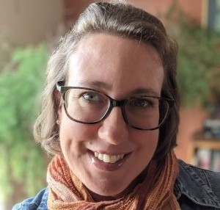
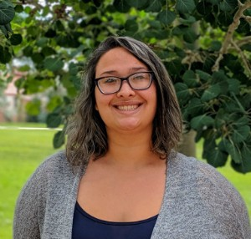
OUR
S TORY
and the goal
"PROBLEMS ARE NOT STOP SIGNS, THEY ARE
GUIDELINES."
ROBERT H. SCHU LLER

Slide 5

Modeling Team Dysfunction
THE LENCIONI
MODEL
Results
Accountability
Commitment
Conflict
Patrick Lencioni's model illustrates the root causes of team dysfunction and keys to overcoming them.
Trust
Fear
Safety

Slide 6
Breaking It Down - Trust
ABSENCE OF TRUST
“Great teams consist of individuals who
have learned to trust each other. Over time, they have discovered each other’s strengths and weaknesses, enabling them to play as a coordinated whole.”
-Amy Edmondson
Results
Accountability
Commitment
Conflict
Trust

Slide 7
Trust Issues
The opposite of trust is fear.
stagnation discomfort reluc tance
self-preservation
“Raisin cookies that look like chocolate chip cookies are the main reason I have trust issues.”
– Unknown

Slide 8
What does a lack of trust in the workplace
look like?
(please discuss in chat)

Slide 9

The
Culture
Code - Peter Coyle
HOW DO WE BEGIN TO BUILD TRUST?
What is the difference between a group of kindergartners and a group of CEOs?
Kindergartners aren't afraid to trust.

Slide 10

Building Trust
C RE ATE PY S C HO LO G IC A L S AFE TY
The shared belief that the team is safe for interpersonal risk.
SHARE VULNERABILITY
Be able to take an honest look at how things are going and discuss it.
ESTABLISH TEAM NORMS
We're all comfortable with each other, but are we all on board?

Slide 11
Triangle of Trust
I E X PE RIE NC E THE REAL YO U
Foster diversity in the workplace.
I BELIEVE YO U
C A R E ABOUT ME
Is everyone getting what they need?
I KNO W Y O U C A N DO IT
They trust your judgement.
Empower your team.
Provide opportunities to meet face to face.
Acknowledge ideas and dialogues.
AUTHENTICITY
E MPATHY
LO G IC

Slide 12

Team Norms
WHAT TO C O N S I DER
"Team norms, the guiding principles for employee conduct in the workplace, provide a standard of set behaviors and attitudes that allow each person on the team to know what is
expected of them."
- INDEED.COM

Slide 13
More Team
Norms
MEANING
How does your team derive meaning?
STRUCTURE & CLARITY
How do you express expectations for professional conduct?
IMPACT
Will you look ahead or reflect on the past?
LEADERSHIP
Are you setting norms for managers and supervisors?

Slide 14
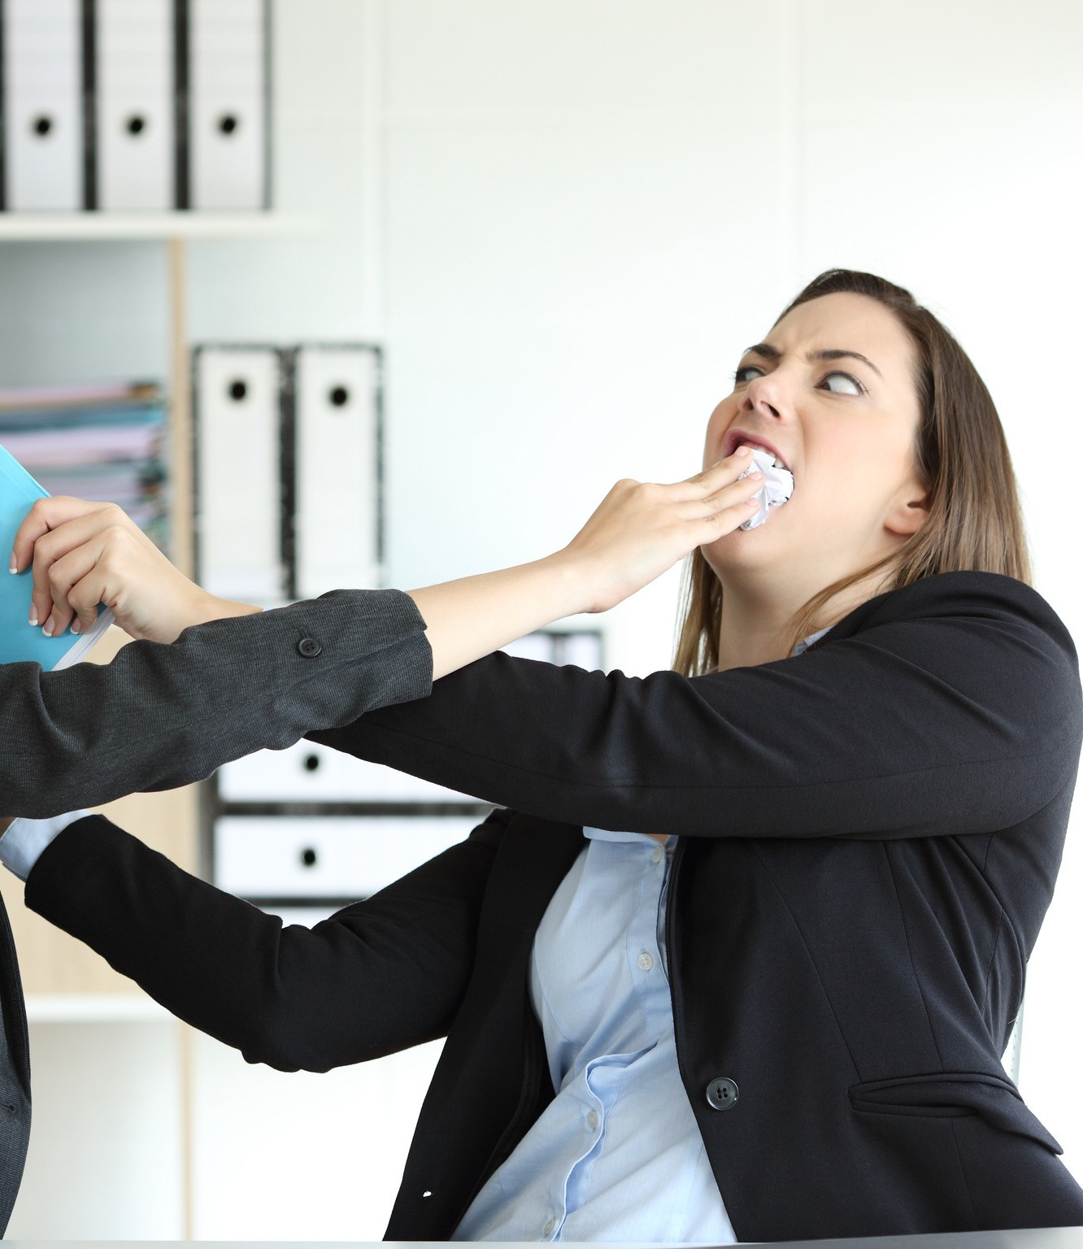
Breaking It Down - Conflict
Fear of Conflict
"For g ood idea s a nd true innova tion, you need huma n interaction, conflict, argument, debate."
-Margaret Heffernan
Results Accountability Commitment Conflict
Trust

Slide 15
Where do you fall on the conflict scale?

Slide 16

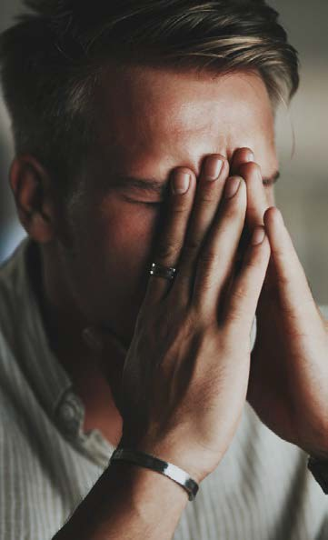

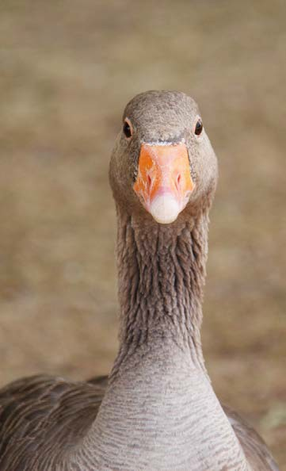
Unhealthy Conflict Behaviors
AV OID A N C E
Withdrawal
A C C OM OD AT ION
Give in
PA S S IV IT Y
Denial
A G G R E S S I O N
Dig in

Slide 17


Examples of Unhealthy
Conflict
Feeling psychologically unsafe
Meeting-after-the-meeting
Unfa i r & ine ff ic ie nt work a round s Withholding constructive feedback
Failure to prioritize or compromise
Resource dilution

Slide 18

Conflict Debt
“ Conf l ic t debt is t he sum of all t he contentious issues that need to be addressed to be able to move
forward but instead remain undiscussed and unresolved.”
- LIANE DAVEY
Can you think of an example where failure to work through a conflict
productively held back your team?

Slide 19
Creativity Break! Choose a color to represent conflict. (You can also draw what you think it looks like.)

Slide 20
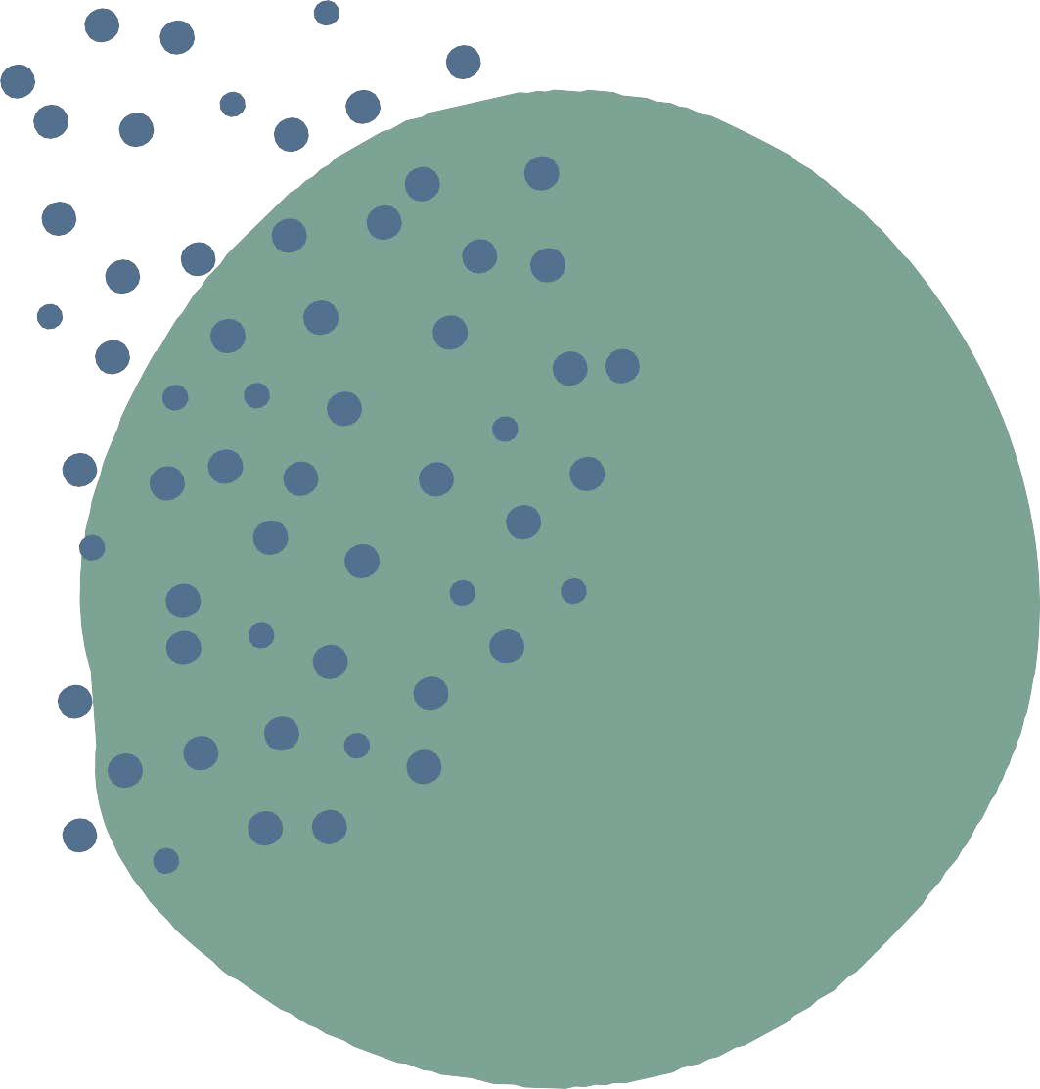
























Healthy Conflict
A Guideline
The best way to manage conflict is by giving your team the tools to handle it
themselves.
Find your motivation
Encourage debates and open discussions
Identify and defuse potential conflicts Encourage space for disagreement

Slide 21
EMOTIONAL INTELLIGENCE AND CONFLICT MEDIATION
EI (EQ): The capacity to be aware of, control, and express one's emotions and to handle interpersonal relationships empathetically.
FIVE KEY ELEMENTS OF EQ
MANAGING CONFLICT
S elf- awa reness Self-regulation Motivation
Empathy
Social skills
Teach EI
Come up with conflict
strategies
Engage in Conflict Mining

Slide 22

Breaking It Down- Commitment
Results
Accountability
Commitment
Conflict
Trust

Slide 23
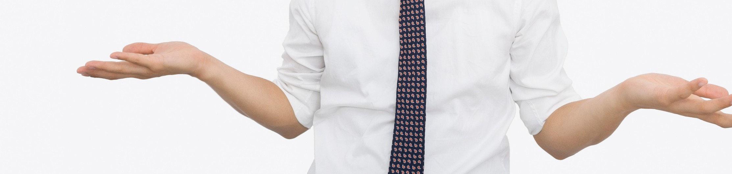

Lack of Commitment
”Unless commitment is made, there are only promises and hopes; but no plans."
-Ralph Waldo Emerson
WHAT IT LOOKS LIKE AND
WHY IT HAPPENS

Slide 24

Commitment
GETTING TO COMMITMENT
C larity Buy-in
Avoid analysis paralysis "Disagree and commit" F.A.I.L.
LACK OF COMMITMENT
Ambiguity
Desire for consensus
Need for Certainty

Slide 25
Breaking It Down - Accountability
Avoidance of
Accounta bility
Acceptance of poor performance.
Wasted time and effort. Discomfort among team members.
"It is not only what we do, but also what we do not do, for which we are accountable."
― Molier
Results
Accounta bility Commitment Conflict
Trust

Slide 26

HAVE C L EA R O B J E C T I V E S
Make sure that everyone is on the same page.
HAVE P R O G R E S S REVIEWS
Check in with the members of your team regularly.
Managing
Accounta bility Avoidance
RE WA RD Y O UR TE A M
Celebrate their wins and growth.

Slide 27
Breaking It Down -
Inattention to
MAKING IT C O M E TOGETHER
Commit to your desired results -
ma ke sure your te a m i s hold ing e a c h other a cco u nta b le .
C he ck that your outcomes align -
d e f ine wha t suc c e ss looks l ike for your team.
Have a set of guidelines to fall back on.
Results
Results
Accountability
Commitment
Conflict
Trust
"Teams that trust one another, engage in conflict, commit to decisions, and hold one another accountable are very likely to set aside their individual needs and agendas
and focus almost exclusively on what is best for the team." -Lencioni

Slide 28
Lessons Learned
WHAT' S C HA N G ED ?
Adopted team norms
Imp le me nte d me thod s for fe e dback
Re g ula r sup e rvisory sta f f meetings
Te a m tra ining s a nd evaluation
C le a r le a rning outc ome s for team members
We're still experimenting… and failing forward

Slide 29
DEBRIEF
Team Dysfunction - defined
Lencioni's five dysfunctions model
Strategies for healthier team behaviors
Lessons Learned

Slide 30
How are you feeling now?

Slide 31


The Five Dysfunctions of a Team, Patrick Lencioni
For more information on the team dysfunction model we highlighted today:
Select resources :
Kim Scott, Radical Candor in Six Minutes video-
https://www.youtube.com/watch?v=YLBDkz0TwLM
Resources
Amy Edmondson's TED Talks on leadership and teams - https://www.ted.com/speakers/amy_edmondson
Mary Scannell, The Big Book of Conflict Resolution Games
Get to know your teammates with the Berkley Personality Lab: The Big Five Inventory https://www.ocf.berkeley.edu/~johnlab/bfi.html
For the full bibliography and resource list, see handout.

Slide 32

Thank You!
Thank you!
twick@western.edu kcrawford@western.edu

