Slide 1
FROM A TO T:
WELCOMING TRANSGENDER CUSTOMERS IN THE LIBRARY
Notes:
https://docs.google.com/document/d/1SASRVSTbtvNdNbXcOsRrSwaH3PEcD1HYT5VaTwgUsXo/edit?usp=sharing

Slide 2
Introductions and Objectives
Build a foundation for fostering gender inclusivity at their library
Give empathetic and equitable service to all customers
Have knowledge of social and legal issues impacting transgender customers
Challenge assumptions and discuss ways to encourage inclusivity in language and action.
Notes:
Carrie
Slide 2: Introductions and Class Objectives
We are not here to change minds. Today’s session is about giving you tools you need so that you meet the library’s customer service expectations
Slide 2: Why you personally are speaking on transgender issues
We are not “experts” on this topic, though all of us have personal, professional, and advocacy experience on transgender issues
We’re not here to present all the answers; we’re here to share some knowledge and facilitate a conversation, and open up space for questions, dialog, and learning
Just like any community, transgender experiences are varied, and there is no “one” perspective or answer.

Slide 3
Norms
Assume good intent
Call people back “in” rather than “out”
Step up, step back
When in doubt, use “people first” language
Notes:
Carrie
Slide 3.
To help us keep the conversation open, we’ll follow some shared guidelines as a group:
When someone offers a comment, assume it’s well-intended.
If someone says something that doesn’t land well with you, let them know in a spirit of calling people back into conversation, rather than in calling them out.
If you find yourself saying a lot, consider leaving some space for others to speak. If you find yourself saying very little, consider sharing your thoughts.
Our goal is to humanize people, so when it doubt let’s use “people first language.” For example: “people with disabilities” rather than “disabled people” or “people experiencing homelessness” rather than “the homeless.”

Slide 4

Framing
Notes:
Bec
We all have frames for how we look at life. They help us define the world around us and can be shaped by many factors in our lives: culture, religion, politics, family. And so all of these things mean we see the world in a certain way.

Slide 5

Shifting Frames
Notes:
Bec
The goal today is to give you tools to expand, or shift your frame so that you can see things that might have previously been outside of your frame of reference.

Slide 6
Assumptions
When has someone made an assumption about YOU that made you uncomfortable?
Notes:
Bec
So now we want to engage you in an exercise to invite you to think about some common ways we frame people. When we meet and interact with folks we can ask questions or make assumptions based off of limited information or that are narrow in scope. This exercise is designed to make you a little uncomfortable and it’s important to follow the instructions carefully!
Activity: Assumptions Exercise
Ask everyone to pair up.
Have the question slide deck up. On each slide there is a different question that starts benign and then get increasingly personal.
Have each pair take turns answering the question for the other person.
There is to be no discussion about whether the person answered correctly or incorrectly.
Activity: Discuss the assumptions exercise
How did it feel to have to answer for someone else?
How did it feel to have someone answer for you?
What came up for people?
Explanation:
These questions may have made you uncomfortable, and maybe you didn’t like someone making such judgements about you. So I’d ask you to think about how it would feel to have something as intrinsic as your sense of gender challenged.
Don’t assume you know what someone’s gender is by looking at them
This also applies to gender and many other things. We rely heavily on visual cues to discern things about people and really there is so much we don’t know. To the best of our ability we should treat every person as a blank slate.

Slide 7
Coffee or tea drinker?

Slide 8
Saver or spender?

Slide 9
Religious or nonreligious?

Slide 10
Democrat or Republican?

Slide 11
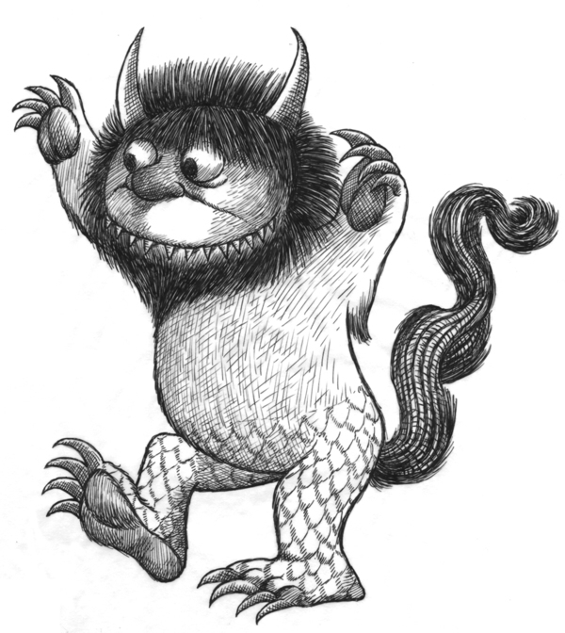

Definitions
Gender
identity
Sexual / romantic orientation
Sex assigned
at birth
Gender
expression
Notes:
Carrie
The people we heard from describe themselves in a few different ways - transgender girl, nonbinary trans person, transgender man - to name a few. We’re going to go over a few basic terms and concepts here. Your handout, Gender Identity Definitions, with the light blue header, covers more in-depth
Gender identity is each person’s internal experience and understanding of their own gender.
Assigned sex at birth is the sex we’re given when we’re born. Typically, a doctor looks at (mostly external) organs and checks one of two gender boxes - male or female. For people who identify as cisgender, gender identity and assigned sex at birth tend to stay the same. For transgender people, gender identity may be different than assigned sex at birth.
Gender expression is how we present ourselves to the world - our clothes, hairstyle, body language. For example, a person might identify as a woman, and have a gender expression that’s more traditionally masculine - wearing men’s clothes and a short hair style, for instance.
Sexual orientation is who we’re attracted to. It’s a separate concept from gender identity. A person can be transgender and identify as straight, gay, queer, or another orientation.

Slide 12

Gender as a Spectrum
Notes:
Carrie
In many LGBTQIA communities, it’s common to think of gender as a spectrum, rather than those two rigid, binary boxes we get assigned at birth. That’s also increasingly a best practice in many professional fields, from social work to health care to education.

Slide 13
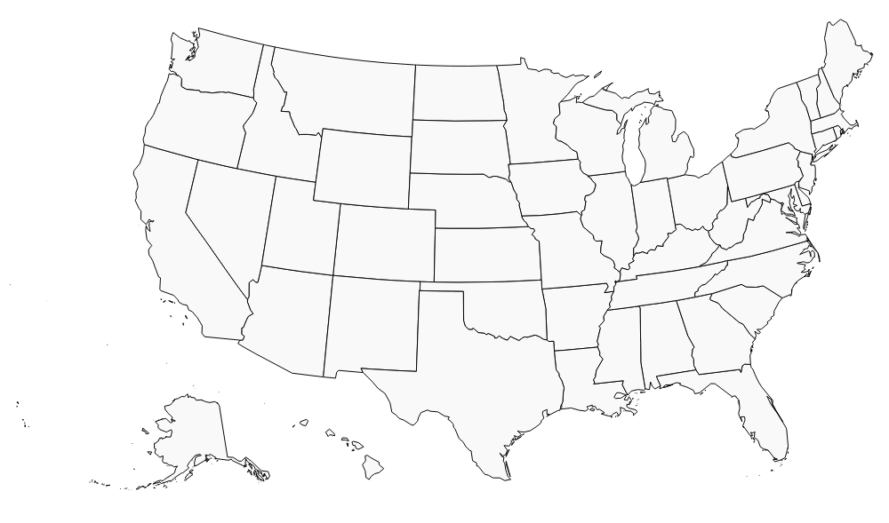
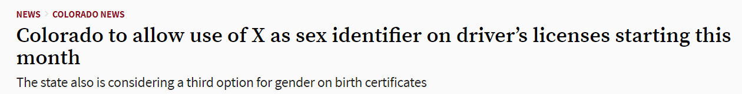
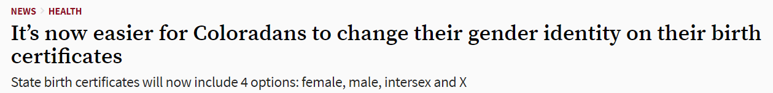
Legal Rights
transequality.org
Notes:
Carrie
Legal rights of transgender people can vary greatly from state to state. In many western states, it’s especially difficult for transgender people to obtain an ID that accurately reflects who they are. For more information about transgender civil rights in your state or municipality, see your Additional Resources Handout or reach out to your state or local LGBTQIA organization.
Legal rights of transgender people can vary greatly from state to state. In many western states, it’s especially difficult for transgender people to obtain an ID that accurately reflects who they are. In Colorado, people are able to update their name and gender on their ID, drivers license, or birth certificate, but there are some BIG structural barriers along the way; ID changes need to be authorized by a doctor, and notice of a name change must be published in a newspaper 3 times within 21 days....AND fees are required. Birth certificate changes are even more invasive, requiring a court order saying that "sex… has been changed by surgical procedure." That means folks who don’t have the funds or inclination for gender confirmation surgery don’t have access to this option.
Also, this administrative process still operates on a binary system and doesn’’t make room for individuals who identify outside of male or female. Colorado doesn’t have a nonbinary option on our IDs, though a few states are starting to. The website TransEquality has more state by state info on this, as well as on legal issues from housing to healthcare to immigration and more.

Slide 14
Resilience
Transgender people face extraordinary levels of physical and sexual violence, whether on the streets, at school or work, at home, or at the hands of government officials.
National Center for Transgender Equality
https://transequality.org/issues/anti-violence
Notes:
We want to point out that while there are incredible levels of resilience and camaraderie among trans communities...trans people in the U.S. face...read quote
More than 1 in 4 trans people has experienced a bias-driven assault, and rates are higher for trans women and trans people of color. (NCTE)

Slide 15
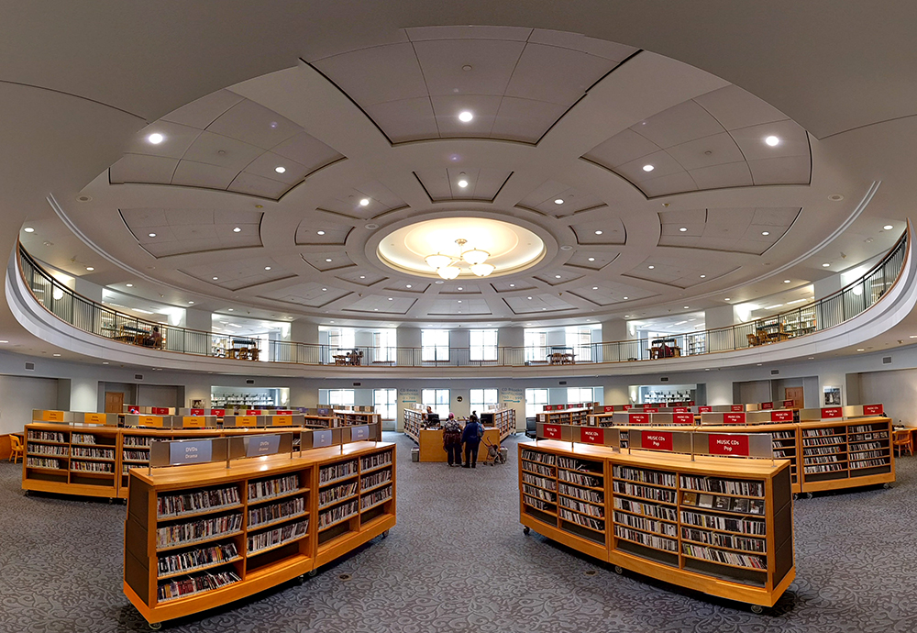
Why is this Important for Libraries?
Notes:
Adrian
So why is all this an issue for libraries? We know that trans people often experience high levels of harassment and discrimination, sadly including from government and other authority figures when accessing services.
Transgender issues in libraries have also been in the spotlight recently. Trade publications and news outlets have reported on library workers who have won rights around healthcare and personal pronouns. Other libraries have faced negative publicity for denying trans patrons restroom access.

Slide 16
Why is this a library issue?
We provide the highest level of service to all library users through appropriate and usefully organized resources; equitable service policies; equitable access; and accurate, unbiased, and courteous responses to all requests.
Code of Ethics of the American Library Association
Notes:
Adrian
Most importantly, in our profession no matter what our job role, we operate by a common code of ethics: read quote.
So, how can we put this into practice when it comes to welcoming transgender customers or coworkers?

Slide 17
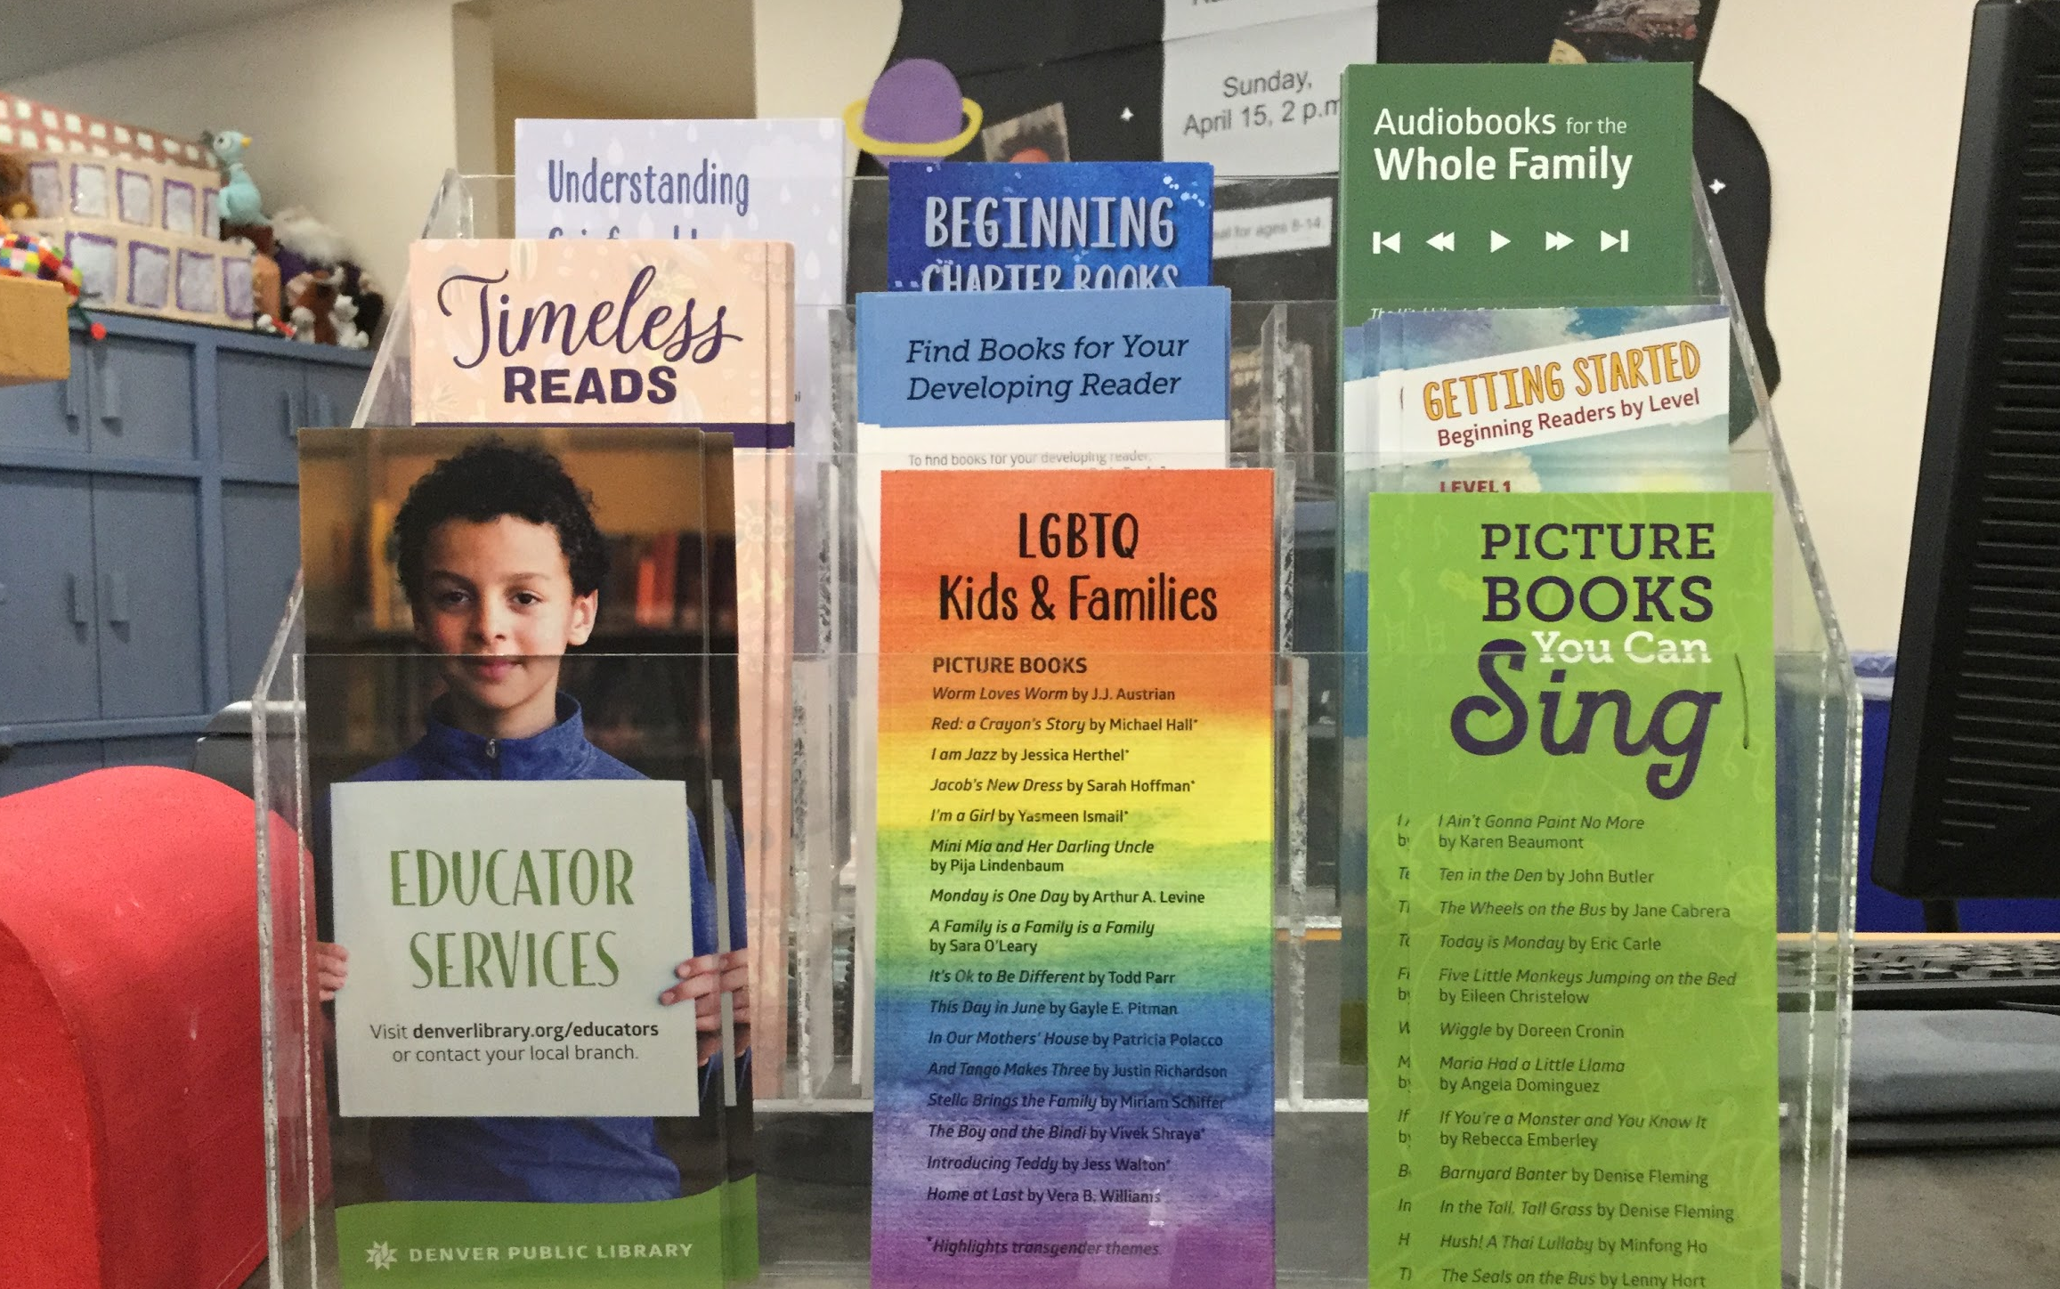
Welcoming Spaces
Notes:
Carrie
Collections, displays, programs, workers
The cues we offer when people enter our spaces are an important first impression. A readers advisory bookmark highlighting children’s books with transgender and other lgbtqia themes, sends a message of welcome to anyone who enters the space. For trans youth, who may be especially vulnerable to discrimination at school or at home, highlighting resources has a powerful impact.

Slide 18
Inclusive Environment
Represent trans topics across collection
Display trans resources
Offer programming on trans issues
Develop a welcoming workforce
Notes:
Carrie
We can also create welcoming spaces by ensuring our collections include up-to-date trans resources across age ranges and formats, and by including these items throughout displays.
Trans-inclusive programs and services, advertised in our printed or online events also send a message about who’s welcome at the library.
And of course, how we hire and train our workers has a huge impact. Are trans people and expertise represented in your workforce? How are library employees trained to serve gender diverse patrons?

Slide 19
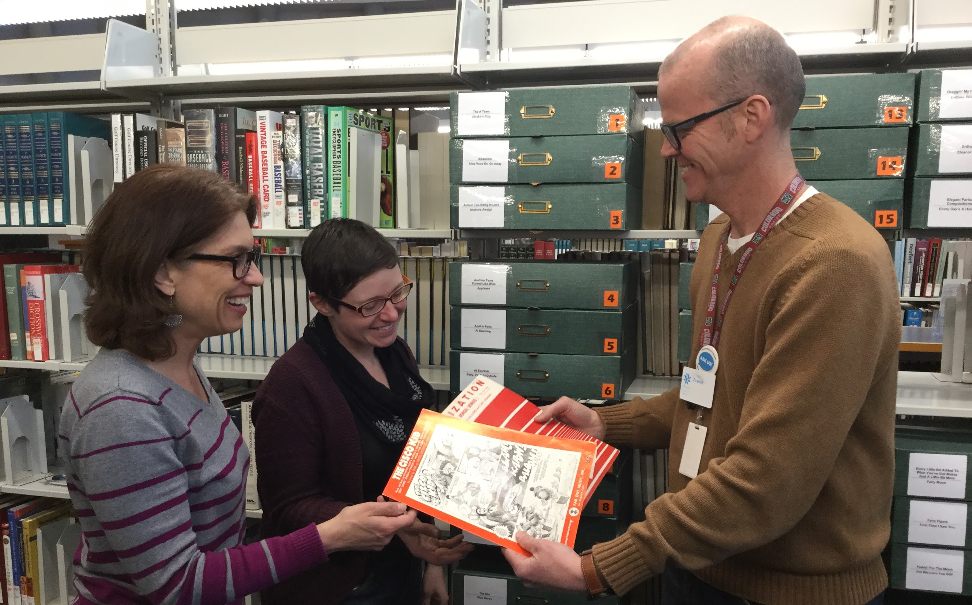
Interactions
Notes:
Adrian
Wherever we work in the library, our work is built on relationships. That might mean with our colleagues, a brief moment of connection the first time we help a customer, or the relationships we build with regulars over time.

Slide 20
Scenario One
A customer walks up to a staff person for assistance and staff refers to the customer as “sir.” The customer tells staff that they do not go by sir and does not offer an alternative. Staff is visibly embarrassed and goes on to make assurances about the customer’s appearance. The staff member then assists the customer, asks for their name, and addresses them by their name when they leave.
Notes:
Adrian
What are some strategies we can use to welcome trans customers in our interactions? Let’s take a look at a scenario. Consider reading it aloud, it might be hard for people to see. Take a moment to read it, then another moment or two to discuss it with the person next to you. What went well in the scenario? What were the sticking points?

Slide 21
Interacting
Introduce yourself by name
Use inclusive language
Honor names and pronouns
Apologize and move on if you make a mistake
Notes:
Adrian
Review welcoming ways to interact with people:
Introducing yourself by name gives people the chance to name themselves in return.
Try to not assume gender. Practice ways to make customers welcome without using a pronoun. (This can be especially tricky with “sir,” “miss,” or “ma’am,” which many of use were raised to think of as showing the utmost respect. For customers who don’t identify as male or female, however, these can be loaded terms.) For instance, instead of “ladies,” or “guys,” try “folks,” or “everyone.”
Honor the names and pronouns people use.
If you use the wrong pronoun, apologize quickly, move on, and find a way to address the customer properly a few seconds later. Excessive apologies and further comments make the situation about you, rather than serving the customer well.
In the resources we share after this presentation, you’ll find more examples of inclusive language to practice

Slide 22
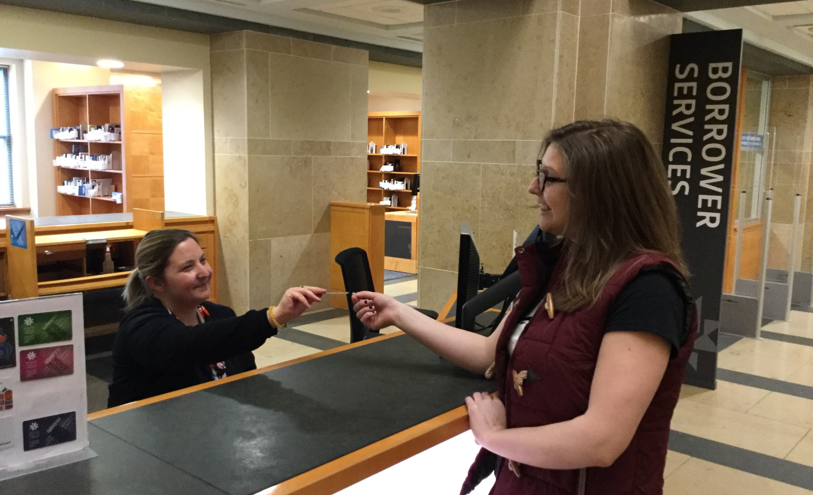
Card Registration
Notes:
Adrian Sometimes we have to ask for people’s IDs to access their accounts.

Slide 23
Customer Accounts
Use welcoming body language
Protect patron privacy
Capture correct names
Avoid collecting gender info
Notes:
Adrian
Be sensitive when verifying identification information. You may ask the customer to confirm their address or date of birth, rather than their name.
Maintain a welcoming, professional stance, including facial expression and body language.
Customers may ask if the library can use a name that differs from the one on their ID. As we’ve mentioned, there are multiple barriers to updating names and gender markers on official documents. At DPL we use the Polaris ILS, which does not currently have an option to capture names other than what’s on people’s IDs. We’re exploring this! Still, you can make a customer feel welcome by asking “what name do you go by?” during the interaction, and ending with “nice to meet you [customer’s name]”
Our software defaults to “N/A” for gender and this is not information we are required to capture. We believe there’s no need to ask customers this question.

Slide 24
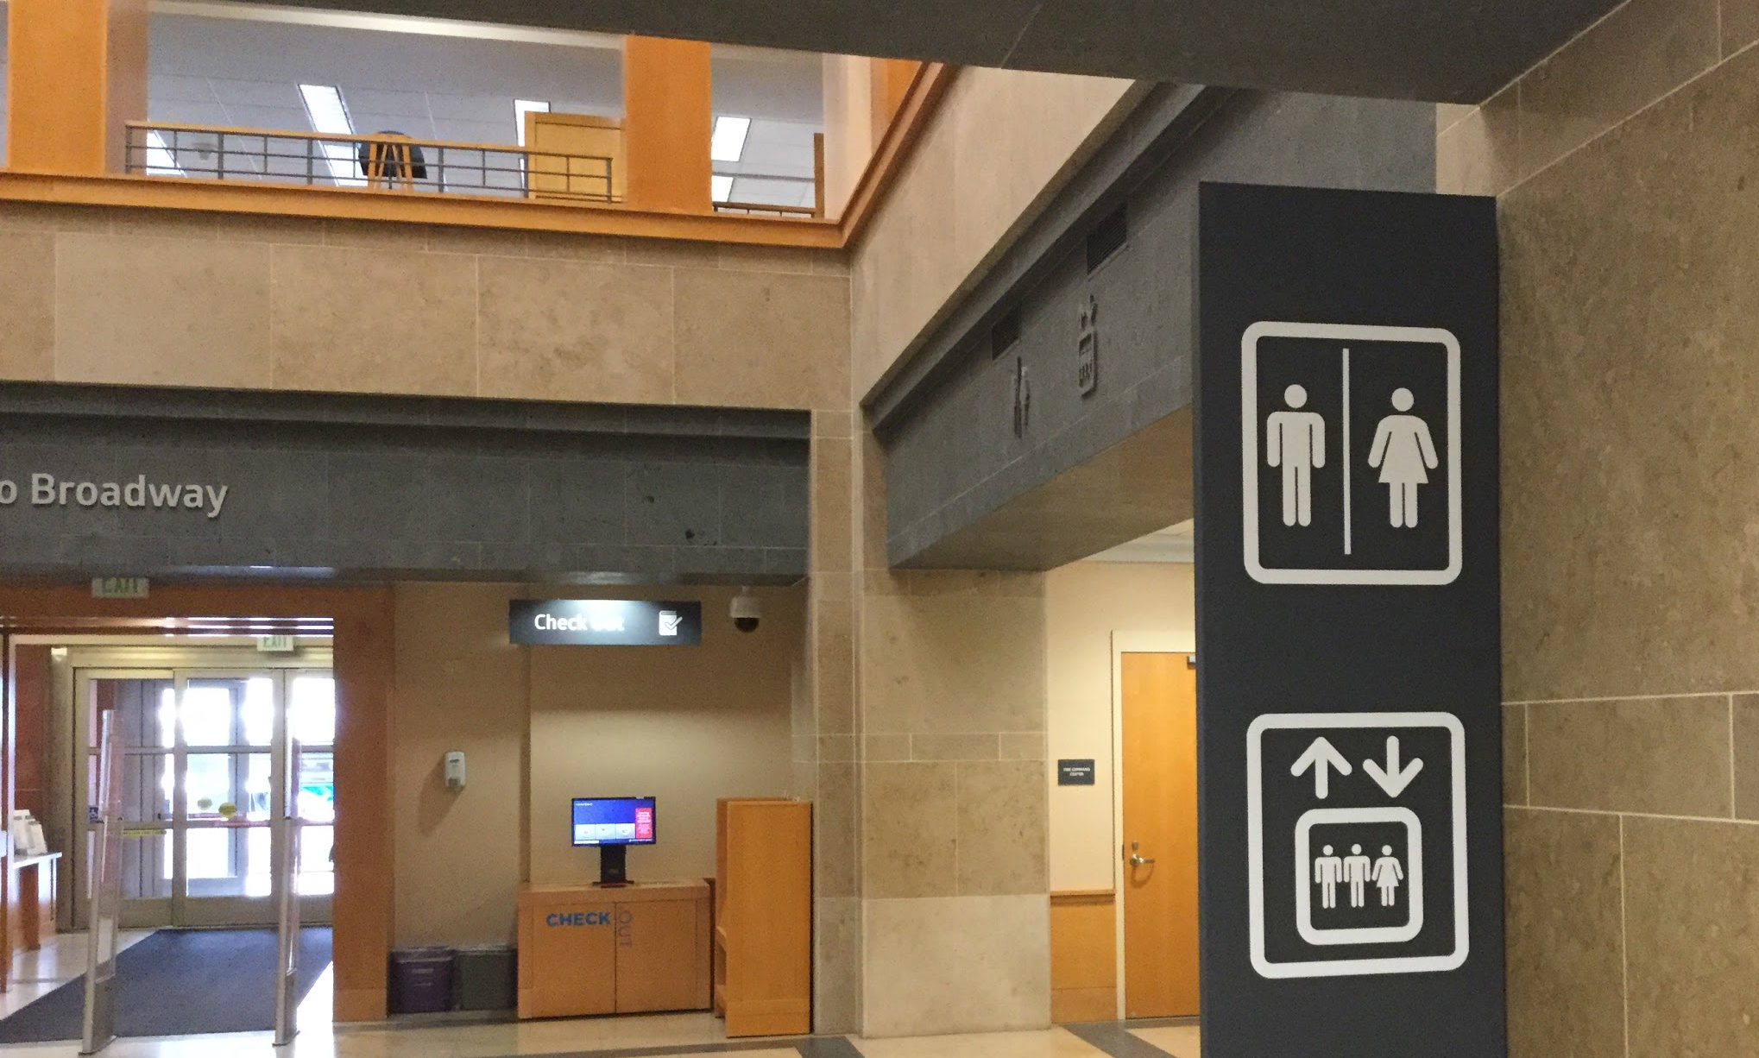
Restrooms
Notes:
Restrooms. Many municipalities have anti-discrimination laws and ordinances allowing transgender people to use public facilities that correspond to their gender identity. This includes Colorado and Denver. As we saw in the video, using public restrooms can be scary for transgender people.
70% of transgender people have reported being assaulted or harassed in public restrooms..

Slide 25
Restrooms Responses
Assume people choose proper facilities
Respond appropriately to incidents
Offer all-gender restrooms
Wash your hands
Notes:
Adrian
Assume that people select the appropriate restroom, and avoid confronting customers about their gender identity. Avoid assuming gender identity. Staff can just describe where all restrooms are without using gender
If a customer believes that someone is using a restroom inappropriately, clarify whether or not there is a behavior issue taking place. You might say “Customers are allowed by law to use the restroom that matches their gender identity. Is there a behavior taking place that violates the library use guidelines?”
If there is a behavior issue, follow your library’s use policies.
If the customer DOES not state that there is a behavior issue, you can politely inform the customer that in compliance with Colorado law customers are allowed to use the restroom that corresponds with their gender identity.
People can NOT be asked to “prove” their gender when using a restroom
Best practice is to offer all-gender restrooms.

Slide 26
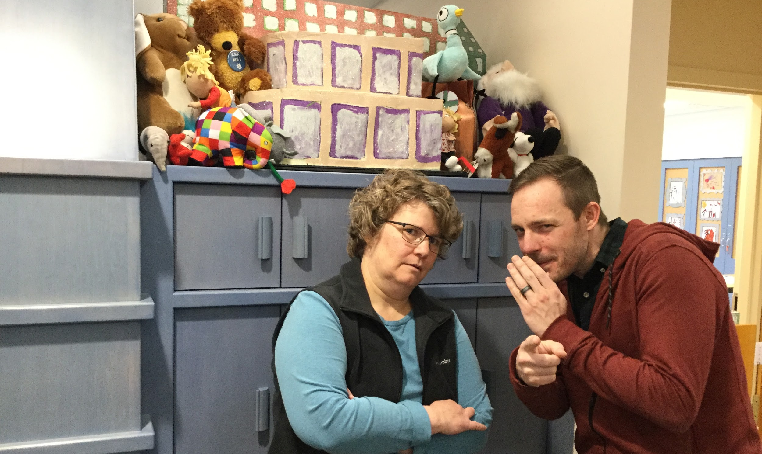
Harassment
Notes:
Carrie Harassment
As much as we do to create welcoming libraries, harassment can and does still happen in our spaces. How can library workers interrupt it when they see it taking place?

Slide 27
Scenario Two
You are working in the children’s section when you see a group of middle schoolers harassing another child. They are making unkind remarks about the child’s appearance. You can tell this is not friendly teasing and the bullied child keeps trying to move away and the others continue to follow.
Notes:
Carrie Harassment
Take a moment to read through this scenario with your partner. Discuss how you would handle such a situation, whether it involved youth or adults.

Slide 28
Harassment Responses
Interrupt harassment
Avoid singling out person targeted
Redirect people doing the harassing
Get backup
Notes:
Carrie
Harassment best practices
Be aware of your space and of developing situations that may become unsafe for library users and be prepared to intervene.
Be visible to and near the targeted person to be available if they feel threatened, but avoid singling them out. You might chat with them about what they’re browsing or ask if they need help finding anything to indicate they have been seen.
Address the group doing the harassing to redirect/distract them. Again, use phrases like “Can I help you?” or “Welcome to the Library.” to indicate they have been seen. In fact, we recommend always greeting and connecting with customers of any age. First, it’s important to welcome customers. Second, it gives you an opportunity to connect before you need to correct or direct behavior.
Address the behavior of a group if necessary, according to your library’s rules.
Understand that the targeted person could be in danger or minimally be made to feel unwelcome in the Library.
Notify Security and other staff (as appropriate) of the situation.
Monitor the situation so that it does not escalate.
Understand your responsibilities in maintaining a safe library environment for all library users.
Know your options for handling harassment situations.

Slide 29
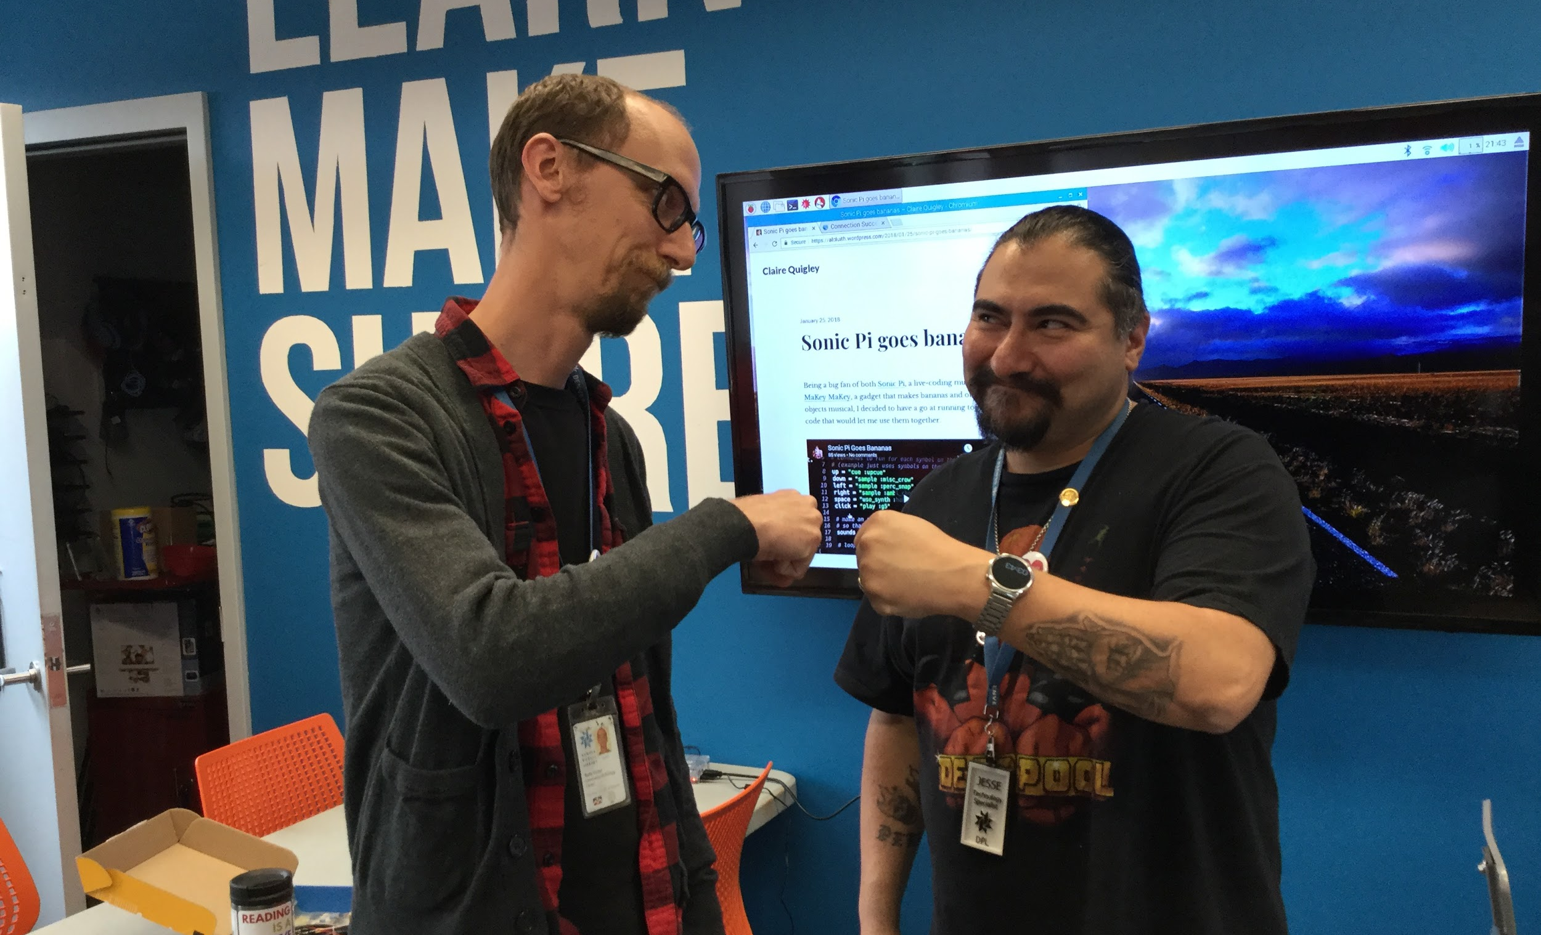
Workplace
Notes:
Adrian In the workplace. What are some strategies we can use to be respectful of our colleagues?

Slide 30
Scenario Three
A library administrator is speaking with a supervisor about an employee who is in the process of a gender transition. They are doing their best to use the employee’s correct pronouns.
The two are discussing what is appropriate to communicate about the employee’s transition. They decide to send an email to all staff, thinking it will help the employee from being misgendered. They start talking about how to update the employee record and realize there is no procedure for doing so and will need to ask the employee.
The supervisor also wonders if there is a need to notify customers as the employee routinely leads programs and the supervisor wants to reduce confusion.
Notes:
Adrian What are some strategies we can use to be respectful of trans colleagues in our interactions? Let’s read through this final scenario.
Consider reading it aloud, it might be hard for people to see. Take a moment to read it, then another moment or two to discuss it with the person next to you. What do you think these library leaders should do in the situation?

Slide 31
Workplace Responses
Respect privacy
Use correct names and pronouns
Educate yourself
Establish supportive policies
Notes:
Adrian
Workplace Best Practices. Make it a habit to use employee’s correct name and pronouns. Practice in private if you need to!
Be aware that using a colleague’s incorrect name or pronouns in front of the public not only outs them against their will, it can be a safety risk.
Transgender employees should always be part of conversations about when and how to come out at work.
Organizations should have procedures in place for supporting transgender employees - not to avoid being sued (though this can happen) - but because it supports meaningful diversity and inclusion efforts.
We support implementing the recommendations in VALUING TRANSGENDER APPLICANTS & EMPLOYEES: A Best Practices Guide for Employers, developed by the National LGBTQ Task Force. While many guides on transgender issues in the workplace are framed as resources for avoiding lawsuits, this guide comes from a perspective of supporting employees.

Slide 32

Final Thoughts
Notes:
Bec
Emphasize contact info & further resources on handout.
Thank students for their participation

Slide 33
Questions?
Denver Public Library Transgender Action Group
tag@denverlibrary.org
Adrian Johnson, Community Technology Center
apjohnson@denverlibrary.org
Carrie Wolfson, Central Children’s Library
cwolfson@denverlibrary.org
Hillary Estner, Reference Department
hestner@denverlibrary.org
Bec Czarnecki, City Librarian’s Office
rczarnecki@denverlibrary.org
From A to T Resource Folder: https://tinyurl.com/dpltag
Notes:
Bec

