Slide 1
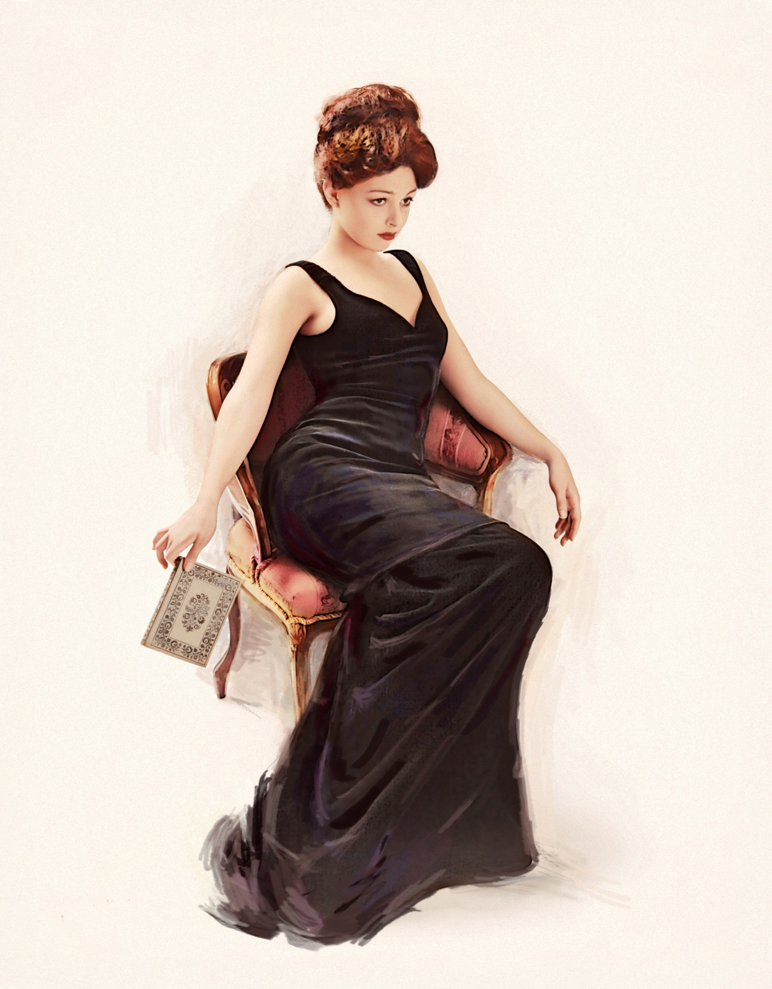
Weeding Isn’t Sexy
But
It Should Be
Jennifer Hendzlik
jhendzlik@anythinklibraries.org
16 JUNE 2016

Slide 2
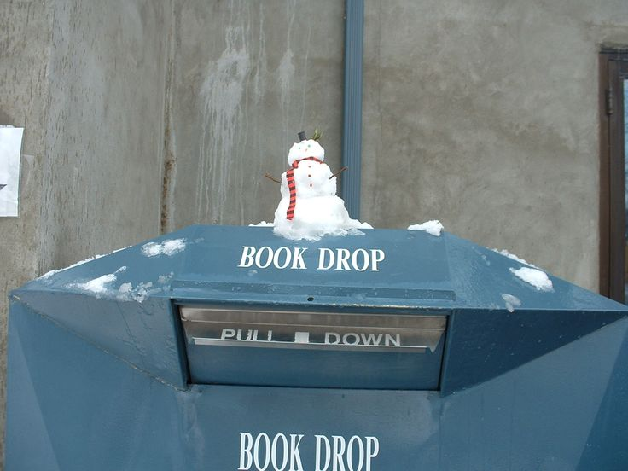
“Next to emptying the outdoor book drop on cold and snowy days, weeding is the most undesirable job in the library. It is also one of the most important.”
- Will Manley, "The Manley Arts," Booklist, March 1, 1996, p. 1108.

Slide 3
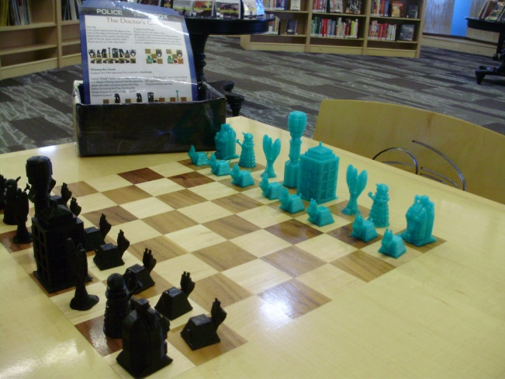
A game of chess

Slide 4
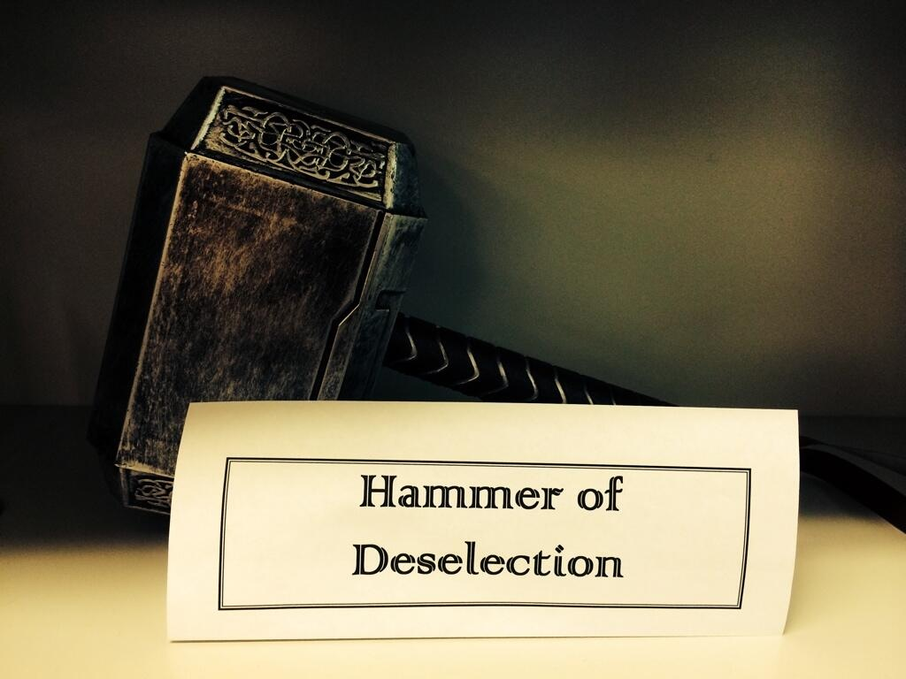
Deselection

Slide 5

Why
Weed?

Slide 6

How
to
Weed

Slide 7
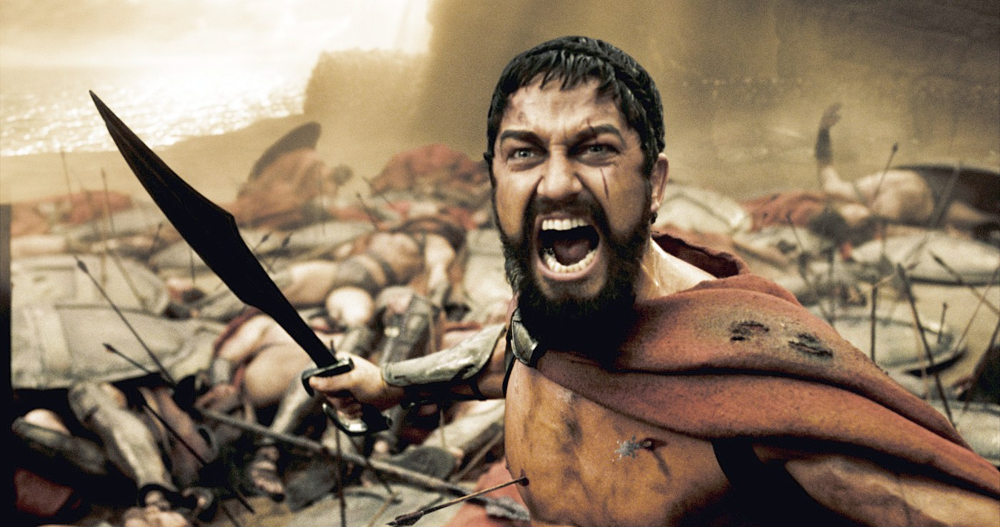
Condition
Weeding

Slide 8
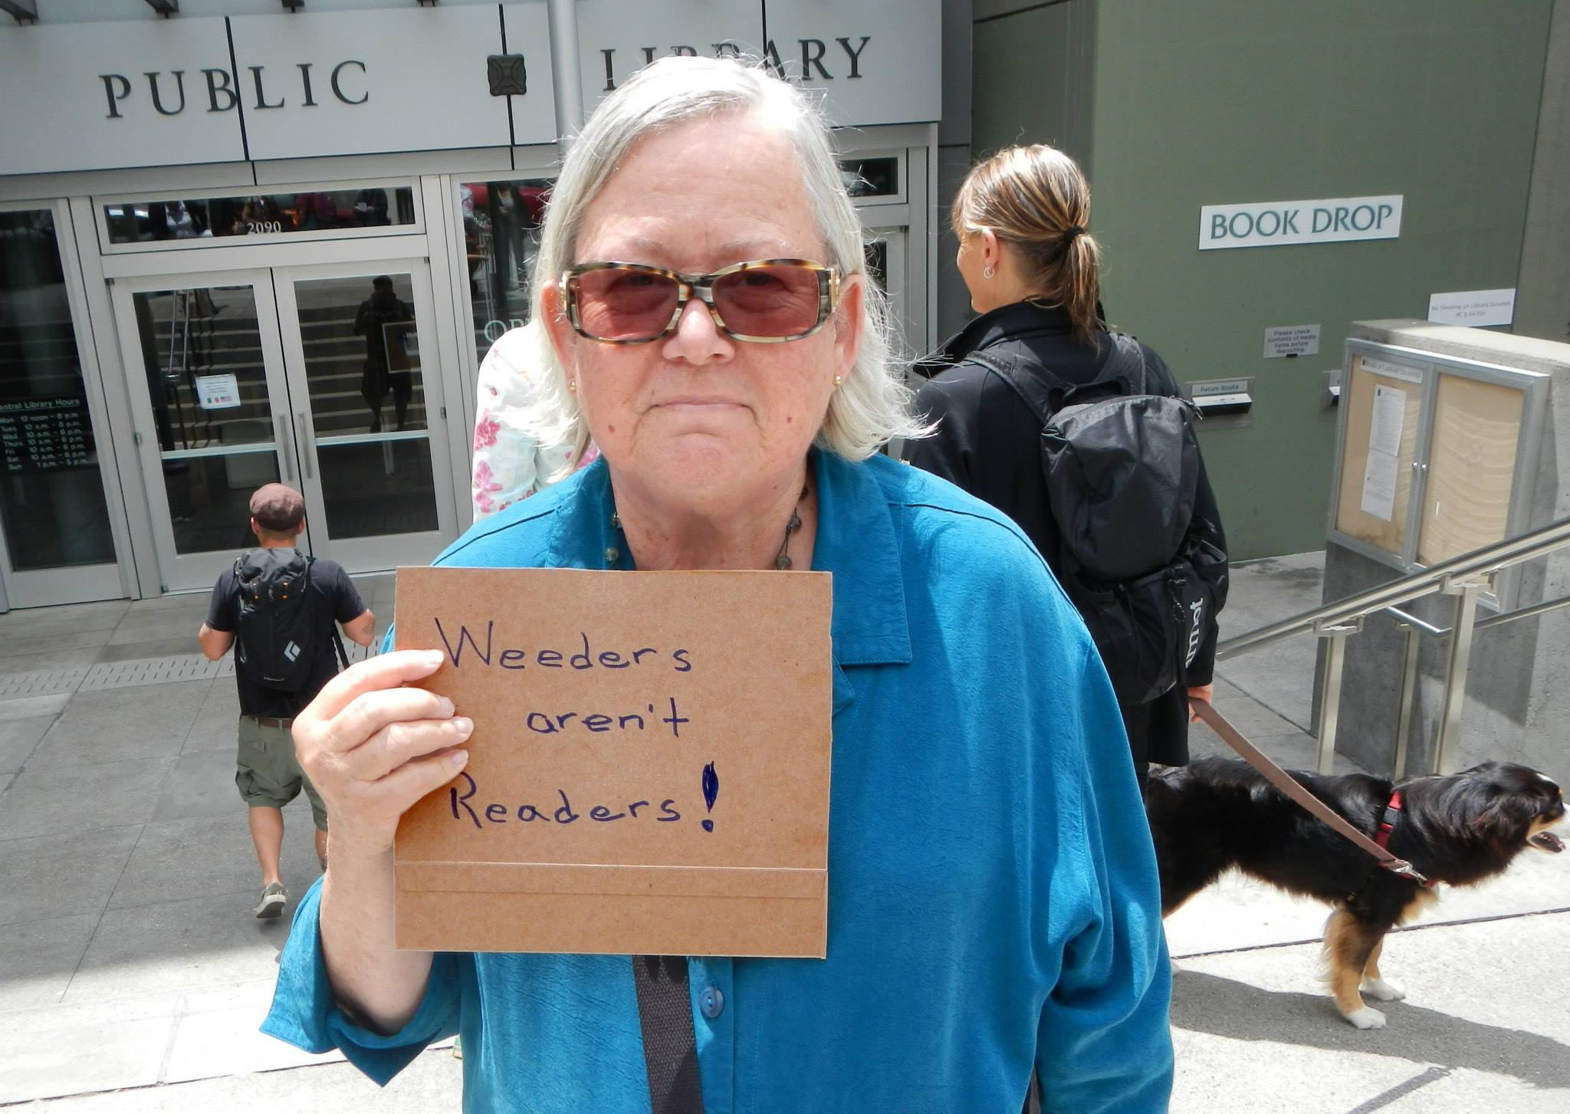
BARRIERS TO WEEDING

Slide 9
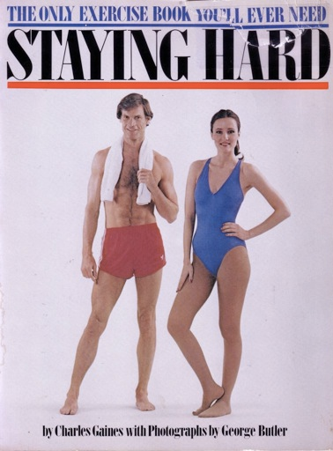
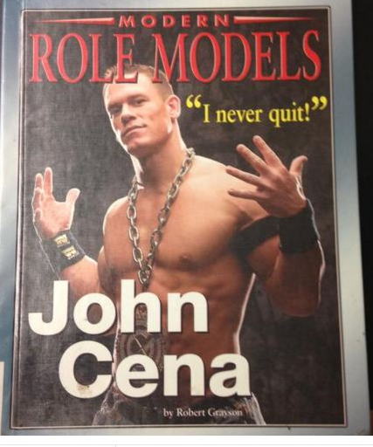
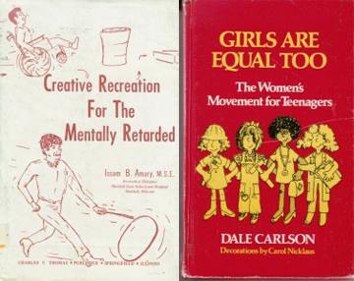
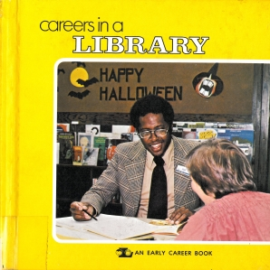
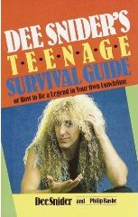

PRACTICE

Slide 10
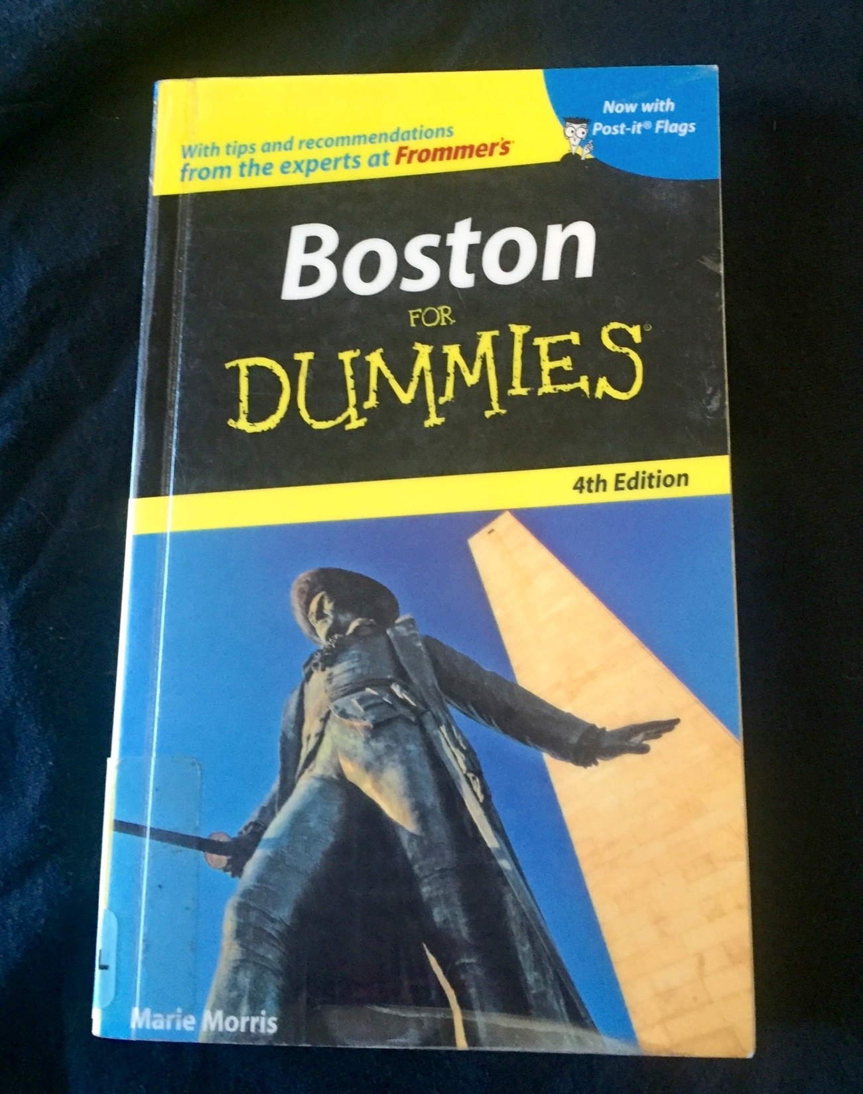
Boston for Dummies
2007 Copyright
Travel guide
Kapco cover
No stains

Slide 11
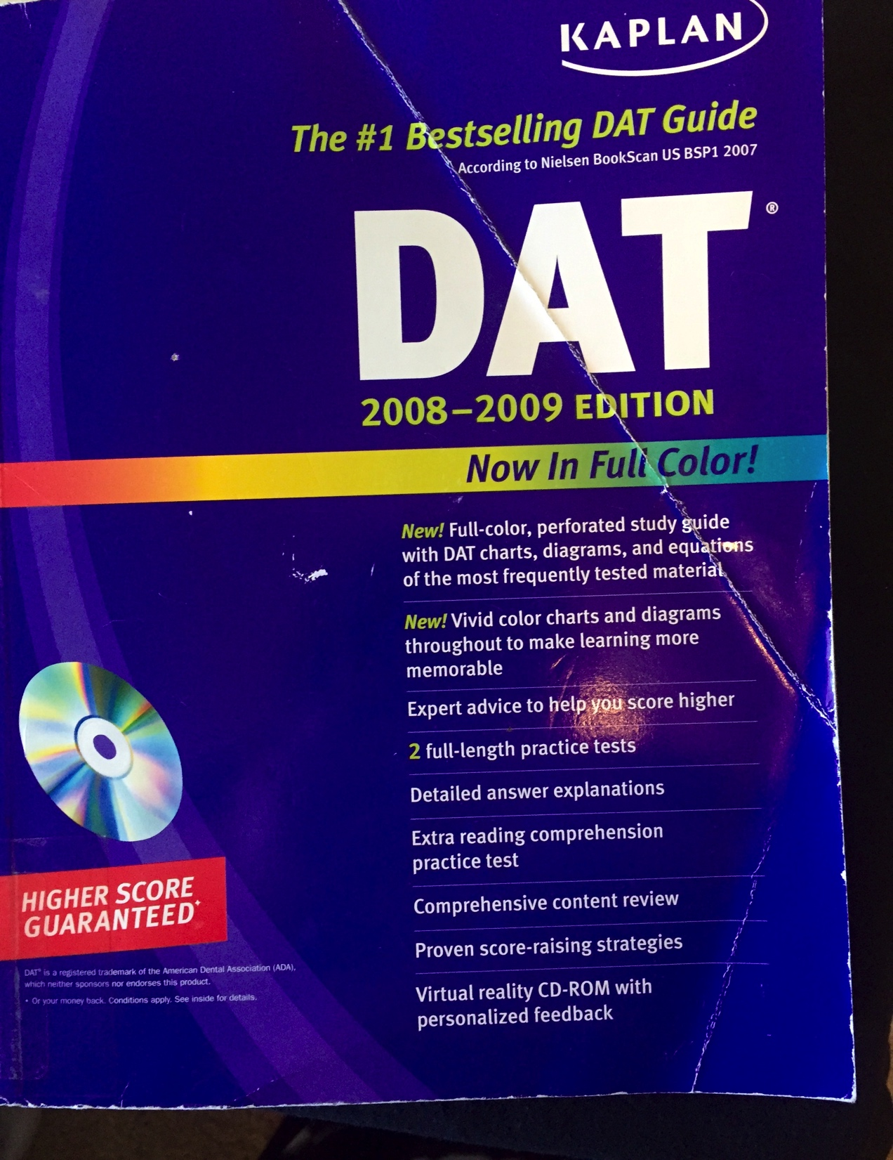
Kaplan Dental Admissions Test
Dental Admissions Test
2008-2009 edition
Have 2010-2016 editions
2017 edition will be out in a few months

Slide 12
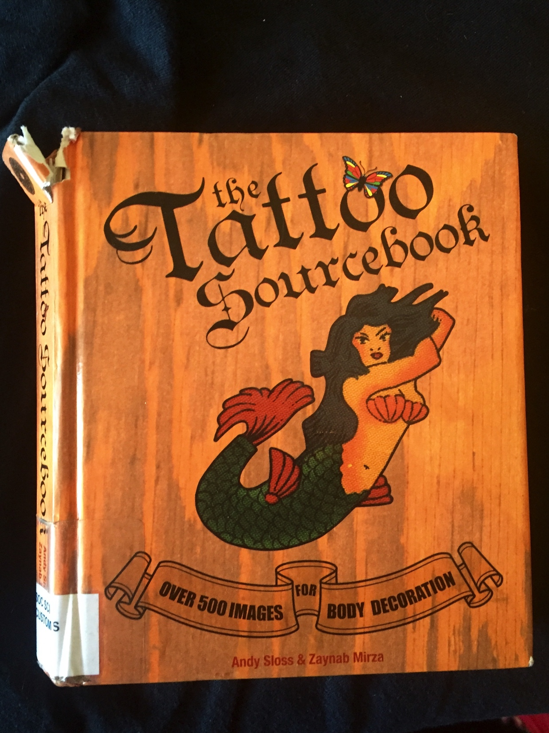
The Tattoo Sourcebook
2008 Copyright
Paperback available
Popular topic, WILL still get use
But…

Slide 13
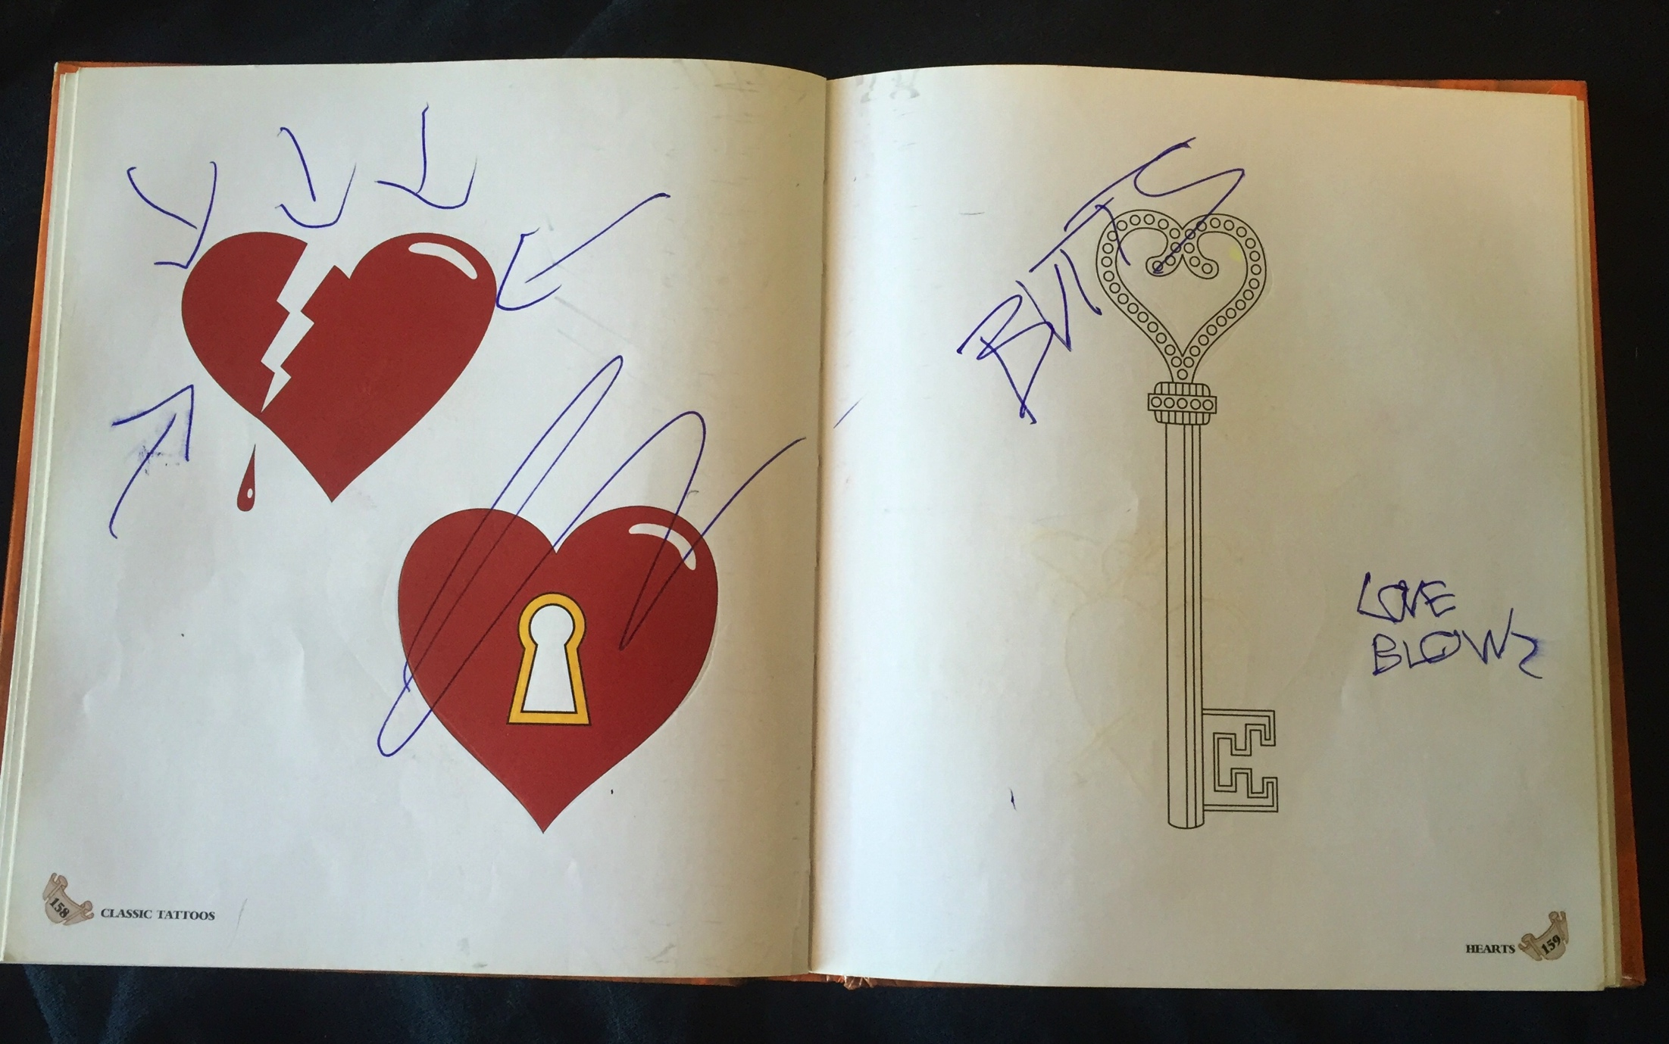
Writing in books

Slide 14
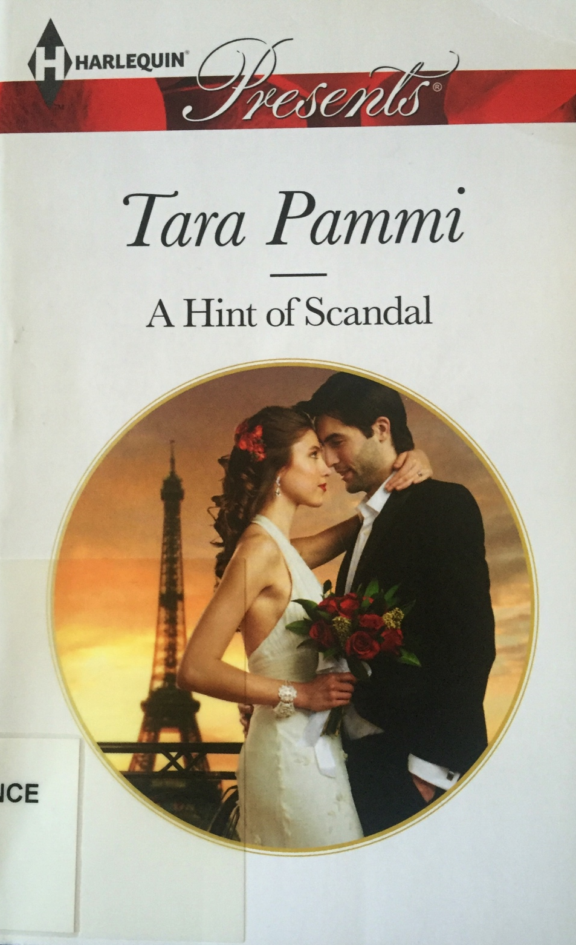
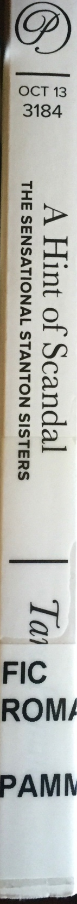
A Hint of Scandal
2013 Copyright
Romance
Perfect condition
1 circ
No cracks, bends etc…

Slide 15
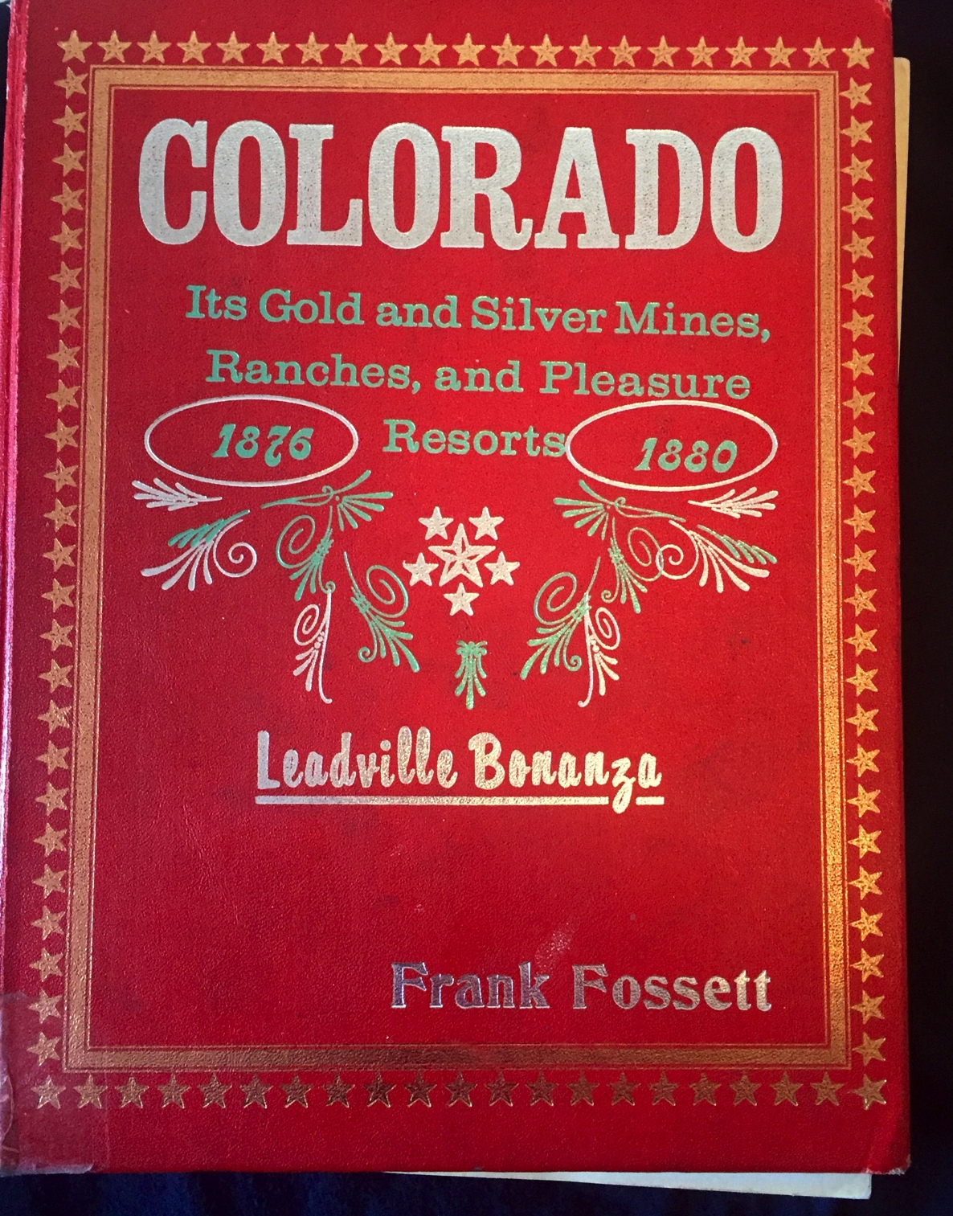
Colorado: Its gold and silver mines, ranches and pleasure resorts
Spine broken
Multiple stains of unknown origin
Pages ripped
Smells terrible
Your library is in Colorado

Slide 16
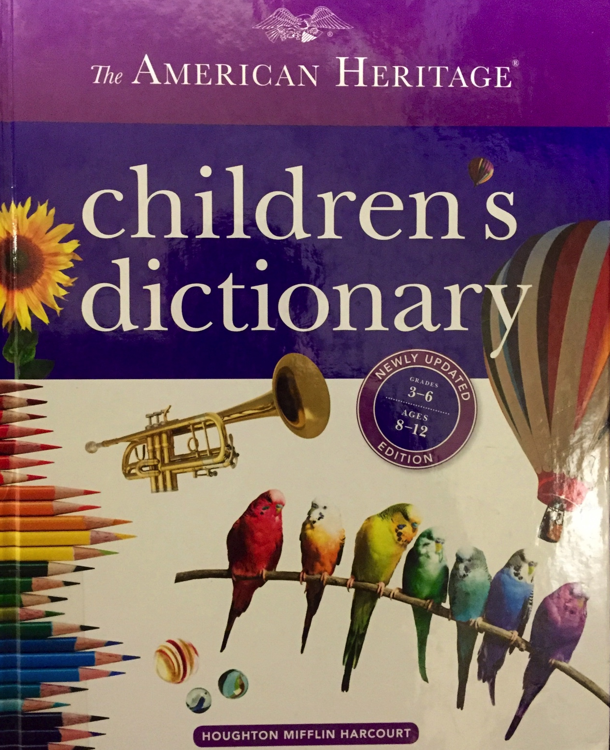
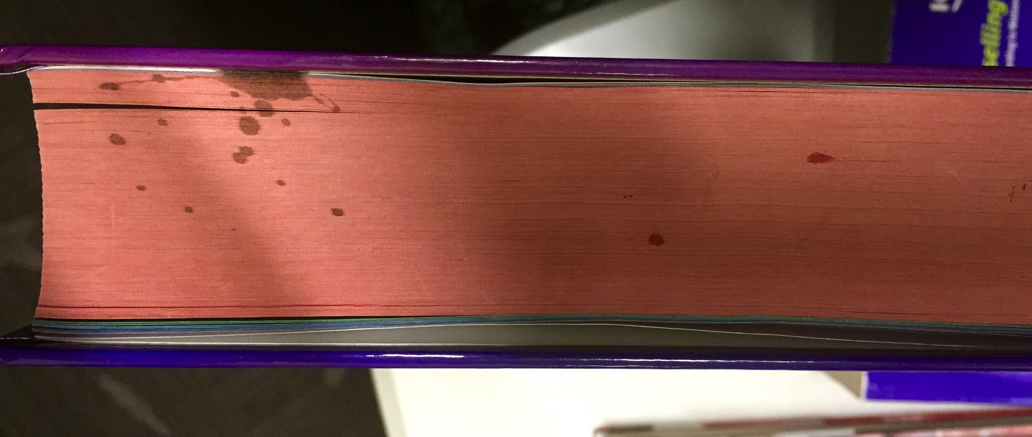
The American Heritage Children's Dictionary
2016 Copyright
There are 2 holds on this title
Great condition
With one or two exceptions…

Slide 17
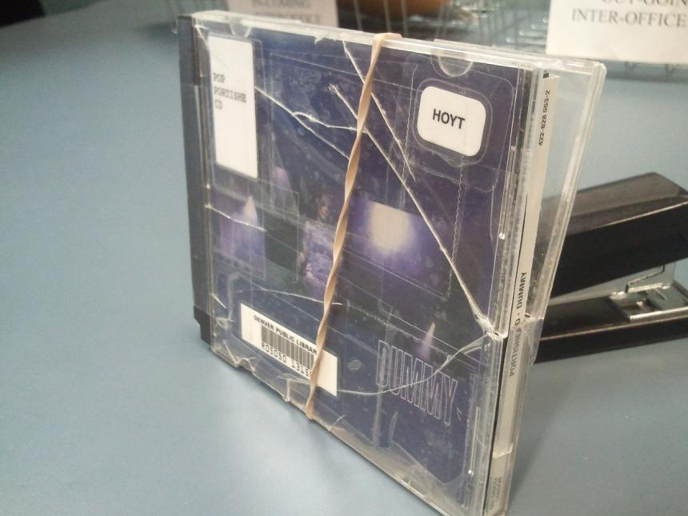
Broken CD case
CD case is in pieces
CD has multiple scratches
Has circulated twice in the last three years

Slide 18
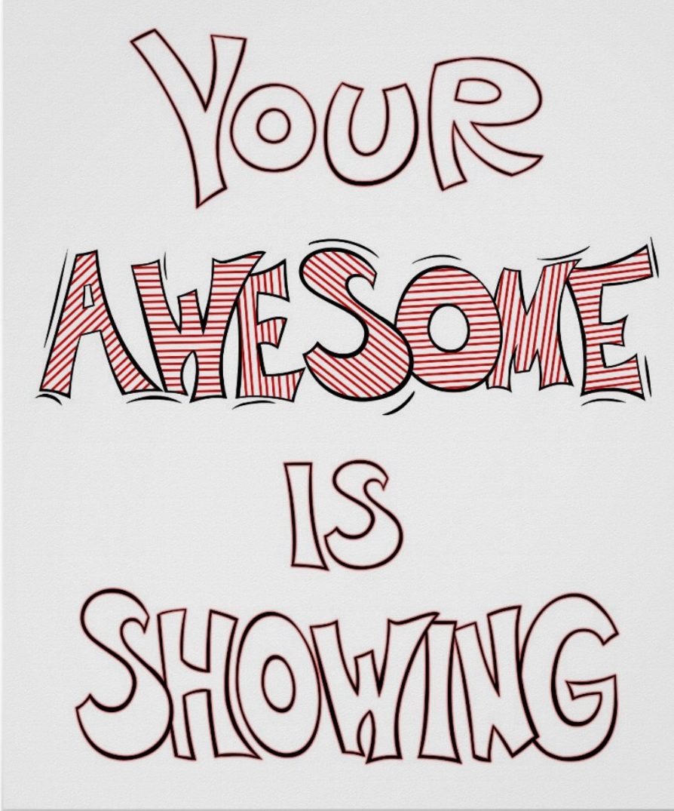
You can do it!

Slide 19
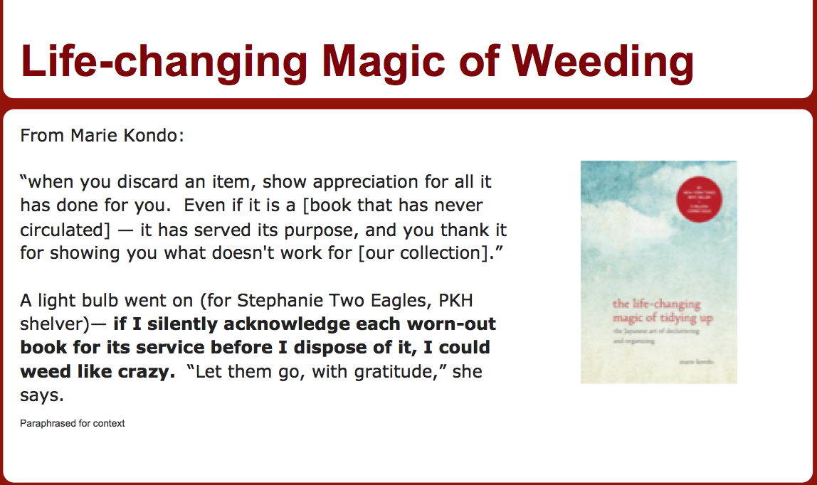
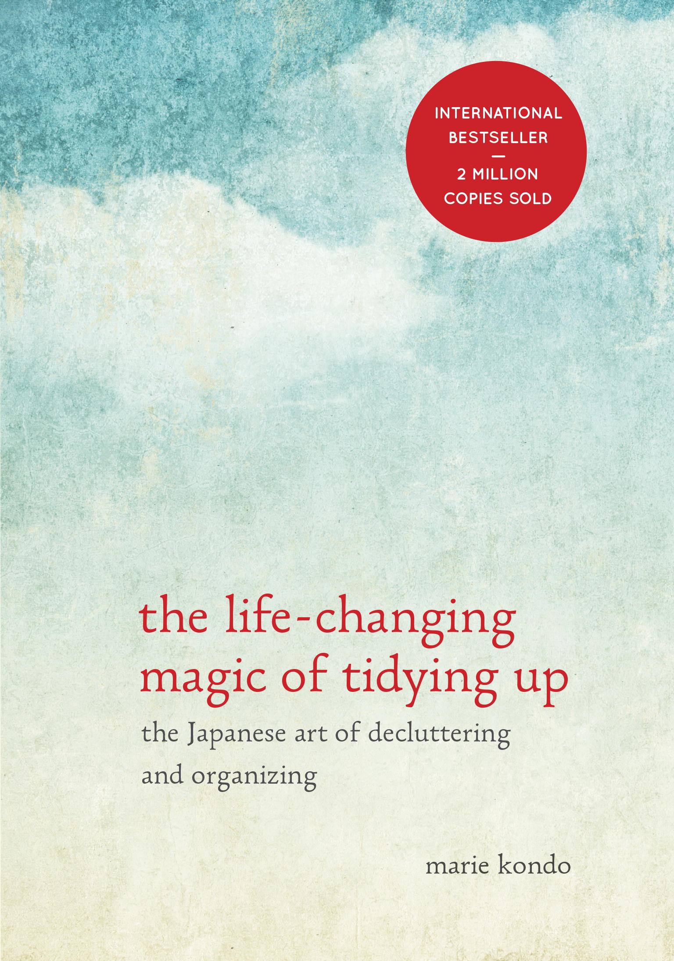
The Life-Changing Magic of Weeding

