Slide 1


Wake Up!
Are you sleepwalking your way through the day?
Jean Marie Heilig
Fiscal Officer
heilig_j@cde.state.co.us

Slide 2
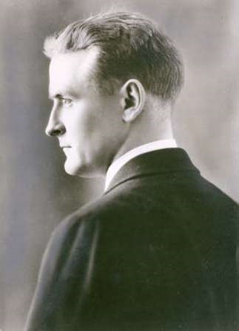
“It appears that every man’s insomnia is as different from his neighbour’s as are their daytime hopes and aspirations.”
- F. Scott Fitzgerald

Slide 3

Sleep Awareness Week 2018
March 11-17

Slide 4
Outcomes
Learn why sleep is so important.
Discover what we can do to get a better night’s sleep.

Slide 5
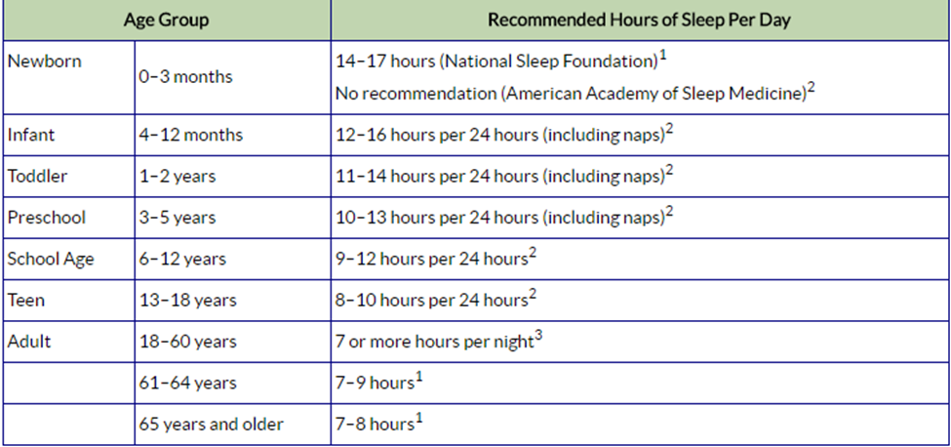
How Much Sleep Do You Need?
www.cdc.gov/sleep/about_sleep/how_much_sleep.html

Slide 6
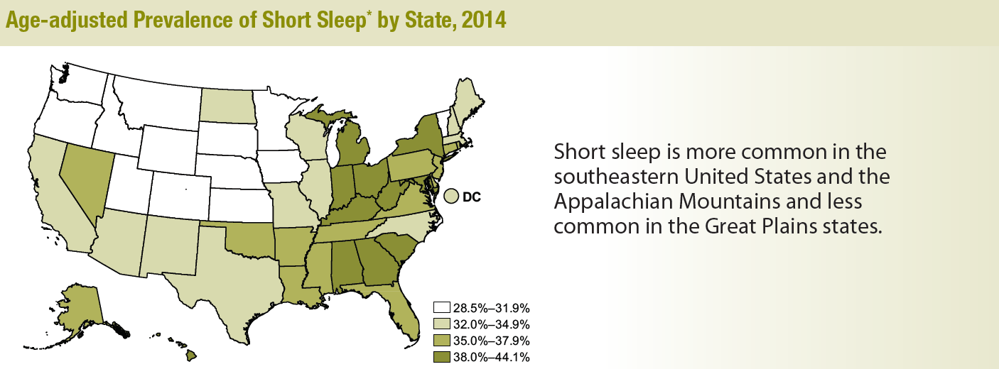
The Numbers - Map
www.cdc.gov/sleep

Slide 7
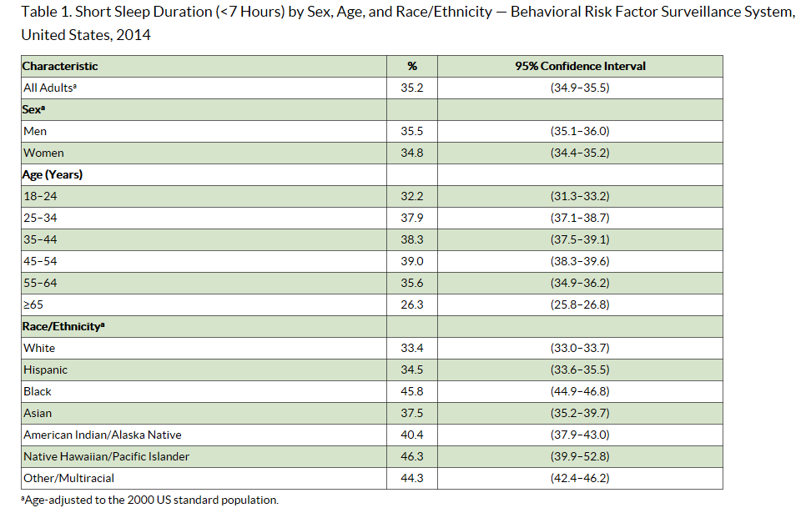

The Numbers

Slide 8
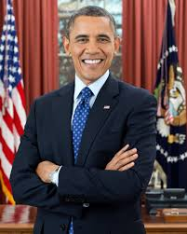



Short Sleeping
“The Sleepless Elite”
< 7 hours
1% Population
Wake Early
Genetics
Optimistic
&
Upbeat
Physically Active
Avoid Caffeine

Slide 9
Why Aren’t We Sleeping?
Insomnia
Difficulty falling asleep
Difficulty staying asleep
Sleep Related Breathing Disorders
Sleep Apnea
Snoring
Sleep Related Movement Disorders
Restless Leg Syndrome
Excessive Daytime Sleepiness Disorders
Periodic Limb Movements
Teeth Grinding
Difficulty returning to sleep
Excessive Sleepiness
Narcolepsy
Extreme Sleepiness

Slide 10

Why Aren’t You Sleeping?

Slide 11
Why I’m Not Sleeping!
Middle of the Night Anxiety Attacks
Time Change
Jet- Lag
Poodle
Noise
Pain

Slide 12

Why Do We Sleep? The Science

Slide 13
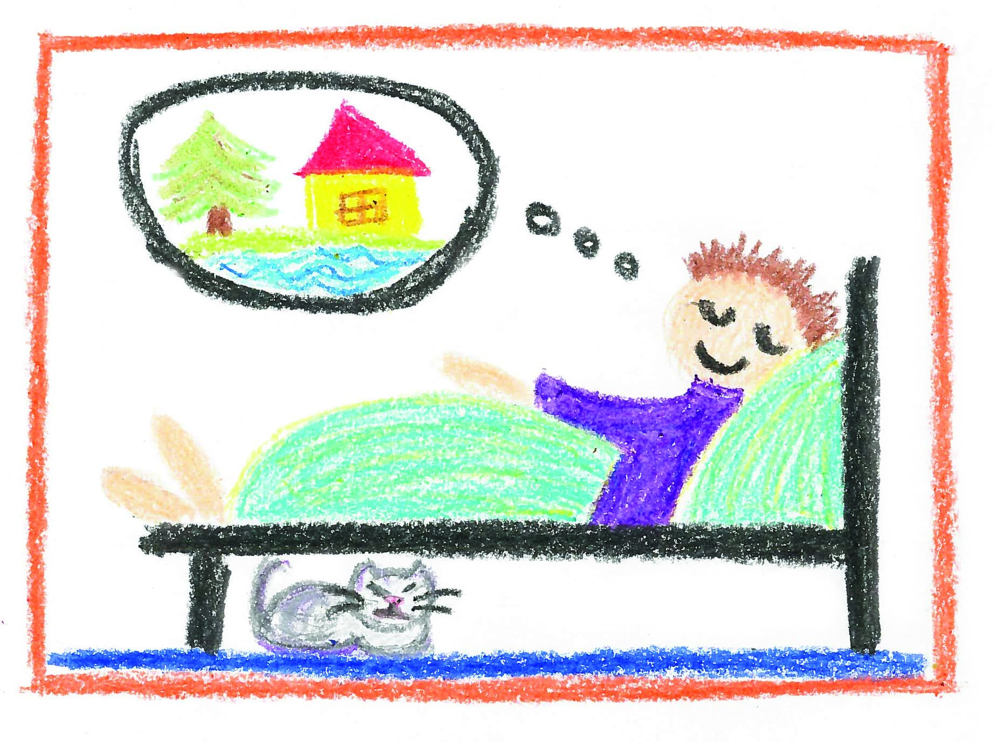
Why Do We Sleep?
Melissa Carlson

Slide 14

Consequences of Not Sleeping - Physical
“Human beings are the only species that will deliberately deprive themselves of sleep without legitimate gain”
-Mathew Walker

Slide 15

Consequences of Not Sleeping - psychological

Slide 16

The Cost of No Sleep

Slide 17

Better Sleep Health = Better Work Outcomes
Fairness
Decision Making
Emotions
Focus
Memory
Creativity
Ethics

Slide 18
What Can Employers Do?
Develop Training Programs
Rework Company Policies
Scheduling
Work-free Vacations
Predictable Time off
Travel
Black Out Time on Email
Practice what we teach

Slide 19
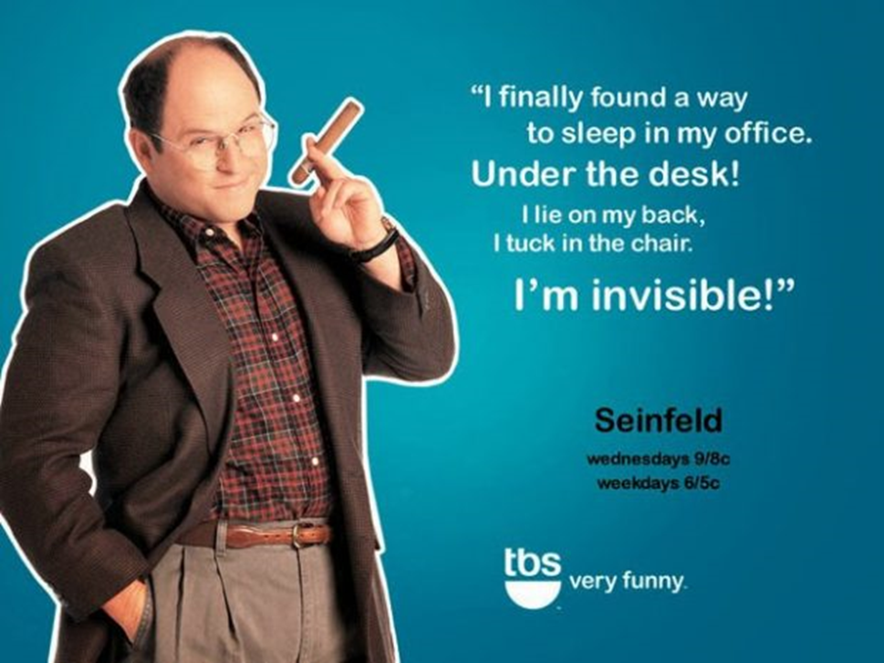
Naps!

Slide 20

Action Idea List

Slide 21

Sleep Hygiene - environment
Real Simple
Christopher Testani

Slide 22
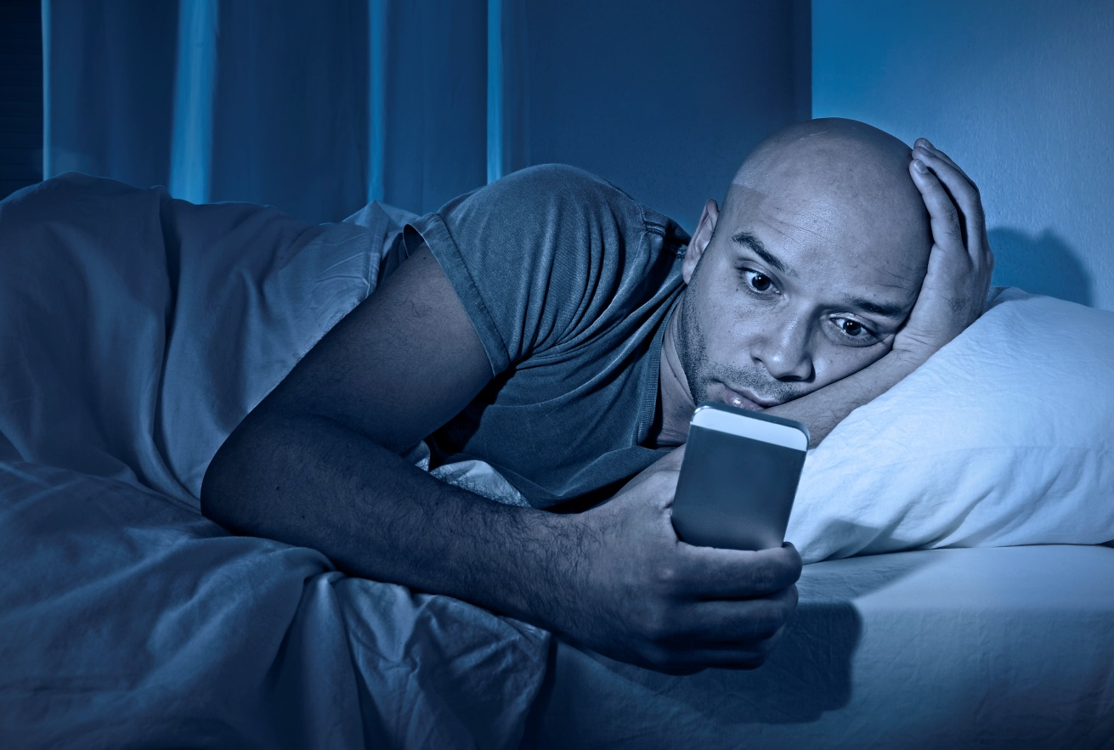
Sleep Hygiene - technology

Slide 23







Sleep Hygiene- Dos

Slide 24
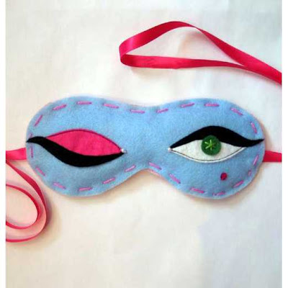
Sleep Hygiene- What works for you?

Slide 25


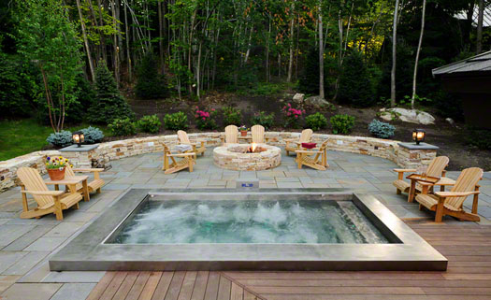

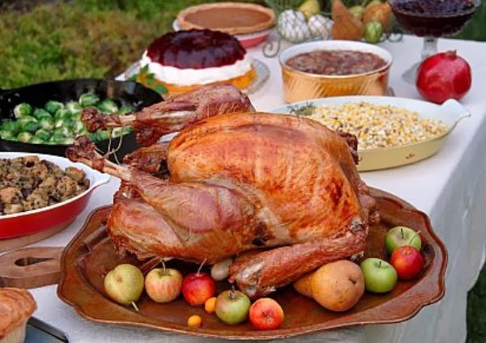

Sleep Hygiene- Don’ts

Slide 26


Getting Our brains to Shut-Up!

Slide 27
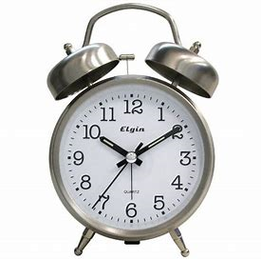
Sleep Opportunity

Slide 28

Sleep Diary

Slide 29
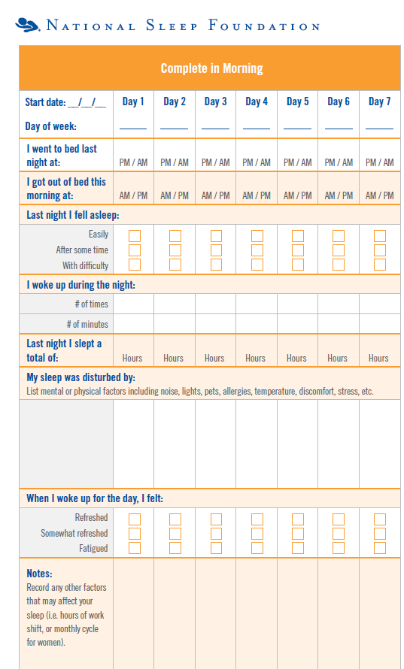
Sleep Diary #1

Slide 30
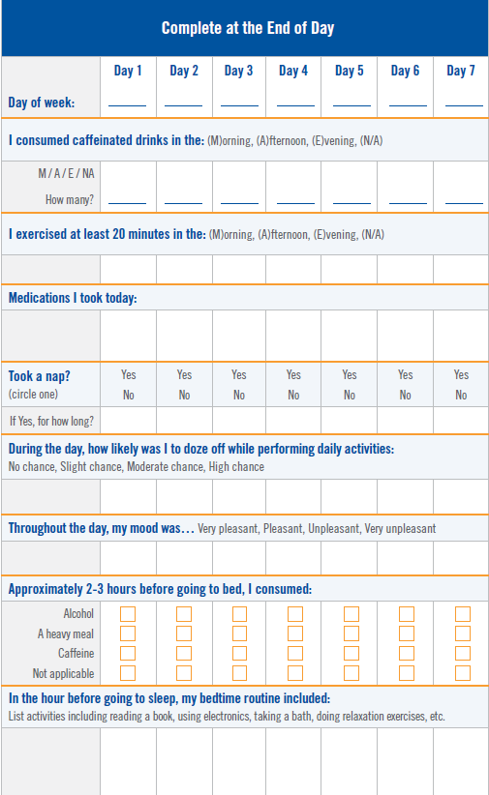
Sleep Diary #2

Slide 31
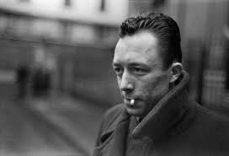
“Some people talk in their sleep.
Lecturers talk while other people sleep.”
- Albert Camus

Slide 32

Questions?

