Slide 1


Unearthing Seed Money: locating grants to fund your innovative project ideas
Jean Marie Heilig
Fiscal Officer
Colorado State Library
heilig_j@cde.state.co.us
303-866-6731

Slide 2

What You’ll Learn
Types of Grants
Types of Funders
Locating Potential Funders
Selecting the Appropriate Funder
Avoiding Rejection

Slide 3

Finding Funding
There are no “magic bullets in fundraising; it’s all about working with people.”
-Waddy Thompson
The Complete Idiot’s Guide
to Grant Writing

Slide 4
The Process…..
Identify Community Problem
Develop Program to Solve Problem
Research Funding Sources
Review Application Guidelines
Complete and Submit Application

Slide 5
The Process…….
Needs Assessment
Goal
Objectives
Activities
Timeline
Partnerships
Sustainability
Budget
Evaluation
Locate
Funders
Supplemental
Materials

Slide 6

What Funders Look For
Meet a need in the community
Have an impact on community
Unique service
Previous success
Adequate resources
Notes:
High quality programs that meet a real need in the community
programs that have an impact on the community
What do you do that no one else does?
Do you have an established track record of effective program delivery?
Adequate Resources
Do you have capable staff that can implement the program?

Slide 7
Types of Grants
Block
Capacity Building
Capital Improvement
Challenge
Discretionary
Emergency Assistance
Formula
Equipment Purchase
Notes:
Block: Fed grant awarded to state or local governments for a specific use.
Capacity Building: strengthen internal operations to become more effective/efficient.
Capital Improvement: bricks and mortar
Challenge: used as a carrot, incentive, If you raise $5,000 we’ll give you $5,000. Must raise additional funds from other sources. For example- Dumb Friends League and Diabetes
Discretionary: Fed or State grant awarded directly to nonprofits.
Emergency: help to recipient for extraordinary short-term or unexpected financial crises.

Slide 8
Types of Grants Continued
General Operating
Matching
Project/Program Support
Research
Start-up/Seed Money
Technology
Technical Assistance
Notes:
General Operating: personnel, administration, and other expenses for an existing program
Technical Assistance: consulting outside of your expertise for example, Human resources, technology, accounting,

Slide 9
Types Of Funding Sources
Government | Private
Federal government | Foundations - Private and Community
State government | Corporations & Corporate Foundations
Local government | Local Clubs & Organizations
 | Professional Associations

Slide 10





Federal Government

Slide 11





State and Local Government

Slide 12












Foundations- Private

Slide 13






Foundations - Community
Notes:
Donor Advised Funds; Donor Directed Funds
Assets from multiple sources. Support a specific community

Slide 14












Foundations - Corporate

Slide 15






Local Clubs & Organizations

Slide 16







Professional Associations

Slide 17





Directories

Slide 18

Track and Find Funding for libraries
http://libraries.foundationcenter.org/

Slide 19
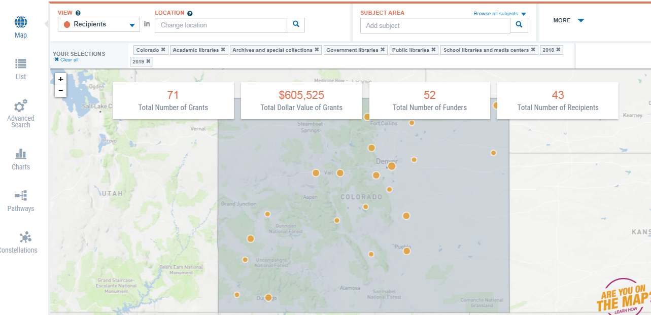
Data Tool Example

Slide 20
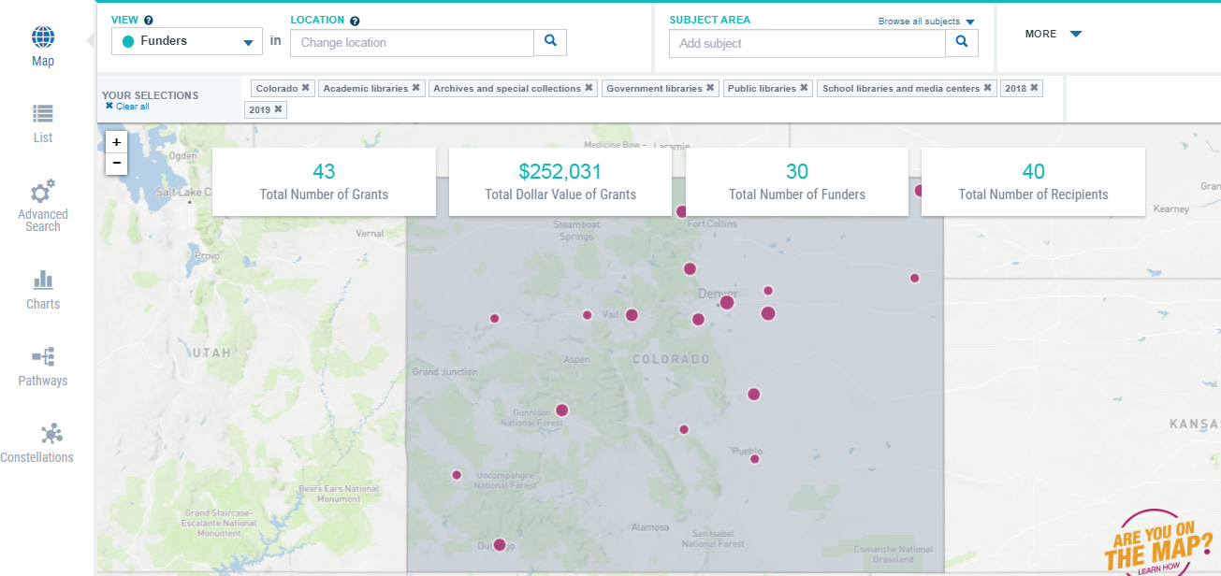
Data Tool example

Slide 21
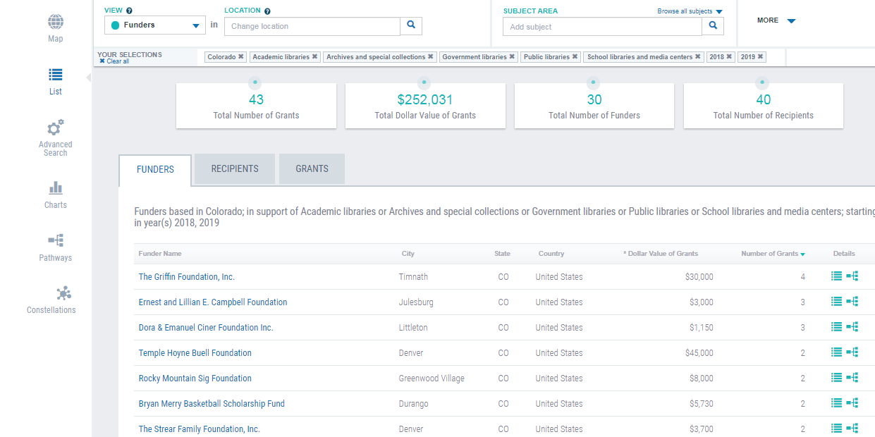
Funders

Slide 22
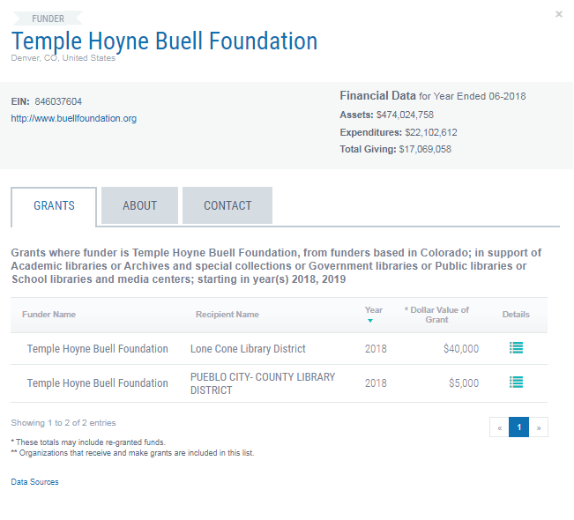
Temple hoyne buell example

Slide 23
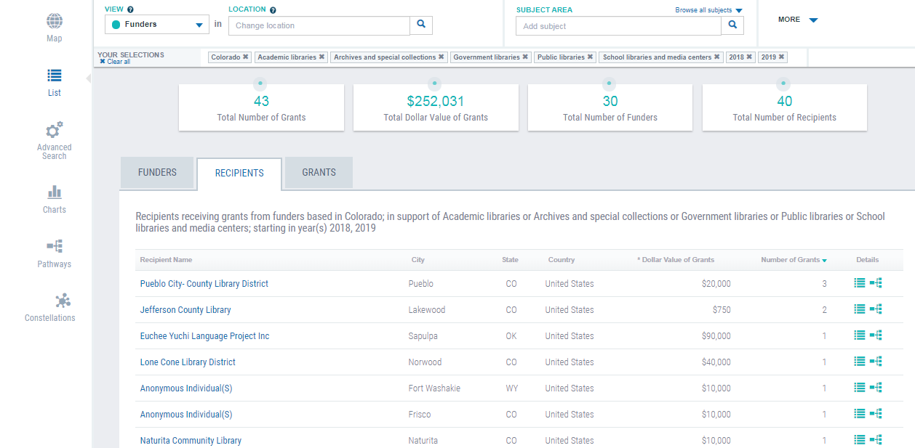
Recipients example

Slide 24
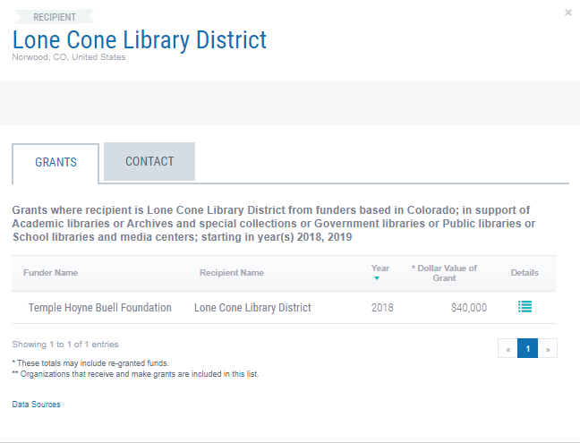
Lone Cone Library District Example

Slide 25
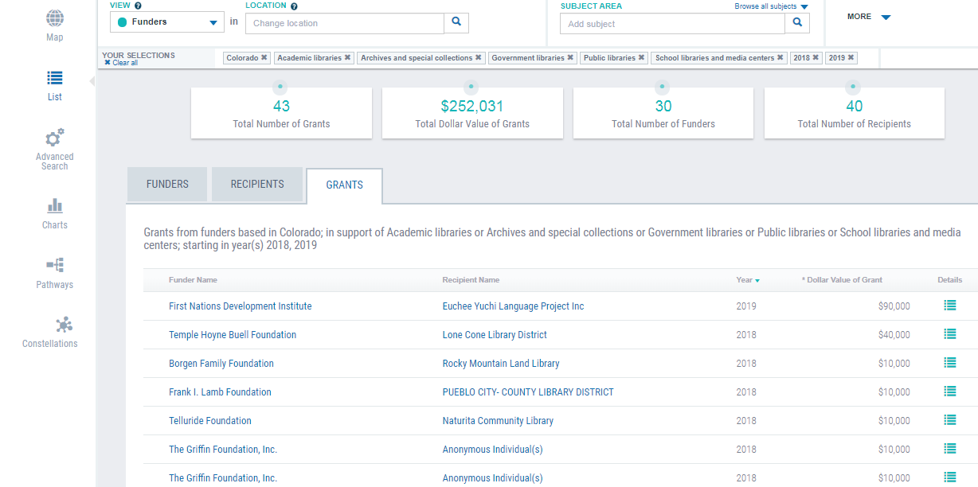
Grants example

Slide 26
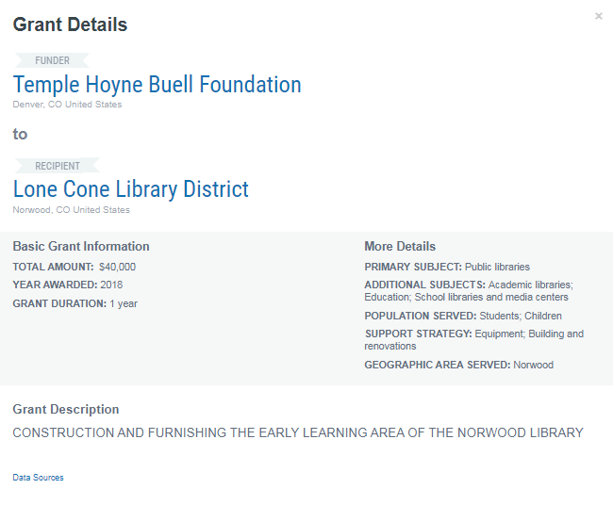
Grant details example

Slide 27
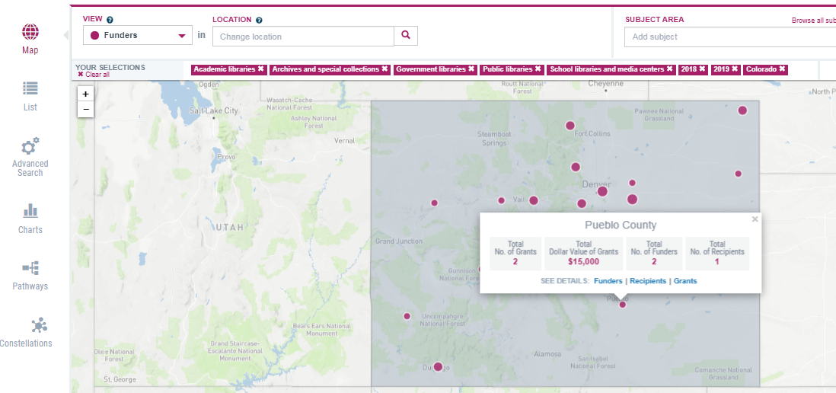
Pueblo County Grants example

Slide 28
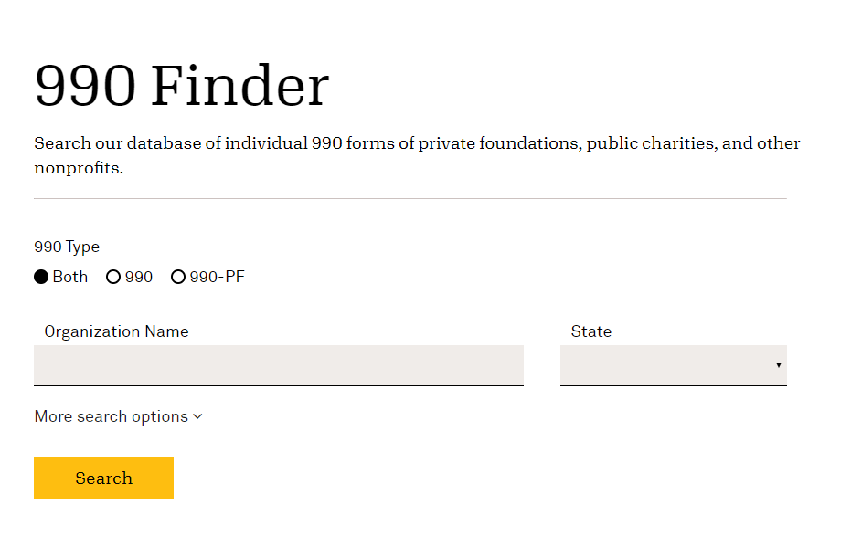
990 finder
https://candid.org/research-and-verify-nonprofits/990-finder

Slide 29
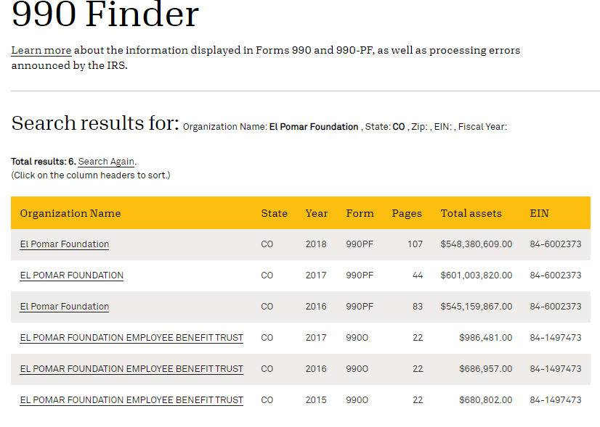

990 Finder by organization

Slide 30

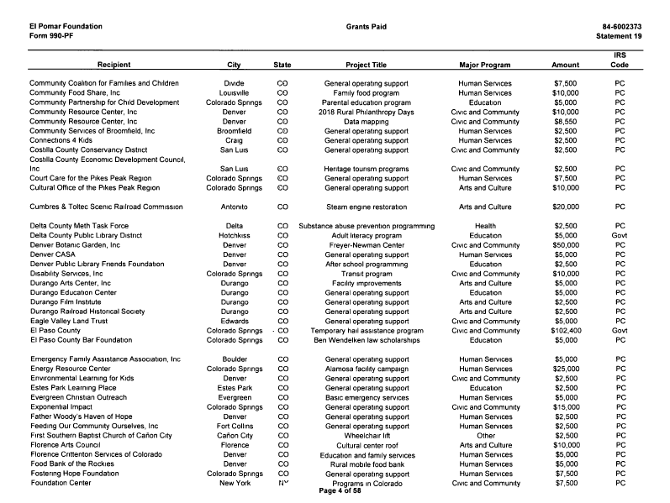


Form 990 example

Slide 31

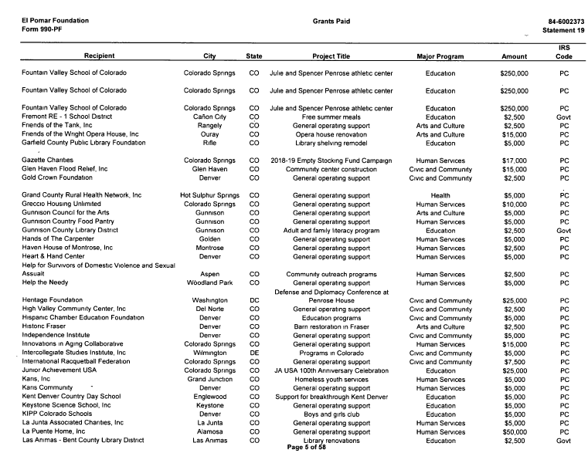


Form 990 example continued

Slide 32
Funding Information Network
Name | City
Denver Public Library | Denver
Mesa County Libraries | Grand Junction
Bud Werner Memorial Library | Steamboat Springs
Estes Valley Library | Estes Park
Eagle Valley Library District | Eagle
El Pomar Nonprofit Resource Center | Colorado Springs
Poudre River Public LD- Harmony Library | Fort Collins
Farr Branch Library | Greeley
Pueblo City-County LD | Pueblo
Laramie County Library System | Cheyenne, WY

Slide 33


Locating Funders-Directories
http://crcamerica.org/

Slide 34
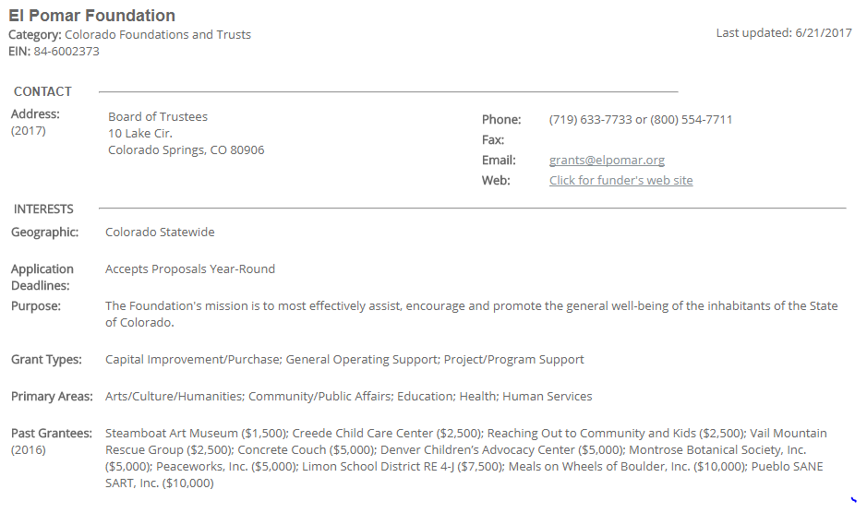
El pomar foundation example

Slide 35

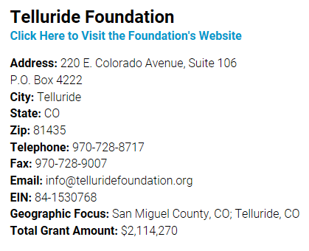
Locating Funders- Directories

Slide 36



Locating Funders - Directories
$99
https://grantstation.com/
Notes:
Regular subscription $699, techsoup $299, 2-3 days a few times a year $99

Slide 37


Locating Funders- Networking
26th Fall Conference & Exhibition
October
Colorado Association of Funders
Community Resource Center
Colorado Nonprofit Association
August

Slide 38


Locating Funders- Networking continued
Northeast RPD
June 9-11, 2020
Heart of Colorado RPD
Sept 23-25, 2020
Notes:
Colorado’s 52 rural counties are divided into 8 rural regions. Two events every year. Each region will hold an event once every 4 years. Individuals who participate in the program are able to increase the effectiveness of their missions, build meaningful collaborations, and achieve fundraising goals.

Slide 39


Locating Funders
https://joiningvisionandaction.com/

Slide 40

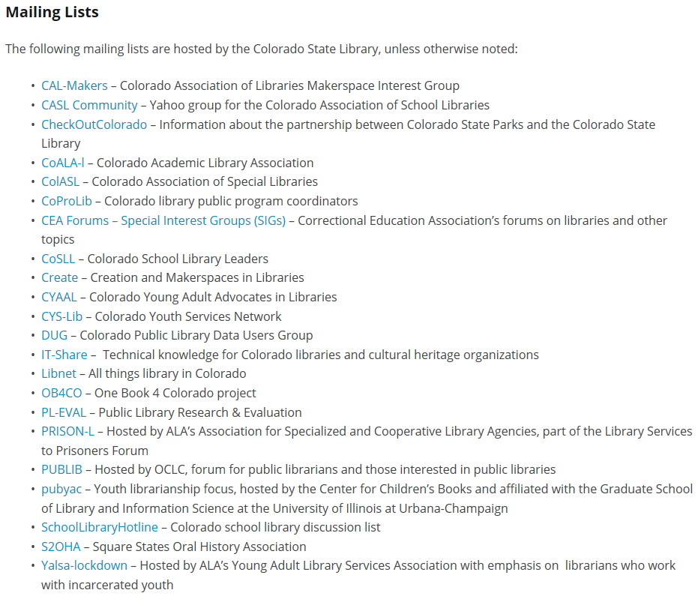
Locating Funders- Discussion Lists

Slide 41

Match Made in Heaven?
Goal Aligns With Funders Mission?
Eligible?
Expenditures Allowable?
Matching Funds?
501(C)3?
Who have they funded?

Slide 42

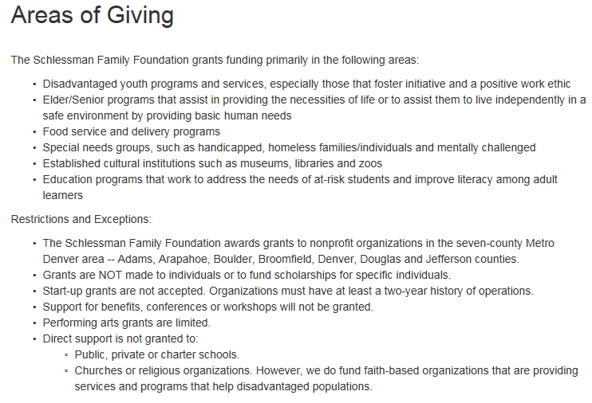

Schlessman Family Foundation example

Slide 43

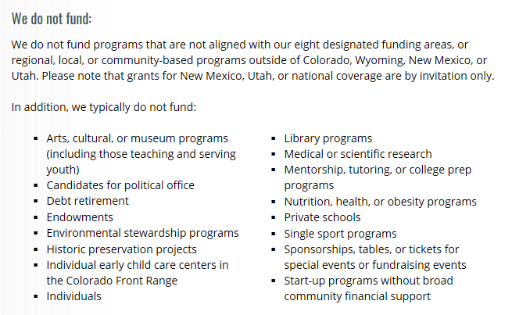


Daniels fund example

Slide 44
Avoiding Rejection
The most frequent reasons that foundations reject proposals are:
they don’t have enough funds to accept every request,
the request falls outside of the funder’s giving interests, and
the applicant didn’t follow application guidelines.
“If you don’t qualify, don’t apply”
-- Grantspace

Slide 45
Avoiding Rejection continued
Poor Fit
Guidelines Ignored
Timing
No Outcomes
Duplication of Service
Poorly Written
Unrealistic Expectations
No Funder Recognition
Notes:
El Pomar- 50% of applications are incomplete or didn’t follow instructions
50% of grant applications do not meet criteria
50% of grant applications are not complete

Slide 46

Questions?

