Slide 1
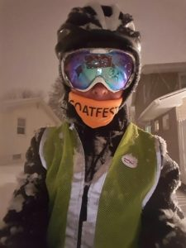
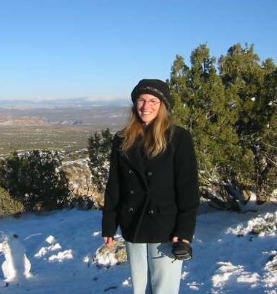
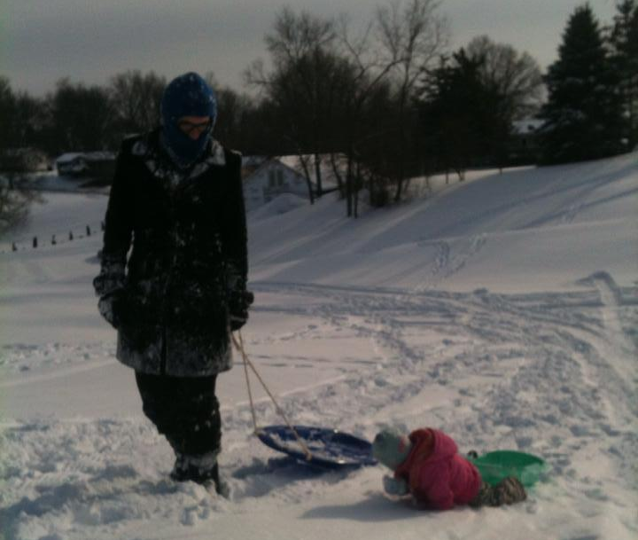
Introductions
Notes:
All

Slide 2
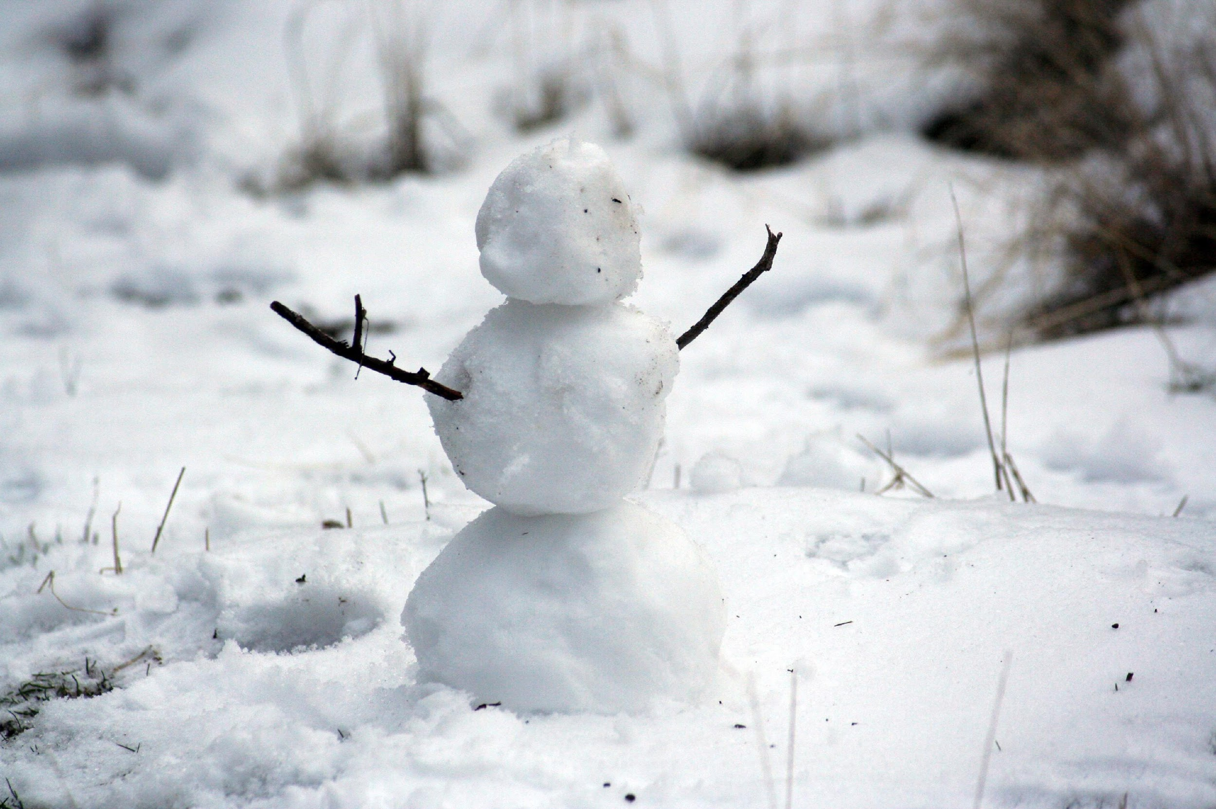
Agenda
YOU
HOW
WHY
Notes:
Maryann - It takes three snowballs to make a snowman, and we have three parts to our session today:
We’ll begin with WHY you should consider winter programming. There are actually a lot of benefits!
We’ll then move on to HOW you can provide winter programming for your patrons—offering lots of ideas and partnership recommendations.
We’ll top it all off by finishing with YOU—ways that YOU can utilize what we’ve discussed today, so we’ll have plenty of opportunities for you to interact and share your thoughts and ideas. We encourage you to do that throughout our session today by utilizing the chat feature!

Slide 3
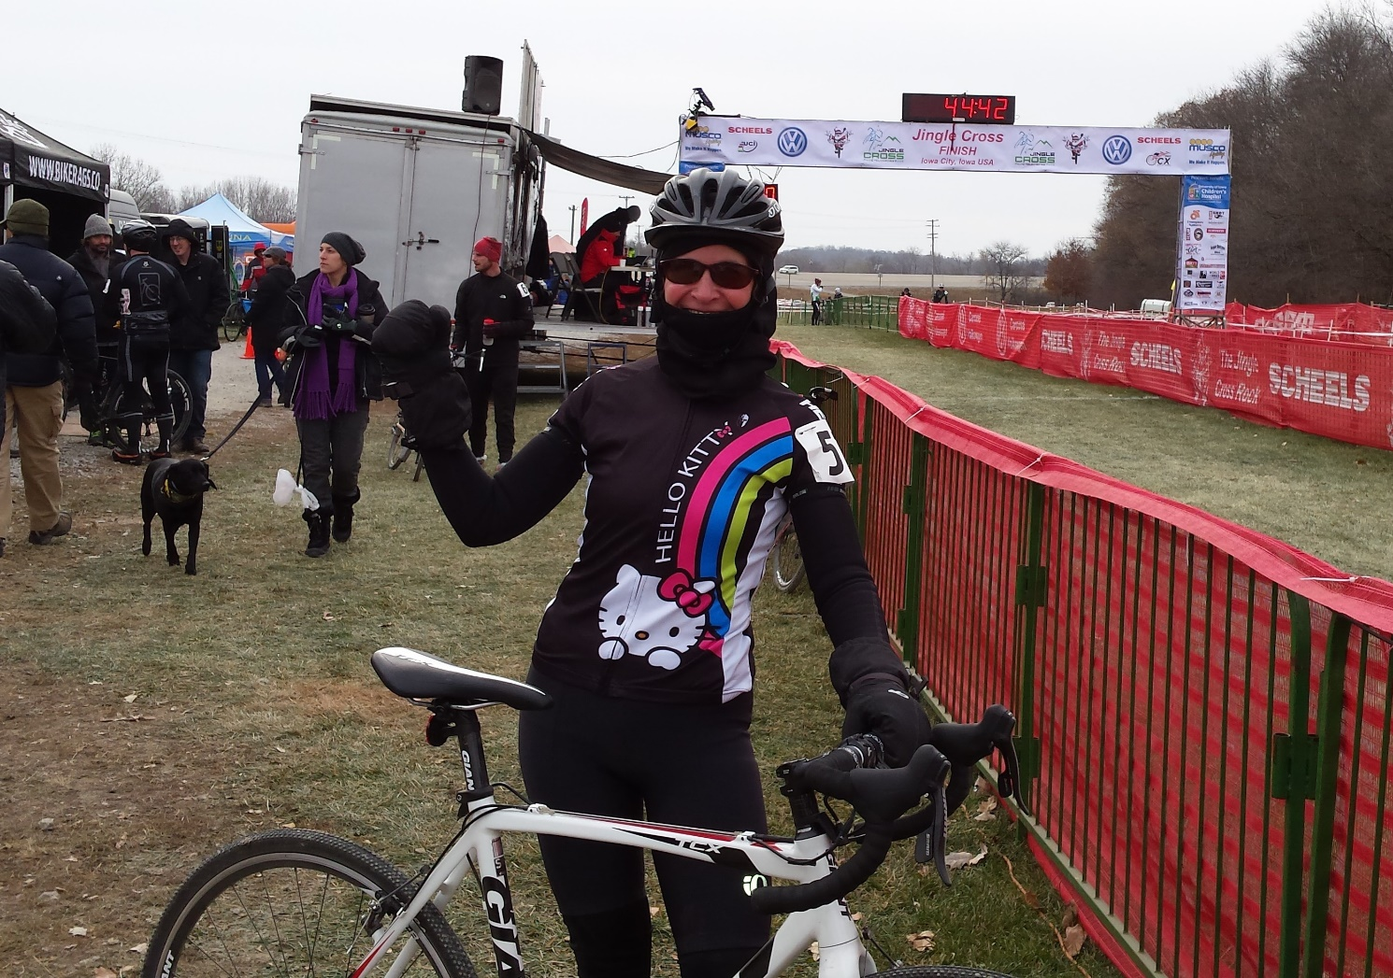
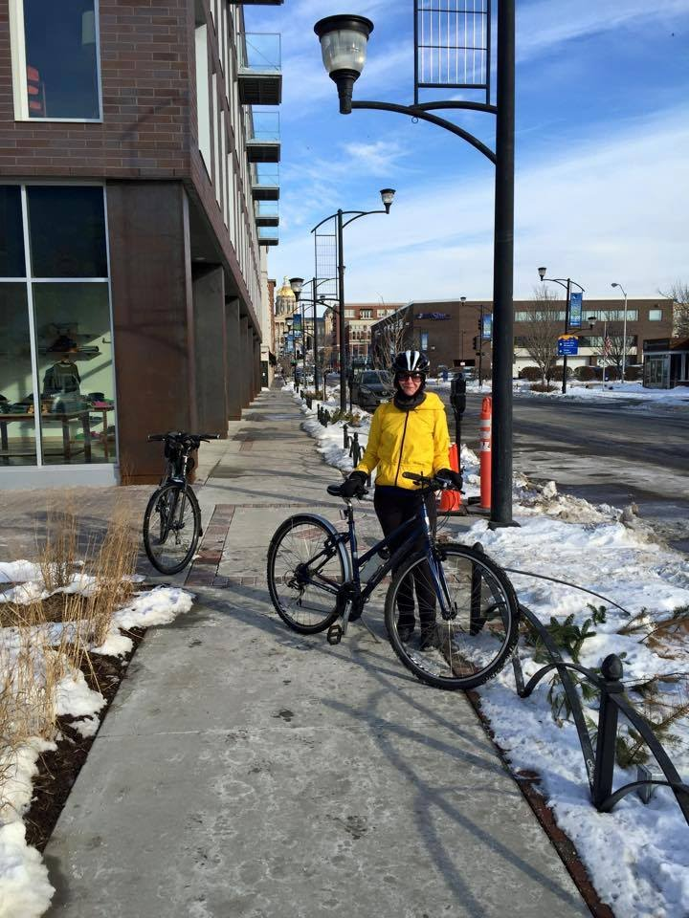
About Maryann
Notes:
Maryann - Here’s what I like to do on a wintry day! And part of what we want to convey to you today are reasons to at least promote outdoor activity if not actually go outdoors yourself during winter. Finding the appropriate clothing---and it doesn’t have to be expensive—can go a long way in appreciating the outdoors in winter. And staying active while outdoors in winters means you’re generating your own heat, so you’re often not as cold outside as you might think.

Slide 4

Why?
Notes:
Maryann- We have several “whys” for being outdoors in winter. The first reason is that outdoor activities are POSSIBLE even during winter…and your library can be the catalyst, if not the provider of those activities! So our first “why” is that it is possible, or to put it another way: “Why not?”

Slide 5
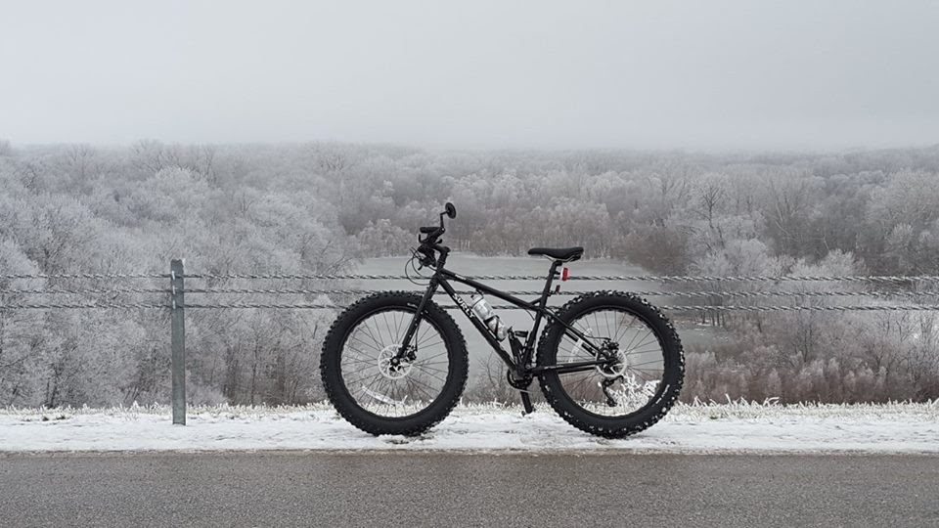
Enchanting and Beautiful
Notes:
Maryann-Another WHY: Because it’s absolutely enchanting and beautiful! This is a picture I took on one of my winter bike rides. It was a magical, awesome experience to be part of this beautiful scene. (This is Central Iowa.) True Confessions: I wasn’t always this enthusiastic about winter, so I get it if you answered our poll with “I groan and go back to bed!” But as we said at the beginning, we’re going to begin by talking about the “why” of outdoor programming during winter. So one of my “whys” is that it’s absolutely beautiful—in ways you won’t see at other times of the year and in ways you can’t enjoy from a car or indoors.

Slide 6
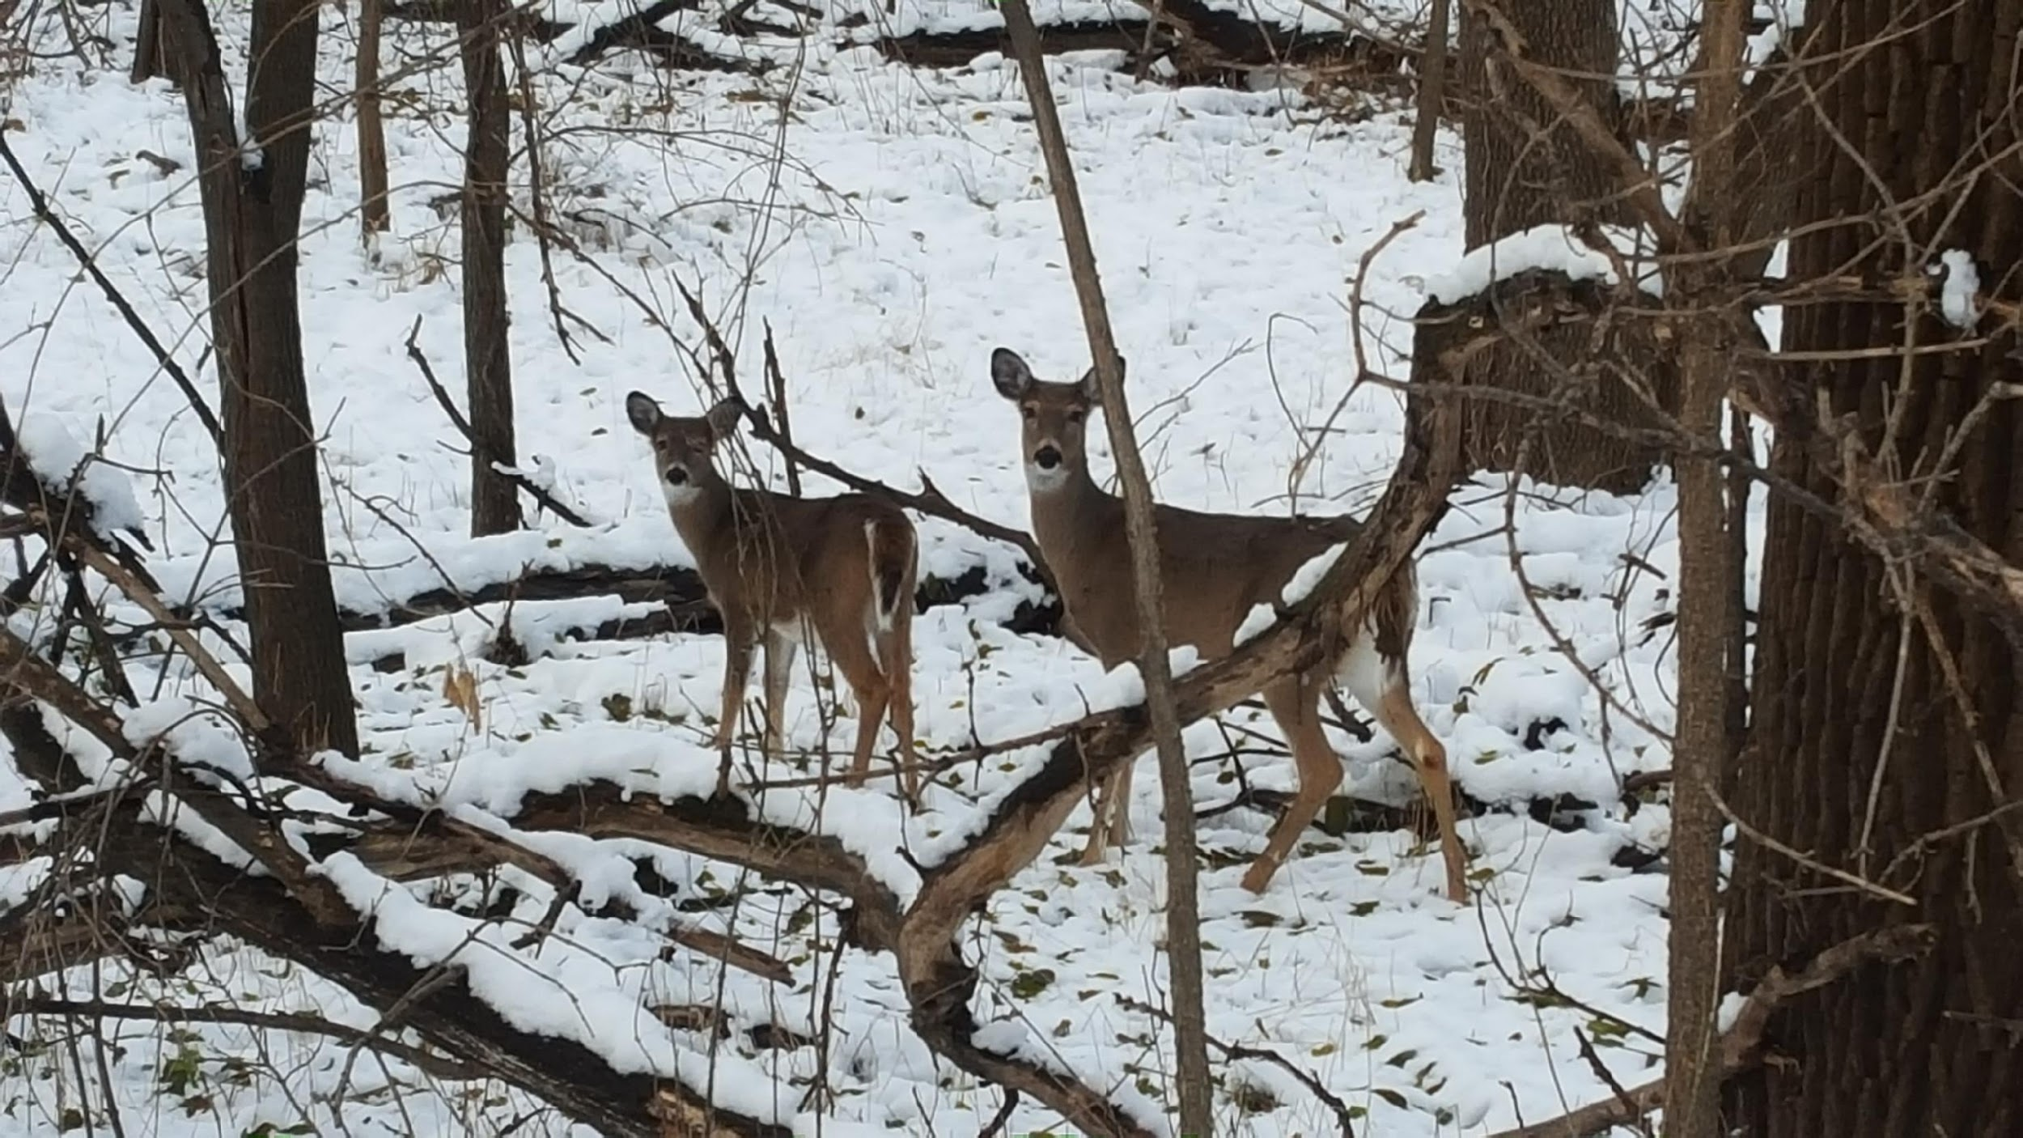
Nature
Notes:
Maryann-WHY go outdoors in winter? Because you’ll see sights like this! I took this photo—and was about “this far” from those deer on one of my winter bike rides. Being outdoors in winter is a unique way to enjoy nature in ways you won’t always find at other times of the year.

Slide 7
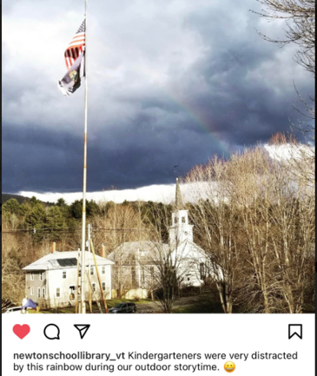
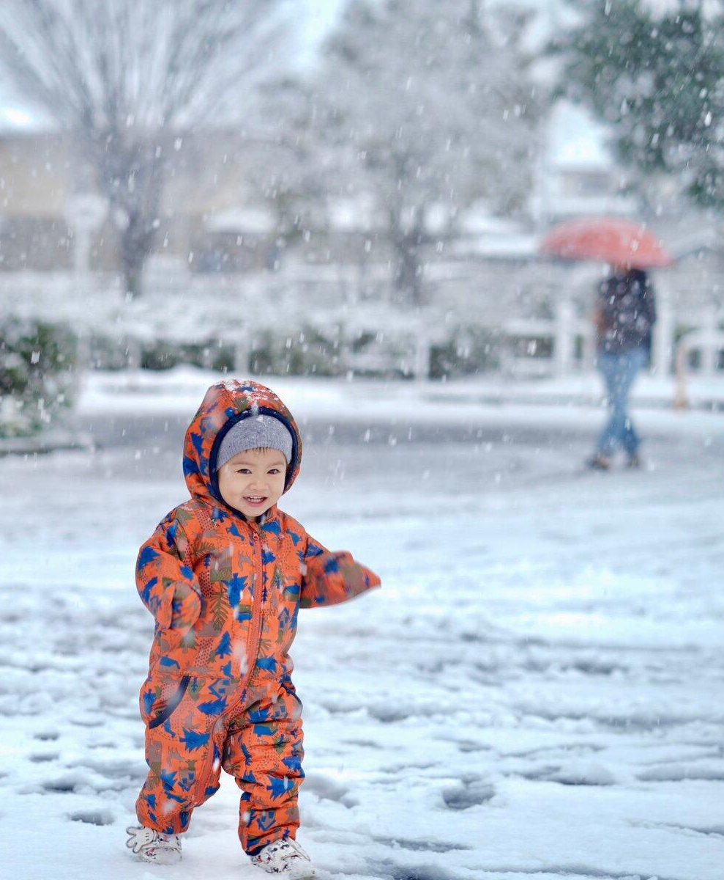
Outdoors
Notes:
Maryann-Here’s a similar example---although I don’t think these kindergarteners at their school library were outdoors, they were at least able to appreciate the outdoors and be distracted (in a good way) by the beauty of this recent winter rainbow.

Slide 8
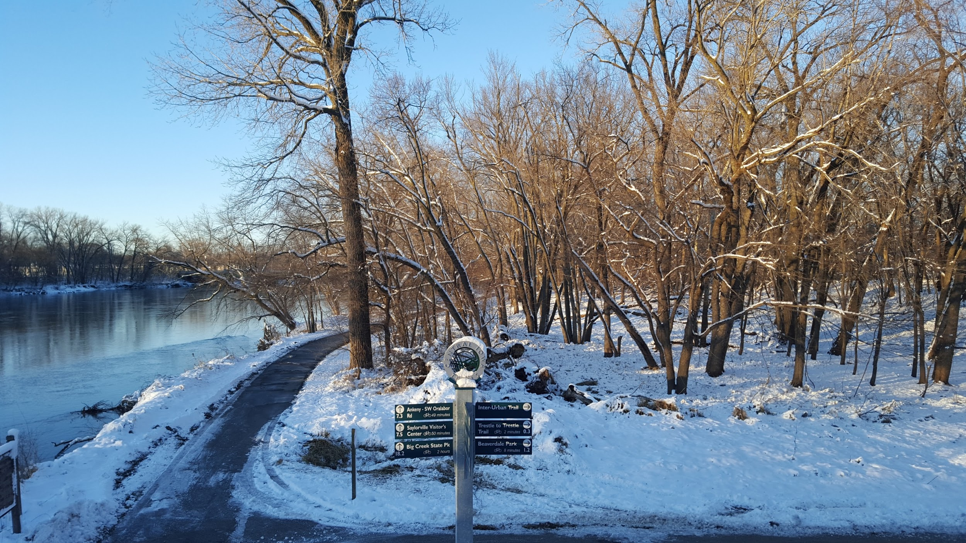
Health
Notes:
Maryann-A wonderful WHY for being outside in winder is that the beauty and briskness of the season does wonders for your physical, mental and emotional health. Exercise and sunshine are two things to help beat winter doldrums! (I just want to note that where I live in Central Iowa, many of the recreation trails are in better shape (as far as snow removal) than our streets!)
Noah has more information about ways the outdoors benefit your mental and emotional health.

Slide 9
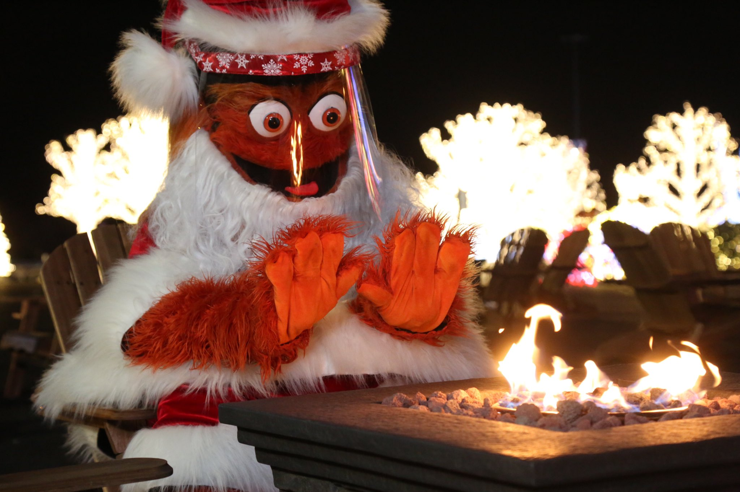
Addressing Nature Deficit Disorder, or Being Stir Crazy during the Winter!
Being cooped up all winter challenges our mental health
Get outside to refresh and re-charge
Learn more about mental health benefits of outdoor engagement during winter at www.childrenandnature.org/ resources/what-is-nature-deficit-disorder/
Source: Philadelphia Flyers
Notes:
(NOAH)

Slide 10
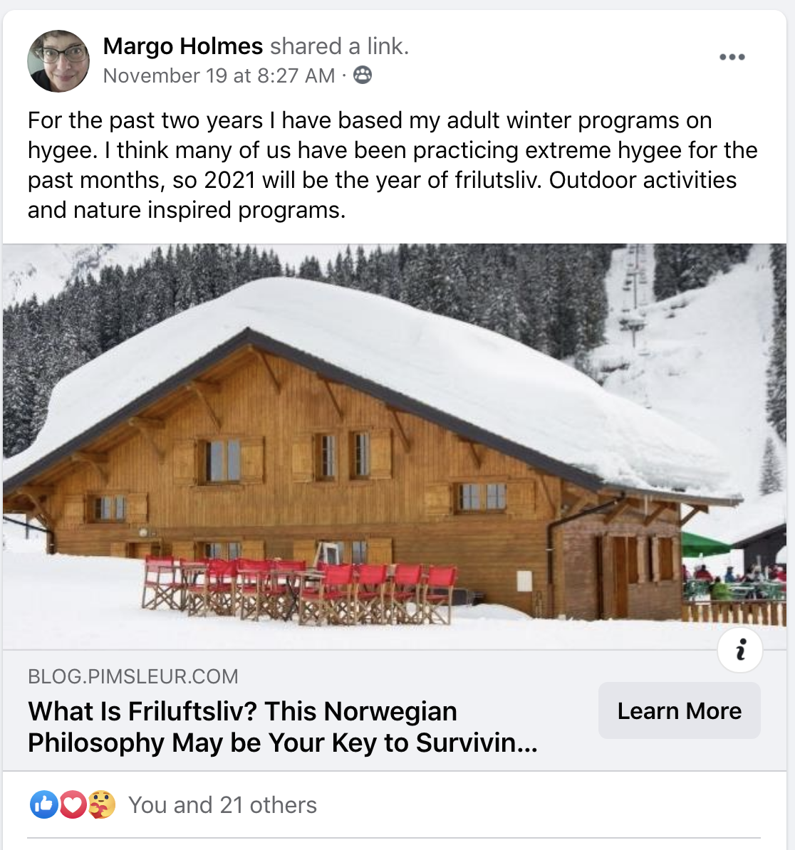
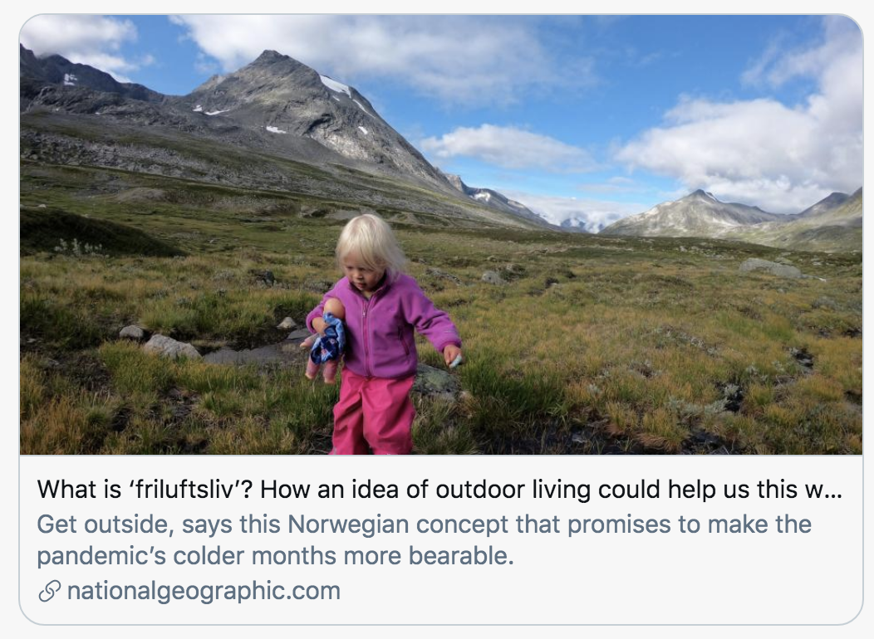
Friluftsliv => The new hygge
Friluftsliv
“open-air living”
Notes:
Noah

Slide 11
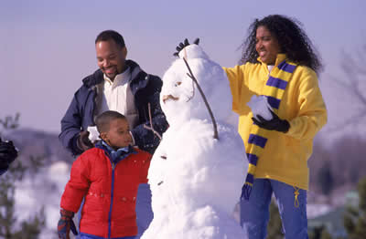
Fun
This Photo by Unknown Author is licensed under CC BY-SA
Notes:
Maryann - Yet another WHY—one of my favorite reasons: It’s just plain fun! Think back to when you were a kid—how much you loved playing outside in the snow. You can regain those simple, happy feelings again as an adult. And if you’ve got kids in your life, that makes it even easier to get outside and enjoy winter! During a pandemic, mental, emotional, and physical health have become even more at risk. Being outdoors this winter is ideal for social distancing, and getting fresh air as well as Vitamin D.

Slide 12
How?
Possibilities,
Programs,
Places, and
Partnerships
Notes:
Maryann - We’ve given you some good reasons WHY you should promote and/or do outdoor activities and programming in winter. Let’s get practical now and help you understand HOW you can do this. It’s really not as difficult as you might think, and we have four points or ideas to share—with plenty of good examples from other libraries to show you.
Four ideas: Possibilities, Programs, Places, and Partnerships

Slide 13
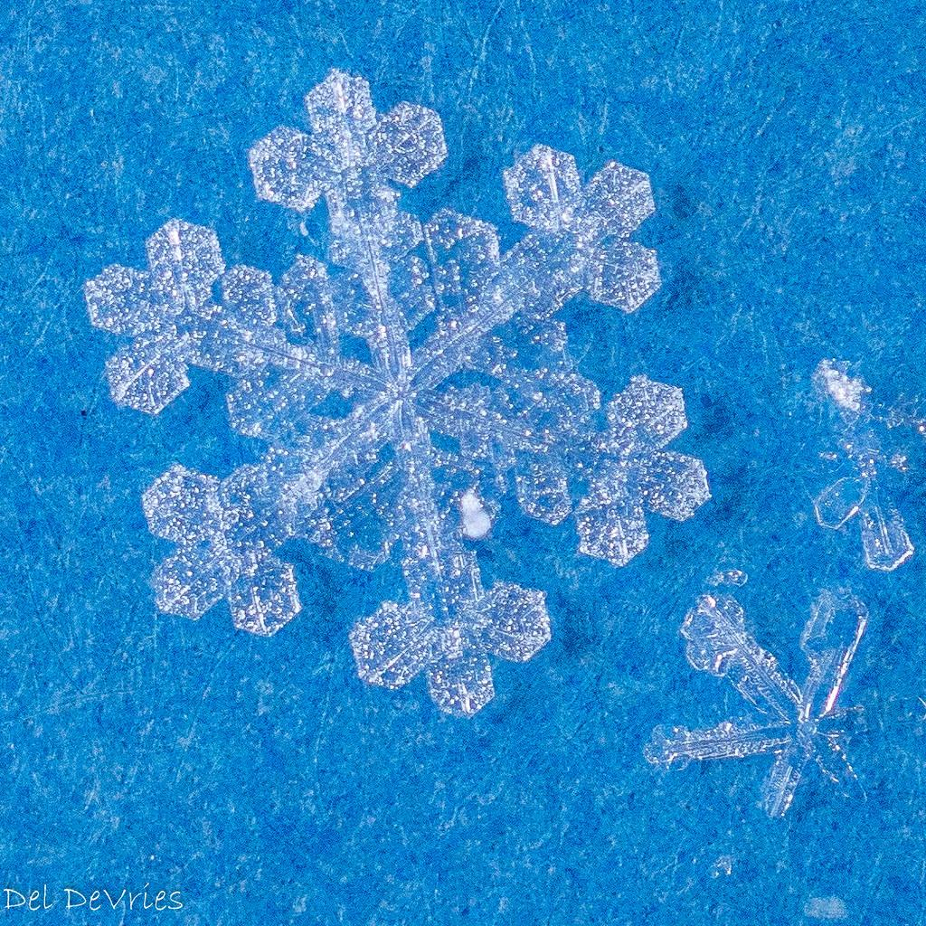
1. Promote Possibilities
This Photo by Unknown Author is licensed under CC BY-SA
Notes:
Beth - Tip #1: Simply promote—promote the possibilities!

Slide 14
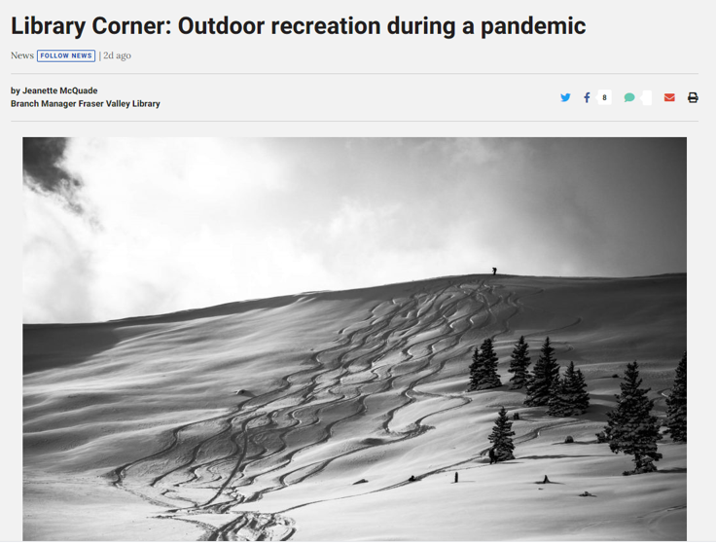
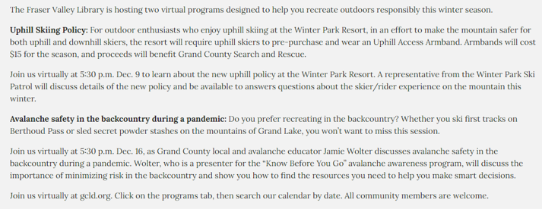
Safety First!
https://www.skyhinews.com/news/library-corner-outdoor-recreation-during-a-pandemic/
Notes:
Beth - That’s exactly what a branch library in the Grandy County Regional system in Colorado did—partnered with other groups, other individuals to provide library programming pertaining to winter activities. Here’s a screen shot of their “Library Corner” article that appeared in a recent edition of the Sky-Hi News source. You can see that the library is hosting “two virtual programs designed to help [people] recreate outdoors responsibly this winter season. Their programs include one about uphill skiing policy –a partnership with the Winter Park Ski Patrol, and a second program about avalanche safety—a partnership with a local avalanche educator.
Find the folks who know the information, and bring them into your library for a wonderful programming partnership!
Local bike or ski shops, sporting goods stores, ski resorts…those and other similar types of businesses can all be good potential programming partners. Such programs can also be an opportunity for the library to tout some of its books, movies and magazines that pertain to the program topic, too!

Slide 15
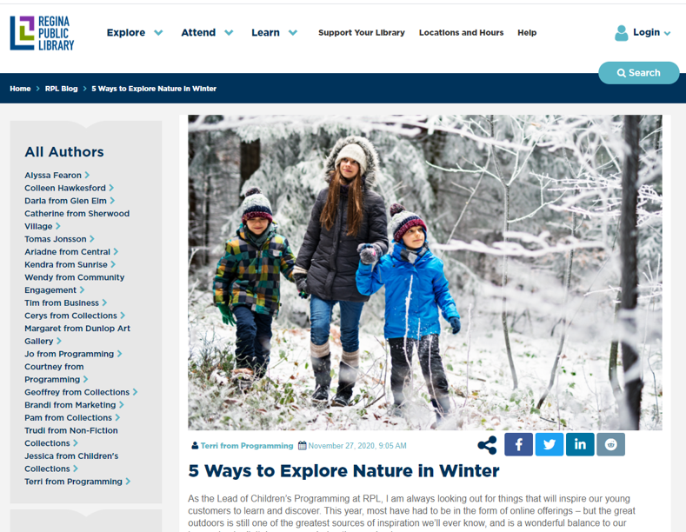
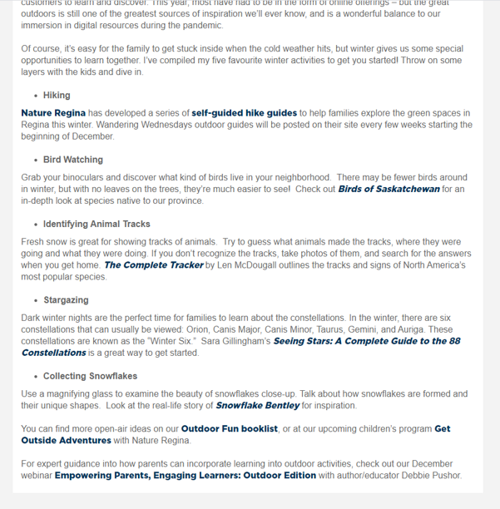
What books or magazines are already in your library that might promote outdoor activities?
https://www.reginalibrary.ca/blog/rpl-blog/5-ways-explore-nature-winter
Notes:
Beth - And don’t forget to promote some of the resources you likely already have at your library! Here’s a wonderful example from Regina Public Library in Saskatchewan ---simply promoting some of their nature books as a means of encouraging people to go outdoors this winter! (CLICK) What books or magazines are already in your library that might promote outdoor activities? Could you post something on your library’s website or make a virtual display about them? How can you best market these resources?

Slide 16
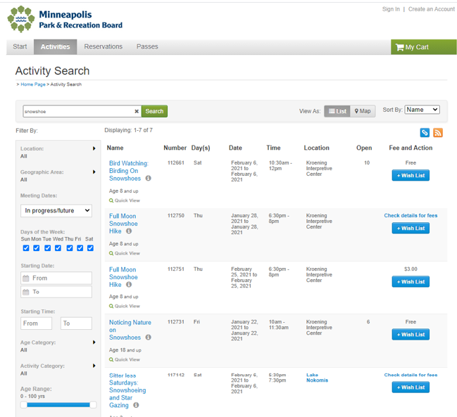
Possibilities…
Do you have a P&R Department in your city? What is it planning for winter?
Also look to conservation groups, state parks, environmental orgs, etc.
Notes:
Beth - You can begin by simply pointing out possibilities from other organizations. For instance, what’s your local Parks & Rec offering? This sample from Minneapolis shows there are quite a few outdoor offerings happening there. Your library can help promote these kinds of activities—which can not only help your patrons learn about the opportunities, but might also strengthen the relationship between your library and another city department. (CLICK) Does your city have a Parks & Rec Department? If so, do you know what kinds of activities it’s doing for winter?

Slide 17
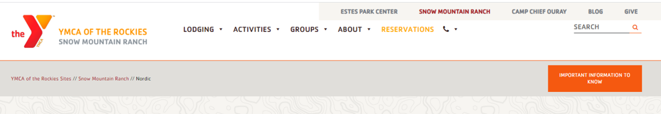
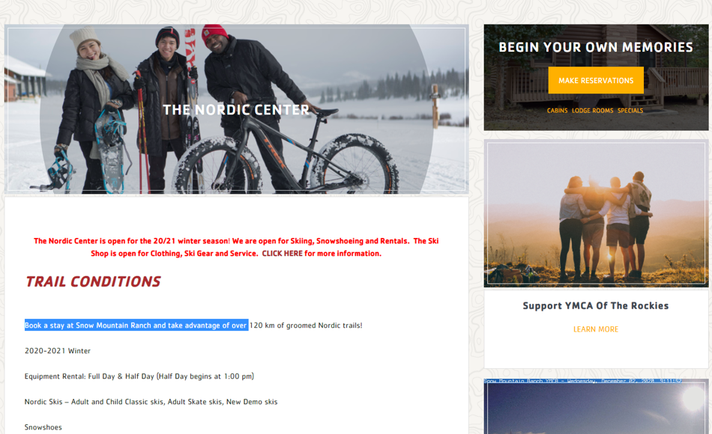
Partners
https://snowmountainranch.org/nordic-center/
Notes:
Beth - Other organizations that might already have outdoor activities scheduled and which you can promote include local sporting stores, county conservations, state and local parks, or local nature conservancies. This example on the screen is from the “YMCA of the Rockies” organization in Colorado. Your library could consider promoting some of these types of organizations’ programs and services, such as their ski or snowshoe rentals.
https://snowmountainranch.org/nordic-center/

Slide 18
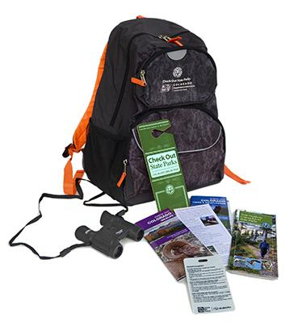
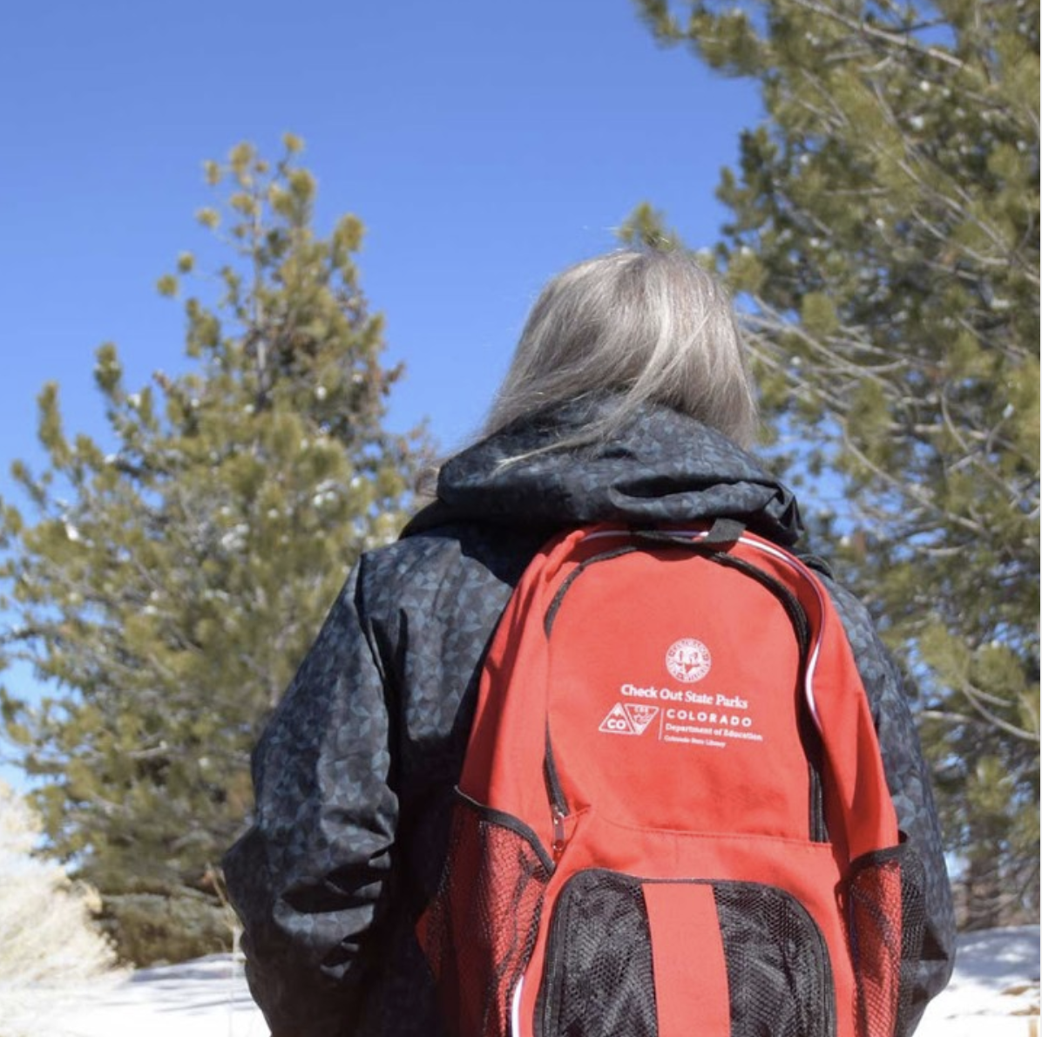
Promote Possibilities
Notes:
Beth – we also promote possibilities by working with partners to extend access to outdoor experiences, without doing any outdoor programming ourselves!

Slide 19
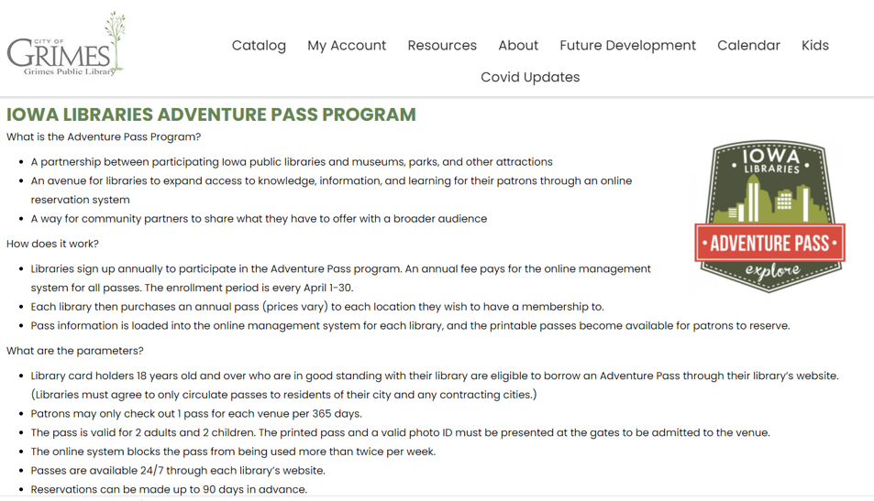
Iowa Libraries Adventure Program
Notes:
Maryann - Here’s another truly wonderful partnership that encourages people to go outdoors year round. Adventure Passes are not unique to Iowa, but since I’m from Iowa, that’s the example you’ll see here. These are passes to area parks, zoos, museums, and other attractions that can be checked out from local public libraries by library card holders. In our area, the pass includes an outdoor ice skating rink!

Slide 20
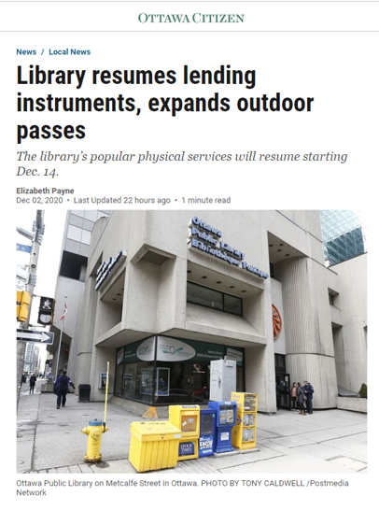
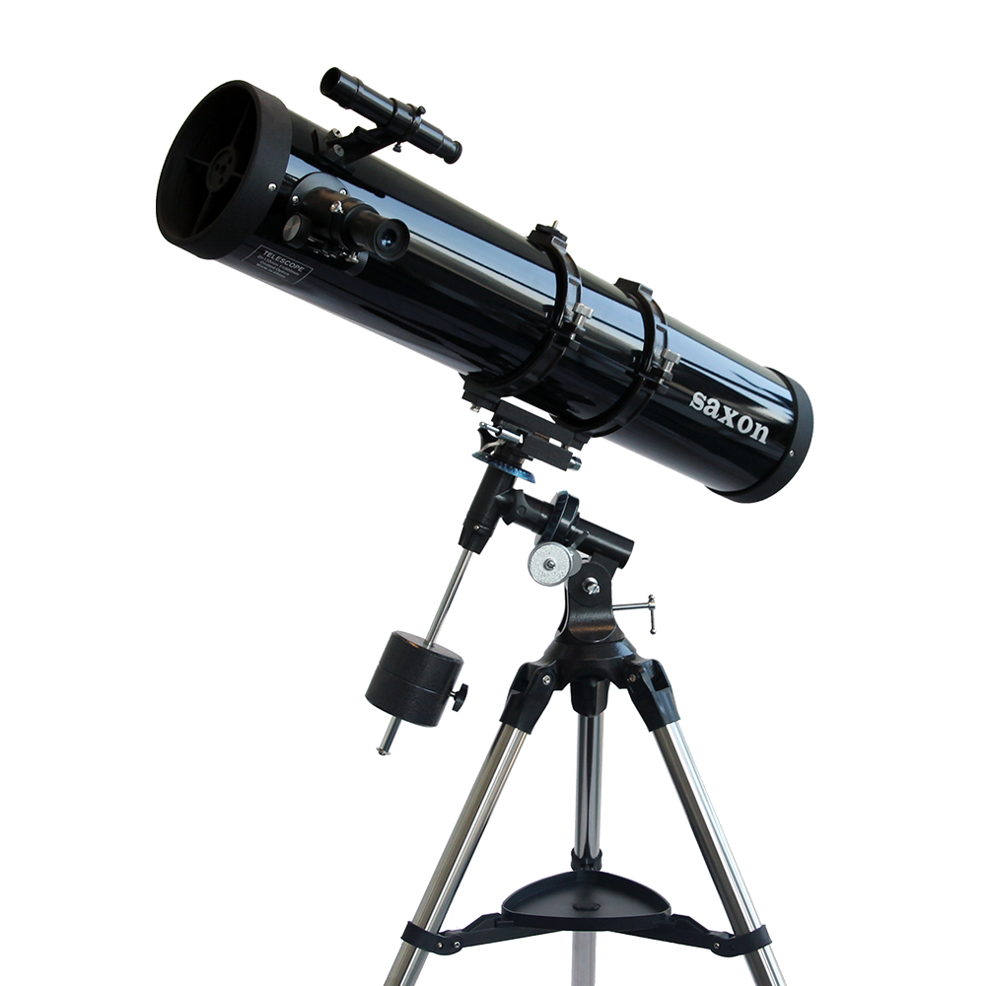
Outdoor Passes
“The library is partnering with the Royal Astronomical Society to help customers set up and use telescopes. The library will also be working with the city to offer outdoor programming in priority neighbourhoods during the winter.”
https://ottawacitizen.com/news/local-news/library-resumes-lending-instruments-expands-outdoor-passes
Notes:
Noah - “Gatineau Park winter passes for skiing, snowshoeing and snow-biking trails as well as City of Ottawa ski passes available …. The library is partnering with the Royal Astronomical Society to help customers set up and use telescopes.”
Details of where and how to borrow telescopes will be available soon. The library says it is adding a dozen telescopes to its collection.
Gatineau Park winter passes for skiing, snowshoeing and snow-biking trails as well as City of Ottawa ski passes will be available on the express shelves of branches offering browsing in the coming weeks. The NCC has donated an additional 30 Gatineau Park passes to encourage outdoor activities during the pandemic.
The library is partnering with the Royal Astronomical Society to help customers set up and use telescopes. The library will also be working with the city to offer outdoor programming in priority neighbourhoods during the winter.

Slide 21
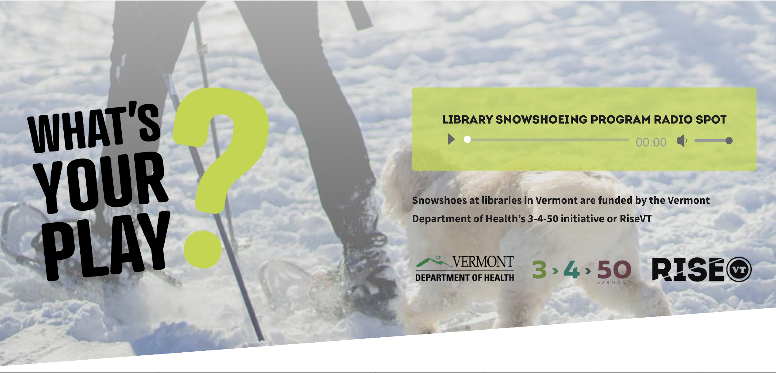
What’s your Play?
https://risevt.org/snowshoeing-vermont/
Notes:
Noah - Or maybe YOUR LIBRARY could consider being a place where folks can borrow snowshoes or other winter activity gear. Here’s an example from Greater Sudbury Public Library in Ontario, which offers a snowshoe lending program at all 10 locations of its library system.

Slide 22
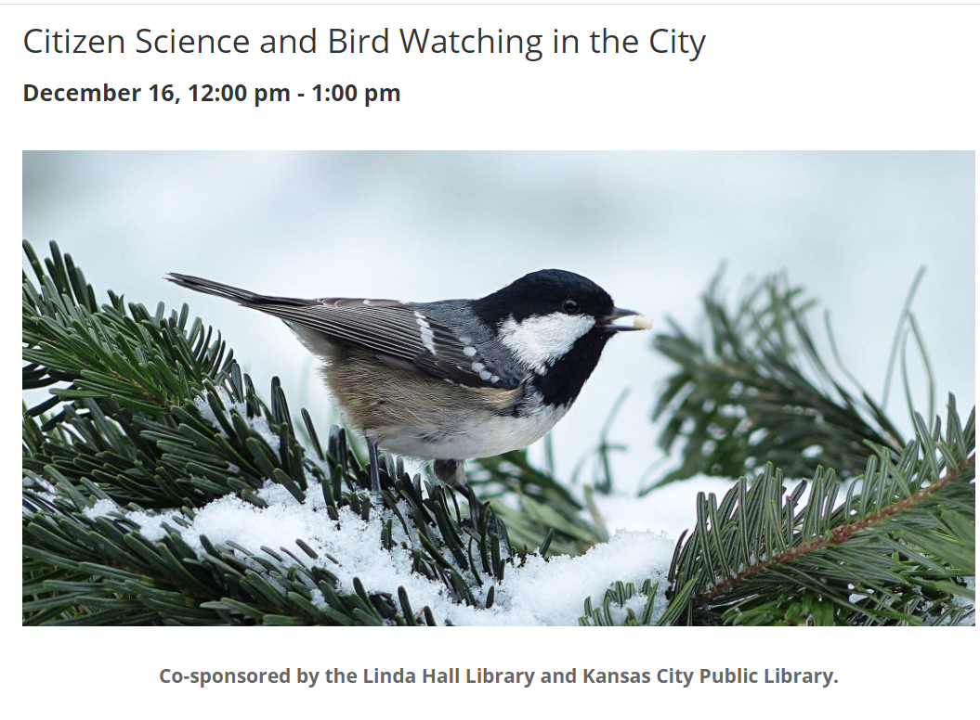



Wildlife Programs
Notes:
Beth- You can promote winter citizen science projects like bird watching, measuring snowfall, and other real-life weather, wildlife, and environment observation projects that professional scientists use data from in their research. This program in Kansas next week features Charles Nilon, Professor in Fisheries and Wildlife at the University of Missouri’s School of Natural Resources, who will discuss how bird watching provides great opportunities to get involved in citizen science, just in time for the National Audubon Society’s annual Christmas Bird Count—the longest-running citizen science survey in the world!

Slide 23
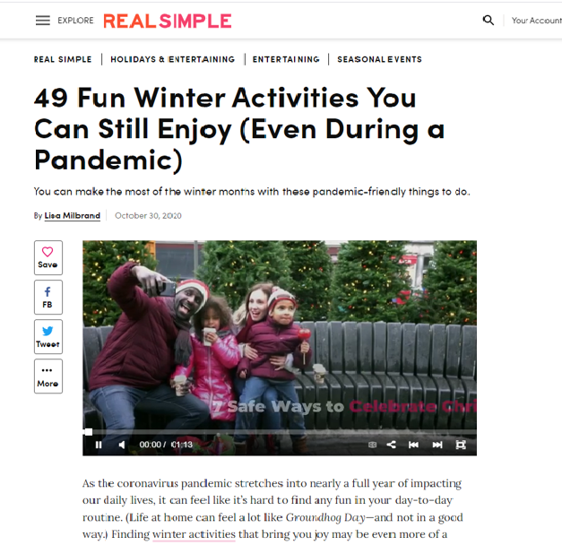
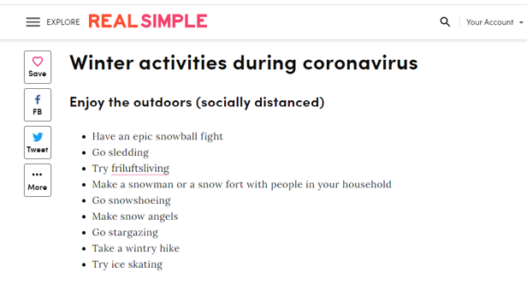
Share Articles
https://www.realsimple.com/holidays-entertaining/entertaining/seasonal-events/winter-activities-during-covid
Notes:
Beth - At the very least, your library can share articles or lists that offer ideas for outdoor winter activities—such as this example from “Real Simple” – Look to our resources for additional links of winter outdoor activities you can promote on your social media and in virtual programming. We’re information professionals. Let’s get the information out!!!

Slide 24
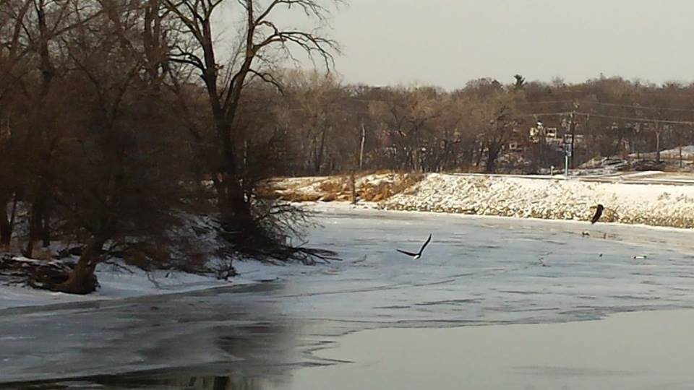
Eagles
Notes:
Maryann - Regina Library mentioned birdwatching as a good outdoor winter activity, so I had to add this photo I took on one of my outdoor winter bike rides. These are some of the many eagles that appear in winter months along the Des Moines River in Central Iowa. You won’t be able to get this kind of view by car!

Slide 25
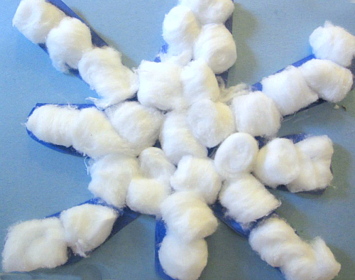
2. Programming ideas
This Photo by Unknown Author is licensed under CC BY-NC-ND
Notes:
Noah - Tip #2: Think about programming ideas. Noah has a lot of these that he has collected from other libraries. We only have time to share a few of them today.

Slide 26
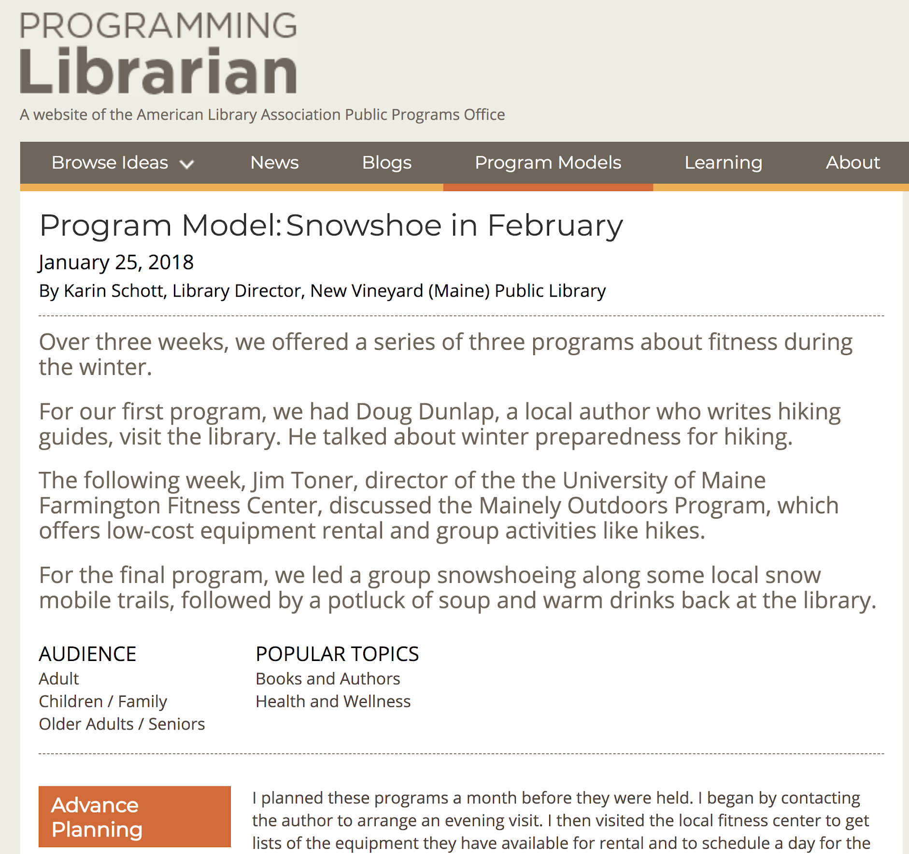
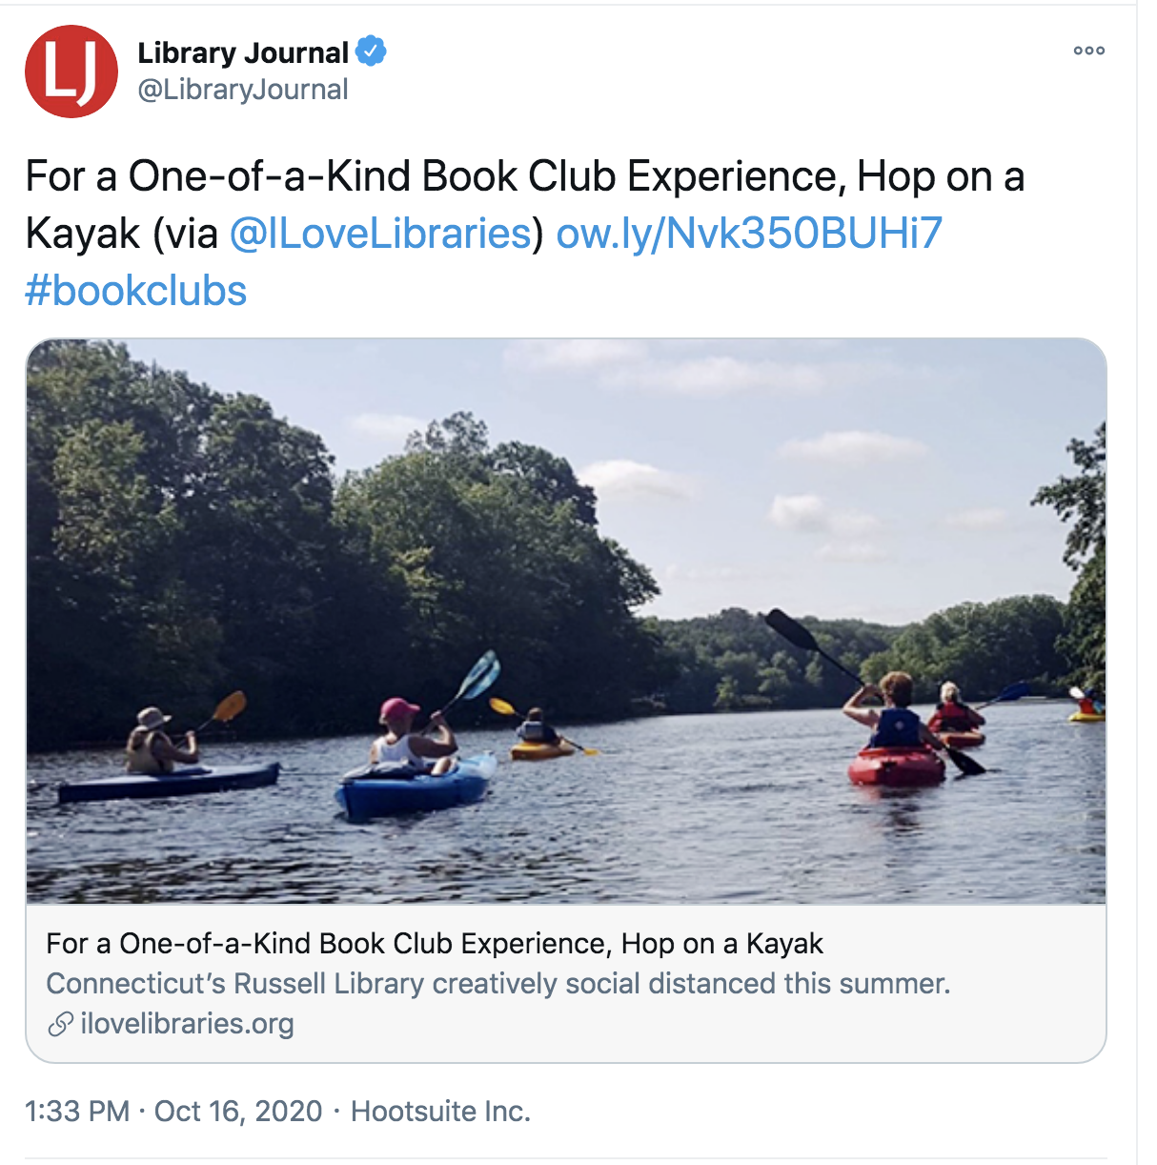
Programming Librarian
Notes:
Noah

Slide 27
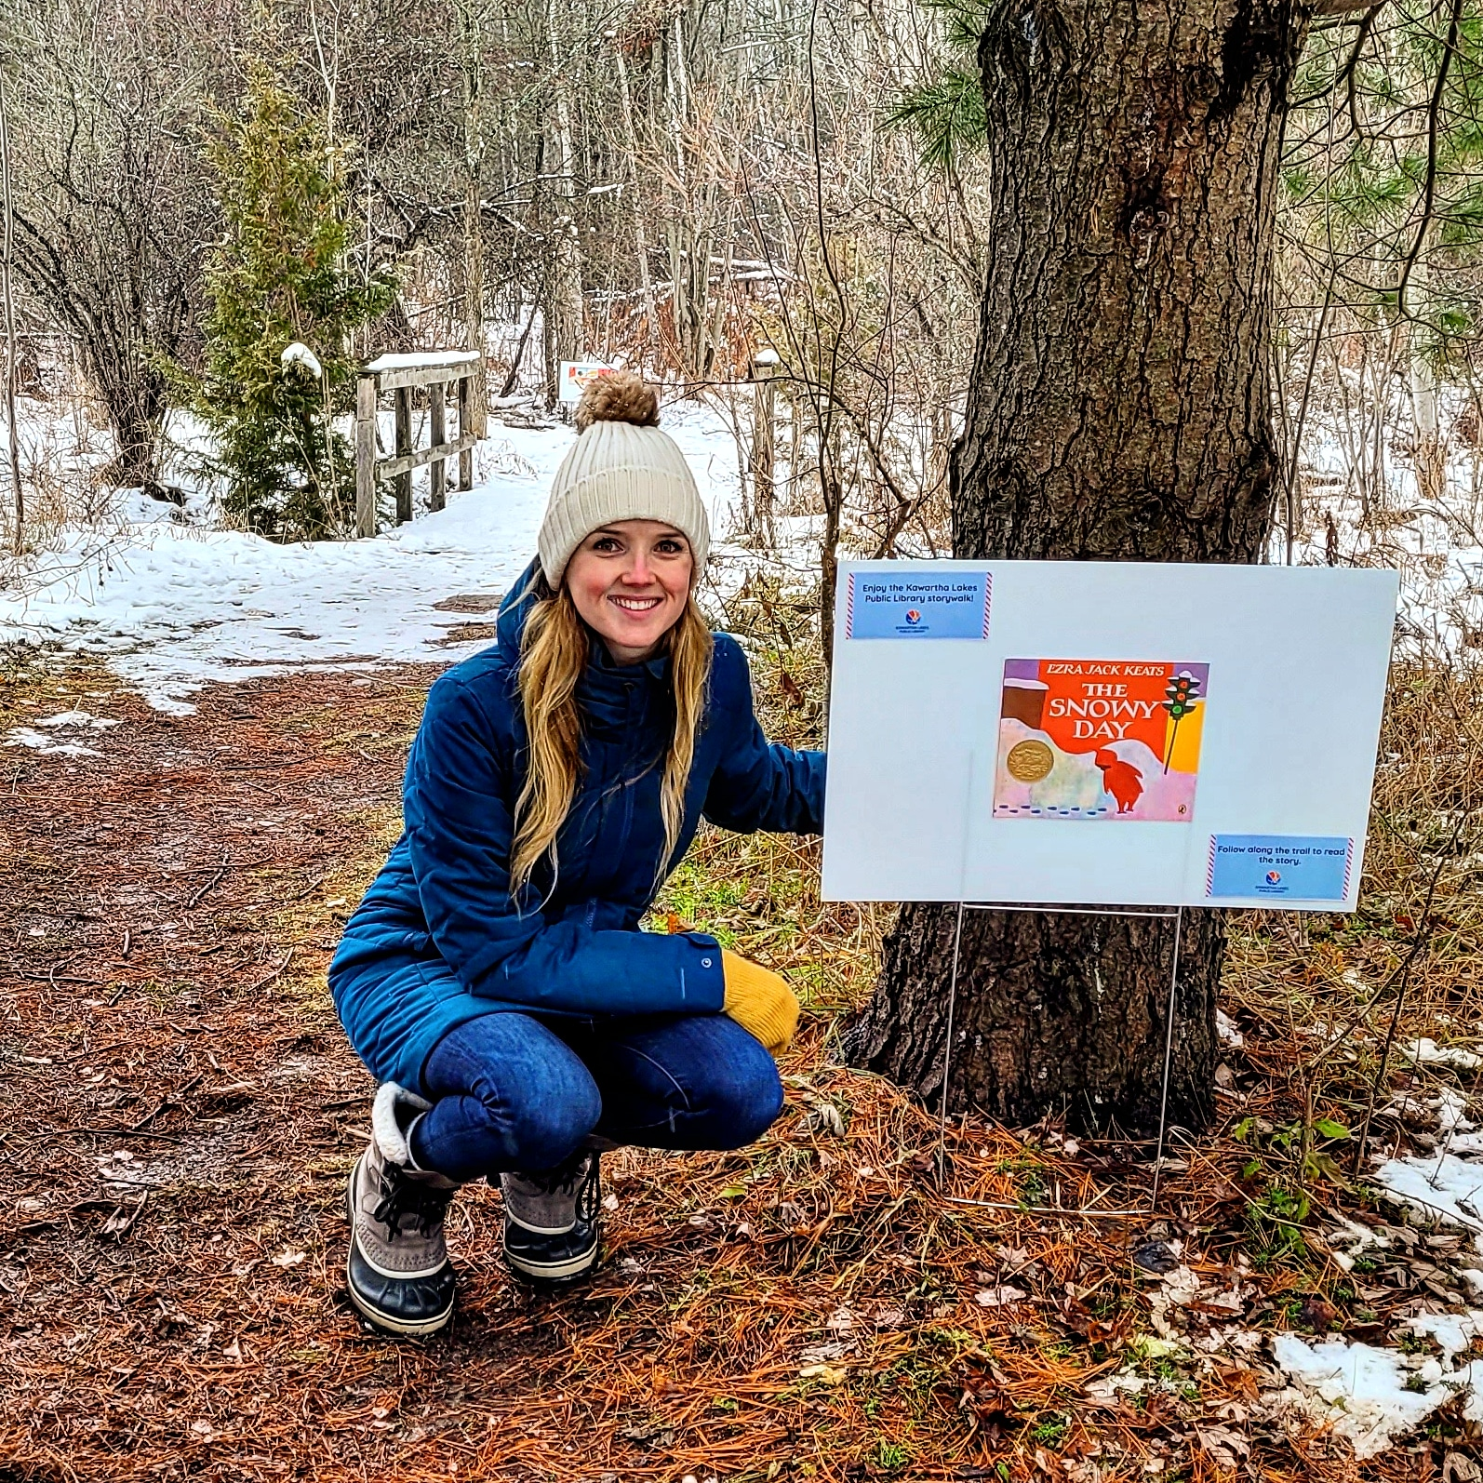
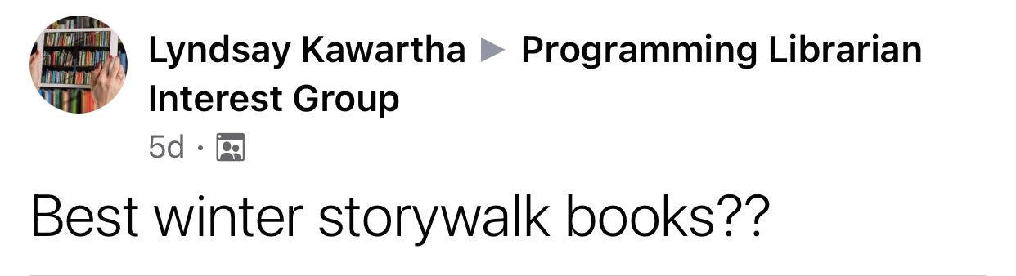
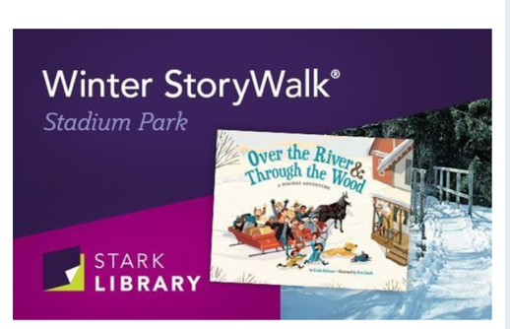
Winter Storywalks
https://twitter.com/KawarthaConserv/status/1334920407728742402/photo/1
https://allevents.in/canton/winter-storywalk-over-the-river-and-through-the-wood/200020426606542
Notes:
Noah - A lot of libraries have storywalks during summer months, but consider doing a winter storywalk! Stark Library in Canton, OH provides multiple winter storywalks with different stories in different locations. including a couple of parks and downtown.

Slide 28
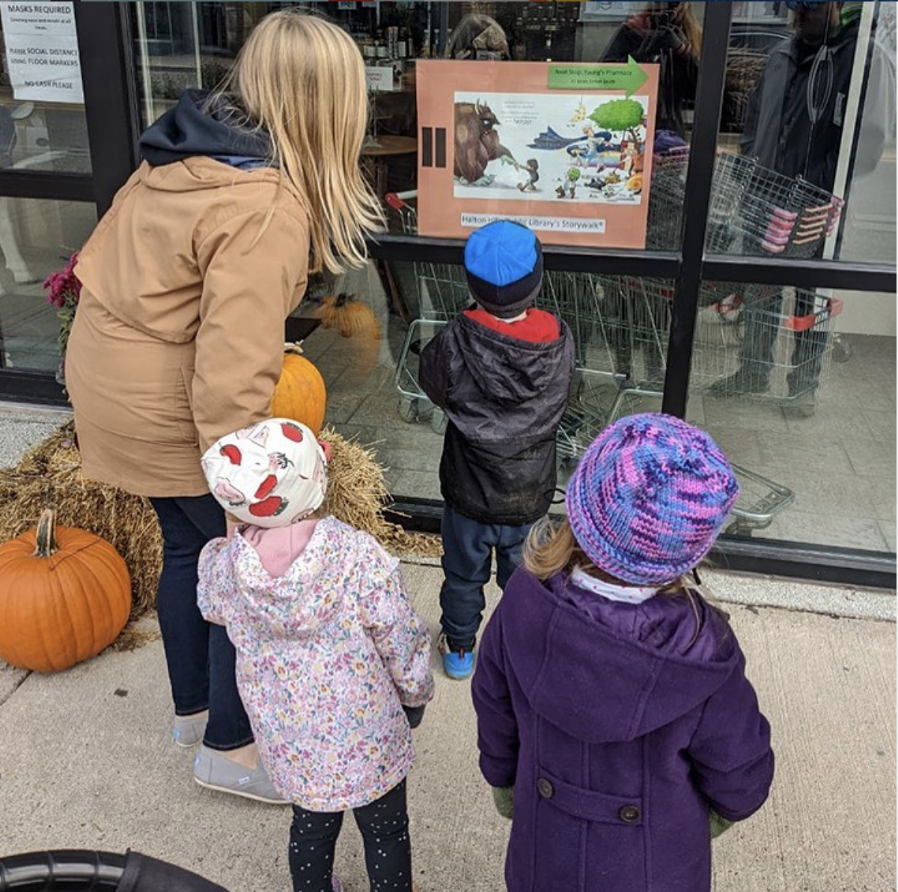
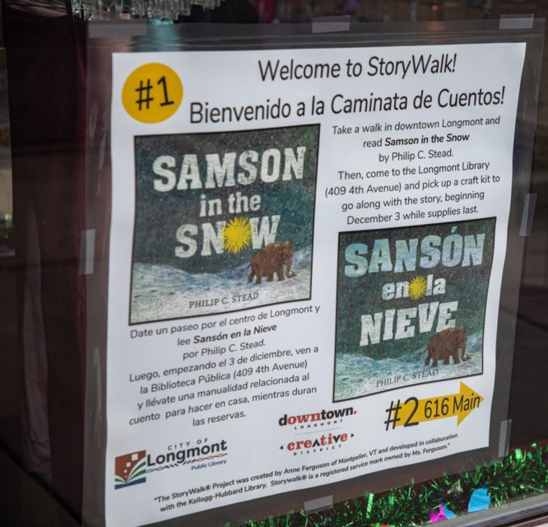
Take it downtown

Slide 29
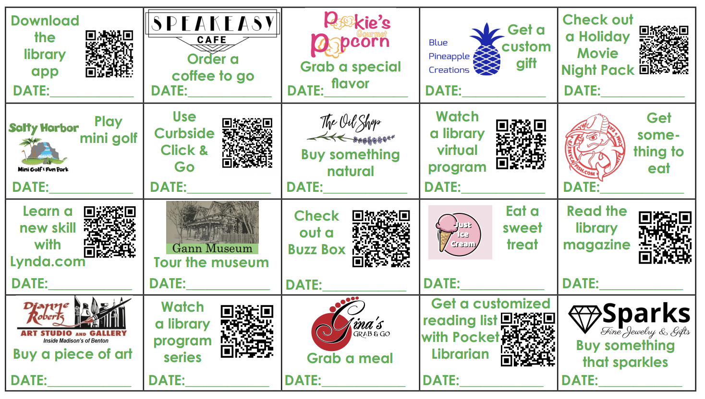


Small Business Scavenger Hunt
https://www.salinecountylibrary.org/news/post/267/small-business-saturday-promotion-starts-november-21st
Notes:
Noah – Scavenger hunts – great ways to get people outside – other ideas for scavenger hunts – find historic places, friendship rocks, geocaching, outdoor activity bingo, etc.

Slide 30
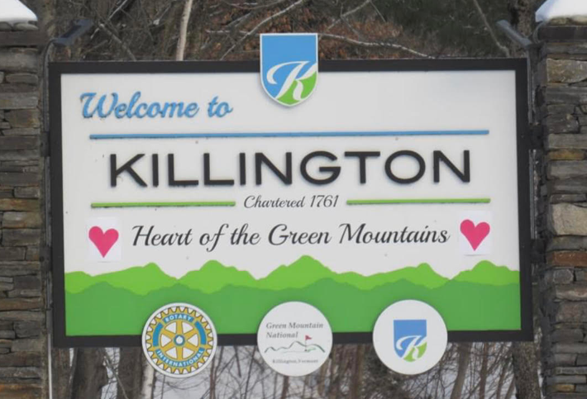

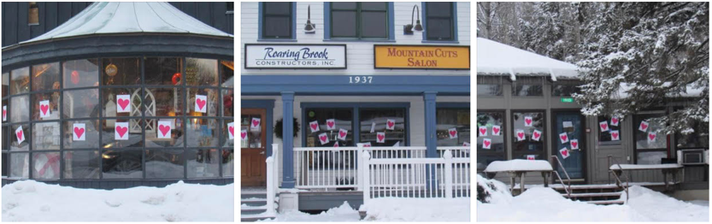
Valentine’s Day Phantom Project
Notes:
(from friend of Noahs---or perhaps on a listserve he follows) “…something that’s been done in Vermont for more than 20 years…’The Valnetine’s Day Phantom Project.’ Every year between midnight and dawn on Valentine’s Day, a mysterious groups of people put hearts on businesses in downtown Montpelier, the state’s capital.” (Noah, you have the rest of this story…)

Slide 31
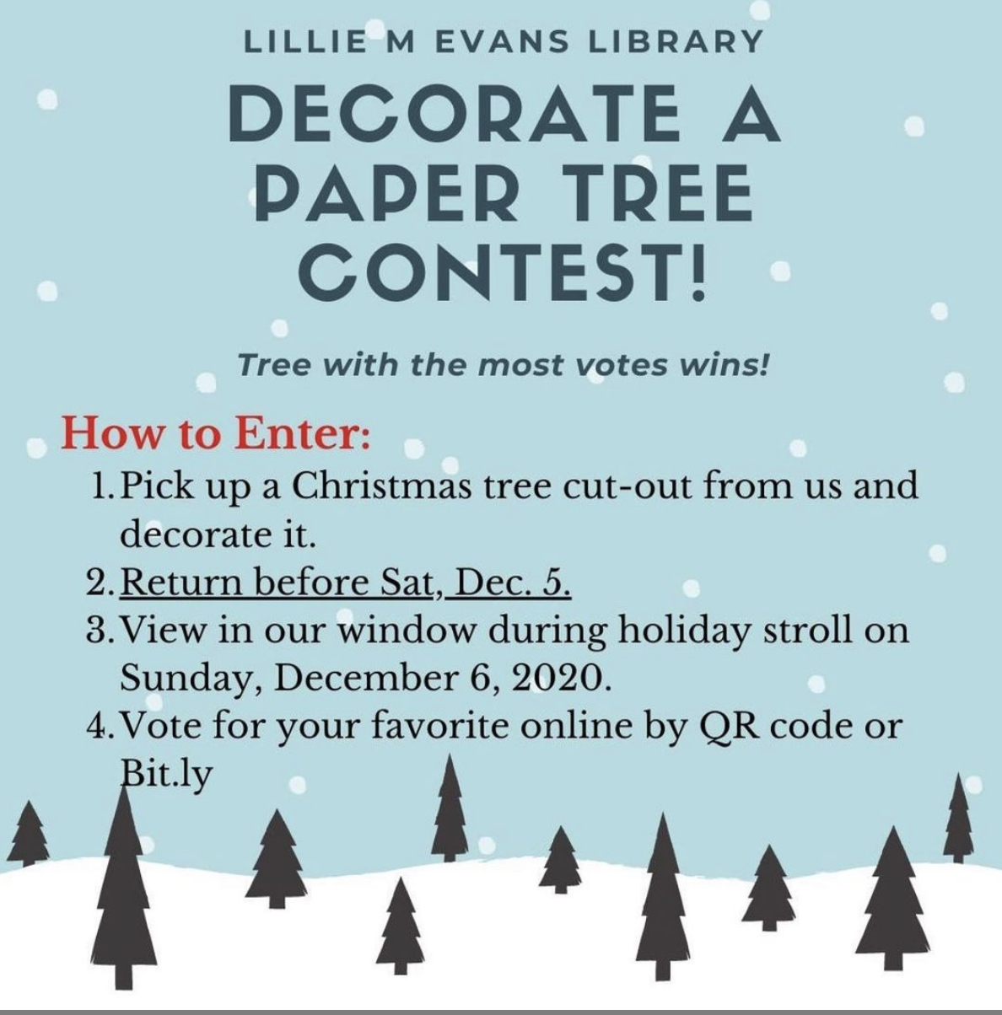
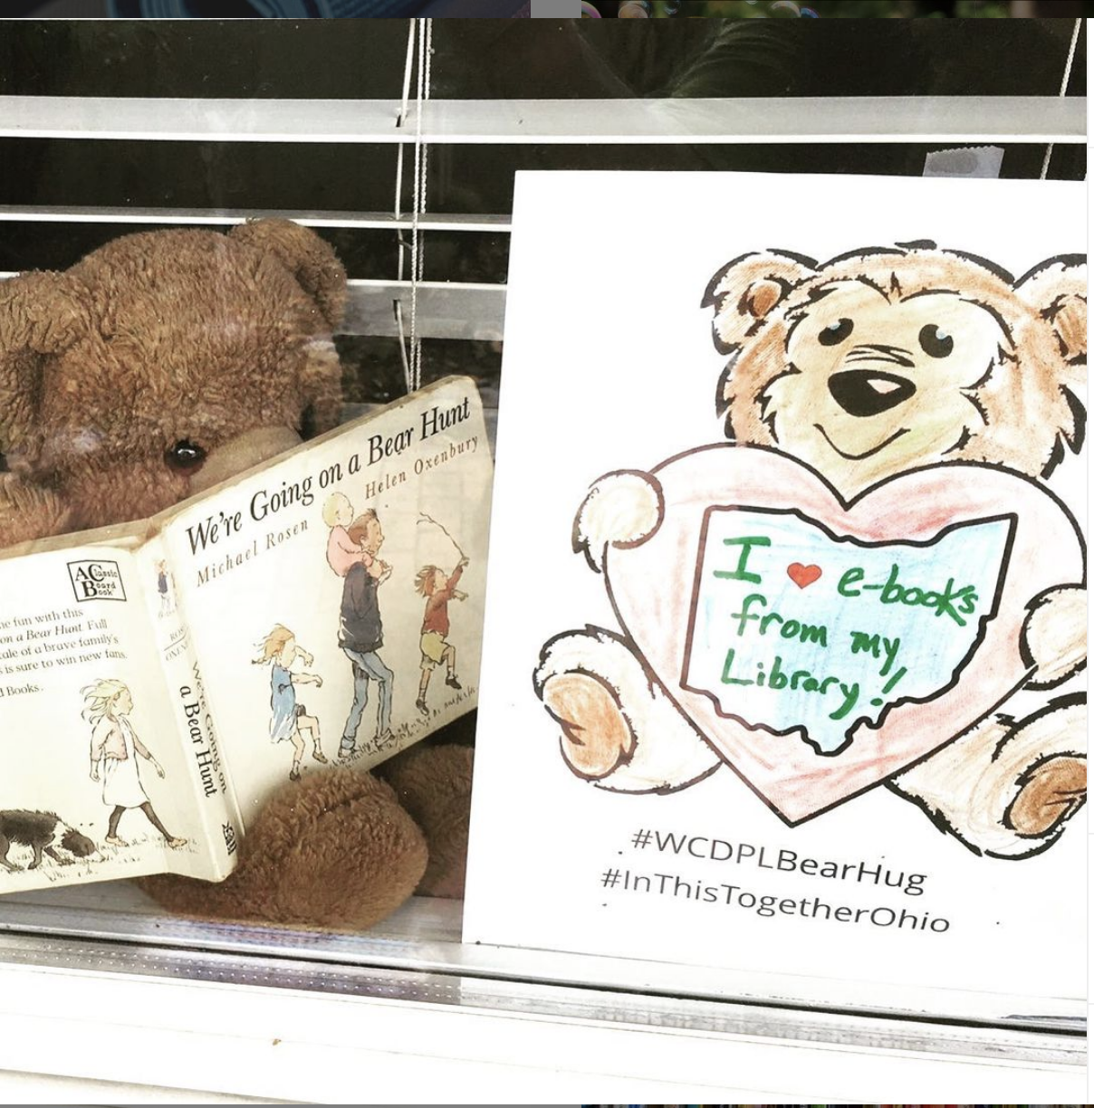
Decorate a Paper Tree
Notes:
Noah

Slide 32
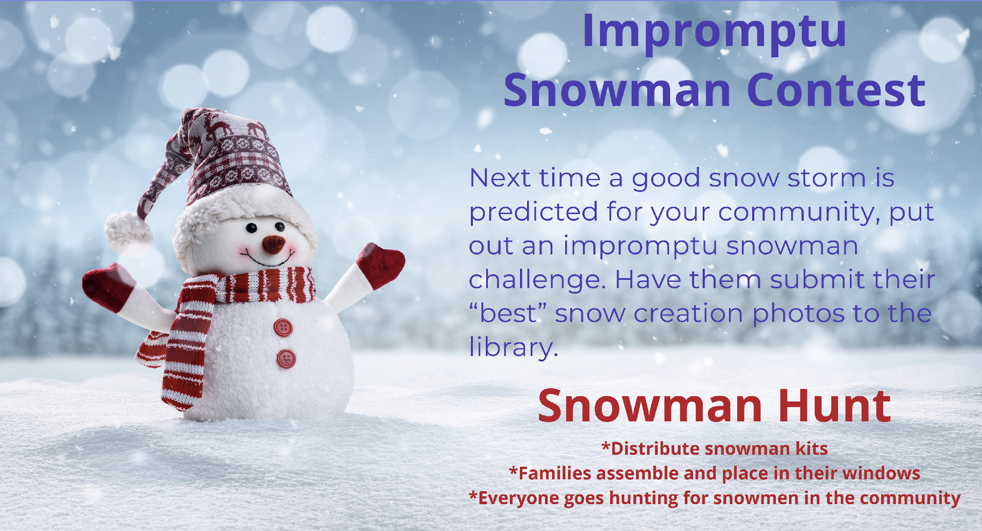
Snowman Contest
Source: https://nhlibraries.org/youthservices/2020/12/01/winter-programs-and-engagement-ideas-slides/
Notes:
Noah

Slide 33
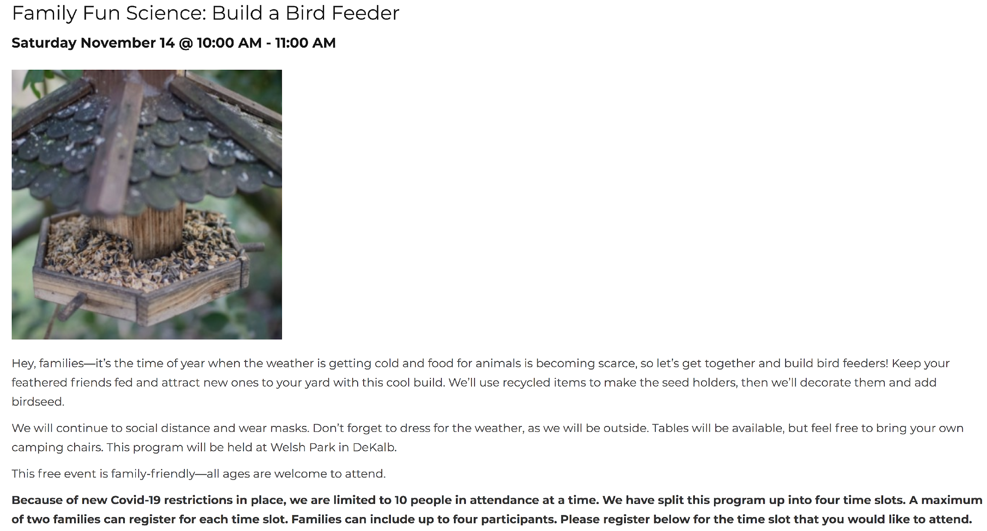

Building bird feeders!
ALTERNATIVE: Take & Make kits (or make at the library) that allow participants to make suet or string berries & popcorn.
Notes:
Noah – Citizen Science - DeKalb library (in Illinois) is providing a “family fun science” program outdoors!
https://www.midweeknews.com/2020/11/04/dekalb-library-continues-family-fun-science-outdoors/aqaxupi/

Slide 34

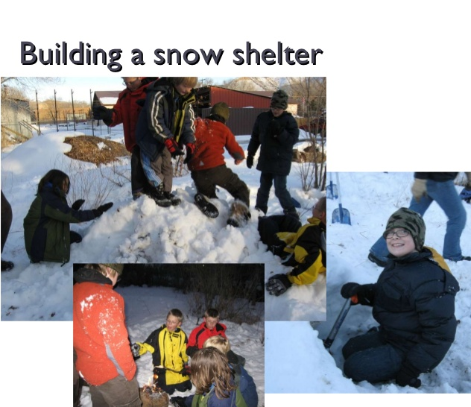
Outdoor Adventures Program
Notes:
Beth-Outdoor Adventures Program for tweens at Mancos Public Library

Slide 35
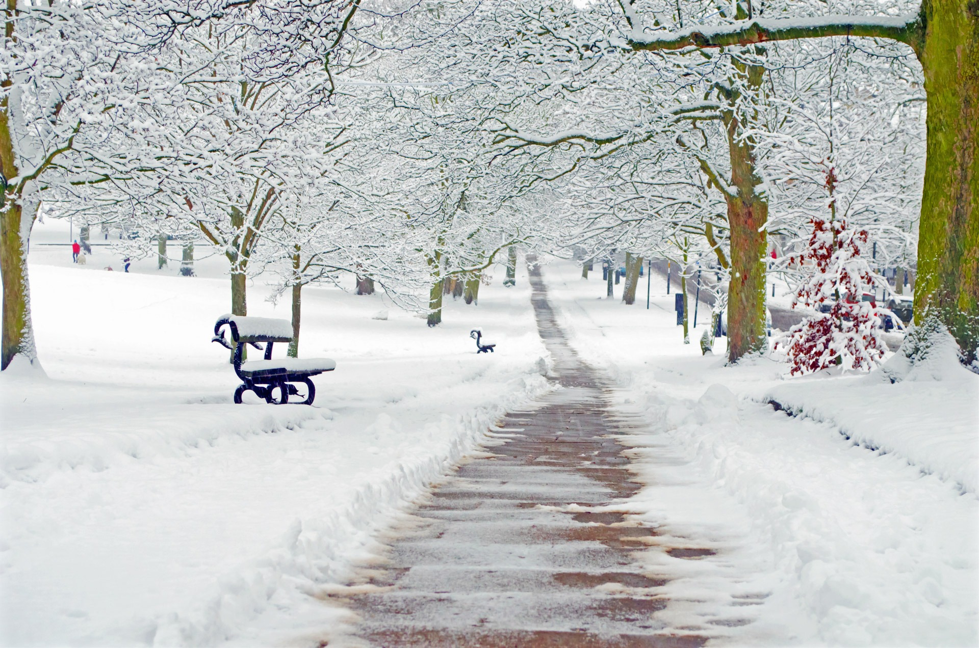
3. Programming Places
Notes:
Tip #3: Consider the places you might be able to conduct some outdoor programming.

Slide 36

Your library!!!
“Thanks to funding from Kaukauna Utilities, a light display has been put up in the library's garden.”

Slide 37

Outdoor Chalk Obstacle

Slide 38


Snow art fest, anyone?

Slide 39


Realx!
This Photo by Unknown Author is licensed under CC BY
Notes:
Maryann: Imagine this is you! Relax, have fun, and…let’s take another poll…

Slide 40

4. Hitch your sleigh…
Partnerships!
This Photo by Unknown Author is licensed under CC BY-SA-NC
Notes:
Noah - Tip #4 for HOW to do or promote winter programming: “Hitch your sleigh…” to an existing activity, group, or event!

Slide 41


Winter Wheels
Notes:
Maryann - I developed the idea for a “winter wheels” series at my local bike shop (where I work part-time). I presented the first session, which was all about winter cycling. I talked about how to get started, clothing and accessory needs, and safe riding. This kind of presentation would be equally applicable in a library setting. Contact your library bike shop, cycle club, or riding enthusiast to see if you can partner with them to sponsor such a program at your library. They provide the information, and you provide the publicity and meeting space! (And yes, that is me in that picture! Temperature was in the 20s, I think…and it was snowing when I took that photo after a winter ride.)

Slide 42



Social and Support Groups
Notes:
Maryann - You might be surprised to learn that there are several online groups that exist to support and promote outdoor winter activity. For instance, I belong to a winter cycling group, and I know there are similar walking and hiking groups –all of which provide support for these types of outdoor winter activities. Your library might be in a position to point your users to such groups.
There might even be local clubs in your community. Check with sporting stores in your area.

Slide 43

Bike Ride to Rippey
BRR (Bike Ride to Rippey)
Notes:
Maryann - Other ways to “hitch your sleigh” is to learn what annual winter events are already taking place in your area, and find a way for the library to be a team player in the event. There is an annual winter bike ride in my area that’s always held the first Saturday in February—no matter the weather conditions. It’s a ride that begins in a community known as Perry and rides about 12 miles out to a small town known as Rippey. Thus, the ride is known as “Bike Ride to Rippey” or BRR. It’s always well attended. I took this photo one year when the temperature was 15 degrees at starting time. Perry Public Library is right across the street from this lineup and usually does a little something to contribute to the festivities. The ride is actually a fundraiser for the local Chamber of Commerce.

Slide 44



Cold Turkey Plunge
https://shelterislandgazette.com/library-turkey-plunge-virtual-this-year/
https://www.nantucketatheneum.org/support/fundraising-events/turkey-plunge/
Notes:
Maryann - Nantucket Atheneum has an annual “Turkey Plunge”—and as you can see, this 2020 event benefitted the Weezie Library for Children.
The Friends of the Shelter Island Public Library (in NY) also sponsors an annual Turkey Plunge. Both organizations conducted these events virtually this year—which could demonstrate that even if your library isn’t located near a beach or body of water, you might still be able to sponsor a similar event by allowing your patrons to get creative with where they might take a winter plunge!

Slide 45


Appleton Window Walk
https://apl.org/node/4978
What kind of annual winter events occur in your area? How can your library join as a participant?
https://appletondowntown.org/2020-light-up-appleton-and-window-walk/
How could you start such an event?
Notes:
Maryann - The city of Appleton (WI) has a big annual “light up” event in their downtown. The event features a downtown “window walk.” You can see that the public library in Appleton also participates. This kind of event encourages people to get outside and stroll—even in winter! And this event includes signage in the downtown windows that includes a QR code, which allows participants more activities and learning they can continue doing at home.
(CLICK) Does such an annual event occur in your community? If so, how could you “hitch up” to it? (CLICK) If not, how could you start such an event?

Slide 46


Leadville Wintermission
Notes:
Noah

Slide 47
What is your library doing?
YOU
HOW
WHY
Notes:
Maryann- We’ve talked about why you should promote the great outdoors even in winter, and we’ve shared plenty of tips and ideas about how to do just that.
Now we want to focus on YOU! Let’s here from you! What ideas are you planning to do this winter? How might you incorporate some of the information from today’s session into programs and promotions at your library?

Slide 48

Weighing Risk
Notes:
Noah – Guidance from Colorado Public Health Department – SAFETY IS ALWAYS THE FIRST PRIORITY

Slide 49

Discussion: Challenges, Ideas, Resources?

Slide 50


Learn more
Winter Places
Wintermission
Canadian Public Health Association
Cold Weather Recess Planning Guide
Embracing Cold Weather
Move & Play Through Winter, Eh?
Get more guidance from local parks, schools, and health departments
What resources have you drawn upon?
Notes:
Noah – learn more – never more resources on this topic

Slide 51



Contact us!
Beth Crist
Colorado State Library
Crist_B@cde.state.co.us
Dr. Noah Lenstra
University of North Carolina at Greensboro
“Let’s Move in Libraries”
njlenstr@uncg.edu
https://letsmovelibraries.org/
Maryann Mori
State Library of Iowa
maryann.mori@iowa.gov
Notes:
Beth

