Slide 1
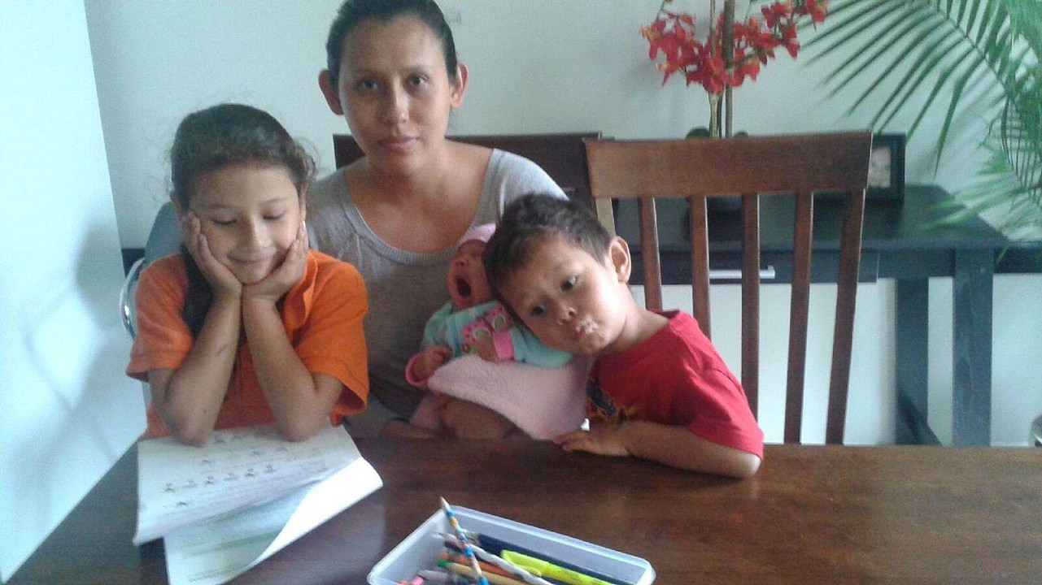
The 2 Generation Approach to Eliminating Poverty

Slide 2
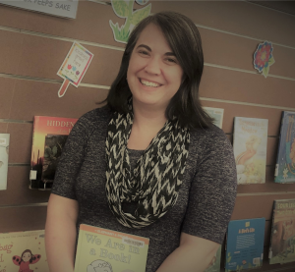



About Us
Becki Loughlin, Children’s Librarian
High Plains Library District
BLoughlin@highplains.us
Beth Crist, Youth & Family Services
Consultant, Colorado State Library
crist_b@cde.state.co.us

Slide 3
Poverty Nationally
In 2017:
*18% of US kids (approx. 13,353,000) lived in poverty
*Significant differences by race and ethnicity: 26% of Hispanic kids and 33% of African American and American Indian kids lived in poverty
*Significant differences by family types: 31% of single parent households lived in poverty
Notes:
Beth
Data from 2018 Kids Count report--link to report on resources handout
The federal poverty definition consists of a series of thresholds based on family size and composition. In 2017, the poverty threshold for a family of two adults and two children was $24,858.
Lower than the 19% national child poverty rate
70% of kids born into poverty stay in poverty all their lives

Slide 4
Poverty in Colorado
In 2017:
*13% of CO kids (166,581) lived in poverty, down from 15% in 2015
*Significant differences by race & ethnicity: 20% of Hispanic kids & 17% of African American kids lived in poverty
*Significant differences by family types: 23% of single parent households lived in poverty
*Significant differences by geography: Costilla County had highest child poverty rate at 43%; Douglas County had lowest, at 2.9%
Notes:
Beth

Slide 5
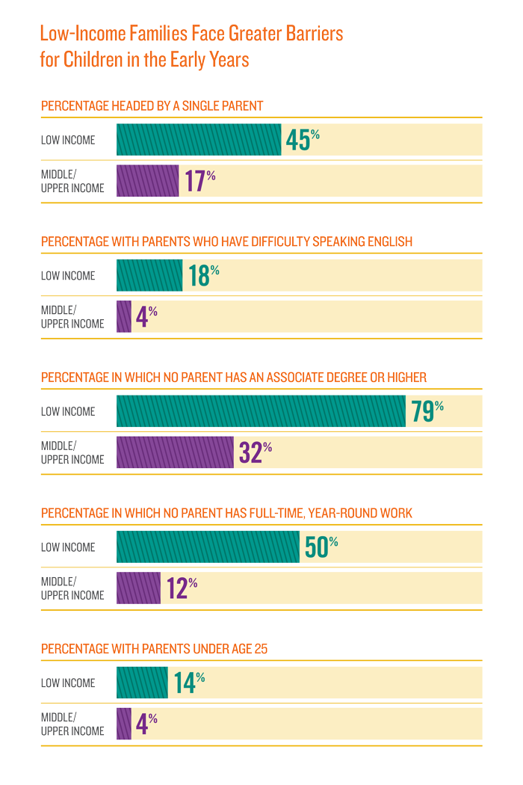
Low-Income Barriers
Annie E. Casey Foundation, Creating Opportunities for Families:
https://www.aecf.org/resources/creating-opportunity-for-families/

Slide 6
Traditional→2Gen Approach
Traditional:
Separate child focused and adult focused services with few community partnerships
1990s-early 2000s:
Increase in programs that taught parenting skills, provided some childcare, and helped with employment and family functioning
Early 2000s:
Mashup of family investment theory and human capital theory lead to 2Gen Approach
Notes:
Beth
Original 2gen program much older though: head start, begun 50 years ago

Slide 7
The 2 Generation Approach
Policies and programs that address both the parents and children in low-income families at the same time. 2Gen aims to improve both individual and family well-being by:
Increasing parent employment, family income, and family economic independence
Reducing parental stress and increasing parenting skills
Facilitating the health and development of children
Increasing family social capital
Notes:
Beth
Mention handout has more resources
When programs and policies are designed with the whole family’s educational and economic future in mind, and families are assisted to reach the social networks and resources they need to be successful in life, opportunity becomes a family tradition. Fragmented approaches to serving families that separately address the needs of children and their caregivers can leave either the child or the caregiver behind, reducing the likelihood of success for all members of the family. The 2Gen approach brings all family members along together, assesses all family members together and provides all family members with opportunities, together, to be successful.
By their nature, libraries provide services and programs for whole family; you already do that, very well, and using this approach can provide a framework for supporting families more holistically.
At the same time, that does not mean that ALL of your programs have to fit neatly into the approach—not at all! Think of it as an overarching philosophy rather than having to fit each program and service into it.

Slide 8
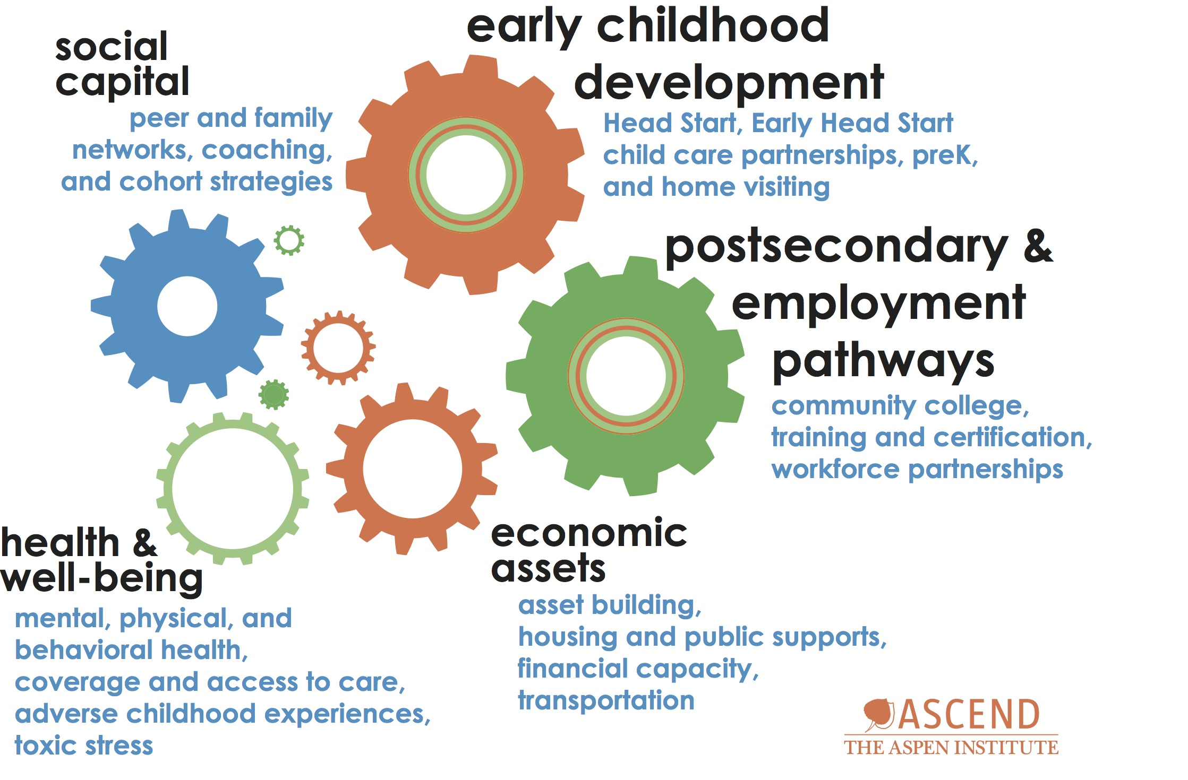
How Libraries Can Help
Notes:
Social capital: storytimes provide networking opportunities
Early childhood dev: outreach to FFN and preschool
Ed and employment: career online high school, resume assistance
Economic assets: financial literacy programs
Health: some libraries hire public health nurses, state park program, Cooking Matters/nutrition

Slide 9
Why does 2Gen work?
*Services are streamlined and more accessible
*A parent’s education, economic stability, and overall health impacts a child’s trajectory for life
*Children’s education and healthy development inspire parents and set the entire family on a more secure path
*In families earning $25,000 a year with young kids, boosting family income by $3,000 can yield a 17% increase in earnings for the kids as adults
Notes:
beth

Slide 10
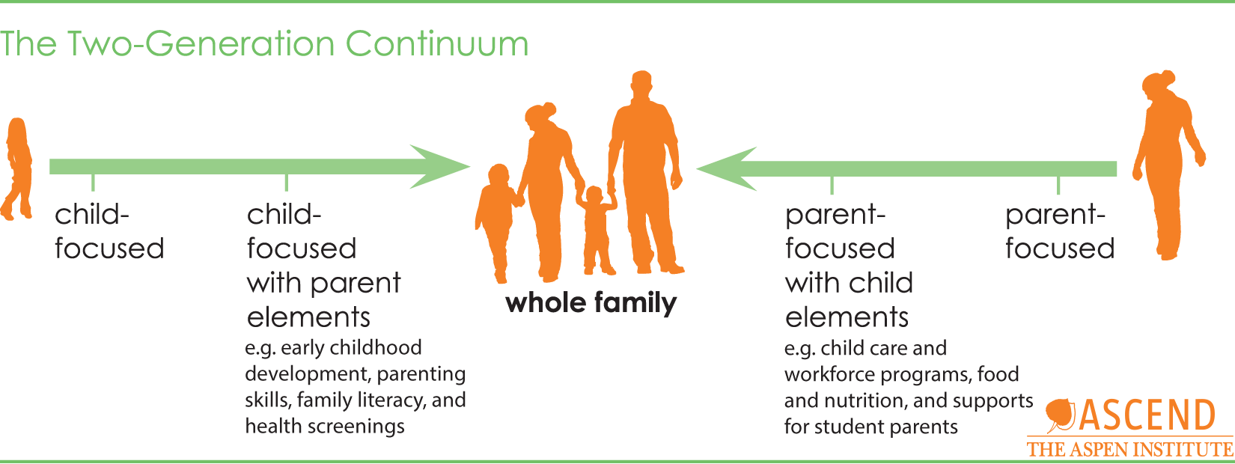
Two-Generation Continuum
Notes:
Question: What do you or could you do at your library that would follow the 2Gen Approach?

Slide 11
Potential Partners
*Think state and local governments, and nonprofits:
*Public health
*Higher education
*Workforce development
*Housing
*Parenting education programs
*Early childhood education programs
*Employment assistance & training for noncustodial parents
*Child care assistance providers
Notes:
Beth
More CO specific resources on handout

Slide 12

Colorado Early Education Network
Colorado Early Education Network (aka Head Start):
*Provide monthly storytimes in every classroom (600+ kids) at 13 locations.
*Provide 1000 Books Before Kindergarten to every student, facilitated by teachers, with parent information on early literacy and library services.
*Provide evening/weekend tours in branch libraries 8 times/year with storytime to promote library services and classes.
http://www.ceen.org/
Notes:
CEEN mission is to “create a collaborative network bridge between resources, programs and participants”.

Slide 13

Little Learners
Immigrant and Refugee Center of Northern Colorado:
*Provide storytimes in “Little Learners” classroom once per week.
*Provide 4 citizenship classes per week.
  15 minutes reserved at the beginning of each for library information.
*Provide classes on email, databases, search engines and other technology.
*Provide on-site lending library that’s updated weekly.
www.ircnoco.org
Notes:
IRC’s mission is “Empowering refugees and immigrants, connecting communities, and advocating for successful integration.” Support speakers of 15 languages; have an education component and a “navigation” component where they assist immigrants and refugees with the day-to-day work of settling into the U.S.

Slide 14
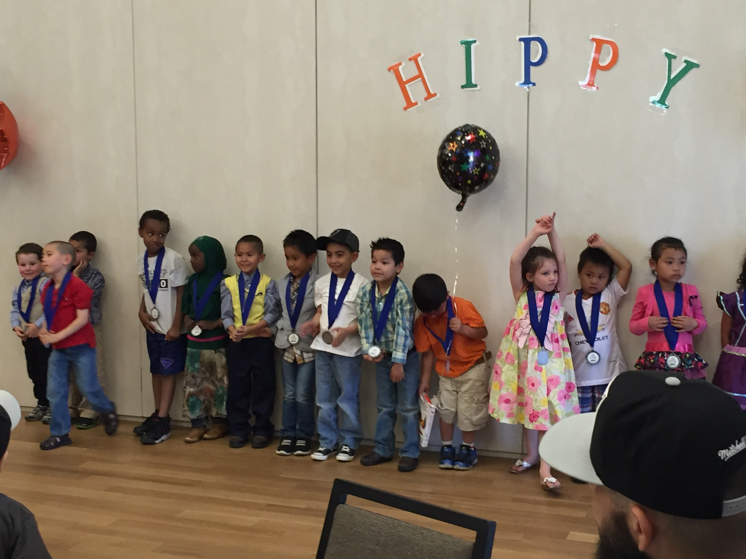
HIPPY
HIPPY – Home Instruction for Parents of Preschool Youngsters:
*Provide bilingual storytimes for participants in libraries.
*Partner to provide an annual family literacy fair.
*Provide early literacy kits for parents to check out at home visitations.
*Provide space and support for student graduation.
Notes:
HIPPY is an evidence-based home visiting program that helps parents prepare their 3, 4 and 5-year olds for kindergarten; relational learning model where parents work with mentors who demonstrate effective teaching and learning strategies for children. Storytimes are targeted to HIPPY participants; Annual literacy fair combines activities from the early literacy fairs that we provide in branches with information for parents; HIPPY, who is already providing home visits in their constituents’ languages of origin provides translators at this event; they also help plan the early literacy activities so that they are culturally relevant.

Slide 15
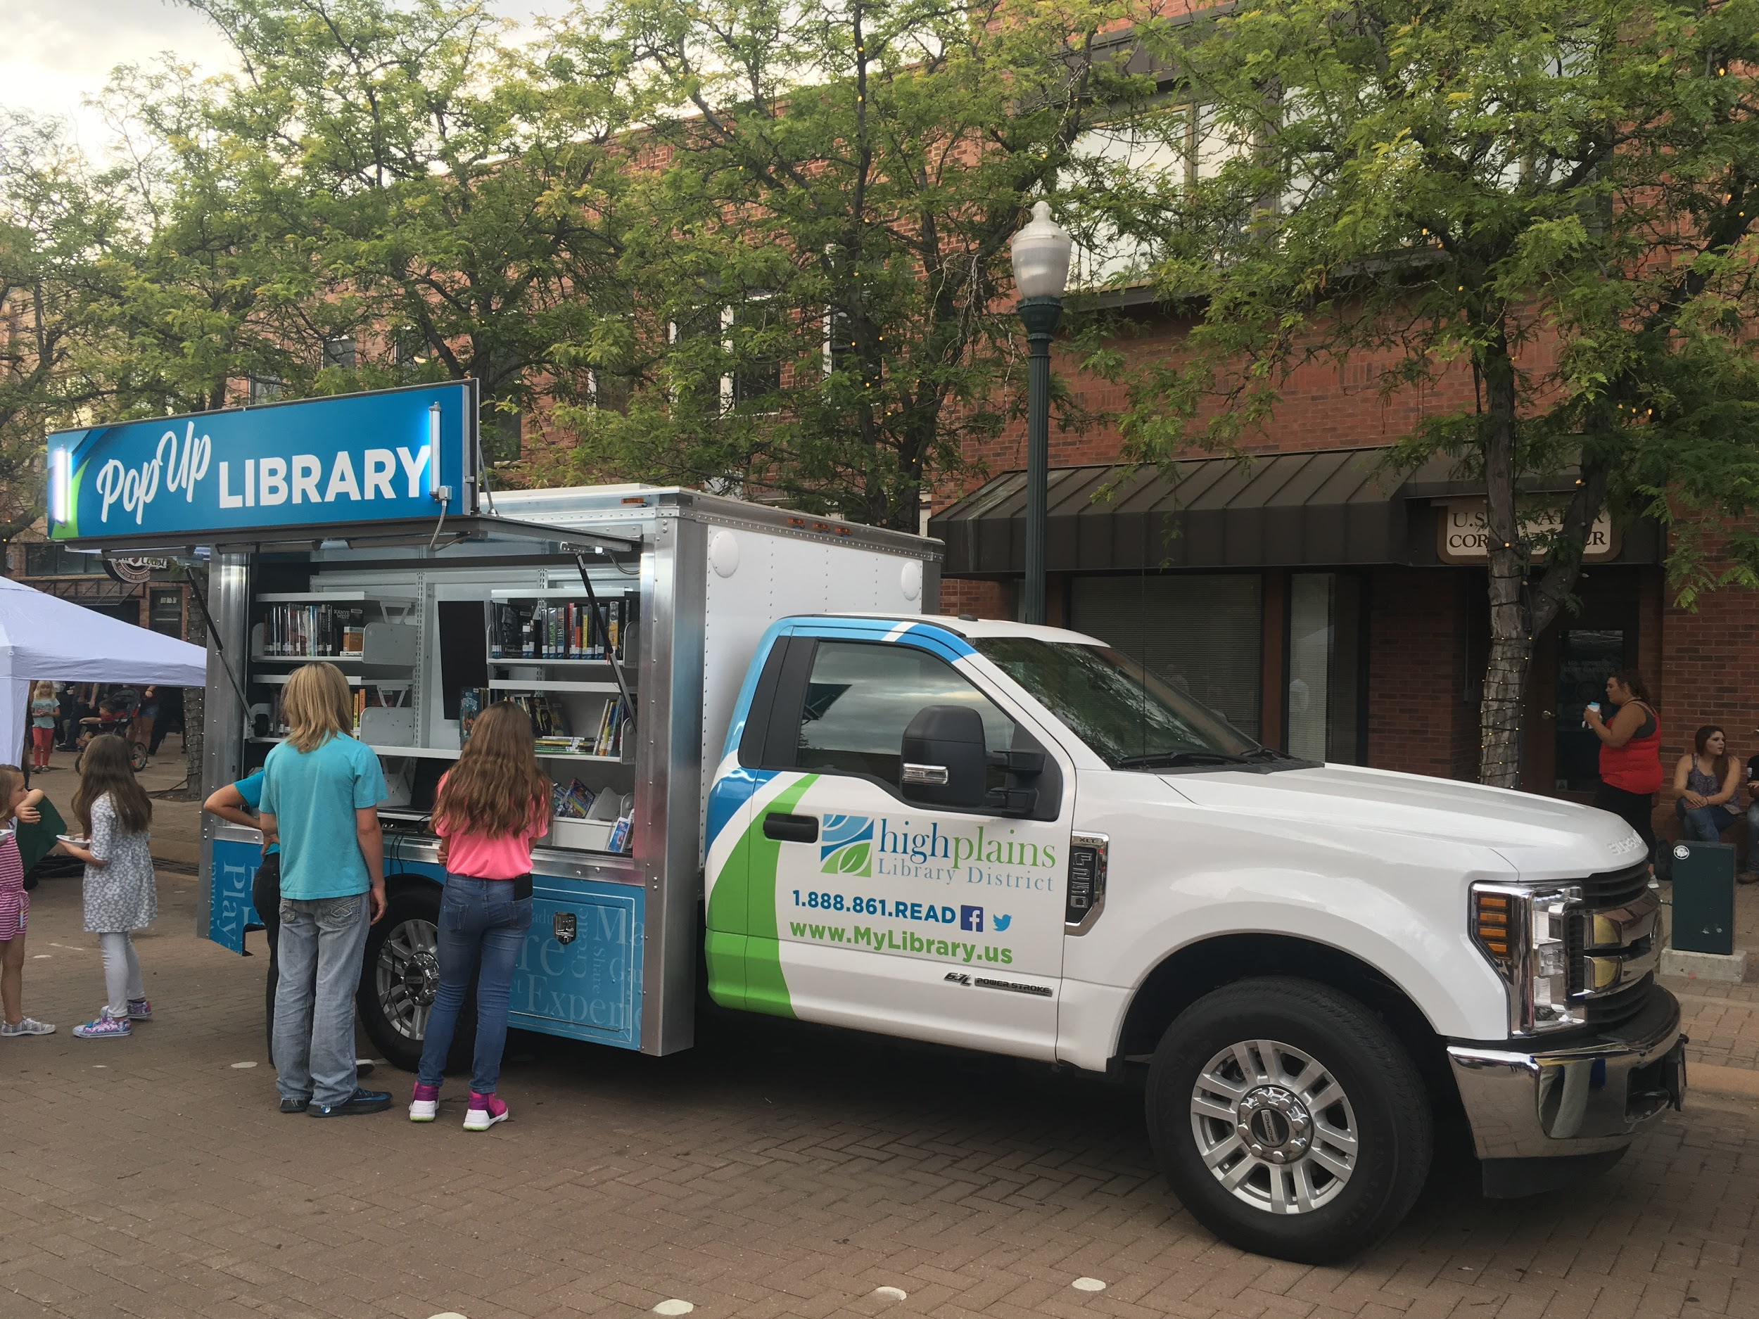
Other examples
Additional Examples:
21st Century bookmobiles and Pop-Up Library.
Family programming in the libraries
  -“Photographing your kids and grandkids”
  -Family Fun Saturdays
  -Movie nights
  -Family Yoga
  -First Friday Art event
Notes:
.. First Saturday: Learn how to play the guitar Second Saturday: Discover LEAP into Science Third Saturday: Theater play Fourth Saturday: Share stories, poems, songs and dance

Slide 16
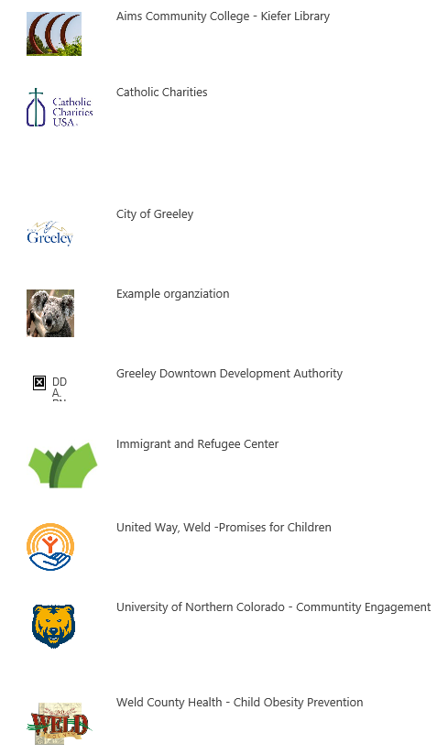
High Plains Library District Partners
Notes:
We keep an up-to-date list on our intranet with the names of the partners, the organization’s contact name, email, and phone, the library’s contact, and a summary of our current engagement with this organization, whether it’s a service we’re providing them, a monthly meeting that we are attending, or goals/ideas for working together; also keep all the fliers and promotional materials for events we receive from our partners in one accessible spot on our intranet. This serves several purposes: awareness among staff, cross-promotion in branches, current or potential outreach opportunities.

Slide 17
How to
*Promote ALL your library services to families
*Discover the 2Gen landscape in your community
*Partner, partner, partner!
*Seek family input into program design
*Ask families about their goals and what they need to achieve them
*Proactively include approach in policies, mission statement, & vision
*One size doesn’t fit all
Notes:
Family input both into overall program and into individual family needs and goals

Slide 18
Questions?

Slide 19
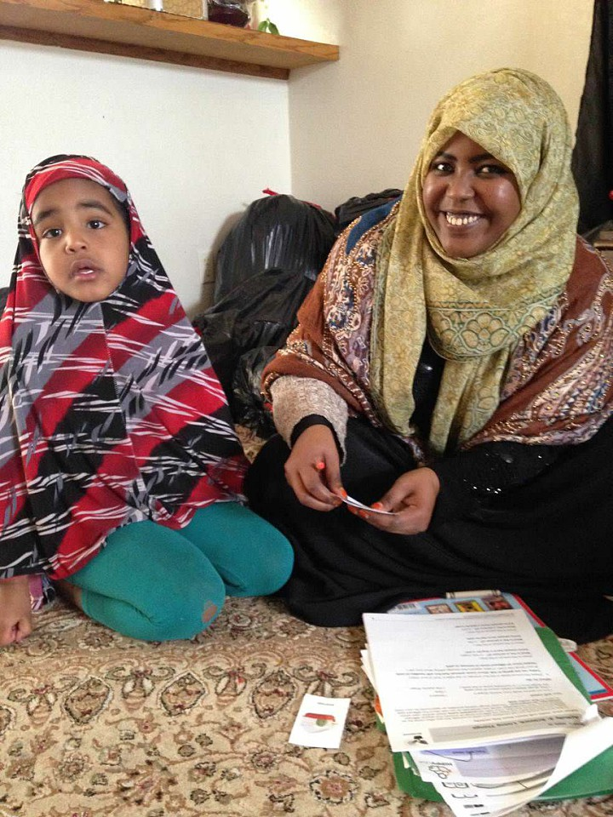
Thank you!
Becki Loughlin, Children’s Librarian, High Plains Library District
BLoughlin@highplains.us
Beth Crist, Youth & Family Services Consultant, Colorado State Library
crist_b@cde.state.co.us

