Slide 1



That’s Not What I Meant!
Improving Your Online Communication Skills
Jean Marie Heilig
Fiscal Officer
Grant Coordinator

Slide 2


Here’s Why This Matters To You…….

Slide 3
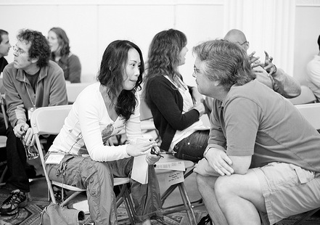
Nonverbal Communication
“It’s how you looked when you said it, not
what you actually said.”*
7% Words
38% Vocal
55% Nonverbal
* The Definitive Book of Body Language, Allan and Barbara Pease

Slide 4

Digital Body Language

Slide 5
Virtual Communication
“Contemporary speech relies more than ever on how we say something rather than on what we say. That is, our digital body language.”
70% of communication among teams is virtual
Avg person sends 30 and reads 96.3 emails
50% of the time the “tone” of our emails is misinterpreted.

Slide 6
Body Language
Showing interest and being approachable
Traditional Body Language:
Nodding, Bobbing our heads up and down
Smiles
Open arms, uncrossed legs
Digital Body Language:
Responding promptly to a text
Replying to email with well thought out comments
Using a thumbs up in virtual meetings
Writing “I completely agree with what you are saying” in video chat

Slide 7
Listening
Listening Attentively
Traditional Body Language:
Head tilted to one side or nodding
Eye contact, smiling
Positive body language
Vocal affirmations (yes, uh-huh, etc.)
Digital Body Language:
“liking” a text
Praising another person’s input in an email
Making a detailed comment verbally or in the chat box during video meetings when someone expresses an idea
“Reading messages carefully is the new listening”

Slide 8
Facial Expressions
Smiling
Traditional Body Language:
It’s contagious
Affects areas of the brain linked to happiness
Feel a stronger sense of connection when someone smiles back
Digital Body Language:
Using exclamation points and emojis (within reason)
Adding a simple “have a great weekend” to the end of an email
Laughing during a video meeting

Slide 9

Email Netiquette
Writing clearly is the new empathy

Slide 10


What Makes You Crazy? Email

Slide 11



Dos and Don’ts
24 Hours
Out of Office
“Reply all”
Subject lines
Be pleasant!
Visuals
Flaming
“Writing is hard; few of us do it well”

Slide 12

Phone Netiquette

Slide 13

What Makes You Crazy? Phone

Slide 14

Virtual Meeting Netiquette

Slide 15

What Makes You Crazy?
Computer

Slide 16

Zoom Fatigue

Slide 17
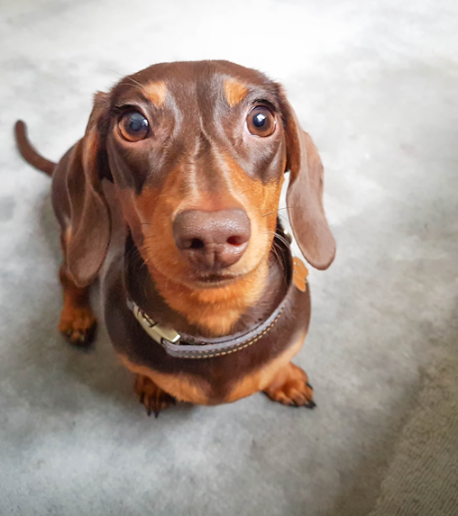
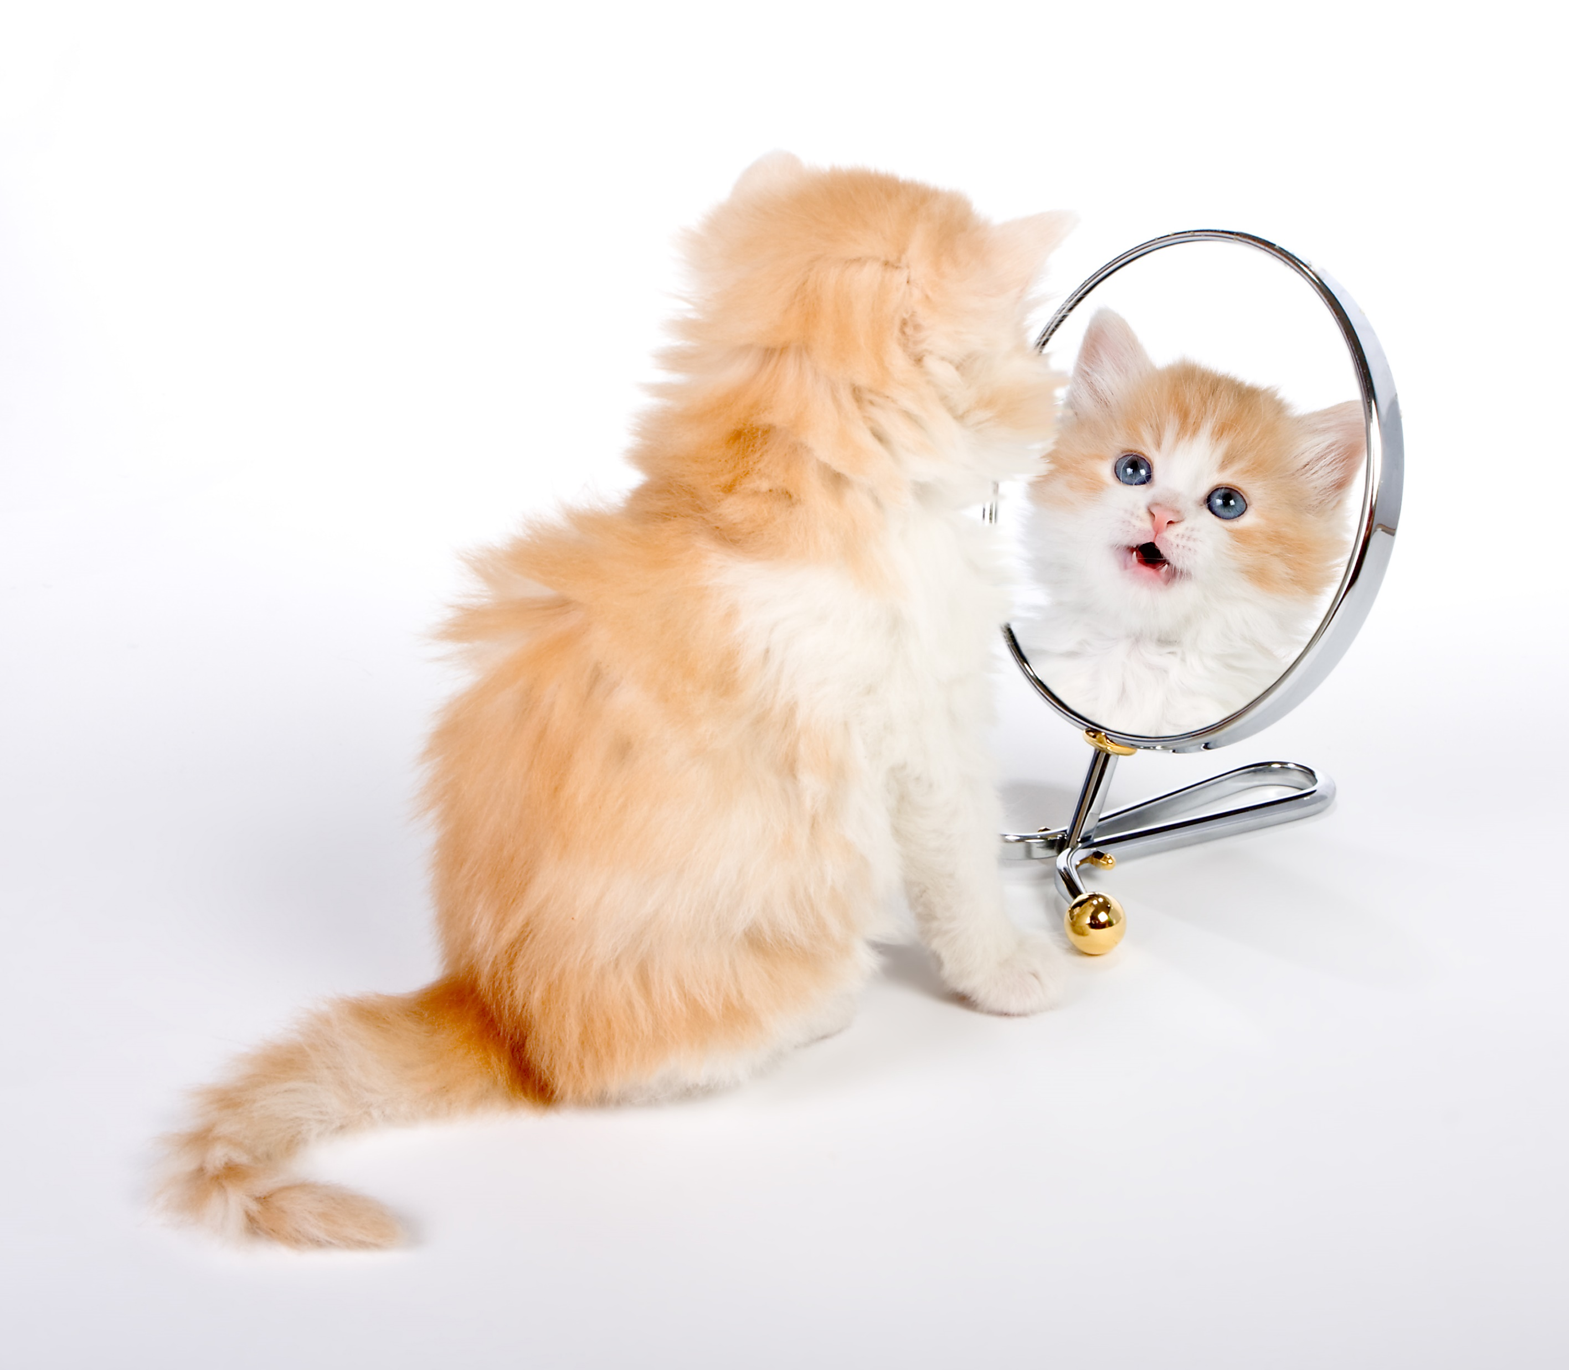

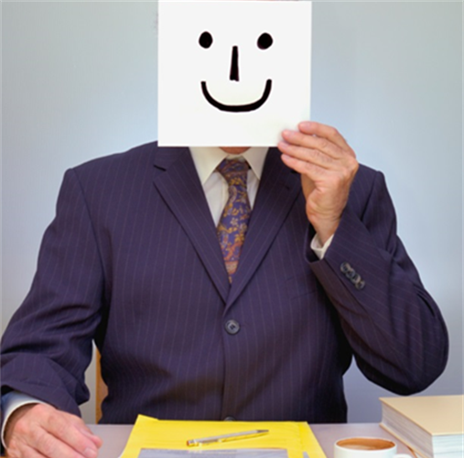
The Causes

Slide 18

Better Meeting Planning Leads to Less Burnout

Slide 19
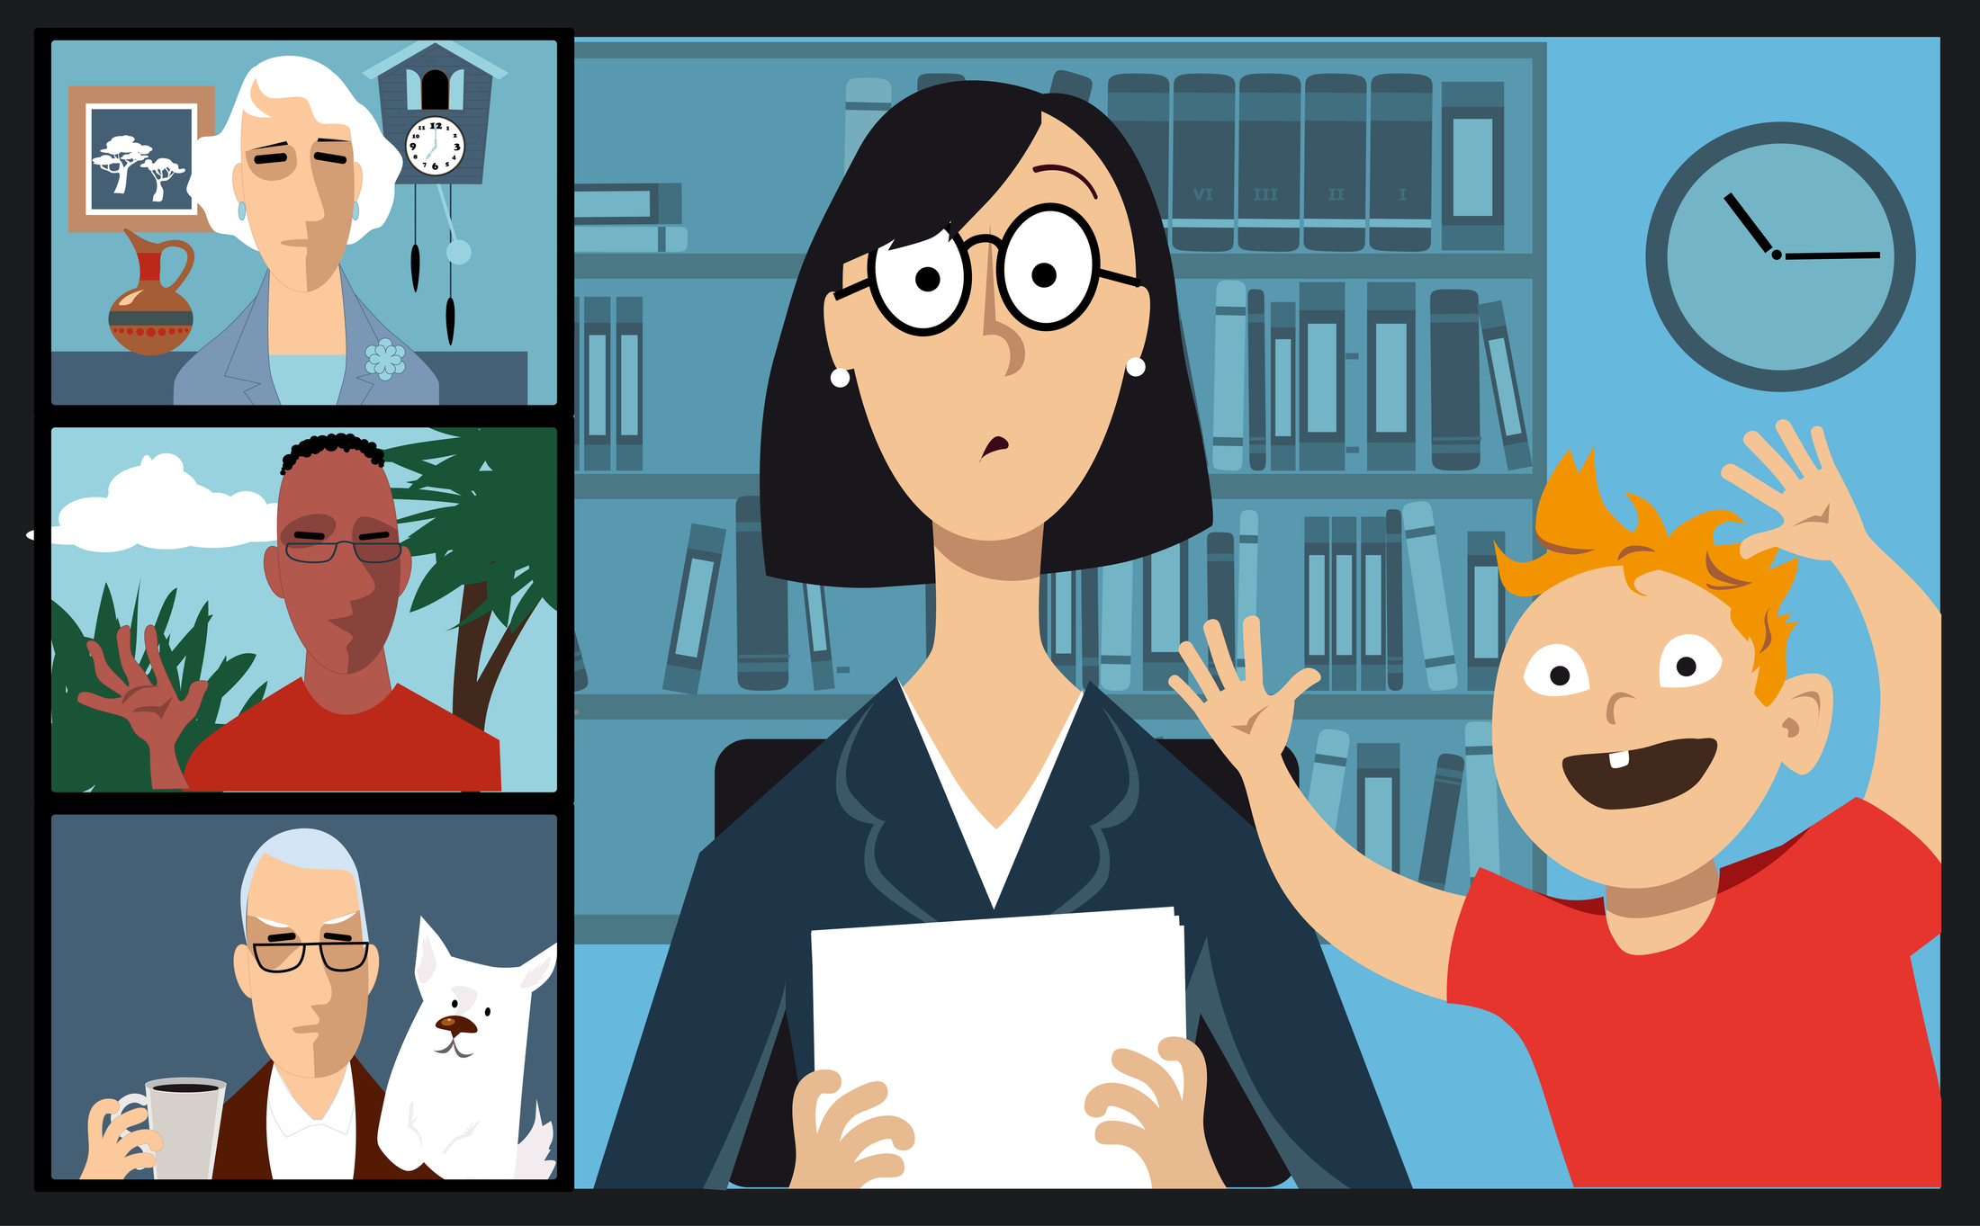
Better Meeting Attendance
Leads To More Productive Sessions

Slide 20
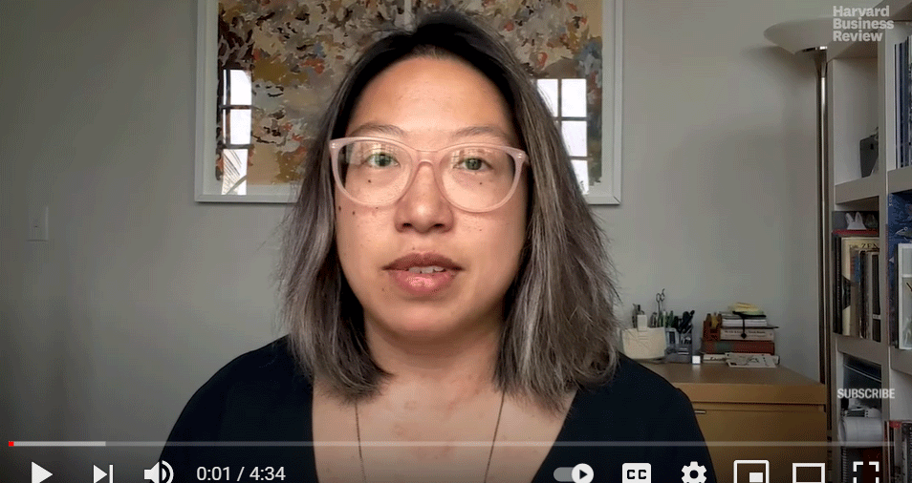
How to Make Virtual Meetings Feel More Real
Harvard Business Review
https://www.youtube.com/watch?v=zchEneW2890

Slide 21

Bonus Tip: Be Forgiving

