Slide 1

Strategies for Success for Neurodiverse librarians

Slide 2

Survey: What does it mean to be neurodiverse?
Notes:
Hard to define. Term is still evolving. Some use it as a framework, and others use it as a social or medical model which Singer believes there is a middle ground for both.

Slide 3
Scenario:
You are working on the reference desk when you overhear an angry patron yelling at your colleague for asking the same question twice. You see your colleague freeze and unsure how to address the patron. You Are not aware that your colleague is neurodiverse.
1) what might you think about your colleague?
2) how would you feel in this situation?

Slide 4

Survey: How many of you are familiar in some way with neurodiverse librarianship?

Slide 5
Social scientist- JUDY SINGER-late 1990’s & Robert Chapman
The neurodiversity movement is a social justice movement based on the philosophy that different ways of thinking and behaving should be embraced and are natural variations of being human. everyone has a unique way learning, processing and applying information.
However, According to American Psychiatric Association the symptoms of neurodiversity interfere or reduce the quality of social, academic, or occupational functioning.
Social or medical model of dis/ability?
Neurodiversity is a broad subject with many areas to consider. there is not a ‘one size fits all’ approach. The needs for dyslexia and dementia are completely different conditions yet labeled under the same category.
Neurodiverse or neurodivergent? Some argue that we are all neurodiverse.

Slide 6

Survey: What challenges have you observed from being neurodiverse or working with someone who is?

Slide 7

What does this look like in the workplace
May be invisiable
Difficulty expressing opinion/troubleshooting
Tasks take longer to complete
Extreme social anxiety
Avoiding certain responsibilities
Avoiding certain people
Extreme introversion

Slide 8
Challenges
CHALLENGES
Forgetting important information
Sensory overloading
Difficulty reading social cues
Not being able to express yourself clearly
Tasks take longer to complete
Co-workers may ridicule you
Extreme frustration
Difficulty hearing/processing information

Slide 9
Strengths
STRENGTHS
“Neurodiversity may be the birthplace of some of humanity’s greatest minds.”
–Harvey Blume, journalist.
Work ethic
Strong attention to detail
Resilience
Creative
Honest
Tenacious
Innovative
Determined

Slide 10

Survey: What modifications do you think Are needed?

Slide 11
Growth strategy
Additional patience and training /Mentor pairing
Spaces for limited work disruptions/Work flexibility
Extra time to complete assignments
UDL Approach/Assistive Technologies
Zero bully tolerance rules enforced by management
Use a clear communication style /Supportive work environment

Slide 12

Techniques for work and daily successes
Writing most important things down with a pen and paper, especially schedules and important dates.
Holding myself in love and trying not to self-stigmatize.
Ask for information/tasks to be repeated/written
Having a therapist who understand disabilities and offers neurofeedback to optimize brain function
Following ‘boom & bust’ technique
Having structure throughout the day
Requesting modifications/ advocating for yourself
Breaking tasks down into smaller steps to avoid ‘overloading’

Slide 13
TECHNIQUES CONTINUED….
Practicing what I want to say before I say it
Having minimal/no distractions when working on a project or assignment
Make a rhyming song to remember important/immediate information
Learning in multi-modules techniques such as visual, auditory, and hands on
Asking myself questions such as ‘how and where’ to get a better understanding of what I am learning and experiencing
Having strong routines
Practicing CBT techniques for anxiety or emotional regulation
Getting enough sleep
Repetition when learning new skills
Setting time/alarm clocks for easy transitioning

Slide 14
More Techniques
Visual/physical calendar and schedule
Marrying concepts, visual pictures, and simple ideas together to remembering and applying information
Reflecting at the end of each day with positive affirmations
Joining support groups that helps support people who are neurodiverse
Exercising daily
Eating well balanced meals
Having health insurance, if possible
Getting regular check-ups from doctor’s offices, if possible
Use intuition, ask lots of questions, pay attention to your body
Do not cope with drugs or alcohol

Slide 15
Steps to take if see your colleague is struggling
Don’t make assumptions
Talk to them in private
Ask if they need help
Maintain confidentiality if personal information has been disclosed
Maintain respectful communication
Look into best practices and procedures for involving management- if needed
Celebrate successes/diversity
Avoid gossip
Share tips and helpful suggestions
Ask how you can support them

Slide 16
Workplace for Americans with disabilities acts
HB21-1110 Colorado Laws for Persons With Disabilities
Americans with Disabilities Act (ADA): Covers employers with 15 or more employees, including state and local governments.
Rehabilitation Act of 1973: Protects individuals from discrimination in employment.
Workforce Innovation and Opportunity Act: Provides employment services for people with disabilities.
Vietnam Era Veterans' Readjustment Assistance Act: Protects veterans with disabilities.
Civil Service Reform Act: Provides workplace protections for federal employees.

Slide 17
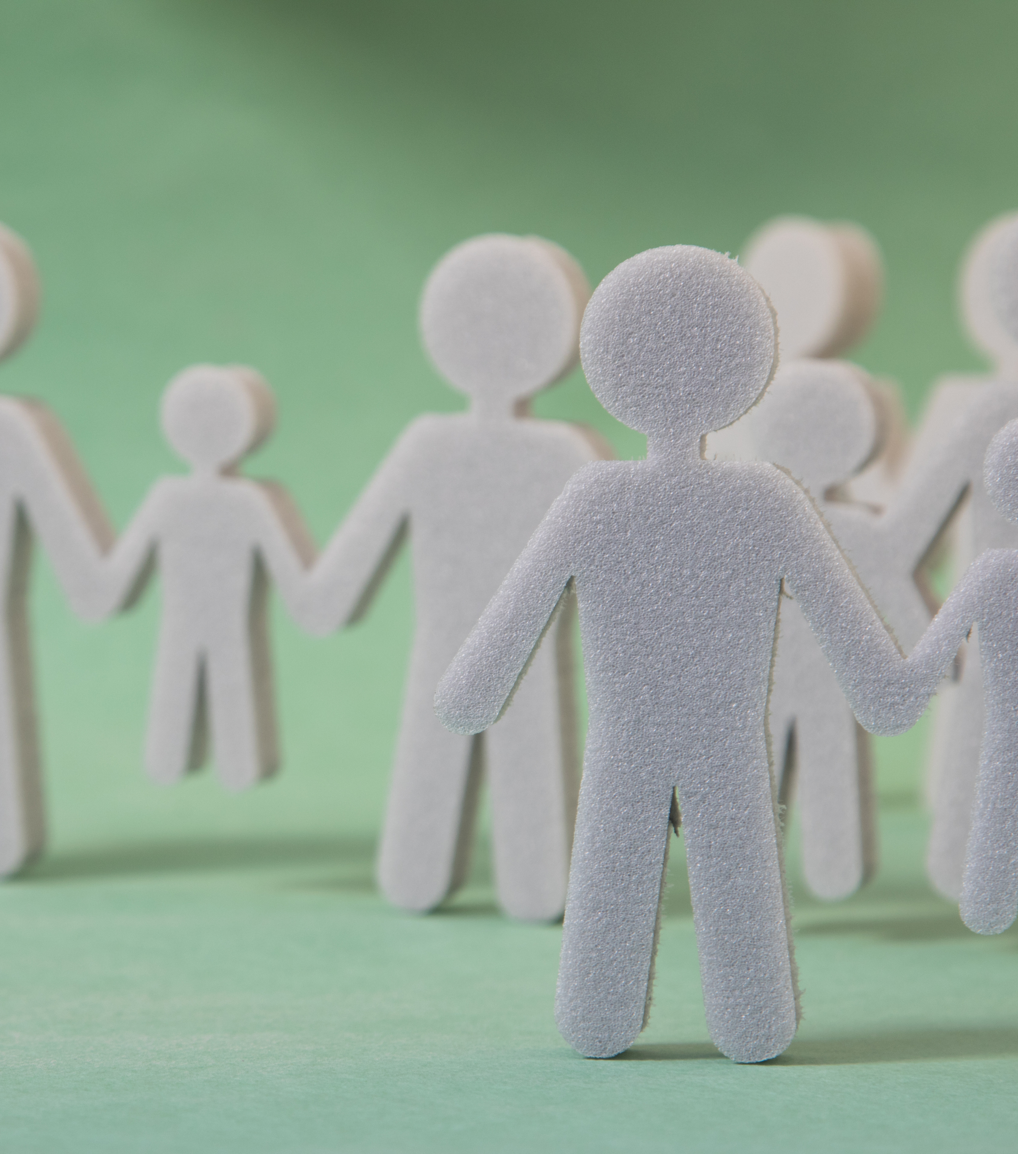
Conclusion:
We still need more research (and money) to better understand neurodiversity
There are many strengths that come with being neurodiverse some being tenacious and creative
Some ways to help neurodiverse staff is to have clear communication as well as different modes of learning and work flexibility
Having minimal/no distractions when working on a project or assignment
Learning in multi-modules techniques such as visual, auditory, and hands on
Remember to be loving and patient with yourself and others who are neurodiverse

Slide 18

Q&A Section

Slide 19
References:
(n.d.). Colorado Civil Rights Division: Home. Retrieved February 16, 2025, from https://ccrd.colorado.gov/
Amelines, A., & HEDLEY, D. (n.d.). What is Neurodiversity. Neurodiversity Hub. Retrieved February 16, 2025, from https://www.neurodiversityhub.org/what-is-neurodiversity
FAQ: HB21-1110 Colorado Laws For Persons With Disabilities | Office of Information Technology. (n.d.). Governor's Office of Information Technology. Retrieved February 16, 2025, from https://oit.colorado.gov/hb21-1110-faq
Guide to Disability Rights Laws. (n.d.). ADA.gov. Retrieved February 16, 2025, from https://www.ada.gov/resources/disability-rights-guide/
https://ccdconline.org/get-assistance/individual-advocacy/. (n.d.).
McDonald WM. Overview of Neurocognitive Disorders. Focus (Am Psychiatr Publ). 2017 Jan;15(1):4-12. doi: 10.1176/appi.focus.20160030. Epub 2017 Jan 11. PMID: 31975834; PMCID: PMC6519631.
Neurodiversity glossary of terms. (2021, June 10). College of Policing. Retrieved February 16, 2025, from https://www.college.police.uk/support-forces/diversity-and-inclusion/neurodiversity-glossary-terms
King, N. S. (2023). An Introduction to Coping with Brain Injury. Little, Brown Book Group Limited.
Public Library Association & Saleh, E. (2024, July 2). https://publiclibrariesonline.org/2024/07/strategies-for-success-as-a-neurodiverse-librarian/. Public Libraries Online Journal. Retrieved February 15, 2025, from https://publiclibrariesonline.org/
World Health Organization. (n.d.). International Classification of Functioning, Disability and Health. World Health Organization (WHO). Retrieved February 16, 2025, from https://iris.who.int/bitstream/handle/10665/42407/9241545429.pdf?sequence=1

Slide 20
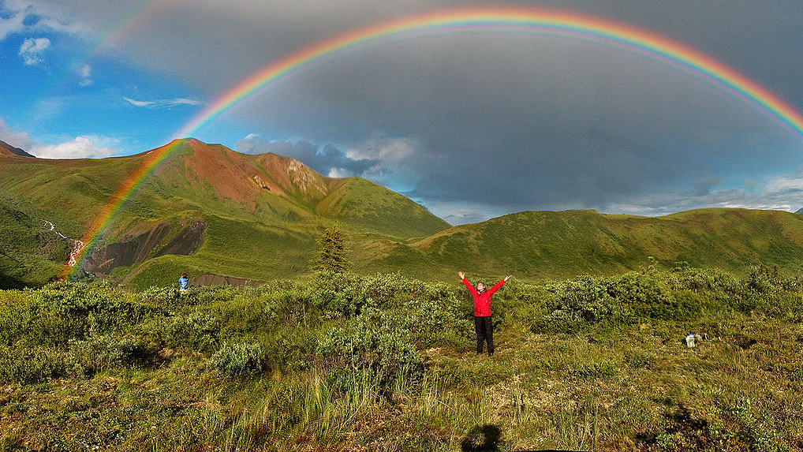
Thank you!
This Photo by Unknown Author is licensed under CC BY-SA

