Slide 1
Speaking Finance
Creating a value-oriented marketing plan for your library
Miranda Doran-Myers
LMCC 2017

Slide 2

Introduction
Librarian
Researcher & Data Geek
Took Econ 101 pass/fail seven years ago

Slide 3
Good marketing
DATA

Slide 4

Think about marketing from a financial perspective
Notes:
Think about marketing from a financial perspective

Slide 5
Goals
Understand return on investment (ROI) and how it can be used in libraries
Practice developing a marketing plan using these concepts

Slide 6
Agenda
Discuss ROI
How it is calculated
How to use it in your library
ROI calculator practice
Go through marketing process
Establish 5 steps of creating a marketing strategy
Develop a strategy to market library’s ROI to city council
Discussion: How do we apply lessons learned using this case study to other situations?

Slide 7
What is ROI?
Return On Investment
 
 

Notes:
First ask: “What does everyone think of when they think of ROI?”

Slide 8

ROI in Libraries
 
 

Measures the “value” a community realizes by the investment of tax dollars into that institution
Notes:
Use money and arrows for r4egular ROI slide

Slide 9
What is not ROI?
Economic Impact




Business
Development
Job Creation
Neighborhood
Value
Workforce
Development
For more information visit: http://www.ala.org/tools/research/librariesmatter/node/12
Notes:
Economic impact
Business development Job creation
  
Neighborhood value increase Workforce development
⇩

Slide 10
A shift in thinking about the library
Drain on resources
Investment in community
Notes:
To speak the finance language with funding decision makers
Cause a shift in thinking – libraries as an investment rather than a drain on resources
“Good marketing can change people’s opinion about something and ask them to act on that opinion.”

Slide 11
Calculating Library ROI

Slide 12
Market Value Data
vs.
Contingent Valuation

Slide 13





Market Value Data
Adult book =
$17
Children’s book =
$17
Interlibrary loan =
$25

Computer use/hour =
$12
Movie =
$4
Assigns a dollar value to library services
Notes:
Have audience guess how much each item/service costs

Slide 14
Contingent Valuation
Placing a value on non-market resources
How much would a patron lose in time/gas if they had to go multiple places for info resources?
What would a child lose if they didn’t have access to hundreds of books?
What could your community lose if they didn’t have workforce development resources?

Slide 15
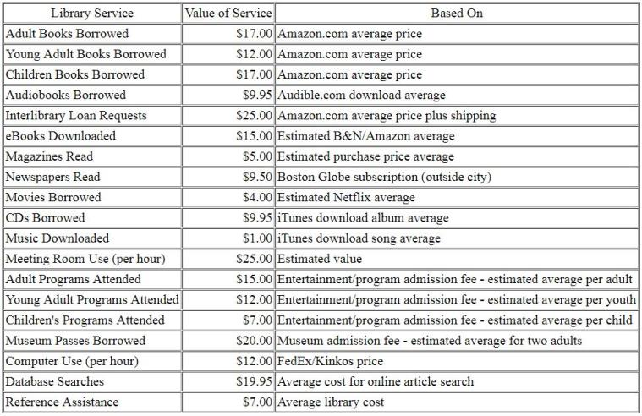
Know how you got your numbers!
Source: Massachusetts Library Association, http://www.swissarmylibrarian.net/librarycalculator/valuecalc_costs.html

Slide 16
For more information…
And lots of other resources, visit:
https://www.lrs.org/lmcc-2017-speaking-finance/

Slide 17
Library Value Calculators
ALA Library Value Calculator:
http://www.ala.org/advocacy/advleg/advocacyuniversity/toolkit/makingthecase/library_calculator
Maine State Library Value Calculator:
http://www.maine.gov/msl/services/calculator.htm

Slide 18
ROI Activity
Use the ALA Library Value Calculator to find the ROI of a patron that, in the past year:
Checked out 6 adult books
Checked out 8 children’s books
Checked out 1 audiobook
Used the library computer for 2 hours
Attended 1 adult program
Attended 2 children’s programs
Used a library meeting room for 1 hour
*Invested* $75 into the library (through taxes)
Notes:
Have them do it, or walk through the steps?

Slide 19
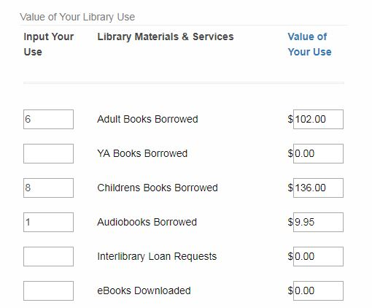
Calculating Library ROI - Example

Slide 20
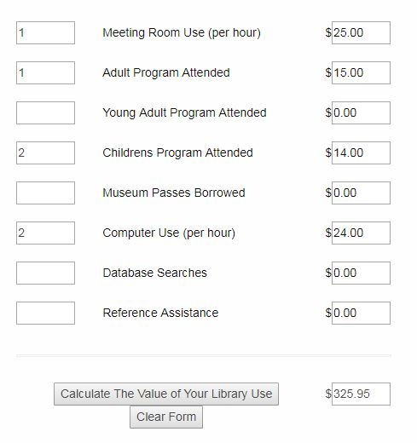
Calculating Library ROI – Example Value

Slide 21
ROI Activity – Step 1
Use the ALA Library Value Calculator to find the ROI of a patron that, in the past year:
Checked out 6 adult books = $102.00
Checked out 8 children’s books = $136.00
Checked out 1 audiobook = $9.95
Used the library computer for 2 hours = $24.00
Attended 1 adult program = $15.00
Attended 2 children’s programs = $14.00
Used a library meeting room for 1 hour = $25.00
Value of services: $325.95
Invested $75 in the library (through taxes)
$325.95/$75=$4.34/$1 return on investment

Slide 22
ROI Activity – Step 2
 
 

Notes:
Use money and arrows for r4egular ROI slide

Slide 23
Developing a Marketing Plan
Notes:
Add an image here

Slide 24
Basic Marketing Steps
Target your audience
Describe your services
Identify your competition
Develop promotional strategies
Establish measurable goals
From: The Accidental Library Marketer by Kathy Demspey (2009)

Slide 25

Case Study: Bookworm Public Library

Slide 26
Basic Marketing Steps - #1
Target your audience
Describe your services
Identify your competition
Develop promotional strategies
Establish measurable goals
From: The Accidental Library Marketer by Kathy Demspey (2009)

Slide 27

Target Your Audience - Questions
Who are your stakeholders?
What do you know about them?
What do they want from the library?
Notes:
Brainstorm with big paper

Slide 28
Target Your Audience - Resources
Resources to learn about your audience:
Pew surveys
Census information
DIY Surveys
Town Hall/City Council meetings
Creating relationships
Notes:
This is the target audience I’m going to focus on in this presentation

Slide 29
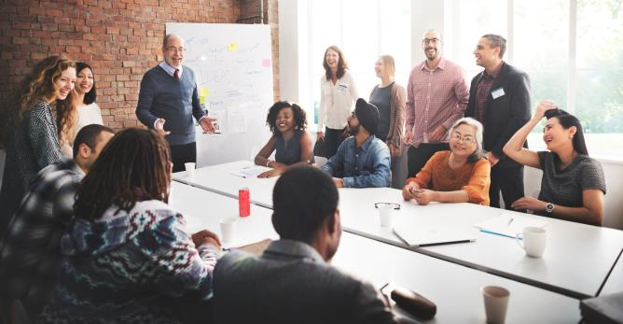
Target Your Audience – Decision Makers
Funding Decision Makers – who are they?

Slide 30
Case Study: Bookworm PL – Step 1
1. Choose and describe your target audience
Target audience:
City Council
What you know about them:
They have a positive of impression the library’s work
_
What they want from the library:
Maintain library services on a smaller budget
_

Slide 31
Basic Marketing Steps - #2
Target your audience
Describe your services
Identify your competition
Develop promotional strategies
Establish measurable goals
From: The Accidental Library Marketer by Kathy Demspey (2009)

Slide 32
“Never impose your language on people you wish to reach.”
- Abbie Hoffman
Notes:
Leads into the next step…

Slide 33
Describe Your Services
What is important to us may not be important to funding decision makers
Use ROI when your stakeholders when they are concerned with library value and financial benefit

Notes:
Talk about the results of survey of library directors vs. public officials
Activity: what is important to your library that might not be important to your stakeholders? And vice versa?

Slide 34


How does your audience learn?

Auditory
Visual
Textual

Slide 35
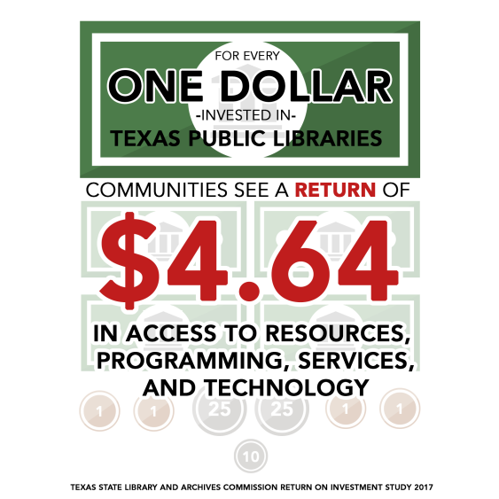
Texas State Library and Archives Return on Investment Stude 2017

Slide 36
Case Study: Bookworm PL – Step 2
2. Describe the services you offer this group, using their language
What is important to your target audience?
Keeping local gov’t costs low
List buzzwords using their language:
Return on investment (ROI)
_
Identify what format will work best:
Visual: infographic
_

Slide 37
Basic Marketing Steps - #3
Target your audience
Describe your services
Identify your competition
Develop promotional strategies
Establish measurable goals
From: The Accidental Library Marketer by Kathy Demspey (2009)

Slide 38
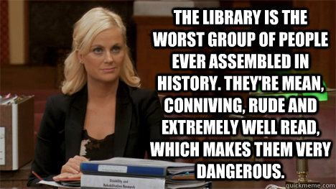
Identify competition
Finite tax money – who else needs it?
Who might be against the library receiving funding?
How do we convince them?
Notes:
Activity: Make a list of the library’s competition

Slide 39
Case Study: Bookworm PL – Step 3
3. Identify your competition and how you can overcome it
Police Dept.: show that your library can help the PD improve their own ROI
_

Slide 40
Basic Marketing Steps - #4
Target your audience
Describe your services
Identify your competition
Develop promotional strategies
Establish measurable goals
From: The Accidental Library Marketer by Kathy Demspey (2009)

Slide 41
Promotional Strategies
The fun part!
Speak your audience’s language
Stay away from library jargon – but do learn their jargon

Slide 42
Promotional Strategies
Use whatever format you’ve discovered that works best for your audience
Come up with short and snappy lines that convey your message
Give context to your numbers


Slide 43
Promotional Strategies – Total ROI
Total library ROI = $2,500,000 per year
OR
Per capita, taxpayers get an average of $5 return for every $1 tax invested

Slide 44




Promotional Strategies - Services
Patrons get a total return on their investment when they:
Check out 4 books
Book a meeting room
Check out 3 movies
After 4 library visits

Slide 45

Promotional Strategies - Comparisons
Compare numbers to other things
Sporting events
Movies
Buying books/videogames
Ex: Taxpayers keep the library running for the cost of a cup of coffee a month

Slide 46
Promotional Strategies - Trends
Show trends over time, like corporations do in their annual reports
Ex: Library ROI per capita has steadily improved over the past 5 years
2012 2013 2014 2015 2016 2017

Slide 47
Case Study: Bookworm PL – Step 4
4. Develop promotional strategies that will reach your target audience
Target audience:
City Council
Format:
Infographic (visual)
Message:
Bookworm PL is a great investment for the community
Strategy:
Make connections with council members
Calculate library ROI per capita
Distribute infographic at next city council meeting

Slide 48
Basic Marketing Steps - #5
Target your audience
Describe your services
Identify your competition
Develop promotional strategies
Establish evaluation goals
From: The Accidental Library Marketer by Kathy Demspey (2009)

Slide 49
Evaluation Goals
How will you know if your marketing campaign worked?
Ask for feedback from stakeholders
Social media effectiveness
Website analytics
Focus group

Notes:
Provide examples

Slide 50
Case Study: Bookworm PL – Step 5
5. Evaluate your marketing strategy
How will you know your marketing strategy worked?
Ask for feedback from council members
What information do you need to improve your strategy for next time?
Local ROI calculations

Slide 51
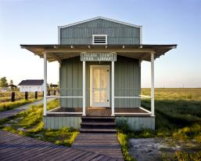
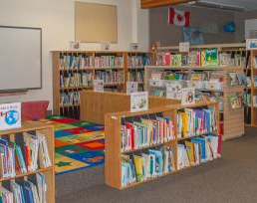

Discussion
How could this process be applied to different types of libraries? Or to different stakeholder groups?

Slide 52
End Reminders
Constant Evaluation
Don’t wait for a crisis
Create and maintain contacts
Always keep your audience in mind and speak their language
Notes:
Constant vigilance

Slide 53
Actionable Items!
This week:
Make contact with a new funding decision maker
Find out how much tax money per person goes to the library
This month:
Download an ROI calculator and customize with your own library’s information
This year:
Develop a marketing strategy using library ROI

Slide 54
Sources
Steffen, Nicolle, Zeth Lietzau, Keith Curry Lance, Amanda Rybin, and Carla Molliconi.
Public Libraries - A Wise Investment: a return on investment study of Colorado Libraries. Denver: Library Research Service, 2009. https://www.lrs.org/documents/closer_look/roi.pdf
Demspey, Kathy. The Accidental Library Marketer. Medford Township, NJ: Information Today, Inc., 2009.
Matthews, Joseph R. Measuring for Results: The Dimensions of Public Library
Effectiveness. Westport, CT: Libraries Unlimited, 2004.

Slide 55
Thank you!
Contact me:
Miranda Doran-Myers
Colorado State Library, Library Research Service
doran-myers_m@cde.state.co.us
(303)866-6787
For more information and resources:
https://www.lrs.org/lmcc-2017-speaking-finance/

