Slide 1
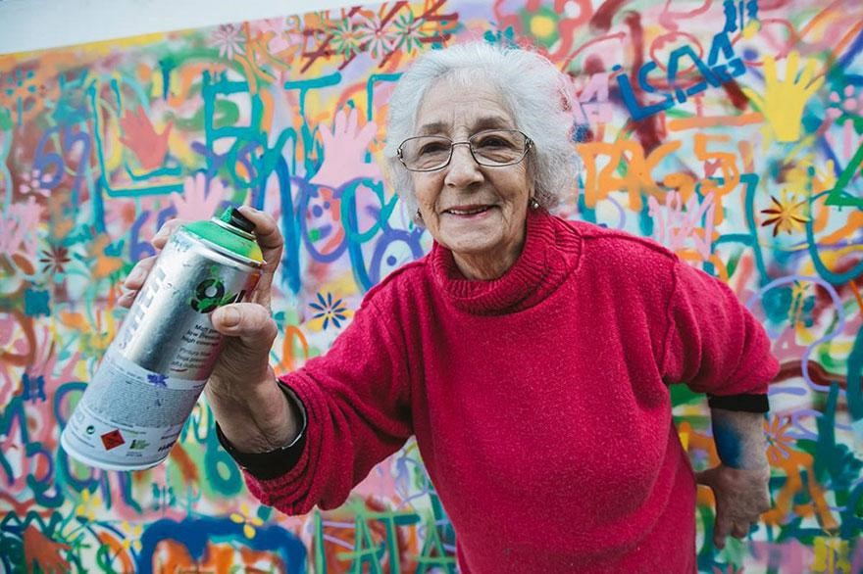
Age Savvy

Slide 2
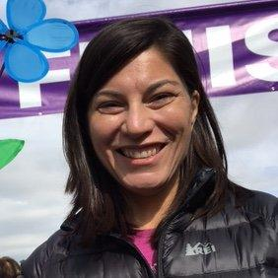
Hello!
I am Amy DelPo
Manager of Older Adult Services at the Denver Public Library
You can find me at adelpo@denverlibrary.org
Notes:
A little bit about me – I am 55 – I’ve worked in public libraries for 11 years
Today – I’m going to give you an overview of older adult services and explain older adult development.
Hopeful that this is a good news presentation for folks

Slide 3
Today’s Agenda
Check ourselves
Introductions
The latest on aging
Development
Neurology
Brain changes
Personality Changes
Ageism
Overview of DPL’s Older Adult Services

Slide 4
Let’s Share #1!
Please put in the chat the words that you associate with the word “old.”

Slide 5
The negative view of “aging” and “old”
Declining
Forgetful
Weak
Out of touch
Sad
Depressing
Rigid
Closed minded
Slow
Disabled
Ugly
Unattractive
Pathetic
Silly
Dried up
Grumpy
Vulnerable
Socially conservative
Bad at tech
Unable to learn
Not interested in new things
Clueless
Notes:
Was it one of these? Well – that makes sense – because this is what our culture tell us that aging and old-ness are all about.
This is a deficit-based, ageist view of aging and of older people – it is limiting and damaging. Are these words true some of the time? Yes – but some of them actually are not – the problem is that they are the only view we have.
And so often I find that library services are rooted in this view of older people. We have large-print books. We have home-bound services. We bring materials to nursing homes. We provide reading glasses at reference desks. We provide Medicare assistance.
All of this is important – and we should definitely do all of it – but it’s just a small tiny part of the story of what it means to age – and so it is a tiny small part of what we as libraries should be doing.

Slide 6

Small view of car
Notes:
It’s not that the deficit-based view is wrong. I’m not denigrating these programs at all. It’s that when we take ONLY a deficit-based view of aging – or we work only with stereotypes, many of which are ageist – we end up seeing just a tiny part of what is happening….

Slide 7

Bigger Picture
Notes:
… and missing the big, beautiful, complicated, rich, meaningful picture.
Aging is a complicated process. Yes – there is loss and decline – but it is part of a bigger context. Older adults experience growth and development, which balances and mitigates the challenges that come with aging.
Aging involves complicated mechanisms happening simultaneously. As we age, we experience both decline AND growth (Gendron, p. 26)

Slide 8
Let’s Share #2!
Please put in the chat:
Your age
Something hard about being your age

Slide 9
Let’s Share #3!
Please put in the chat:
Your age
Something wonderful about being your age

Slide 10
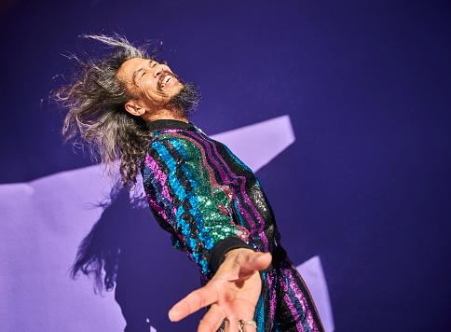
Expansive View
Notes:
So how do we get to this more complicated, beautiful, expansive view of aging? We look at what is really happening with older adults – developmentally, neurologically, and emotionally.

Slide 11

Child Development
Notes:
We already do this with children….

Slide 12
Carl Jung’s
Afternoon of Life
Notes:
Around the turn of the 20th Century, the great Swiss psychiatrist Carl Jung regarded aging as a developmental stage – and he urged us not to just live through it – but to enjoy it
Carl Jung believed that in our later years we go beyond the roles we were assigned in life – we finally have freedom. He thought that the great gift of aging – the great task of aging – is discovery.
Jung viewed old age as a time of dynamic creativity, encompassing internal growth, spiritual deepening, and the securing of meaning, as well as years of physical decline and inevitable losses.
None of those words were on the ageist list I gave you…

Slide 13

Jung’s Quote
The afternoon of life is just as full of meaning as the morning; only, its meaning and purpose are different.
– Carl Jung
Notes:
Jung offered a positive, life-enhancing approach to aging in which psychological and spiritual development is possible across the life span.
He did not ignore the difficulties and pain and losses of aging, but he contextualized them into a process that had meaning.
People in the second half of life can work toward the possibility of continuing creativity and fulfillment, and a deepening of spirituality. The key is to turn inward during the second half of life. It is a journey of self-exploration and inner discovery that Jung called "individuation," which is the central concept of analytical psychology. We can discover and build on our inner life, opening ourselves up to new ideas and experiences, continuing to grow and learn as we age, leading to a new sense of meaning and purpose in our life. This process of looking inward can open us to new ways of thinking about ourselves, our identities and the past and lead to the formation of new values and goals that can bring vitality and energy to our lives as we age. We can be open to conscious grieving and let go of goals that we did not achieve earlier in life. We can refocus our energy on those things that we can still achieve during the second half of life.
He was one of the first psychological thinkers to see the positive dimensions of aging, while still acknowledging the presence of debilitation, loss, and discontent.
So, far from being merely the accumulation of candles on the birthday cake, aging can be a time of discovery, growth, development, inner expansion and enrichment of life.
As we grow older we are all offered the opportunity to find meaning and purpose in becoming whole and wise.
Unfortunately, for those unable to respond to this new call for inner growth there is a tendency to experience depression, despair, fear of death and regret.

Slide 14

Treasure Chest
Notes:
We take our hopes and dreams and ideas about ourselves….

Slide 15
Gene Cohen’s Developmental Stages of Aging
Notes:
Half a century later, Gene Cohen applied new MRI imaging and researched the lives of thousands of older adults to create a theory around the developmental stages of aging that was strikingly similar to Jung’s work.
Cohen was a pioneer in the field of geriatric psychiatry, and he helped shift the emphasis in gerontological research from the problems of people as they age to their potential
Based on his research, he was optimistic about aging. He was positive about it, and he wanted the world to be positive about it, too.
Cohen debunked the prevailing stubborn myth that aging is negative, an illness, a stagnation, a falling apart, that is dominated by the inevitable decline of body and mind. He urged us to expect positive growth with age and to embrace the scientific findings that the aging brain can form new memories and grow new brain cells. He said that older adulthood is filled with meaning and purpose and new learning and growth.
Cohen posited that we are all endowed with an Inner Push that urges us on with our development at every age, including old age.

Slide 16
Four Stages of Maturity
MIDLIFE REEVALUATION
(mid-30s to mid-60s)
A time of quest, not crisis. A search for truth and meaning. Openness to life’s complexities. Stronger sense of self.
II. LIBERATION
(late 50s to late 70s)
A time of experimentation and innovation. A push toward liberation and not compliance. Innovation and risk taking.
M
L
Time of review and resolution. A desire to give back. What is the meaning of my life?
III. SUMMING UP
(late 60s through 80s)
Reflection and celebration. Learning continues along with experience and wisdom.
IV. ENCORE
(late 70s to end of life)
S
E
Notes:
Refer to this document for notes for this page.
These stages are super complicated and interesting – and they are rooted in what is neurologically happening in our brains – and I just don’t have time to do them justice. But quickly, they are:
Midlife re-evaluation – the questions are Where have I been? Where am I now? Where am I going?
Liberation – If not now, when? Why not? What can they do to me?
Summing up – What is the meaning of my life? How do I give back, make the world a better place? Are there unresolved conflicts I can make right?
Encore – reflection and celebration
Enriched environments necessary –

Slide 17
Developmental Intelligence
Advanced thinking that is not possible in our youth. It is a deepening of wisdom, judgment, perspective, and vision.
Notes:
Gene Cohen saw Developmental Intelligence as the greatest gift of the aging brain.
He said it reflects “the maturing synergy of cognition, emotional intelligence, judgment, social skills, life experience, and consciousness.”
Advance developmental intelligence is marked by three types of thinking:
Relatavistic – recognizing that knowledge may be relative and not absolute
Dialectic – the ability to uncover and resolve contradictions in seemingly opposing and incompatible views
Sytemic – Being able to see the larger picture – to distinguish the forest from the trees
In youth, we see things in black and white, right and wrong. In older age, we can tolerate complexity and grey area – we can hold a paradox.
Older brains have learned more than younger brains

Slide 18

Gene Cohen Quote
Some of life’s most precious gifts can only be acquired with age.
– Gene Cohen
Notes:
He viewed age as a gift, and the things that came with it as treasures.

Slide 19

Neuro-
plasticity
The brain’s ability to change and adapt throughout our entire lifespan
Notes:
Neuroplasticity can be viewed as a general umbrella term that refers to the brain’s ability to modify, change, and adapt both structure and function throughout life and in response to experience.
Our culture and our library giving people opportunities to grow – if we provide them, people will do it.
Interestingly, thanks to tremendous advances in medical imaging techniques for assessment of brain structure and function, mounting evidence for lifelong brain plasticity has been generated over the past years.
While traditional views suggested neural networks and behaviours become fixed after these age-windows ‘close’, it is now accepted that there is more flexibility, with learning relying strongly on experiential influences rather than purely age.
Those environmental factors – like enriching experiences and stimulating learning activities – are things that the library can and should provide. Just as we do for children to enhance their development and learning, we should do it for older adults as well.
A remarkable set of studies, done initially by Marian Diamond and colleagues, looked at the impact of an enriched and challenging environment on the anatomy and physiology of the brain. What the researchers found startled the scientific community. They found that animals exposed to a challenging environment sprouted considerably more dendrites than those in a control group that were not exposed to the same challenges. The cells were like trees sprouting new branches. A single nerve cell can sprout hundreds or even thousands of these dendrites.
Picture these cells and their extensions like trees with limbs, and then picture the neurotransmitters like squirrels. Trees with more branches make it easier for squirrels to jump from one to another. In effect, cells that sprouted more dendrites made it easier for neurotransmitters to move from one cell to another. What the researchers also discovered was that the cells produced more of the transmitter acetylcholine, which is the neurotransmitter involved with memory and intellectual functioning.

Slide 20

Creative
Aging
Awakening human potential in the second half of life.
Notes:
https://creativeagingresource.org/
There is no denying the problems that accompany aging. But what has been universally denied is the potential. The ultimate expression of potential is creativity
On an individual level, challenging our brains through creative exercises and encouraging creativity, in general, helps improve brain plasticity and/or neuroplasticity (Cohen, 2006;. Art activities appear to be particularly salient in impacting plasticity and decreasing the risk of dementia-type disorders (Cohen, 2006;Verghese et al., 2003). ...
Cohen's research showed us that old age can be a time of creativity. One study showed that older people involved in community-based arts programs were healthier and more independent after a year, than people of the same level of health who didn't take part. This made sense, he said, because science shows that brain cells do not die off as we age, but continue to grow.

Slide 21
Changes in the brain as we age
The brain’s emotional circuitry becomes more balanced
The limbic system grows calmer
The architectural circuitry becomes more complex
Young people use one hemisphere or the other; older people use both at the same time

Slide 22
New research on emotions as we age:
Older adults experience stronger desires than younger adults
Older adults are better at resisting these desires
Older people tend to have more positive emotions and fewer negative ones
Older people are more emotionally stable
Older people tend to be happier
Older people are better able to be present
Notes:
https://www.wsj.com/articles/the-emotional-benefits-of-getting-older-11587652302
This slide is important because it is in contradiction of the stereotype. This slide is based on research – the stereotype is based on ageism

Slide 23
New research on personality as we age:
People tend to become more conscientious and agreeable and less neurotic
The dark triad of personality traits – narcissism, machiavellianism, and psychopathy – go down
We develop into more altruistic and trusting individuals
We develop a better sense of humor
People tend to be nicer and more socially adaptive
Notes:
Our personalities are not fixed – they are fluid and malleable
These trends are universal and can be seen across cultures.
There is a lot of debate about how and why this happens.
https://www.bbc.com/future/article/20200313-how-your-personality-changes-as-you-age

Slide 24

Wall Street Journal Quote
The stereotype of older people as grumpy and curmudgeonly needs some revision.
Notes:
The Wall Street Journal

Slide 25
Ageism
Prejudice or discrimination against people based on age. It typically applies to older people but can also affect young people. Ageism negatively impacts physical and mental health and is linked to earlier decline and death.
Notes:
Ageism is a systemic form of oppression, but unlike other causes of inequity, such as racism, sexism, or ableism, anyone can experience it. Although it is universal, people do not always take ageism as seriously as other forms of inequity.
Ageism is the shame-inducing, anxiety producing guilt mongering force in our culture that is everywhere and all but invisible.
Ageism against older people is widely prevalent, accepted, and based on a systemic value that idealizes youth over old age.
It is also impossible to disentangle ageism from ableism.

Slide 26
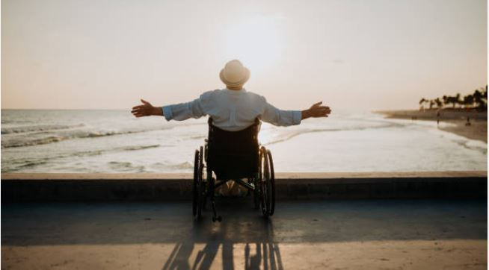
Quote
Ageism is prejudice against our feared future self.

Slide 27
The self-inflicted harm of ageism:
If you have negative feelings toward older people in general, you are more likely to struggle with negative feelings toward your own aging.
If you have negative feelings about your own aging, you are less likely to age in a healthy and happy way.

Slide 28
Types of Ageism
CULTURAL
The everyday, invisible, and profoundly ingrained and normalized negative messages about old people embedded in movies, TV, songs, jokes, etc.
INTERNALIZED
How we feel about ourselves as aging people.
Older adults discriminating against and maginalizing other older adults.
BENEVOLENT
Patronizing, paternalistic beliefs that older people need to be protected and taken care of by younger people.
IMPLICIT
Attitudes, feelings, and behaviors toward people of other age groups that operate without conscious awareness.
Notes:
Cultural: The everyday, invisible, and profoundly ingrained and normalized negative messages about old people embedded in movies, TV, songs, jokes, etc. Just as an example, only 1.5 percent of characters on television are older people, and most of them have minor roles and are often portrayed for comic effect, drawing on stereotypes of physical, cognitive, and sexual infectiveness. Cultural ageism normalizes the idea that it is scary and awful to be old.
Internalized: How we feel about ourselves as aging people (we are all aging, btw) -- comments like "I lost my keys, I must be getting old" (nevermind that younger people lose things, too!) or "I'm too old to even try to learn something new" (despite the reality that neuroplasticity means that we can learn throughout our entire lifespan).
Internalized: Older adults marginalizing and discriminating against other older people
Benevolent: Patronizing, paternalistic beliefs that older people need to be protected and taken care of by younger people. This type of ageism leads to overaccommodating behaviors that limit older people’s opportunities and agency. It assumes people need protecting because of their age. Stereotypes of older people as fragile or lonely provote sympathy and behavior that may or may not be welcome. Helping someone cross the street is a lovely gesture. Assuming someone needs your help just because they look older is not.
Implicit: Attitudes, feelings, and behaviors toward people of other age groups that operate without conscious awareness.

Slide 29
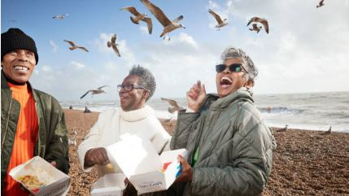
Fran Pratt Quote
Americans have been socialized to understand the problems and pathology of old age. What they do not understand is the great potential for activity, happiness, and wellness throughout long life.
Notes:
*(Fran Pratt, founder, Teaching and Learning about Age Project)..

Slide 30
Poll
Have you ever been the victim of ageism because you are younger?
Have you been the victim of ageism because you are older?

Slide 31
Prevalence of Ageism:
93 percent of folks said they experienced ageism in their day-to-day lives (Allen et al)
93 percent said workplace age discrimination is common (AARP)
56 percent of folks in their 50s are pushed out of the workplace or laid off (Urban Institute)
38 percent of hiring managers admit to reviewing resumes with age bias (Resume Builder)
Notes:
Longitudinal study of 20,000 people who entered their 50s with stable employment

Slide 32
Things to Know About Ageism:
It intersects with and compounds other forms of bias
Ageist beliefs are internalized at a young age
Ageism has a real impact on our health
Ageism in American medicine is a matter of life and death
Ageism hurts us on the job
Ageism decreases our financial security
Notes:
It intersects with and compounds other forms of bias, including racism, sexism, ableism, and homophobia. Multiple, intersecting forms of bias compound, disadvantage, and worsen the effects of ageism on people's health and well-being.
Ageist beliefs are internalized at a young age. By the age of 3, children develop negative age stereotypes that get reinforced over their lifetimes. Think about how older adults are portrayed in children's picture books and chapter books. (Maybe look for a different book for storytime if you are considering one that treats old people in a flat, negative, stereotyped way.)
Ageism has a real impact on our health. People with age-positive beliefs (which we promote here at the library!), live 7.5 times longer -- and are immeasurably happier -- than people with age-negative beliefs.
Ageism in American medicine is a matter of life and death. Negative age stereotypes often result in less effective care, such as denial of treatment options, under diagnosis, and mismanaged pain.
Ageism hurts us on the job. Older workers face longer periods of unemployment, discrimination during the hiring process, and fewer professional development opportunities.
Ageism in medicine – chronological age is not relevant – that’s the number of years you’ve been on this earth. More relevant is biological age – that is, the wear and tear on your body https://theconversation.com/are-you-a-rapid-ager-biological-age-is-a-better-health-indicator-than-the-number-of-years-youve-lived-but-its-tricky-to-measure-198849

Slide 33

Children and Ageism:
Children as young as three express ageist ideas and attitudes
Children are anxious and scared about their own aging journey
In picture books, older people are portrayed as sad, sick, lonely, grumpy, and forgetful

Slide 34
Ageism in Books
A book may be sensitive and caring, may provide a wonderful lesson, and still contain ageism and stereotypes.
You can’t see people as fully human if all you can feel for them is pity.

Slide 35
Aging (not ageism)
The slow and steady process of change that ultimately leads us to becoming our unique, individual selves.
Notes:
We are all aging. It is a vital part of our human identity and the human condition. It involves hard-earned life lessons and experiences that enable us to become fully realized. (Gendron at preface)

Slide 36
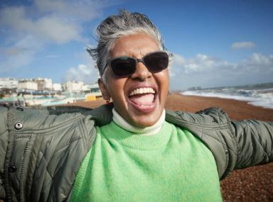
Age Positivity:
Increased longevity (7.5 years)
Improved physical and mental health
Greater ability to recover from setbacks, illness, and injury
Reduced likelihood of dementia (by almost half)

Slide 37
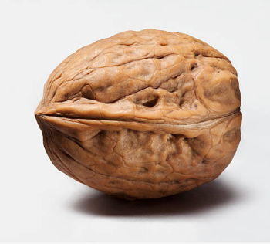
DPL OAS:
In a Nutshell
50+
Many stages of life
Broad spectrum of wants and needs
Intersectionality
Potential-based vs. deficit-based approach

Slide 38

DPL OAS:
Foundation
Developmental stages of aging
Neurology of the aging brain
Emotional and personality changes as we age
Goals and Alignment
Data and Evaluation

Slide 39
Goals and Alignment:
OAS: DPL Values:
Alleviate social isolation/ Connection
Create community Connection
Elevate joy Connection
Promote lifelong learning Curiosity
(behavior change)
Provide resources/solve problems Curiosity/Equity
Fight ageism – internalized and societal Equity
(behavior change)
Staff training/subject matter expert Welcoming/Equity
Notes:
So those were foundational elements based on our latest understanding of aging – but what about DPL-specific goals that are rooted in our values and our strategic roadmap? I took all of that information about aging and the developmental needs of older adults – and then I took our values and strategic roadmap – and I found my path and vision based on where those things overlap.

Slide 40
Library Programs for the New Old Age
Notes:
So in thinking about everything that we have learned today, what are some additional programs that libraries can offer to older people – to meet their developmental needs – in the same way that we meet the developmental needs of children and teens?
How can you create this enriched environment so that older adults can go through these developmental stages and thrive?

Slide 41

Positive Aging Programs
Art classes
3D Printing
Advanced tech classes
Songwriting
Community Singing Group
Autobiography writing
Understanding Neuroplasticity
Biking, walking, hiking
Mini Med School
Meditation and Qigong
Notes:
Positive aging programs look at the potential inside older adults – the potential for growth and change. They recognize the need for an enriching, creative environment for people to thrive as they age. They take into account the developmental stages of aging and give people opportunities and information to be present in those stages. They give people the opportunity to engage creatively. They also recognize the importance of needing information and community to work through these stages

Slide 42

Positive Aging Programs
Cooking
Gardening
Intergenerational connections
Volunteering
Small business startup
Solo travel
Solo aging
Navigating grief
Memory Cafe
Financial Wellness

Slide 43
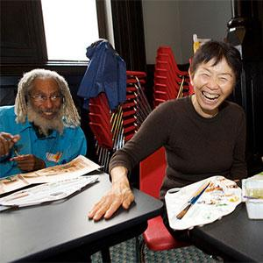
Art class at Brooklyn Public Library
Notes:
Art class at Brooklyn Public Library

Slide 44
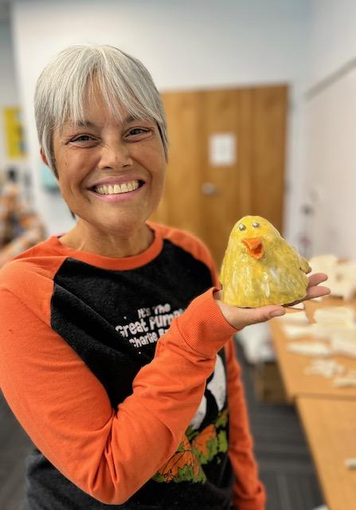
Art class at Brooklyn Public Library
Notes:
Art class at Brooklyn Public Library

Slide 45
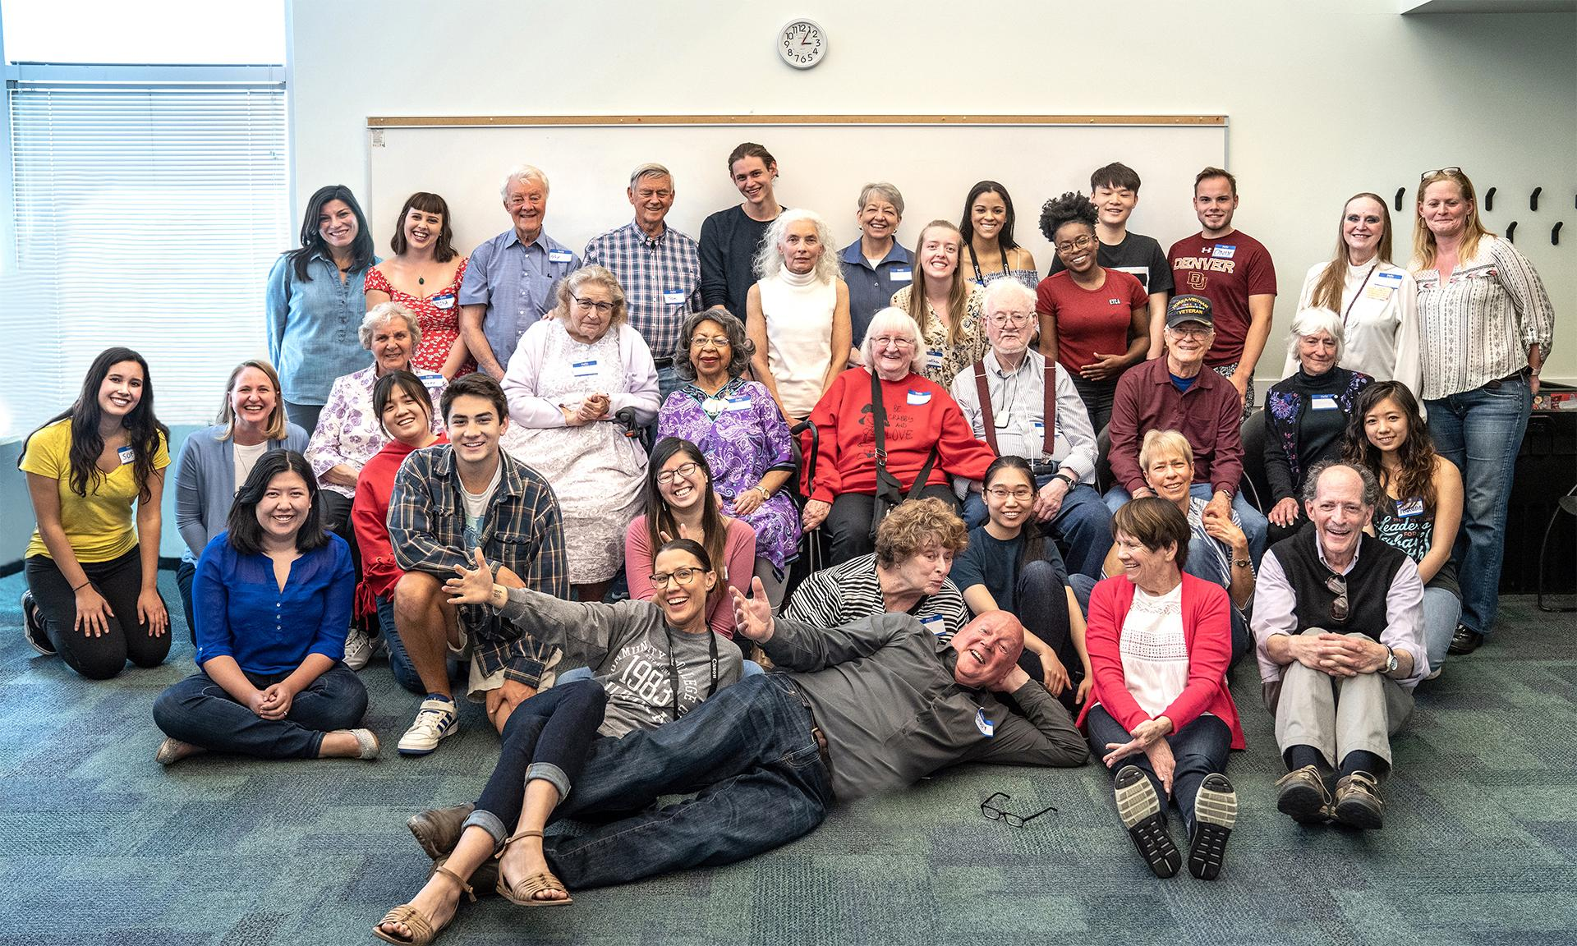
Intergenerational photography class at DPL
Notes:
Intergenerational photography class at DPL

Slide 46
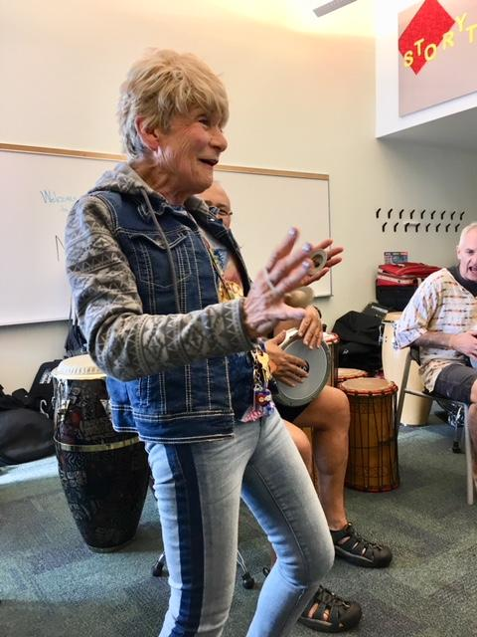
African drumming and dance at DPL’s Memory Cafe
Notes:
African drumming and dance at DPL’s Memory Cafe

Slide 47
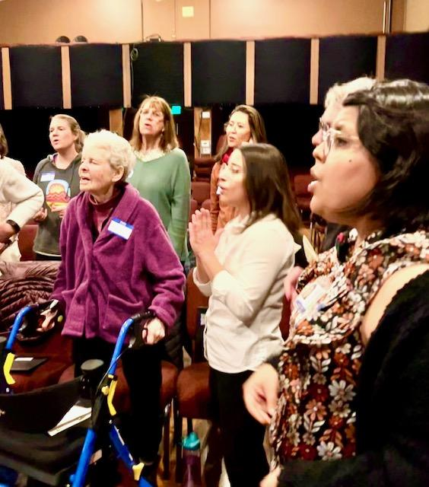
Older adult singing club at a public library in Hawaii
Notes:
Older adult singing club at a public library in Hawaii

Slide 48
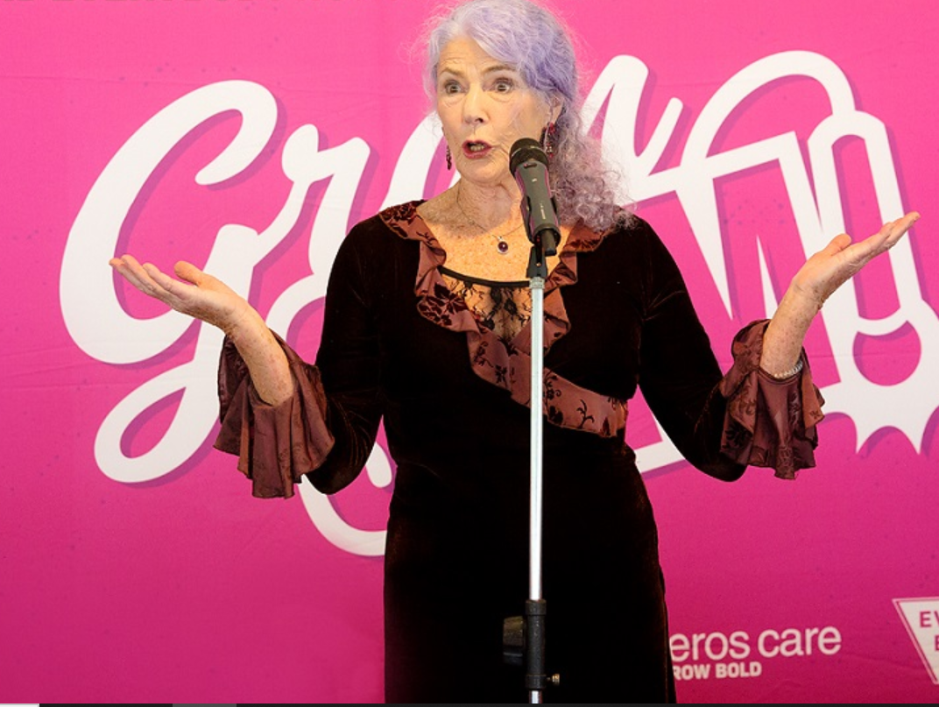
Poetry Slam
Notes:
Poetry slam

Slide 49
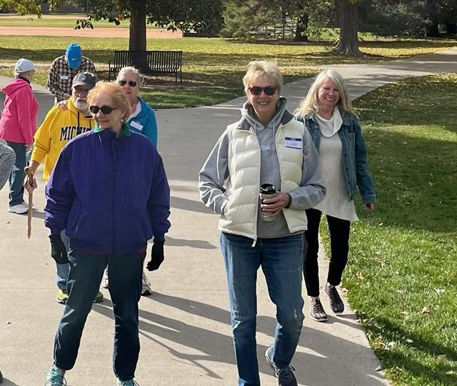
Memory Café Walk
Notes:
Memory Cafe Walks at DPL

Slide 50
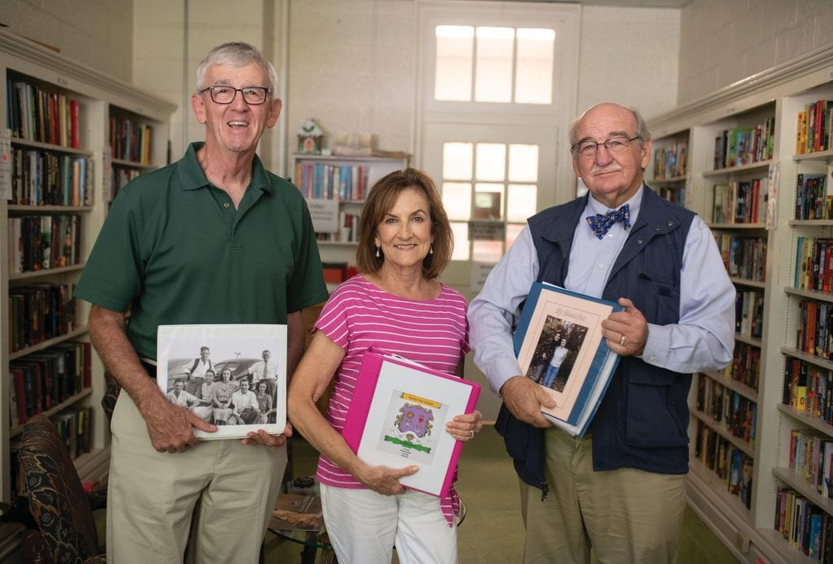
Memoir Writing Class in Chesterfield, SC
Notes:
Memoir Writing Class in Chesterfield, SC

Slide 51
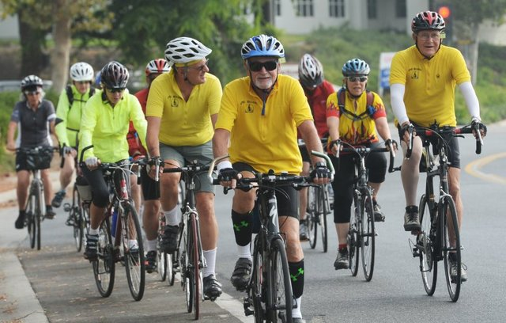
Older Adult Biking Club
Notes:
Older Adult Biking Club

Slide 52
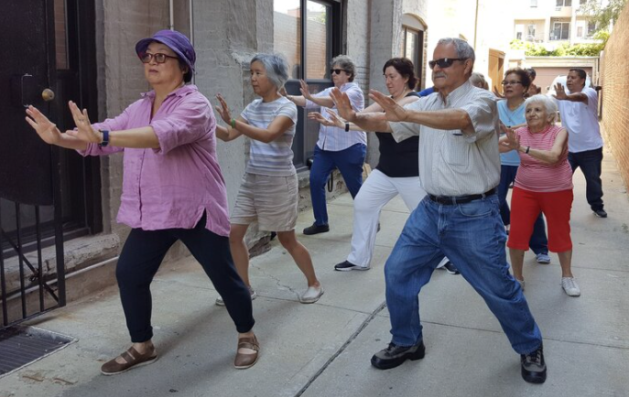
Qigong at Brooklyn Public Library
Notes:
Qigong at Brooklyn Public Library

Slide 53
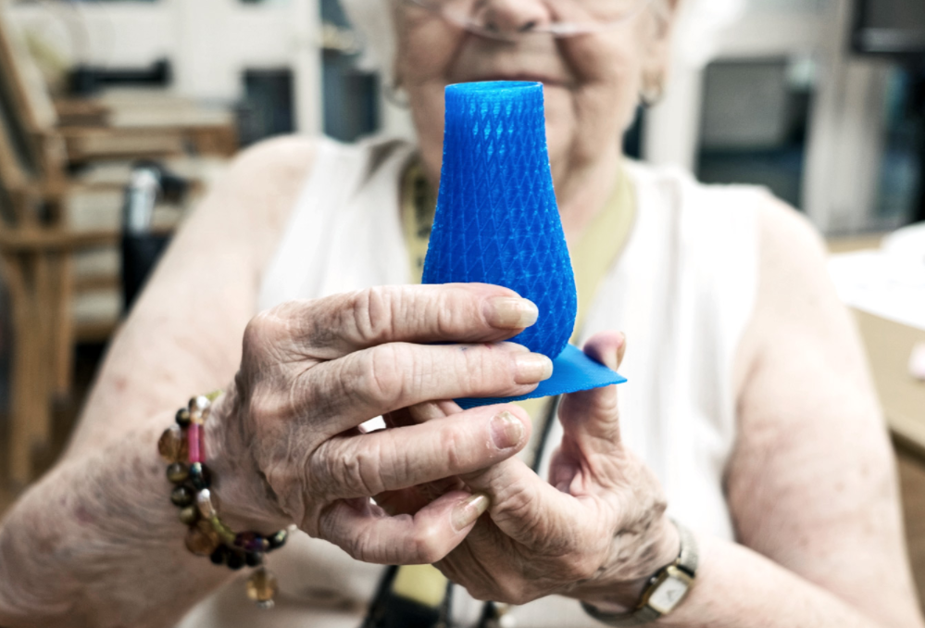
3d printing at a makerspace in New Jersey
Notes:
3d printing at a makerspace in New Jersey

Slide 54
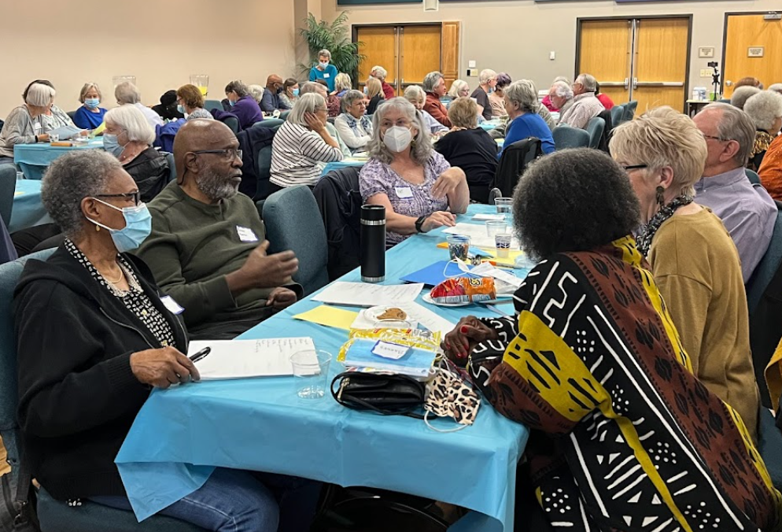
Workshop about equity, diversity, and inclusion at DPL
Notes:
Workshop about equity, diversity, and inclusion at DPL

Slide 55
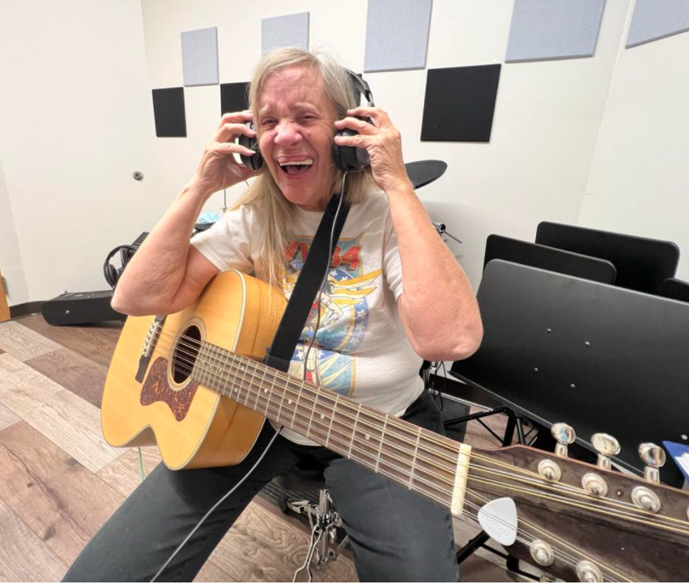
London Public Library recording studio
Notes:
London Public Library recording studio

Slide 56
Thanks!

