Slide 1

Receptive to Race
Normalizing the Discussion of Race with Children in Libraries
CSL In Session
August 27, 2020
Subway ride / Heather Lynn Miller ; illustrated by Sue Ramá.
Notes:
Greetings everyone; good afternoon and welcome to this presentation about the discussion of race with children in libraries. I want to thank you from the start for taking the time to be here with me today to learn about and grapple with this very important topic. I have been working on this and collecting research and best practices for about a year and a half, and this is the collective synthesis of what I’ve learned thus far.
Especially in recent months due to the national reckoning we are having around race, there has been a lot of additional information coming out on anti-racism in general, and specifically on using anti-racist practices in educational settings with children. I have tried to sift through as much information as I could find to make updates to this presentation from when I originally gave it last September, with the most current information that I’ve found, and apply it to our work with children in libraries.
For a moment, let me also acknowledge that some of us are just beginning our journeys regarding anti-racism, so I want this to be a safe space to ask questions and participate in discussion. I am here to offer information and I also want this to be a conversation among us where we share ideas that can help us become better practitioners. I ask that throughout this conversation that we assume best intent from each other and remain curious around this sensitive topic.
In my opinion, at this point in our collective cultural experience, I feel as a person of privilege that opting out of this conversation is no longer an option. And thus I am here today to facilitate the discussion, encourage us to all let go of doing this work perfectly, and come to an understanding of why exactly this is so very important.
First I want to start by asking a question, and here it is: On a scale of 1 to 10, how experienced or comfortable are you with discussing race with children and caregivers in the library? (Pause and wait for answers…also ask, “For those who are on the upper half of the scale, say, 6 or over, there will be a chance a little bit later to share some of your experiences. So if you can, begin to think about one experience that might be useful to share with the group – it can be funny, serious, embarrassing, rewarding – no judgement here – just something that perhaps we all can learn from.

Slide 2
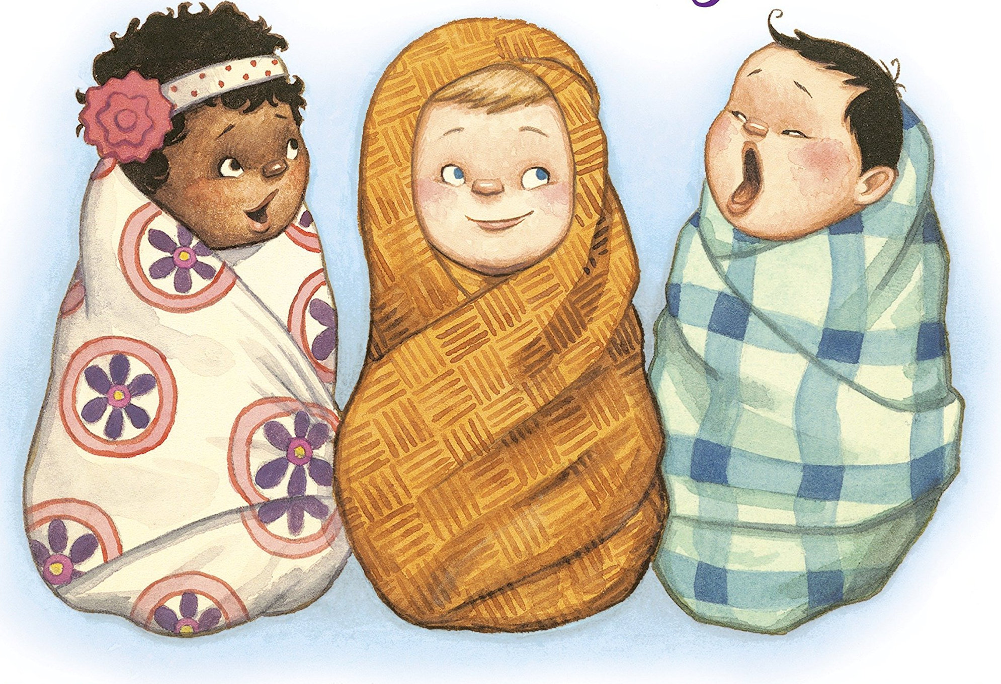
Stages in racial/cultural identity development
Infants:
Respond to skin color at 6 months.
Form a cultural identity.
1-2 years:
Learn cultural “rules”.
Curious about physical characteristics of self and others.
Littles : and how they grow / Kelly DiPucchio ; illustrated by AG Ford
MYTH: Preschoolers are too young to understand race. Ibram X. Kendi
Notes:
I’d like to jump right in and begin by debunking some of the popular myths around racism, racial identity and cultural identity. If you are a children’s librarian or otherwise work with young children, you probably know a bit about early literacy and brain development, as well as the social-emotional development of children, but we don’t hear or talk much about the stages of cultural and racial development in children, other than the specific note in the Every Child Ready to Read practices, which tell us that it’s best for parents to read, talk, sing write and play with their children in the parent’s first language, and even then, that has a bit more to do with brain development and formation of language as it correlates to language exposure.
I’ve taken some information from an article by Louise Duncan-Sparks, whom I’ve cited at the end of this presentation, as well as Ibram X. Kendi’s book, Anti-Racist Baby, which if you haven’t seen yet, I highly recommend checking out or purchasing for your collection. (As an aside: Even if that’s the only action item you take from this presentation, you will be enlightened on this topic just by reading that book.)
One of the major myths out there is that “We should not discuss race with preschoolers because they are too young to understand.” While those at a young age certainly are too young to understand race as a social construct, or in some other abstract way, there is scientific evidence to support the fact that children can and do understand differences in skin color, as well as gender and other physically manifesting attributes, from as young as 6 months of age. Along with this natural cognitive stage, they are also learning from their families and educational settings, in their neighborhoods and environments in which they live, what their cultural identity is, and as they grow into toddlers and preschoolers, children are becoming grounded in this cultural behavior. Therefore, just as we as library professionals advocate for reading with infants for brain development and we also socialize children to love reading, for those same reasons, we should most certainly also acknowledge differences among people as we’re working with children, specifically as we’re reading with and to them. We’ll talk a bit later about some of the ways that we can do this effectively.

Slide 3
More stages in racial/cultural identity development
5-6 years:
May reject home culture for dominate one.
Interested in how people get skin color.
May select to play only with children close to their identities.
Enjoy exploring cultures; can think critically.
3-4 years:
Becoming grounded in cultural behavior.
Identify people according to physical characteristics.
Overgeneralize differences.
Form stereotypes.
Have a strong sense of empathy.
7-9 years:
Establish group identities and membership.
Children of color aware of racism.
Rise in name-calling based on racial identities.
Learning about their “history.”
MYTH: Children cannot develop racial prejudices unless they are explicitly taught. Ibram X. Kendi
Notes:
Another myth is that “Mentioning race will put ideas in their heads.” Or another way of putting this is that “Children cannot develop racial prejudices unless they are explicitly taught,” like they grow up in a white supremacist home or something like that. And we know from again social and scientific research that this is simply not true. Children are exposed to many influences that affect their perception of race and of other differences among people. Actually, by not talking about it, and by not normalizing the discussion of race, and by not bringing it up, children are left on their own to categorize people and to negotiate power structures, and oftentimes, in an unfair and prejudiced way and as they get older, those prejudices eventually can and do turn into racism. So, in the same manner that you wouldn’t leave a child to feed themselves or teach themselves to read, we shouldn’t be leaving children to figure out on their own what to make of racial differences.
There’s a great book out called Anti-Bias Education in Young Children, which has a brand new 2020 edition – so I highly recommend reading it or purchasing it and here is an excerpt from that book that describes this concept very well:
“...just as we do not wait until a child asks questions about how to read before planning how to provide a range of literary learning opportunities, anti-bias education is the teacher’s (or librarian’s!) responsibility, not the child’s, to initiate.” We talk about laying the foundation for reading through our early literacy practices, and we can also think similarly about laying the foundation for anti-bias and anti-racism through our early anti-bias practices.
One of the things I haven’t yet mentioned is the harmful impact that not speaking about race with children has on the children who are on the receiving end of racism. Children of color may develop lifelong self-identity and self-acceptance issues as they grow and become more aware of and experience racism in their lives, which could include their communities, in their schools, and in their friendships. Some of us have a visual of racism as being the police brutality we’re witnessing or for example, voter discrimination – in other words, issues that impact adults, and even when we speak of the pervasive microaggressions that occur against people of color, we generally think of adults or at least younger adults. But what about the children who have been separated form their parents due to racist policies. What about the children in schools (or storytimes) whose names are pronounced in a way that is more convenient to the pronunciator. What about children who experience potentially thousands of microagressions as they grow up? Racism infects children’s lives all the way back to early childhood, and it’s our responsibility to address this with the same amount of passion as we do early literacy.
The good news is that children, as they grow, and learn to think more critically, become more receptive to teachings of empathy and fairness, if they are given the proper guidance on these matters.

Slide 4



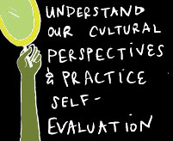
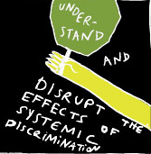
ALSC Guidelines
Notes:
Many of you are familiar with or members of the Association of Library Services to Children, and we follow their best practices in general for children’s services. Did you know that there are several references to interrupting discrimination and bias in the core competencies for library workers serving children put out by the ALSC?
These images on the screen are some handy-dandy thumbnails of the core competencies that surround race, but just to give you a more specific sense, here is what they include
Someone who fulfills the core competencies of library service to children
-Demonstrates respect for diversity and inclusion of cultural values, and continually develops cultural awareness and understanding of self and others.
-Recognizes racism, and other systems of discrimination and exclusion in the community and its institutions, including the library, and interrupts them by way of culturally competent services.
-Recognizes the effects of societal factors, new knowledge and tools, income inequality, health and food insecurity, etc., on the needs of children. (that would definitely include racism)
-Assesses and responds on a regular and systematic basis to the needs and preferences of children, their caregivers, educators, and other adults who use the resources of the children’s department, including those unserved and underserved by the library.
-Cultivates an environment for enjoyable and convenient use of library resources, specifically removing barriers to access presented by socioeconomic circumstances, culture, privilege, language, gender, ability, and other diversities.
So, that’s a lot! But don’t feel overwhelmed or feel like you have to fulfill all of these at the same time or immediately! These are guidelines and goals, so I suggest starting with one at a time to focus on. At times, we are bound to feel uncomfortable traversing this great divide that we have in our country, in our communities, and in our libraries, sometimes dealing with our own staff and perhaps even our administration, so these are helpful guiding tools for doing the work of anti-racism in your professional life.
I just want to pause at this point and ask if there are any questions or comments or any other knowledge that you want to share at this point. (Pause 7 seconds.)

Slide 5
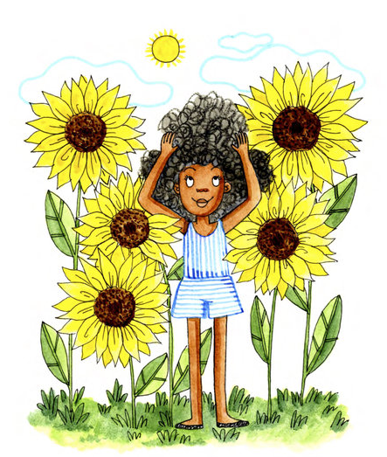
Storytime – Just start
Why are there Black people?
Why am I called Black if my skin is brown?
Why does Ruben speak Spanish?
Your nose is different because it goes up.
Why am I called White if my skin is peachy?
I’m going to eat a lot of melanin so my skin can be brown.
Why am I darker than other kids?
You don’t look Black.
Don't touch my hair! / Sharee Miller.
Notes:
Okay, now we are going to start talking about story time, as that’s the most common service we provide in children’s library land, and this is where I am going to welcome your experiences so feel free to chime in as we are going along.
So step 1, is : Don't be afraid. Don't be afraid to start. We've established all the good reasons why we need to do this, so jump in with both feet and don't worry about making a mistake, being vulnerable, just go for it. Think about it as the same as when you first did story times, or when you try out a new theme or book – sometimes it goes well and sometimes it requires more practice, but you always keep trying. Jessica Anne Bratt who is the author of the Let’s Talk About Race Toolkit says that doing this is the crossroads among sincerity, intentionality, and advocacy, so the most important thing is to try, and to not ignore the reasons this is important that we’ve already covered.
I think one of the reasons we are hesitant to start is that we are afraid of embarrassing or awkward questions or situations. And here are some examples of very common questions and statements that are representative of how young children think. And I’m here to encourage you to take these perspectives as they come, and to feel free to "answer questions honestly, even if they are embarrassing, and to say, I don't know, let me think about that for a little while.." Does anyone have an example of an interaction like this with a young child?
(If no one answers: Recently, during quarantine, Michelle Obama was reading a book each Monday on the PBS Facebook page, and I was watching this with my preschooler, who had just turned 3. She asked me, Mommy, is that lady scary?" And as you can imagine I was somewhat horrified, here I am thinking I am an ally and a racial justice activist and being all proud of myself and my own child is perceiving this strong Black woman so differently. And then I thought, no, she's 3, she is asking, calm down, she needs to know, and so I calmly asked, "why do you think that?" And she said, "because she has big, curly hair like the scary lady on tv" and she was referring to someone on a cartoon – I can't remember which one, and I said, "No honey, that lady's not scary, look, she's reading a book to us. That is Michelle Obama. She is married to a President. (which got her asking me what the heck President meant). And I said, did you know your middle name is Michelle? Just like that lady? We gave you your middle name because of that lady! she is a nice lady and she is going to read you a story. She has curly hair like our friend so-and-so, but hers is darker...
Many of us, when doing story time, have already started bringing in some social-emotional learning into the story time process, such as discussing manners, or sharing, or emotions, yoga or breathing. etc. And this is our chance to practice our own social-emotional learning (remember that core competency of the ALSC of working on our selves as part of this – you can do it, it’s going to be okay.)

Slide 6

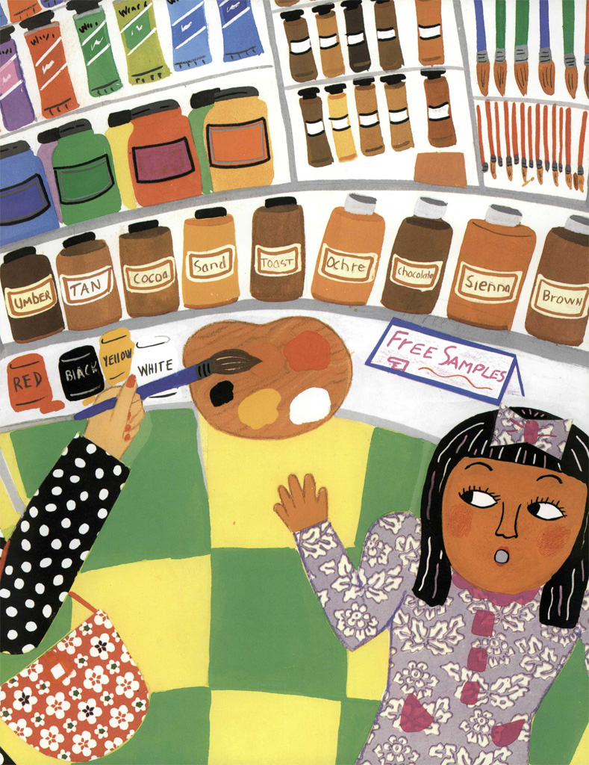
Storytime –
Diverse books
Highlight that physical diversity among people is desirable, and that all colors and shades of skin, hair, eyes, are good.
Talk about differences in a tone of delight and interest.
Explore skin color, hair, and eyes. There is ample opportunity to explain the science behind variations (STEM!)
The colors of us / Karen Katz.
Jessica Bratt’s Let’s Talk About Race toolkit
Notes:
Okay, now that we’ve established that we may encounter some awkward questions from kids, we are going to use more books that depict people of color, and when we do, we are going to point out differences among characters in books. Think about adding in a highlight or two about the people you see. Talk about colors and shades of skin, textures of hair, differences in eyes or clothing. Doing this can be a very simple expression that highlights physical diversity and models that it’s okay to acknowledge this, and models ways to acknowledge these differences appropriately.
For example, this book here is The Colors of Us by Karen Katz, and there are lots of pictorial depictions, as well as language woven into the story, about how people come in all shades of colors. You could simply say, something along the lines of “Ooh, look at her beautiful skin. Is her skin lighter or darker than your skin? Did you know that people can be born with all different colors of skin? Isn't that great? Oh, you want to know why? There's something inside our skin called melanin that tells the skin what color to be!" And proceed from there by making it a simple, natural, factual statement of differences and by showing these in a positive light. We all know that young children want to know the “why” behind everything, so this is one other time we can help them understand “why” with our thoughtful explanations.
It's also okay, if you notice you are using a book that is fairly ubiquitous in terms of representation, which is not hard to find, to say, “you know what? I don't see any people in this book who have brown skin! I really wish I could see more people that look like everyone that I see in the world! What kind of people do you wish you could see in this book?“ And by doing this, you are acknowledging the omission of certain groups of people and it may open up the conversation to aspects of fairness and empathy.
What both of these strategies does is to not only get kids thinking about who’s in the books they read in relation to people they encounter in the real world, but it also acknowledges the people of color who exist in your audience or your community. If children don’t encounter much diversity, these strategies provide a “window” to the outside world so they become more aware there indeed are people who exist that are different from them in physical ways and that they are equally worthy of time on the pages of our books. And if they do encounter diverse people in their lives, or are a person of color themselves, it provides a mirror to acknowledge and affirm their experience. Finally, it plants a seed in caregivers’ minds as to what they can and should be looking for when they pick books for their children.
I have a whole book list that is in the handouts, and in my citations, I also have some great web sites with lengthy book lists that you could consult for more ideas.
Highlight…some books that you can do this with include All the Colors We are; Shades of people; shades of black; The colors of Us (which is the one pictured here.)

Slide 7
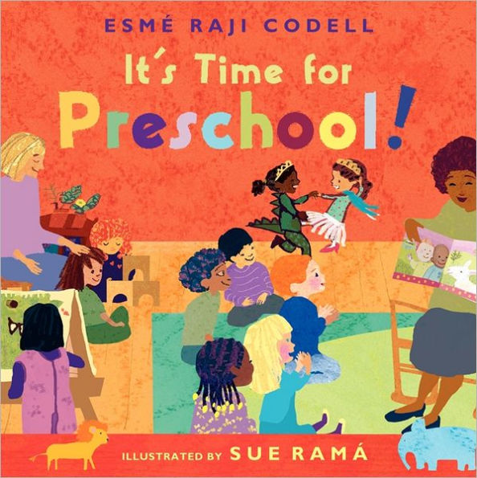
Storytime - Model
What's going on in this picture?
What do you see that makes you say that?
What more can we find?
These questions affirm that children’s ideas matter and opens the opportunity to discuss differences.
Megan Dowd Lambert’s Whole Book Approach
It's time for preschool! / Esmé Raji Codell ; illustrated by Sue Ramá.
Notes:
After we can comfortably acknowledge that our books depict people of color, you can begin to demonstrate, again modeling for caregivers, that despite our color, we all share commonalities. Look at the two little princesses in the back of this picture from….You can ask, “What do you see in this picture?” and they may say, there are two girls playing and other kids listening to the story! And there’s a mommy reading!” And you could say, yes, that could be a mommy, or I wonder if it could be a teacher? Or a librarian!” Whatever situation the children are in, whether their classroom or story time represents this one or not, they are seeing what is, which either affirms their perceptions or affords the opportunity to discuss differences from their experience. Let us all aim to use contemporary stories that show “kids being kids” featuring people of color to demonstrate the universality and normality of our collective experiences, and fortunately, these types of books are becoming increasingly easier to find.
In addition to the depictions of normal, everyday experiences, we can also use books that depict a particular group’s specific cultural experience, in order to better understand their background, their origins, their unique experiences. For example, we often state the title and the author when we begin reading a book. It’s also okay and encouraged to state that the author is African-American or Native-American, or Mexican-American, or any other race or nationality. If you do this, having spent time with preschoolers, what do you think is the first question they are going to ask? “What does that mean?” What’s African-American? This practice immediately opens the conversation to discuss the people who make up our nation!
Some of the questions we may ask if we are reading books that show the cultural experience in more than just pictures, but through the language, the relationships, the typeface, the endpapers, could be “What do you notice on this page? What are you wondering about? How do words and pictures work together in this book? What do pictures tell you that words do not? Or simply, “why is he/she doing that?” I’ve taken the questions on the screen and these last questions from Megan Dowd Lambert’s Whole Book Approach, which she applies to reading all picture books, but that I think are quite relevant to our discussion today as well because they are meant to transform listeners’ experience from a passive one to an active one.

Slide 8
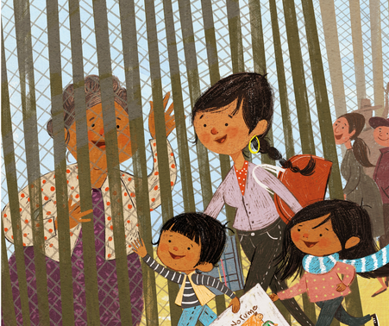
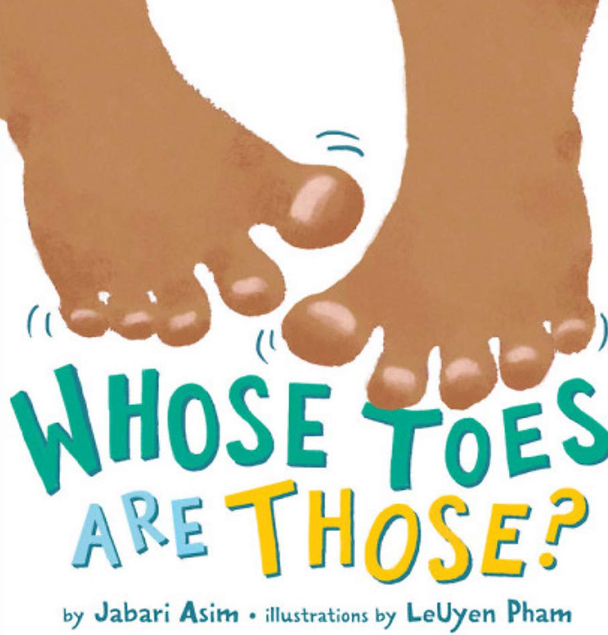
Storytime
Whose toes are those? / by Jabari Asim ; illustrations by LeUyen Pham
Who wrote this? Who do you notice on this page?
Between us and Abuela : a family story from the border / Mitali Perkins ; illustrations by Sara Palacios
Megan Dowd Lambert’s Whole Book Approach
Notes:
In addition to the depictions of normal, everyday experiences, we can also use books that depict a particular group’s specific cultural experience, in order to better understand their background, their origins, their unique experiences. For example, we often state the title and the author when we begin reading a book. It’s also okay and encouraged to state that the author is African-American or Native-American, or Mexican-American, or any other race or nationality. If you do this, having spent time with preschoolers, what do you think is the first question they are going to ask? “What does that mean?” What’s African-American? This practice immediately opens the conversation to discuss the people who make up our nation!
Some of the questions we may ask if we are reading books that show the cultural experience in more than just pictures, but through the language, the relationships, the typeface, the endpapers, could be “What do you notice on this page? What are you wondering about? How do words and pictures work together in this book? What do pictures tell you that words do not? Or simply, “why is he/she doing that?” I’ve taken the questions on the screen and these last questions from Megan Dowd Lambert’s Whole Book Approach, which she applies to reading all picture books, but that I think are quite relevant to our discussion today as well because they are meant to transform listeners’ experience from a passive one to an active one.

Slide 9
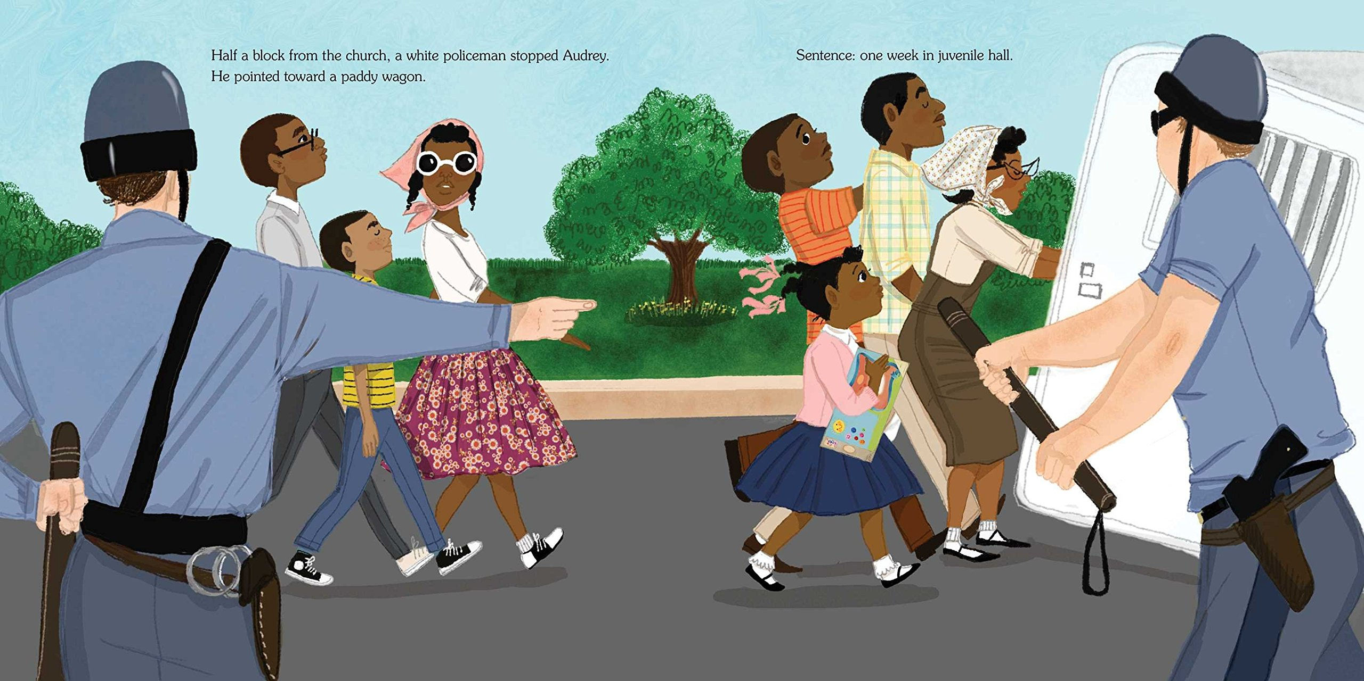
Storytime – Difficult Topics
Offer opportunities for empathy.
Define fair and unfair.
The youngest marcher : the story of Audrey Faye Hendricks, a young civil rights activist / Cynthia Levinson ; illustrated by Vanessa Brantley Newton.
Teaching Young Children about Race: A Guide for Parents and Teachers, https://socialjusticebooks.org/
Notes:
At this point, if we have practiced the first few pieces of choosing our books more carefully, acknowledging differences, and digging deeper into what the story is saying and the book itself is about, we may be able to go even a bit further to appeal to our children’s ability to think somewhat more critically, and to discuss and encourage empathy and fairness.
You can also point out some of the harder topics like social justice, and people perhaps abusing their power – are police officers nice? Do these police officers look nice? What are they doing to those kids? Why are they doing that? Did they do something wrong? Does this seem fair? Why do you think they are treating these children unfairly? In the same way that we don’t default to pirate stories for boy and princess stories for girls, we also need to be aware of stories that depict community helpers such as police, may reinforce a sense of otherness if that friendly, jovial, looking out for everyone’s needs hasn’t been the child’s experience. You could also ask the audience; how would you respond in this situation? Never single out one specific child. Everyone has a racial identity and therefore activities can pertain to all of the children.

Slide 10
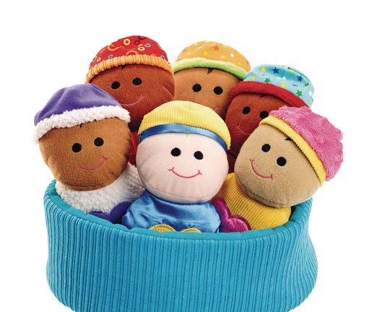
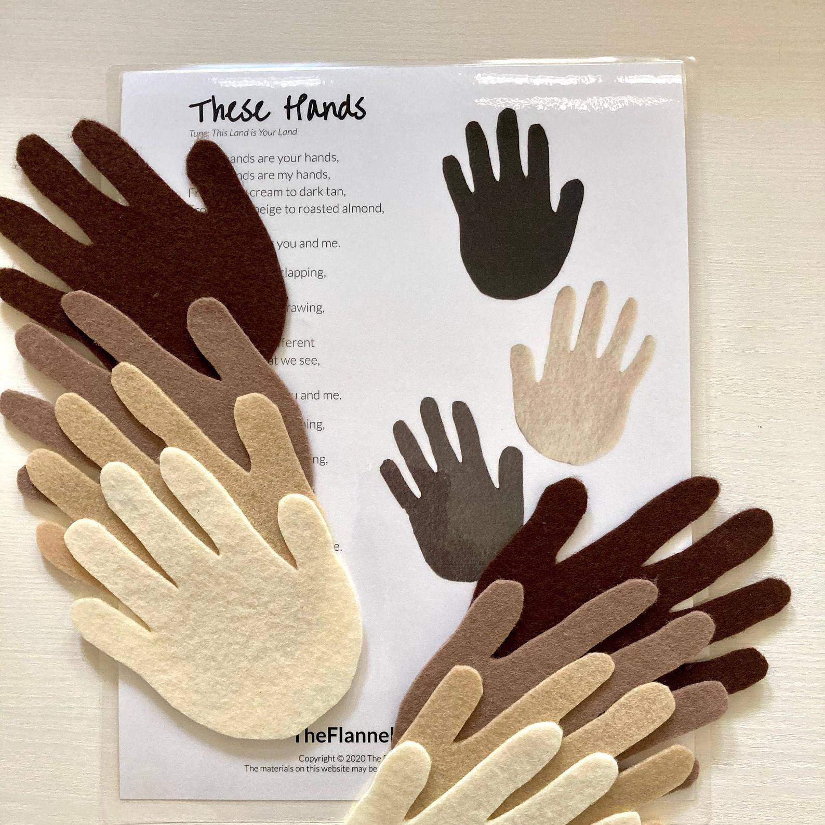
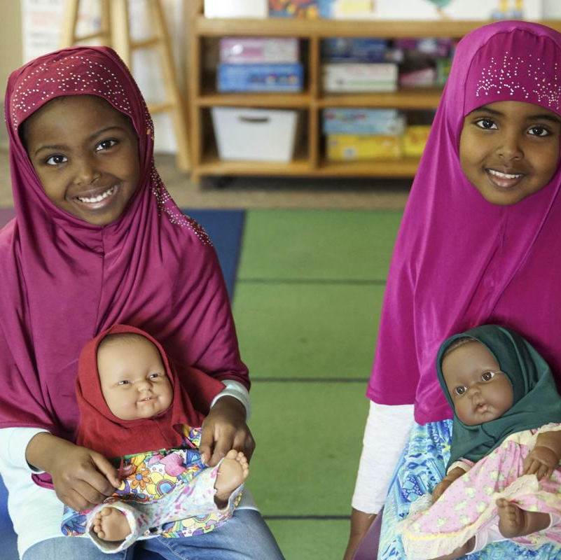

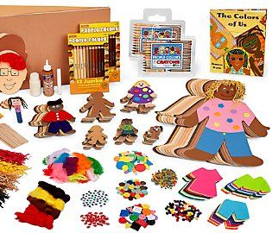
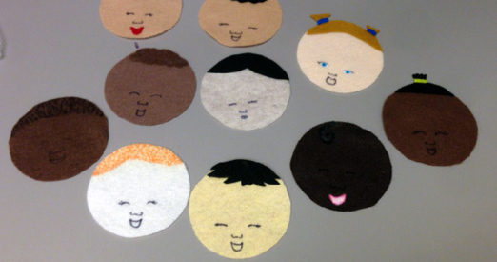
Storytime - More
Notes:
Up to this point, we have mostly talked about stories and reading books, and as we all know, story times are about more than books, so I want to also briefly touch on incorporating this discussion of race into some of the other early literacy practices. For example, I want to make a note about songs. There are song lists available now that educated us on the racist origins of some songs, like x, y, and z – also, when you are singing songs, do you use a variety of names? Do you call on all the children? Do you expose white children to names and songs that originate in other cultures? There are lots of ways like this to incorporate the acknowledgement of race into our early literacy practice of singing.
As far as playing, what types of manipulatives do you use and if they depict people, are there any people of color? Do you have Crayola’s crayons of the world readily available so that when kids are coloring in pages you leave out, there are multiple options available to them? While providing crafts, flannel board stories, or handouts and now that we are doing a lot of take and make materials due to Covid, are the people represented all ubiquitous or do they represent the diversity that exists and make all races and cultures feel included? So aside from books, there is a lot we can do to incorporate this into the rest of our services to children as it relates to story time and all its relative pieces and parts.

Slide 11
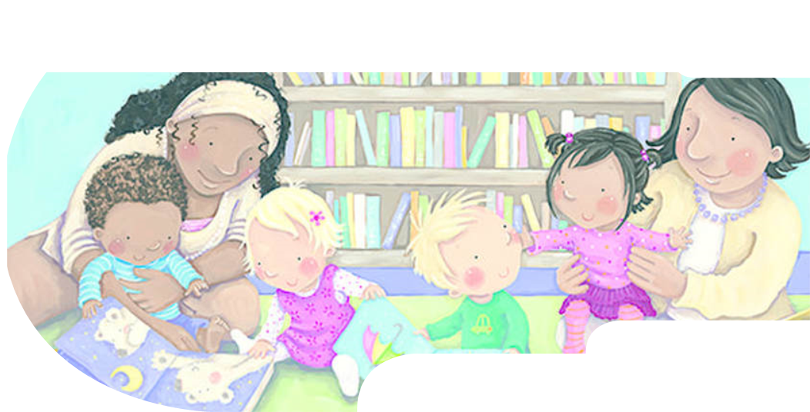
What other tips do you have for discussing race in storytime?

Slide 12
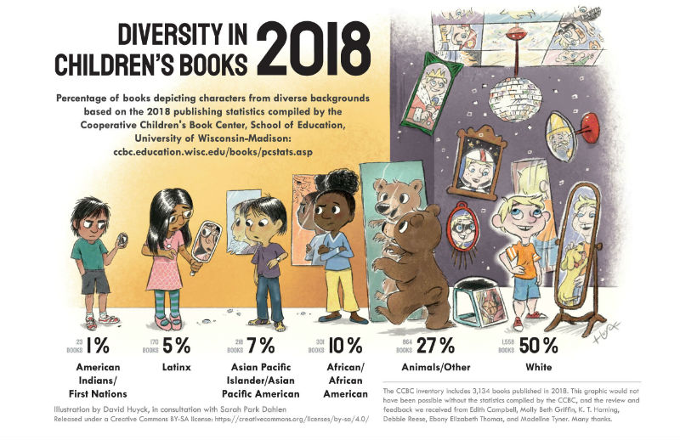
Collection Development
Notes:
Now I’d like to ask you to jot down the percentages of books they think depict characters of diverse backgrounds – white, African/African-American, Asian, Latinx, First Nations/Indiginous peoples.
Ibram X Kendi says one of the most important things we can do for children in this country is to teach children of color that they are not unworthy because of their skin color, and teach children who are white that they are not worthy because of it.

Slide 13
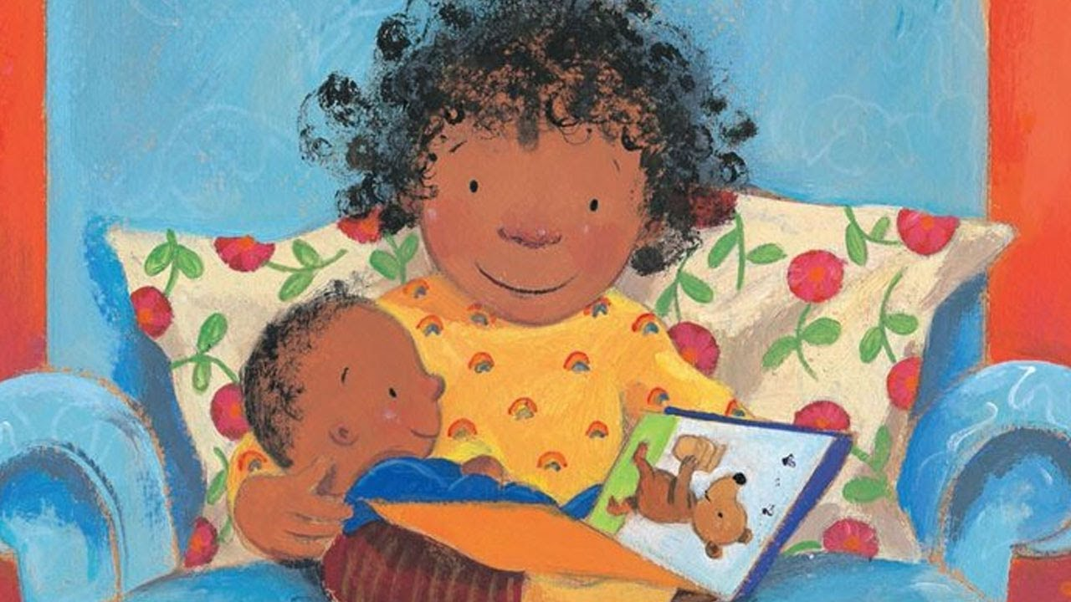
Collection Development – Foster visibility
  Will all the children you serve see themselves?
  Will all children of color, including those with mixed heritage, see characters with whom they can readily and positively identify?
Lola reads to Leo / Anna McQuinn ; illustrated by Rosalind Beardshaw
Guide for selecting anti-bias children's books, https://socialjusticebooks.org/
Notes:
All authors write from a cultural as well as from a personal context. In the past, most children’s books were by authors and illustrators who were white and members of the middle class, so, naturally, a single cultural and class perspective dominated children’s books. There are now excellent books by people of color from a range of backgrounds. So now we want to use the excellent array of resources available to us as librarians to do the following:
FV: Does your book collection depict diversity among people within a specific racial/ethnic group, such as a range of family structures, living environments, socioeconomic conditions and types of work, and male/female roles within the family?
Consider the author’s:
Some of the resources available to us now include ALA Awards pertaining to representations of color, such as the Pura Belpre award and the Coretta Scott King award; the web site and project We Need Diverse Books, which has a plethora of book lists; Colorin Colorado; School Library Journal has a number of portals for various types of diverse books; and the list goes on and on.
Then I would say, proactively use those books in your storytimes, in displays, in social media promotion, especially now as more patrons are engaging with us online. As an anecdote, one person made a comment that they purchase what they feel is a diverse book collection, but “those books” don’t get checked out because they don’t represent the community in which they live, and therefore it becomes harder to justify the cost. I would argue that this is even more reason to highlight these books as much as possible in front of patrons, so that they are exposed to differences, just as we talked about at the beginning of this presentation.
I also will say, there is a movement if you will, where more and more books are simply depicting kids being kids, regardless of their race, skin color, culture, background, etc. So if you want to, that might also be a starting place – think about Leo Loves to Swim and Puppy Truck and My Pet Wants a Pet – these have nothing to do with the character’s race, but normalize the fact that all kids in general take swim lessons and play with trucks and have pets.

Slide 14
Collection Development – Avoid tokenism
Check the storyline for power relationships.
Does your collection include a balance of people who have made important and honored contributions?
Do some of your books about important people include struggles for justice?
Guide for selecting anti-bias children's books, https://socialjusticebooks.org/
Notes:
Read slides:
Check the storyline for power relationships: who are the central figures and who are in supporting roles? Who is pitied and who is a hero? Does the non-white character have to do something extraordinary or forgiving to gain approval? Are people of color depicted as passive or otherwise inferior? (One challenge I can give you today is to look closely at your collection to see if you can find examples of these types of books, just to see what they look like and to begin to think about them in a different way. In other words, just having one person of color in a book does not a diverse book make.
Balance of people: There are a ton of great biographies out now that represent the rainbow of people that make up our nation’s history.
Justice: Children are able to understand right from wrong at this age, and distinguish fairness from unfairness, so you can begin to discuss racial injustices that have occurred in a concrete way.

Slide 15
Collection Development - Representation
Don’t always substitute animals for people.
Don’t expect every book to show diversity. The goal is to have a balanced collection.
Culture is also current and evolving and therefore needs to be represented.
Guide for selecting anti-bias children's books, https://socialjusticebooks.org/
Notes:
What does this bring up for people, and/or does anybody have any additional tips, or comments about creating a more representational library collection?
Crickets? Is anyone else feeling perturbed that we still have to have this conversation in the year 2019?

Slide 16
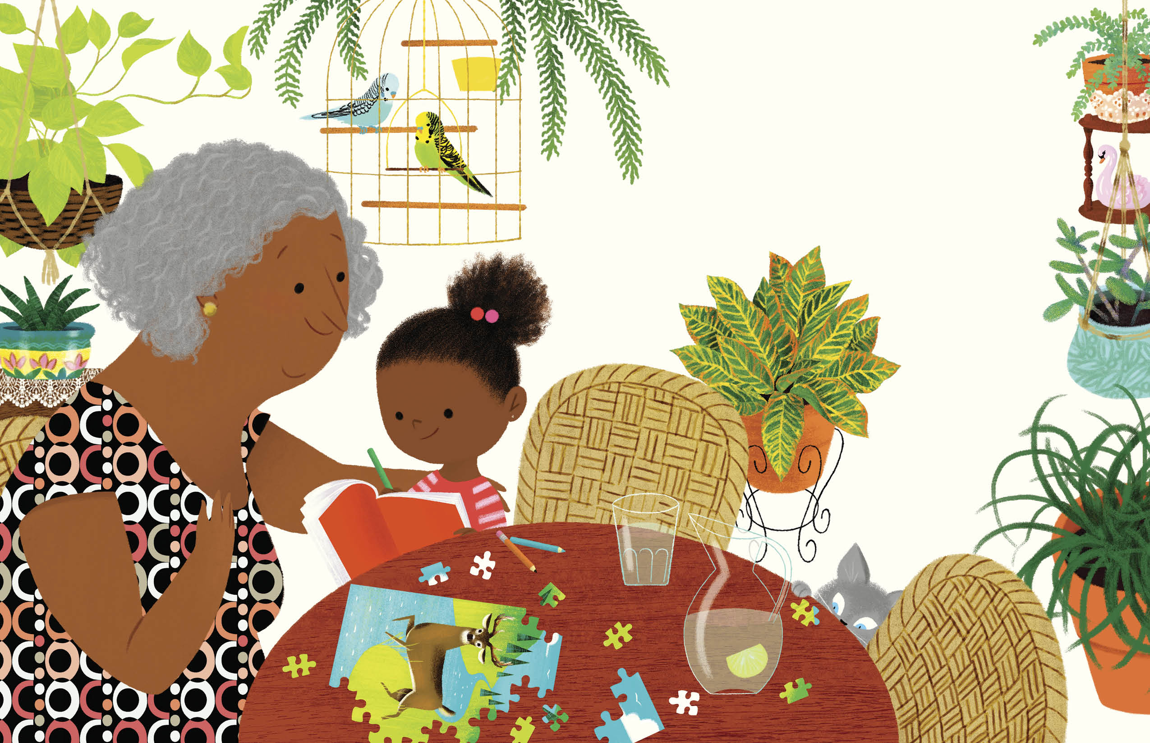
Programming
Parent education
Let’s Talk About Race
Celebrate Peace
Black Storytime
Voices of Race/Human Library
Author Events
Summer Reading
Translation services
Islandborn / by Junot Díaz ; illustrated by Leo Espinosa.
Notes:
In 2018, there was an ALSC conference, which I did not attend, but I heard about a panel there on the topic of discussing race with children. I found the presentation online and contacted one of the presenters, Kirby McCurtis from the Multunohmah Co. library in Oregon. Kirby and a colleague designed a four-week series to educate caregivers on how to talk to preschoolers about race. The series was limited to twenty families, and each week Kirby and her colleague modeled storytime practices, asked caregivers how they would respond in certain scenarios, and gave them homework. They even worked with their early childhood department to offer course credit.
When I heard about this program, I thought it sounded wonderful…AND because of where I was working at the time, the Erie Community Library, a suburban library with a very dense programming calendar and non-stop demand for children’s programming, I decided to put my own spin on Kirby’s program and invite children to attend, too. I designed the program similarly to a storytime, only with more reading and discussion/play activities. I also limited attendance to 10 families so that kids and parents could speak freely, with the goal of applying practical tools for discussing race with young children. This program was recreated by two other librarians in our district as well as our Outreach department who is partnering with county services on a series of workshops on this topic – remember, partner partner partner. We offered tips and resources, similar to what we’ve heard about today but for caregivers to apply at home.
Black Storytime
The African and African American experience comes alive for children from birth to age 6 (with a favorite adult and other family members). In a positive and affirming environment, have fun with books and stories, songs, and movement activities. Black Storytime builds language and literacy skills your child needs to be ready for kindergarten.
Voices of Race program: Coming Together is a unique project initiated ten years ago to present in depth, the special cultural diversity of our community. Originally begun in Skokie, it now consists of Skokie, Morton Grove, Lincolnwood and Niles. Its goal is to study one culture each year for six to eight weeks, with an emphasis on literacy. Each culture chooses the programs it wants to present. Almost every program is free and open to the public. Activities range from the arts, history, panel discussions on important current issues, food, movies, plays, traditions and more. Everything is done on a volunteer basis.
Explain importance of translation services
Cultural celebrations are fine, and diversity should be celebrated, but be careful to not gloss over the reasons for certain groups being in this country or other discussions of power or priviledge. So for example, we have a lot of Somoli refugees in our county, and if we were to have a Somali Day or another celebration of Somali culture, we would want to have a piece that discusses why there is a need for them to seek refuge in the United States, and even why it is important that the U.S. is a refuge for people.

Slide 17
Programming ideas
What other programming ideas have you tried, or could you envision to contribute to the conversation on race?

Slide 18
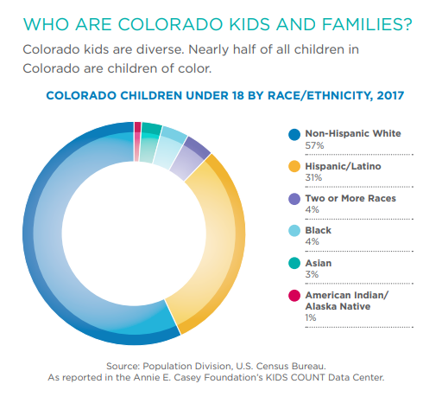
KidsCount! In Colorado
In 14 of 64 of Colorado’s counties, kids of color already make up the majority.
By 2032 children of color are predicted to be the majority among all of Colorado’s child population.
1 in 4 Colorado kids live in an immigrant family (9 out of 10 are US Citizens.)
Notes:
Finally, in wrapping up, I just want to give you a vision of what racial distribution among children looks like in Colorado. This graph comes from the KidsCount! In Colorado report, and this is the most recent data available, from 2017. It goes without saying that because our children are going to be living in a more racially diverse Colorado in the future, we need to begin their education on this topic now as early as possible. (Highlight stats on slide)
In addition to this data, according to data compiled by Colorado law enforcement in 2019, the number of hate crimes reported in Colorado between 2017 and 2018 almost doubled, from 96 to 185. The majority of the hate crimes — 112 of the 172 victims reported — involved bias against race, ethnicity or ancestry. In May 2019, the Denver Police Department created a special Bias-Motivated Investigative Unit since crimes were rising at an alarming rate.

Slide 19
Discussion
What idea(s) from today can you implement at your library?
What questions do you have?
Notes:
I’d like to conclude by asking this question: What idea from today can you implement at your library?
An educator quoted in a report in School Library Journal from October 2018 stated, “Anti-blackness is at an all-time high. And I think that however we can disturb those notions, we can remind children of color that they are beautiful and they are powerful, and we can provide literature that affirms them…That’s the work we need to do right now.” In fact, as children’s librarians, our professional organization calls us to do just that.

Slide 20
Resources
10 Tips for Reading Picture Books with Children through a Race-Conscious Lens. (2020). Retrieved 25 August 2020, from https://www.embracerace.org/resources/10-tips-for-reading-picture-books-with-children-through-a-race-conscious-lens
ALSC Core Competencies in Comics - www.alsc.ala.org/blog/2015/12/core-competencies-in-comics/
Coming Together (Project) – comingtogether.in
Derman-Sparks, L., Edwards, J. O. (2020). Anti-Bias Education for Young Children and Ourselves. United States: National Association for the Education of Young Children.
Derman-Sparks, Louise. Stages of Children’s Racial Identity Development. Retrieved 25 August 2020, from https://www.earlychildhoodwebinars.com/wp-content/uploads/2016/02/Stages-of-Childrens-Racial-Identity-Development.pdf
Embrace Race – www.embracerace.org
Guest Post: Talking to Kids About Race in Storytime and the Let's Talk About Race Tooklkit - Jbrary. (2018). Retrieved 25 August 2020, from https://jbrary.com/guest-post-talking-to-kids-about-race-in-storytime-and-the-lets-talk-about-race-tooklkit/
Guide for Selecting Anti-Bias Children's Books - Social Justice Books. (2016). Retrieved 25 August 2020, from https://socialjusticebooks.org/guide-for-selecting-anti-bias-childrens-books/
Kendi, I. X. (2020). Antiracist Baby Board Book. United States: Penguin Young Readers Group.
KidsCount in Colorado – www.coloradokids.org
Lambert, M. D. (2015). Reading Picture Books with Children: How to Shake Up Storytime and Get Kids Talking about What They See. United States: Charlesbridge.
Payne, R. G., & Ralli, J. (2018). Discussing Race with Young Kids. School Library Journal, 64(10), 22.
Racial Equity Tools – www.racialequitytools.org
Teaching for Change - www.teachingforchange.org
Teaching Young Children about Race - Social Justice Books. (2015). Retrieved 25 August 2020, from https://socialjusticebooks.org/teaching-young-children-about-race/
Tolerance.org - www.tolerance.org/classroom-resources/teaching-strategies
We Need Diverse Books – diversebooks.org

Slide 21
THANK YOU
Becki Loughlin
Library Manager
High Plains Library District
Email:
bloughlin@highplains.us

