Slide 1
Learning to Read At School and
Loving to Read at the Library
How librarians and teachers play complimentary roles in the reading lives of children
Jess Hesselberg, MLIS Teacher and Librarian jess.h.hesselberg@gmail.com

Slide 2

Learning Outcomes
How do Teachers teach reading to young children?
Why is learning to read so hard?
How do we learn to read?
What is the Colorado READ Act?
How do Librarians instill a love for reading and support reader development?
Public Libraries and Reading Instruction Similarities
What librarians do to support reading instruction?
What are decodable readers?

Slide 3
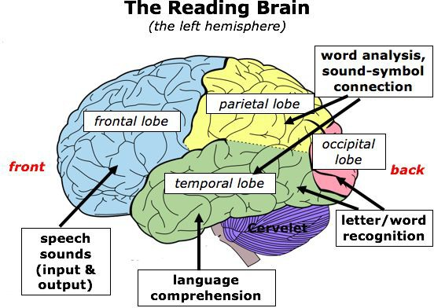
Why is learning to read so hard?
Myths About Learning to Read
Learning to read is a natural process
Skilled readers need to “guess” words
Children just need to be given enough time
Reading programs are generally successful
Video: What Science Says About Learning to Read

Slide 4
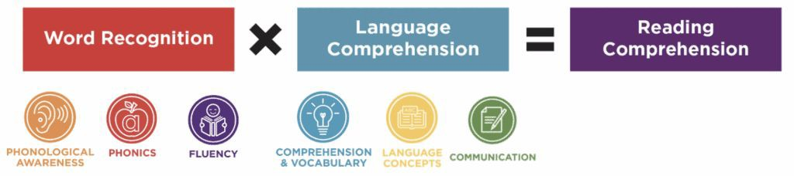
How Do We Learn to Read?
Simple View of Reading
Simple View of Reading Video

Slide 5
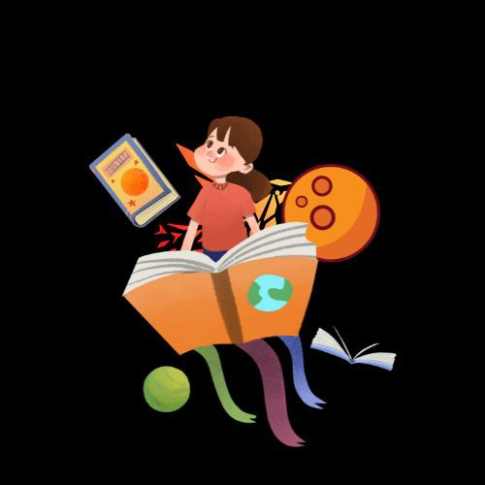
What Skills Support Reading Proﬁciency?
Research is clear about what matters to teach in early literacy instruction.
Phonological awareness
Phonics and word recognition
Fluency
Vocabulary
Oral language comprehension
Reading comprehension
The Science of Reading Explained

Slide 6

What is the Colorado READ Act?
School districts must provide evidence-based reading curriculum and instruction that is focused on
phonemic awareness; phonics
vocabulary development
reading ﬂuency, including oral skills
Text comprehension
K-3 teachers must complete training based in the science of reading.
Colorado READ Act

Slide 7
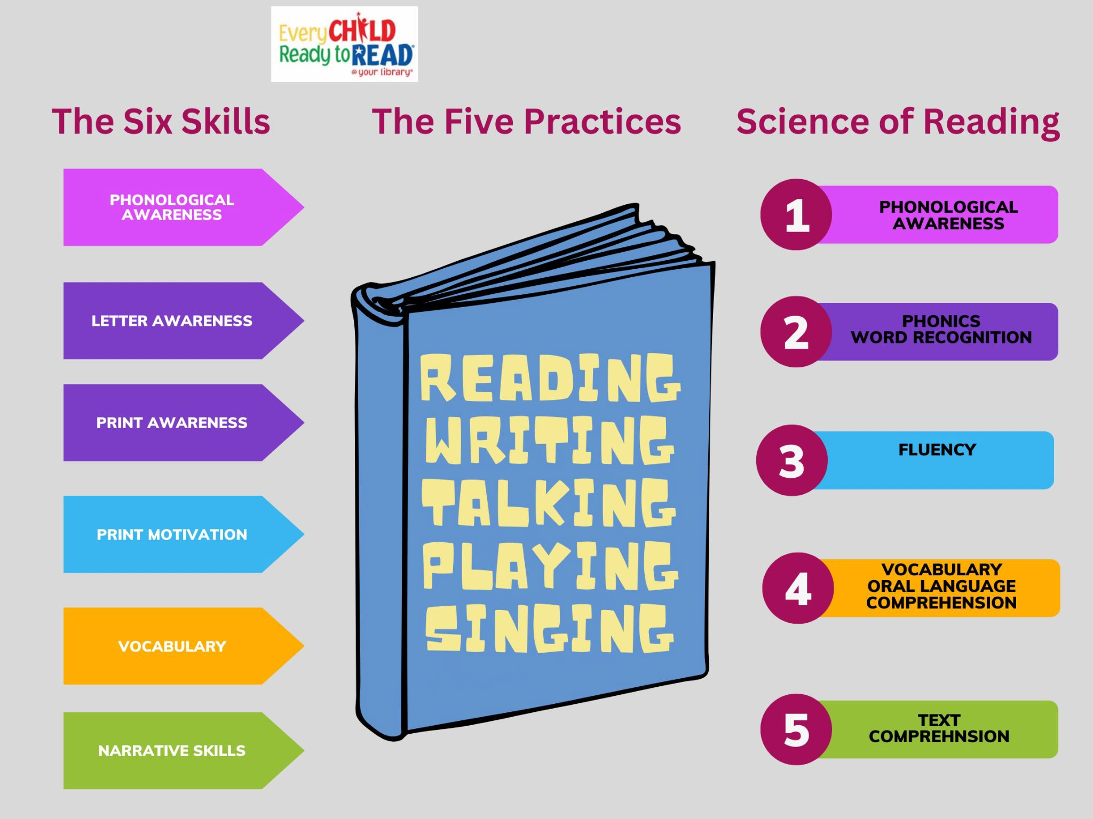
Public Libraries and Reading Instruction Similarities

Slide 8
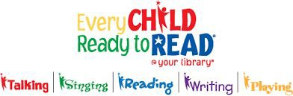
What does this mean for librarians?
Continue to focus of what you do best:
Inspire readers through storytimes, rich programming and readers advisory
Build library collections that provide for all
readers, interests and abilities
Collaborate with schools and families
Support beginning and struggling readers
Reach out to school librarians!
Communicate with district library leader
Offer to come visit schools!
Provide information on your resources
Example: ALD Outreach and Educator Support

Slide 9
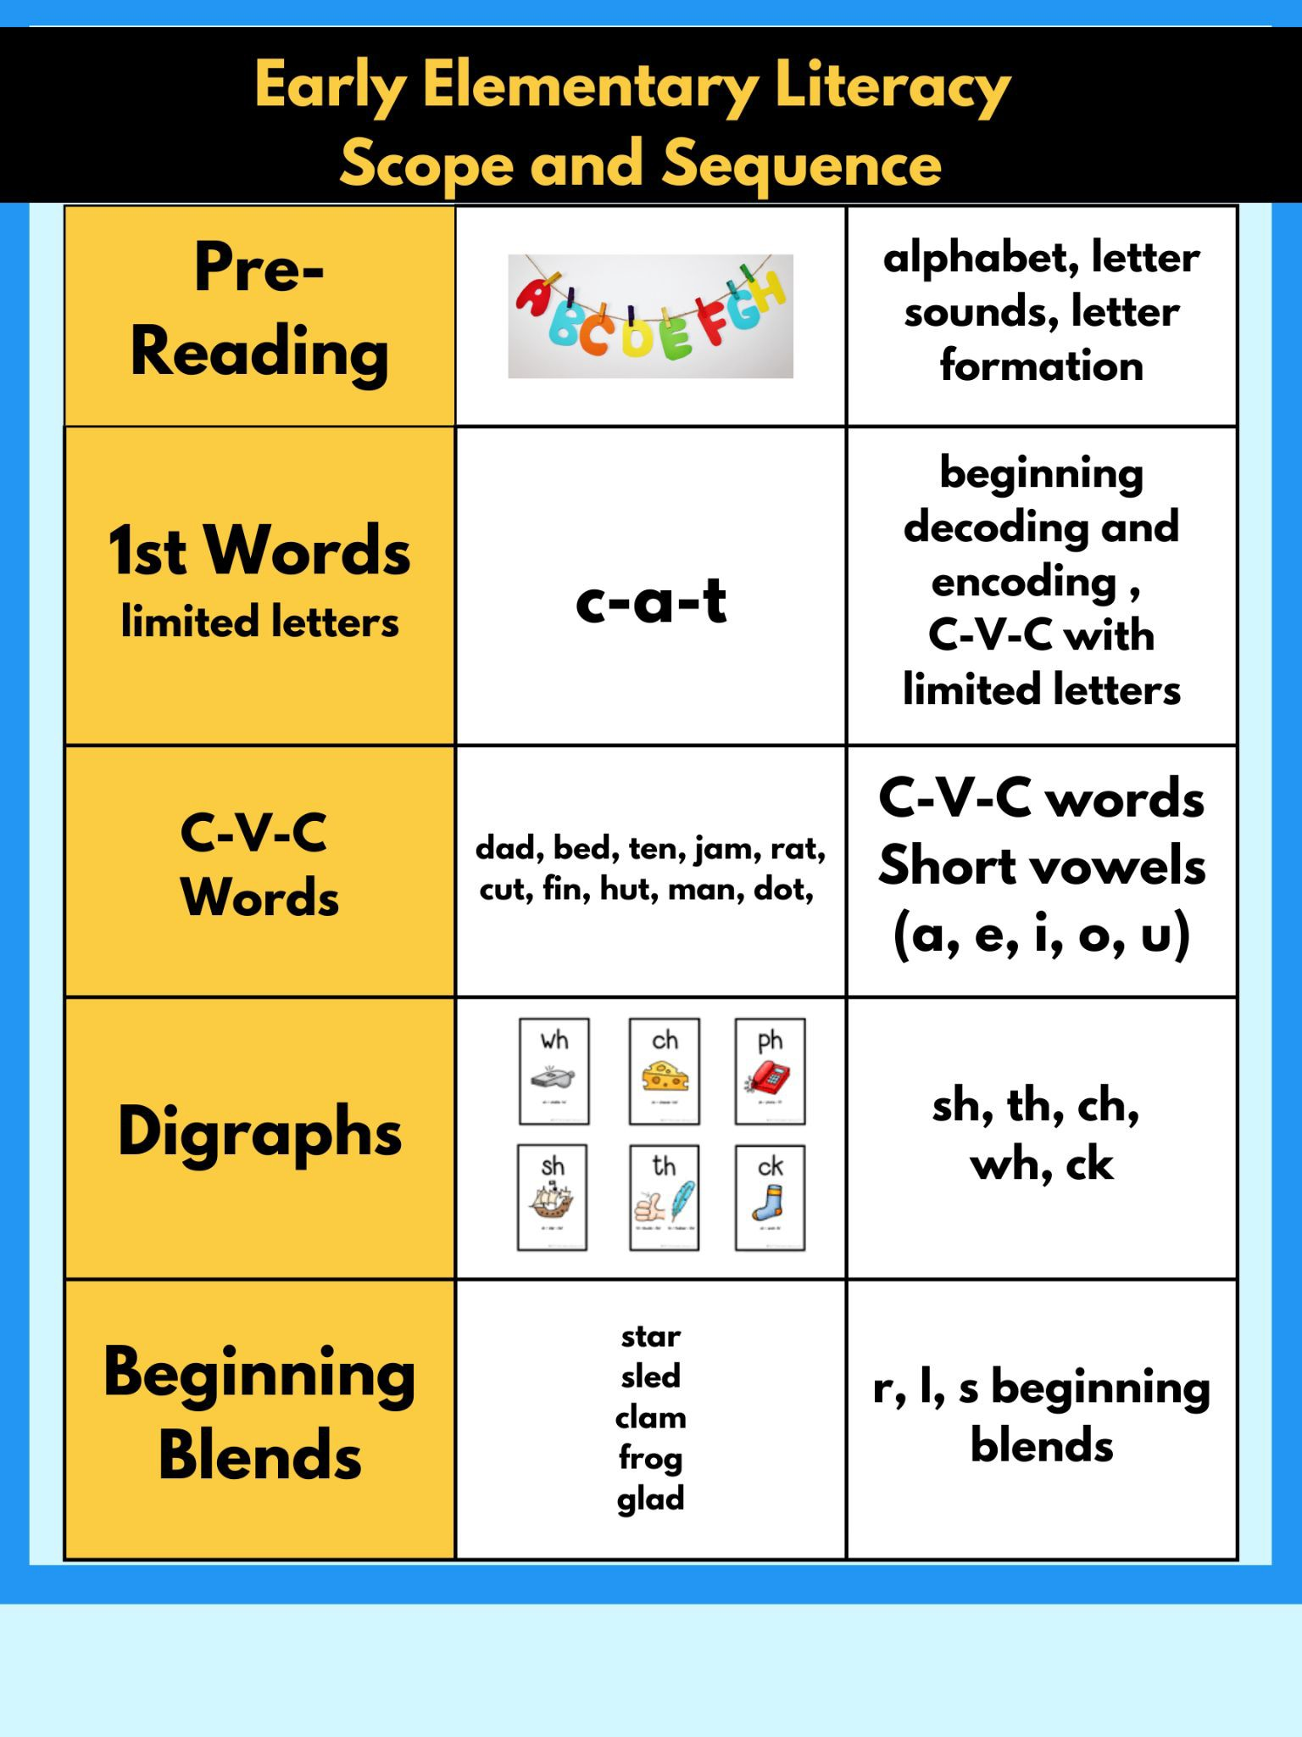
What are decodable texts?
(and are they all as awful as we think they are?)
Decodable books are texts that contain speciﬁc knowledge which students have been taught.
They can be great tools for early readers or struggling readers because the words are easier to decode and match their learning.
Decodable books consist of phonics (letter-sound code), digraphs, blends and eventually irregular, high frequency words often known as sight words, tricky words or heart words.

Slide 10
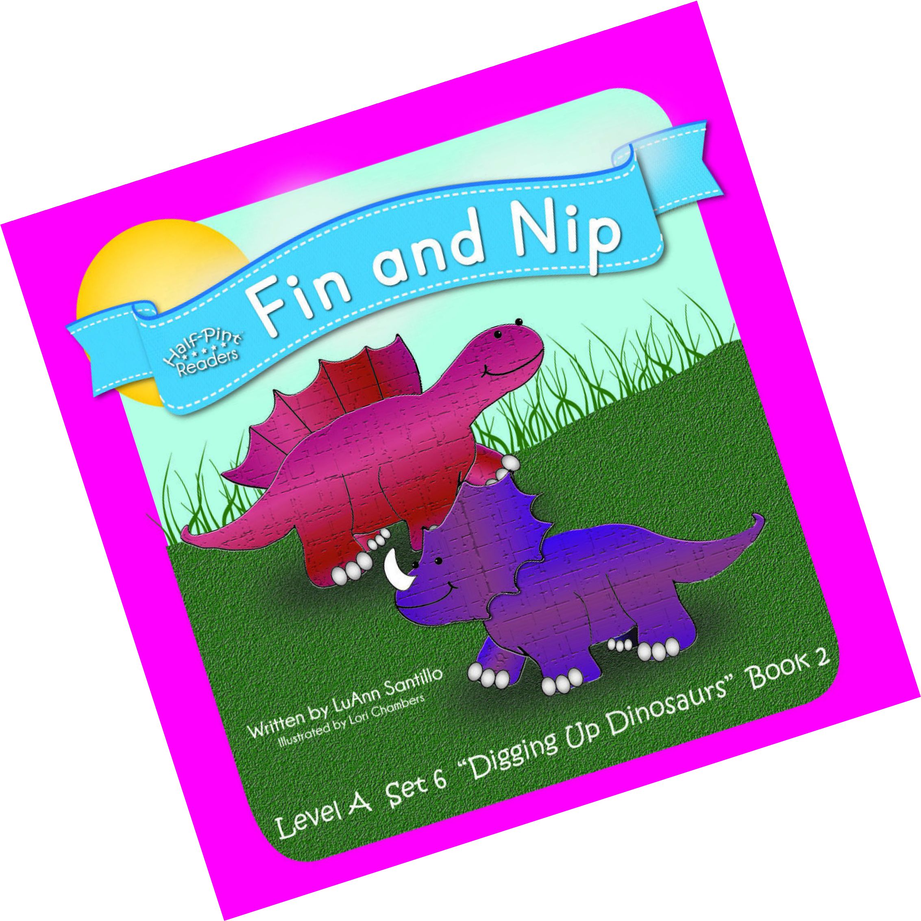
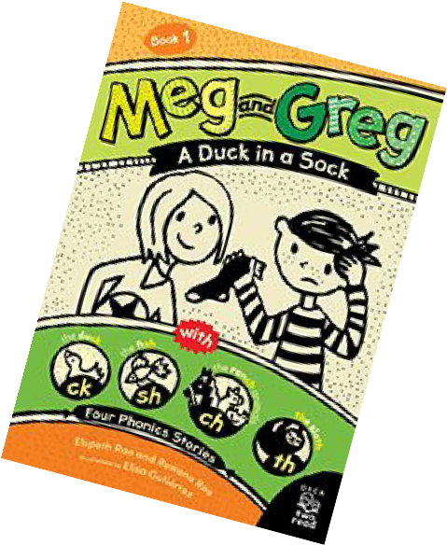
Examples of Decodable Books
Half Pint Readers:
Level A is perfect for brand new readers who are just starting to sound out words. Level B introduces blends, digraph and simple word endings. Level C features long vowel sounds and more blends and word endings
Flyleaf Decodable Books:
Higher quality in comparison to some others, and also more expensive, but a really great series of books for kids who are advancing in reading fairly quickly.
Geodes:
Mostly nonﬁction books, and really great for building knowledge and reading skills. I’ve even used these in read alouds a few times.
Toucan Series for 2-4th Graders
High quality decodable readers for older elementary students. Meg and Greg Books

Slide 11

Questions?

Slide 12
Resources and Further Learning
Ending the Reading Wars: Reading Acquisition From Novice to Expert
10 Myths About Learning to Read
Reading SOS: Expert Answers to Family Questions About Reading Libraries Build Readers and Learners ALSC Blog
Building Readers CLEL Blog
Maya’s Book Nook: Promoting Language and Literacy Skills Through Diverse Children’s Literature READ Act for Libraries
Evidence-Based Training In Teaching Reading Science of Reading Basics

Slide 13
References
Dehaene, S. (2009). Reading in the brain: The new science of how we read. New York, NY: Penguin Viking.
Wolfe, M. (2007). Proust and the squid: The story and science of the reading brain.
New York, NY: Harper Collins.

