Slide 1
Radical Cataloging:
Using Alternative Subject Headings Locally to Promote Inclusiveness and Diversity
Sol María López & Laura Wright
UNIVERSITY OF COLORADO BOULDER LIBRARIES
October 16, 2018
Notes:
Give introductions
Sol
Laura

Slide 2
Today we will…
Introduction
What is radical cataloging?
Background on “Illegal aliens”
Project description (Two universities)
Examples
Administrative decision-making
Other impacts & Implications
Q&A
Notes:
Welcome everyone!
Before we get started I want to say that we are very happy to be given an opportunity to speak to the larger library community about our topic.
Today we will be discussing what is defined as “radical cataloging”; I will provide background information on a specific subject heading for “illegal aliens” or the “i-word” and the role of the Library of Congress and other national organizations; I will talk about the specifics of our project, which has been implemented at two universities in Colorado; and I’ll go over some examples. Then, I’ll hand it over to my colleague Laura, who will talk about the administrative side of things and will discuss other impacts and implications of inclusive practices done at the local level.
**Before we begin, thanks for letting us know what type of library you work in. To get to you know you all a bit better, we have a few more questions for you.
1. Do you have experience using LOCAL subject headings?
Yes
No
2. Have you, or your organization ever discussed using non Library of Congress (non-sears – for public libraries) subject headings?
Yes
No
I don’t know

Slide 3
Radical Cataloging
“…refers to addressing the root–systemic, or structural–issues behind social problems. Radical cataloging, in this way, is not necessarily an attempt to do away with or subvert cataloging altogether, but is rather intended to address the root issues that can make access to information problematic.”
Notes:
I wanted to start by sharing one definition for “Radical cataloging” – a term I only learned about after I sought to implement this project.
The definition was borrowed from a paper titled “Radical cataloging: from words to action” (Read…”Radical cataloging….refers to addressing the root-systemic, or structural-issues behind social problems. Radical cataloging, in this way, is not necessarily an attempt to do away with or subvert cataloging altogether, but it is rather intended to address the root issues that can make access to information problematic.”
The authors go further by stating “Radical cataloging seeks to give a voice to people and concepts that are difficult to access through library subject searches.” They go on by breaking down specific areas of radical cataloging.
Lember, H., Lipkin, S., & Lee, R. J. (2013). Radical Cataloging: From words to action. Urban Library Journal, 19 (1). Retrieved from https://academicworks.cuny.edu/ulj/vol19/iss1/7

Slide 4
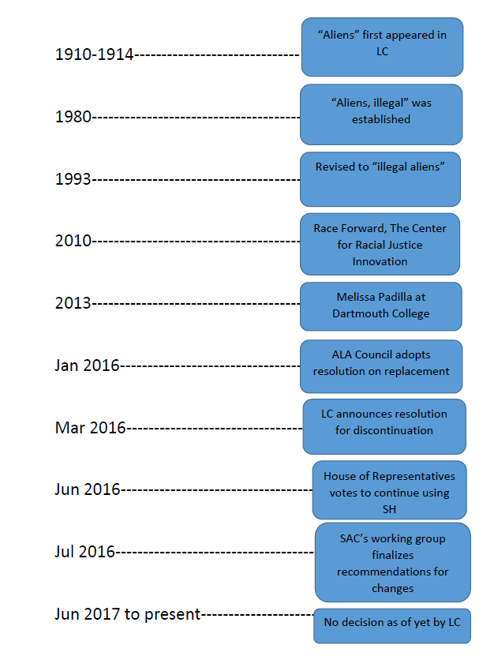
Subject Heading Timeline
Notes:
This here is a timeline on the use of the subject heading “illegal aliens” as well as some of the events that have unfolded since.
Between 1910-1914: “Aliens” appeared in the LC’s first edition of Subject Headings Used in the Dictionary Catalogues of the Library of Congress
1980: “Aliens, illegal” was established
1993: Revised to “Illegal aliens”
2010: Race Forward, The Center for Racial Justice Innovation launched the “Drop the I-word” campaign, seeking to eliminate the widespread use of the word “illegal” to refer to immigrants, a term they consider to be inhumane and derogatory
2013: Melissa Padilla and librarians at Dartmouth College worked together to petition LC to change SH. *They get all of the credit for truly and proactively fostering a diverse and inclusive environment impacting libraries.*
January 2016: At the ALA 2016 Midwinter meeting, the Cataloging and Metadata Management Group’s (CaMMS) Subject Analysis Committee voted to create a working group to review the Library of Congress Subject Heading “Illegal aliens” and report to SAC with a recommendation to change the heading, keep the heading, or establish a relationship with another heading.
March 2016: Library of Congress announces resolution for discontinuing to use “illegal alien” as a subject heading
June 2016: U.S. House of Representatives voted 237-170 to order LC to continue using the “i-word” “to duplicate the language of federal laws written by Congress”
July 2016: Report was made from the ALA/Association of Library Collections and Technical Services (ALCTS)/Subject Analysis Committee Working Group on the LCSH for “illegal aliens”, making recommendations for changes; LC posted a survey and accepted comments from the public on the proposed changes
June 2017 to present: A decision by the LC has not been made
HR 4926, also known as the Stopping Partisan Policy at the Library of Congress Act = directs the Library of Congress to retain the headings “Aliens” and “Illegal aliens,” as well as related headings. Its sponsor, Rep. Diane Black (R-TN), cited the subject heading revision as “needless policy change” that would ultimately cost taxpayers money in a statement on her website.
In addition, Sen. Ted Cruz (R-TX), Sen. Jeff Sessions (R-AL), Rep. John Culberson (R-TX), and Rep. Lamar Smith (R-TX) sent a two-page letter on May 16 to acting Librarian of Congress David Mao criticizing LC’s “misguided decision” and urging it to revoke the changes.
When I did my research, I found that what was most fascinating about these events is how college students at Dartmouth College worked together with their librarians to bring about much needed change at the national level.
Regardless of the outcome, libraries from all over had much to say about these events, and the situation was so unique in that you had government officials interfering with how the Library of Congress operates and make changes.

Slide 5
Why NOT “Illegal Aliens” ?
Notes:
“A common objection to the term "illegal aliens" is that "Use of the i-word denies due process."[i]”
“It inappropriately declares the outcome, "making a judgement when the subject had not actually been adjudicated in court."[ii]”
“Illegal alien” is a “dehumanizing, inaccurate, offensive, and inflammatory term”
[i] "Historical Background and Legal Implications." Drop the I-Word Campaign, Race Forward. Available online at: https://www.raceforward.org/sites/default/files/DTIW_HistoricalBackground.pdf
[ii] "Moving the Race Conversation Forward." Race Forward. Available online at: http://act.colorlines.com/acton/attachment/1069/f-0115/1/-/-/-/-/Racial_Discourse_Part_2.PDF
Library of Congress Drops Illegal Alien Subject Heading, Provokes Backlash Legislation, by Lisa Peet, http://lj.libraryjournal.com/2016/06/legislation/library-of-congress-drops-illegal-alien-subject-heading-provokes-backlash-legislation/#_
**Activity-Chat – Now that I’ve given you some background information, I wanted to ask you to please answer the following question in the chat section:
What are other subject headings that could be made more inclusive?
We’ll be discussing other alternative subject headings later in the presentation.

Slide 6

FOR SUPPORT>>ACRL DIVERSITY STANDARDS
Standard 1. Cultural awareness of self and others
“…appreciating the importance of multicultural identities in the lives of the people they work with and serve”
Standard 6. Language diversity
“…work to foster a climate of inclusion aimed at eliminating discrimination and oppression based on linguistic or other diversities.”
Standard 9. Cross-cultural leadership
“…creation of proactive processes that increase diversity skills; empower colleagues, co-workers, and constituents from diverse backgrounds; share information about diverse populations”
Image from www.ala.org/acrl
Notes:
Moving on, after I did my background research, I was also looking at ways to support an initiative like the one implemented.
I looked at the Association of College and Research Libraries Diversity Standards. There are a total of 11 diversity standards. I felt that these 3 encompass and strongly support a project such as this one. The standards were developed by the ACRL Racial and Ethnic Diversity Committee, emphasizing the need and obligation for academic and research libraries to serve, and advocate for, racial and ethnically diverse constituencies.
Standard 1. Cultural awareness of self and others
Librarians and library staff shall develop an understanding of their own personal and cultural values and beliefs as a first step in appreciating the importance of multicultural identities in the lives of the people they work with and serve.
Standard 6. Language diversity
Librarians and library staff shall support the preservation and promotion of linguistic diversity, and work to foster a climate of inclusion aimed at eliminating discrimination and oppression based on linguistic or other diversities.
Standard 9. Cross-cultural leadership
Library leaders shall influence, support, and encourage the creation of proactive processes that increase diversity skills; empower colleagues, co-workers, and constituents from diverse backgrounds; share information about diverse populations; and advocate for their concerns.

Slide 7
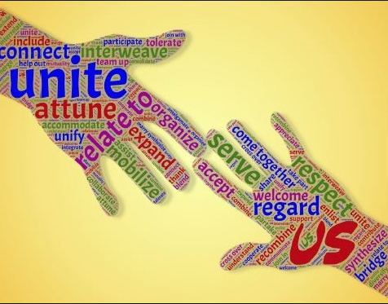
FOR SUPPORT>>CU BOULDER UNIVERSITY LIBRARIES STRATEGIC PLAN 2016-2020
Student Success Goal #4
Student Success Goal #7d
Image from http://incol.scld.org/fall-2017-workshop-developing-inclusive-and-welcoming-libraries/
Notes:
Pertaining to our implementation project at CU Boulder, I also looked at the libraries’ strategic plan.
Student Success Goal #4 states, “Augment partnerships and initiatives that foster students' engagement, belonging, and participation within campus communities.” (p. 2).
Student Success Goal #7d states, “Develop or redesign existing library spaces to foster academic success, to provide an inclusive atmosphere, and to connect users to library services and resources, through (d) - Web presence that enhances discovery, access, and usability.” (p.2).
It was very important to look at these goals, and it was very exciting to be able to tie them when the proposal was submitted for approval.
At the time I looked at how many undocumented students were in our campus, I learned that there were approximately 70, which is a large number! My colleague Laura actually found that the number is quite higher now; she’ll talk more about that shortly.

Slide 8
ADDITIONAL SUPPORT
Program for Cooperative Cataloging (PCC)
Subject Analysis Committee (SAC)
Notes:
Next, I had found additional sources for support from conference reports
Reports from Association of Library Collections and Technical Services and the Cataloging and Metatada Management Section, and the Subject Analysis Committee at the last ALA Midwinter meeting of 2018 precisely on this topic, stated the following, “A possible alternative way forward is for cataloging agencies to apply non-LCSH terminology to works about undocumented immigrants and similar concepts. Such terminology could be sanctioned by PCC or the Program for Cooperative Cataloging, the Subject Analysis Committee, or another body.” (2018 ALA Midwinter Conference Report, p.4).
And I would love to see this happen sometime soon!

Slide 9
CONT’D.
Which indexing & abstracting services use the alternative subject headings already?
ERIC
Sociological Abstracts (ProQuest)
U.S. National Library of Medicine (MeSH)
Worldwide Political Science Abstracts
Which resources use the negative LCSH terms?
Government resources
Notes:
This slide shows the academic resources that already use “undocumented immigrants”
You can see that it is government resources that still use the offensive terms

Slide 10
PROJECT DESCRIPTION
Project: Use Create Lists and Global Updates to enhance bibliographic records in Sierra at CU Boulder Libraries by adding the alternative subject headings recommended by the Subject Analysis Committee for the following Library of Congress Subject Headings. Alternative SH include:
1. Aliens >> Noncitizens 5. Illegal alien children >> Undocumented immigrant children
2. Illegal Aliens >> Undocumented immigrants 6. Illegal aliens in literature >> Undocumented immigrants in literature
3. Alien detention centers >> Immigrant detention centers 7. Women illegal aliens >> Women undocumented immigrants
4. Children of illegal aliens >> Children of undocumented immigrants
Notes:
This has the description of my proposal at CU Boulder Libraries.
My proposal asked for the ability to enhance and help with discovery and access to our collections on the topic of immigration.
The enhancement would add access by allowing the alternative subject headings to be searchable as keywords. I have an example of this later.
This slide has a list of all the alternative subject headings that were inserted in our bibliographic records.

Slide 11
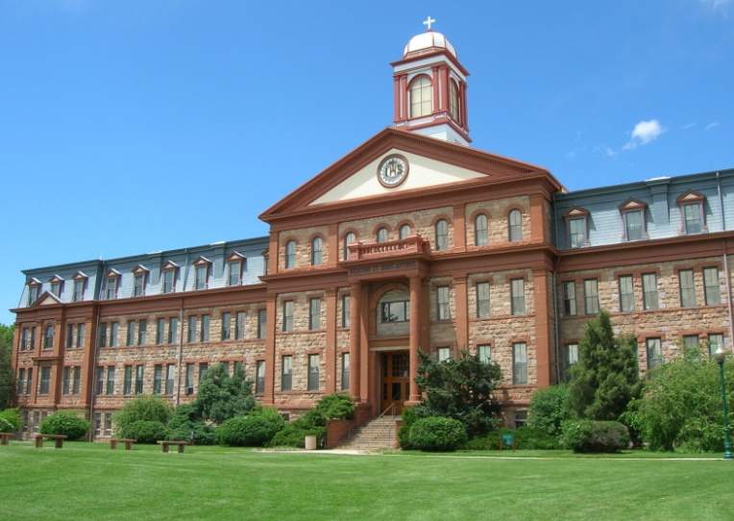
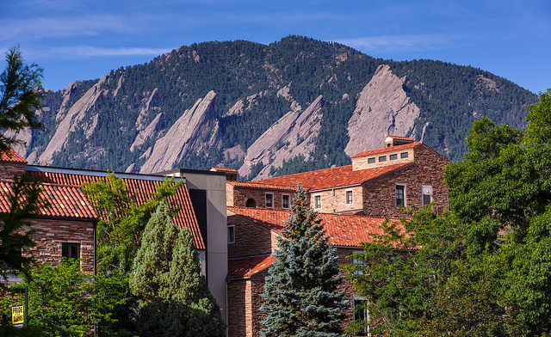
TWO ACADEMIC LIBRARIES IN COLORADO
Regis University – Dayton Memorial Library
(June 2017)
CU Boulder Libraries (June 2018)
Image from Wikimedia Commons
Image from www.learningDSLTVideo.com
Notes:
These are the two institutions where the project has been implemented, along with dates of implementation.

Slide 12
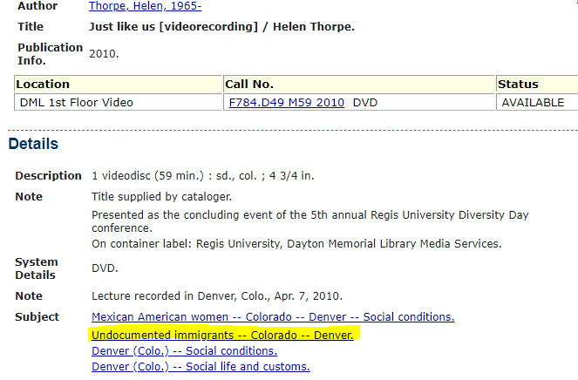
EXAMPLE (REGIS UNIVERSITY)
Notes:
While at Regis University, as a Cataloging Librarian, I used Create Lists to identify all bibliographic records with the offensive LCSH terms. I ran a separate lists for each of the 7 terms.
I then used Global Updates to delete the offensive terms, and replaced them with the alternative ones. I edited about 500 records this way.
Because I had stripped the offensive terms altogether and replaced them, I was able to keep the subdivisions. In this example, the subdivisions are “Colorado—Denver” in the same subject string.
Once a month, I ran the saved queries, to make sure I kept up with the intended changes, a process that was very fast and easy.

Slide 13
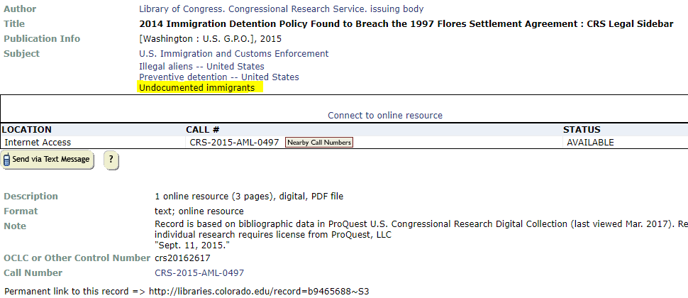
EXAMPLE (CU BOULDER)
Notes:
At CU Boulder, the project was implemented differently. Because our libraries are members of the PCC (Program for Cooperative Cataloging) library, and as participants we contribute bibliographic records to international databases, we did not eliminate the offensive subject headings. Instead, we kept them as is, but added the alternative subject headings as keywords, as shown in the example above. The added keywords provide discoverability to each of the records.
Total number of records changed: approximately 5,500 records

Slide 14
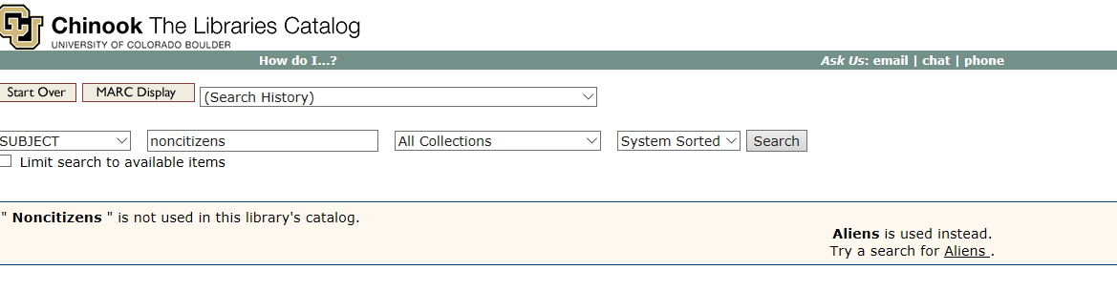
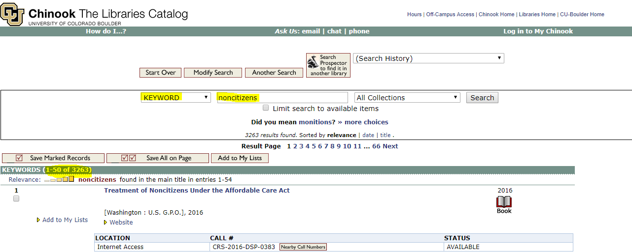
Subject Vs. Keyword searches at CU Boulder
A.
B.
Notes:
This slide has the public view of our online catalog at CU. Because the SH “Noncitizens” is only a See Reference under the authorized “illegal aliens” authority record, when searched for it as a subject term, the catalog instructs the users to search using “Aliens”
This is very problematic!
On the bottom half of the slide, you can see how our project allows users to search for “Noncitizens” as a keyword search, with over 3,000 results!
This slide has the before and after results so to speak. Seeing the results in this way, from the public view, is extremely satisfying to a cataloger, I will say!

Slide 15
How Did We Do This???
And Why???
Notes:
In summary…
*Changes were done in batches using Create Lists and Global Updates in our ILS (Sierra)
*Run Create Lists once a month to make sure changes stay consistent and that any new record entered in the system containing any of the offensive terms gets batch edited/enhanced
*So now, we’ll switch gears slightly and talk about the administrative decision making background information, which Laura will enlighten you with!

Slide 16
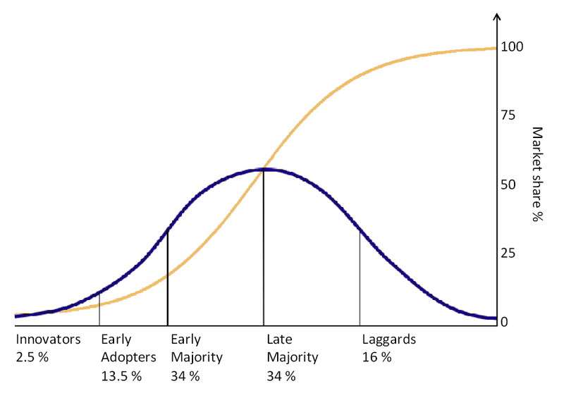
The tipping point
Image from Wikimedia, The Diffusion of Innovation
Notes:
Before Sol joined our department I had thought a lot about this issue, but I was still really considering it from a detached, theoretical perspective. I think it’s important to talk about how Sol changed my mind about appropriate responses to and actions on the issue of these subject headings not being updated by the Library of Congress.

Slide 17
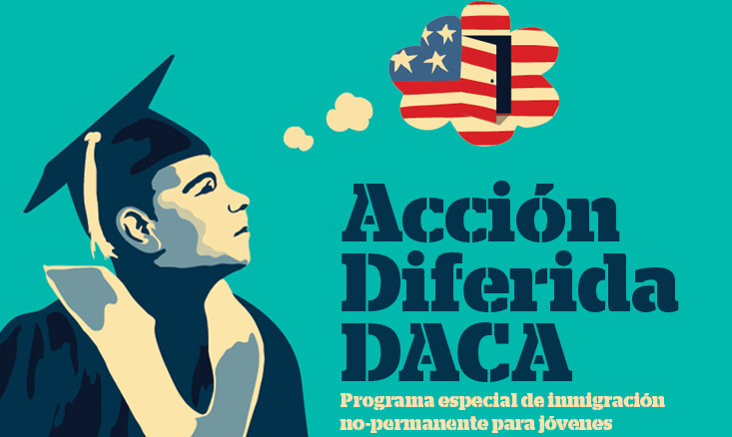
These are real people
There are more than 70 DACA students at the University of Colorado Boulder.
Notes:
I had been thinking that this change needed to happen at the national level, that is, in the Library of Congress Subject Authorities. I still think this needs to happen. But Sol’s outline of the issue made me realize I had been waiting for change to come from above. Now I think that perhaps the change needs to start with us and move up.
What really got to me was the number 70. This was the number at the time Sol made the proposal to address this issue, but according to our University’s latest reports, there are currently close to 100 DACA students at our institution. I imagined each of those students not feeling welcomed by the library and it made me want to cry. That was the moment I changed my mind. I had been focusing on the technical aspects of this problem and I am grateful to Sol for helping me see this issue from a human perspective. After all, what’s the use of being technically proficient if we don’t serve our real users’ basic needs? Those needs include feeling safe and being included in the intellectual discourse of their education.
**Activity chat: Activity Chat:
1. What challenges do you see in proposing a project like this?

Slide 18
Logistical considerations
7 million bibliographic records
Batch loading, batch updates
Ongoing maintenance
Cooperative cataloging environment
Notes:
Once I decided that we needed to actively address this, I rethought the technical and logistical issues. Our database is large, we have over 7 million bibliographic records. And we have records from a number of different sources, including many that are batch loaded and routinely batch updated. We can’t make local changes and count on them not being overwritten.
Furthermore, we are a PCC library – we participate in the BIBCO, CONSER, and NACO programs and we have to create records that meet community standards. So we can’t throw out the LCSH terms entirely (yet). But we can add alternative terms.

Slide 19
Questions to ask
Keep LCSH and add alternative terms vs Replace LCSH
Global editing capability
Ongoing maintenance
  How often
  Who is responsible
  Where is it documented
  Can it be automated
Notes:
In the next few slides, I’ll talk through each of these questions and their implications.

Slide 20

  Keep LCSH and add alternative terms?
  Replace LSCH?
Creator:Randen Pederson
Notes:
I chose this image because there is a tension between maintaining cooperative, shared standards and addressing local needs. Both are important.
The arguments in favor of keeping the LCSH terms include keeping in sync with the cooperative cataloging environment, the ability to programmatically change these once they are officially changed (I’m being optimistic), and maintaining access for those who know and use the established terminology. Additional considerations need to be given to indexing: in our system local subjects are indexed as keywords only, so there is no hyperlinked browse option in the online catalog for those. Reindexing is costly and would have other, broad impacts as well. This was one of the additional reasons we kept the official, questionable terms rather than replacing them entirely.
Another option, if you maintain a local authority file, would be to change those records so that a search, for example, for “Illegal aliens” would result in a see reference to “Undocumented immigrants.” We did not consider this solution because we outsource our authority control.
Finally, there is the possibility, depending on your discovery tools, to keep the LCSH terms in your records but display them differently to users. Kristina Spurgin at the University of North Carolina at Chapel Hill is experimenting with this. I have some hope that in the future linked data will facilitate more customizable displays, perhaps even to the point where users could choose a different “skin” that would display concepts in the terms they are most familiar or comfortable with.

Slide 21
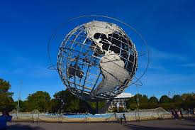

Global editing capability
Creator:MaxPixel's contributors
Credit:https://www.maxpixel.net/
Notes:
Whichever option you choose, you’ll need to come up with efficient ways to identify records that need changing and to make changes. Are records updated routinely or will only new records need to be changed? Can changes be made at point of cataloging or loading rather than afterward? The flexibility and/or limitations of the tools available to you may dictate your approach to a project or process like this.

Slide 22
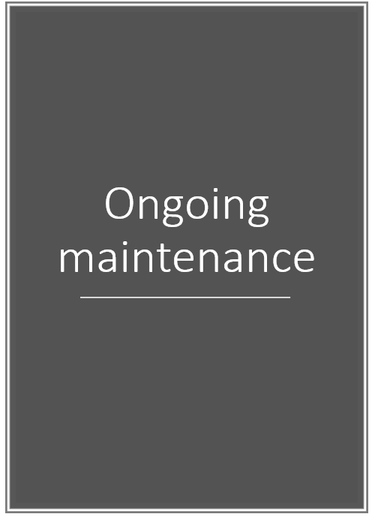

Ongoing maintenance
Notes:
Then, there’s ongoing maintenance. Once again, it’s important to consider the tools and resources you have. Who is responsible for maintaining changes like this in the catalog? How often can it be done, realistically? Where is it documented? And, can it be automated? Automation is something we are looking at, as that is the only way we could feasibly expand on efforts like this. We have approached this as a pilot project with our Libraries IT.

Slide 23

Still to do
Analyze search logs
Get feedback
Advocate for change at higher level
Reiterate – what other areas need similar attention?
Notes:
Really, we’ve only just begun.
There are many similar problems in other areas – for example subject headings such as “Problem children,” and many Indigenous names, both for places and people.
Then there are related issues, such as the mis-assignment of subjects and the subsequent acceptance of these subjects via cooperative cataloging workflows. An example of this came to our attention recently via our Music Librarian. [summarize excepts of e-mail from Music librarian below]
The record has subsequently been updated in OCLC. In our catalog, it is now classed in the MTs and the subject headings are Singing--Instruction and study, School music--Instruction and study, and Transgender students. In considering this issue, I also looked at other subjects related to transgender people and realized that currently they are segregated, like women, with terms such as “Transgender artists” and “Transgender athletes.” We still have a long way to go in combating the biases of our culture and their influence on how we describe library resources.
My current question is this: How do we balance being efficient and giving sufficient attention to individual materials?
(E-mail message)
It recently came to my attention that there are fairly widespread cataloging errors when it comes to the “Singing teacher's guide to transgender voices,” a landmark new book on vocal technique for transgender students. I brought this issue up in a cataloger’s Facebook group today, and it sparked an excellent conversation and even some private messages to me regarding the situation. On that note, I decided that it seemed right to bring this to MLA-L as well.
We are purchasing this book at both of our campuses, and were disgusted and shocked to see some of the existing catalog records available for this item. Quite a few libraries, including the Library of Congress, have cataloged this book under an RF call number (the LOC subclass for otorhinolaryngology, i.e. "the study of DISEASES of the ear nose and throat"). The subject fields it has been given in these records are: “Voice disorders -- Treatment," "Communicative disorders -- Treatment," and "Voice culture – Complications."
Regardless of how you may feel personally about transgender individuals and their rights, it is painfully obvious that this type of catalog record does a disservice to our library patrons while also grossly insulting an already marginalized group of people. This is a book of vocal pedagogy, not a tome dealing with diseases of the ear nose and throat! I do not know for certain where this cataloging originated, but its adoption by the Library of Congress causes me much pain and anger, as so many libraries look to LOC for copy-cataloging purposes, and as such, have likely copied their record verbatim. A quick perusal of WorldCat, and then the library catalogs of those who own this item showed me that these errors have persisted into many local records. While some libraries have taken it upon themselves to re-catalog the item almost entirely, there are too many others who have not done so. I am not seeking blame or derision of any individuals at LOC or elsewhere, but am simply trying to bring awareness of this issue to the community. I implore you all to please, take a look in your catalogs and, if you do own this book (which I highly recommend!), check to make sure the catalog record has been updated with less-offensive, not to mention more accurate, copy.

Slide 24
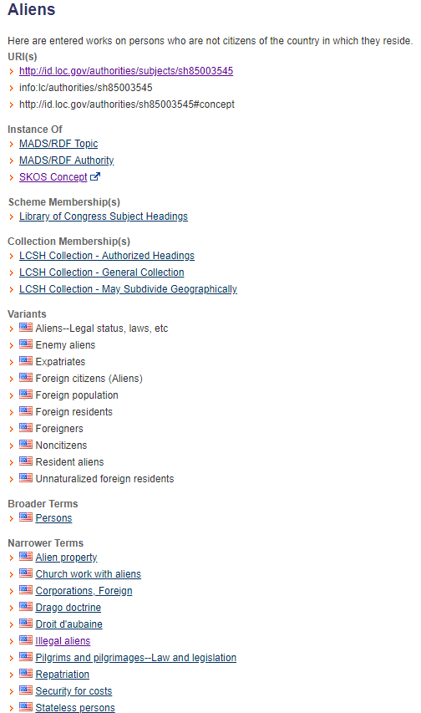

Local vs
National?
How much attention should we give to making local changes vs advocating for change at the national level?
Notes:
I don’t have the answer to this. And although this image is a bit tongue-in-cheek I hope it’s apparent that I think these issues should be taken seriously. How we describe materials impacts how and whether our users can find and use them.
Now I’ll hand it back to Sol to finish

Slide 25
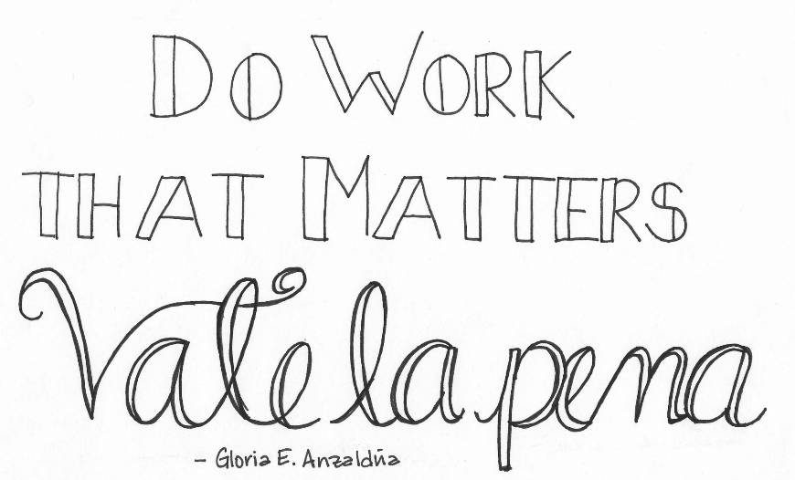
Do Work that Matters
Image from Viva La Feminista blog: http://www.vivalafeminista.com/2017/02/do-work-that-matters.html
Notes:
Thank you, Laura!
To share a concluding inspirational quote, Do Work That Matters, Vale La Pena ( or It’s Worth It) by Gloria E. Anzaldúa, a poet, writer, and scholar. The quote applies so well to this initiative.
And lastly, I know there are many libraries and librarians who deeply care about oppression and social justice issues. For me it is encouraging, and so refreshing, to see colleagues respond so positively to this and other initiatives that specifically foster diversity and inclusivity to the users we serve. I want to thank you to all who have shown your support! We are in fact, a service profession and our collective efforts are for good causes and they don’t go unnoticed!

Slide 26
REFERENCES
Annual 2016 - Report from the SAC Working Group on the LCSH “Illegal aliens” http://connect.ala.org/node/255185
CU pledges to continue admitting students 'without regard to their immigration status. (2017). http://www.dailycamera.com/cu-news/ci_31272056/university-colorado-daca-students
Dartmouth’s Evidence for Library of Congress case document http://connect.ala.org/files/ATT-5-Dartmouth-EvidenceforLibraryofCongressCase.docx
Lember, H., Lipkin, S., & Lee, R. J. (2013). Radical Cataloging: From words to action. Urban Library Journal, 19 (1). Retrieved from https://academicworks.cuny.edu/ulj/vol19/iss1/7
Library of Congress Drops Illegal Alien Subject Heading, Provokes Backlash Legislation, Lisa Peet, http://lj.libraryjournal.com/2016/06/legislation/library-of-congress-drops-illegal-alien-subject-heading-provokes-backlash-legislation/#_
Race Forward, The Center for Racial Justice Innovation https://www.raceforward.org
Report from the ALA/ALCTS/Subject Analysis Committee Working Group on the LCSH for “illegal aliens” http://connect.ala.org/node/255185
Notes:
Here are our references.

Slide 27
Thank You! ÍGracias!
Questions / Comments?
Contact information:
Sol López
Sol.lopez@Colorado.edu
Laura Wright
Laura.wright@Colorado.edu
Notes:
Thank you for attending our webinar! Thank you Christina for working with us to present today with the Colorado State Library.
We’ve included our contact information for comments or questions regarding the presentation.
**Final Activity (if there is time) – 2 chat windows
1. Who will you share this idea with at your organization?
2. What is one thing you can do to move this idea forward at your library?

