Slide 1


Colorado State Library
GRT Quick Bites
20 Minute Topics in Early Learning
A-B-Cs & 1-2-3s! Numeracy and Early Literacy
Kate Brunner

Slide 2



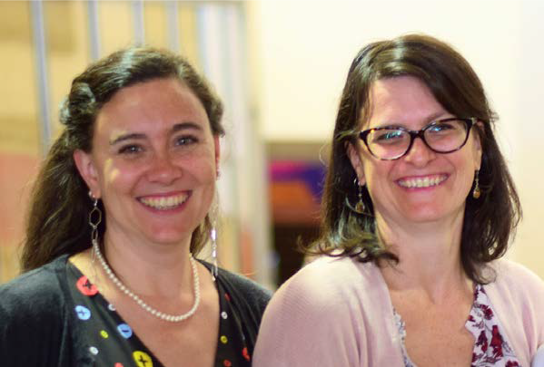


Your Colorado Early Learning Support Team
Kate Brunner Melody Garcia
Photo by N. Romano (2019)

Slide 3


Program Background & Goals
Growing Readers Together & Early Childhood in Colorado
Up to 57% of children under 6 are cared for informally by family members, friends, & neighbors (FFN caregivers)
GRT prioritizes & supports library service to FFN caregivers
GOAL: To increase FFN’s awareness of library resources and services through outreach, community partnerships, and relationship building.

Slide 4


Today, let’s explore...
Whole child early learning
The numeracy-literacy connection Early numeracy in libraries

Slide 5

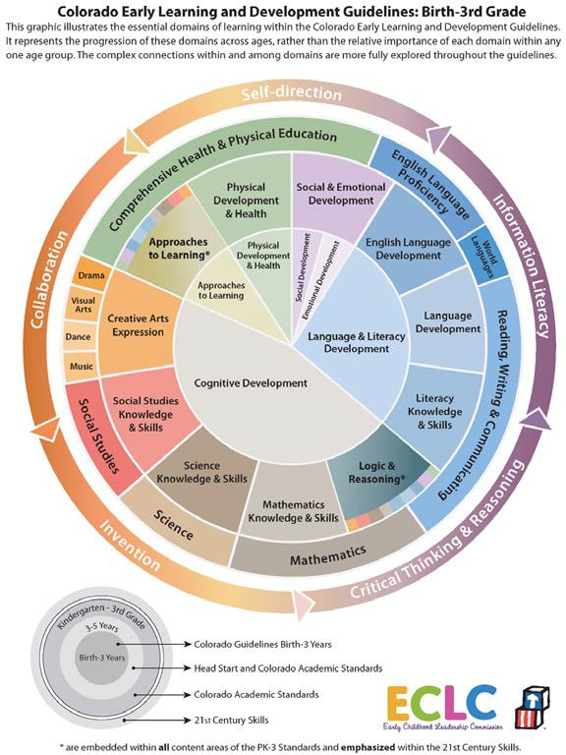
Whole Child Early Learning & Development
-Physical development & health
-Language & literacy
-Cognitive development (STEM, logic & reasoning, arts & humanities)
-Social-emotional development
-Approaches to learning
https://earlylearningco.org/guidelines/introduction/

Slide 6

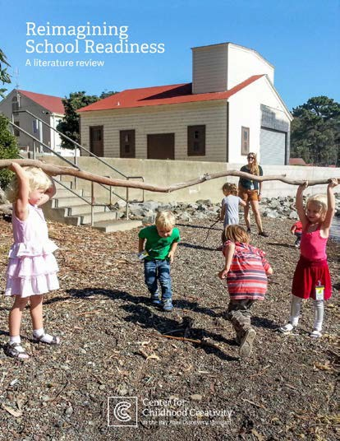
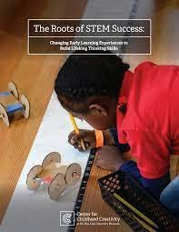



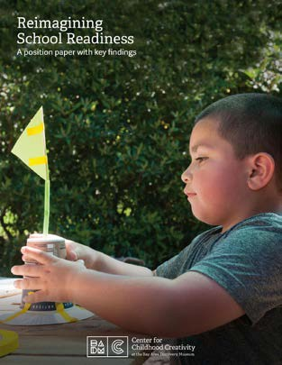
Reimagining School Readiness
Center for Childhood Creativity
at the Bay Area Discovery Museum

Slide 7

Early Numeracy
Numbers Sense & Operations - (ex. 1-to-1 correspondence, ordinality, subitizing, operational problem solving)
Geometry & Spatial Sense - (ex. shapes, directions, & relationships) Measurement - (ex. quantity, frequency, & comparison)
Patterns & Algebraic Thinking - (ex. dynamic/static patterning, prediction) Data Analysis & Classification - (ex. sorting and using information) Creativity & Reasoning - (ex. problem solving, communicating ideas)

Slide 8

Numeracy-Literacy Connections
“...there is growing evidence that both
early literacy and early numeracy skills
are strong predictors of children’s long-
term achievement (e.g., Duncan et al.,
2007; Watts, Duncan, Siegler, & Davis-
Kean, 2014), with early numeracy
emerging as the strongest predictor of
later success.”
https://www.renaissance.com/2019/08/01/blog- connections-early-literacy-numeracy-preschool/

Slide 9

Early Numeracy Environments
“An engaging and encouraging climate for children's early encounters with mathematics develops their confidence in their ability to understand and use mathematics. These positive experiences help children to develop dispositions such as curiosity, imagination, flexibility, inventiveness, and persistence, which contribute to their future success in and out of school (Clements & Conference Working Group, 2004).”
“Mathematics in Early Childhood” - National Council of Teachers of Mathematics (NCTM)

Slide 10


Early Numeracy in the Library
Use, share, and model mathematical and spatial language.
Engage inquiry-based problem solving mathematical and spatial activities.
Provide opportunities for children to explore and explain.
Model praising process and effort.

Slide 11
Additional Resources
★ CA Early Math Symposium - https://www.earlymathca.org/2021-early-math-symposium
★ BADM Reimagining School Readiness Activity Database - https://bayareadiscoverymuseum.org/school-community- programs/educator-resources/activities
★ Dr. Jo Boaler’s work - What’s Math Got to Do With It?, Mathematical Mindset, and Limitless Mind, as well as her website, https://www.youcubed.org/

Slide 12
Upcoming Learning Opportunities
★ August 18 at 11am MT
Reimagining School Readiness Training with Beth Crist & Melody Garcia - free registration required by Aug 4th
Register here: https://docs.google.com/forms/d/e/1FAIpQLScFd1J7iJZZmaAzCsBJ SeEfqNNRAzuk1gHIjmpFS3vXYl8Wiw/viewform?usp=sf_link
★ October 6th-8th
Colorado Libraries for Early Literacy Online Conference (Reimagining School Readiness preconference training Oct 6th at 12:30 MT open to all conference participants.)
For more information: https://www.clel.org/conference

Slide 13

Fall 2021 GRT Opportunities
★ Bring GRT’s Play, Learn, & Grow programming to your Colorado library - in-person or online.
★ Reach out to Kate or Melody to chat about continued development of early learning spaces, programs, services, & outreach at your library.
Kate Brunner - Western Slope: Email: brunner_k@cde.state.co.us Phone: 720.595.9248
Melody Garcia - Front Range & Eastern Plains: Email: garcia_m@cde.state.co.us
Phone: 720.355.2217

Slide 14
We Welcome Your Input!
Please complete this short feedback survey:
https://www.surveygizmo.com/s3/4404594/ GRT-Team

