Slide 1
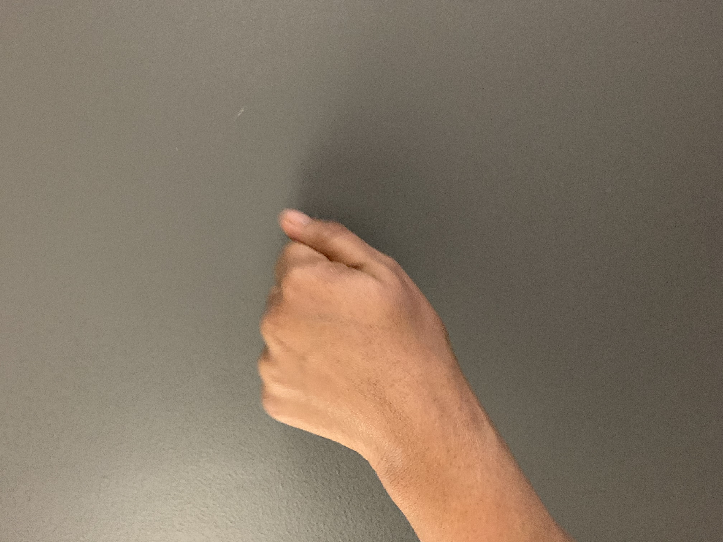
JOKES

Slide 2
WHAT MADE YOU JOIN THIS SESSION ON PLAY?
Sometimes I’m a grump - I need to be more playful at work.
I’m a clown at work but really, I get a TON of work done. How can I be valued for my humorous ways?
I’m a skeptic about play at work. Work should be serious.
Other (please share in the chat area)

Slide 3
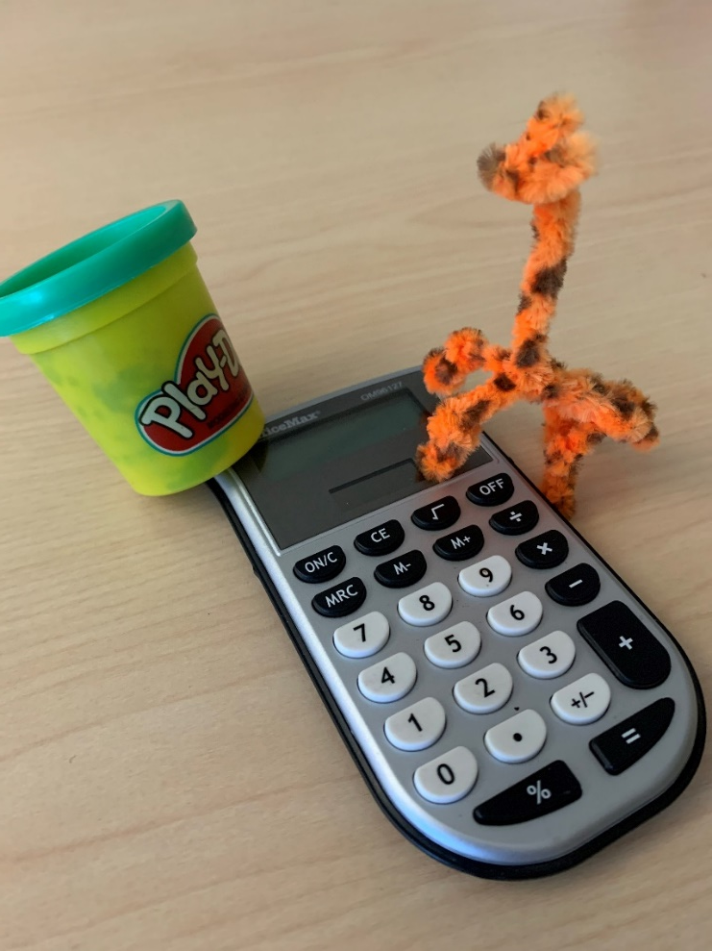
TODAY’S OBJECTIVES
Greater understanding of play & the benefits of play at work.
Clarity on your play personality.
Plan for adding more play into your work.

Slide 4
AGENDA
Define
Play
Benefits of Play
Intro
Your Play Style
Play with Others
Play at Work

Slide 5
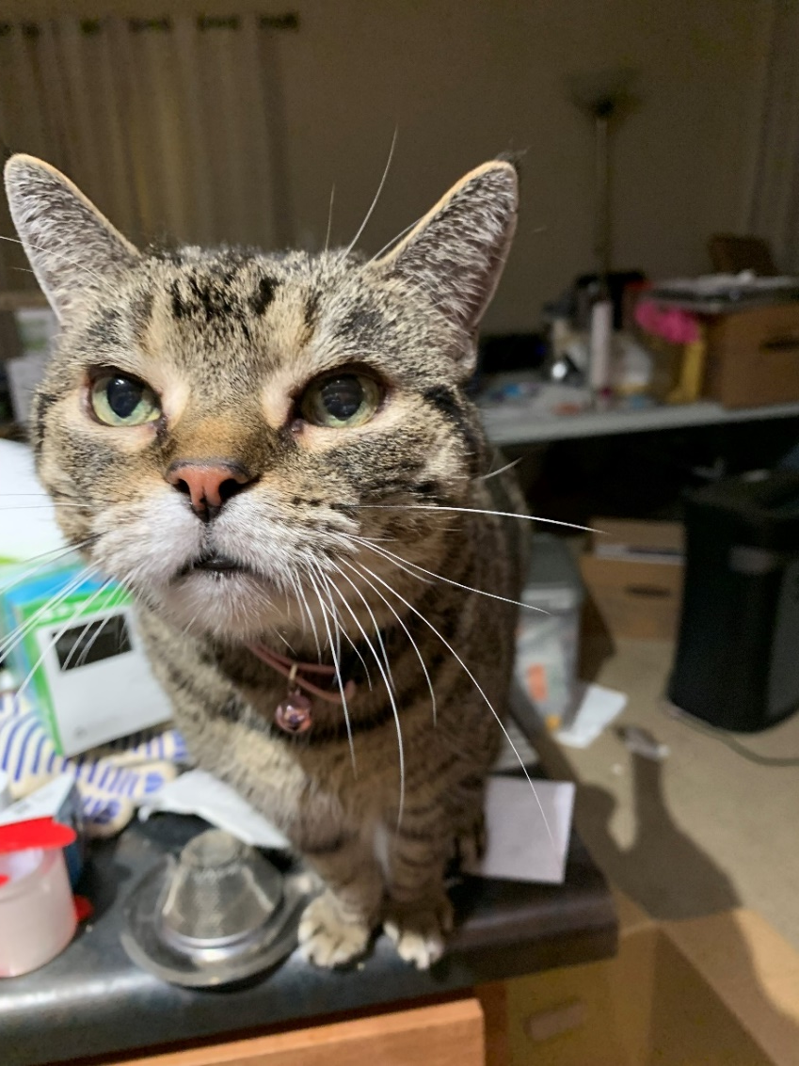
ACTIVITIES – BE CURIOUS

Slide 6
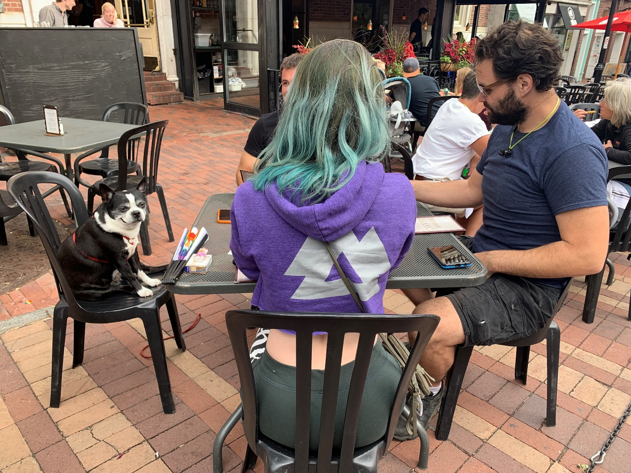
ACTIVITIES – JOIN IN!

Slide 7

PLAY PATCH #1 – COLLECT ALL SIX!

Slide 8
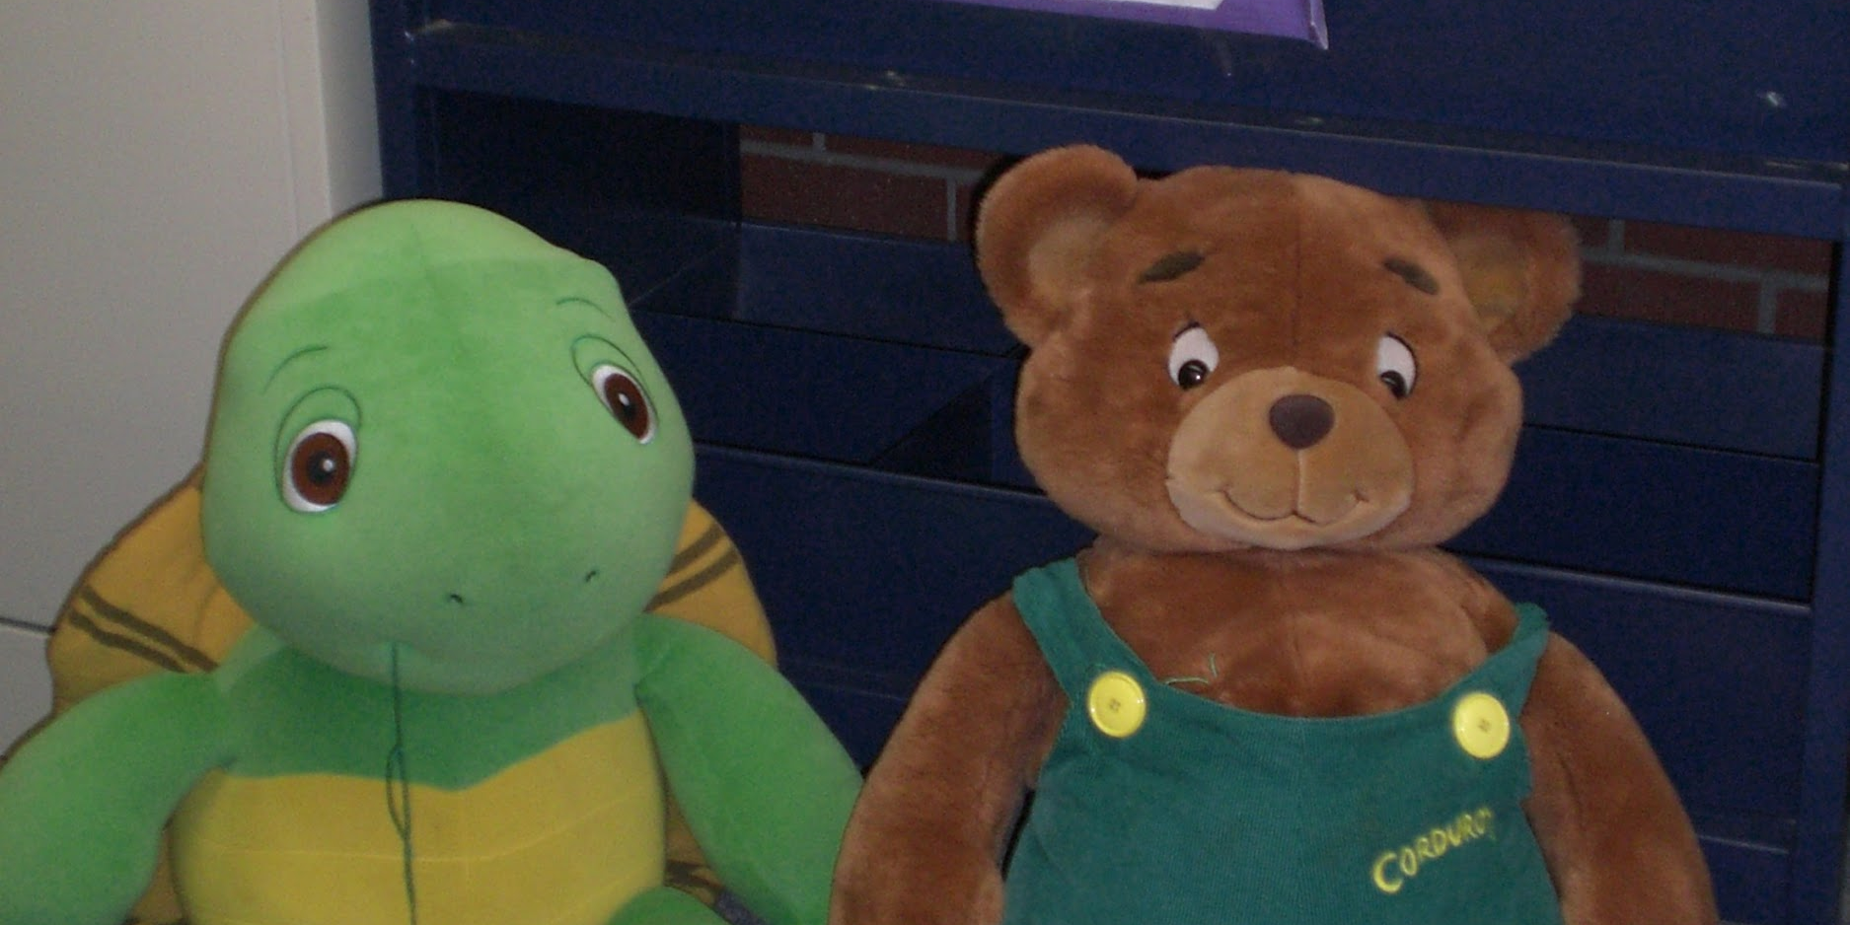
AS A CHILD, HOW DID YOU PLAY? WHAT DID IT FEEL LIKE?
Please used the chat area to share your early experience with how it felt to play.

Slide 9
DEFINING PLAY
Purposeless Intrinsically motivated All-consuming
Nonliteral (involves pretense) Active (not passive)
Fun Engaging Self-chosen Self-directed
Imaginative Requires attention Non-stressed frame of mind
Freeing (unimpeded movement) Arouses friendly feelings
Increases joy Absent of serious, practical or harmful intent
Spontaneous activity
Aimless Whimsical For enjoyment and recreation

Slide 10
THE OPPOSITE OF PLAY IS NOT WORK, IT’S DEPRESSION – BRIAN SUTTON-SMITH
  Purposeless Intrinsically motivated All-consuming
Nonliteral (involves pretense) Active (not passive)
Fun Engaging Self-chosen Self-directed
Imaginative Requires attention Non-stressed frame of mind
Freeing (unimpeded movement) Arouses friendly feelings
Increases joy Absent of serious, practical or harmful intent
Spontaneous activity
Aimless Whimsical For enjoyment and recreation

Slide 11
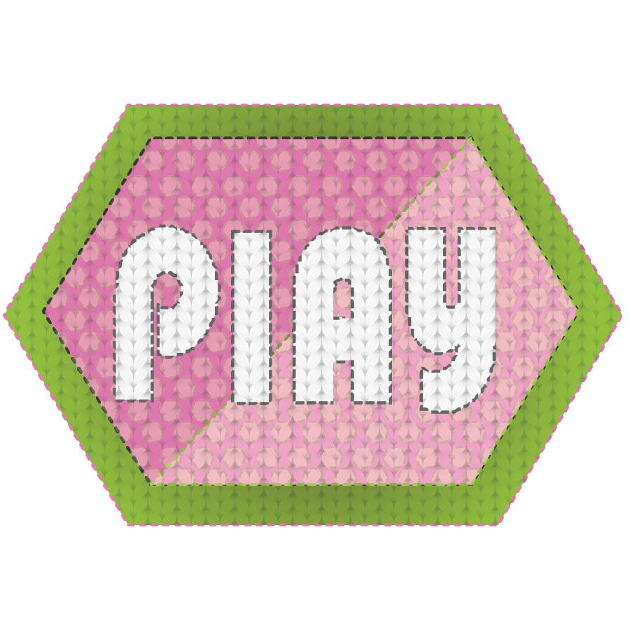
PLAY PATCH #2

Slide 12
BENEFITS OF PLAY – STUART BROWN
Better work relationships
Increases productivity
Reduction in stress
Skill development
More creative
Increases intelligence
More adaptable
Notes:
KH

Slide 13

PLAY PATCH #3

Slide 14
Draw a Library
Notes:
KH

Slide 15
WHAT DID YOU THINK?
Fun! Collaborative!
Would rather draw on my own.
Not Fun. Frustrating.
Notes:
Activity Whiteboard

Slide 16
PLAY
TYPES
Joker Jokes, humorous remarks, puns, hilarious stories, nonsense, practical jokes | Kinesthete Movement, dance, active sports (not to win), yoga, physical play | Explorer Venture to the unknown, new things or ideas, visit new places
Competitor Being your best, like specific rules and clear winners, keeping score | Director Natural organizer, fun in planning and executing events, being in control, work magic | Collector Collect the most, rarest, best, of things that interest you, things or places
Creator/Artist Making something out of nothing, doodling, process rather than results, make or fix things | Storyteller Imaginative, creating stories to tell or show, make things interesting through story | Other (Your examples)

Slide 17
PLAY
P
E
R
S
O
N
A
L
I
T
Y
Joker Jokes, humorous remarks, puns, hilarious stories, nonsense, practical jokes | Movement, dance, active sports (not to win), yoga, physical play | Explorer Venture to the unknown, new things or ideas, visit new places
Competitor Being your best, like specific rules and clear winners, keeping score | Director Natural organizer, fun in planning and executing events, being in control, work magic | Collector Collect the most, rarest, best, of things that interest you, things or places
Creator/Artist Making something out of nothing, doodling, process rather than results, make or fix things | Storyteller Imaginative, creating stories to tell or show, make things interesting through story | Other (Your examples)

Slide 18
PLAY
TYPES
Joker Jokes, humorous remarks, puns, hilarious stories, nonsense, practical jokes | Kinesthete Movement, dance, active sports (not to win), yoga, physical play | Explorer Venture to the unknown, new things or ideas, visit new places
Competitor Being your best, like specific rules and clear winners, keeping score | Director Natural organizer, fun in planning and executing events, being in control, work magic | Collector Collect the most, rarest, best, of things that interest you, things or places
Creator/Artist Making something out of nothing, doodling, process rather than results, make or fix things | Storyteller Imaginative, creating stories to tell or show, make things interesting through story | Other (Your examples)
Notes:
White board activity here

Slide 19

PLAY PATCH #4

Slide 20
PLAY AT WORK

Slide 21
PLAYTIME!
Its Monday morning, and you know you are going to be on the desk most of the day. How can you incorporate play into the day?
Now, it is Wed. afternoon, and you are dragging a bit. You have a meeting this afternoon. How can you incorporate play?
It is the eleventy millionth day of a global pandemic, how are you…or can you incorporate play into your day or life?

Slide 22

PLAY PATCH #5

Slide 23
YOUR TURN – MEETING, PROJECT, ETC.
Benefit You Want
Better work relationships
Increased productivity
Reduction in stress
Skill development
More creative
Increases intelligence
More adaptable
Your Play Style
Your Ideas for Play
(Remember others’ play styles too)

Slide 24
TEAM PLAY
Pick one!
Your Play Style as Part of a Team
Your Ideas for Play for Teamwork
(Remember others’ play styles too)
Benefit You Want
Better work relationships
Increased productivity
Reduction in stress
Skill development
More creative
Increases intelligence
More adaptable

Slide 25
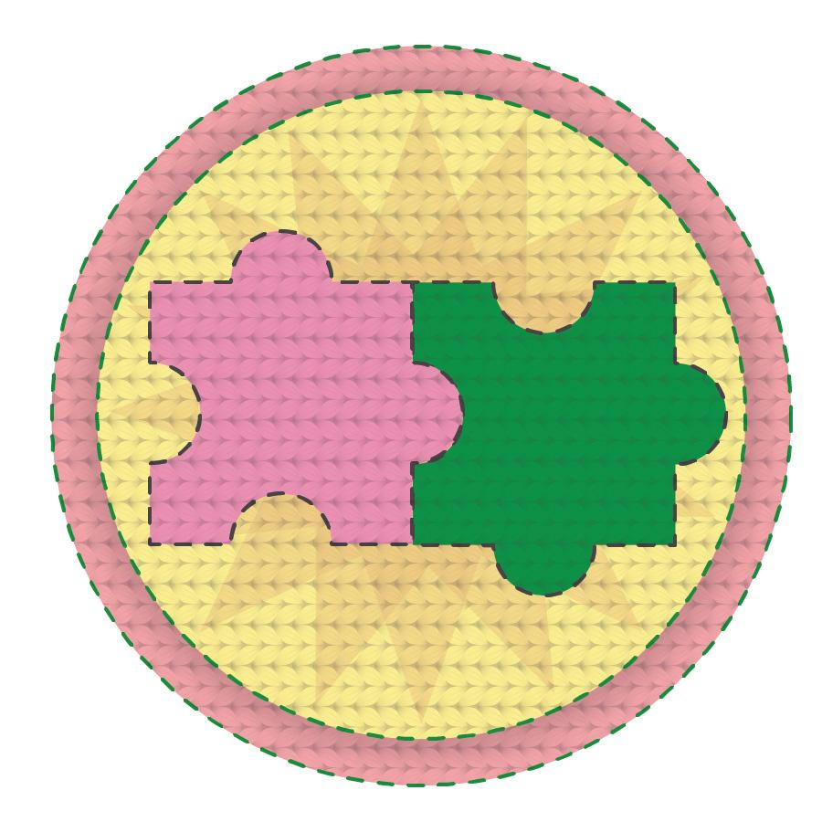
PLAY PATCH #6
Notes:
CK

Slide 26
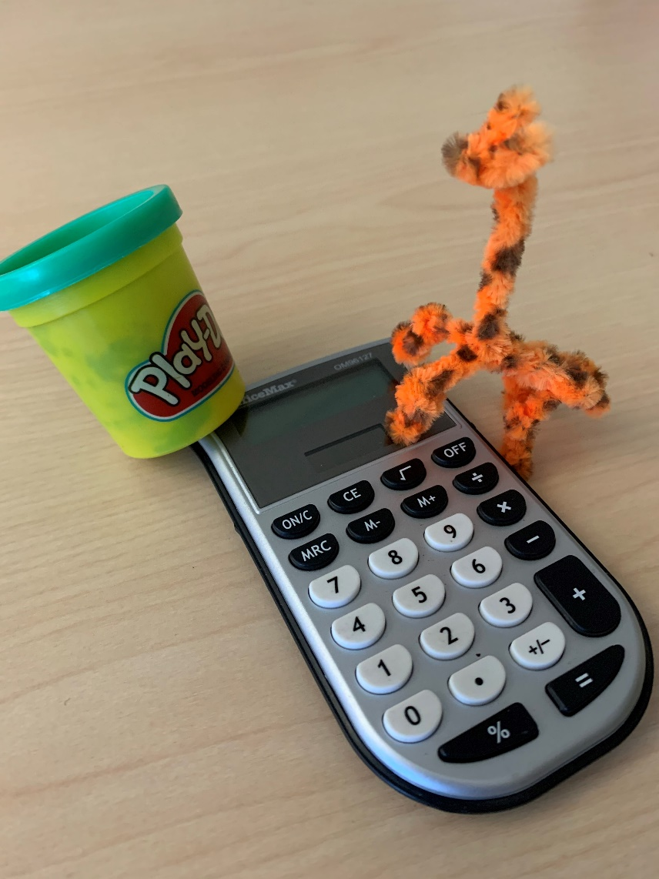
TODAY’S OBJECTIVES - Review
Greater understanding of play & the benefits of play at work.
Clarity on your play personality.
Plan for adding more play into your work.
Notes:
Kieran

Slide 27
ONE WORD TO DESCRIBE HOW
YOU FEEL AFTER THIS SESSION
Notes:
Kieran

Slide 28
Thanks for Playing with Us
Questions?
Kieran Hixon - hixon_k@cde.state.co.us
Sharon Morris - morris_s@cde.state.co.us
Christine Kreger - kreger_c@cde.state.co.us

