Slide 1

Partnerships with correctional libraries
CSL in Session – March 6, 2018
Notes:
EB
Welcome! The goal of this CSL in Session is to put ideas in your minds about serving the incarcerated.
We’re going to cover:
The correctional environment
Reasons and methods for partnering with libraries in correctional facilities
Concerns and obstacles you might face
Rewards of partnering

Slide 2

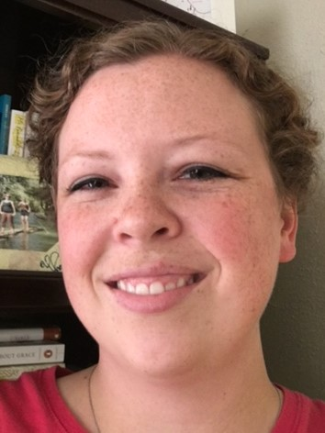
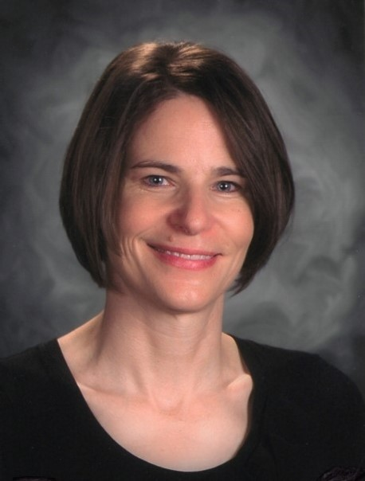
Presenters: Institutional Library Development
Erin Boyington
Teresa Allen
Notes:
We’ll each introduce ourselves
Erin Boyington, Adult Institutions Senior Consultant for the Colorado State Library. I work with incarcerated adults throughout the state. Before coming to the Colorado State Library, I was the library manager for the Sterling Correctional Facility Libraries.
Teresa Allen, Youth Institutions Consultant for Institutional Library Development. I do the same thing as Erin but for youth populations. Before coming to the Colorado State Library, I worked as a school librarian before that I taught middle school language arts and high school English to teen felons (similar behaviors!) I’ve also volunteered at the Denver Public Library’s Community Technology Center at the Central downtown branch.
Our experience is with state-owned, state-operated correctional facilities, but many of the things we talk about today can be applied to other secure settings like city and county jails or residential treatment centers in your area.

Slide 3
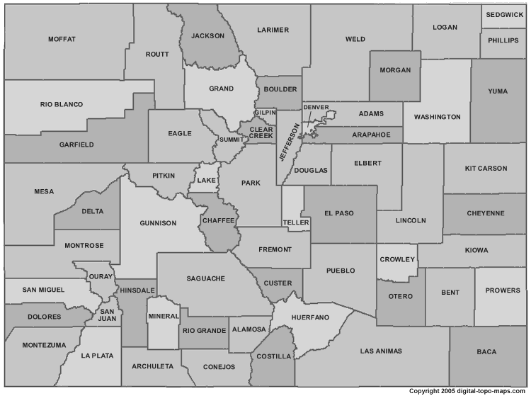
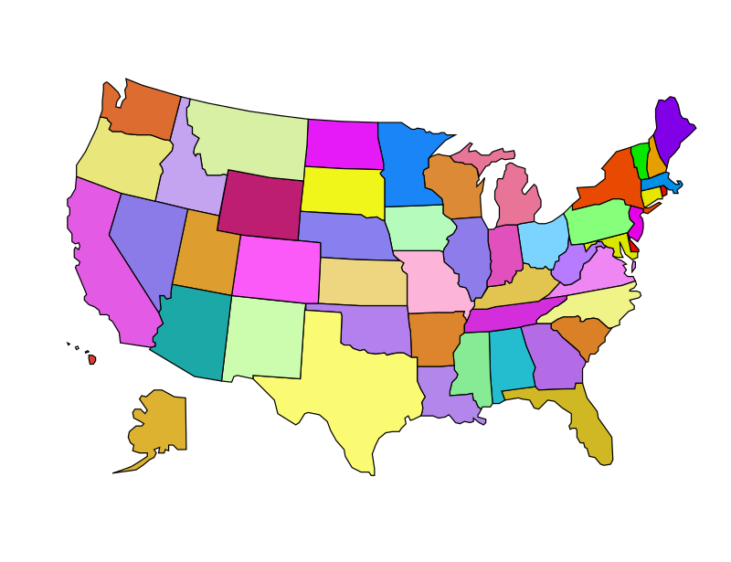
You! – 1) Mark your location on a map below. 2) Type into chat what type of library you work in.
Colorado
Elsewhere?
Notes:
TA
Now we’d like to learn a little bit about you.
Mark your location with a dot.
Type into chat what type of library you work in.
We can comment on any patterns or observations.

Slide 4

Corrections 101
Type in the chat box words that come to your mind when you think of prison.
Notes:
EB –
Ask: Type in the chat box words that come to your mind when you think of prison. Mention “stress” and “boredom” if they don’t.
The terms “jail” and “prison” are often used interchangeably, but they mean very different things depending on what state you’re in. Be aware that each type of institution has a different government oversight (county, state, federal), and may have very different security requirements and population profiles. You may also have private institutions close by, which have contracts. For today’s session, we’ll use the term “facility” to refer to all of these types of places that incarcerate people.
Chances are that you’ve met people on parole in your libraries now. Not everyone who is convicted and released then goes on to parole, but many remain under some type of supervision after release.
I would say that a primary problem of being incarcerated from the offender’s standpoint is simply being bored. There are few chances to improve as a person, to learn and grow. This is where libraries come in!

Slide 5
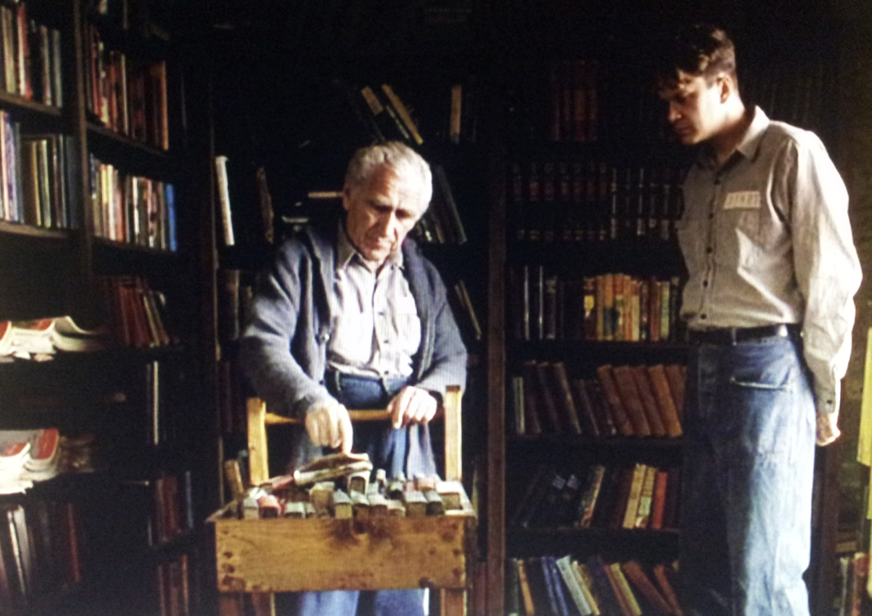
Libraries in correctional facilities – Example #2
Notes:
EB
Image: The Shawshank Redemption library
Your idea of prison may come exclusively from the movies. They may get some details right, but each facility is as different as one library is different from another.

Slide 6
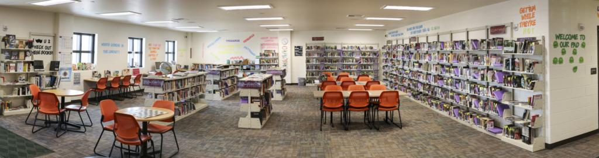
Libraries in correctional facilities – Example #1
Notes:
EB
For example, here is a photo of the Youthful Offender Services Library in Pueblo, Colorado. This is the newest-constructed library in CDOC. Colorado’s correctional libraries have the benefit of budgets, which means they receive new materials as well as donated ones. They can be the most welcoming place in the entire facility. I’ve had patrons tell me they come to the library because it’s the only place they can feel normal, and it’s often a peaceful haven.
Staffing varies by state, but Colorado mostly employs paraprofessionals to do the work at the state prisons. There are only four professional librarian positions in CDOC statewide, and they all manage multiple libraries.
Our paraprofessional staff have a wide range of experience and training
They are incredibly busy with day-to-day library tasks, as well as tasks required by their institutions. Searching books, supervising offenders, etc. “Other duties as assigned” might mean making sandwiches in the kitchen during a lockdown, or searching shelves for contraband.

Slide 7

Why partner?
97% will be released
Notes:
TA
Why create partnerships with these facilities?
You’ve already got so much to do! These are criminals! Why spend your time and energy helping them?
We’re guessing that if you are here, you are a part of “the choir,” and we don’t need to preach to you, but you may need to explain to other people why we should support the incarcerated.
Here are some reasons to support those who are incarcerated:
97%: Most people in prison have less than two year sentences and 95-97% will get out. These are your future patrons (and neighbors), and we want them to be the best citizens they can be. The small percentage who will NOT get out need our support, too.
Our country locks up A LOT of people, and most are from populations that are already disadvantaged. In Colorado, approximately 800 men and women are released monthly from these facilities with a majority returning to the Denver metro area. Of these 800, 150 release into homelessness. Often, they lack significant family support or personal resources to provide for basic needs. Many have struggled with troubled or abusive childhoods, poor education, and mental health or substance abuse issues. The majority are economically disadvantaged upon release. They yearn for self-sufficiency and self-respect, while endeavoring to live as productive citizens.
$: In 2016, almost 23,000 men and women were incarcerated in Colorado State correctional facilities at an average cost to taxpayers of close to $36,000 per person per year.
Over half recidivate (or return to prison) within five years, again costing more taxpayer dollars.
If offenders become less likely to recidivate, they will be less of a financial burden on society.
So how do we reduce recidivism? Improve their chances for successful reentry to their communities.

Slide 8

Reentry
Returning to the community from jail or prison
Notes:
EB – Define reentry.
“A broad term that refers to the issues related to the transition of ex-offenders from incarceration to community. Reentry specifically involves using programs that promote the effective reintegration of ex-offenders into communities when they are released from prison and jail.”
National Crime Prevention Council
“Returning to the community from jail or prison is a complex transition for most offenders, as well as for their families and communities. Upon reentering society, former offenders are likely to struggle with substance abuse, lack of adequate education and job skills, limited housing options, and mental health issues.”
National Institute of Justice
I’ve heard reentry from prison compared to shuttle reentry from orbit, and I think it’s an apt image. Both can be jarring, fearful, and dangerous. And unlike astronauts, ex-offenders may have little help or training before launch.

Slide 9















Reentry needs
Notes:
TA – You got it! You covered many of the reentry needs faced by the formerly incarcerated.
Pretend for a moment that you were recently released from prison after being locked up, say, 8 years (since 2010). What are you going to have to figure out in the first couple of weeks after release?
Identification– A current state-issued ID is essential for adulting, but that might be a problem if you’ve been locked up (? Mention DOC initiative to release all offenders with w state-issued IDs?)
Housing – As we in the Denver metro area know, it’s hard to find affordable housing, even w/o a criminal background.
Family – Not everyone gets visited in prison, and you may have to work hard to reestablish or repair connections with family members.
Work – If you have a felony record, meaningful, well-paid jobs are especially challenging to find. Ex-offenders are more likely to end up in labor-intensive, blue collar jobs – if they can find a job at all.
Transportation – Do you have money saved to buy a car? If not, can you afford public transportation? Can you even understand a bus schedule?
Food – Can you afford food? Do you know how to eat healthfully?
Clothing – Even if you have clothing, do you have a place to launder it?
Health care – Many offenders need prescriptions upon release. In that case, you need to find (and get to) a health care practitioner. Then you need to fill (and pay for) your prescriptions, which may or may not be in the same location as your health care practitioner.
These are the same kinds of problems many of your public library patrons face, right?
Money management skills – If you’ve been locked up, you may not have a bank account when you get out. What if your new employer offers direct deposit only? How do you make court-mandated payments if you don’t have a checking account?
Smart phones – NOT allowed in facilities. Do you know how to use one? (I’ve had one for 12 years, and I can’t even figure out all the functions.) Imagine that a flip-phone was cutting-edge technology at the time you got locked up. Can you even afford a phone – or qualify for a plan?
Education – It’s harder to get a good job if you don’t have a diploma or GED. Do you have study skills to improve your education?
Computers – Incarcerated folks generally do not have access to the internet, and they often lack basic keyboarding or mouse skills. Now, they need to fill out online applications for jobs or government assistance. Do you have a computer? Even setting up an email account can be excruciating the first time. Oh, and forget about managing passwords. Right?!
Time management – Maybe, as part of your parole, you have a behavioral plan requiring anger management classes. Then your parole officer is suddenly requesting a random urinalysis. How do you get there and to your job and to your visitation appointment on time without a car?
As you can see, this messy slide represents the astonishing obstacles faced by those reentering their communities after incarceration.
Stress and mental health problems can lead to mistakes or bad behaviors that result in recidivism.
Oh, and there is the ever-watchful eye of parole officers and law enforcement
Reentry is overwhelming and most difficult in the first two weeks. You can see why we compare it to a spaceship reentering the atmosphere.
People in facilities can’t be successful re-entering society if they wait until the DAY or WEEK or MONTH before they get out to figure all these things out. We like to say, “Reentry begins on Day 1 of incarceration” so offenders have time to learn skills for reentry.
That’s why we need your help. We want you to consider supporting offenders WHILE THEY ARE INCARCERATED.

Slide 10

How to Serve in Corrections
Notes:
EB – Tiers handout
Each tier represents a different level of complexity and commitment – not the value of services to offenders. The services at the first tier can change someone’s life just as much as the third tier.

Slide 11
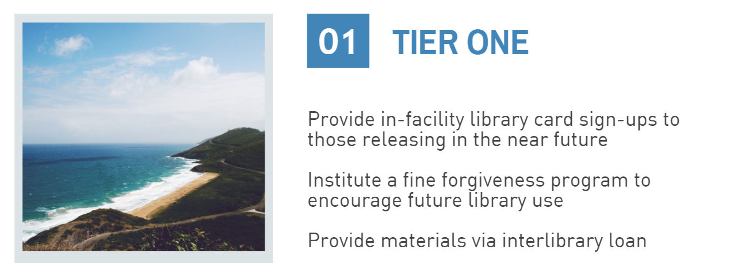
How to connect – Tier One
Notes:
EB

Slide 12
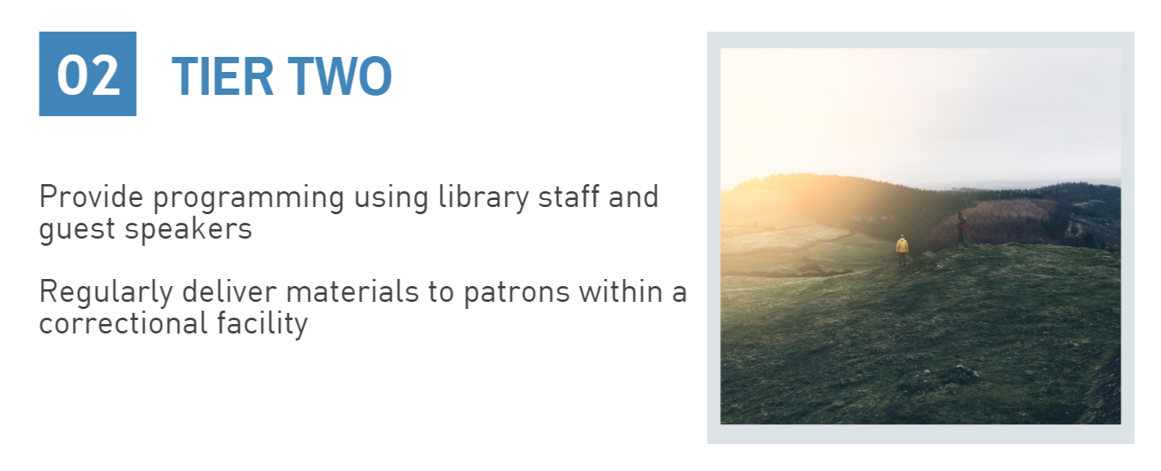
How to connect – Tier Two
Notes:
EB

Slide 13
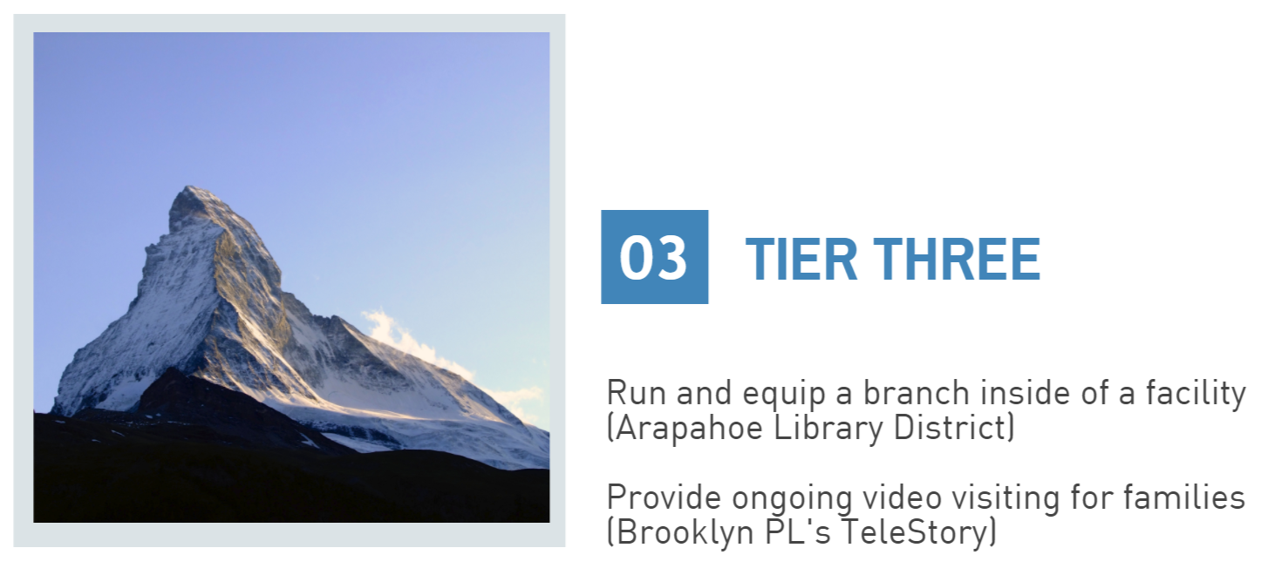
How to connect – Tier Three
Notes:
EB
Arapahoe Library District – has a contract with the sheriff’s office that they have to negotiate and review regularly.

Slide 14
Chat
Type in the chat box how you already serve the incarcerated.
Notes:
EB
Things you’re doing, or things you’ve heard of others doing beyond what we’ve shared today.

Slide 15
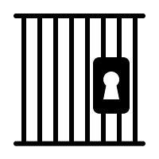


Obstacles and concerns
Notes:
TA:
Bars & lock icon = Gatekeepers you will face before even getting in the doors to help the incarcerated. Prison is designed for preventing people from getting out rather than letting people in. The best advice I can give is to identify a nearby facility and find an inside point of contact of contact who will advocate to get you in and help you navigate possible bureaucratic red tape. We recommend that you laser focus on library staff. Usually, on the internet, you can find the main switchboard number for a facility. When you call, ask to be transferred to the library or education department. Those are the folks who will be most likely to help you get in. Then, bear in mind that these folks are BUSY, so initial contact may not be enough. It will take some time and patience to earn their trust. It may take many follow-up calls or emails so they know you’re not just some rando or salesperson.
Key = Security - Safety is the top concern in correctional facilities. You will likely need advance permission to enter the building and prior approval for materials you want to bring in. You may be restricted from bringing in certain items (cell phones), and you may be expected to dress in a particular way (no jeans). Sometimes you will have to push a button at the front door and try to communicate with an incomprehensible voice to request entry. Of course, expect fences and razor wire and gates and metal detectors (but not always).
Umbrella = Personal protection - You may need to take special care in an institution, but it’s not as scary as what you might see on TV or movies. Offenders will not be aggressive toward you, but they will be curious about you, VERY curious. Anything new in their boring environment is VERY interesting to them. Trained staff will keep you safe, and, if this is going to be a long-term engagement, you may have an opportunity to attend training for volunteers.

Slide 16

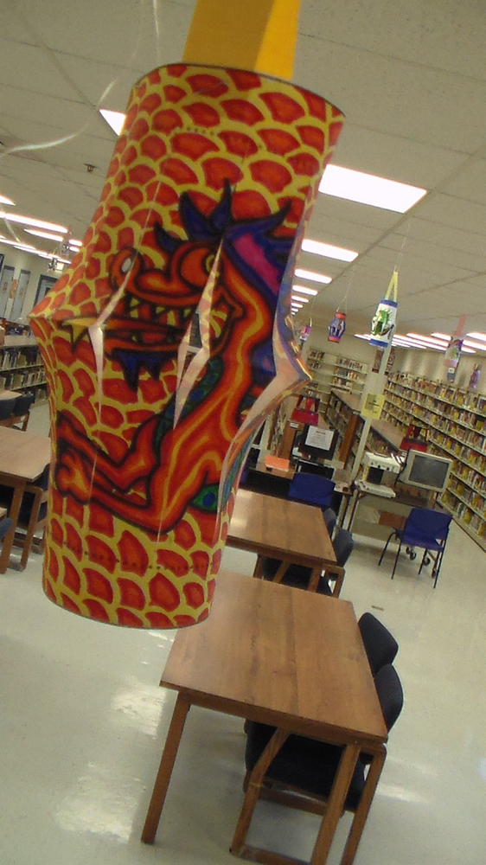
Stories
Notes:
EB: Personal experiences/stories/reactions
Art by: Mr. Keven Nechville, shown with permission. Created for Asian American Heritage Month – we had a very simple passive program with paper lanterns which got hung in the library. Mr. Nechville colored several, all with this incredible level of detail. He came in one day bleary-eyed, and told me he’d stayed up all night drawing and coloring. He wasn’t the only one who was able to create something beautiful because of a library program.
Those in institutions are often the most grateful patrons you can hope to meet. Volunteers who bring programs to institutions are regularly impressed by the intense interest and creativity shown by participants. You may find that serving them is your new passion!

Slide 17
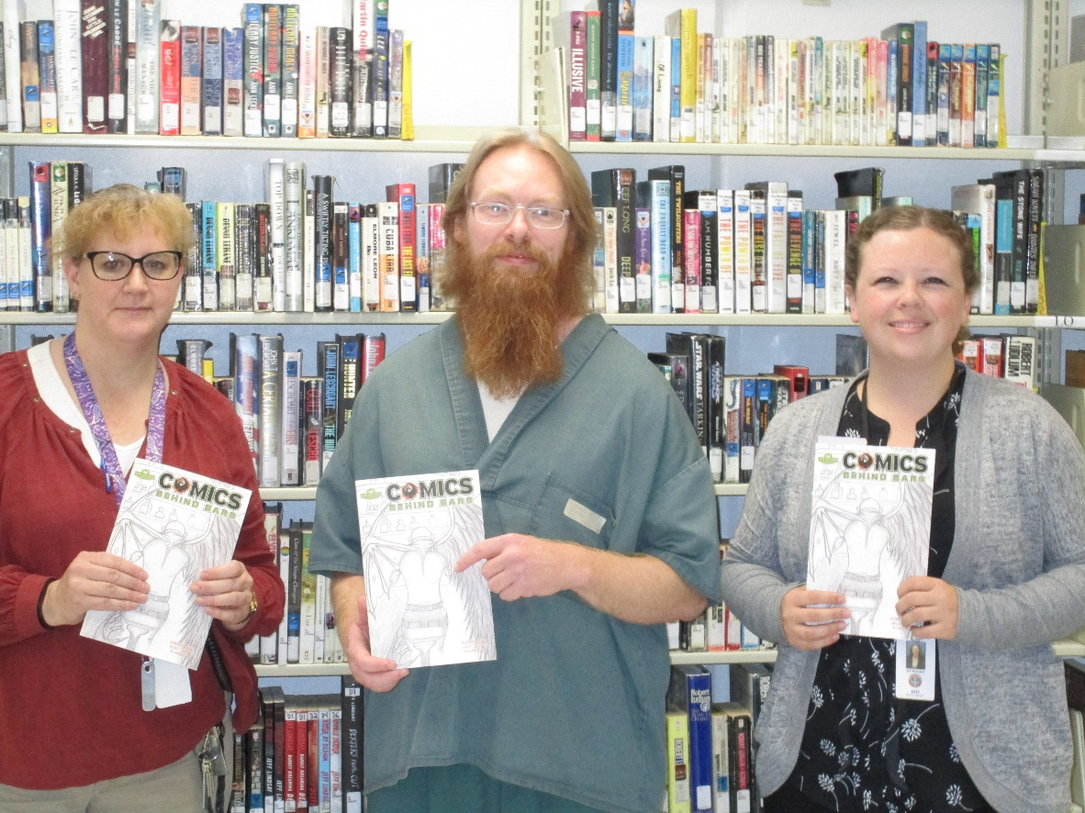
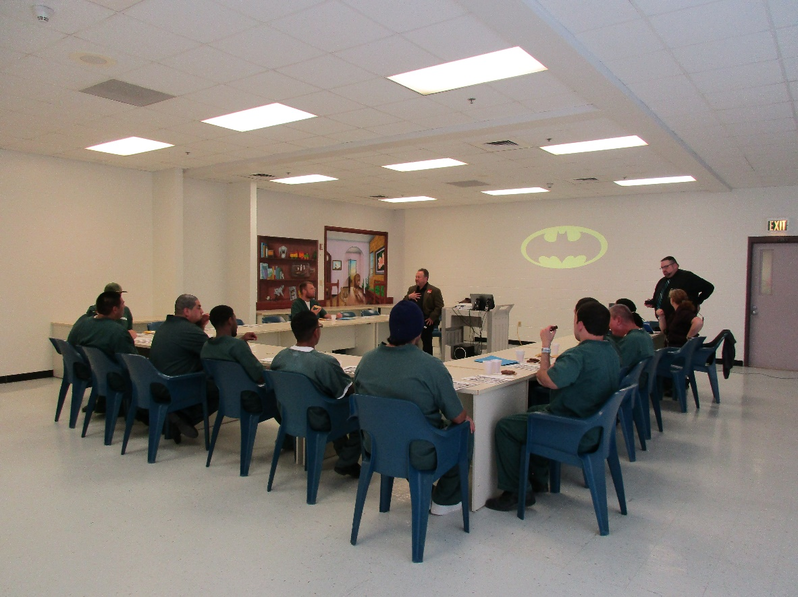
Rewards
Notes:
EB: Personal experiences/stories/reactions
Thanks to a nonprofit called Pop Culture Classroom in Denver, my prison library got this incredible program called LEAD With Comics. Offenders could learn to draw and write their own comic book, plus they read graphic novels purchased for us by PCC. On the left is a picture of me with an SCF teacher, Renae Kubitz, and one of our first students to complete the program, Mr. Matthew LaBonte. I’m on the right. His comic, which was a poem he wrote and illustrated, was published in a collection produced by PCC. The State Library even sent a copy home to his dad.
On the left is the 2017 Eisner grant-funded lecture. I applied for ALA and the Eisner Foundation’s grant, and received materials to use in LEAD and in our libraries. A professor from CU Boulder, Dr. Kuskin, volunteered his own time to give the lecture. This is the first group of attendees. We had an amazing set of conversations about art, literature, and superheroes.
Dr. Kuskin even mentioned that the level of conversation he experienced was comparable to what he’s seen in graduate-level seminars.

Slide 18

Questions?
Notes:
TA
Answer questions, if any.
If you’re in Colorado, contact me or Erin to locate info about your nearest state facility

Slide 19

Resources
Erin Boyington, erin.boyington@state.co.us
Teresa Allen, allen_t@cde.state.co.us
CO Institutional Library Development website https://www.cde.state.co.us/cdelib/prisonlibraries/institutions
Remerg (resources for those formerly incarcerated) http://remerg.com/
Brooklyn Public Library (TeleStory)
https://www.bklynlibrary.org/outreach/transitional-services
Notes:
TA
Our contact info
ILD CSL page
Library Services to the Incarcerated
Remerg in case you are currently serving the formerly incarcerated in your library

Slide 20
Image credits
Slide 4: https://www.familysearch.org/wiki/en/Colorado,_United_States_Genealogy, https://openclipart.org/detail/33871/united-states-map
Slide 5: istock_173582254-metal jail bars
Slide 6: The Shawshank Redemption, 1994
Slide 9: https://www.astronautinews.it/2014/07/20/il-rientro-infuocato-dellatv-ripreso-dal-suo-interno-2/
Slide 11: All icons from https://thenounproject.com/: Shane David Kenna, Sasha Lantukh, Gilad Sotil, Gabriela Rodriguez, Marvdrock, Sergey Deushkin, Bonegolem, Nikita Kozin, Aenne Brielmann, Dan Hetteix, Diana
Slide 18: All icons from https://thenounproject.com/: Ralf Schmitzer, Daria Moskvina, Xinh Studio
Slide 21: https://thenounproject.com/: Ethan Russon
Slide 22: https://languagelabunleashed.org/2014/03/twenty-questions/

