Slide 1

Virtual Services
Presented by:
Lynde McCaleb, Outreach Librarian, She/Her/Hers Jamie Lowen, Virtual Services Supervisor, He/Him/His
Brittany Raines, MOVE Manager, She/Her/Hers

Slide 2
Objectives
Learn:
What our Virtual Library is and how it functions
Additional Virtual Services provide by our MOVE department
How we moved the Virtual Library to working from home
How we evaluate our virtual services

Slide 3
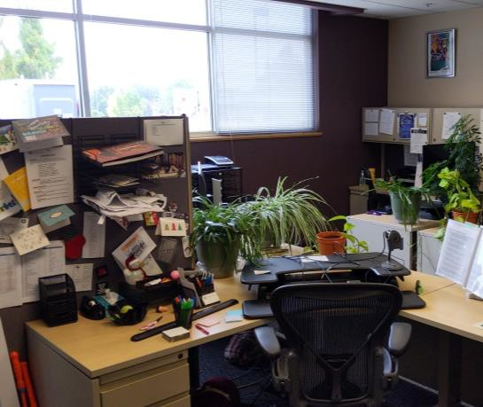
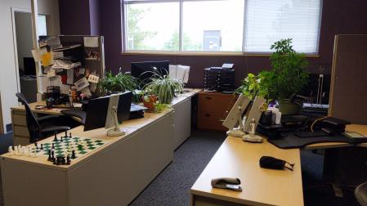
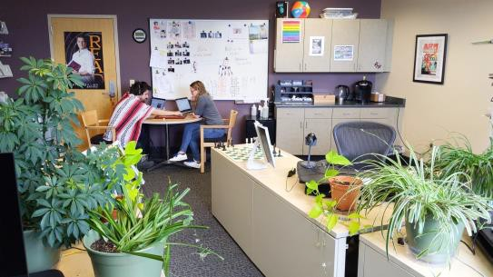
The Virtual Library

Slide 4
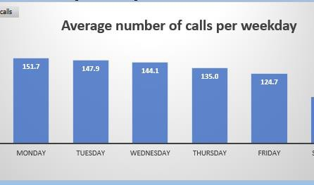
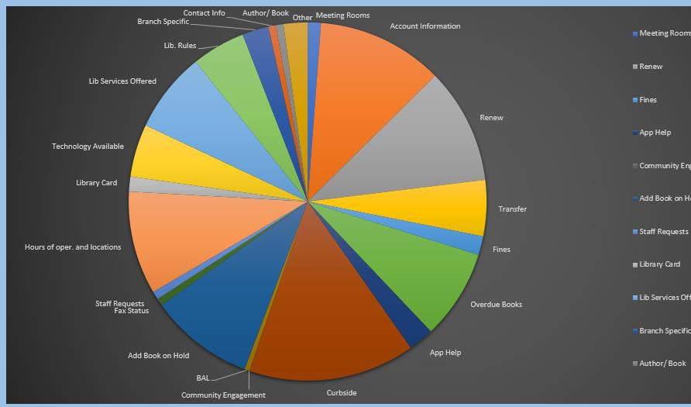
The Virtual Library - stats
The Virtual Library was created in December 2011 and is our main Virtual Services Department.
Why was it created?
Bundle four services into one department: contact center, web inquiry, virtual reference, and web oversight.
A department that will deliver a consistent message to patrons.

Slide 5
Four Functions, One Department
Contact Center
Provides a consistent message to patrons and vendors
Keeping information up to date, creating phone lists for staff, developing canned responses for quick turnaround, and more
Web Inquiry
Reduced number of staff handling emails
All reply messages are consistent throughout the district and response time is quick and efficient
Virtual Reference
Offers consistent hours and staffing to field reference questions
Aid with online resources
Web Oversight
Assist in testing and updating website

Slide 6
CONTACT CENTER: PHONE
SERVICES
Types of Services
Patron Assistance
Account issues/resolution
Renewing items
Placing Holds
Checking account statuses
Reference Help
Connecting patrons with other services
Registering patrons for programs
Library Staff Assistance
Connecting staff with other library staff
Answering staff questions
Communicating to district about issues

Slide 7
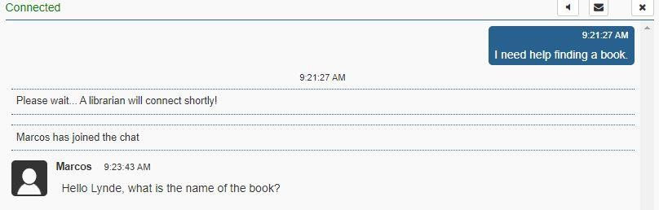
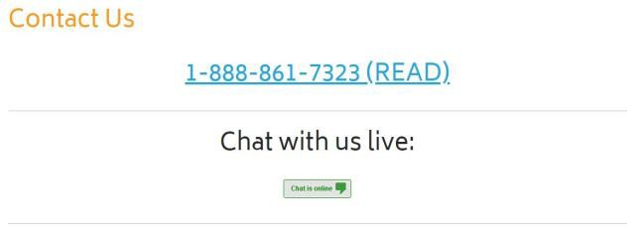
Webinquiry/Chat Services
General Questions
Account Help Placing Holds Renewing Materials Reference Help
Connecting patrons with other services
Registering patrons for programs

Slide 8
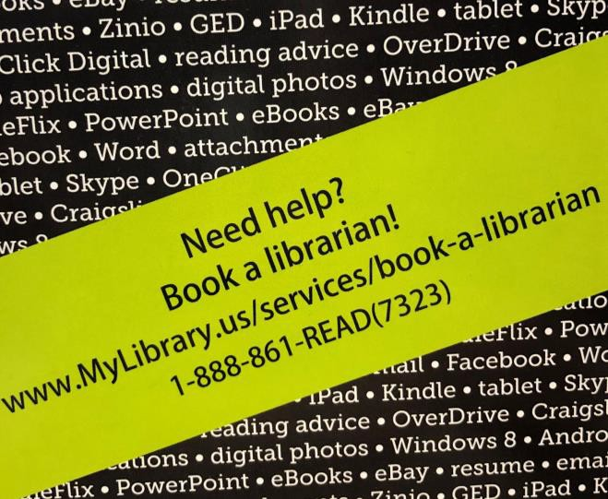
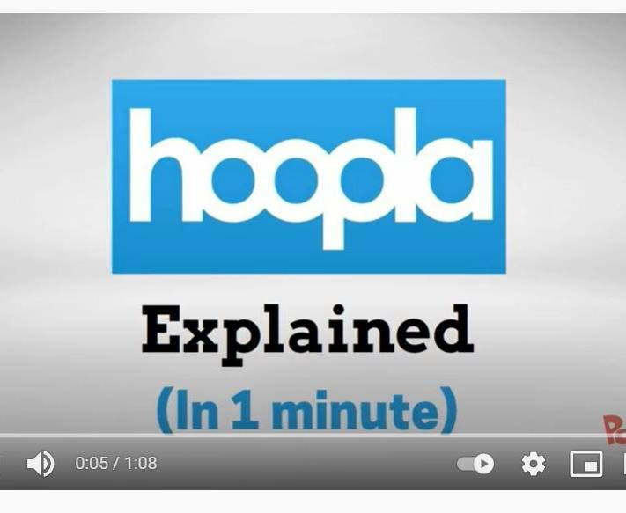
Virtual Reference
eResource Guides
Book-a-Librarians
Reference services that take longer than 15 minutes and may require more in-depth 1:1 help.
Virtual Book-a-Librarians over phone, chat, or email
Scheduling in-person Book-a-Librarians
at library branches.
Specific database assistance.

Slide 9
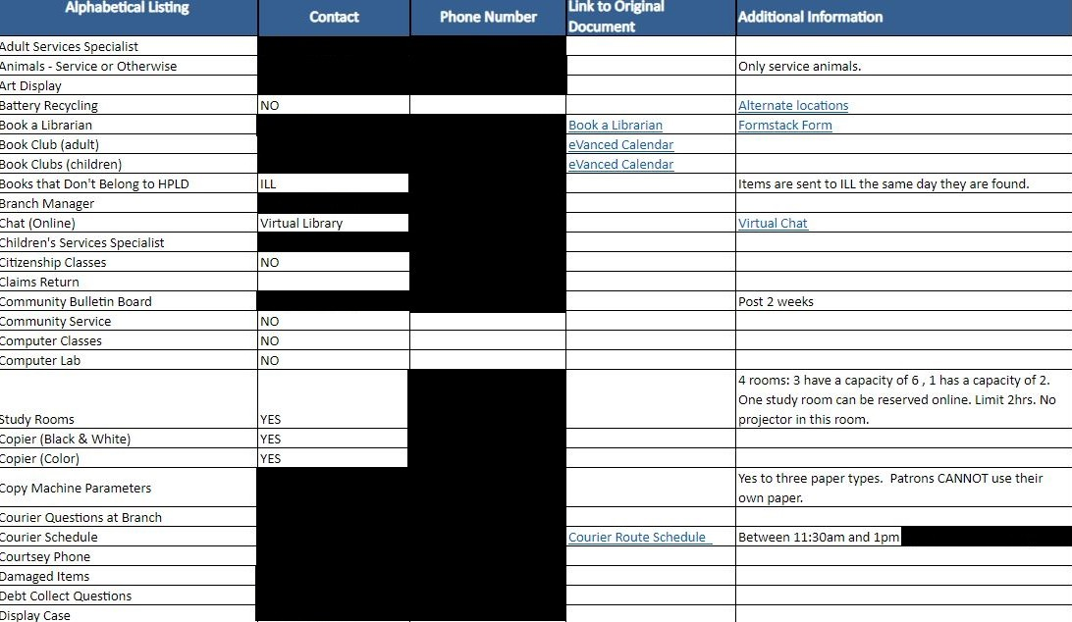
Web Oversight
Website:
Tax Information
Test for Usability and Function
Communicate inaccuracies
SharePoint (Intranet):
Branch Audit
Updates Community Contacts
Phone Lists
District-wide communications- posting (closures, weather updates, and community resources)

Slide 10

Other Virtual Services
Virtual Programs
Virtual/E-Card Maintenance
Database assistance
As well as...

Slide 11
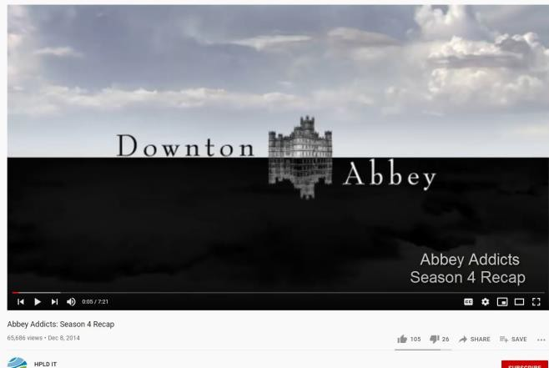
Virtual Programming
Virtual programming pre-pandemic
Downton Abbey Club from a few years ago
Book reviews
E-resource instructions
Virtual programming post-pandemic
Outreach adapted quickly

Slide 12
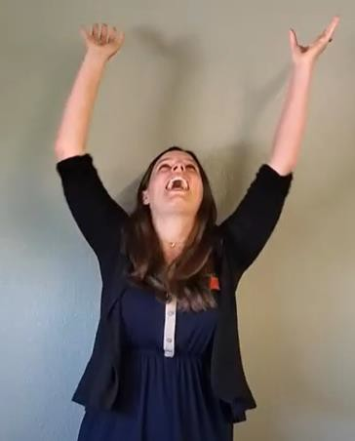
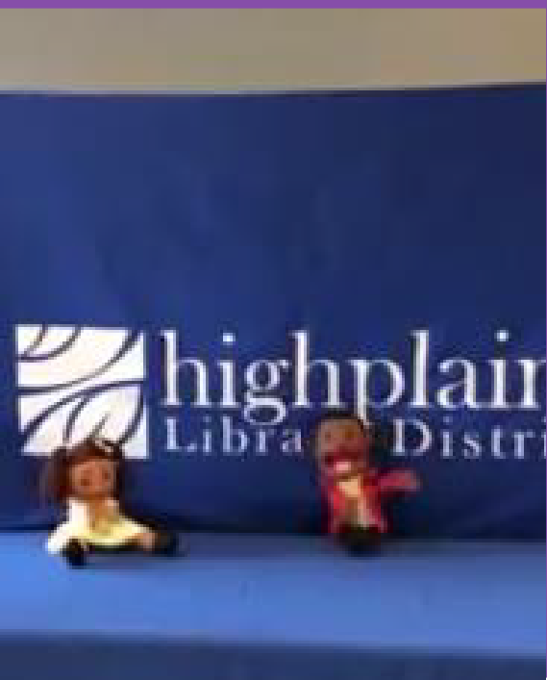
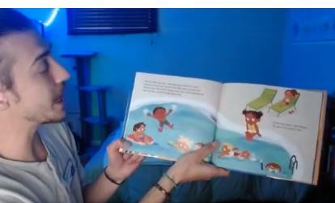
Virtual Programming Examples
Virtual Storytimes
Puppet Shows

Slide 13
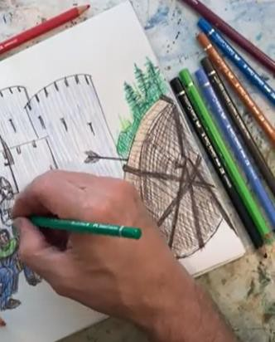
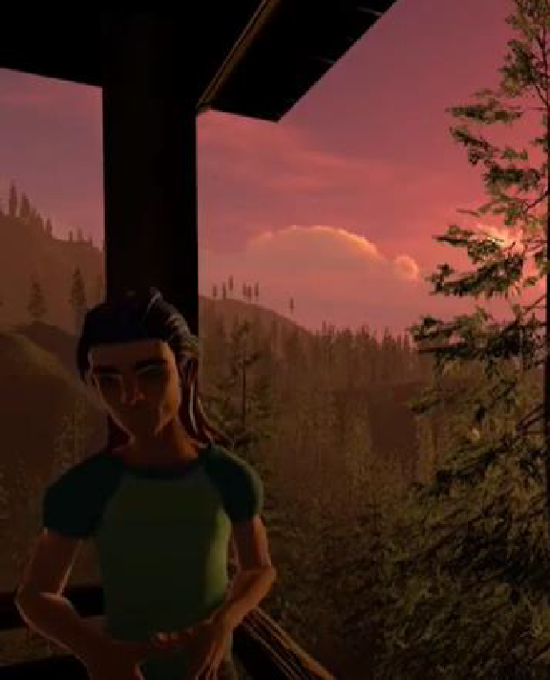
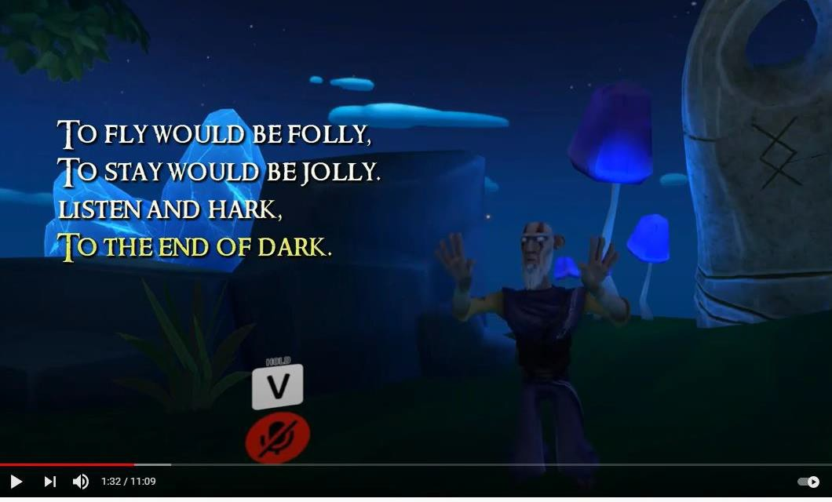
More Virtual Programming
Oral Storytelling
Virtual Reality Storytimes

Slide 14
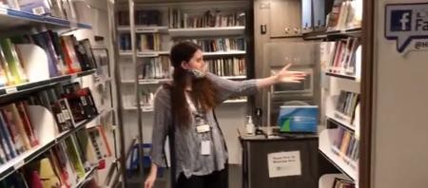
Virtual Tours of Vehicles

Slide 15
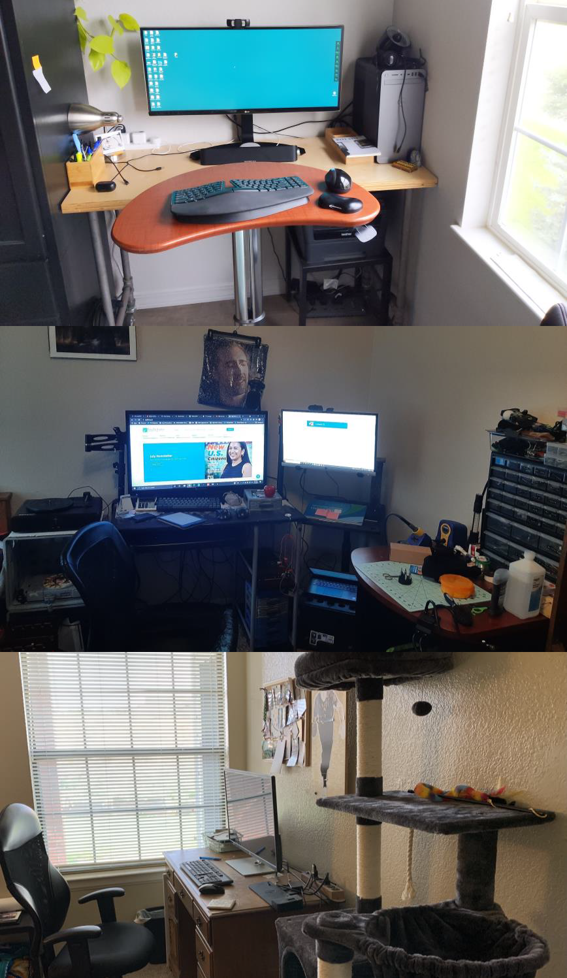
Working From Home

Slide 16
Procedures
Working From Home
Equipment
Management of Virtual Environment

Slide 17
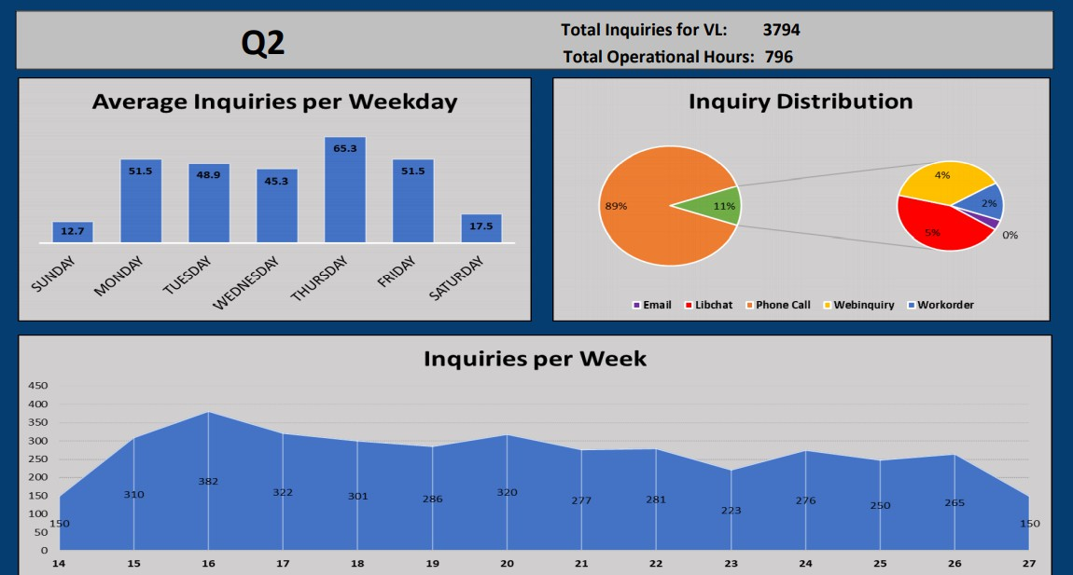
Evaluation of Services
Data gathered regularly from various platforms...
Phone logs
Workorder logs
Email
Chat
…and compiled for monthly,
quarterly, annual reports.

Slide 18
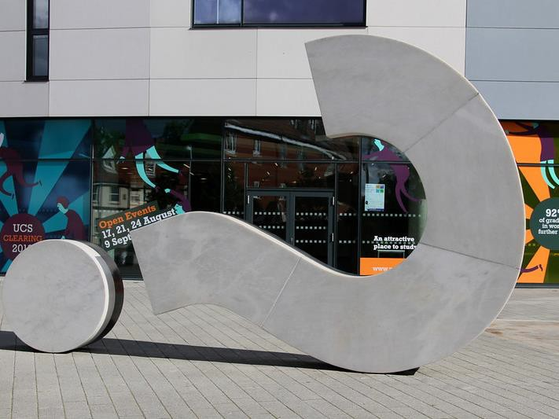


Questions?

Slide 19
Contact Us!
Jamie Lowen Virtual Library Supervisor
jlowen@highplains.us
Lynde McCaleb Outreach Librarian
lmccaleb@highplains.us
Brittany Raines MOVE Manager
braines@highplains.us

Slide 20
What’s Coming Up in this Series:
Events Services, Community Conversations and Feedback Loop, October 5th
Community Partnerships, October 12th
Collecting Data in Outreach and Community Assessment, October ₁₉th
Outreach Advocacy, October 26th
Previously Recorded:
Outreach Foundations, September 7th
Mobile Services, September 14th Outreach Services, September 21st

