Slide 1

Outreach Services
Presented by:
Lynde McCaleb, Outreach Librarian, She/Her/Hers Megan Lowery, Mobile Services Supervisor, She/Her/Hers Brittany Raines, MOVE Manager, She/Her/Hers

Slide 2

Objectives
Learn about different types of outreach services
Learn about different priority populations and services/programs designed for them
Learn about community requests and how this shapes services as it aligns with priority populations
Learn about challenges experienced when delivering outreach services and programs
Attribution: Alpha Stock Images - http://alphastockimages.com/

Slide 3
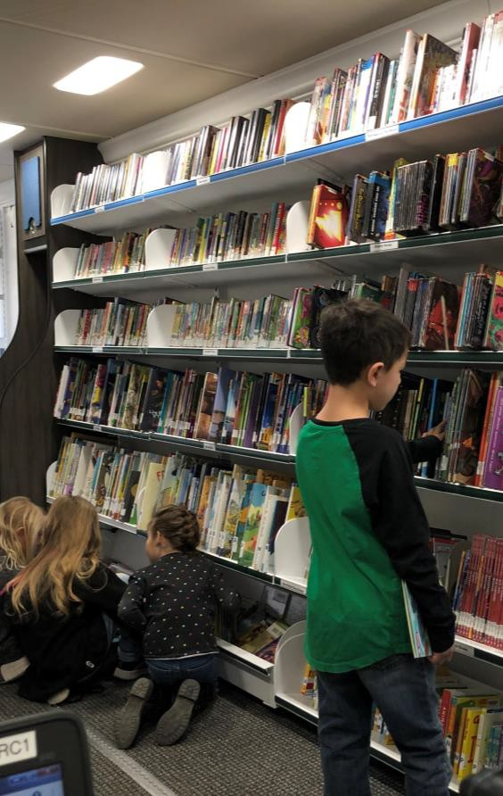
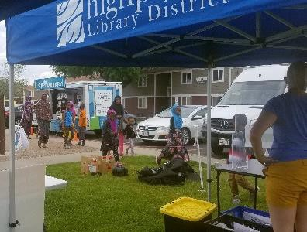
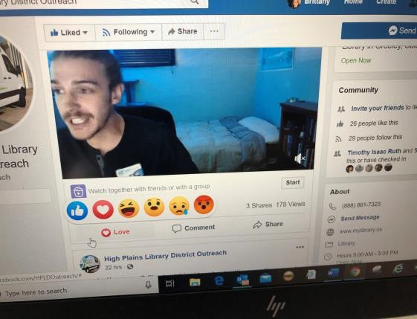
Types of Outreach Services
Mobile Services
Programming
Book-A-Librarians
Virtual/Online Services
Education Support
Off-Site locations

Slide 4
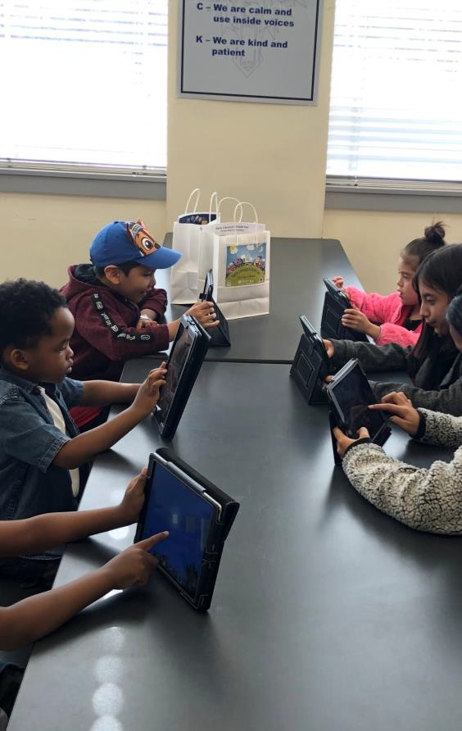
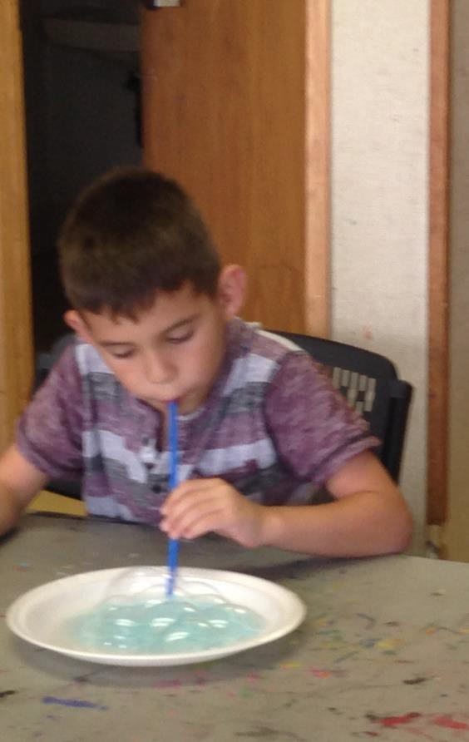
2021 Priority Populations
Newcomers (IRCNOCO, HIPPY, D6 Family Center)
Homeless (GCC, Cold Weather Shelter, Housing Navigation Center)
Senior Citizens (Lobby Stops, Senior Centers)
Re-entry (ICCS, Alternative Homes for Youth)
Underserved Populations (Rodarte Center, CEENs, Veterans, Boys and Girls Club, rural communities, people with disabilities)

Slide 5
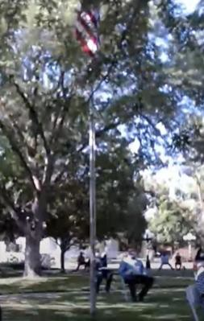
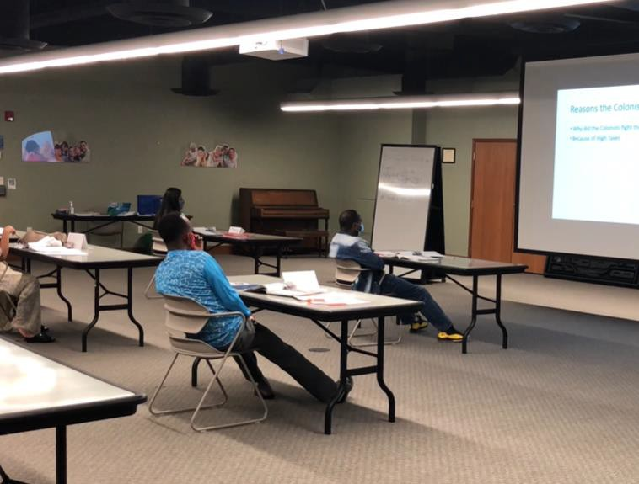
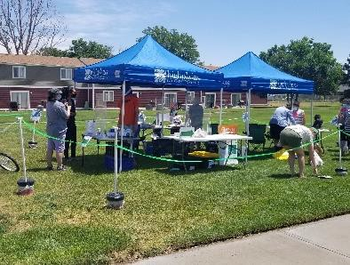
Services to Newcomers/Immigrants and Refugees
Citizenship Classes
Annual Naturalization Ceremony
Lending Library at IRC
Book-A-Librarians: Citizenship Test prep help
Storytimes at Little Learners
International Neighborhood stop
IRC Food Distribution- Started during COVID to connect with the community when it was the only option for Outreach
Nursery Rhyme Booklet creation and added to HPLD collection

Slide 6
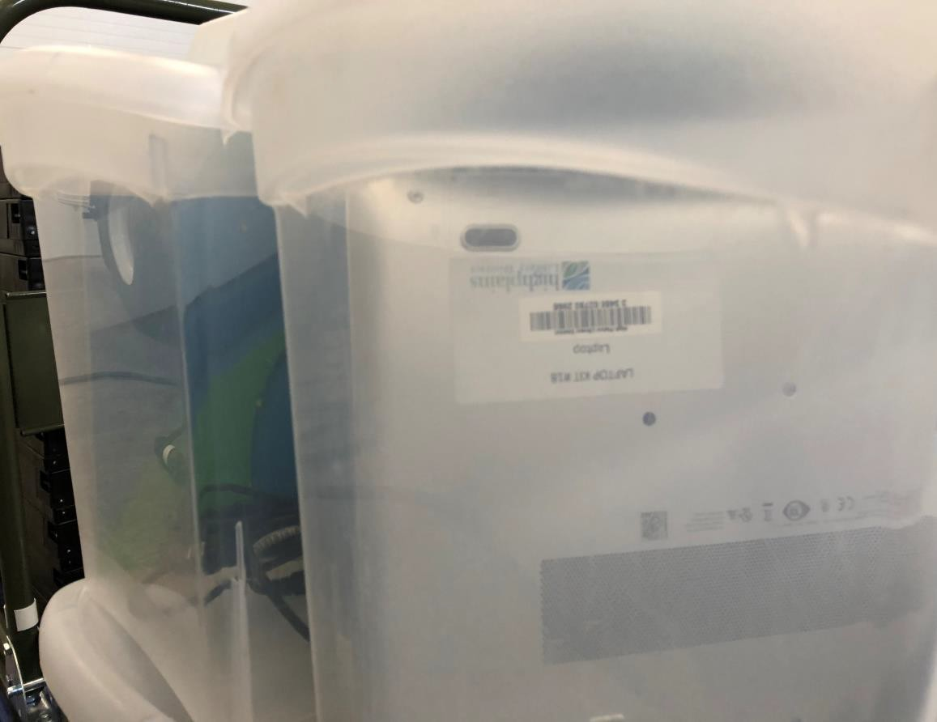
Services to People Experiencing Homelessness
Bookmobile stop at Guadalupe Community Center (Homeless Shelter)
Book-A-Librarians for resume help and tech help
Services at the Housing Navigation Center and Cold Weather Shelter
Laptop checkouts at the Cold Weather Shelter
Partner sharing equipment to Guadalupe Community Center: 4 laptops and 2 printers for use inside the facility

Slide 7
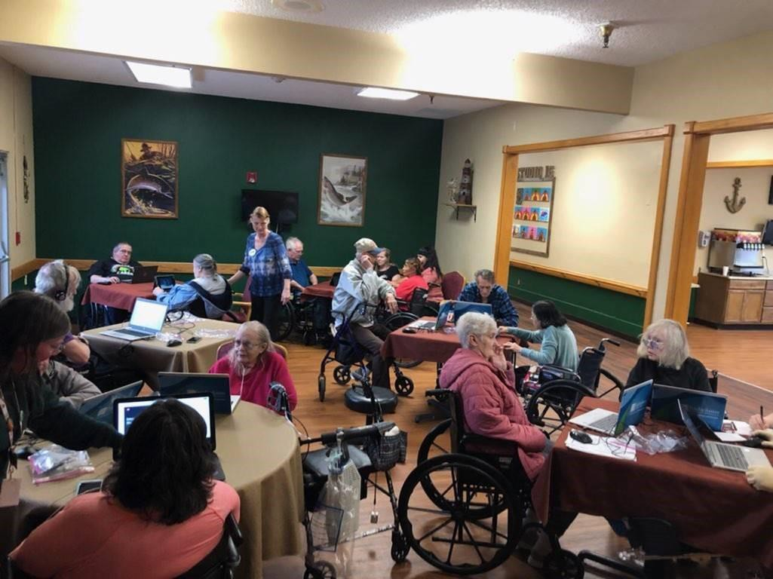
Services to Seniors
Lobby Stop Visits to 25 locations
Book Deposits
Book-A-Librarians: 1:1 tech assistance, Readers Advisory
Programming: Tech Classes, Read-a-Louds, Book/Movie Clubs, Card Exchange with HIPPY students
Signing Up and facilitating exchanges for Colorado Talking Books

Slide 8
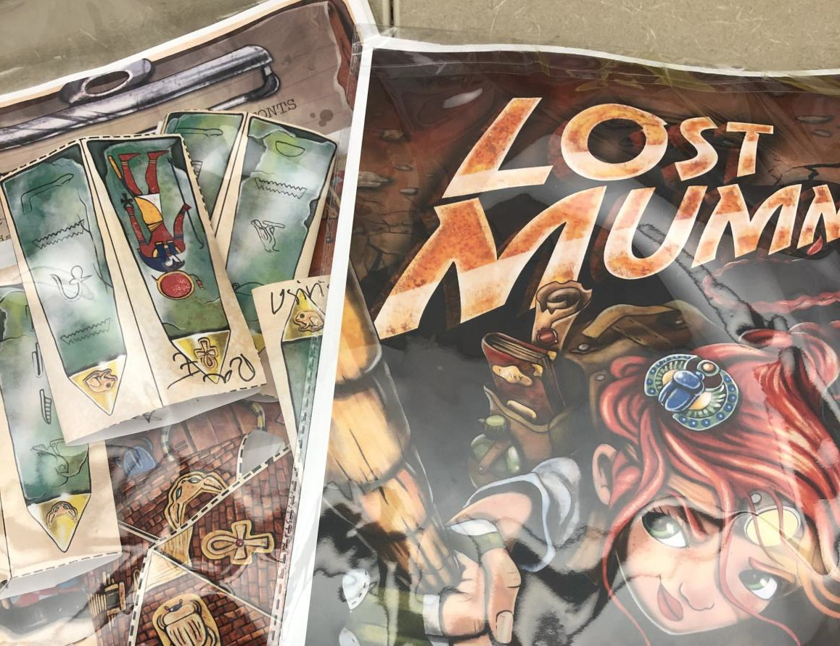
Services to Re-Entry Populations
Lobby Stop Visits and Programming to ICCS and AHFY
Book-A-Librarians at Jobs of Hope

Slide 9
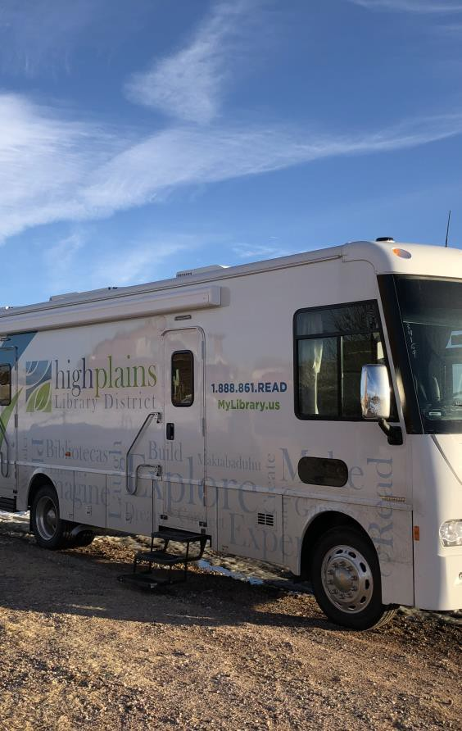
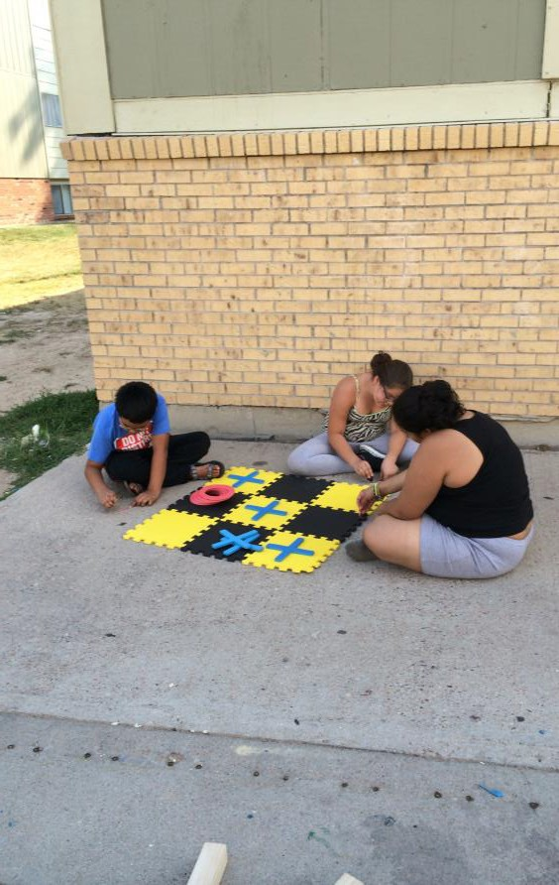
Services to Underserved Communities
Rural schools and
communities
Low-income preschools
Low-income urban areas
Youth centers and clubs
People with
disabilities

Slide 10
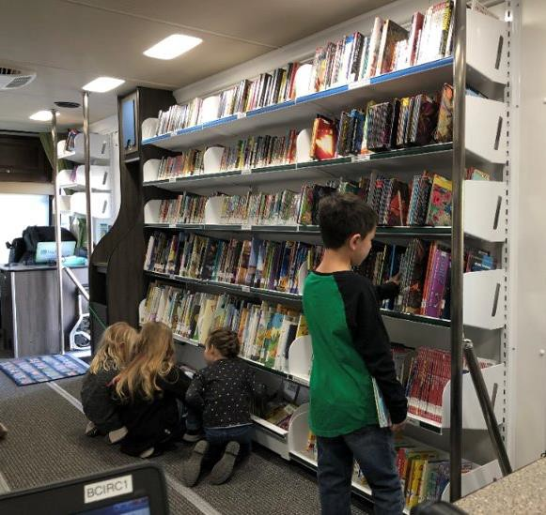
Services to Rural Schools
Bookmobile visits
Classroom deposit collections
Book clubs
Classroom instruction supplement (books)
Database instruction
E-resource access and classroom support and training
Partnerships for supplemental programming

Slide 11
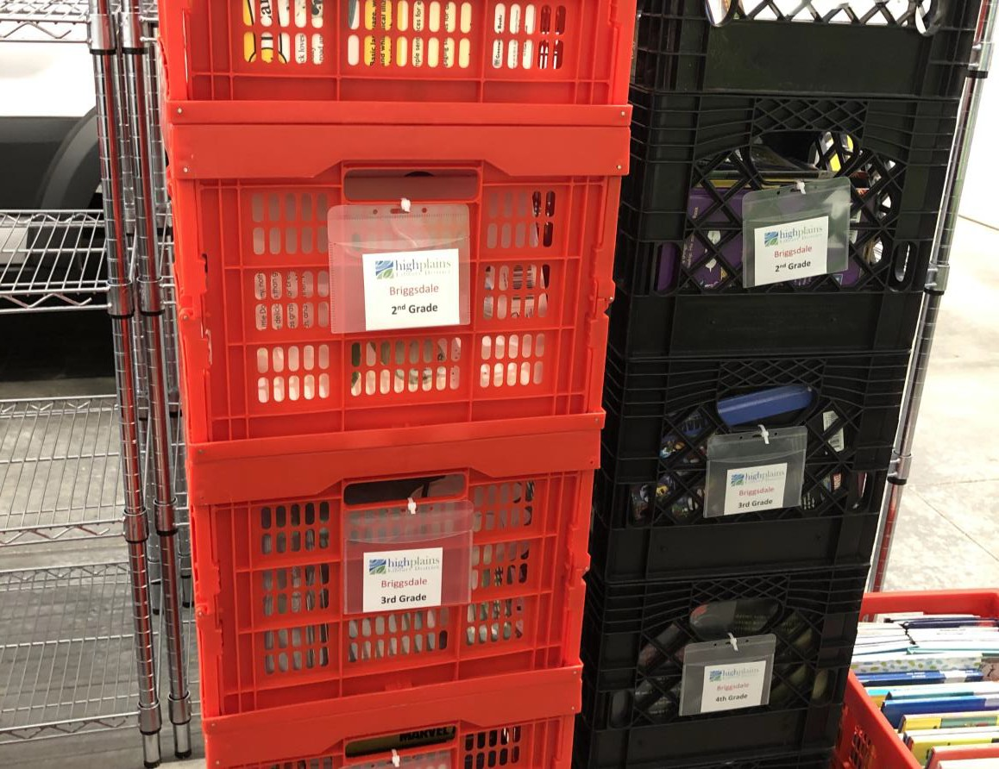
Classroom Deposit Collections
Schools in small communities within 15 miles of a public library
Each classroom gets a classroom deposit of 40 grade- appropriate books that are rotated
Combination of nonfiction, fiction, graphic novels, etc.
Sites of Book Deposits
Highland Elementary School in Pierce
Milliken Elementary School in Milliken
Cardinal Community
Academy in Keenesburg
Hoff Elementary School in Keenesburg
Galeton Elementary School in Galeton

Slide 12
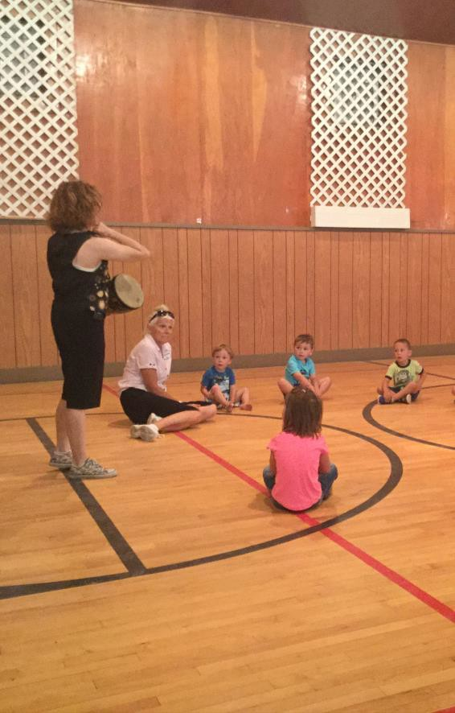
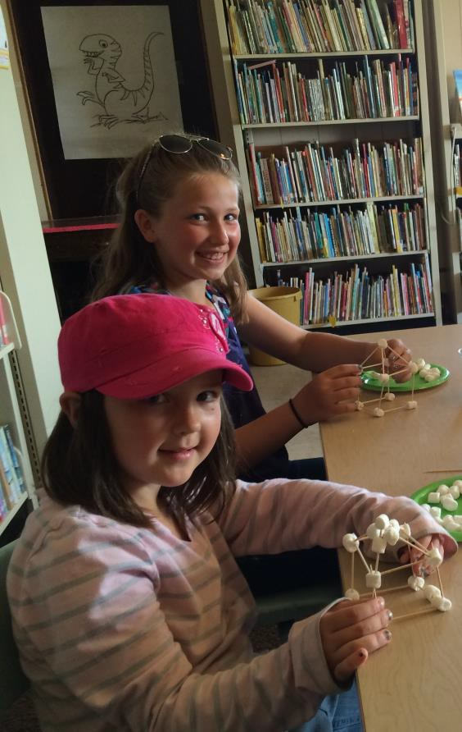
Services to Rural Communities
Bookmobile visits
Specialty checkouts
Book-A-Librarians
Programming
Social media
engagement
Presence at community events (re: library advocacy)
Internet Service Point in Kersey Mobile Home Park

Slide 13
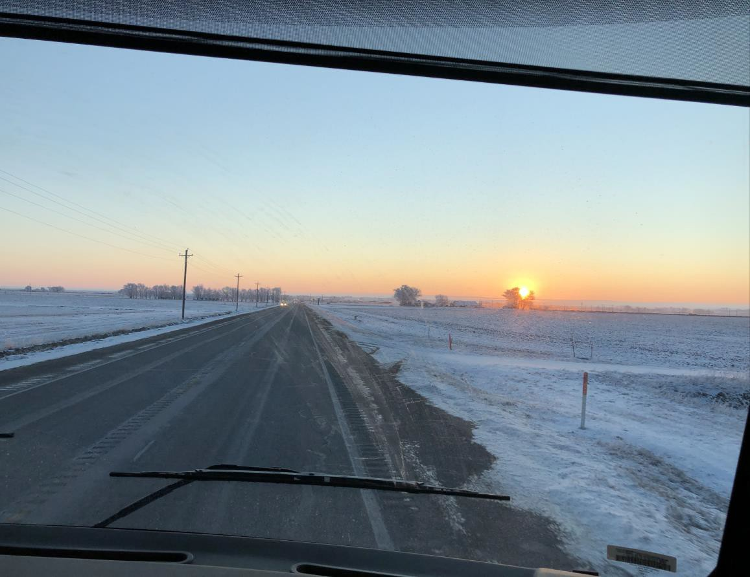
School vs.
Community Bookmobile Stops
School Stops
Visit local K-12 schools in rural areas.
All grades are welcome
Community members welcome to visit bookmobile at school.
Community Stops
Timing is everything
Park at public places
Parks
Rec Centers
Post Offices
Park at centers of community
Churches
Apartment community buildings

Slide 14
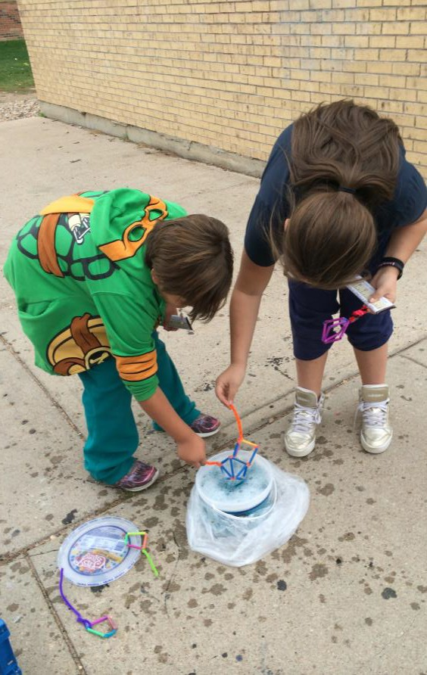
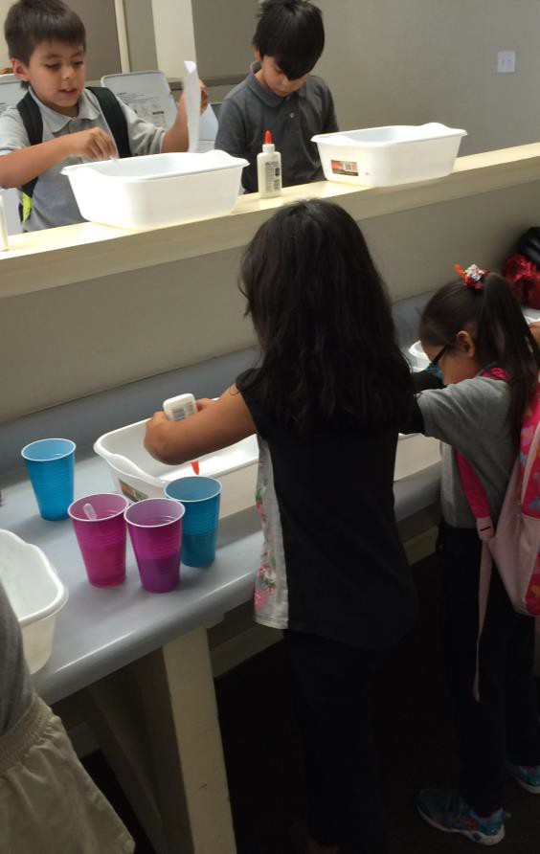
Underserved Populations: Low-Income
Low-Income urban
areas
Pines Apartments
Porterhouse Apartments
Guadalupe
Apartments
Internet Service Access Points
Pine Meadows
Villa Apartments
Kersey mobile
home park
Anna Gimmestad

Slide 15
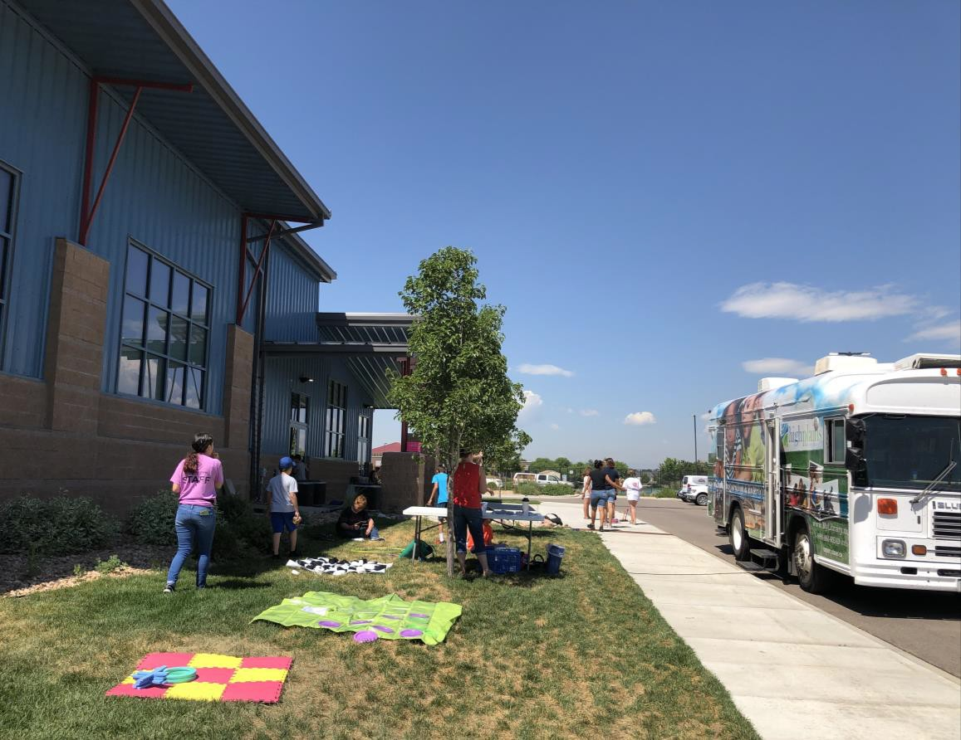
Youth Centers
Bookmobile stops during the summer at the
Rodarte and Boys and Girls Clubs
circulation
services
programming
Strategic support (library development)
Brokering relationships with other community service providers
Year-round
programming at the Rodarte Center and Anna Gimmestad (City of Greeley Partnership)
STEM, Yoga, Summer Reading

Slide 16
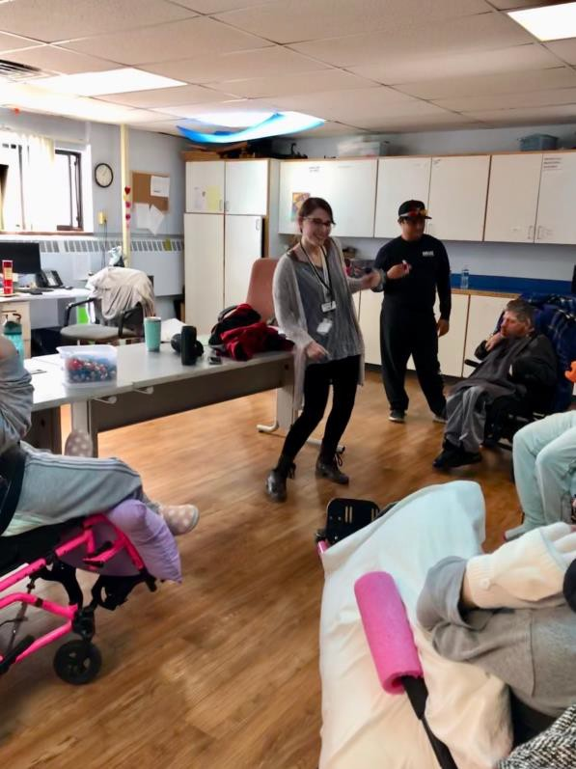
Services to People With Disabilities
Programming
Music Programming
Music & Movement at local day program center
Arts Programming
Art/craft program at local residential care center
Provided Take & Make Kits to places during pandemic
Technology Help
Book-a-Librarians with Connections for Independent Living
Other accessibility considerations:
Wheelchair lift on Bookmobile
Providing lobby stops to independent living centers
Working with community members/organizations to raise awareness/assistance

Slide 17

Low Income Preschools
Colorado Early Educational Network (CEEN)
Service all Weld County locations, 12 sites
Partnership with Glenn
Jones Member
Library staff
Parent Meeting to teach parents about early literacy practices and library resources
Centro
Preschool for children of migrant parents

Slide 18
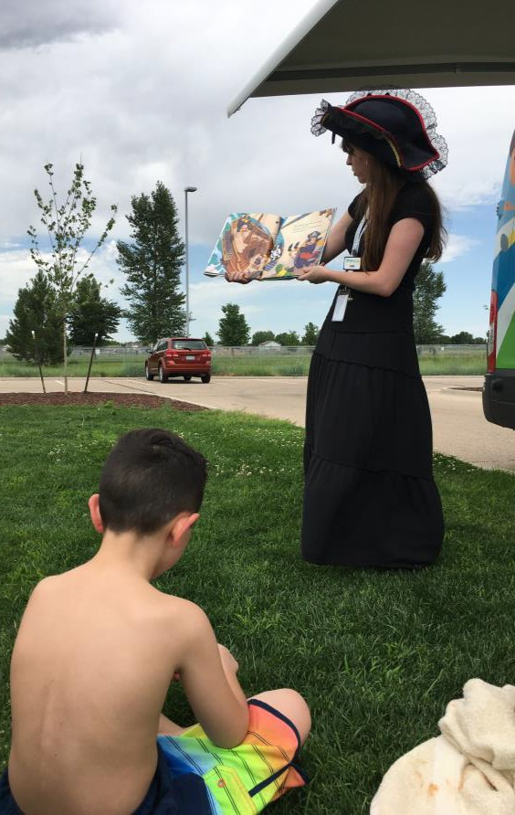
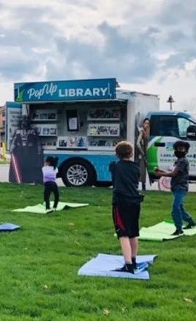
Additional Outreach Efforts
Event and Experiences
PopUp Parties
Discovery Bay Storytimes
Friday Fests
Food and Flick
Friday
Centennial Board of Cooperative Educational Services (CBOCES)
Project Connect

Slide 19
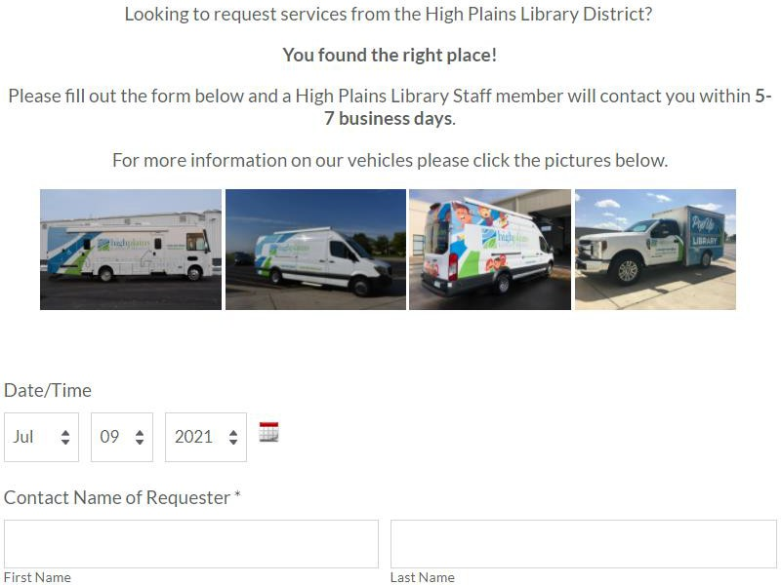
Community Request Form

Slide 20
Community Request Form Workflow
1. Request is received through our Request
a Visit link
2. Evaluate based on goals and priority populations
3. Decision: To Pick Up
or Not To Pick Up
4. Picked Up: Request is assigned to staff to lead through Workorder system
5. Staff follows up with requestor

Slide 21

Challenges
Communicating with site and partner contacts that have high turnover rates
Evolving and changing services based on grants
Losing senior patrons
Secondary trauma
Maintenance of our
vehicles
Unknown environments
Evaluating sites/services

Slide 22
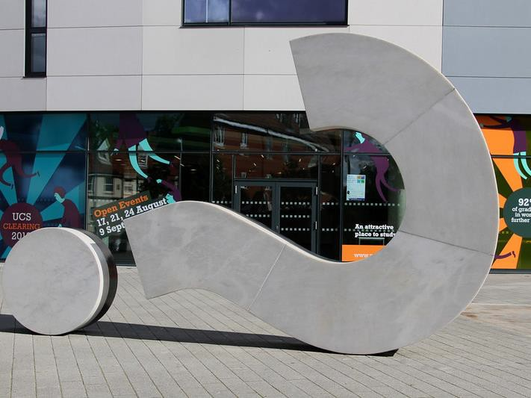


Questions?

Slide 23
Contact Us!
Megan Lowery Mobile Services Supervisor mlowery@highplains.us
Lynde McCaleb Outreach Librarian lmccaleb@highplains.us
Brittany Raines
MOVE Manager
braines@highplains.us

Slide 24

What’s Coming Up
Virtual Services, September 28th
Events Services, Community Conversations and
Feedback Loop, October 5th
Community Partnerships, October 12th
Collecting Data in Outreach and Community Assessment, October 19th
Outreach Advocacy, October 26th
Previously Recorded:
Outreach Foundations, September 7th
Mobile Services, September 14th
Virtual Services, September 28th
Events Services, Community Conversations and Feedback Loop,
October 5th
Community Partnerships, October 12th
Collecting Data in Outreach and Community Assessment, October 19th
Outreach Advocacy, October 26th

