Slide 1
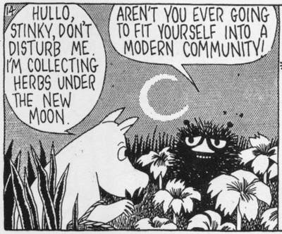
Library Services: Making the Atypical, Typical

Slide 2
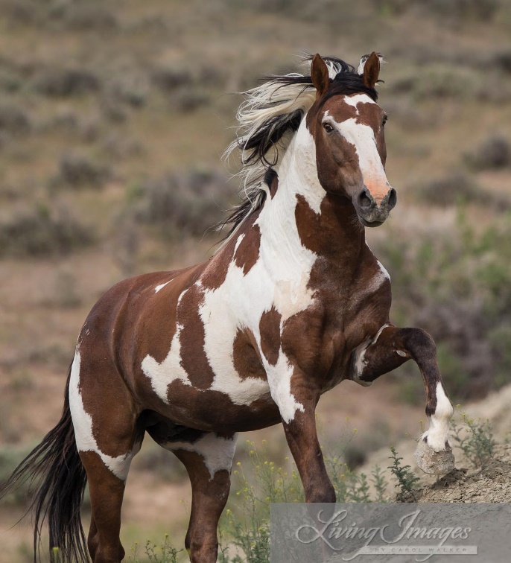

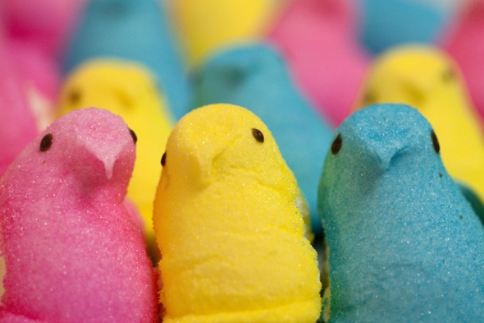
What do Peeps, wild mustangs, and Ninja warriors have in common?
Notes:
All happening at the library…………………..relate later--

Slide 3
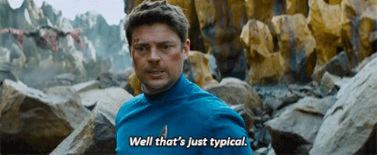
Who’s here today?
And…Do you consider yourself typical or atypical?
Notes:
Add interactive quiz

Slide 4

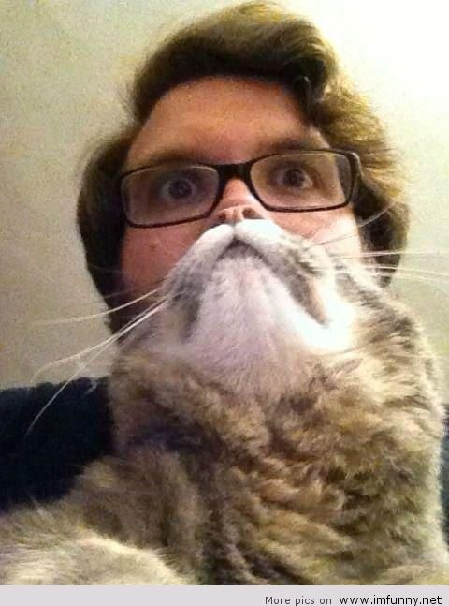
Depends on your perspective…..

Slide 5
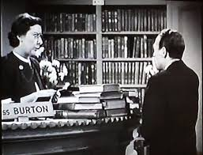
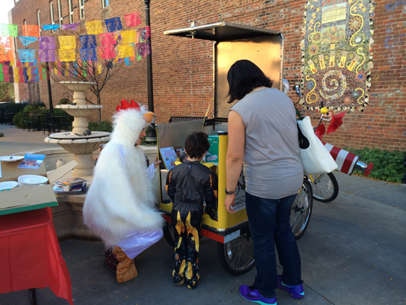
How about your library services?
And who you serve?
Typical or Atypical? What does that mean in 2017?
Notes:
Christine— Ido quick poll on how they would define their services? And maybe find out if any of the participants are involved with special populations? Are human services now “atypical”—brainstorm experiences with automated/algrorithmic….”assisted technology”—full circle; synchronic—human-rovbot----

Slide 6
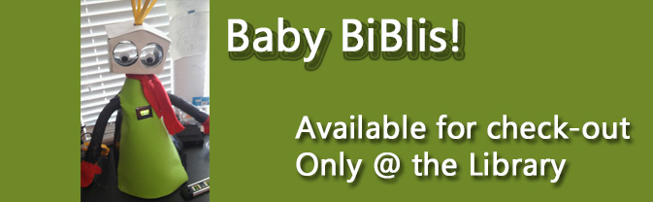
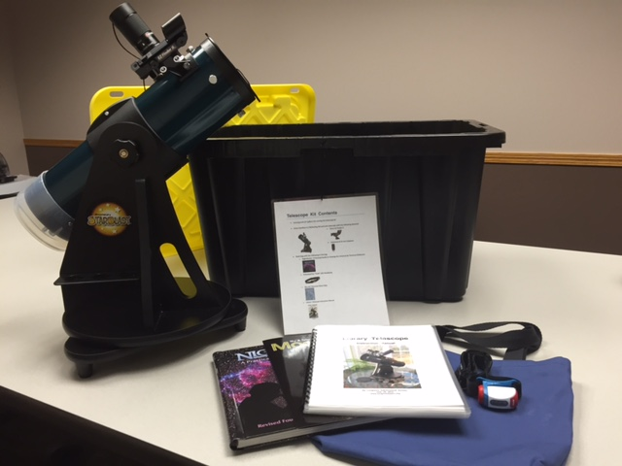
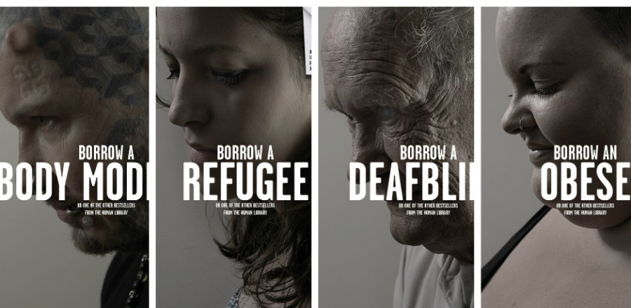
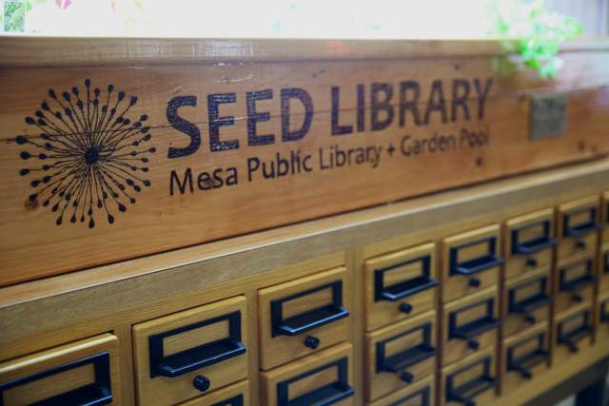
What about the items you circulate?
What are some other nontraditional items you know are being circulated?
Notes:
Use the chat……and find out what people are circulating…and what do they hope to circulate in the next year? What can’t we circulate? What makes certain things prohibitive? Image of human library? Cultural passes? --sharing economy—didn’t we start that????

Slide 7

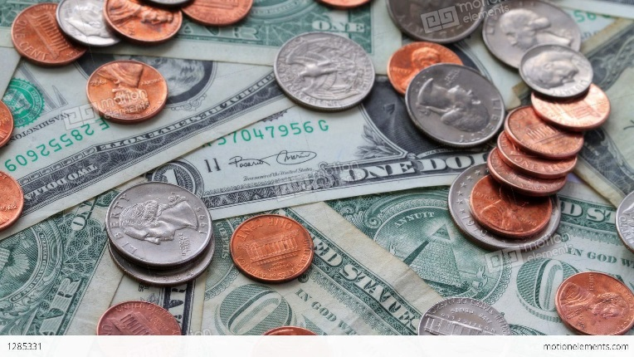
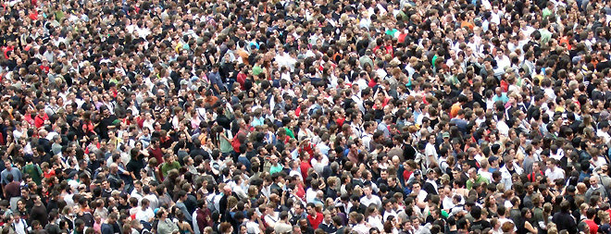
How do you define and measure the success of your programs and services?
Success looks different in different contexts--
Smiles and hugs?
Dollars and cents?
Crowd size?
Notes:
When have how you measure success different than your leadership team? Or your community? Your measure vs……..your Board’s? If you’ve impacted one person; never really know who will come back and find you; impacted that

Slide 8
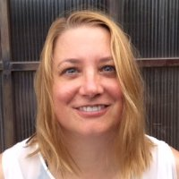
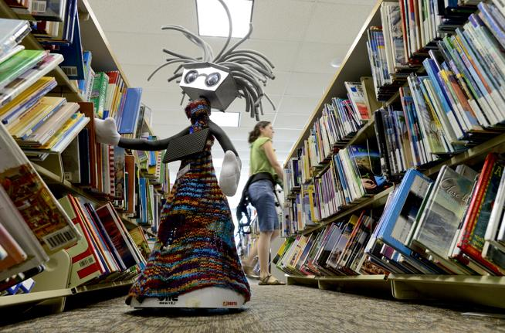

Our library’s story…
A librarian walked into my office…
A robot walked into my office…
A City Attorney walked into my office…
Notes:
….provide a sense of scale of our library….(talk about synergy and how one creative catalyst led to so many); talk about the momentum of new and very unexpected partners; an entrepreneur helping reframe how I see libraries as the go-to community partner); mention how I got into a bit of legal trouble…..
Nothing as easy as it looks----bare bones of getting things up and running; partnerships—what to find out; human relationships; marketing aspects so interesting; really did reach a whole new population—celebrity of it; and do people lose faith when not work out;

Slide 9
Point- in- time survey of our department now
Since we began our Autism programming three years ago…..
Rainbow storytime
Services for children and teens who are
visually-impaired
Informational and Advocacy programs on Dyslexia
BookCycle outreach to our City’s Summer Meals Programs
Artist-in-Residence Program
Therapy Pony
Cuentos Y Conversaciones—homeschoolers requested this!
The largest Lego Club on the Front Range!
Public Works storytime: Snowplow drivers love it!
Which one of these do you think is currently the most challenging? Why?
Outpost library—at the Recreation Center
Hip-Hop Artist Talkback!
Notes:
Talk about Rec Center challenges--//DIY Fair; Teen parents storytimes;

Slide 10
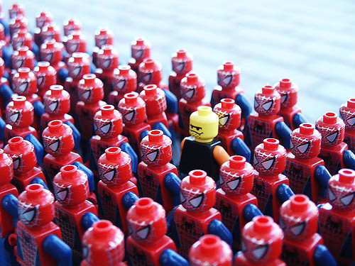
Who on your team…..
Is different than the rest?
How can this be a huge advantage?
Notes:
Open it up to chat..brainstorming….if you’re on a hiring team…what do you look for? Is it always good to have a team that “gets along”? When can that not be a good thing? Then when get different opinions, how get consensus--

Slide 11
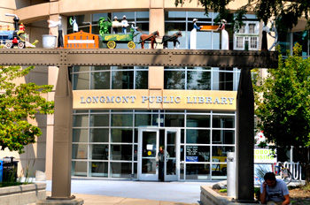
A sense of scale….our library….yours…….
Notes:
How can we apply this to us? Think back to atypical options on your staff—facts of one library stats; poll on who in District; who stand alone; consortium—pros and cons—for your services and programming; how much flexibility do you have? Where are the disconnects?

Slide 12
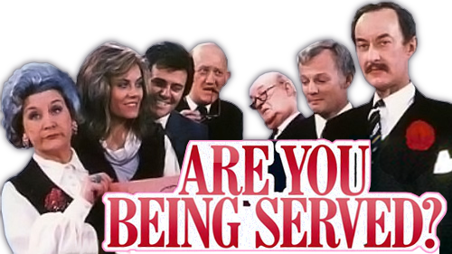
Who would you serve?
Notes:
Hi Christine—here is my idea for the 2 scenarios: If you had $500 in staff and programming money and you could choose between a Program for developmentally delayed young adults (18-21)who have very few social opportunities in community; cost—staff time and materials= $500; 10 adults—with a caregiver come and stay for an hour; 5 books get checked out OR for $500 you could provide 2 free lego clubs for families; 300 adults and children come in total ; 50 books get checked out; Which would you repeat on a regular basis? Why? What other factors other than money would you consider in this decision?

Slide 13
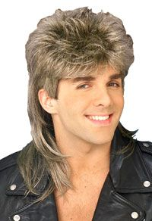
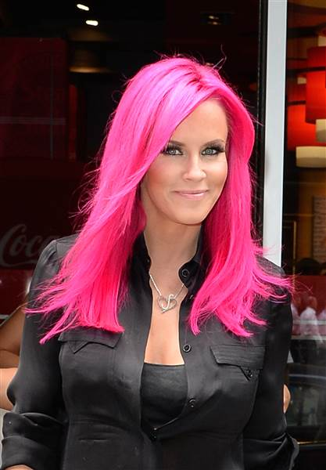
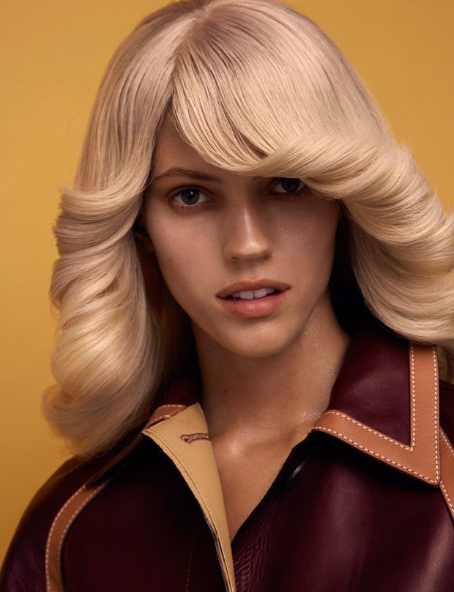
How do you balance trends with core services?
Notes:
makerspces

Slide 14
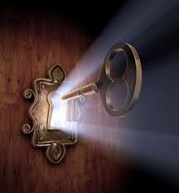
Community partnerships and cultural brokers
Creating strong partnerships and developing long-term cultural brokers in your community is the key to creating an inclusive and balanced service model that reflects your community.
It’s also the only sustainable model for creative programming.
Notes:
Community; sub populations; brainstorming; business leaders; ; men in early literacy; who are your cultural brokers? Step further with partnersips--shja

Slide 15
Stretch your brains and your outreach….
What do you think is the most unlikely population to use your resources?
Why?
Now figure out what you have for them!
(And maybe where do you have to go to find them?)
Notes:
Chat question—and give example of for us—sports people—so when will they come to the library? It’s hard to move non-users to become users, but you can move infrequent users to users…..; 25-37 bracket—cycle of life events;

Slide 16

Library programs have their own life cycles
Notes:
Start and also do finish; don’t be too personally attached; sunken costs; askyourself business quyestion

Slide 17
Resources to further stretch your services and programming model….
Zig-Zag: The Surprising Path to Greater Creativity by Keith Sawyer—”Prepare your mind
The most creative people are voracious learners; they dabble in things they know nothing about. Teach yourself something about weaponry, hypnosis, glass blowing, auto repair, Sufi mysticism…”—sound like any librarians you know?
Marketing to Millennials: Reaching the largest and most influential generation of consumers ever by Jeff Fromm—” (Millennials) Refuse to remain passive consumers—they expect to participate in product development and marketing…” sound familiar—any patrons you know?
Introduction to Marketing: for entrepreneurs and small business owners by Alex Genadanik—recommended first read on marketing by our Library Marketer, Teresa Myers

