Slide 1

Supporting Developing Readers at the Library
Literacy-Based Programs
Presented by Warren Shanks, Children’s Librarian
and Carrie Wolfson, Children’s Librarian
Notes:
CW + WS
Intro by Christine. Introduce Carrie and Warren
Pre-survey Interactive: Raise your hand if you attended the the first session. Use the chat pod to write any lingering questions you have. If you didn’t attend the first session, write what you’d like to get out of this.

Slide 2
Learning Objectives
Articulate the impact of third grade literacy
Explain the five grade level reading skills
Identify criteria for selecting book titles to support developing readers
Incorporate the five skills into your programs and interactive spaces
Notes:
CW
By the end of today’s webinar, you’ll be able to:
Explain the five grade level reading skills
Articulate the impact of third grade literacy
Select titles for successful programs
Incorporate the five skills into your programs and interactive spaces

Slide 3
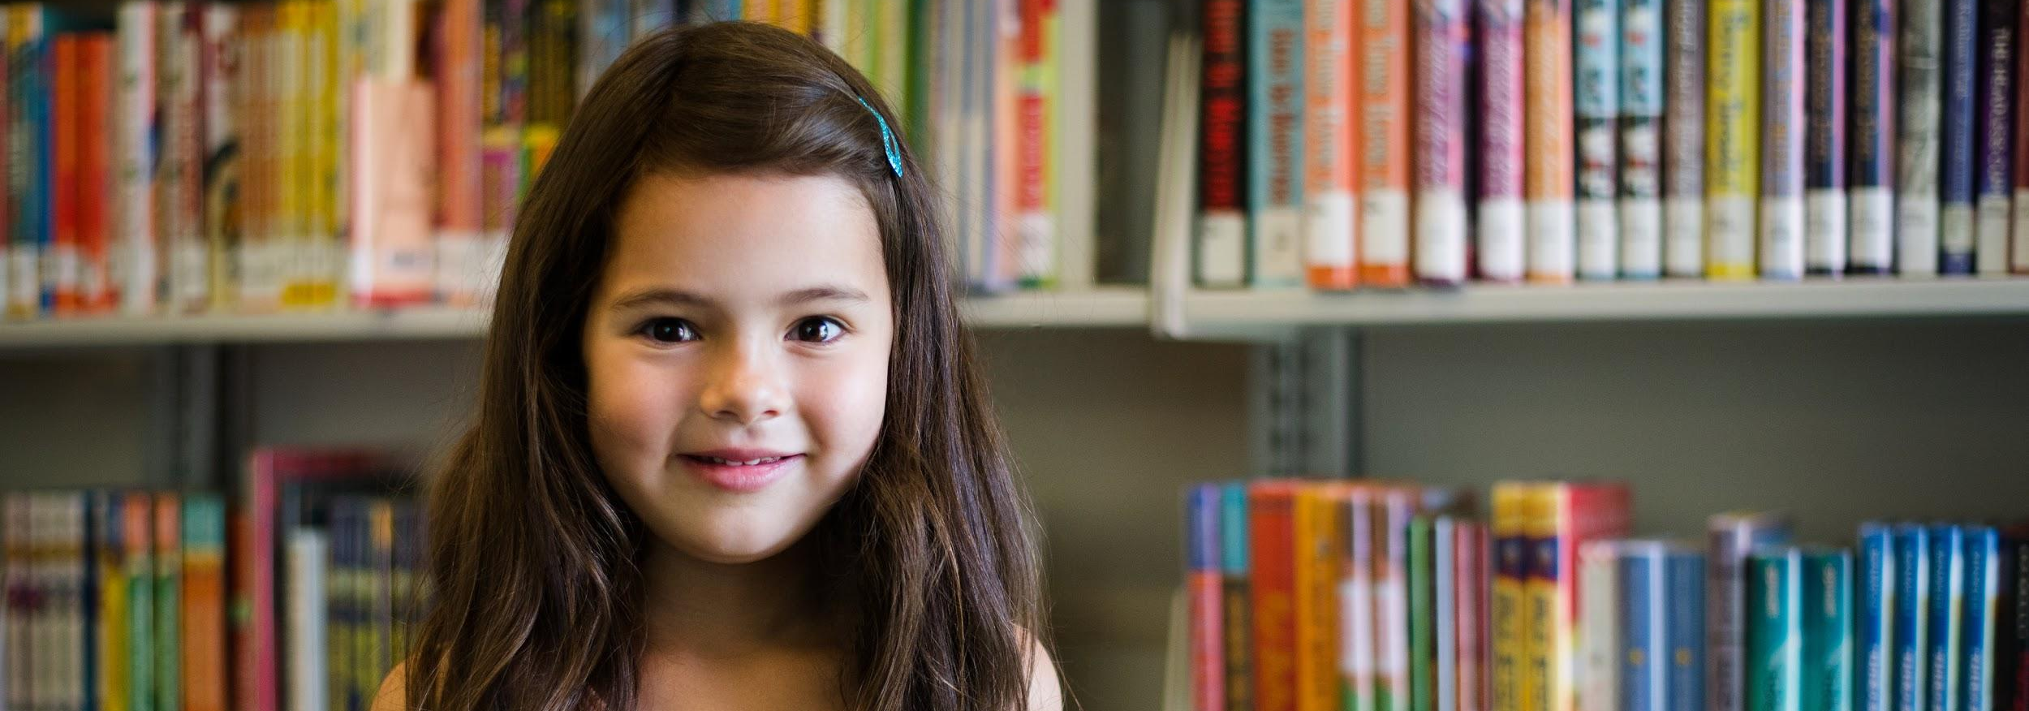
Ice Breaker Chat
Share an example of a book-based program offered at your library.
Notes:
CW
Christine We’ll use the chat pod for this

Slide 4
Why focus on grade level reading?
Notes:
CW

Slide 5
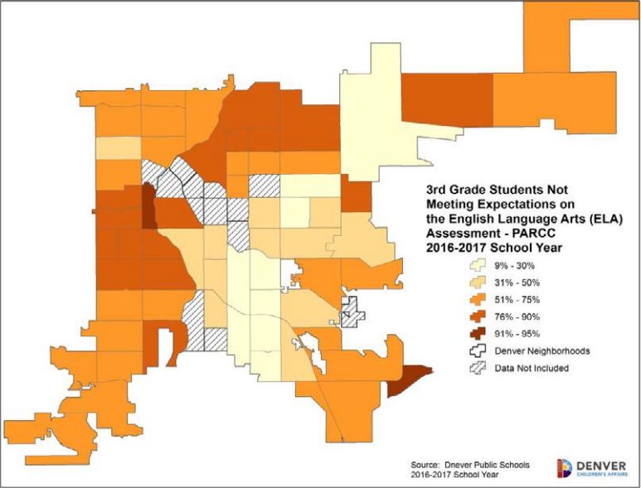
40%
of students in Colorado read at grade level
Notes:
CW
In Colorado, 40% of 3rd graders are reading at grade level. In Denver it’s a little lower, 38%. On this map, the darker the shade of orange the more students there are in the neighborhood NOT reading at grade level.
The ability to read is a foundation students need to in order to navigate future grades, and life after school. The Denver Office of Children’s Affairs states that “Beginning in fourth grade, children transition from learning how to read to reading to learn.”
---------
In Denver Public Schools, 38% of third graders read at grade level. Statewide in Colorado, 40% of third graders read at grade level.
One of our Mayor’s Five Goals for Children is to “Increase the number of students who can read at grade level at the end of their third grade year.”
Office of Children’s Affairs states that “...the ability to read at grade level by the end of third grade is an important marker for future academic success. Beginning in fourth grade, children transition from learning how to read to reading to learn.” The Status of Denver’s Children: A Community Resource 2018, page 88
Additional Resource
Early Warning! Why Reading by the End of Third Grade Matters: A KIDS COUNT Special Report on the Importance of Reading by 3rd Grade
By the Annie E. Casey Foundation
https://www.aecf.org/resources/early-warning-why-reading-by-the-end-of-third-grade-matters/

Slide 6
Grade Level Reading Project Mission
Support and empower library staff, families and educators to connect children (K-3rd grade) with diverse books they enjoy and that inspire curiosity to foster lifelong readers.
Notes:
CW
This project comes from internal work by a team of Children’s Library staff after it was incorporated in Denver Public Library’s work plan. After lots of research, the Grade Level Reading Team came up with this project statement:
-------
Limited term librarian hired in March 2018.
Internal work team composed of Children’s Library staff.
DPS connection critical to understanding what reading instruction looks like for most (80%) of our customers
Grade Level Reading was first incorporated into the library’s 2018 Work Plan, but there were no specifics beyond a charge to “Determine ways to support grade level reading.” This is a HUGE idea! It was difficult to know how to wrap our heads around our task. What would the role of the library be? What would our role be? How could we impact change in a big way?
After all our research, we created a mission statement and work plan with specific goals and objectives to guide our work. This webinar series highlights some of the services and practices we’re piloting as a result of our research. One of the concepts that’s guiding our work is what we call the Five Grade Level Reading Skills. If you’ve never heard of these, don’t panic! It’s just a title we gave to skills all developing readers need. Liesel will now fill you in on the details.
Grade Level Reading Workplan 2018

Slide 7
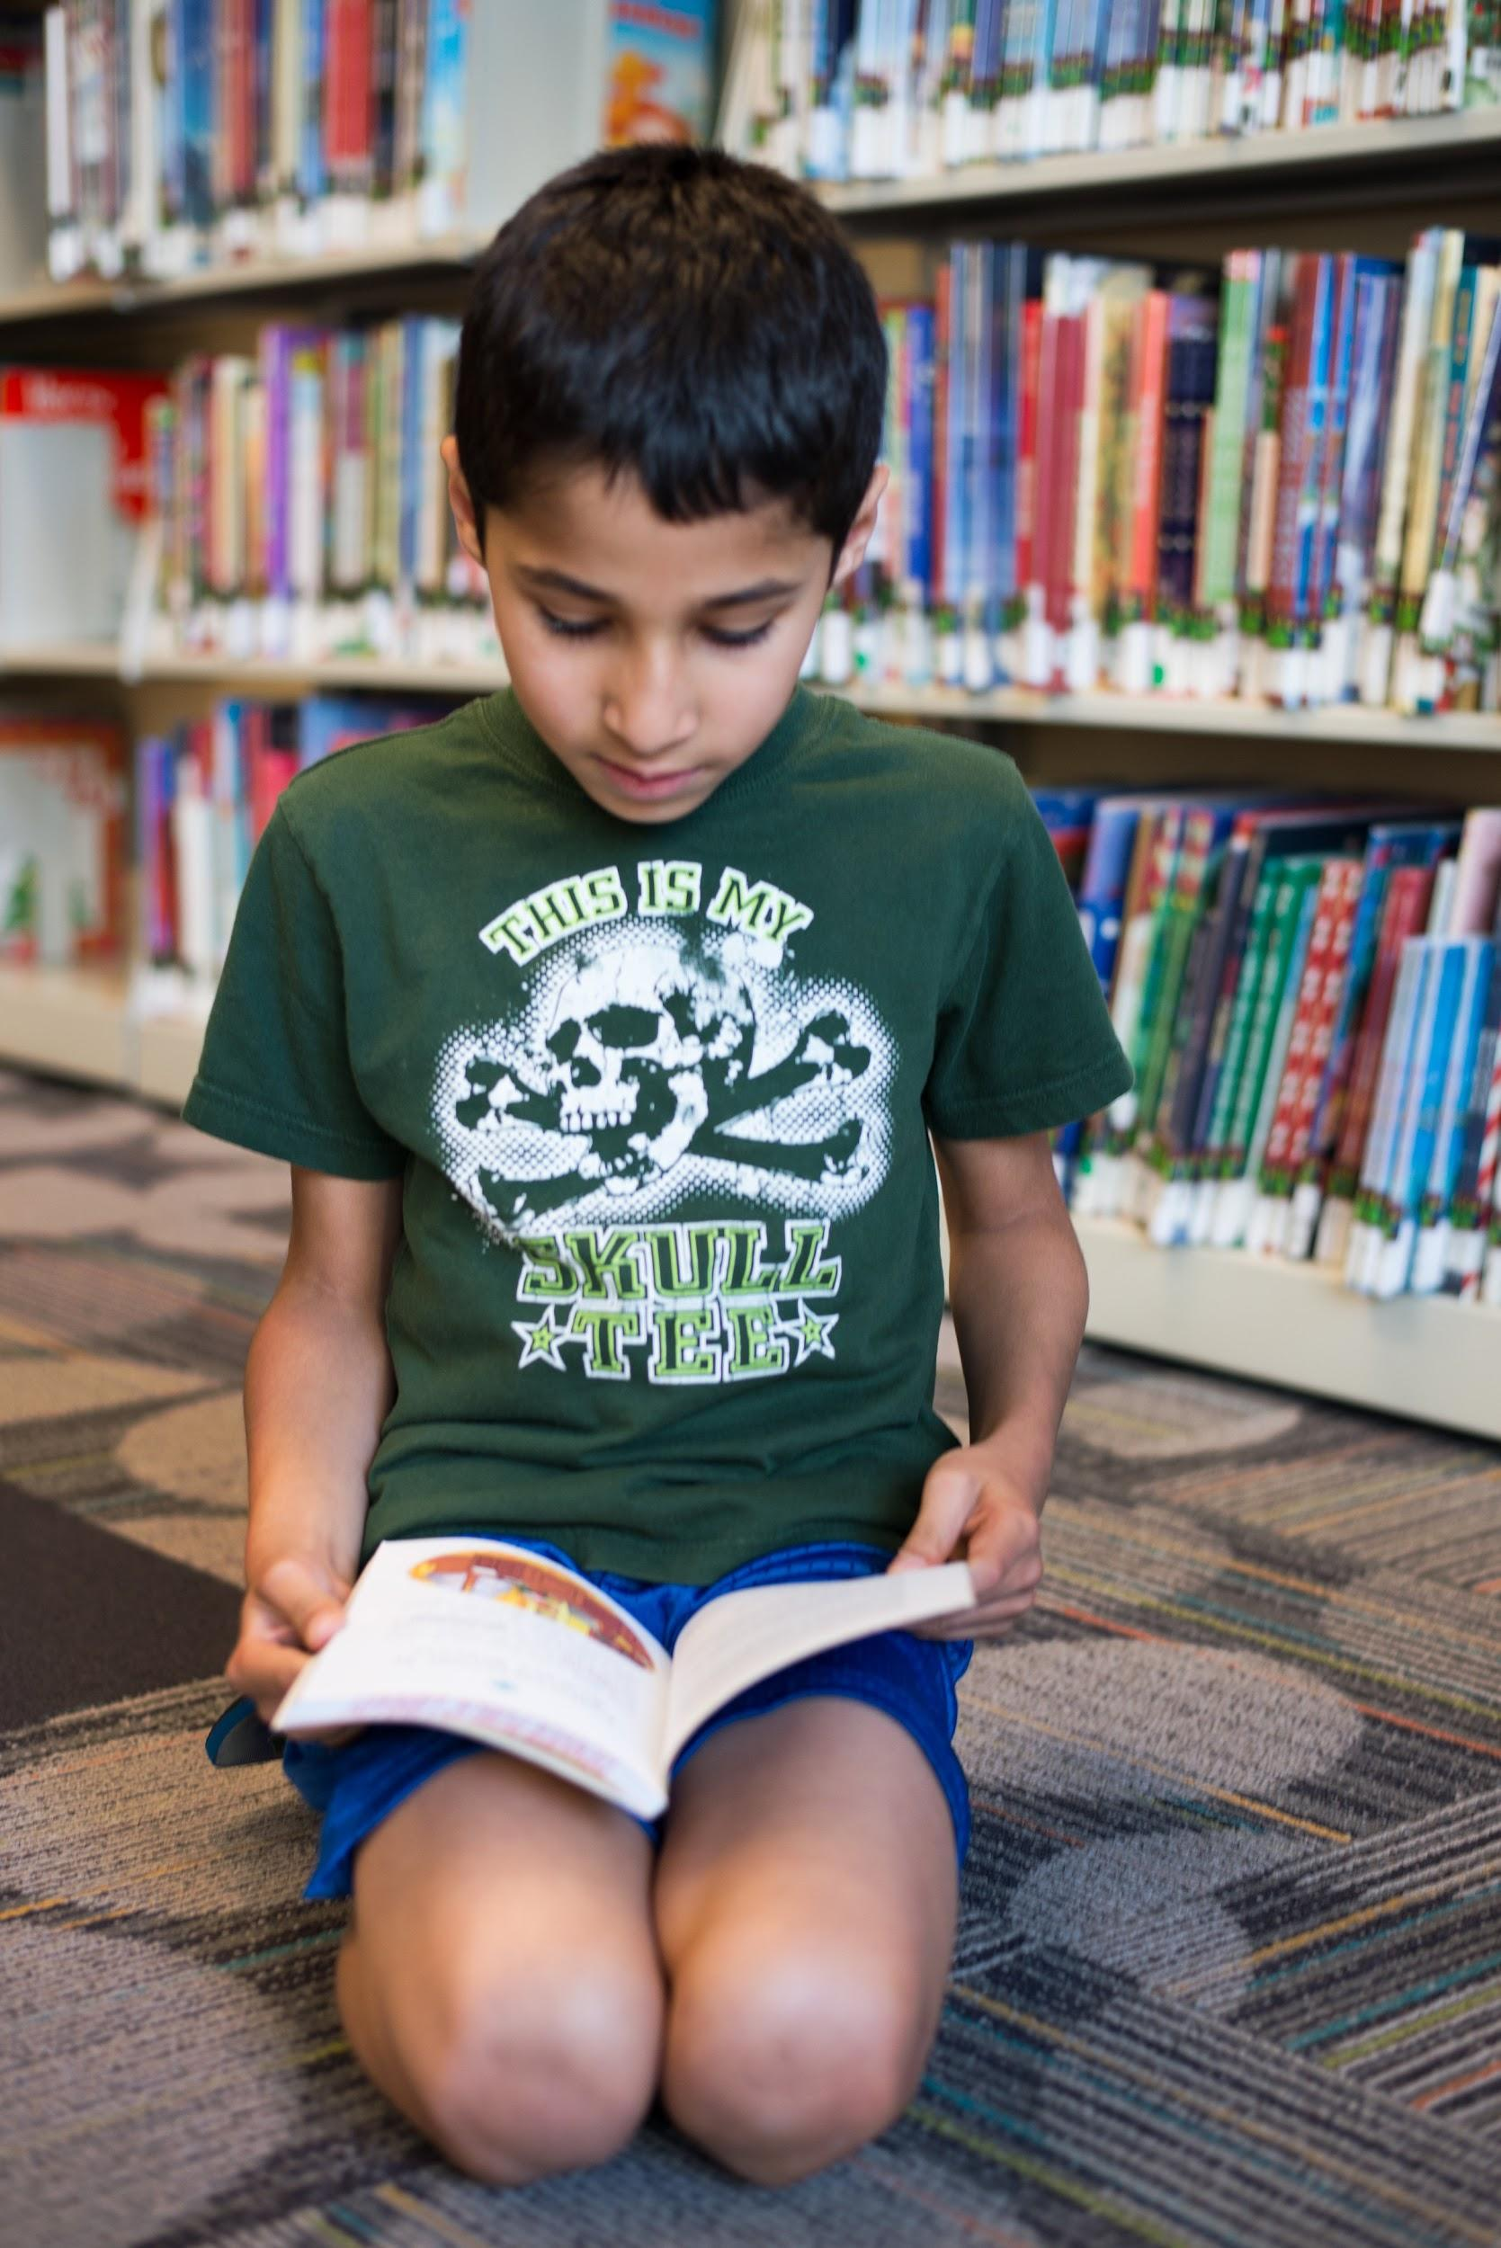
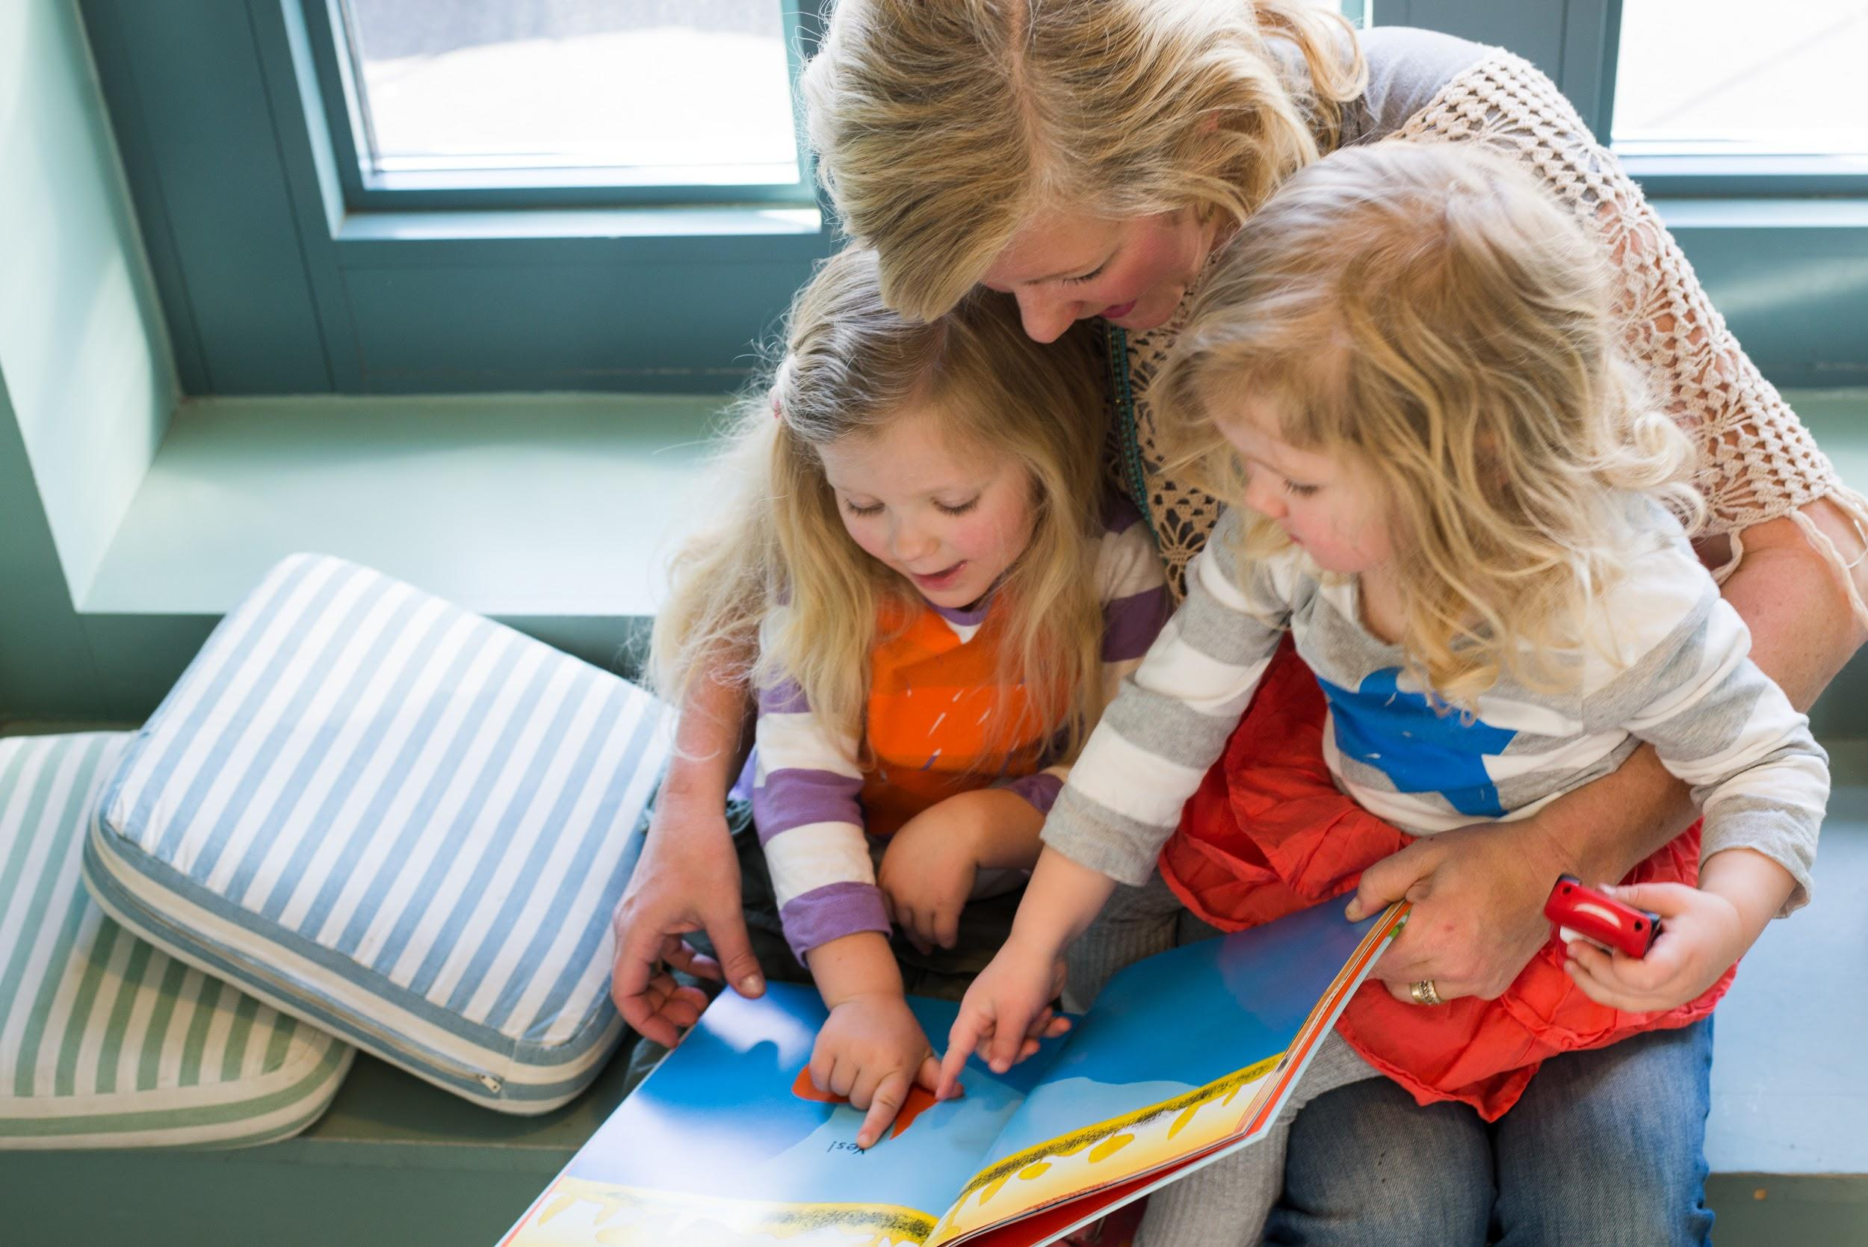
Every Child Ready to Read
Notes:
CW
This is an extension of our early literacy and Every Child Ready to Read (ECRR) work serving children from birth to 5 and their parents and caregivers.
Our focus on Grade Level Reading is our attempt to serve children in K - 3rd grade and their parents and caregivers.
We want to be intentional about the transition from “ready to read” to “learning to read” and ensure library staff is just as confident serving and supporting K-3rd graders in their reading journey as they are serving younger children.

Slide 8
Five Grade Level Reading Skills
Notes:
CW
The Grade Level Reading team came up with five grade level reading skills around which to base our services. Like the the Every Child Ready to Read practices, these skills provide a foundation for our readers advisory, programming and outreach. They focus on five specific aspects of learning to read.
Interactive Does anyone who attended the first session remember the names of the skills? [Pause for answers], Great! We’ll each on a little more shortly. You’re also welcome to follow along with the handout attached.
These are: background knowledge, decoding, reading motivation, fluency and comprehension. Each of these elements contributes to skilled reading. There are lots more important elements to reading, but these skills are areas where library staff particularly can make a difference. Library staff, educators and caregivers can collaborate with students as they build strength in these five skills. I’ll talk more about each of these skills and then we’ll talk about how these skills can be incorporated into your readers advisory.
The creation of our 5 Skills came through meetings with DPS curriculum planners and modeled off of their 6 Components of Early Literacy.
Most kids learn to read through explicit, systematic instruction at school. But, we all know learning at school is only a small piece of the learning environment kids are exposed to. How can library staff support caregivers who want to help their children build reading skills? How can we support students who are struggling? And moreover, how can we better support educators when they are looking for resources to help their students?

Slide 9
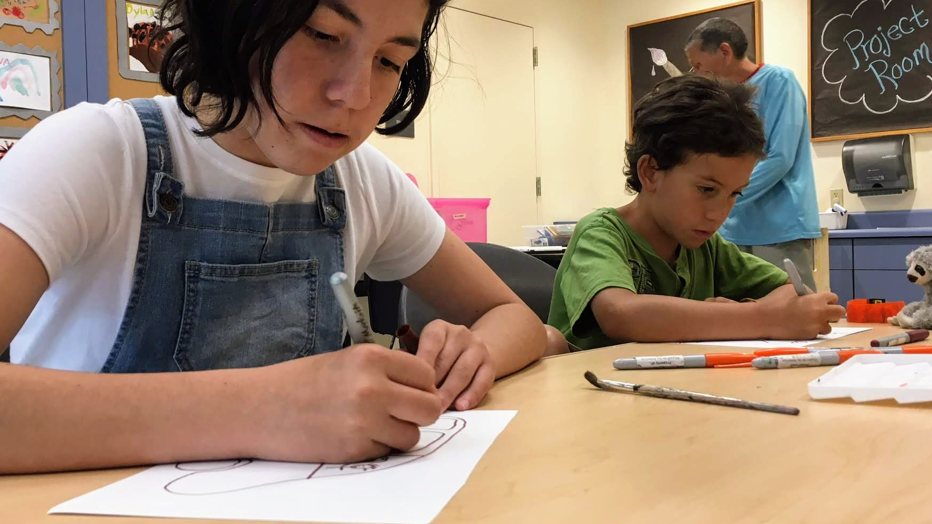
Background Knowledge
Notes:
CW
Interactive What do you all remember about background knowledge? Write your answers in the chat box.
Background knowledge refers to what kids already know before they begin reading a text. From birth, children are building background knowledge. They are learning vocabulary and gaining an understanding of new concepts and experiences. That background knowledge will play a huge role in learning to read. Background knowledge also plays a role in skilled reading throughout our lives.
Even skilled readers benefit from the background knowledge they have. A 1988 experiment, which has been widely repeated, asked readers to read a text about baseball. Poor readers who were familiar with the sport understood more from the text even than skilled readers, if the skilled readers were not familiar with the rules of baseball. Understanding the context for what we are reading, knowing the vocabulary, and feeling comfortable with the concepts discussed, helps skilled readers and developing readers alike. Especially when kids are just starting out as readers, it’s important that they have some understanding of the words and concepts they are reading.
There’s an old saying that kids up through third grade are learning to read, while kids older than third grade are reading to learn. But, that’s not exactly true. Kids are always reading to learn. Skilled readers are better able to get more complex information out of the books they read, but even developing readers are learning from their reading. Think about the ways that we introduce new subjects and vocabulary words in storytime. And, how often does a six year old ask you where the dinosaur books are? Have you ever met a kid who can name every type of construction vehicle because they read about it?
This is important because it means that we can promote background knowledge by exposing kids to books about all kinds of topics. The vocabulary that kids develop when they listen to us read out loud and the facts they learn when they delve into the nonfiction section will help developing readers find their footing. There are lots of ways to promote background knowledge through books in kindergarten through third grade.
Background Knowledge Related Terms:
Explore
Expand
Vocabulary
Ideas
Inquiry

Slide 10
Background Knowledge Example
"Observations using X-rays, the Sunyaev-Zeldovich effect, and weak lensing and galaxy distributions from the optical band, have over the last decade helped to unravel this exciting new frontier of cluster astrophysics, where the infall and virialization of matter takes place.”
Notes:
Interactive To put us into the shoes of a child learning to read, let’s look at an example of how background knowledge is important. Take a moment to read it to yourself. What did you notice? What are you reactions?
Citation: Walker S, Simionescu A, Nagai D, et al. The Physics of Galaxy Cluster Outskirts. Space Science Reviews. 2019;215(1):1. doi:10.1007/s11214-018-0572-8.
“As the largest virialized structures in the universe, galaxy clusters continue to grow and accrete matter from the cosmic web. Due to the low gas density in the outskirts of clusters, measurements are very challenging, requiring extremely sensitive telescopes across the entire electromagnetic spectrum.

Slide 11
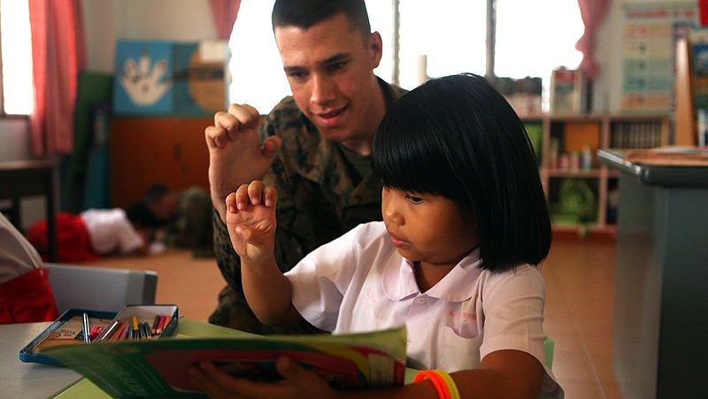
Decoding
Notes:
CW
Interactive What about decoding? What does that mean? [Pause for answers and discuss]
-------
When we learn to read, we are learning to connect the way a word looks with how it sounds and what it means. Decoding is when we use our knowledge of letter-sound relationships to pronounce words that are written. That relationship, between the way letters look and the way they sound, is called phonics. So, understanding phonics helps us decode words. When learners sound out words, they are decoding them.
The English language has 26 letters that make 42 to 46 phonemes or sounds when they are pronounced. In order to read an unknown word, a child needs to be able to look at letters and connect them with sounds.
Most kids need systematic, explicit phonics instruction to learn to read--and that’s the kind of learning that usually happens in schools. In libraries, we’re providing a support role. I often find myself directing parents and caregivers to our beginning or easy reader section to find books that their child can use to practice decoding.
Kids who are learning to connect the way a letter looks with the way a letter sounds benefit from books with very simple words. Think of words that are made up of first a consonant, and then a vowel, and then a consonant. Like bat, cat or mat. Those words are easier to sound out than longer words.
Decoding Related Terms:
Foundational Skills
Sound Out
Letter Sounds
Phonics

Slide 12
Decoding Example
galaxy
ɡæləksi
Notes:
Here’s an example of decoding. The bold and plaintext words say the same thing - one uses the English alphabet, and one uses phonetic symbols. Unless you know the sound that goes with each phonetic symbol, pronouncing the word will be difficult. The ability to connect a letter symbol to a sound and string those together to make a word is called decoding. In practice, this looks like “sounding it out.”

Slide 13
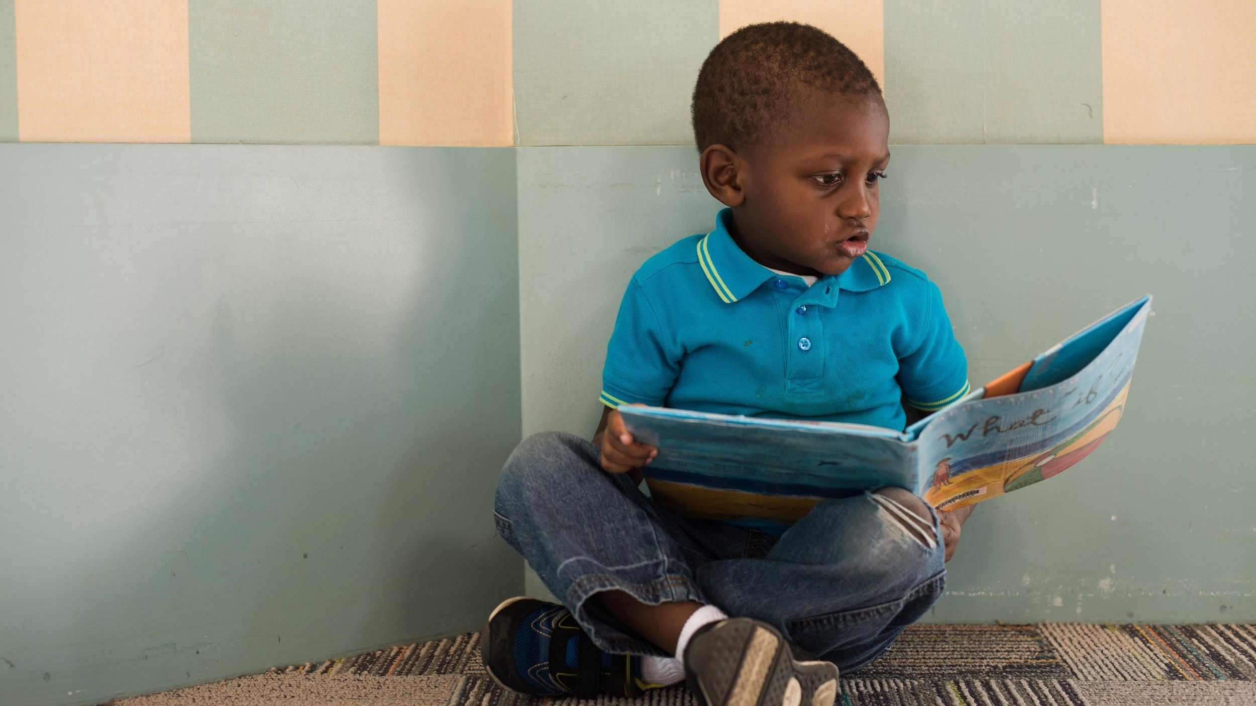
Reading Motivation
Notes:
CW
This next skill, reading motivation, is kind of our specialty in libraries.
Learning to read takes a lot of practice. We’re basically big data machines, synthesizing all kinds of knowledge about letters, sounds and reading rules as we read more and more. Explicit, systematic instruction is crucial, but on top of that, it takes just a ton of practice. Kids who are excited to read will be much more likely to get the practice they need. Plus, kids who are engaged in what they are reading are more likely to develop the focus they need to become skilled, lifelong readers.
A huge factor in developing reading motivation is choice. Kids who are allowed and encouraged to exert some choice over what they read are much more motivated. Self-concept, or the way that we think of ourselves, is also a critical factor in reading motivation and reading success.
Reading Motivation Related Terms:
Enjoyment
Fun
Genres
Choice

Slide 14
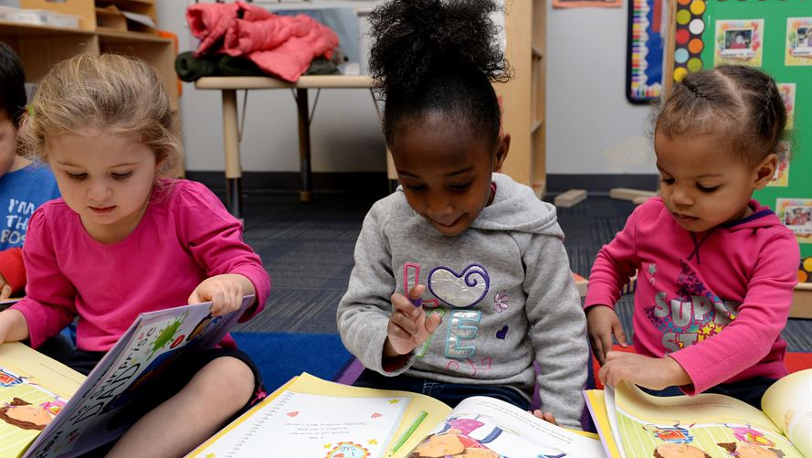
Fluency
Notes:
Fluency is the ability to read a text quickly, accurately and with expression. It’s the step that helps readers connect word recognition with word meaning. This is the stage in which the phonological and orthographic reading networks are working smoothly to create meaning. Fluent readers recognize and comprehend at the same time. Fluency practice happens when kids find books at the right level and practice reading those books. While the library does not provide reading instruction, we help connect kids and educators with books at the right level for developing fluency.
Word recognition is an important part of fluency, but fluency really develops when words are read together with expression.
Fluency also depends on background knowledge and vocabulary. And, strong executive function is important, too. We must be able to infer, organize, and pay attention all while continuing to read.
Image source

Slide 15
Fluency Example
Princess Magnolia minced to the door. Her glass slippers went tink-tink-tink-tink.
“You’re going to just leave me here?” said the duchess.
“I’ll hurry back!” said Princess Magnolia.
She smiled sweetly. She shut the door softly.
And then Princess Magnolia ran.
Notes:
CW
Interactive To put us into the shoes of a child learning to read, let’s look at an example of how background knowledge is important. Take a moment to read it to yourself. What did you notice? What are you reactions?
Citation: Princess in Black by Shannon Hale and Dean Hale Page 7.

Slide 16
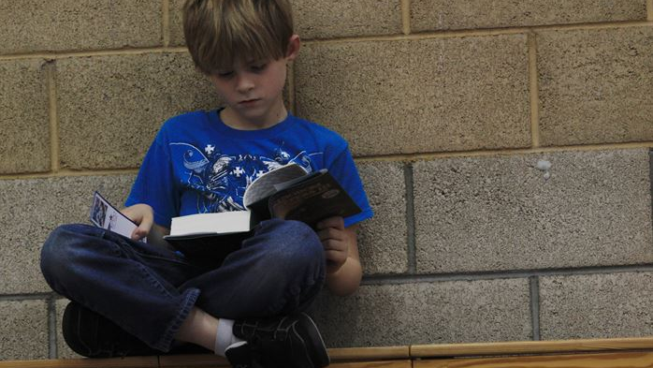
Comprehension
Notes:
CW
Comprehension is the reason for reading. All of the skills we just talked about: background knowledge, decoding, reading motivation, and fluency add up to comprehension. Kids who are learning to read are also learning a variety of comprehension techniques that will help them figure out the meaning of a text. Considerate texts support comprehension through features such as an introduction, a clear sequence of topics and the use of cohesive words that tie the text together, like “first,” “second, “however” and “although.” Texts that introduce new vocabulary carefully--and repeat new words so that kids can become familiar with them are also providing support for developing readers.
Often early and developing readers gravitate toward book series that have consistent characters and setting from book to book. They are beginning to read for meaning, to become absorbed by what they read!
Texts can help support these five skills and Ann will talk more about that. First though, let’s pause to reflect on the five grade level reading skills.
Image source: Lance Cpl. Derrick K. Irions
Comprehension Related Terms:
Explain
Understand
Retell
Discuss

Slide 17
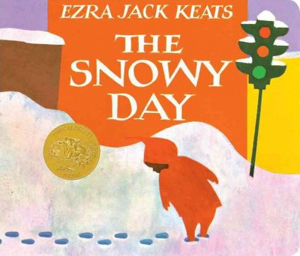
Comprehension Example
What happened in the story?
What’s the setting?
Who’s the main character?
How did the story end?
Notes:
CW
Interactive To put us into the shoes of a child learning to read, let’s look at an example of how background knowledge is important. Take a moment to read it to yourself. What did you notice? What are you reactions?
Citation: Princess in Black by Shannon Hale and Dean Hale Page 7.

Slide 18
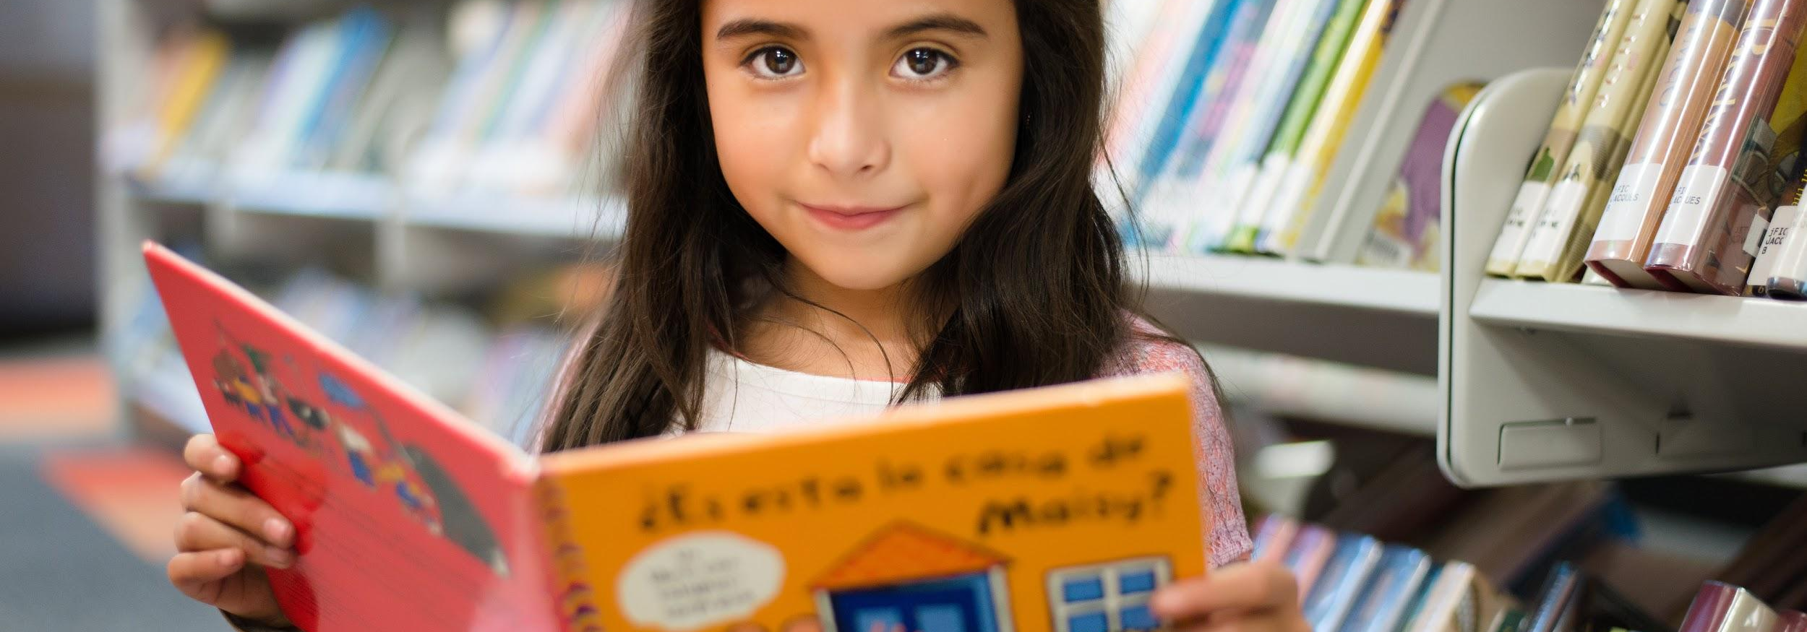
Chat
What was it like when ECRR was first implemented at your library? What are you already doing that connects to Grade Level Reading in your programs?

Slide 19
Supportive elements in books help developing readers
Notes:
Selecting Books tools in the handout.

Slide 20
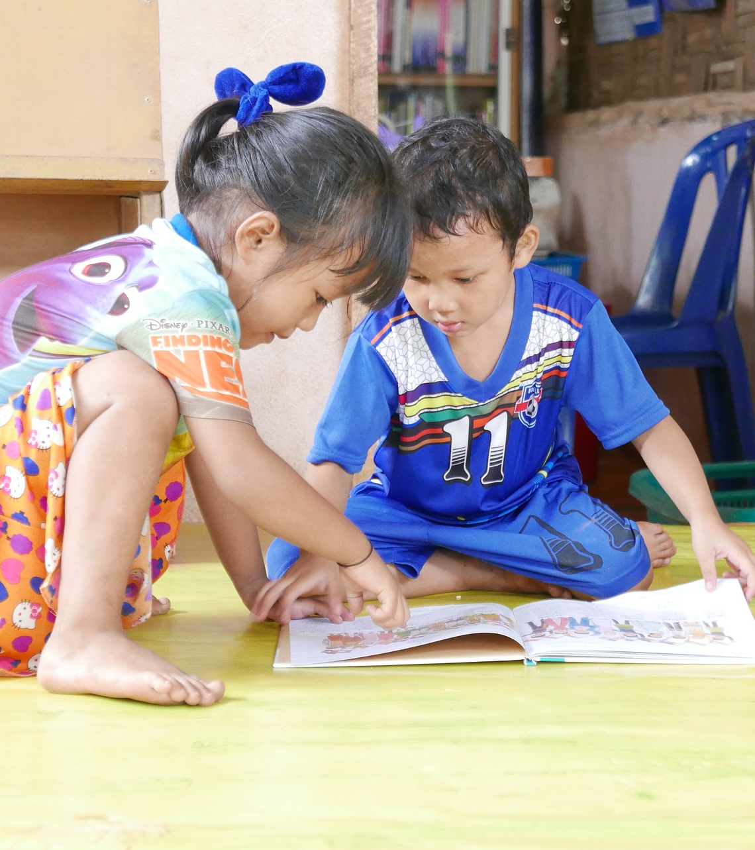
Books help readers move through the stages of reading development.
Notes:
Early books and Transitional books subject terms have been added to books we’ve identified as helpful.

Slide 21
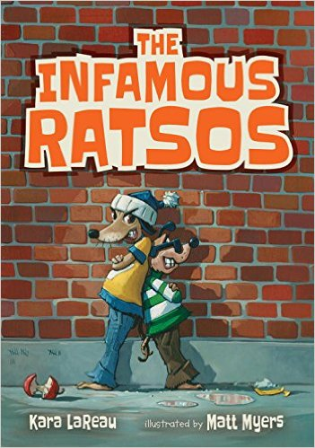
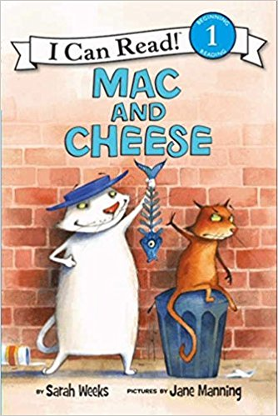
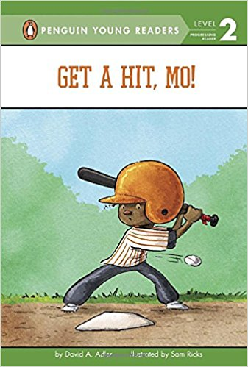
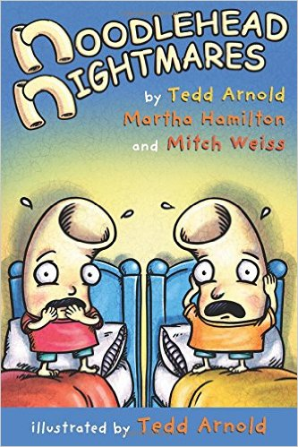

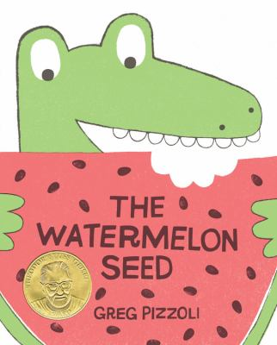
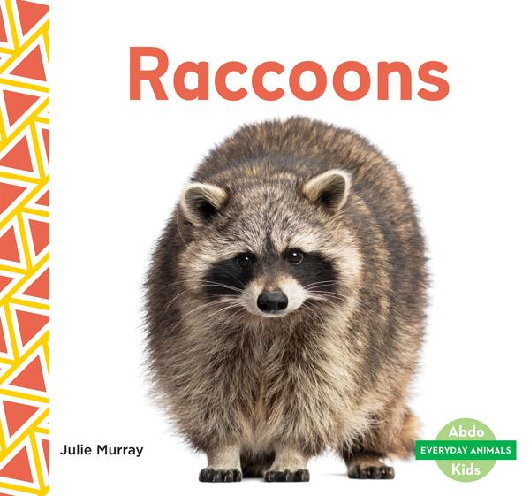
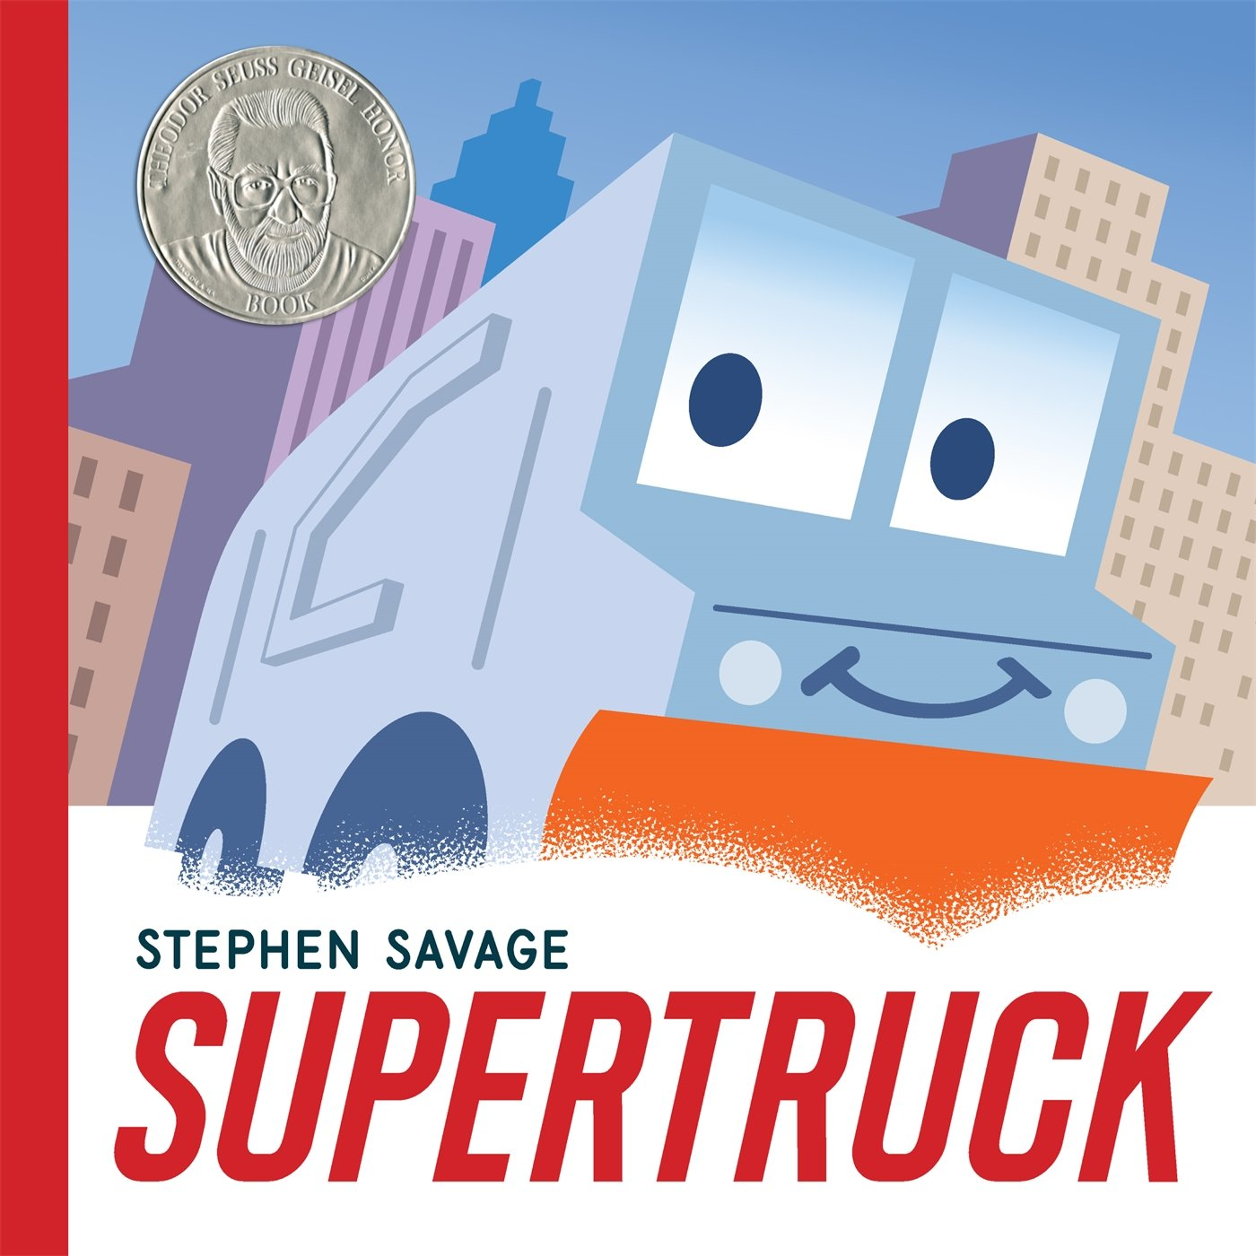
Supportive books can span
across collections/genres.
Chapter Books
Readers Picture Books Graphic Novels Nonfiction Bookpacks
Notes:
WS
More about the specific elements in the Session 1 archive
We have identified titles through all of these collections.

Slide 22
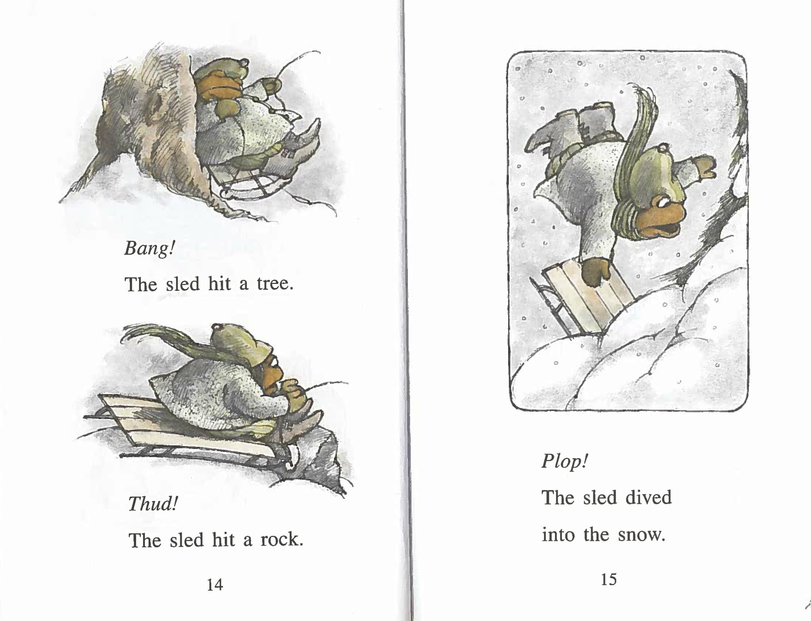
Supportive
Elements
Frog and Toad All Year by Arnold Lobel
Notes:
Repetition
“The sled hit…” repeated so the reader can practice
Punctuation
period, exclamation point
Short words/sentences
Short, declarative sentences are easiest to convey and decode.
White Space
Lots of white space gives new readers the chance to focus on the words, gives their eyes a chance to rest. Remember, using those new muscles can get tiring!
Leading - the space between lines should be equal to the size of the typeface. It’s easier to focus on an individual word when it isn’t crowded by other words.
Illustrations
give clues for context, build interest/motivation to keep going.

Slide 23
Incorporating the five skills into programs.
Notes:
Our goal is to create fun and easy to implement literacy-based programs for K-3rd graders to practice and gain confidence reading, and for the caregivers in their lives to learn about DPL tools and resources, as well as ways to foster family engagement beyond the library. Literacy-based programs include activities to support one or more of the GLR Skills. Literacy-based programs can take many forms (drop-in, time specific, etc.).
Adding it into pre-planned programs
Programs we’ve tried - Successes and lessons learned
Template and Guides
Read-aloud - Sharing a book is a solid intro to kick off a program. Reading smoothly and with expression is a great way to demonstrate reading with Fluency. Discussing new concepts and vocabulary builds Background Knowledge.
Mix and Match Flip Book - Break up the names of animals (or whatever is being mixed/matched) to encourage Decoding in a hilarious way.
Book Bin / Book Display - Having read-alikes or titles on related topics easily accessible for browsing supports Reading Motivation.
Drawing/Writing Station / Writing Prompts - Provides opportunties for kids to retell or create a new story. An ideal next step is for them to explain or tell it to caregivers. Either way, this activitiy builds Comprehension skills.
Booktalks - If you're conducting a book-based program, you could sneak in some quick recommendations or read-alikes. Reading Motivation!
Observation Journals - Animal programs are an easy in to encourage kids to create observation journals and build Comprehension skills. These can be premade or made on the day by attendees. They work during a program or as a way to extend it.
Props - Use props to retell a story, and they don't have to be anything fancy, unless we're talking waffles here. Retelling or recreating a story works on Comprehension.
Listening Station - There's some good options in Bookpacks tagged with the Early Books subject term. Simply put out a CD player and set of headphones (or a splitter and two sets of headphones) and you're good to go! It's probably easier to build around a program around these books but some of the books could tie in to various programs.

Slide 24
Supertruck
by Stephen Savage
Notes:
Supertruck
Popular subject matter works for a good age range and supports Early Learning and Developing Readers
Geisel Honor Title
We want to develop a drop-in program where staff won’t have to be present the whole time but may need to step into the space occasionally to check on customers and reset/resupply.
Let’s plan this one thinking about reading skills we want to work in and add the program offerings from there.
Desired skill - Fluency: As we mentioned before, we’re looking for smooth and expressive reading. As there won’t be staff present to read aloud, let’s drop in a listening station.
Station 1: Listening Station
Skills Supported:
Fluency - Listening to the bookpack will model reading with fluency
Reading Motivation - Will increase interest/awareness of Bookpack collection
Comprehension - Sign will prompt caregivers to ask open-ended questions after listening
Activity: Have CD player and a copy of the bookpack for kids and caregivers to listen to and read along.
Setup: Secure a copy of the bookpack. Find a CD player and headphones, and a headphone splitter. Could also be done without headphones. Place the CD player, headphones, and book on a table along with a sign encouraging customers to listen and read along, and for caregivers to ask follow up questions after.

Slide 25
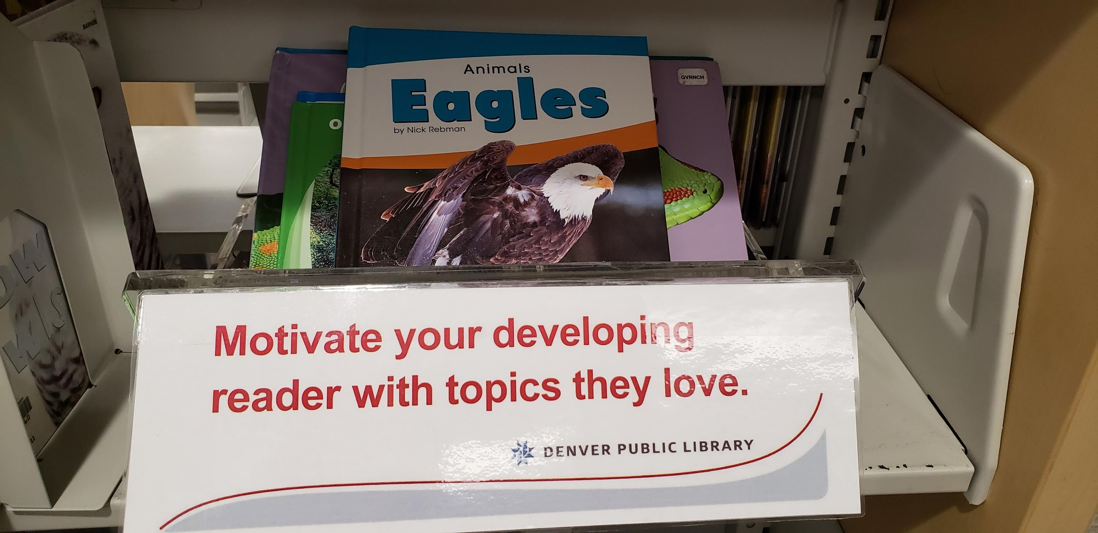
Reading Motivation Example
Notes:
Let’s drive home Reading Motivation on this one.
Station 2: Book Display (Can be copies of super truck or other related titles)
Skills Supported:
Reading motivation - Attendees will be able to check out additional reading
Activity: None
Setup: Find age appropriate materials about trucks, cities and snow and a surface to display them.
Station 5: If I were a Truck Writing Prompt
Skills Supported:
Comprehension - Attendees will write and draw about the kind of truck they’d like to be and what their superpower might be, building on Supertruck’s disguise and superpower.
Activity: Attendees will write in their ideas about what kind of truck and their superpower they would want on a printable sheet. The sheet will have room for drawing a picture of your truck before and after changing into a hero.
Setup: Print If I were a Truck Template. Place on table with markers, crayons, and pencils. Along with a sign and examples.
How will the program facilitator encourage meaningful interactions?
When stopping by the program space to tidy up and refresh supplies, program facilitator will introduce themselves to customers, ask about their projects, and encourage them to check out books.
How will the program facilitator invite caregiver interaction with children?
Signs will be included at activity stations to prompt interactions.
Additional talking points…
There’s obviously more that goes into planning than my boiled down example here. We have the benefit of a large department and we bounce ideas off each other and are all quite efficient in stealing program ideas from other libraries.

Slide 26
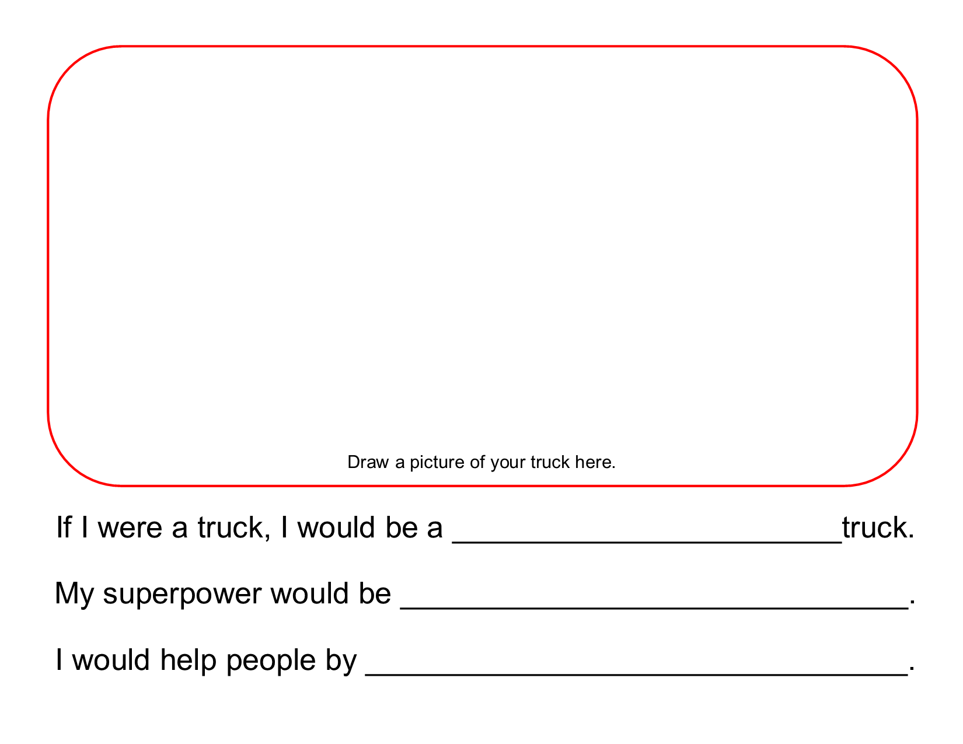
If I Were a Truck Reading Prompt
Notes:
Comprehension
Station 5: If I were a Truck Writing Prompt
Skills Supported:
Comprehension - Attendees will write and draw about the kind of truck they’d like to be and what their superpower might be, building on Supertruck’s disguise and superpower.
Activity: Attendees will write in their ideas about what kind of truck and their superpower they would want on a printable sheet. The sheet will have room for drawing a picture of your truck before and after changing into a hero.
Setup: Print If I were a Truck Template. Place on table with markers, crayons, and pencils. Along with a sign and examples.

Slide 27
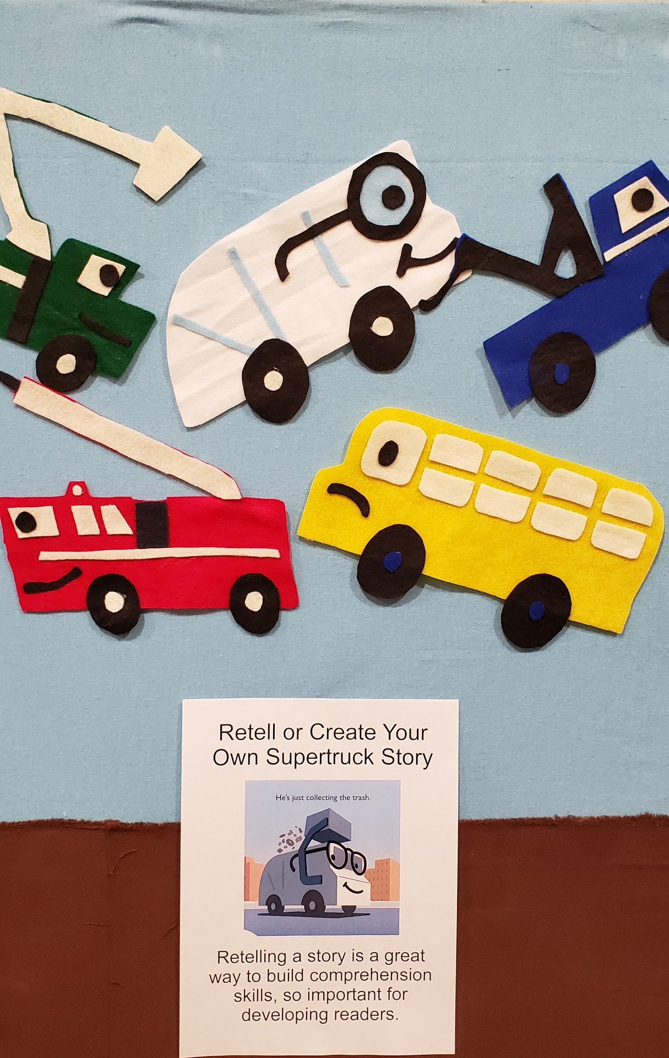
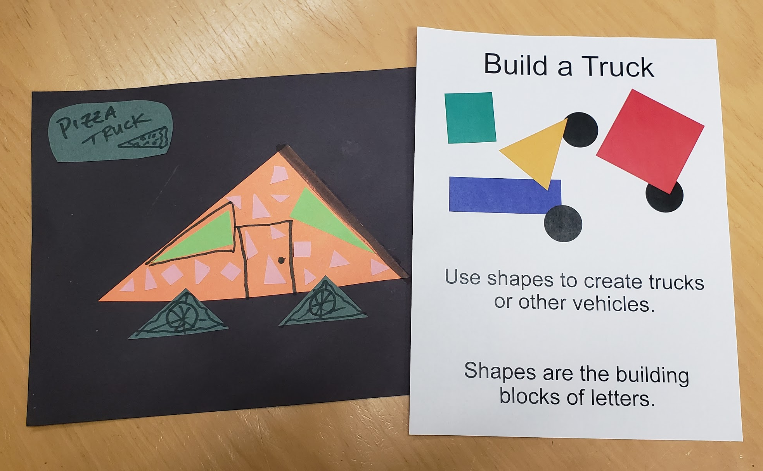
If I Were a Truck Activities
Notes:
Station 3: Build a Truck
Skills Supported:
n/a
Activity: Attendees use paper shapes and glue to create paper trucks.
Setup: Cut out squares, circles, and rectangles from construction paper. Place in bins on table along with glue sticks, scissors, markers, and large pieces of construction paper to glue materials to. Include a sign and an example or two.
(x) Station 4: Flannel Board
Skills Supported:
Comprehension - Attendees will retell or create their own Supertruck stories using flannel board pieces.
Activity: Attendees interact with a flannel board and felt trucks and skyscrapers to retell and create Supertruck stories.
Setup: Make felt board pieces by scanning, printing and laminating images from the book, or by creating felt versions of the truck and skyscrapers. Place a copy of the book nearby, along with a sign encouraging caregivers to read the book and retell it on the flannel board with their child.
(x) Station 5: If I were a Truck Writing Prompt
Skills Supported:
Comprehension - Attendees will write and draw about the kind of truck they’d like to be and what their superpower might be, building on Supertruck’s disguise and superpower.
Activity: Attendees will write in their ideas about what kind of truck and their superpower they would want on a printable sheet. The sheet will have room for drawing a picture of your truck before and after changing into a hero.
Setup: Print If I were a Truck Template. Place on table with markers, crayons, and pencils. Along with a sign and examples.
How will the program facilitator encourage meaningful interactions?
When stopping by the program space to tidy up and refresh supplies, program facilitator will introduce themselves to customers, ask about their projects, and encourage them to check out books.
How will the program facilitator invite caregiver interaction with children?
Signs will be included at activity stations to prompt interactions.
Additional talking points…
There’s obviously more that goes into planning than my boiled down example here. We have the benefit of a large department and we bounce ideas off each other and are all quite efficient in stealing program ideas from other libraries.

Slide 28
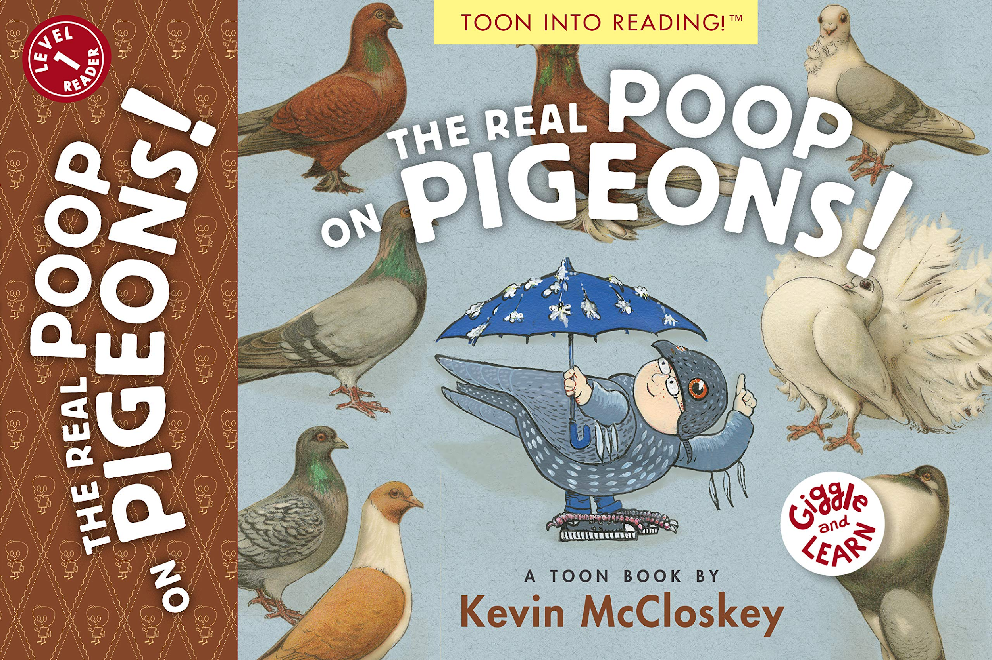
The Real Poop on Pigeons!
by Kevin McCloskey
Notes:
Real Poop on Pigeons
Graphic format with good humor
Reading level is a good fit for developing readers.
Unfortunately no pictures from the program.
When scheduling presentes for our Summer of Adventure program, we requested that they be able to tailor a program to a specific book. Nature’s Educators was on board. They were happy to do it and actually already had different book tie-ins for their programs(Harry Potter, Pokemon). We chose this one because it fit our Grade Level Reading initiative and we thought city kids would find it relatable - We also already had Hawk Quest bringing owls or something so we felt safe with pigeons.
A staff member read the book aloud at the start of the program then Nature’s Educators did their thing. We did have books on display too - We put out copies of this as well as nonfiction tie-ins and Mo Willems’ Pigeon books.
We didn’t hit all 5 skills butt the read aloud provided a demonstration of reading with fluency and the presenters provided background knowledge. The book display actually did well which isn’t always the case so the reading motivation must have been there.

Slide 29
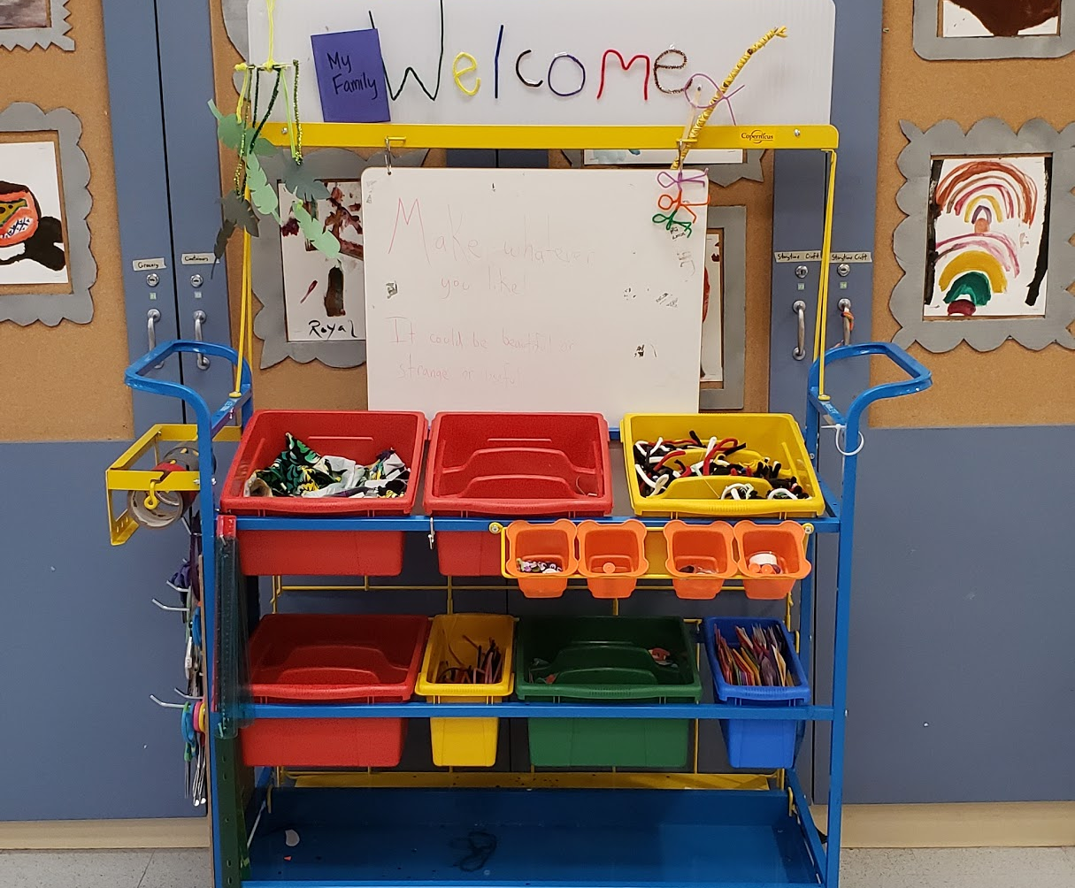
Winter Break Programming
Notes:
For our break programming we’ve been offering 2 hour blocks of maker time with a loose book tie-in. We filled this cart in the background with a variety of materials - being intentional about there being a product should customers want it but also setting this up for process exploration.

Slide 30
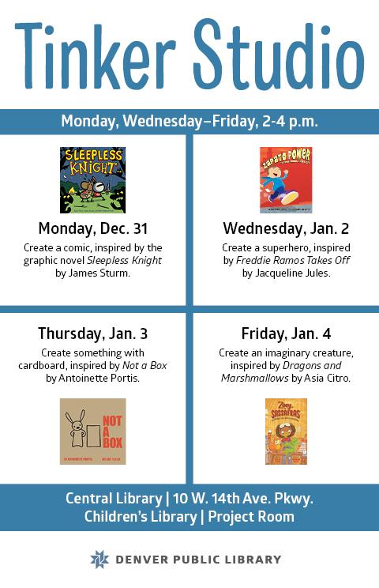
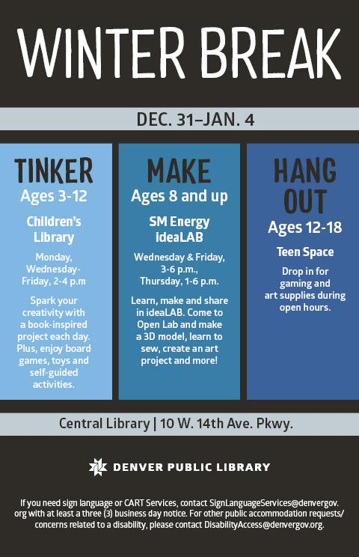
Example Programs #1
Notes:
As for the books we’ve tried to have various levels and genres.
Sleepless Knight
Zapato Power
We’ve tagged this title with the Transitional Books subject heading. So even though it not have been read in some time, I can be assured that it’s been vetted and has supportive elements.
Not A Box
Another one that works for early literacy
This inspired some of the best creations to come out of our tinker space. We put out a ton of cardboard and there were ships and other great creations. We saw families work together kids work independently…
Dragons and Marshmallows
Opportunity to model for caregivers.

Slide 31
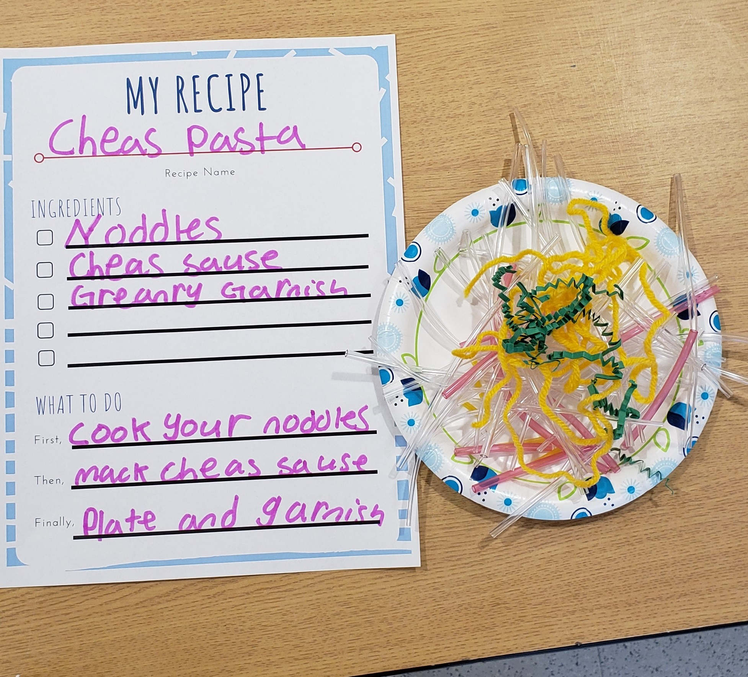
Example Programs #2
Notes:
I couldn’t find any photos from those events so… This one didn’t have a specific book tie in but Cooking and following recipes is great background knowledge. We did have some cookbooks out on display for the program.

Slide 32
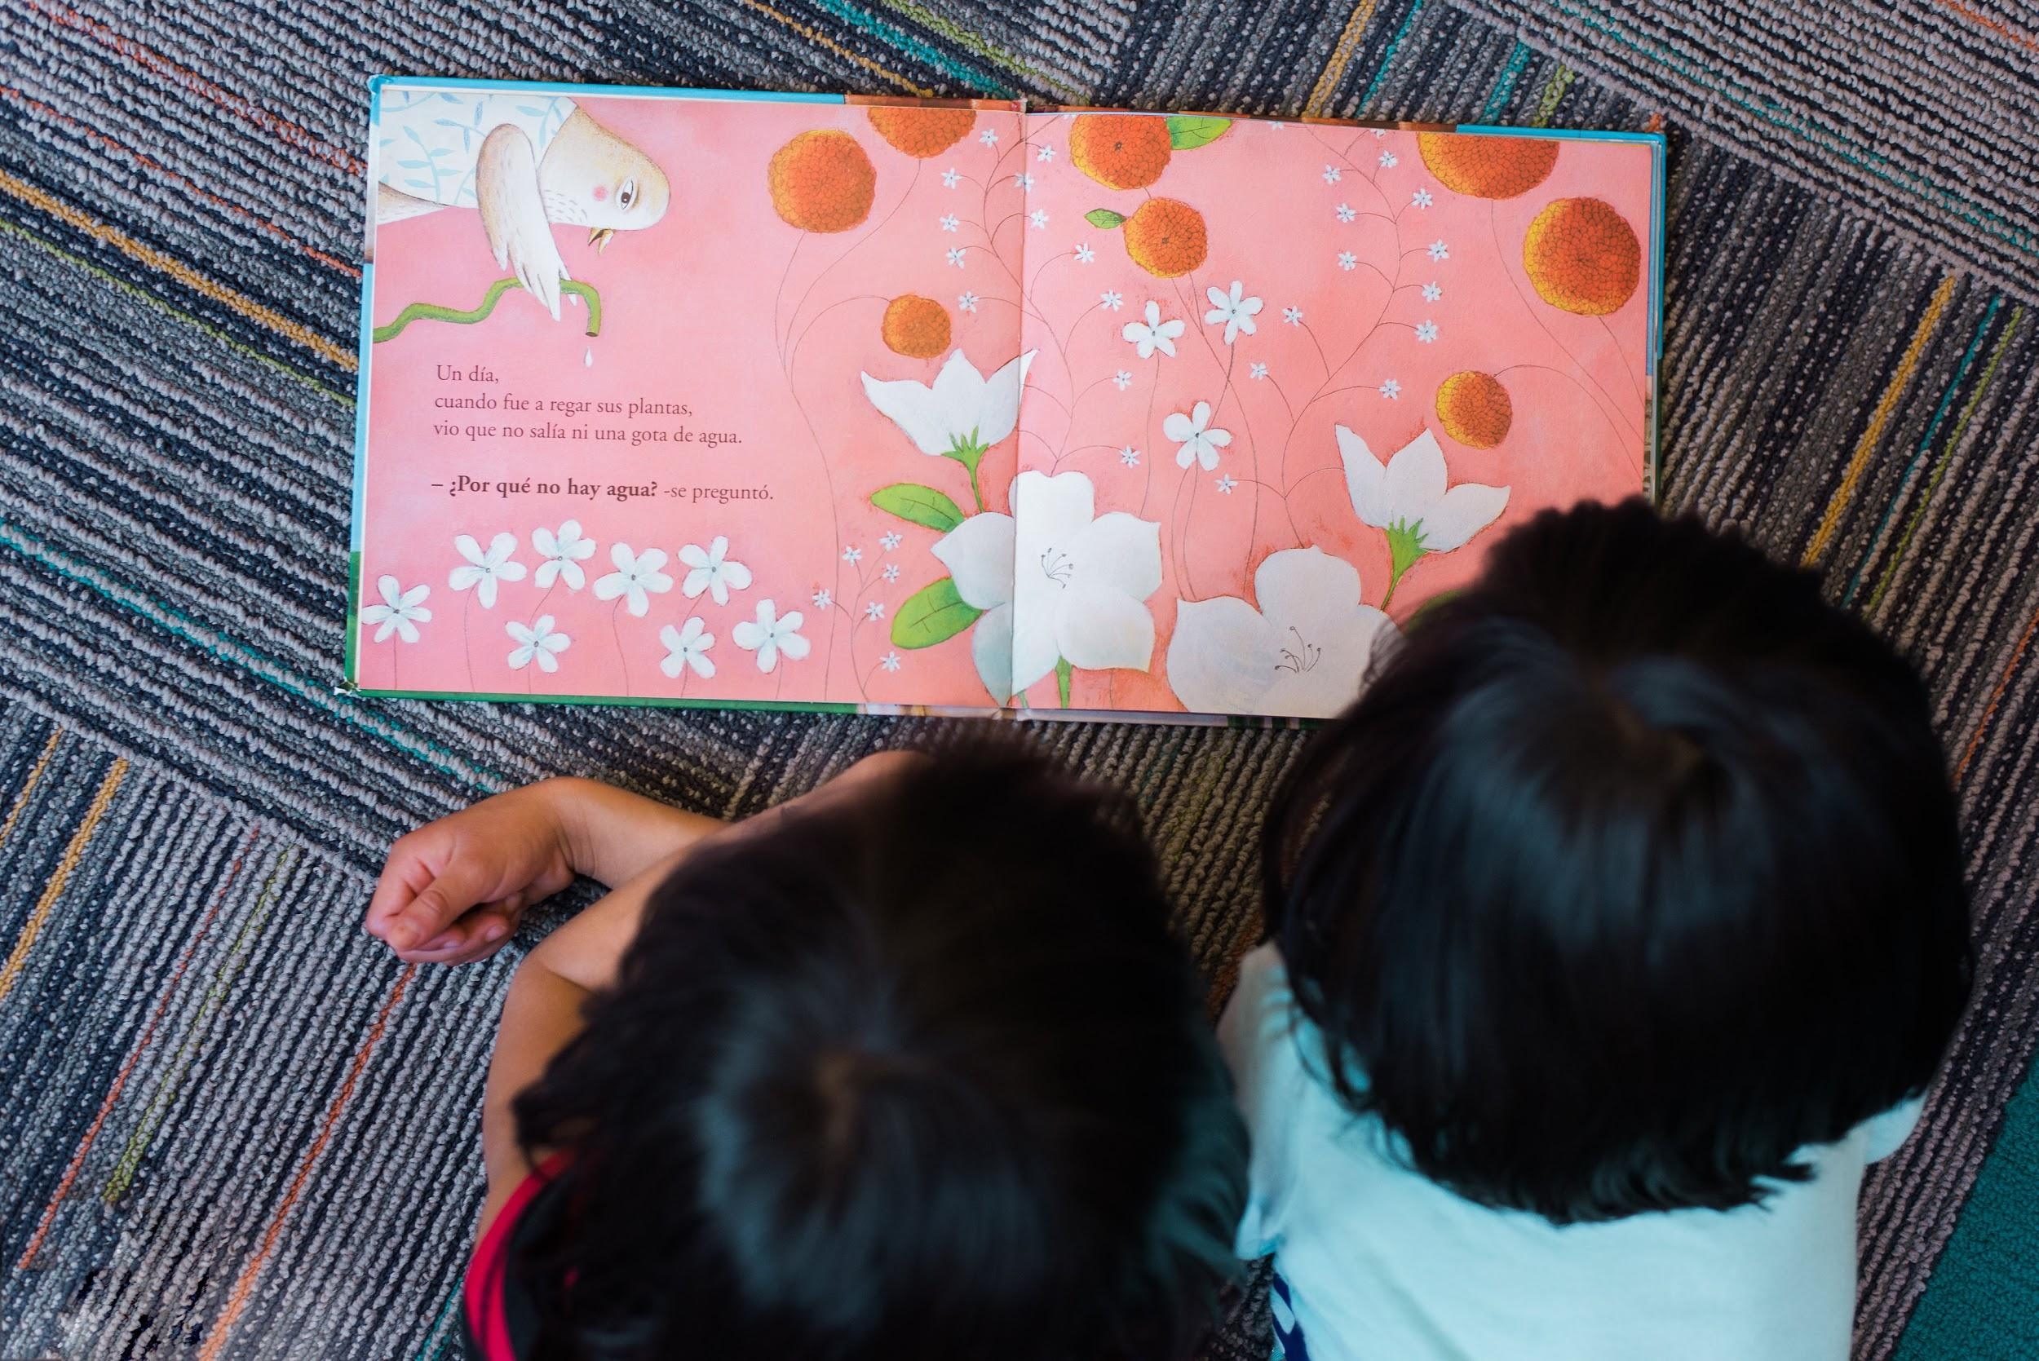
Reading Conferences
Notes:
Modeled after a high school english teachers experience doing this same-ish thing (From The Unexpected Power of Reading Conferences by Jori Krulder)
For fiction:
What made you choose this book?
What’s happening so far in your book?
What do you predict will happen next? Why?
Tell me more about the characters? Who’s your favorite? Least favorite? Why?
Would you be friends with this character? Why or why not?
Is there a problem in the book? How have the characters tried to solve the problem?
Could this book actually happen in real life? How do you know?
If you could change one thing about the book, what would it be? Why?
Does this book remind you of a movie or television show?
Would you have ended the book differently? Why?
Why do you think the author wrote this book?
Who would you recommend this book to?
For nonfiction:
What made you choose this particular book?
What did you already know about this topic before reading this book?
What have you learned so far?
What was the most interesting fact you’ve learned?
Has this book changed your thinking on the topic? How? Why?
What do you still want to learn? What else would you be interested in finding out about this topic?

Slide 33
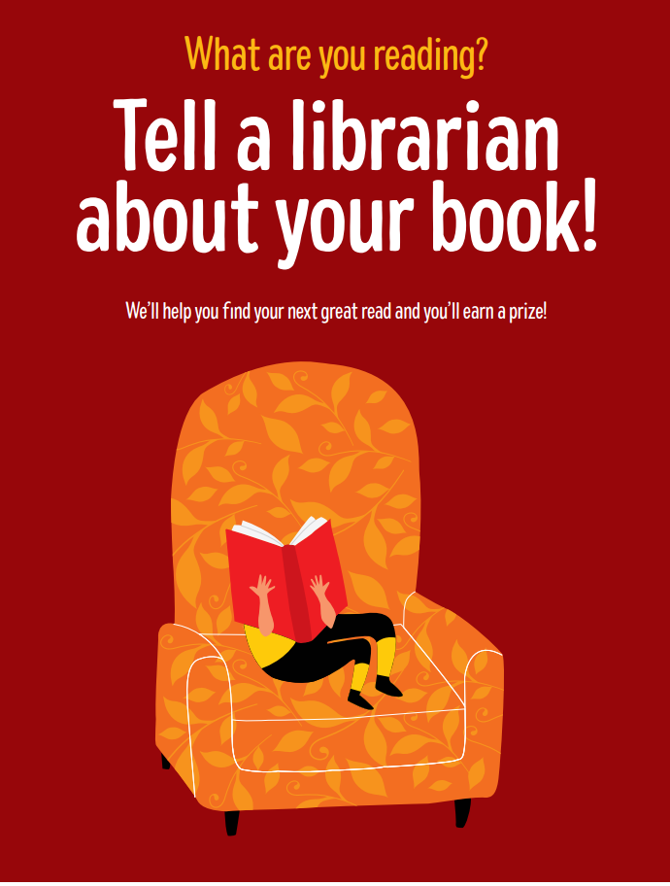
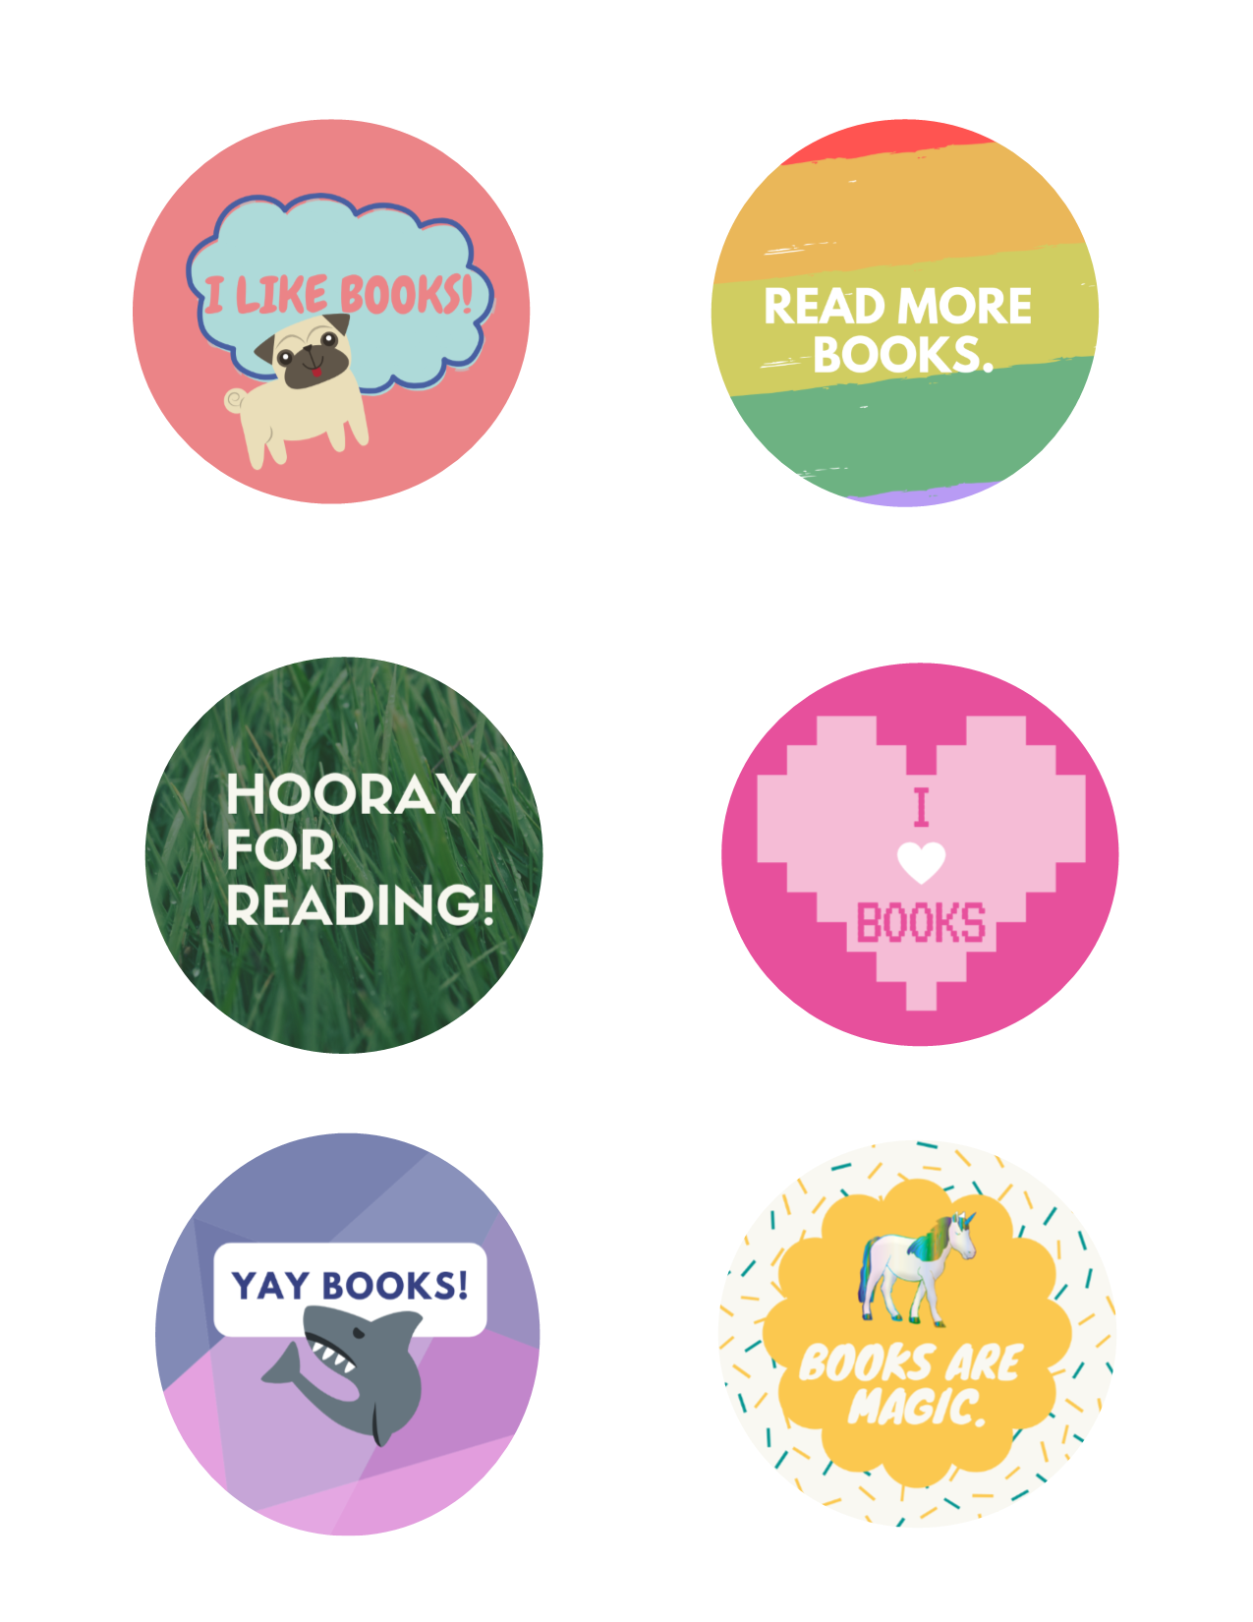
Tell a Librarian about your Book
Notes:
We’ve put several of these signs throughout our space to encourage children to tell staff about a book they are reading. Creating an intentional opportunity for customers to discuss books will help us build relationships as well as an easy in for plugging Grade level Reading materials and services.
This is easy to implement in any space but all staff should be aware. Customers should be able to tell anyone be it shelver, security clerk or librarian. Signs could be placed in acrylic sign holders above collections, on end-caps or at the entrance to the children’s area. We make buttons as prizes for chatting with us as an extra motivator.
This conversations can simply be the child recalling what they read and working on comprehension or it can lead to staff making further recommendations ...

Slide 34
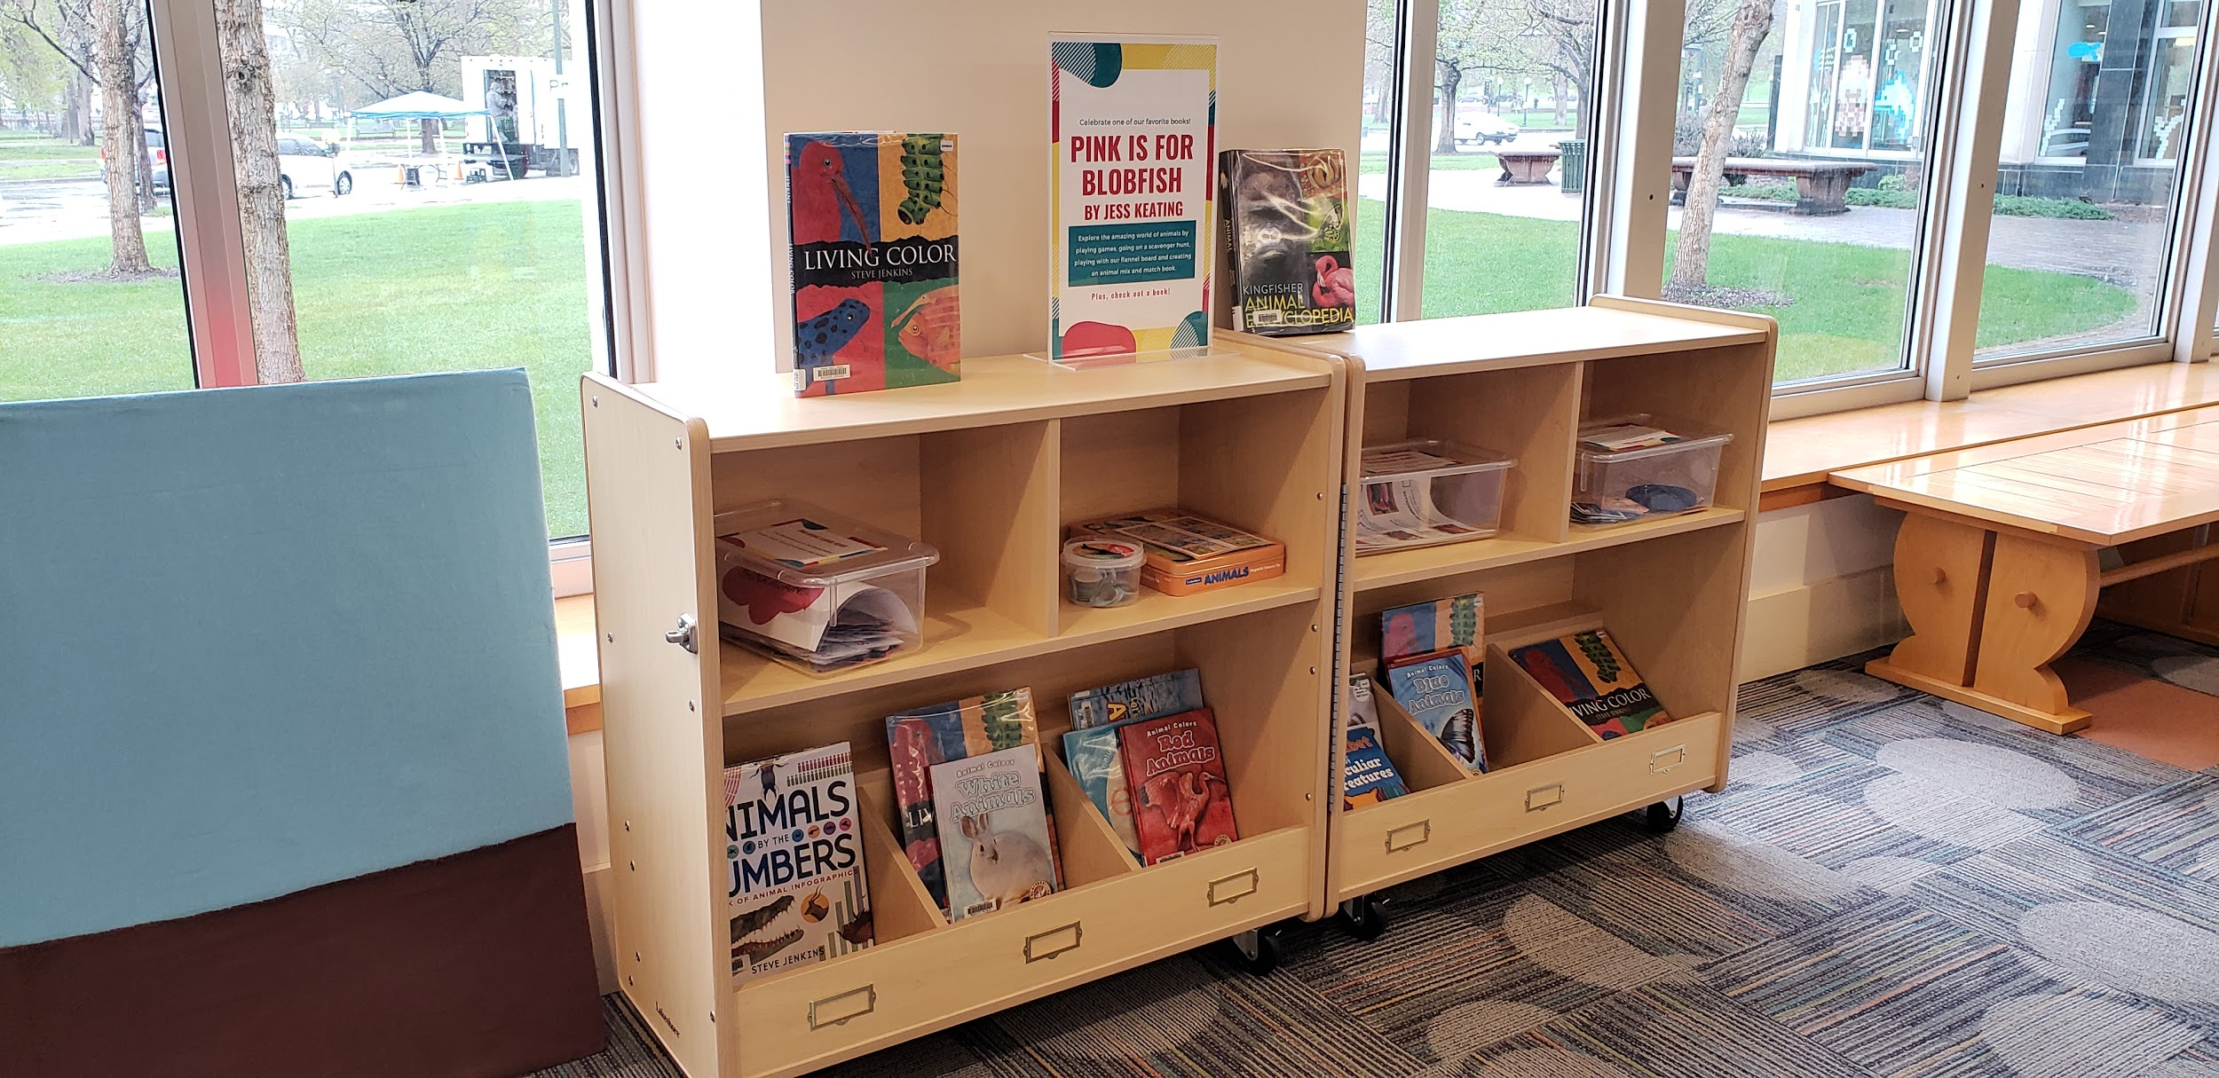
Reading Area
Exhibits
Notes:
These “exhibits” last 3 months and are open when we are. These are modeled after the Children’s Museum and the name has worked well enough - Only a few people have been confused. This one pictured is built around the book Pink is for Blobfish

Slide 35
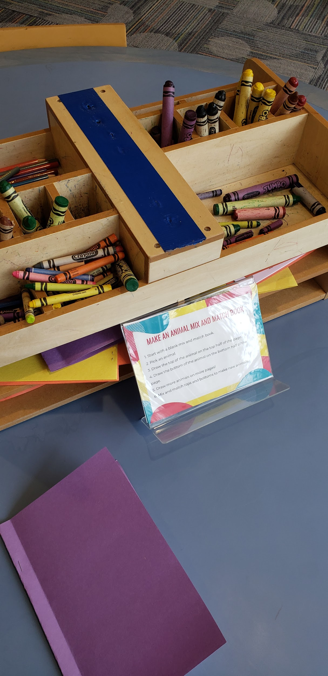
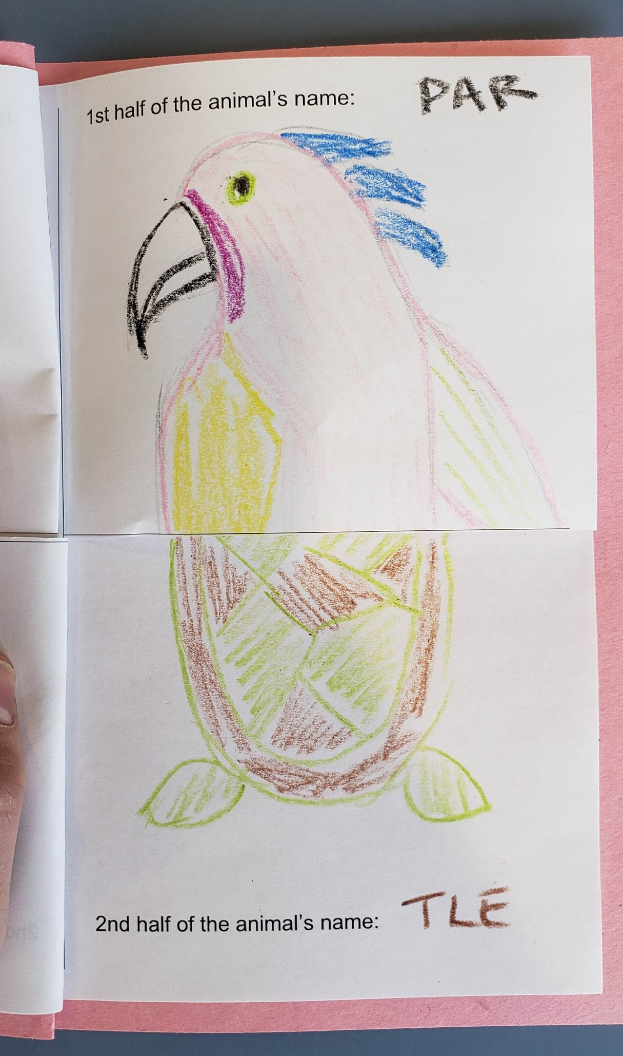
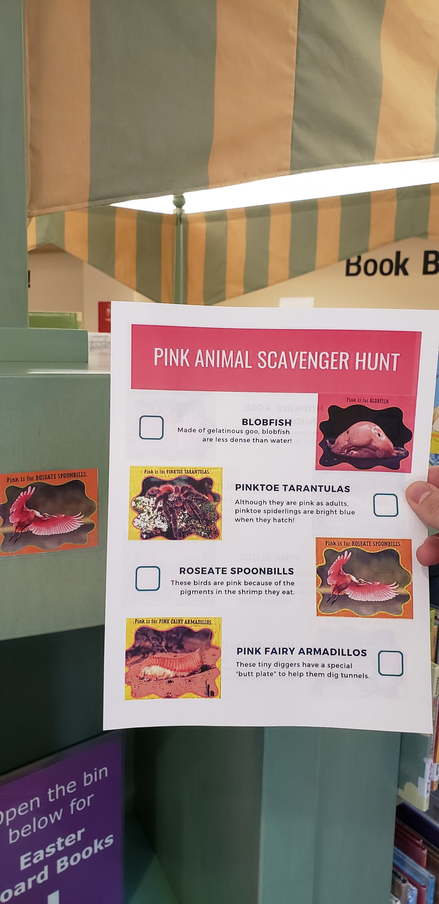
Exhibit Example
Notes:
Animal Mix and Match Book
Pink Animal Scavenger Hunt
Can Do! Animals Game
Flannel board with pink animals
Animal Magnetic Activity

Slide 36
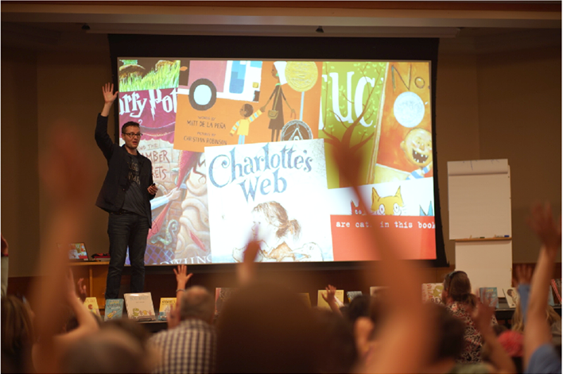
Author Visits
Notes:
Our most recent author visit was this lovely human being. The author of the Narwhal and Jelly books, Ben Clanton. The books are such strong titles for developing readers but I also have older readers tell me how much they liked it. His visit was the ultimate reading motivation example. People were so excited seeing our promotional stuff leading up to the event.
Aside from the intentional selection of an author whose work supports our grade level reading initiative, we also like our visiting authors to lead some interactive element beyond their presentation or read aloud. Clanton

Slide 37
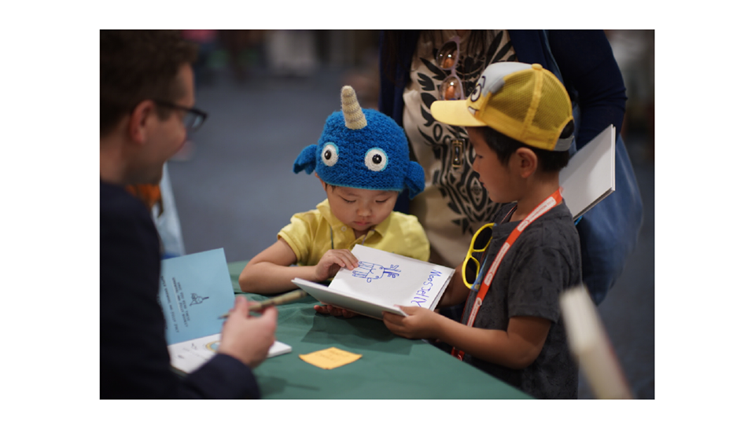
Author Visit Example
Notes:
His interactive element was leading a workshop …
He’s signing a book for these kids and they’re showing him their creation - MoosJelly!

Slide 38
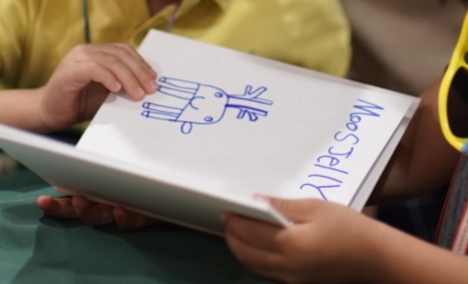
MooseJelly Darwing
Notes:
MoosJelly!

Slide 39
Template and Guides
Notes:
To help make this as easy as possible for staff to fold the 5 skills into their program planning, we’ve made a template to use as an organizational aid as well as a way to keep all the facets in mind, as well as some other program guides that have already been designed, kid-tested and approved. Feel free to use these templates and programs as-is, modify them to better fit your library and community or use them for inspiration to add GLR elements to your program.

Slide 40
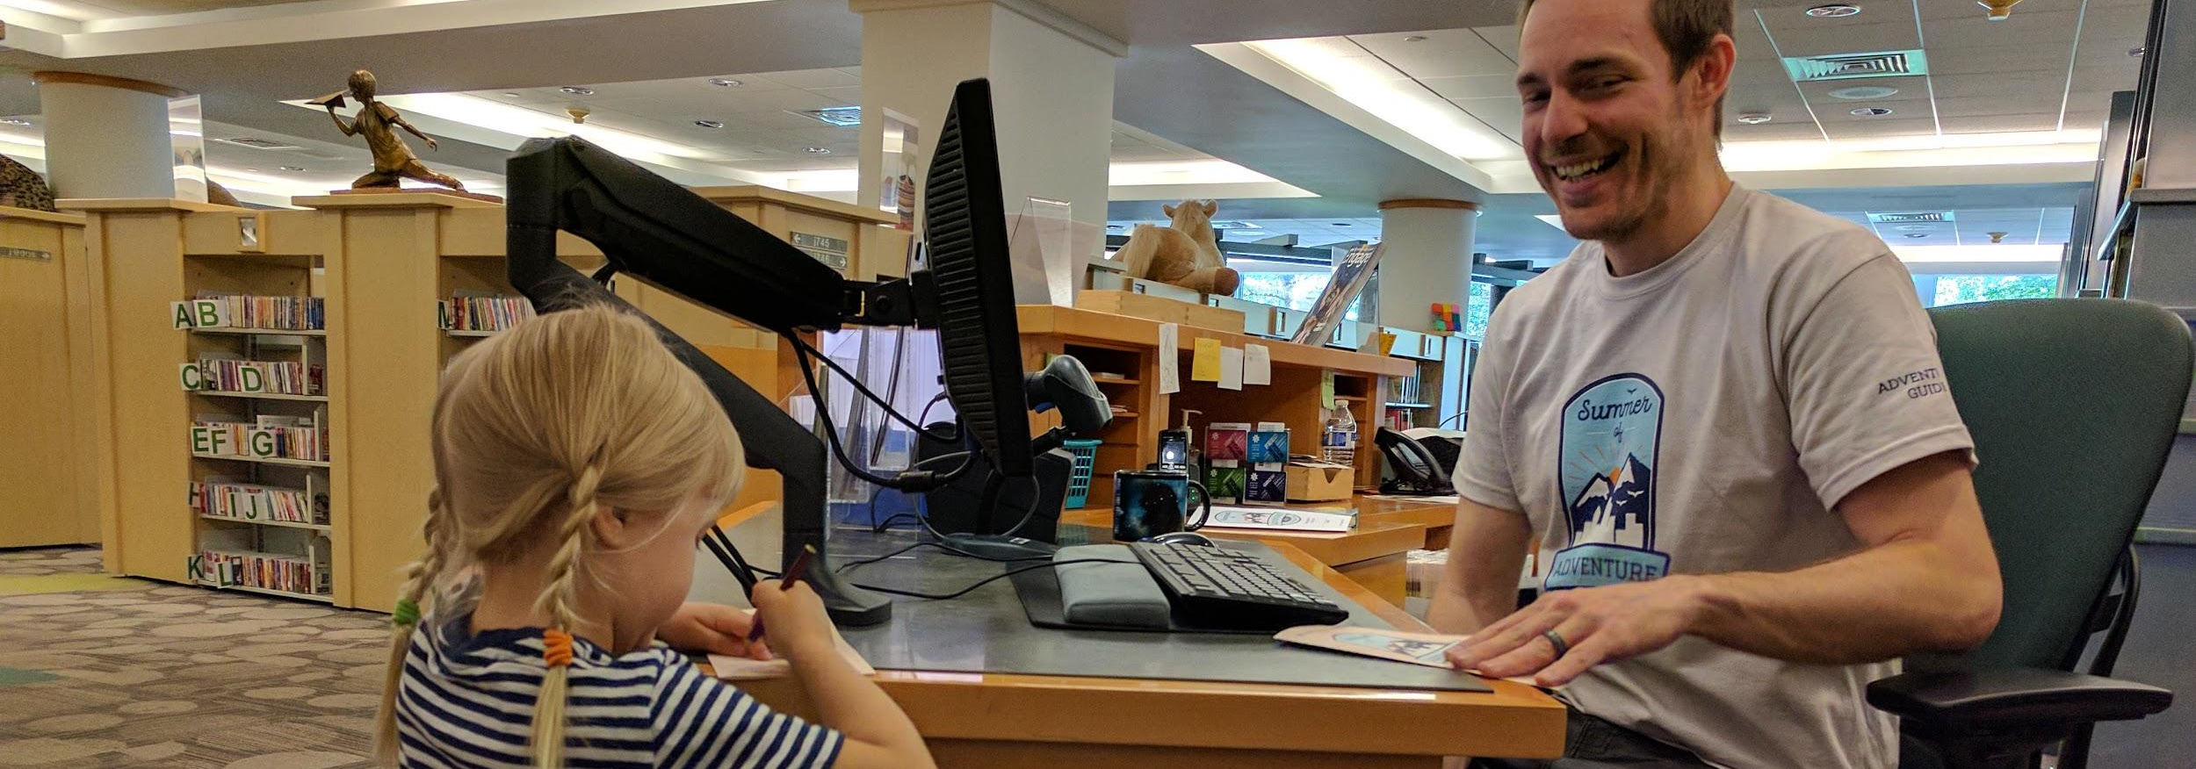
Now, let’s practice. What ideas do you have for embedding GLR skills in different kinds of programming?
Notes:
Okay, now let’s practice. We’ve got three scenarios in the polls. What ideas do you have about how to handle each of these questions in your library? You can type in your thoughts as a short answer.
Scenarios:
How could you tweak an existing program to include more GLR elements?

Slide 41
Thank you for attending!
Join DPL librarians for the other webinars in our grade level reading series:
Part 1 – Supporting Developing Readers at the Library: Reader’s Advisory for K-3rd Graders is archived.
Part 3 – Collection Development for K-3rd Graders is scheduled for September 24, 2019.
Part 4 – Outreach for K-3rd Graders is scheduled for November 4, 2019.
Notes:
Thank you for your time and engagement today! Be sure to sign up for the next webinars in our series focused on grade level reading.

Slide 42
Sources and further reading
Amplify Education, Inc. (2017). A new guide with the latest research on how children learn to read. Retrieved from http://go.info.amplify.com/primer-pt1
Annie E. Casey Foundation. (2010, January 1). Reading by Third Grade. Retrieved from https://www.aecf.org/resources/early-warning-why-reading-by-the-end-of-third-grade-matters/
Dehaene, S. (2010). Reading in the brain: The new science of how we read. New York: Penguin Books.
Denver Office of Children’s Affairs. Retrieved from https://www.denvergov.org/content/denvergov/en/office-of-childrens-affairs.html
Ferlazzo, L. (2016, September 02). 'No More Reading For Junk': An Interview With Barbara Marinak & Linda Gambrell. Retrieved from https://blogs.edweek.org/teachers/classroom_qa_with_larry_ferlazzo/2016/09/no_more_reading_for_junk_an_interview_with_barbara_marinak_linda_gambrell.html
Gambrell, L., & Marinak, B. (2009). Reading motivation: What the research says. Retrieved from http://www.readingrockets.org/article/reading-motivation-what-research-says
Hanford, E. (2018, September 10). Why aren't kids being taught to read? Retrieved from https://www.apmreports.org/story/2018/09/10/hard-words-why-american-kids-arent-being-taught-to-read
Horning, K. T. (2010). From cover to cover: Evaluating and reviewing children’s books. New York: Harper Collins.
Lin, G. (2015, August 19). It's Not an Easy Reader. Retrieved from https://forum.teachingbooks.net/2011/01/guest-blogger-grace-lin/
Miller, D. (2014). The book whisperer: awakening the inner reader in every child. Chichester: John Wiley and Sons.
Pacific Resources for Education and Learning (2013). Stages of reading development. Retrieved from http://www.readingrockets.org/article/stages-reading-development
Parrott, K. (2017, August 28). Thinking Outside the Bin: Why labeling books by reading level disempowers young readers. School Library Journal. Retrieved from https://www.slj.com/?detailStory=thinking-outside-the-bin-why-labeling-books-by-reading-level-disempowers-young-readers
Perma-Bound Books. Text Leveling Correlation Guide. Retrieved from https://www.perma-bound.com/static/common-core/EC_Correlation_Lexile_Poster_12_NEW.pdf
Pinell, G. S. (n.d.). What Is Leveled Reading? Retrieved from https://www.scholastic.com/teachers/articles/teaching-content/what-leveled-reading/
Reading Rockets (2016). Welcome to reading 101! Retrieved from http://www.readingrockets.org/teaching/reading101-course/welcome-reading-101
Recht, D. R., & Leslie, L. (1988). Effect of prior knowledge on good and poor readers memory of text. Journal of Educational Psychology,80(1), 16-20. Retrieved from http://www.literacyhow.com/wp-content/uploads/2016/03/Effect-of-Prior-Knowledge-on-Good-and-Poor-Readers-Memory-of-Text.pdf
Seidenberg, M. (2018). Language at the speed of sight: How we read, why so many can’t, and what can be done about it. New York: Basic Books.
The status of Denver's children: A community resource 2018. (2018). Retrieved from https://www.denvergov.org/content/dam/denvergov/Portals/713/documents/data-resources/StatusOfDenversChildren_2018.pdf
Wexler, N. (2018, April 13). Why American students haven't gotten better at reading in 20 Years. Retrieved from https://www.theatlantic.com/education/archive/2018/04/-american-students-reading/557915/
Wigfield, A., Gladstone, J., & Turci, L. (2016). Beyond cognition: reading motivation and reading comprehension. Child development perspectives, 10(3), 190-195. Retrieved from https://www.ncbi.nlm.nih.gov/pmc/articles/PMC5014370/
Wolf, M. (2007). Proust and the squid: The story and science of the reading brain. New York: Harper Collins.
Notes:
And, last by certainly not least, here are our sources. Explore these if you’re looking for more information. We also have information available as a downloadable handout. Thank you for attending! Goodbye.

