Slide 1
Library Marketing 1.0
How to successfully market your library without getting another degree
Teresa Myers
Marketing Communications Specialist
Longmont Public Library
November 2018

Slide 2

Why is marketing important?
Corporations spend millions of dollars studying and analyzing consumer behavior.
They use this information to both create and reinforce consumer behavior and expectations.
ALL OF YOUR PATRONS ARE CONSUMERS.
Libraries do not operate in a vacuum of consumer behavior and expectations, nor are we wealthy or big enough to reverse corporate consumer expectations.
To adequately serve those expectations, we must understand them and meet them.
Notes:
Grocery store example
Also:
Convenience vs. gauntlet
Lobby = impulse buys
Merchandising trails

Slide 3
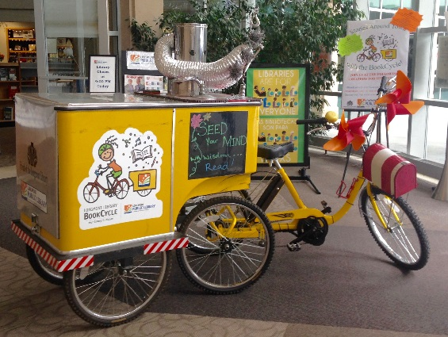
Know Your Library’s Brand
A brand is not just a logo.
It is a feeling people have or will have about your library.
It is a group of adjectives that either currently describes your library or you want to eventually describe your library.
Every single display you make should reflect and promote your brand.
Figure out who you are or want to be and don’t try to be anything else.
Longmont Public Library brand = helpful, friendly, fun
Notes:
Describe Longmont brand and what we AREN’T.

Slide 4







Your logo should visually represent your brand
If it doesn’t, you either need a new logo or a new brand. Period.
Notes:
Put your logo on EVERYTHING.
Signs, flyers, bookmarks, etc.
Design quick templates and insist that staff use them.
More professional, more cohesive.

Slide 5
Interactive Work Session #1
Take a few minutes to think about:
what is your current library brand?
does it reflect what you are?
does it reflect what you want to be?
Then we’ll share a few.

Slide 6
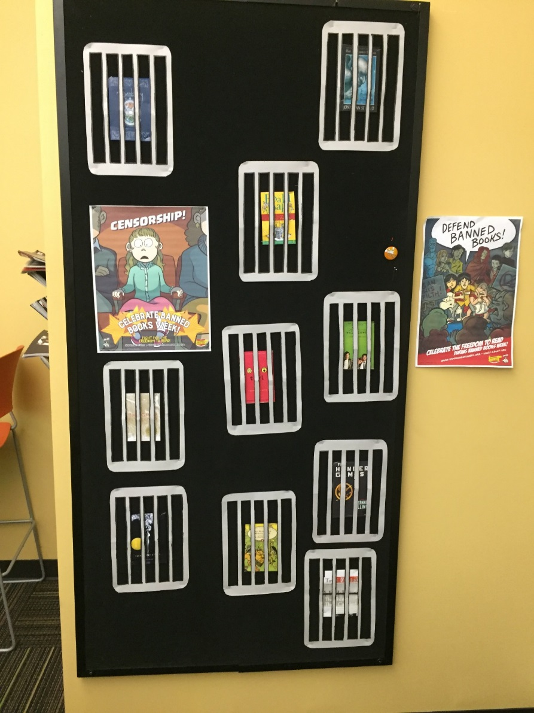
Basic Marketing Components
Posters
Book Displays
Flyers & Bookmarks
Website pages and calendar
News Releases
Social Media
Articles in the Media about you
Advertising
Anything you send outside of your library to spread the word
Anything in your library that promotes a service or collection
Notes:
All of these are tools in your marketing toolkit
Need to decide which tools to use for each material, service, or program you want to tell people about.
You won’t use all of them all of the time.

Slide 7
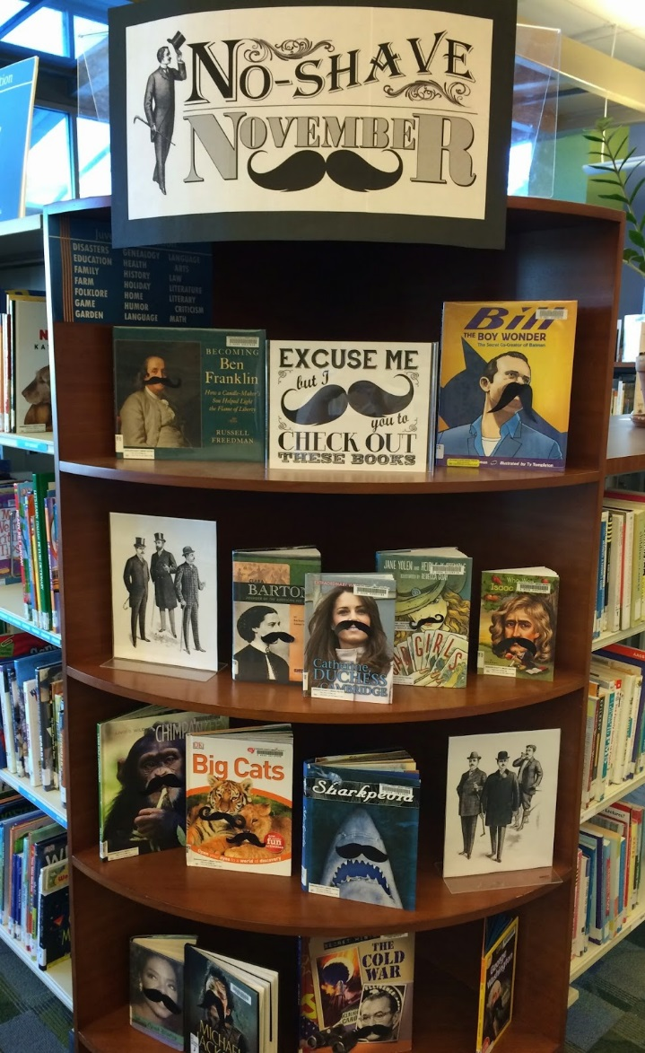
Create a Marketing Checklist
Some items to include on your checklist:
Program/Material/Service Name
Date, duration and other details
Graphics needed(e.g. web banner or button, lobby screen slide)
Web content needed (identify which webpages information needs to go on)
Calendar entry (on website and/or paper?)
Posters, bookmarks, flyers, newsletters
News releases and where you’re sending them
Planned advertising
Planned social media
Use your checklist every time, and don’t be afraid to continually fine-tune it.
Notes:
I am a one-person, part-time marketing division.
Checklists, calendars, and templates are your best friends.
I use
marketing checklist
social media planning calendar & scheduling software for posts/tweets
templates for flyers, signs, news releases, and emails
Don’t reinvent the wheel every time you have to do marketing.

Slide 8
Interactive Work Session #2
Take a few minutes to think about:
how do you currently organize your marketing efforts?
what works for you?
what do you need help with?
Ask questions or share your ideas!

Slide 9
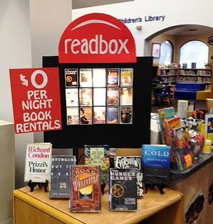
Merchandising:
You’re already doing it (whether you know it or not!)
Examples of merchandising:
Book displays
Book placement on shelves
Placement of items within your library
Packaging of materials, such as kits
Notes:
Merchandising is important bc whether we like it or not, it influences our behavior.
Think back to grocery store example. Fruit displays, bakery displays, store layout.
Now think about how you approach merchandising in your library.
Are you intentional?
Do you take the time to make sure it is attractive?
Does it reflect your brand?
Are you having fun with it?

Slide 10
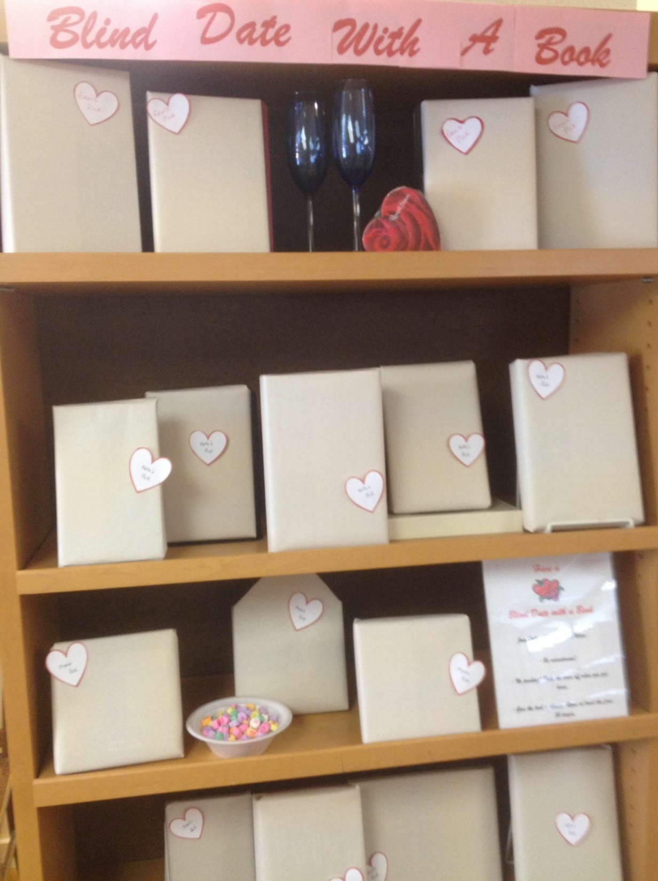
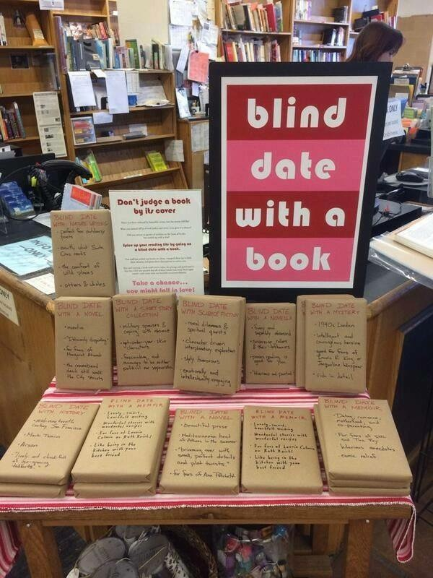
Blind Date with a Book

Slide 11
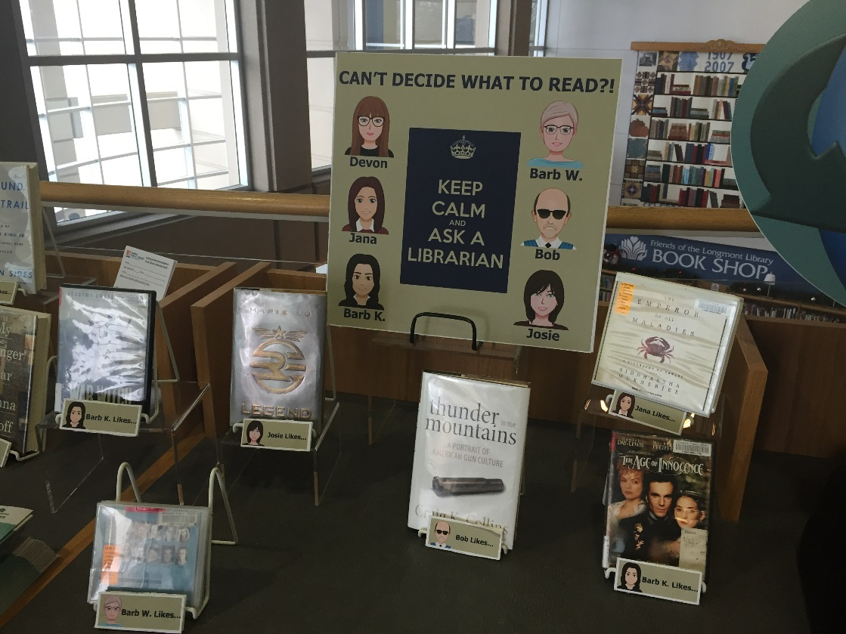
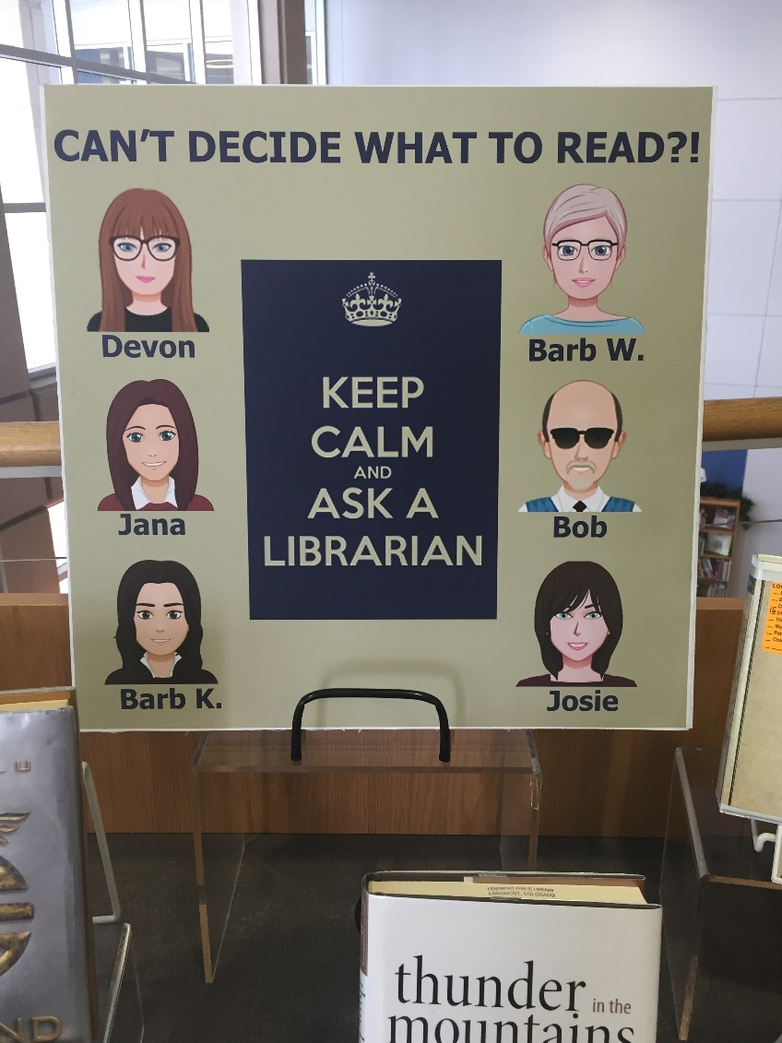
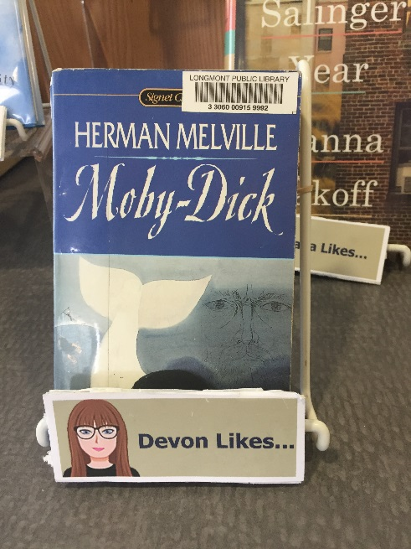
Staff Picks

Slide 12
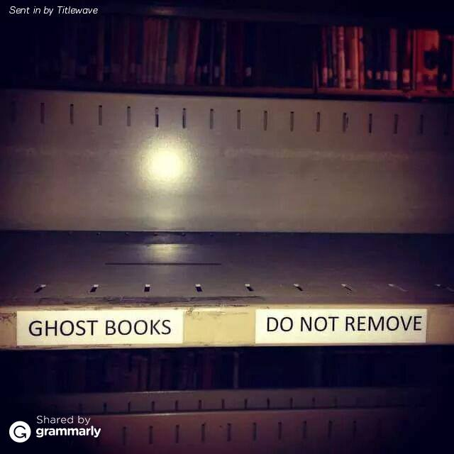
Example display

Slide 13


Example program flyers
Notes:
These posters represent times when we pushed the envelope a little bit.
The Kennedy presentation
Promoting new “Fast Pencil” self-publishing software.

Slide 14
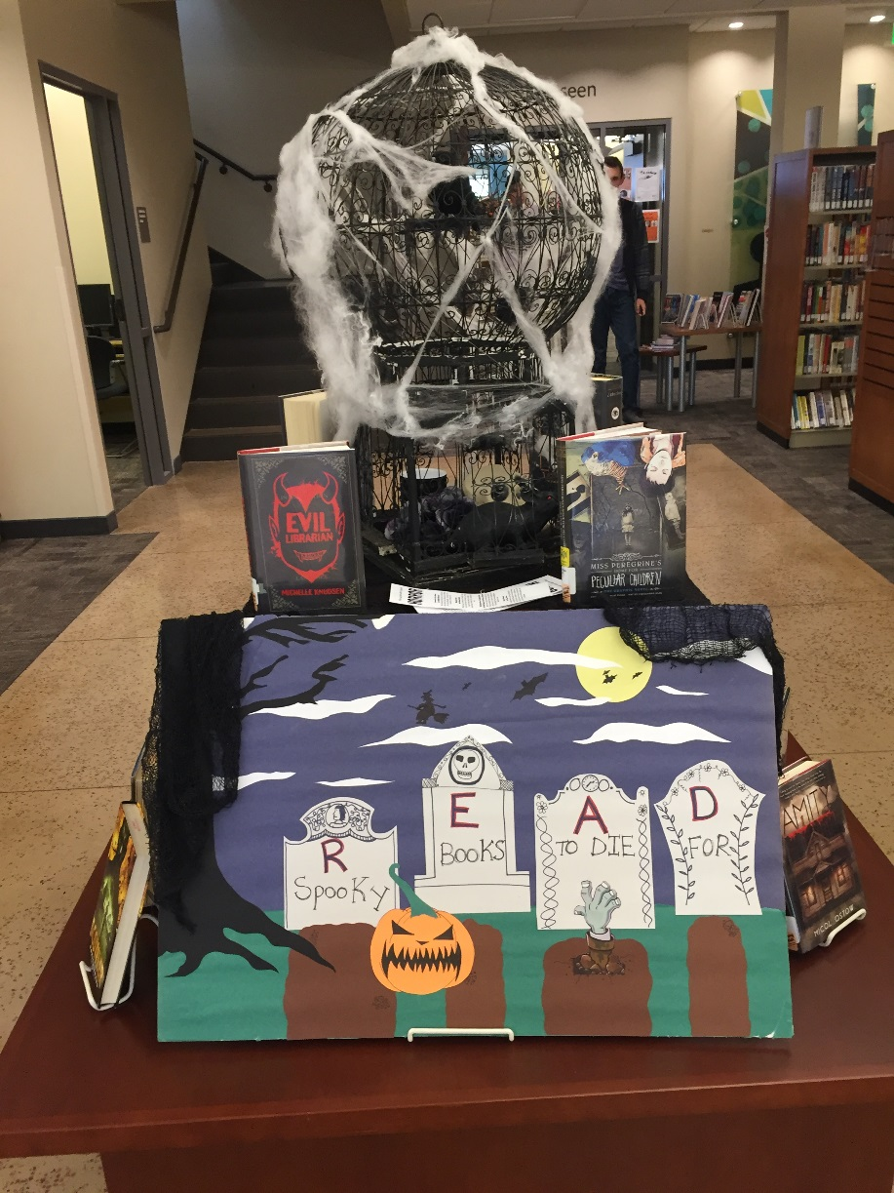
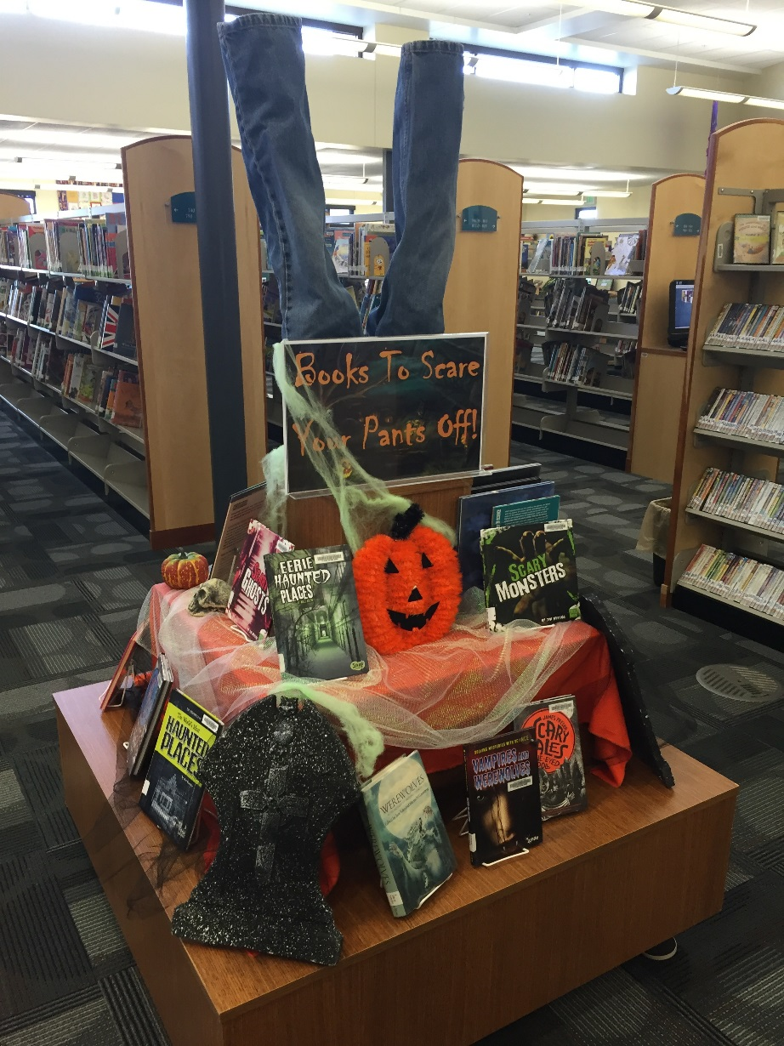
Halloween Displays
Which looks more professional?
Which is more creative?
Which are you more likely to remember?

Slide 15
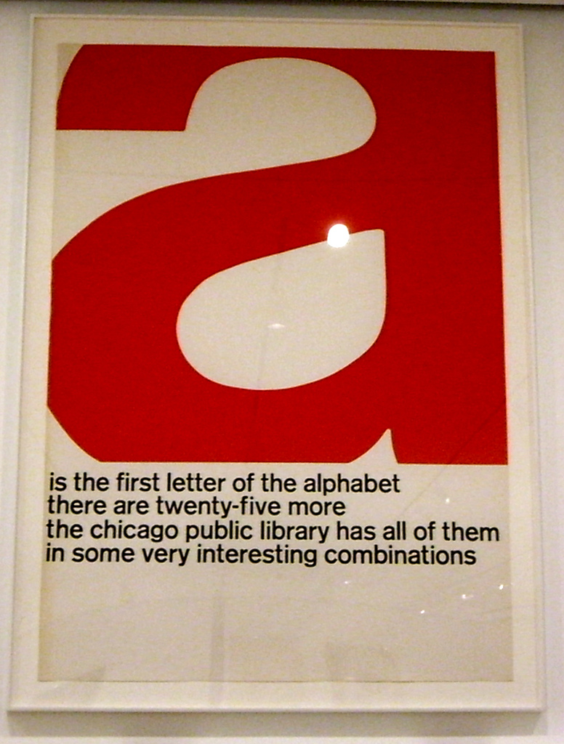
Merchandising Tips:
Unless you’re a school library, avoid construction paper and glue; you’re professionals, so look like it.
Use interesting (but readable) fonts, colors, and images.
Avoid clip art; take advantage of free, common use photos on the internet (one of my favorites is pexels.com) or purchase a small subscription to stock photos and images.
Label all book displays; don’t make patrons guess what’s going on.
Pay attention to your packaging and ask yourself if it represents your brand well.
Avoid outdated library jargon and acronyms; patrons don’t want to feel like they aren’t smart enough to use your library.
Take photos of your library and really LOOK at the photos; oftentimes you’ll see clutter and other problems more clearly in a photo than in real life.
Beware of the “more signs = more awareness” trap. This is often (usually?) untrue. More signs sometimes just means more visual clutter. We all have to accept that some patrons will just never read signs.
Be creative and HAVE FUN! If you’re having fun with it, your patrons are bound to enjoy it, too.
Notes:
Merchandising is important bc whether we like it or not, it influences our behavior.
Think back to grocery store example. Fruit displays, bakery displays, store layout.
Now think about how you approach merchandising in your library.
Are you intentional?
Do you take the time to make sure it is attractive?
Does it reflect your brand?
Are you having fun with it?

Slide 16
Interactive Work Session #3
Tell us about a successful merchandising or marketing effort that you were involved in.
Sharing ideas is a marketing fundamental!

Slide 17
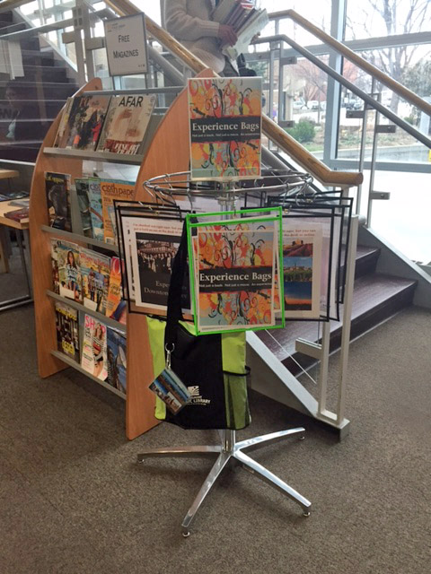
Final Takeaway Tips
Visit other libraries and use online resources for ideas. Don’t be afraid to beg, borrow and steal ideas. BUT be ready to change them to fit YOUR library.
Use humor that fits your audience whenever possible. Everyone likes to smile.
Don’t be afraid to push the envelope sometimes. If you make a mistake, learn from it.
If budget is tight, take advantage of library giveaways and thrift store finds.
Assign merchandising tasks to those who are best suited to them. Not everyone has a great eye for visuals or graphics; likewise, not everyone is a great book selector.
Use your webpage and social media to tie your brand and merchandising together.
Know that you CAN do this – it isn’t rocket science!
Network with other librarians and marketing people. Creativity needs nurturing!
High Plains Library District GAVE me this display carousel! (thank you, thank you, thank you!)

Slide 18
Free Online Resources to Get You Started
General Library Marketing and Design Advice
http://librariandesignshare.org/
https://www.socialmediatoday.com
Tools for Images, Charts, and Graphics
http://www.inc.com/jeff-haden/where-to-find-free-stock-photos-online.html
http://memegenerator.net/
http://www.easel.ly/
http://www.xmind.net/

