Slide 1

Level It Up!
Evaluating Beginning Readers
Presented by Katie MacKendrick, Librarian and
Gigi Pagliarulo, Children’s Librarian
Notes:
KATIE

Slide 2
Learning Objectives
Explain access issues related to Beginning Readers and leveling
Understand the details of the Beginning Reader Collection Criteria and Classification Rubric used for evaluating books in Beginning Reader collections by level
Gain experience using these tools to evaluate Beginning Readers by level
Notes:
KATIE
By the end of today’s webinar, we hope that you’ll be able to:
Explain access issues related to Beginning Readers and leveling
Understand the details of the Beginning Reader Collection Criteria and Classification Rubric used for evaluating books in Beginning Reader collections by level
Gain experience using these tools to evaluate Beginning Readers by level

Slide 3

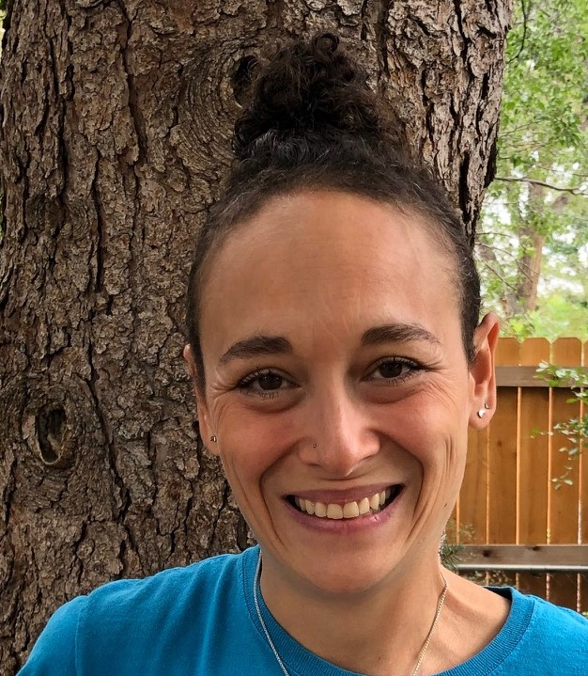
Who We Are
Katie MacKendrick
Librarian
Gigi Pagliarulo
Children’s Librarian
Notes:
Introductions (KATIE and GIGI)

Slide 4
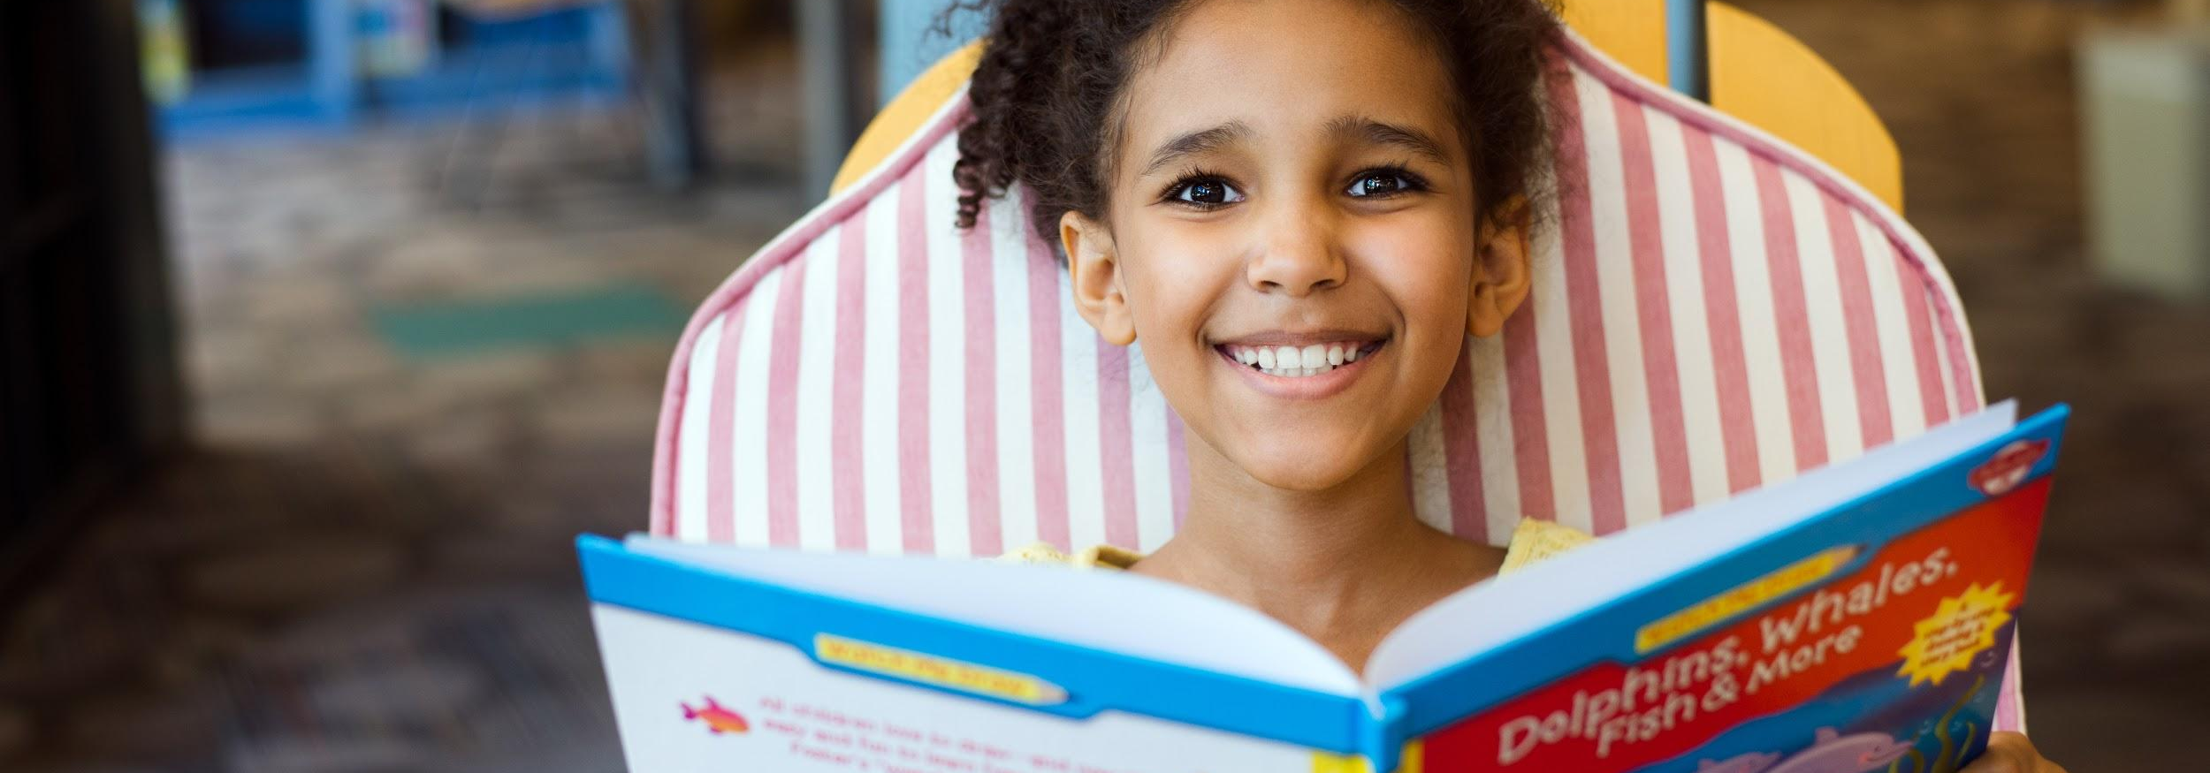
What issues have you experienced with Beginning Reader levels or leveling systems?
Please share your experiences in the chat box!
Let’s Chat!
Notes:
KATIE
To get us started, let’s take a minute to share any issues you’ve encountered about Beginning Reader levels.
Please type your answer into the chat box.

Slide 5
Grade Level Reading
at the Denver Public Library
Notes:
GP

Slide 6
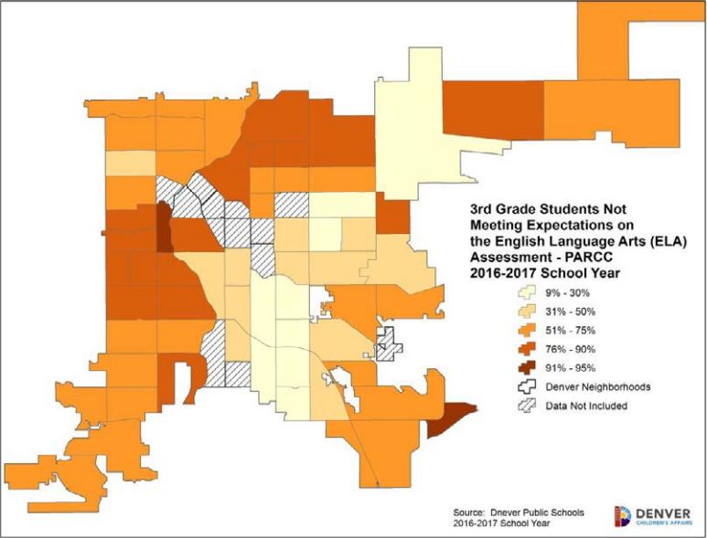
Why Grade Level Reading?
40%
of students in Colorado read at grade level
Notes:
GP
For the Grade Level Reading (GLR) Project Team this heat map from the Status of Denver’s Children report has been our constant companion.
On this map, the darker the shade of orange the more students there are in the neighborhood NOT reading at grade level.
According to a recent Chalkbeat article, just 26 out of 178 Colorado districts have more than half of their third-graders reading at grade level.
In other words, in Colorado, 40% of 3rd graders read at grade level.
And in Denver that number’s a little lower at 39.4%.
The ability to read is a foundation students need to in order to navigate future grades, and life after school.
The Denver Office of Children’s Affairs states that “Beginning in fourth grade, children transition from learning how to read to reading to learn.”
In response to this, DPL put together an internal work team to look at what our role could be in supporting developing readers.
At the public library, it’s not our MO to limit children or our collection by reading level. So what does it mean for us to support this work?

Slide 7
Grade Level Reading Project Mission
Support and empower library staff, families and educators to connect children (K-3rd grade) with diverse books they enjoy and that inspire curiosity to foster lifelong readers.
Notes:
GP
After lots of research and discussion, the GLR Project Team came up with this project mission:
To support and empower library staff, families and educators to connect children kindergarten through 3rd grade with diverse books they enjoy and that inspire curiosity to foster lifelong readers.
In our meetings with Denver Public Schools, we heard a clearly articulated need for DPL to focus on the joy of reading, rather than the nuts and bolts of learning to read.
And that made sense to us, because library employees aren’t trained to teach people to read.
But we are trained to connect readers with materials that match their interests and reading levels!
One way we connect readers to materials is creating as many access points as possible for customers and staff alike.
And this is how we began thinking about the criteria for books for developing readers.

Slide 8
Early and Transitional Books
Notes:
GP

Slide 9
Early and Transitional Book Subject Headings
Subject headings created to increase access points to books for developing readers.
Early Books
Support kids beginning to read.
Transitional Books
Support kids bridging from early books to chapter books.
Notes:
GP
We asked: How can we make it easier for caregivers and DPL staff to find excellent, diverse books for readers in kindergarten through 3rd grade?
One important effort: Subject headings--local subject heading points.
This basically means we created them in-house (locally), they weren’t created by a vendor or given to us by the Library of Congress.
We landed on subject headings as a way to provide more access points for customers and staff.
Subject headings meant no shelving changes, no stickers, and no stigma!
These subject headings are searchable via the online public access catalog (or OPAC), as well as our staff-side interface.
We use Polaris, if you’re curious.
And, yes, subject headings plural! We created two.
We considered a bunch of different terms, but finally landed on these two.
The first subject heading, Early Books, supports kids just beginning to read.
And the second, Transitional Books, supports kids bridging from early books to chapter books.
We have criteria for each subject heading that covers support elements, such as design, font, vocabulary, as well as the importance of the inclusion of titles with diverse representations.
These subject headings are helpful, but only if the books within each section make sense. It's not helpful if a jR2 is labeled an Early Book but is really more of a Transitional Book.

Slide 10
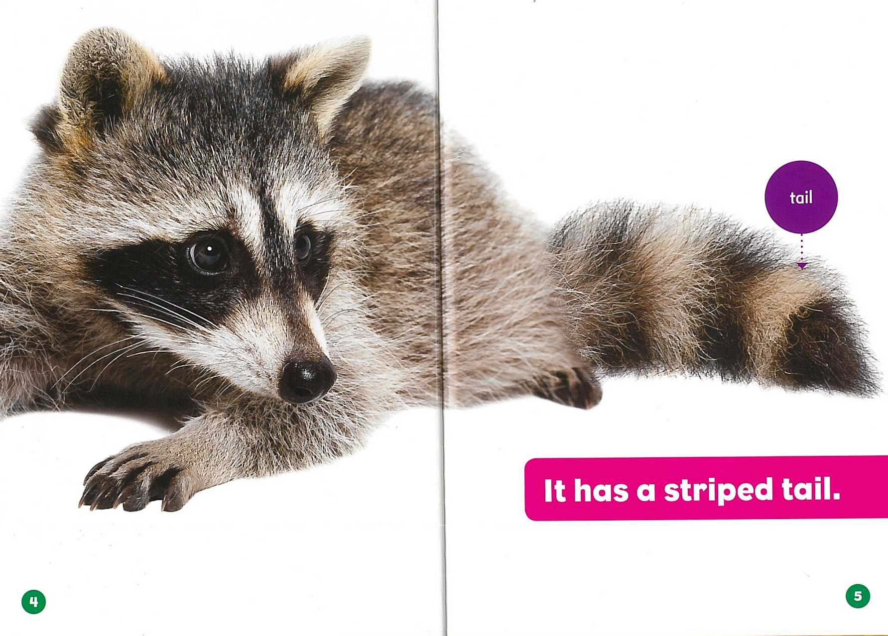
Early Books Criteria: Forest Babies
Lexile 0-350
Font is 14 pts or larger
Ample white space around and between text
Forest Babies series: Raccoon Cubs by Genevieve Nielsen
Notes:
GP
Part of our work was putting together criteria for each of the subject headings.
Much of it based on K.T. Horning’s book, From Cover to Cover, as well as the Geisel Award Criteria.
We wanted the criteria to be detailed enough to help us determine if a book was a good fit.
But there also needed to be some wiggle room for informed judgement.
For instance, our criteria for Early Books includes a Lexile range of 0 to 350, which we’ve found is usually about on target.
However, if a title doesn’t have a Lexile level or it fits all the other criteria except the Lexile level, we’ll use our own informed judgement as librarians to decide what to do.
In the case of this example, it’s pretty clearly on target. Racoon Cubs has a Lexile level of 110.
We look for a large font that has ample white space between words, as well as around the text. This helps the eye focus because we have to train our eye muscles to read.
White space doesn’t have to be white, it could be blue or green or in this case pink. The important thing is that it provides an uncluttered background to make the words stand out to readers.

Slide 11
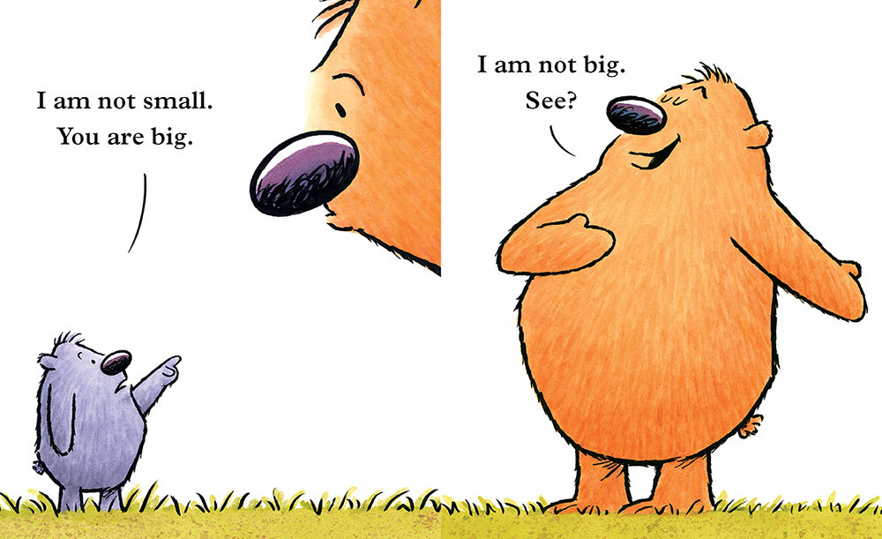
Early Books Criteria: You are (Not) Small
Strong word repetition
Short words and sentences
Illustrations on every 2 page spread
Punctuation is clear and simple
You are (Not) Small by Anna Kang, Illustrated by Christopher Weyant
Notes:
GP
Here’s another Early Book example.
We look for sentences made up of no more than 1-12 short (just one or two syllables a piece) words.
And it’s best if those words repeat often so readers have a chance to practice and gain confidence with them.
Simple punctuation is another important element for very new readers. Colons, semi-colons, and my least favorite, ellipses, can be really confusing!
For Early Books, we want illustrations on every two page spread that help readers by supporting the text.
In this example, we have visual representations of you and I, big and small.
Also, illustrations are representative of the text and are enticing enough to promote reading motivation.
In case you’re wondering, You Are (Not) Small has a lexile level of 60.
We’ll talk more about specific criteria for each level in the next section.

Slide 12
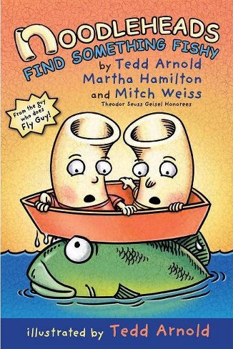
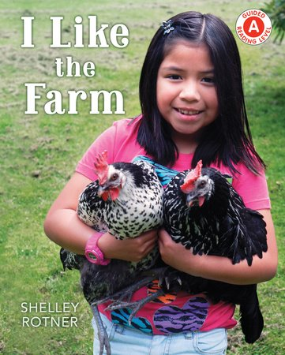
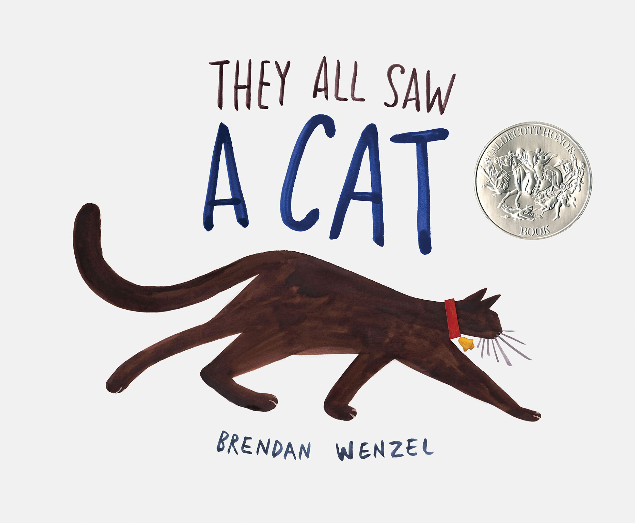
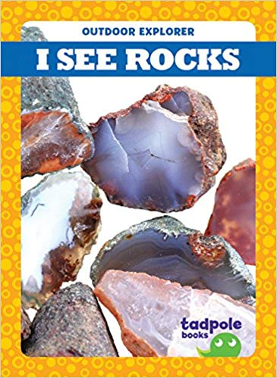
Early Books Examples
Notes:
GP
Here are a few examples of excellent Early Books. Title and author information is included in the slide notes. As you can see the titles include nonfiction, picture books, graphic novels, and beginning readers.
Noodleheads Find Something Fishy by Tedd Arnold, Martha Hamilton and Mitch Weiss
I Like the Farm by Shelley Rotner
They All Saw a Cat by Brendan Wenzel
I See Rocks by Tim Mayerling

Slide 13
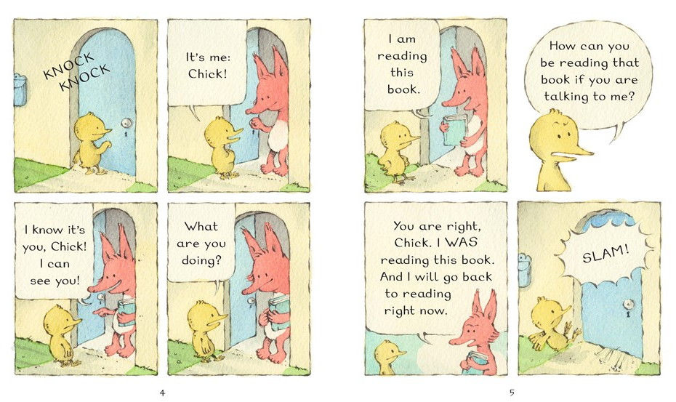
Transitional Books Criteria: Fox + Chick
Wide margins and sufficient white space around and between text
100 pages or less
Font is 13 pts or larger
Fox + Chick: The Party and Other Stories by Sergio Ruzzier
Notes:
GP
Criteria for Transitional Books, as you might expect, allows for longer books with more text.
In general, we’re looking for books no longer than 48-100 pages. Although, nonfiction titles are often much shorter.
The font should still be large, though it doesn’t need to be as large as the font we find in an Early Book.
We still want wide margins and white space, but as we can see in this example, it doesn’t have to be as plentiful as in an Early Book.

Slide 14
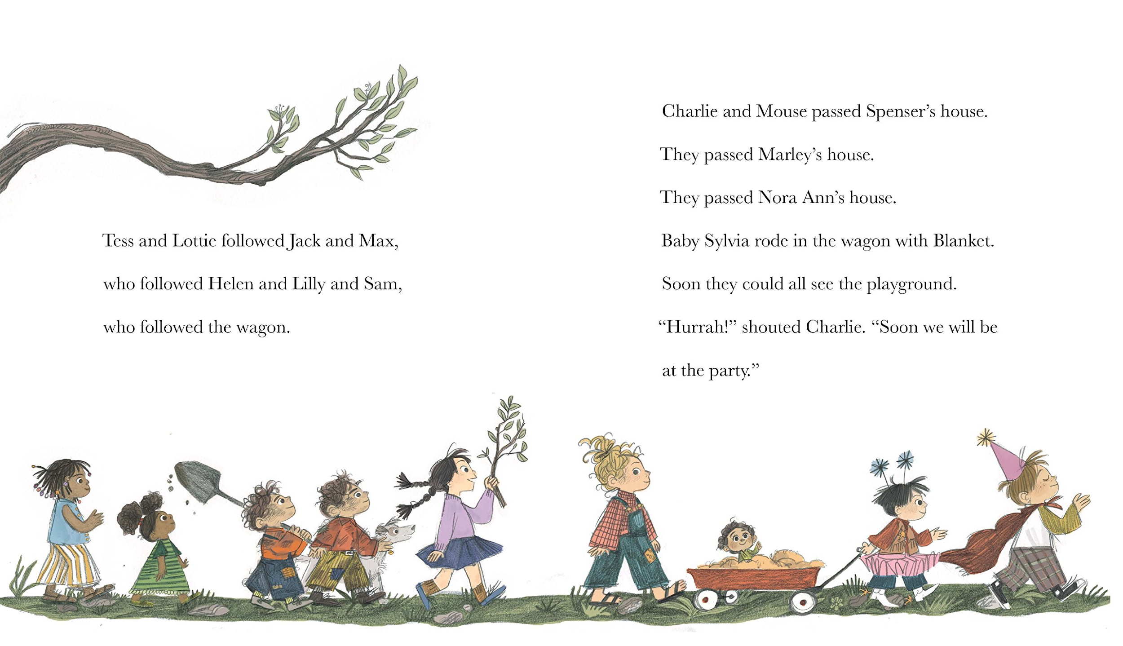
Transitional Books Criteria: Charlie & Mouse
Lexile 350-750
If chapters are present, no more than 15 pages long
Illustrations about twice a chapter
Charlie & Mouse by Laurel Snyder, Illustrated by Emily Hughes
Notes:
GP
Here’s a second Transitional Book example.
Lexile-wise, we’re looking at titles around 350 to 750. Fox + Chick, our example from the previous slide, comes in at 370 and on this slide Charlie & Mouse is leveled at 420.
Although not all Transitional Books have chapters, we have found it helpful to have a ballpark number of pages per chapter.
For context, chapters in Charlie & Mouse are between 6-12 pages. Fox + Chick has longer chapters, between 15-16 pages, but that makes sense because it’s a graphic novel.
Finally, we still want illustrations that are representative of the text to keep readers engaged, but they don’t need to be on every page as with Early Books.

Slide 15

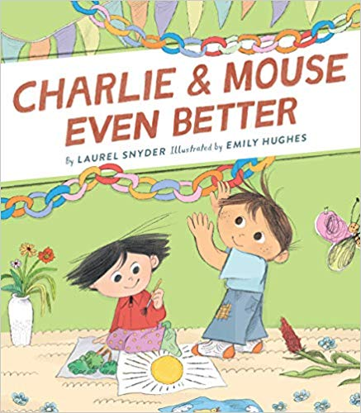
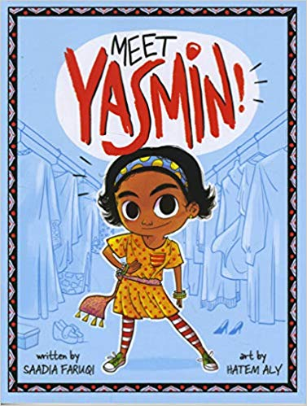

Transitional Books Examples
Notes:
GP
Here are a few examples of wonderful Transitional Books. Again, you’ll see we have beginning readers, early chapter books, graphic novels, and nonfiction.
Tiger vs. Nightmare by Emily Tetri
Charlie & Mouse Even Better by Laurel Snyder, illustrated by Emily Hughes
Meet Yasmin! by Saadia Faruqi, illustrated by Hatem Aly
Fly Guy Presents: Sharks by Tedd Arnold

Slide 16
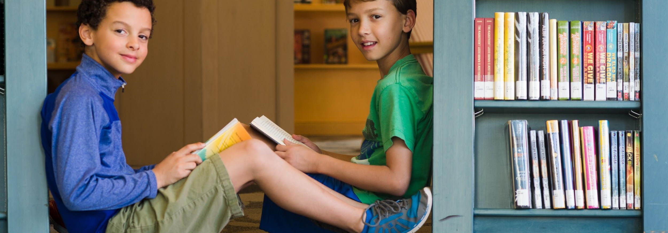
How is the Beginning Reader collection organized at your library? Do you have separate designations for Early and Transitional books (or a similar name.) And what about levels? Do you use any kind of leveling system for Beginning Readers?
Let’s Chat!
Notes:
KATIE
Let’s take a few minutes to share about how the Beginning Reader collection is organized at your library.
Please type your answer into the chat box.

Slide 17
Beginning Reader Collection Criteria
Notes:
GP

Slide 18
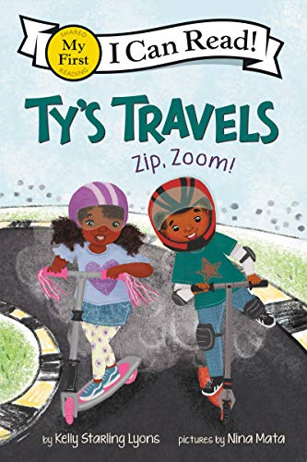
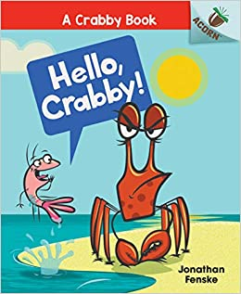
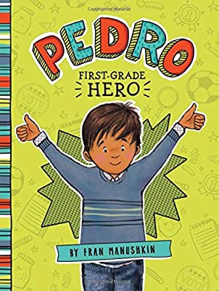
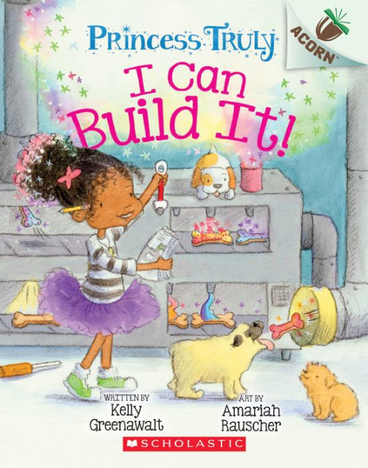
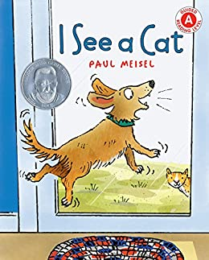
Beginning Reader Collection Criteria Recommendations
Created by the Grade Level Reading Team in response to several needs:
Understanding the inner workings of the different leveling systems of multiple publishers.
Notes:
GP
Spoiler alert: it’s incredibly complex and inconsistent!
The Beginning Reader criteria and rubric are meant to be used in tandem to assist in evaluating individual beginning reader titles to determine inclusion in a Beginning Reader collection and if so at what level.
DPL has three levels: jR1, jR2 and jR3.
Prior to the creation of these tools, at DPL, publisher assigned levels were used to determine Beginning Reader collection levels (example: a title had a published assigned level of 1, therefore it would be a jR1 in DPL’s collection). Based on our research, we have discovered that there is quite a bit of inconsistency between and within publisher assigned levels.
Every publisher has its own leveling system
Within publishers, imprints could have different leveling systems
Media tie-ins will often have even other leveling systems, or be totally inappropriate for the Beginning Reader Collection

Slide 19
Beginning Reader Collection Criteria - 1
Created by GLR Team in response to several needs:
2. Consistency and clarity in DPL’s leveling system for Beginning Readers for the existing collection as well as new books to make them easier to access
3. Enhanced staff access to Beginning Reader collection
4. Enhanced customer access to Beginning Reader collection
Notes:
GP
The existing collection needs consistent and clear leveling.
The Beginning Reader Leveling Project will involve trained staff working on a long-term timeframe to evaluate every existing title in the Beginning Reader collection using the Beginning Reader Collection Criteria and Classification Rubric.
We offered an extended version of this training in May to staff and formed a core team of folks who have been working
So far they have leveled about 10% of the collection.
The new books need consistent and clear leveling.
Our Children’s Collection Development Specialist now uses these tools for every new Beginning Reader she buys.
By creating our own criteria we are attempting to provide a basic structure to support customers and staff in locating books at a helpful level for their developing reader.
At the same time, we believe in intellectual freedom and the right to choose books based on interest, as well as or instead of reading level. With that in mind, our three levels intentionally encompass a range of reading levels so readers can be both challenged and feel a sense of mastery.

Slide 20
Beginning Reader Collection Criteria - 2
Books at each level - jR1, jR2 and jR3 - are evaluated using the following criteria categories:
Words
Sentences
Pagination
Repetition
Illustrations
Notes and Exceptions
Notes:
GP
Each category has several criteria.
Many criteria have quantifiable factors like number of words per sentence or page, syllables per word, pages with illustrations on them, font size etc.
Many criteria require a level of informed judgement, like evaluating if illustrations are representative of the text, or if sentence structure is simple or more complex.
The more books you review using these criteria as a lens, the more comfortable you’ll feel making these judgements.
We’ll have some opportunities to practice using these criteria on books later in the presentation.
This document also includes detailed instructions on using the Beginning Reader Collection Classification Rubric.

Slide 21
Beginning Reader Collection Classification Rubric - 1
Weighted system
Based on the criteria
Each criteria item is scorable and weighted
Weights are determined by importance to category
Criteria items scored by prevalence
Make your own copy here:
https://docs.google.com/spreadsheets/d/1DZSIiPHHEXdgwHFrPIwbtYefA1TmAdwWUIewh_7EsIk/copy
Notes:
GP
A weighted system for scoring books based on the criteria.
Each criteria item has a place for evaluation and scoring.
Each item’s criteria weight is determined by importance to the overall category.
Each item is scored by its prevalence in the book.
If a title fulfills the criteria 75%+ of the time, give it full points.
If a title fulfills the criteria 50-75% of the time, subtract 1 point.
If a title fulfills the criteria less than 50% of the time, subtract 2 points.
When reviewing a title that is a hybrid/multi-level book, base scoring on the hardest portion/section of the book.
Click the link to make your own copy and start playing in the sandbox!

Slide 22
Beginning Reader Collection Classification Rubric - 2
EDI (Equity, Diversity and Inclusion) Column
Use EDI lens for all of our work
Although there’s no point value for this column, we feel it’s important to denote diverse representations in a collection that is largely devoid of them
Notes:
GP
A weighted system for scoring books based on the criteria
Each criteria item has a place for evaluation and scoring
Each item’s criteria weight is determined by importance to the overall category
Each item is scored by its prevalence in the book
If a title fulfills the criteria 75%+ of the time, give it full points.
If a title fulfills the criteria 50-75% of the time, subtract 1 point.
If a title fulfills the criteria less than 50% of the time, subtract 2 points.
When reviewing a title that is a hybrid/multi-level book, base scoring on the hardest portion/section of the book.

Slide 23
Let’s try it out!

Slide 24
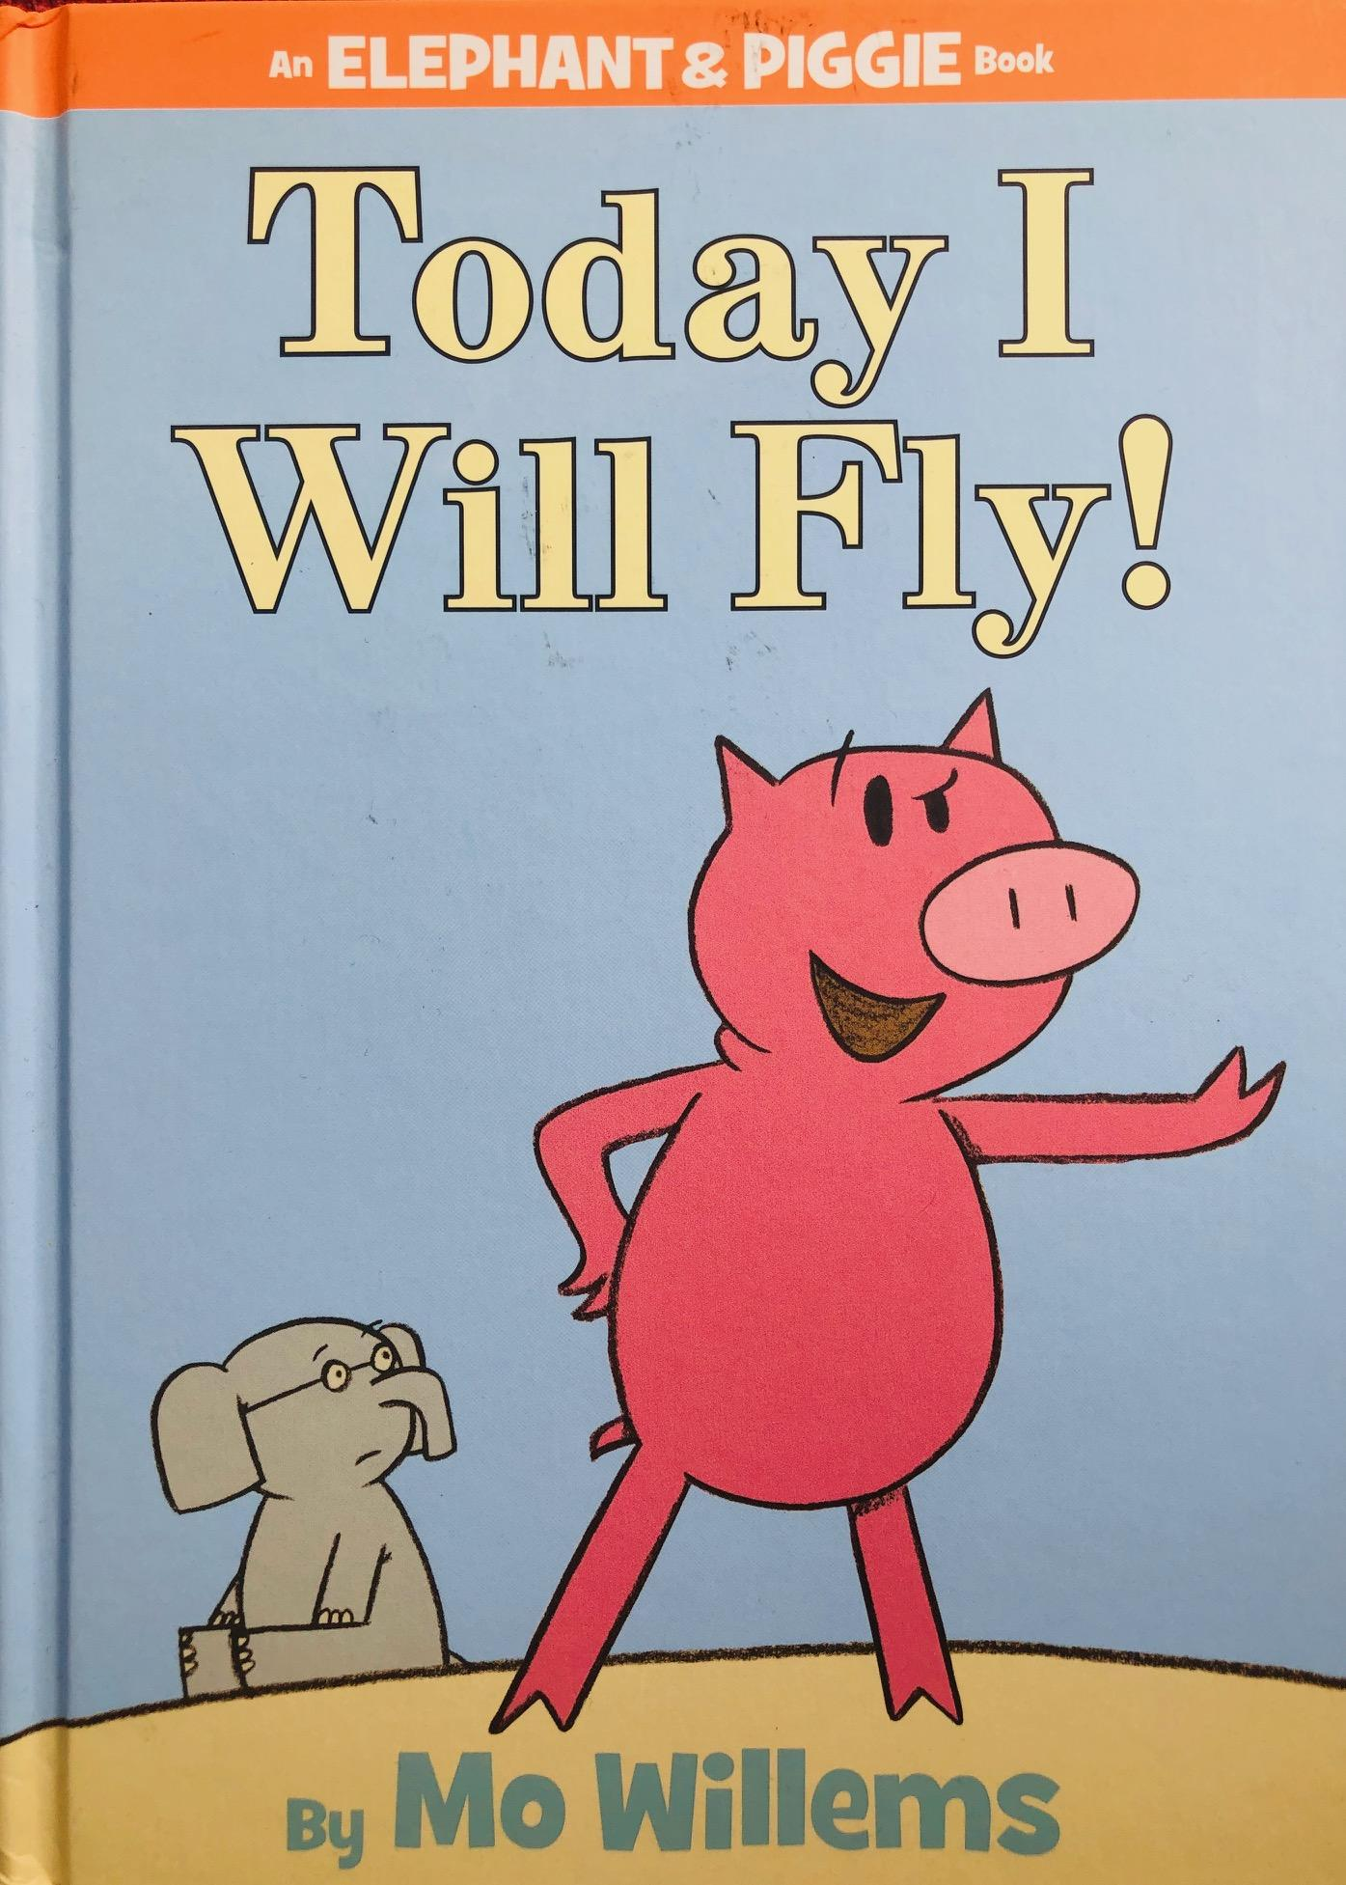
Level 1
Today I will Fly! by Mo Willems
Elephant & Piggie series #1
Geisel Award-winning series
Notes:
KATIE

Slide 25
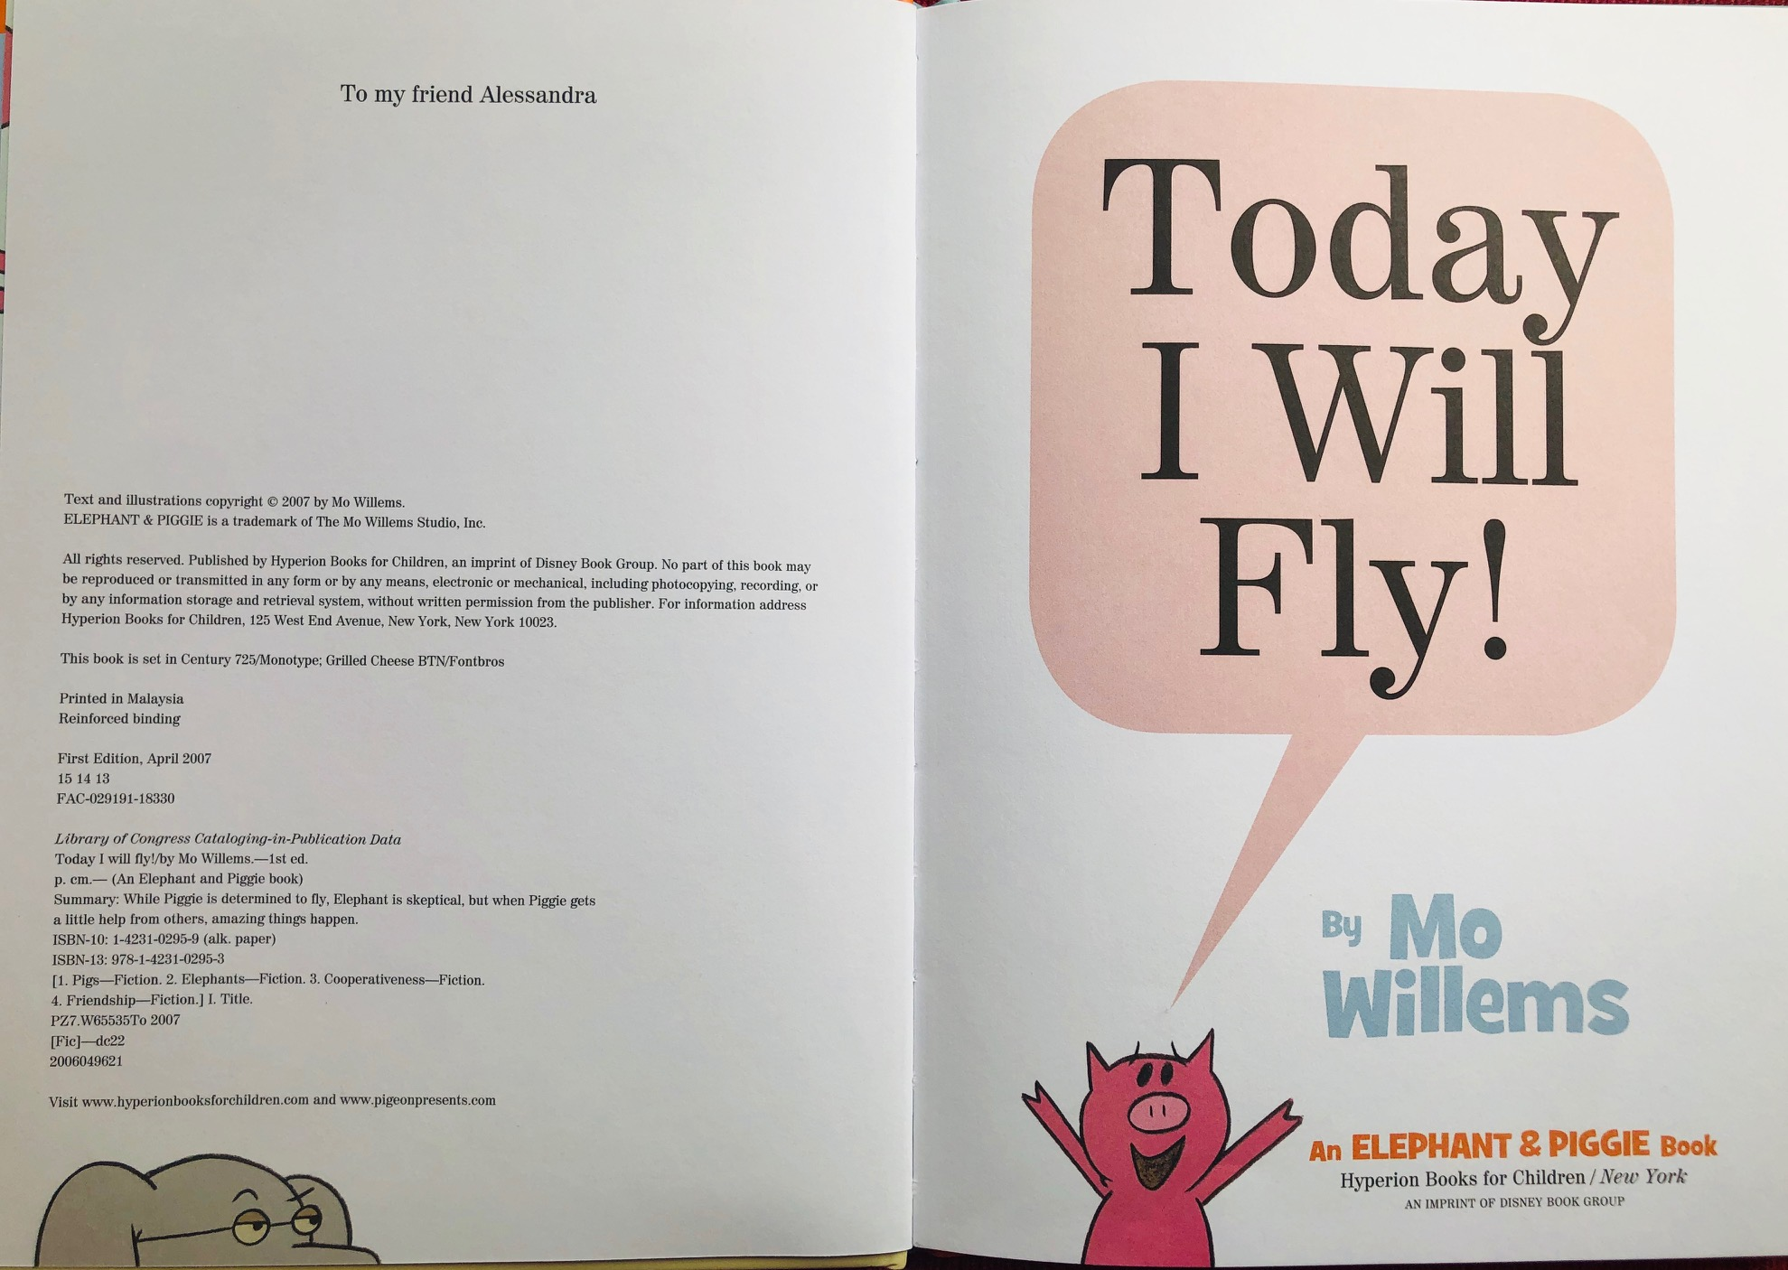
Example from today I will Fly
Notes:
We want to acknowledge that we are sharing scans of only a few pages of each book, as we don’t want to violate copyright laws.

Slide 26
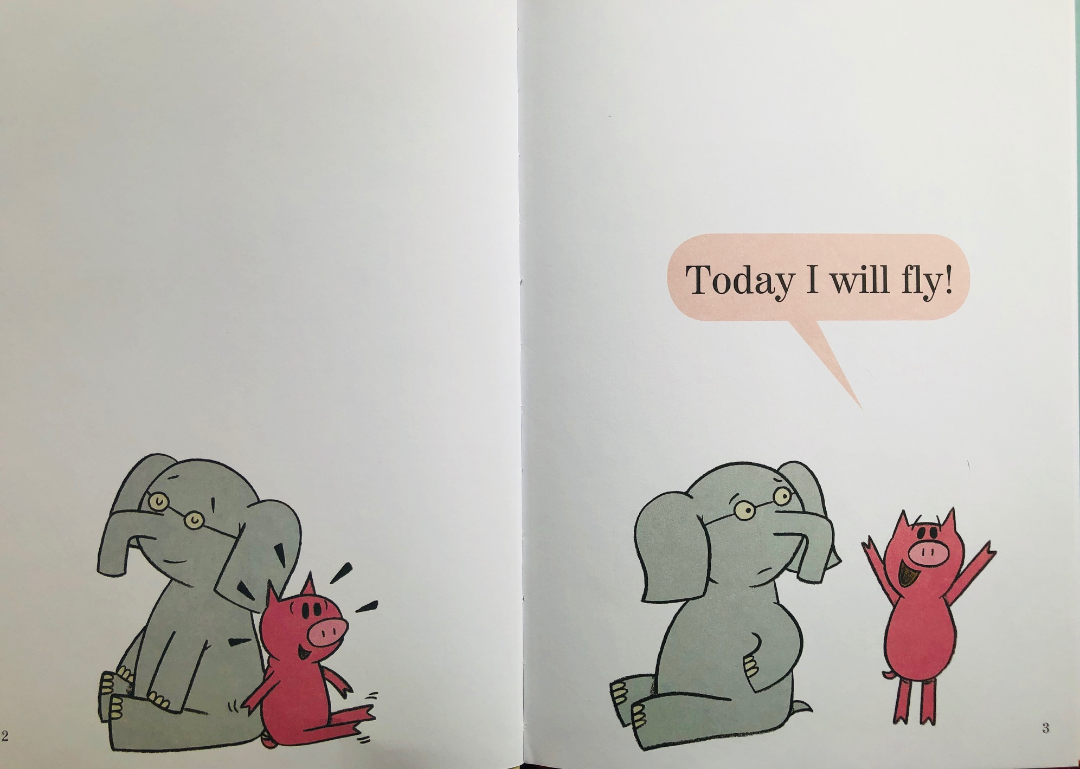
Page 1

Slide 27
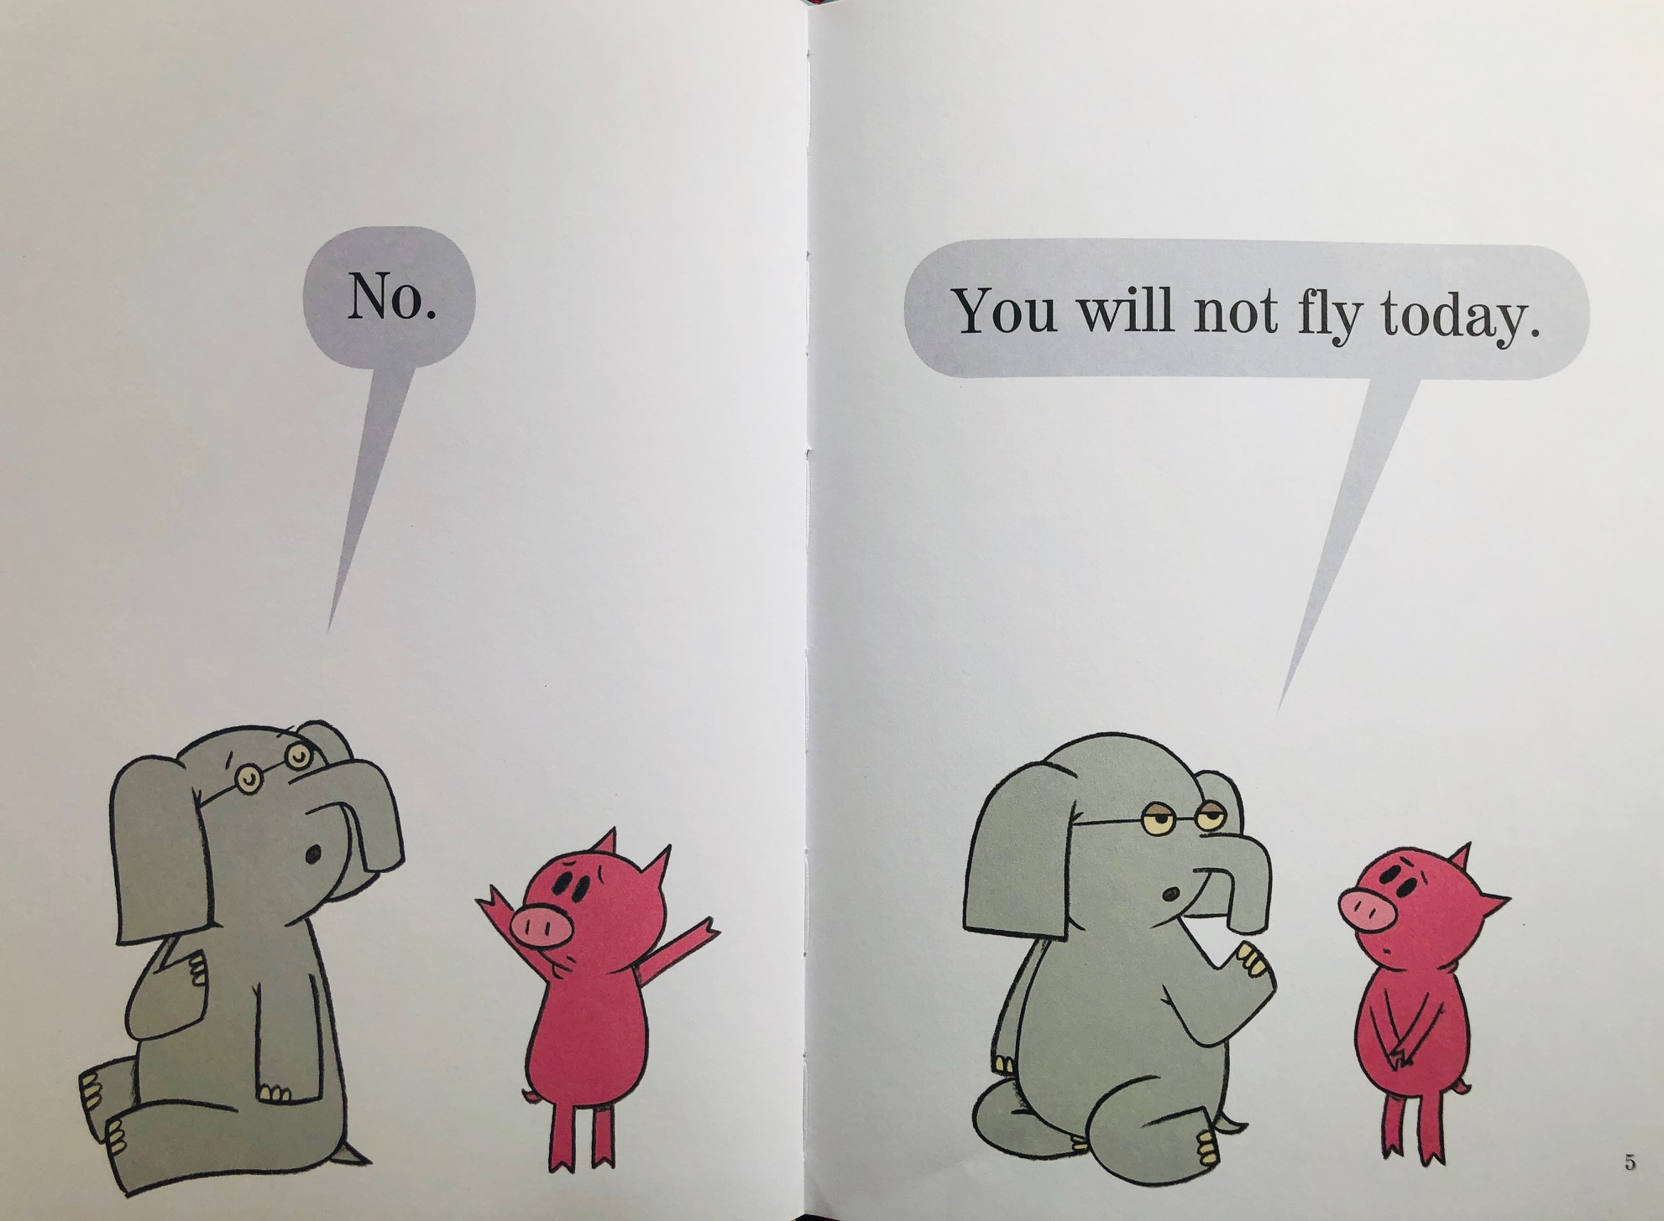
Page 2

Slide 28
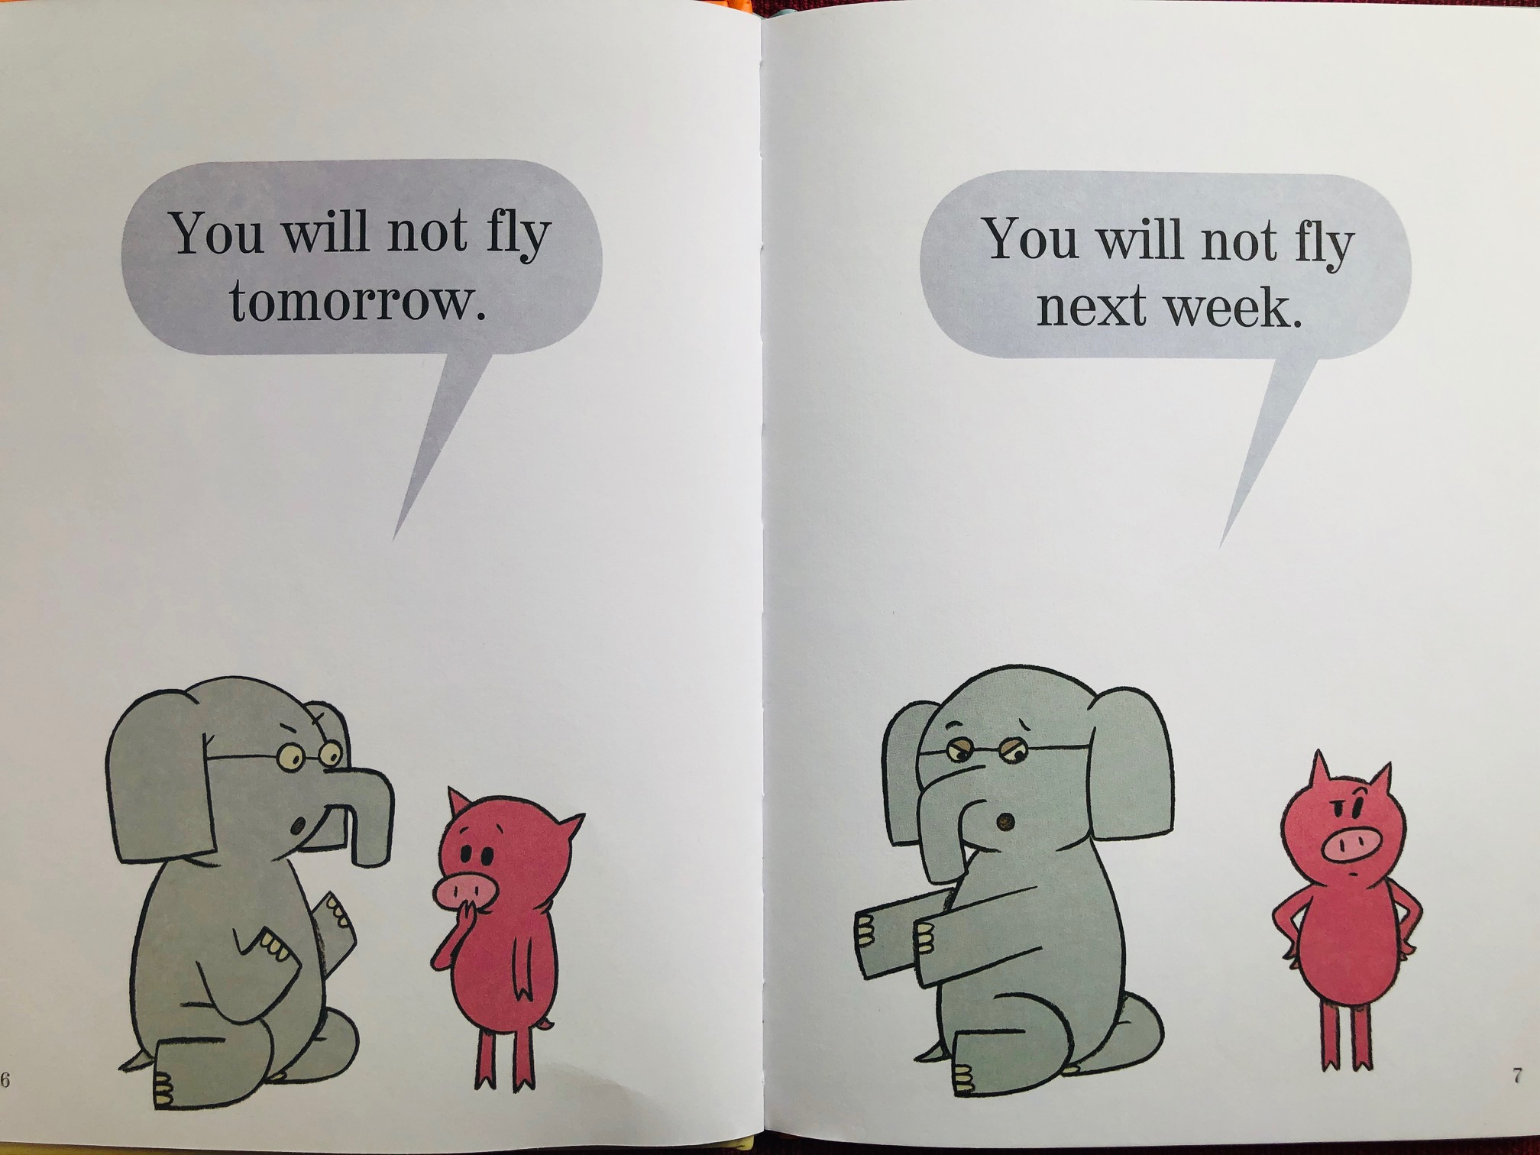
Page 3

Slide 29
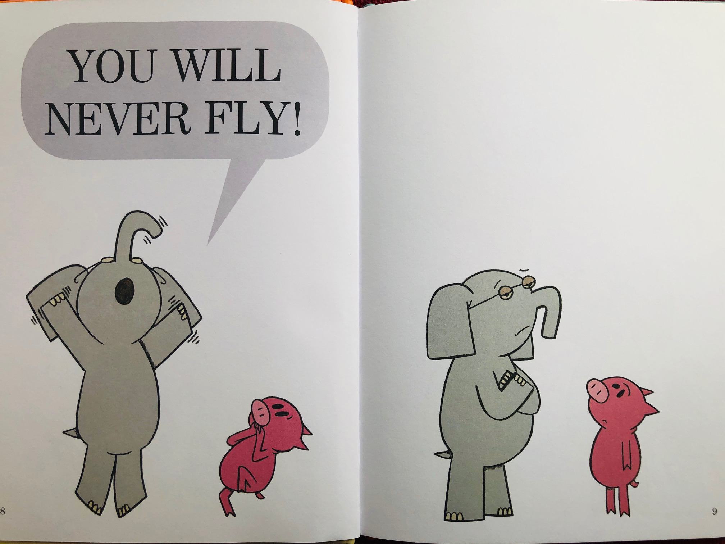
Page 4

Slide 30
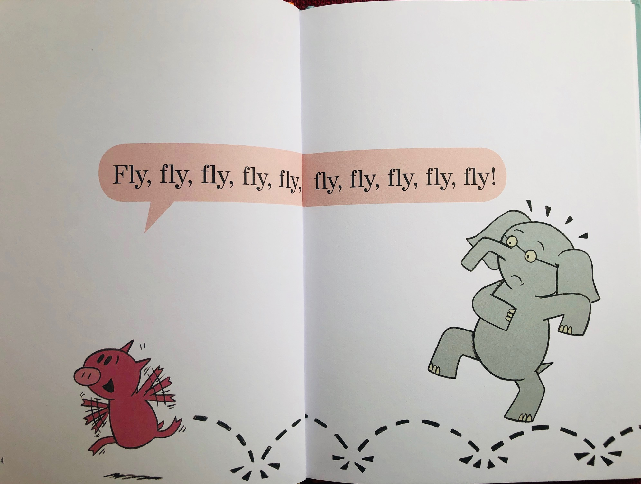
Page 5

Slide 31
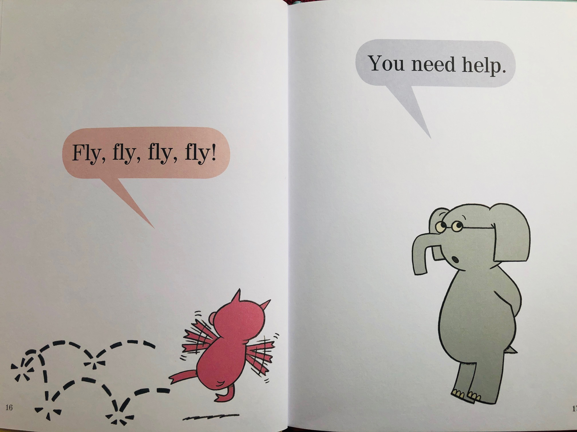
Page 6

Slide 32
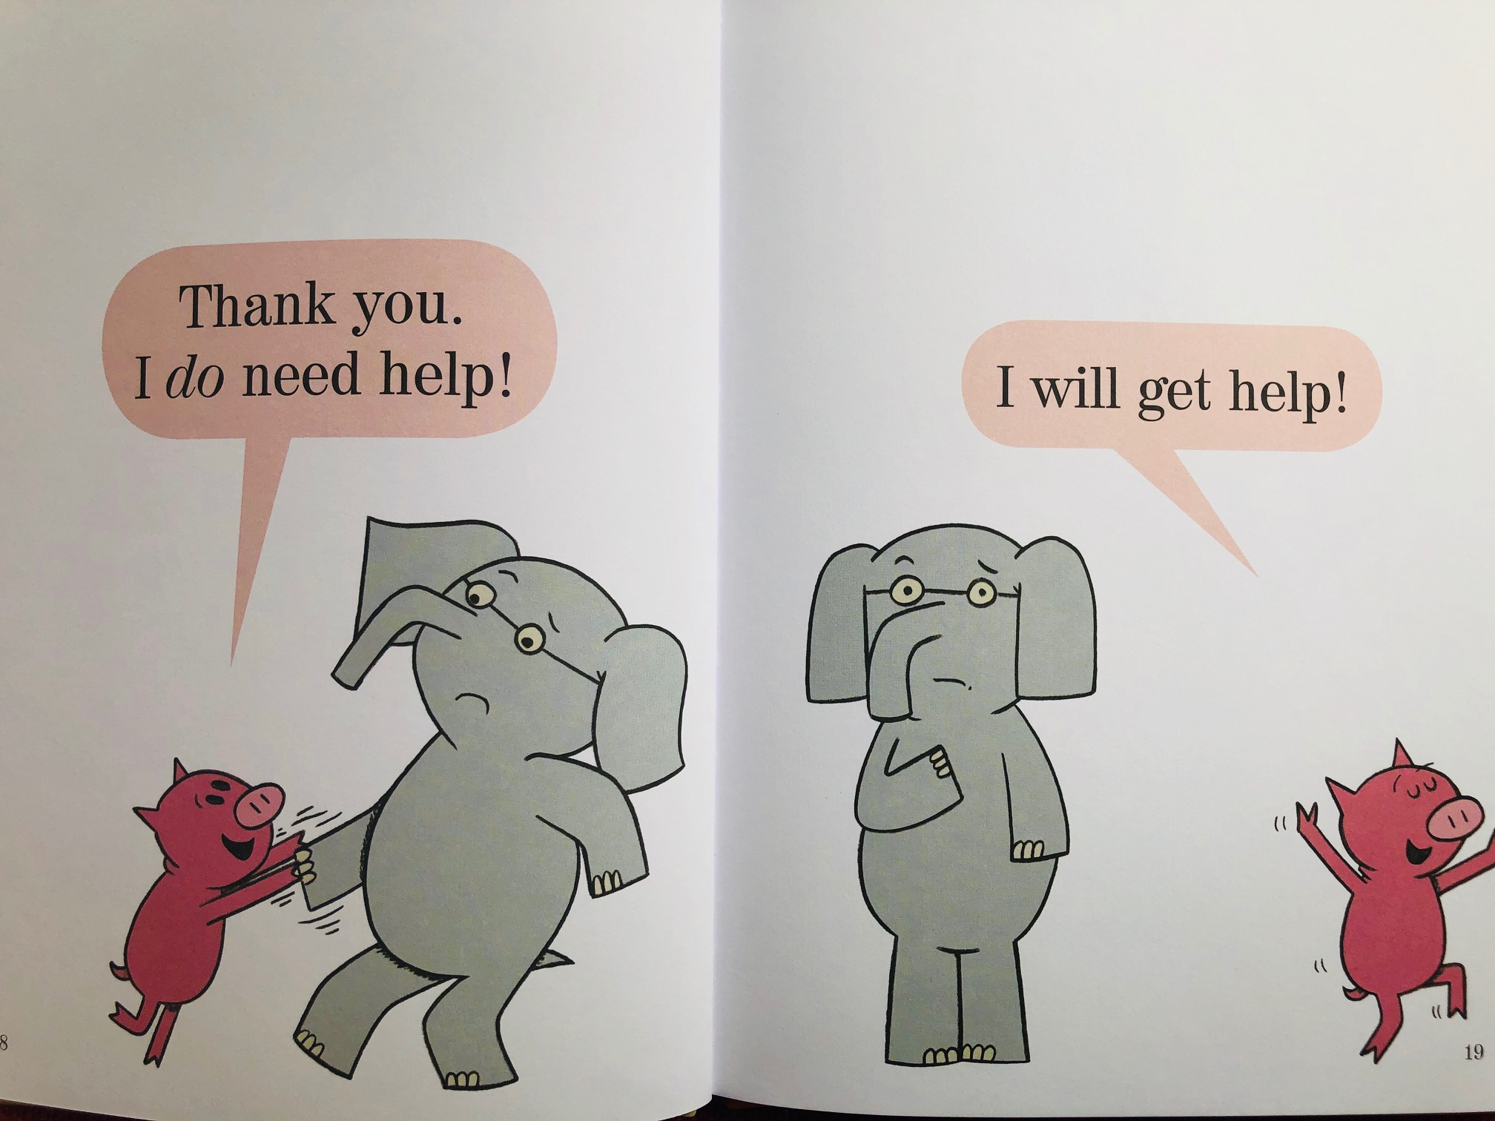
Page 7

Slide 33
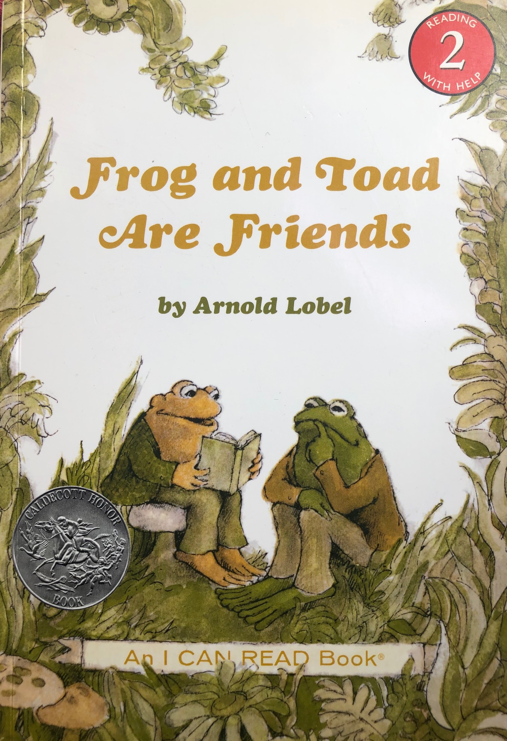
Level 2
Frog and Toad Are Friends by Arnold Lobel
Frog and Toad series #1
Caldecott Honor Award-winning book
Notes:
GP

Slide 34
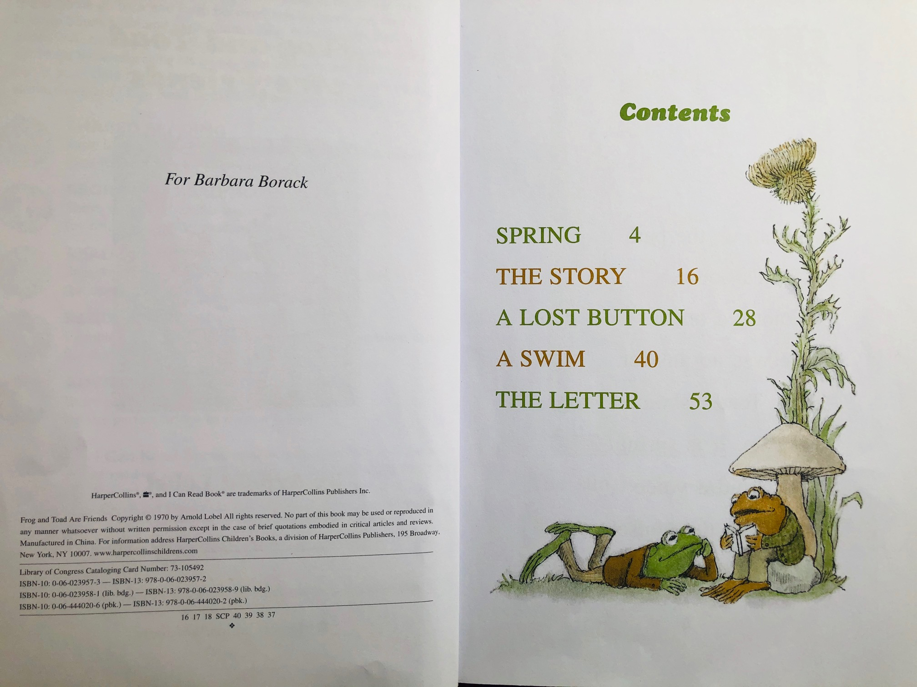
Contents
Notes:
GP
We want to acknowledge that we are sharing scans of only a few pages of each book, as we don’t want to violate copyright laws.

Slide 35
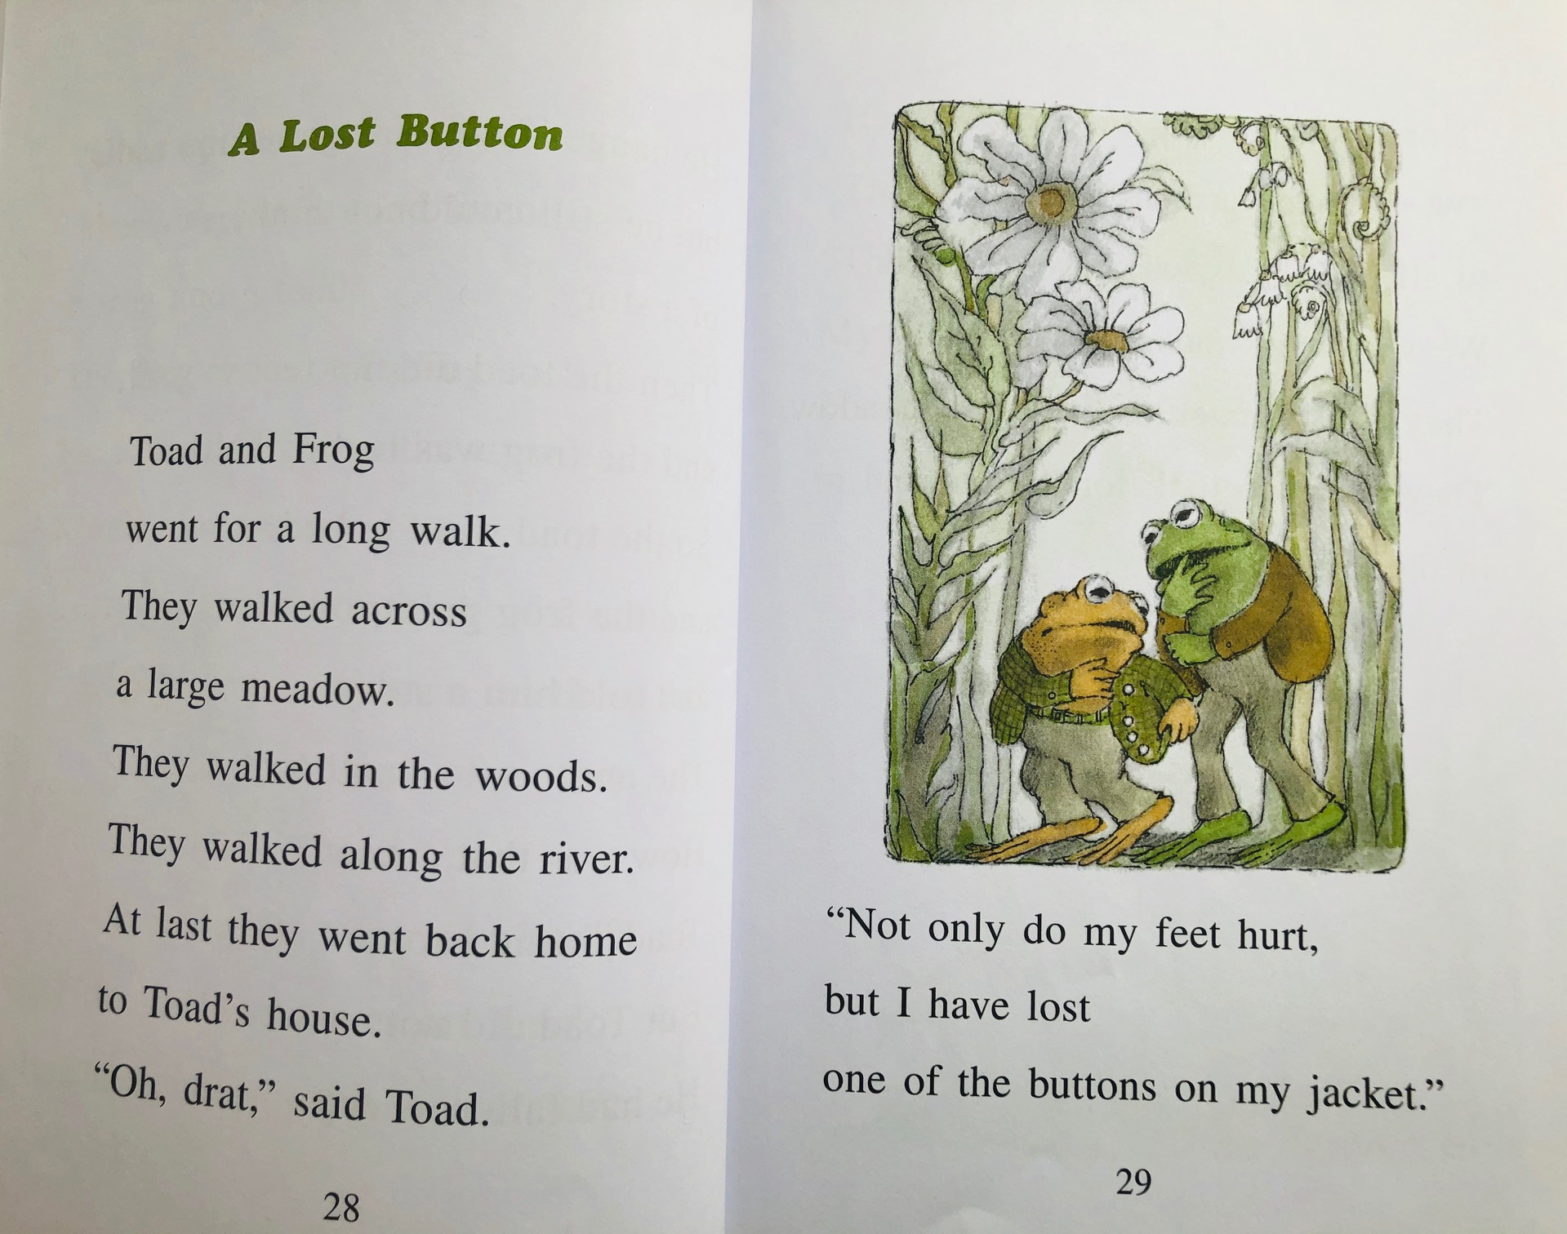
Frog and Toad Example 1
Notes:
GP

Slide 36
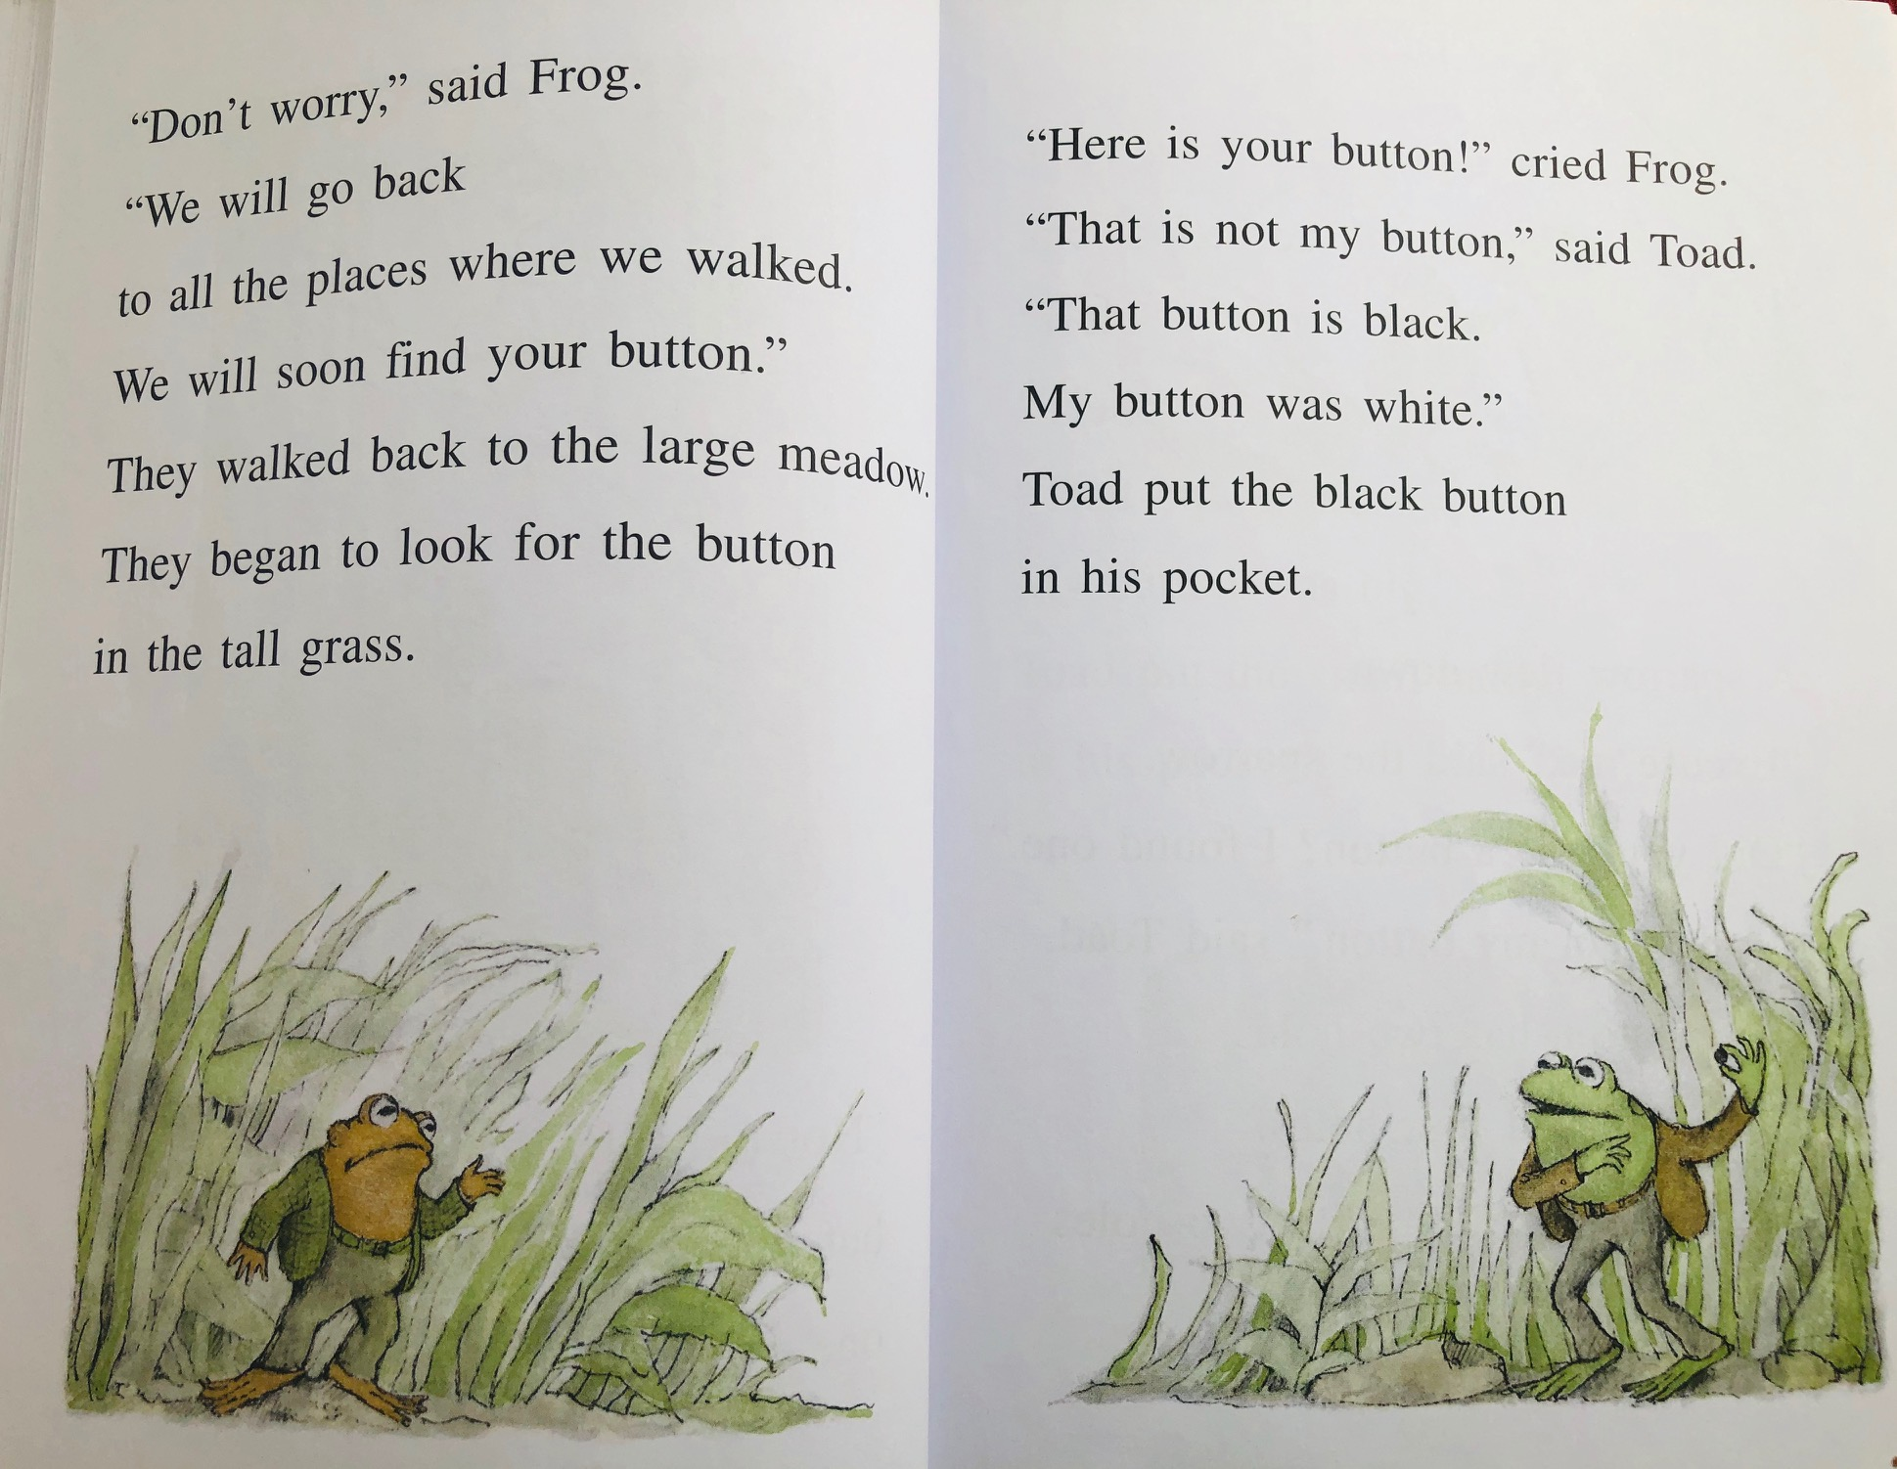
Frog and Toad Example 2
Notes:
GP

Slide 37
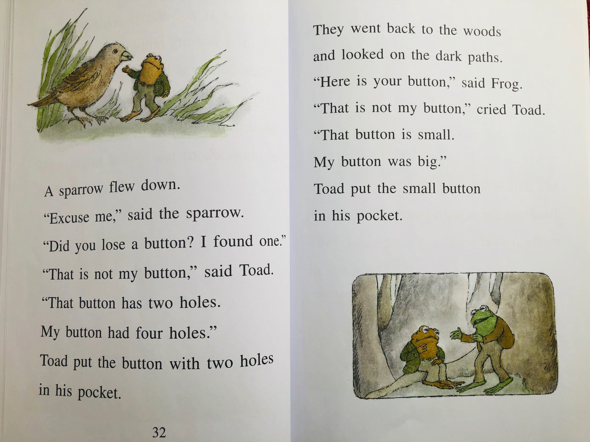
Frog and Toad Example 3
Notes:
GP

Slide 38
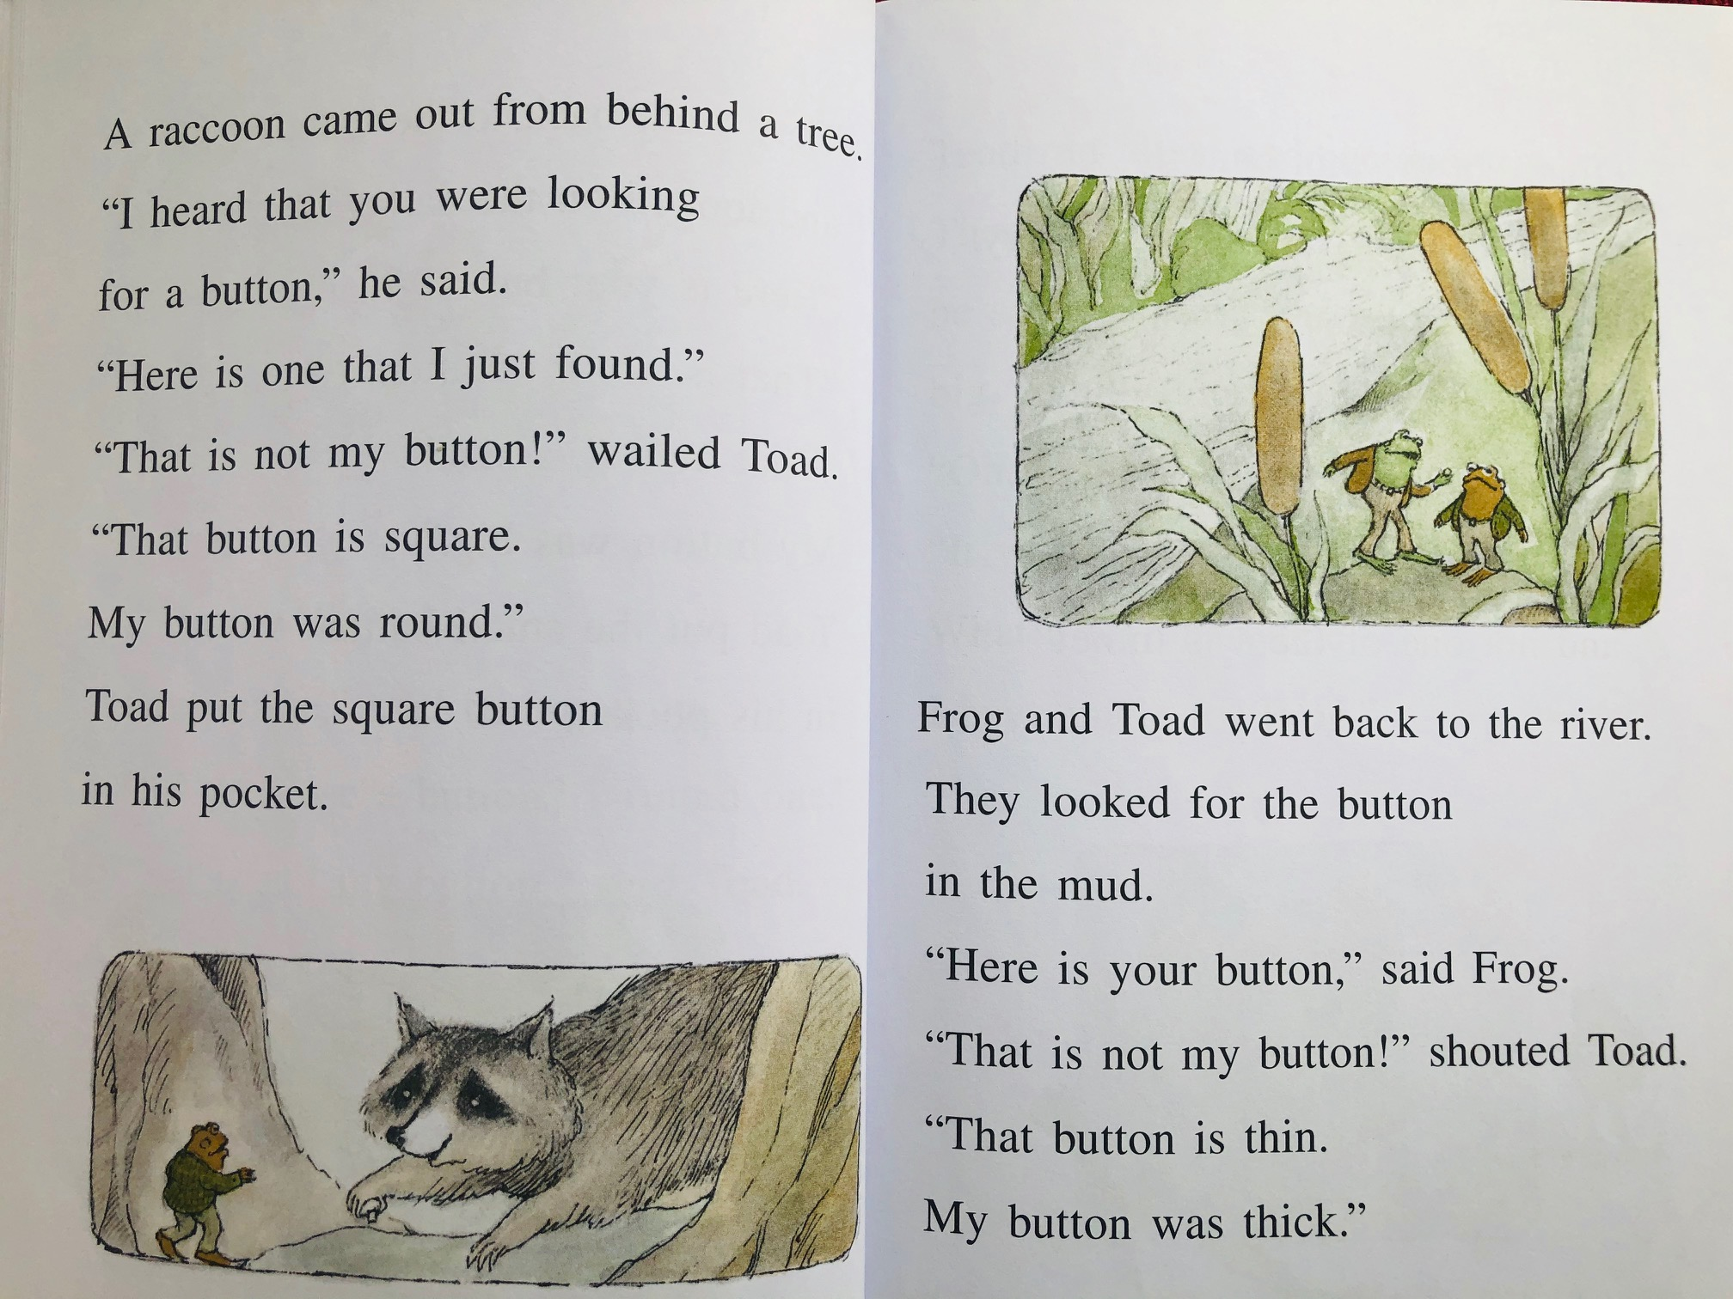
Frog and Toad Example 4
Notes:
GP

Slide 39
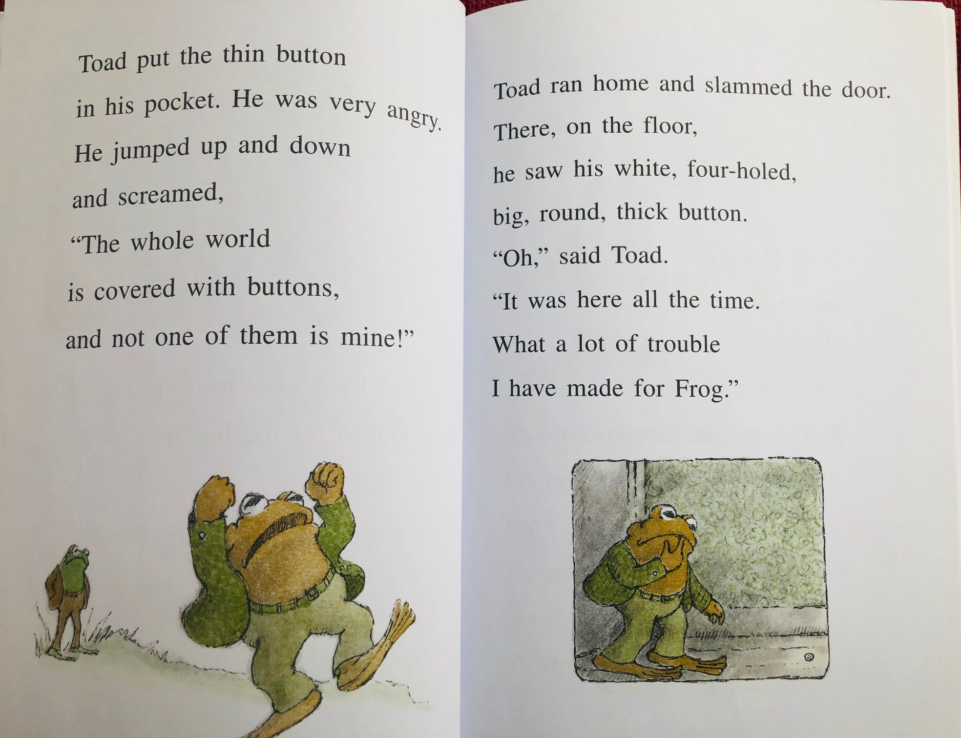
Frog and Toad Example 5
Notes:
GP

Slide 40
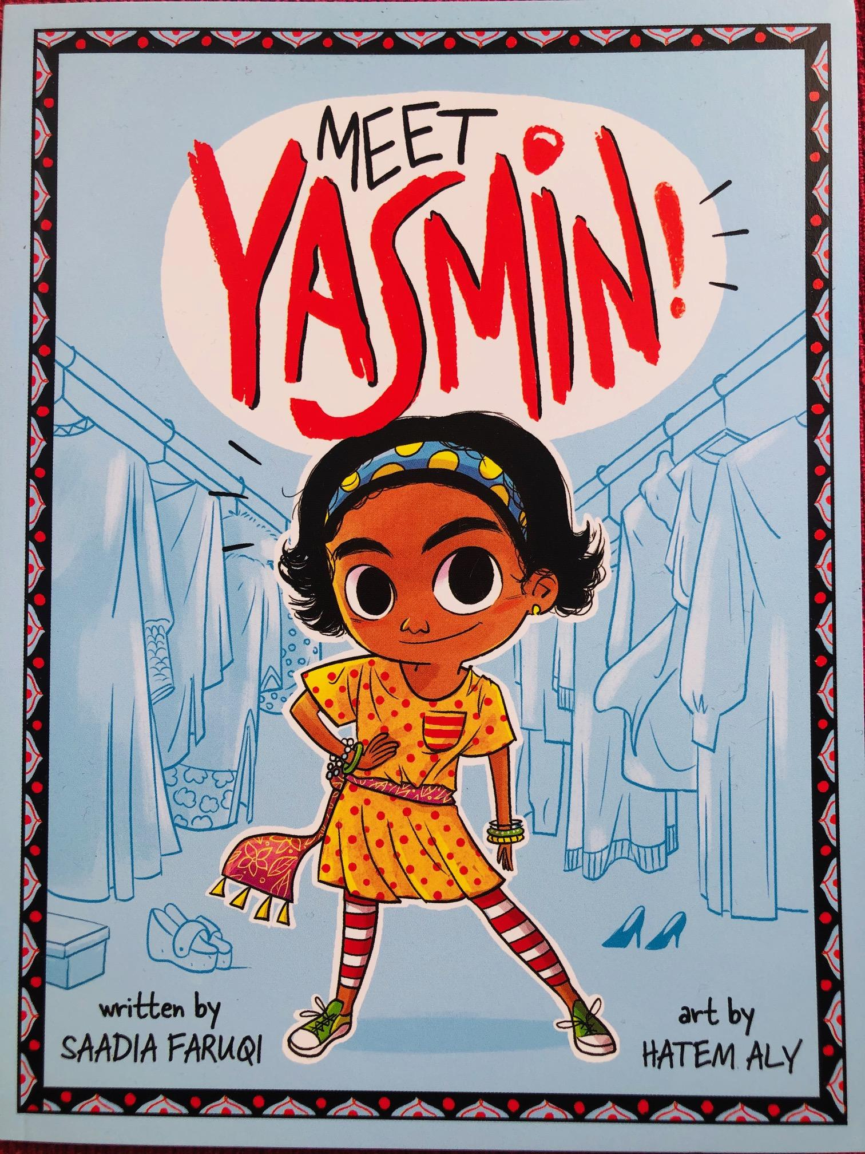
Level 3
Meet Yasmin! by Saadia Faruqi
Yasmin series #1
Starred reviews, Kirkus, SLJ, Amazon, JLG best books
Notes:
GP
We want to acknowledge that we are sharing scans of only a few pages of each book, as we don’t want to violate copyright laws.

Slide 41
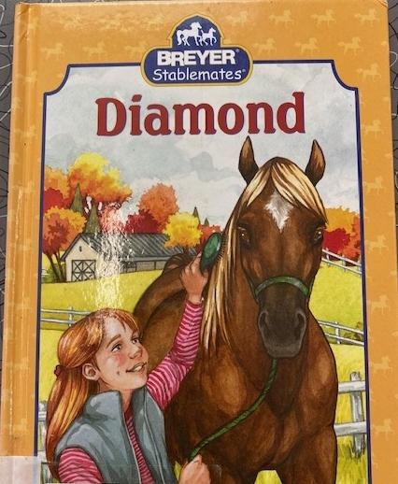
Level ???
Diamond by Suzanne Weyn
Breyer Stablemates series #1
Notes:
KATIE
We want to acknowledge that we are sharing scans of only a few pages of each book, as we don’t want to violate copyright laws.

Slide 42
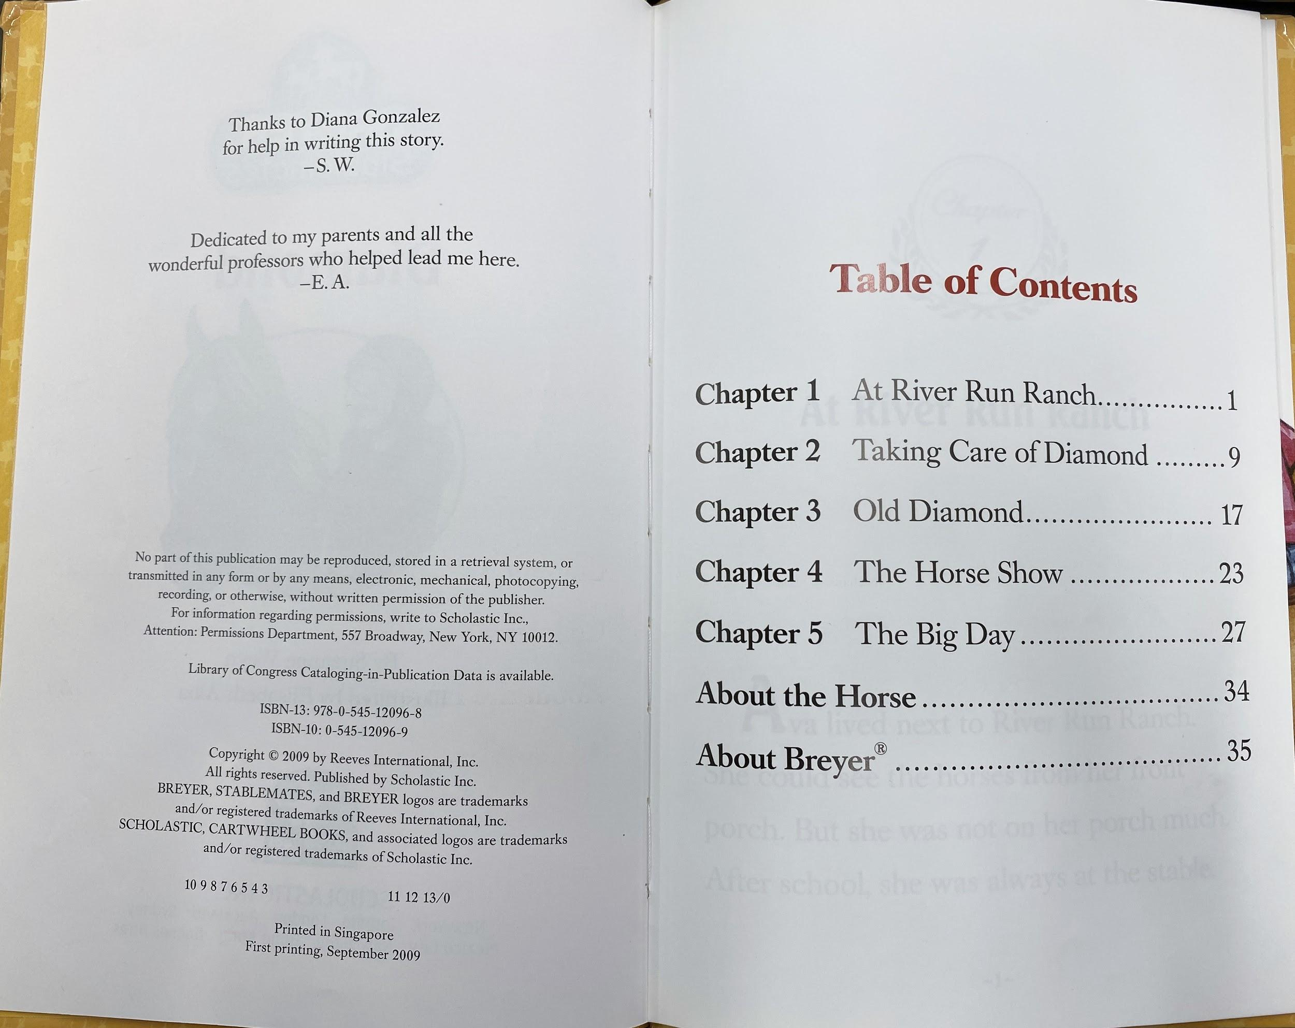
Diamond example 1

Slide 43
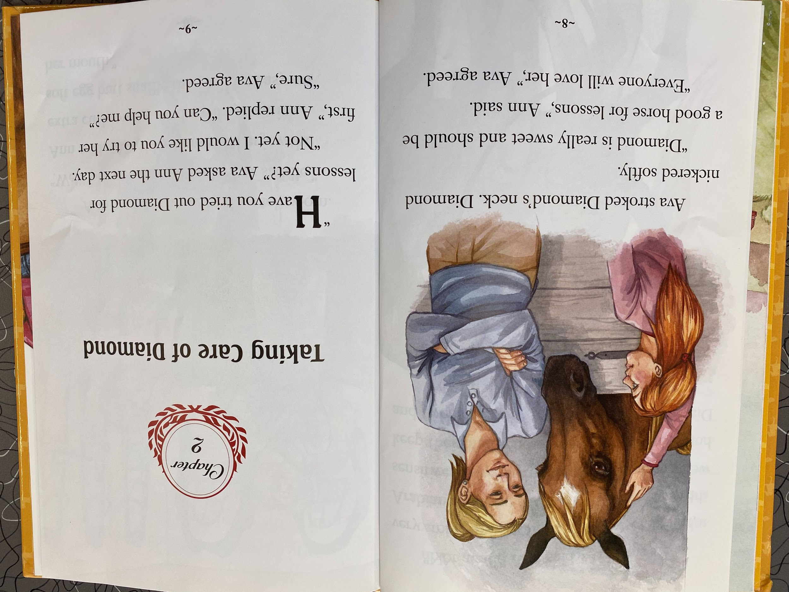
Diamond example 2

Slide 44
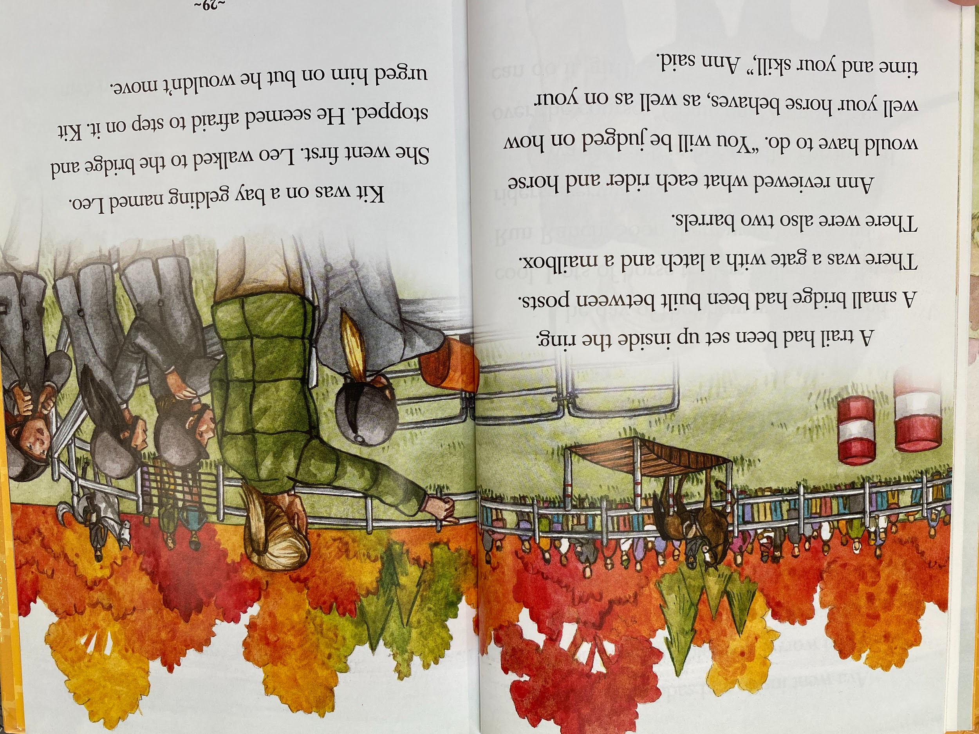
Diamond example 3

Slide 45
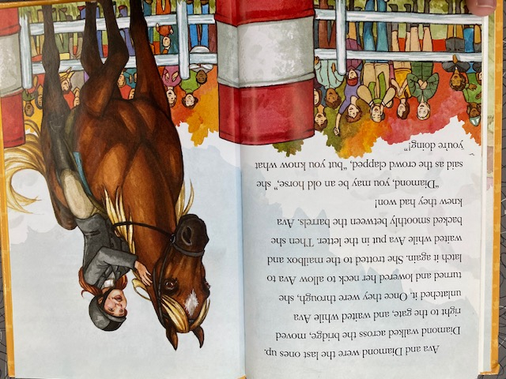
Diamond example 4

Slide 46
Questions?
Notes:
GP

Slide 47
Resources
Notes:
GP

Slide 48
Criteria and Rubric Links
DPL Beginning Reader Collection Criteria
DPL Beginning Reader Classification Rubric
  Make your own copy here:
  https://docs.google.com/spreadsheets/d/1DZSIiPHHEXdgwHFrPIwbtYefA1TmAdwWUIewh_7EsIk/copy
Notes:
GP
Here are a few examples of excellent Early Books. Title and author information is included in the slide notes. As you can see the titles include nonfiction, picture books, graphic novels, and beginning readers.
Noodleheads Find Something Fishy by Tedd Arnold, Martha Hamilton and Mitch Weiss
I Like the Farm by Shelley Rotner
They All Saw a Cat by Brendan Wenzel
I See Rocks by Tim Mayerling

Slide 49
Sources and further reading
American Library Association. Labeling and rating systems: An interpretation of the Library Bill of Rights. Retrieved from http://www.ala.org/advocacy/intfreedom/librarybill/interpretations/labelingrating
Association for Library Services to Children. Theodor Seuss Geisel Award terms and criteria. Retrieved from http://www.ala.org/alsc/awardsgrants/bookmedia/geiselaward/geiselawardtermscriteria/geiselawardtermscriter
Association for Library Services to Children Intellectual Freedom Committee. Leveling and labeling: An interview with Pat Scales. Retrieved from https://www.alsc.ala.org/blog/2015/03/leveling-and-labeling-an-interview-with-pat-scales/
Denver Public Library. Read Play Learn. Find books for your developing reader. Retrieved from https://kids.denverlibrary.org/blog/k-3/find-books-your-developing-reader
Denver Public Library. Read Play Learn. Reading level resources. Retrieved from https://kids.denverlibrary.org/activities/k-3/reading-level-resources
Guessing Geisel: A Mock Blog. Retrieved from https://guessinggeisel.blogspot.com/
Horning, K. T. (2010). From cover to cover: Evaluating and reviewing children’s books. New York: Harper Collins.
Meltzer, E. (2019, August 15). Most Colorado students not proficient in reading and math — but there’s some good news. Retrieved from https://www.chalkbeat.org/posts/co/2019/08/15/2019-colorado-test-results/?utm_source=newsletter&utm_medium=email&utm_campaign=cb_bureau_colorado
Park, S. (2019, June 19). Picture this: Diversity in children’s cooks 2018 infographic. Retrieved from https://readingspark.wordpress.com/2019/06/19/picture-this-diversity-in-childrens-books-2018-infographic/
Pinell, G. S. (n.d.). What Is Leveled Reading? Retrieved from https://www.scholastic.com/teachers/articles/teaching-content/what-leveled-reading/
Shanahan, T. (2019, February 13). Which texts for teaching reading: Decodable, predictable, or controlled vocabulary? Retrieved from https://www.readingrockets.org/blogs/shanahan-literacy/which-texts-teaching-reading-decodable-predictable-or-controlled-vocabulary
The status of Denver's children: A community resource 2018. (2018). Retrieved from https://www.denvergov.org/content/dam/denvergov/Portals/713/documents/data-resources/StatusOfDenversChildren_2018.pdf
Notes:
GP
Here are some sources, both ones we used in the presentation, and some great articles to get you thinking even more about Beginning Readers, levels and leveling systems.

Slide 50
Contact Us!
Gigi Pagliarulo
gpagliarulo@denverlibrary.org
Katie MacKendrick
cmackendrick@denverlibrary.org
Notes:
GP

Slide 51
Thank you for attending!
Notes:
BOTH

