Slide 1
Let’s Talk About… Parental Leave
Colorado State Library Webinar
April 27, 2023

Slide 2

Hello!
I’m Courtney Drysdale (she/her)
Research and Instruction Librarian, Associate Professor Regis University - Denver, CO
Mom of two, ages 6.5 and 4

Slide 3
Our Time Together Today
PROJECT & RESULTS
Background
Literature
Survey
Results
Multiple Answer
Open-ended
SHARING
Sharing your own experiences (anonymously)
Questions

Slide 4
Project Background
1

Slide 5
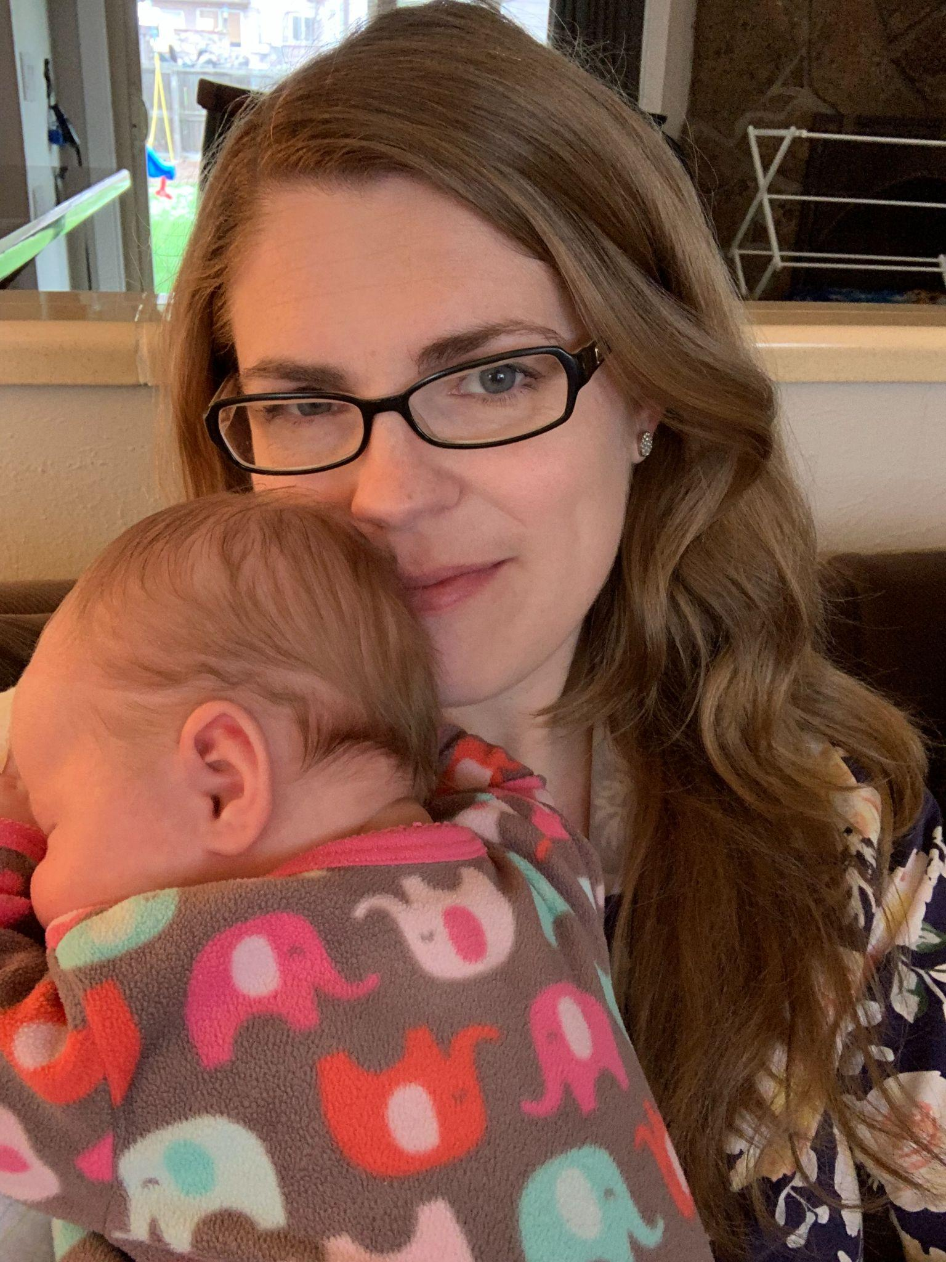
Why this Project?
Why is parental leave so hard?
Is there anything we can do to make it feel better, even if we can’t change policy?
Which policies should we put our efforts into for advocacy?

Slide 6
Research question
Which policies help academic librarian mothers feel supported before, during, and after parental leave?

Slide 7
The Literature
2

Slide 8
Literature Searches
Parental leave in academic libraries
Parental leave in higher education in general
Parental leave in general
Librarianship and motherhood
Literature list link
Notes:
https://docs.google.com/document/d/18SyEnn2TIIlMcDP6dlK8QUQxQmi9XLRxdDpp4l2SnDg/edit?usp=sharing

Slide 9
The Survey
3

Slide 10
The Survey - linked here
Distributed in February 2022
On Twitter (131 responses) and several academic library listservs (122 responses)
253 respondents - 227 eligible responses
3 qualifying questions
5 multiple answer questions
4 open-ended questions
6 demographics questions
Notes:
https://docs.google.com/document/d/1pd7_TWE7ky_j38hoewWuWE-h11pXYFhYuI1jcq0U3KA/edit?usp=sharing

Slide 11
The Results
4
Multiple Answer Questions

Slide 12
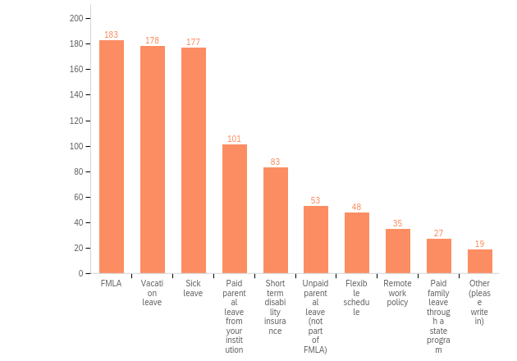
Q4 - Which of the following formal policies were available to you when your child(ren) was born? (choose all that apply)
n=227
Notes:
227 individual responses to the formal policies. They could choose as many as they had available, so there were 904 total answer choices selected.

Slide 13
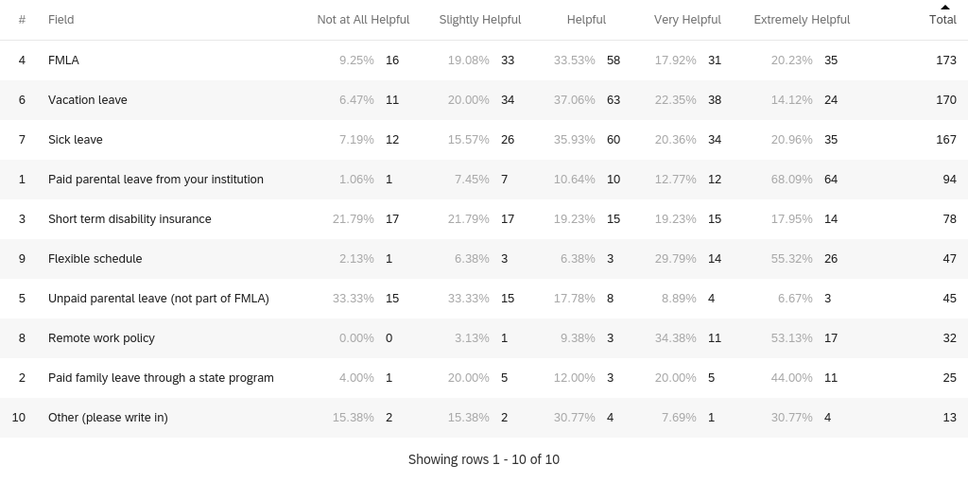
Q5: How helpful were these policies
to you as a new parent?

Slide 14
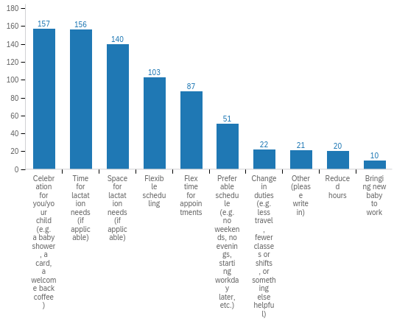
Q7 - Which of the following informal policies or practices did your workplace, library, or department have to support you as related to preparing for a new baby, being away from work to care for a new baby, or returning to work after leave? (Choose all that apply or add your own)

Slide 15
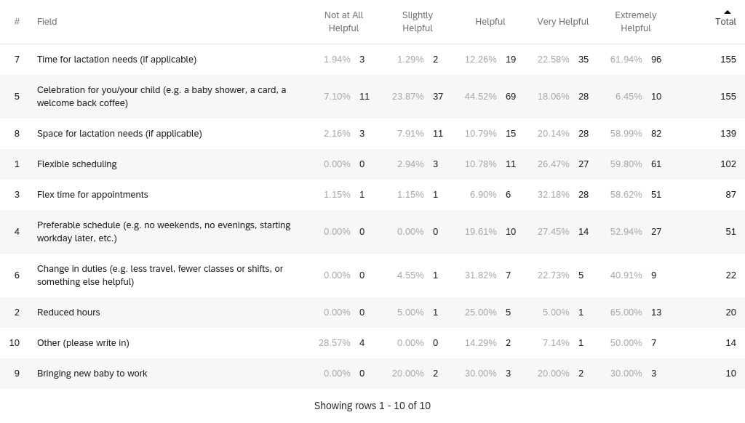
Q8 - How helpful or not were these informal policies and practices?

Slide 16
The Results: Open Ended Questions
5

Slide 17
Open-ended questions
Answers were coded into categories and grouped using Taguette
Tables created with numbers from each category
Quotes were selected to represent some categories (either higher numbers or unique)
Link to selected quotes

Slide 18
Q9 - Thinking about all of the formal and informal policies available to you when your child or children joined your family, what was most helpful to you? N = 190
Code | #
Paid parental leave | 48
Flexible schedule | 48
Vacation or sick leave | 34
Lactation space | 30
Remote work | 29
FMLA | 26
Code | #
Supportive supervisor | 23
Lactation time | 20
Supportive colleagues | 13
Amount of leave time | 12
Short term disability leave, reduced hours, pref. schedule, nothing, state family leave policy, supportive admin, donated sick leave, a celebration, and baby at work policy | ≤7

Slide 19
Q10: Were there any barriers to using these formal and informal policies at your institution? N = 183
Code | #
No barriers | 32
Knowledge of policies | 30
Lactation space lacking | 19
Exhausted leave balances | 17
Human resources difficulties | 14
Paperwork | 14
Code | #
Subjective informal policies | 10
Institutional culture | 10
Time for lactation needs | 9
Money | 7
Didn’t qualify for leave policy | 7
Rude comments | 2

Slide 20
Q11: What support do you wish you had had as related to preparing for a new baby, being away from work to care for a new baby, or returning to work after leave? N = 178
Code | #
Paid leave | 52
Remote work | 39
More time off | 31
Flexible schedule | 26
Childcare support | 19
Part time options | 19
Code | #
Lactation space | 14
Better knowledge of policies | 8
Consistent policies | 8
Ability to bring baby to work | 6
Supportive colleagues, understanding supervisor, close parking, reduction in duties, support for foster or adoptive parents | ≤4

Slide 21
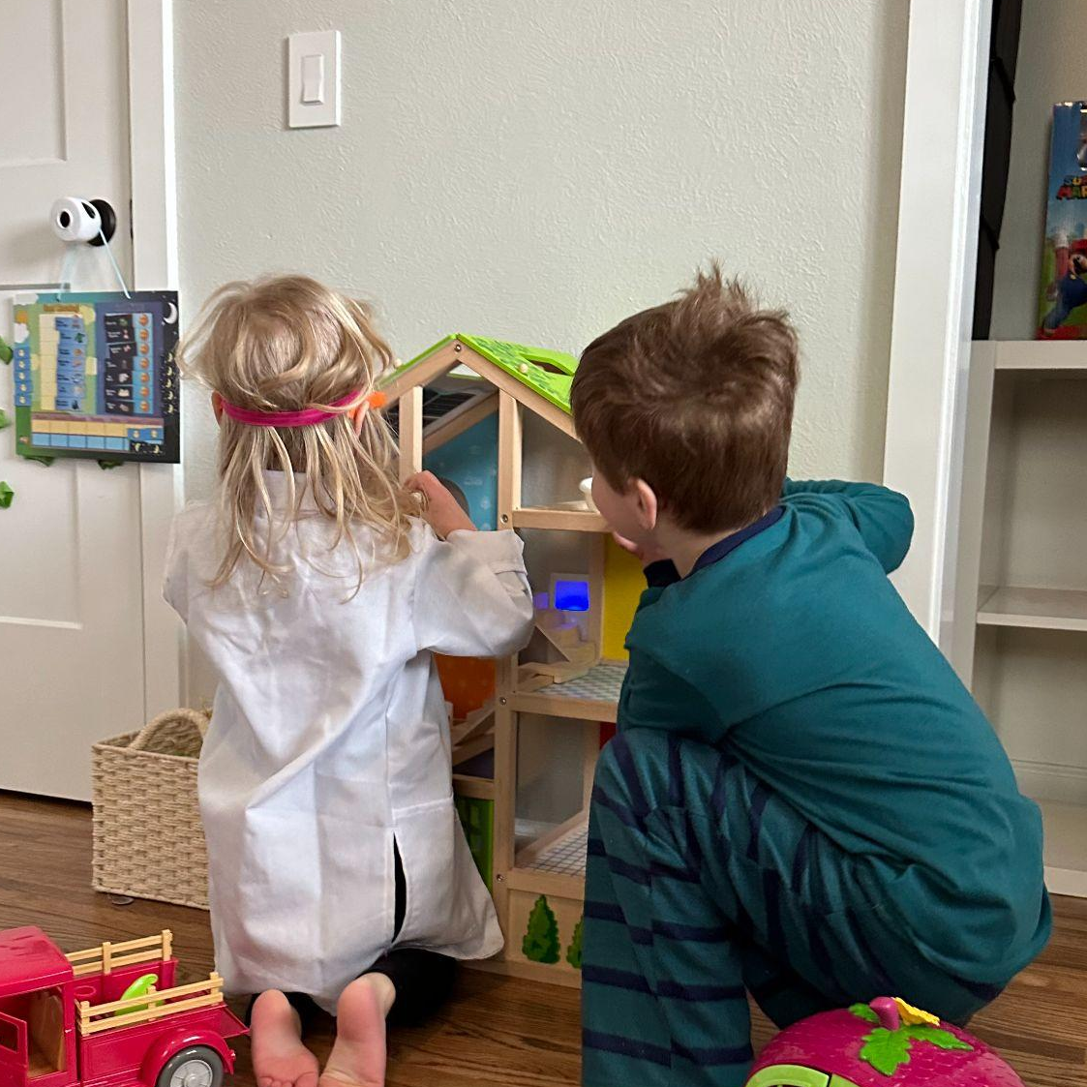
Let’s Share
We will share through a Jamboard that will be maintained after the session. You are also welcome to share by unmuting and speaking, but the Jamboard is fully anonymous. We want you to feel safe!
Jamboard Link

Slide 22
Thanks!
What questions do you have?
Courtney Drysdale, cdrysdale@regis.edu

Slide 23
Resources for Advocacy
for Paid Leave
Chamber of Mothers
MomsRising
Paid Leave for All
A Better Balance
The Arc
Zero to Three Advocacy Toolkit

