Slide 1
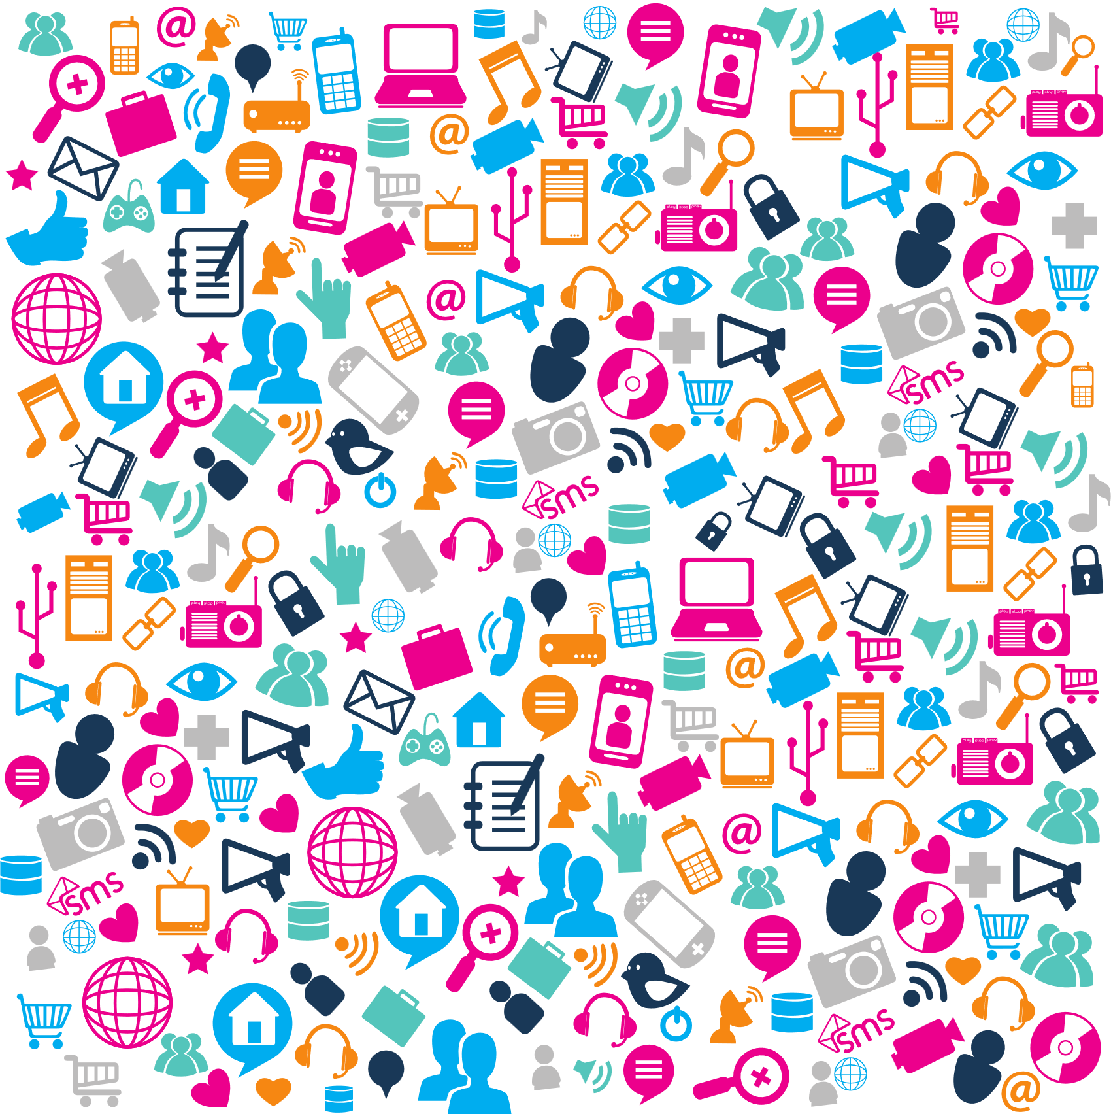
Let’s Get Digital
Let's Get Digital
How To Successfully Bring Your Programs Online

Slide 2
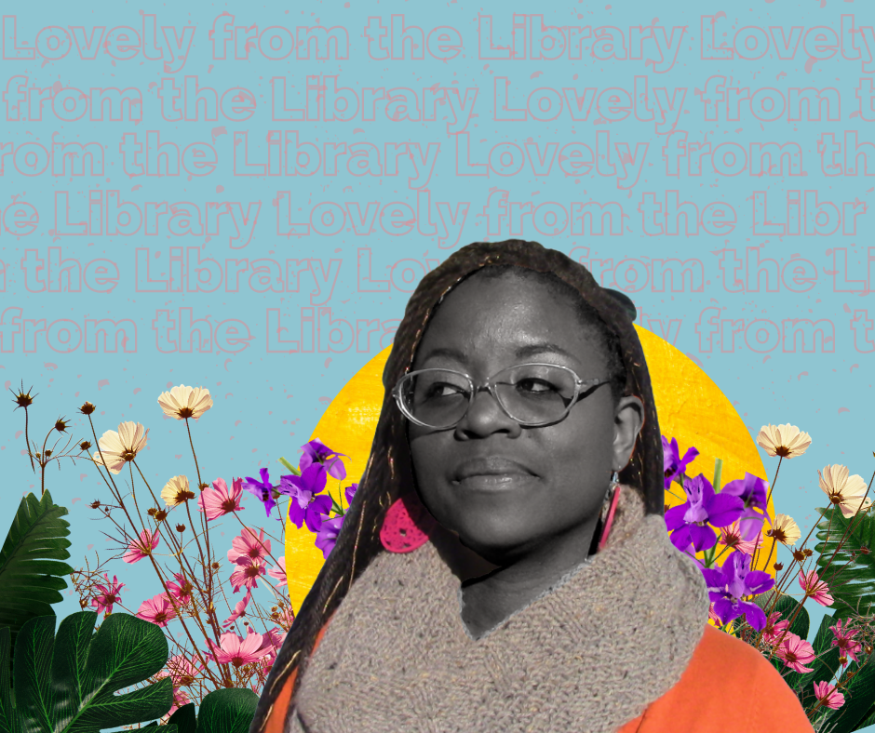
Hey Y'all,I'm Lovely
I've been with the Pueblo City County Library District for seven years.
I host a digital book club on my facebook page Lovely From The Library & a podcast of the same name.

Slide 3
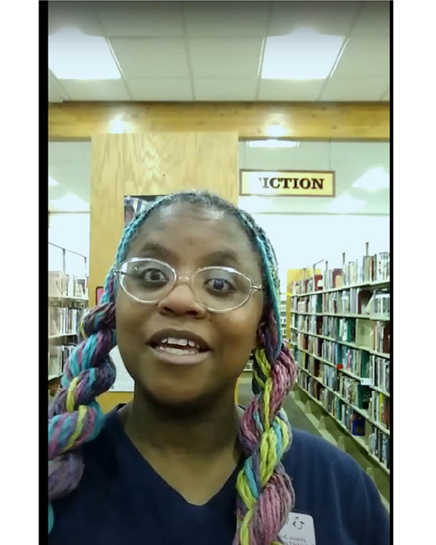
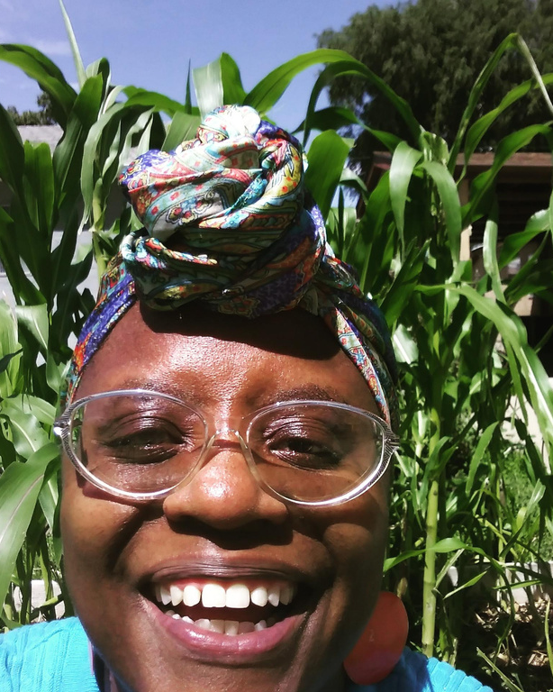
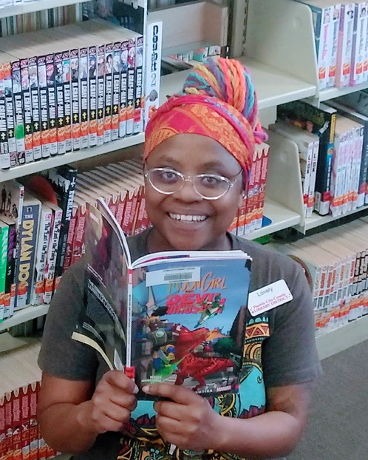
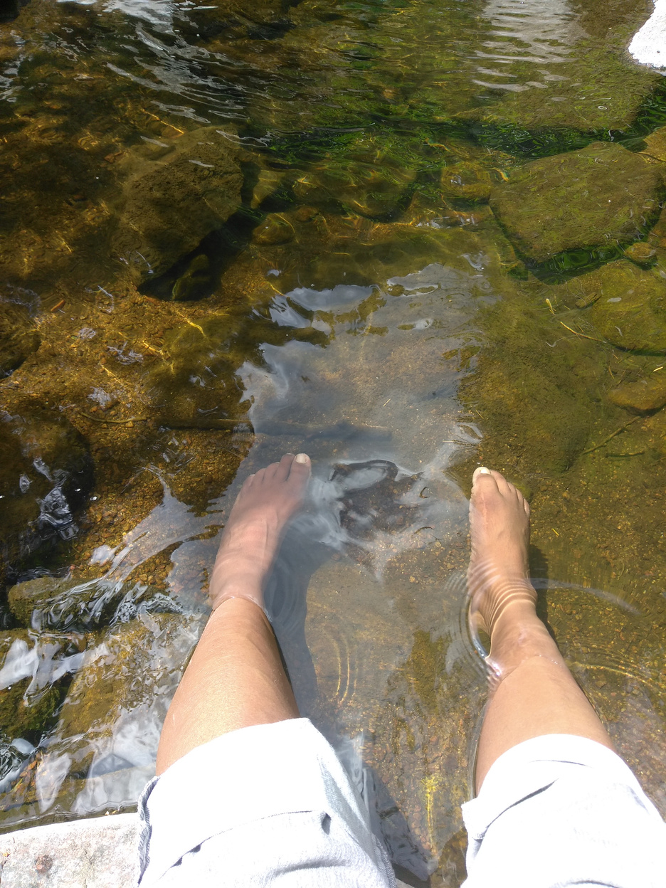
More In Four
About Lovely
Social Media Maven
Plant Propagator
Avid Reader
Nature Enthusiast

Slide 4
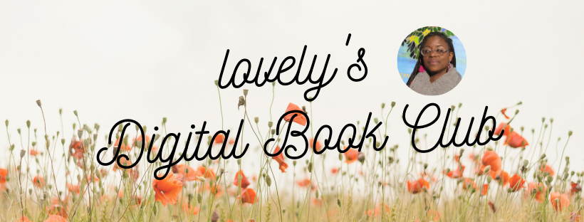

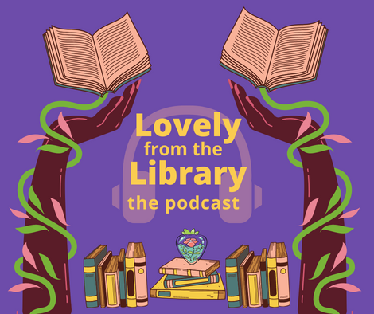
How It All Began
Book Club
Facebook Page
Podcast

Slide 5
What We Are Going To Cover
Know Your Audience
Choose your Platform
Content: Create vs Curate
Data Collection & Analytics
Marketing Tools

Slide 6
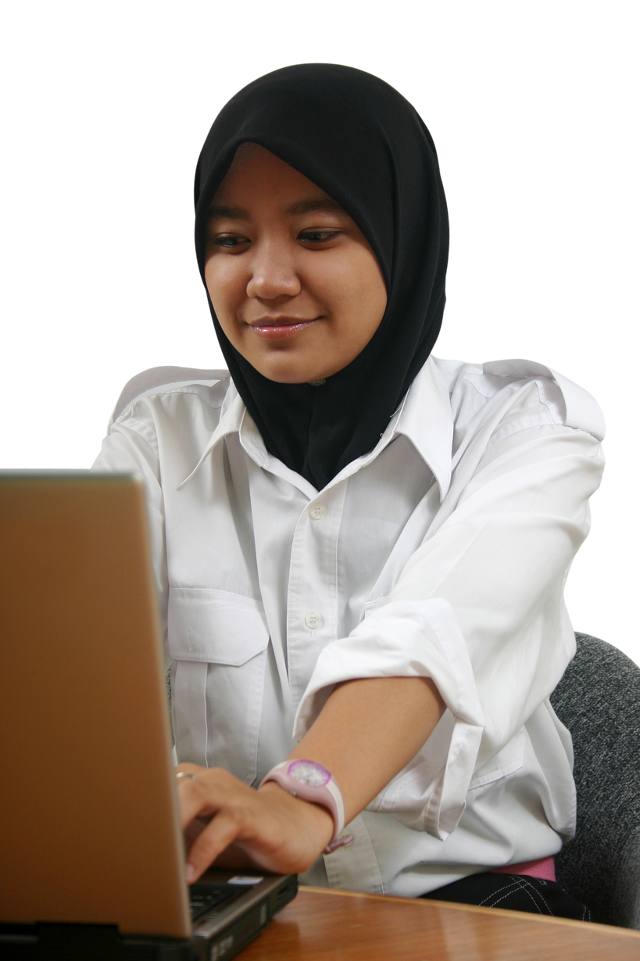
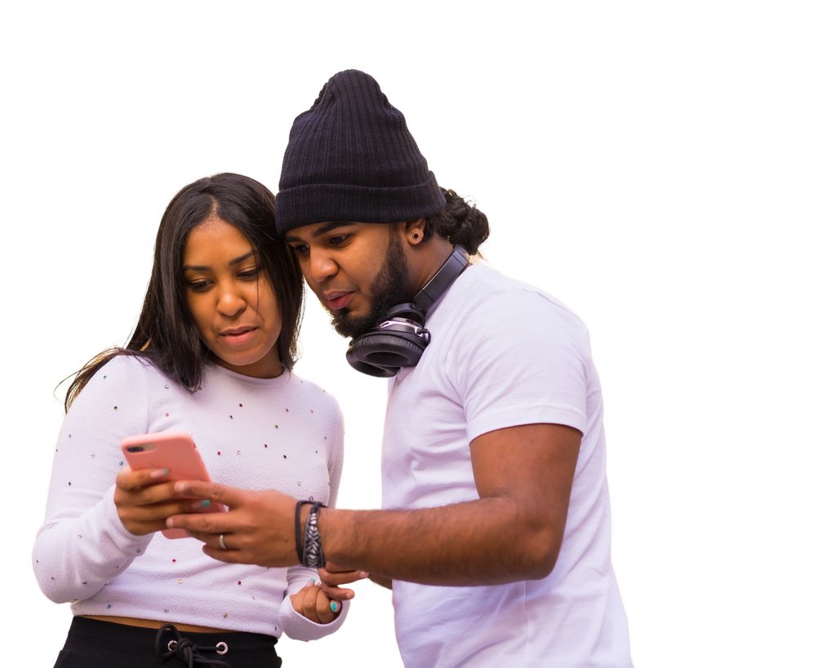
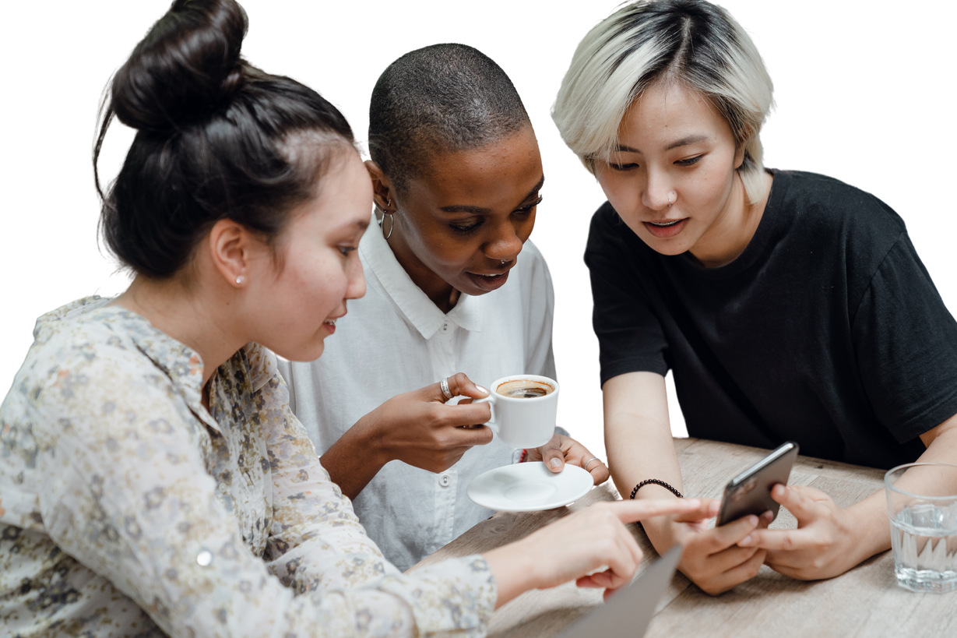
Know Your Audience

Slide 7

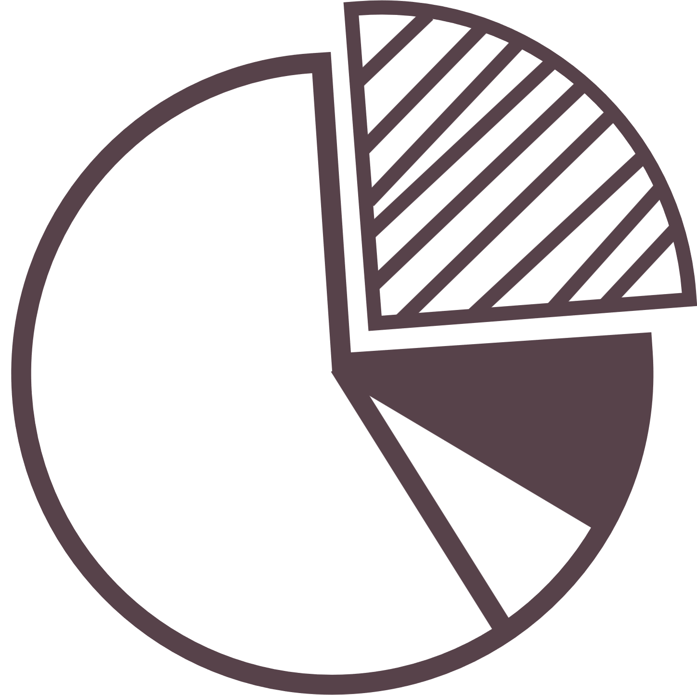
Daily Active Social Media Users
3.5 Billion
That is roughly 45%
of the global population
(Emarsys, 2019)

Slide 8
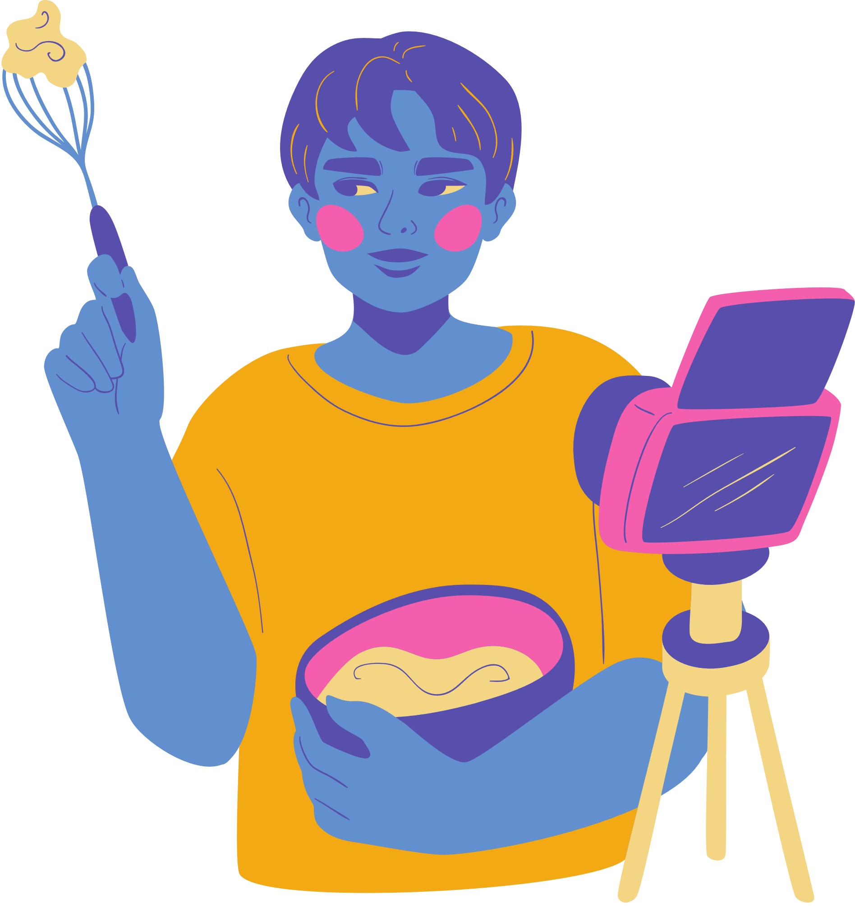
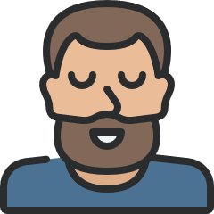
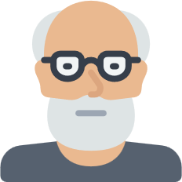
Daily Social Media Usage By Generation
Millennials
25-40
(1981-1996)
90.4%
Gen X
41-56
(1965-1980)
77.5%
Boomers
57-75
(1946-1964)
48.2%
(Emarketer,2019)

Slide 9
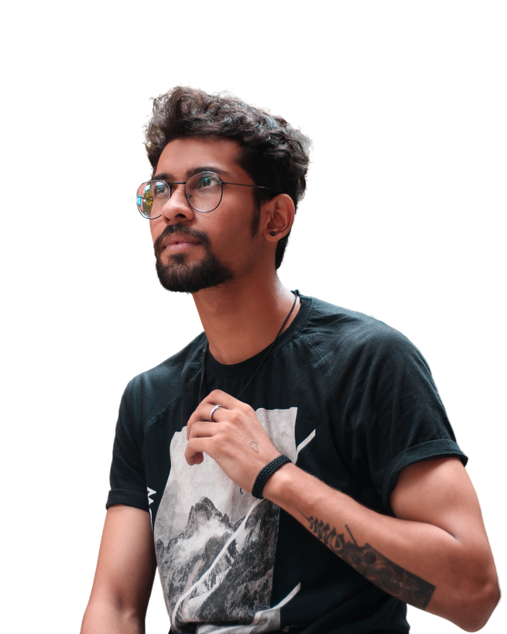
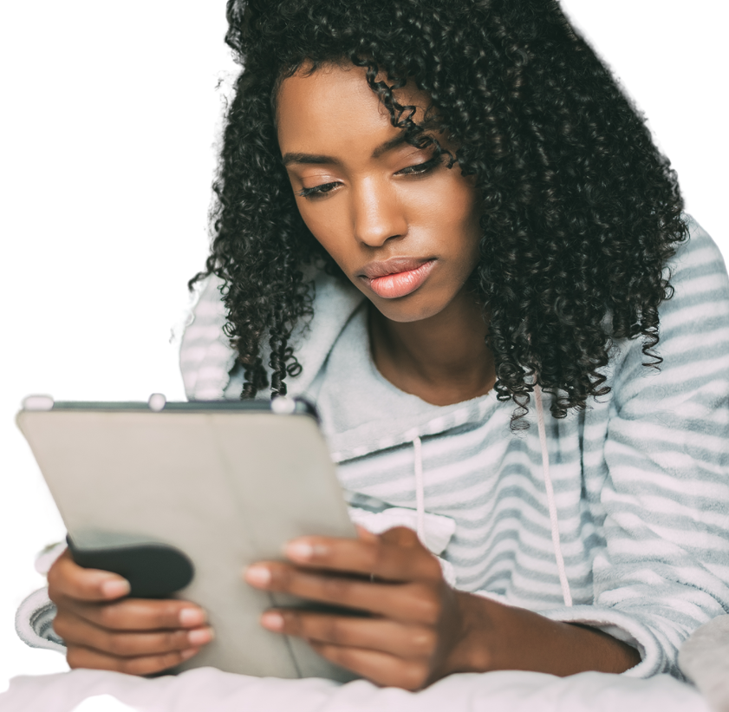
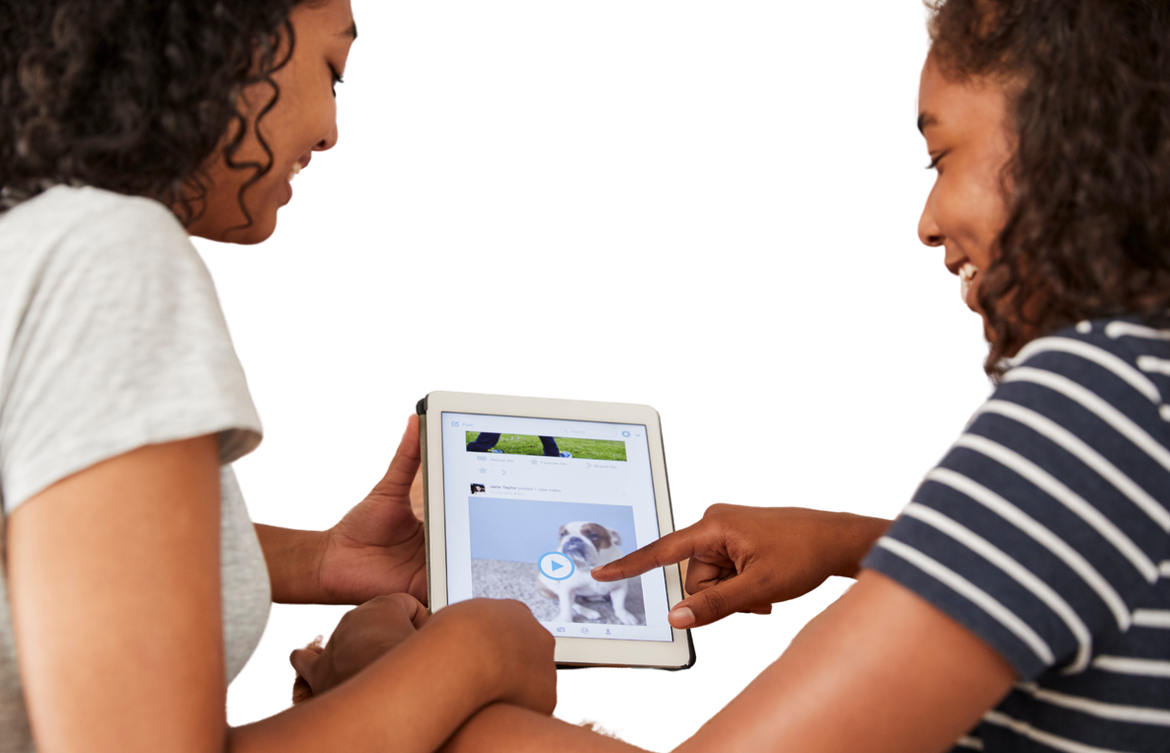
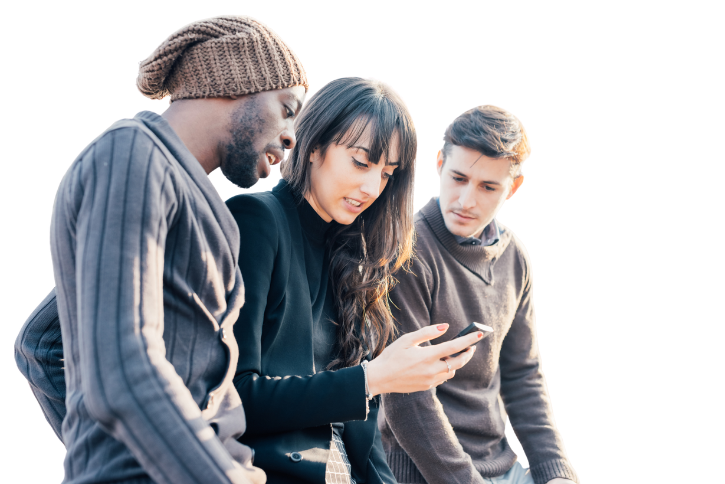
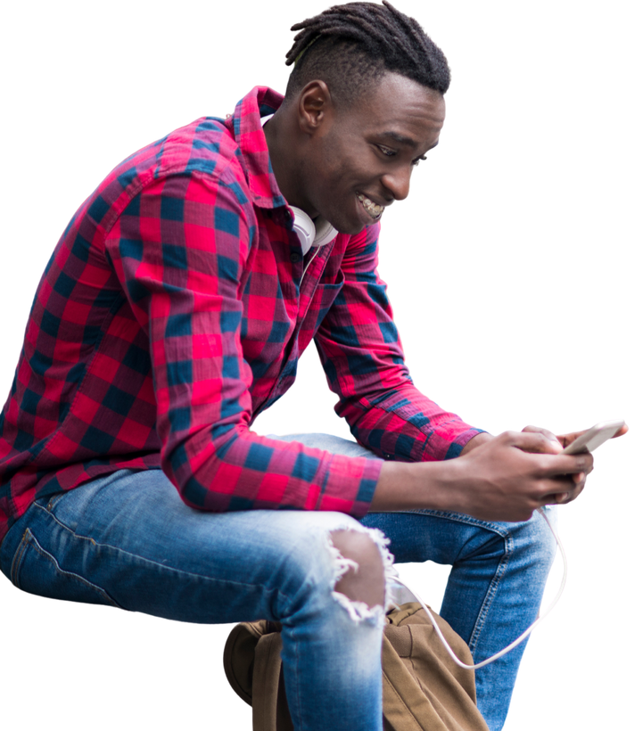
Avid Readers & Their Engagement
Avid Readers Are diverse
Avid readers engage with4+ books a month
Emerging groups (Black,Latinx, Millenials, Men)
Digital Readers are multi-tasking

Slide 10
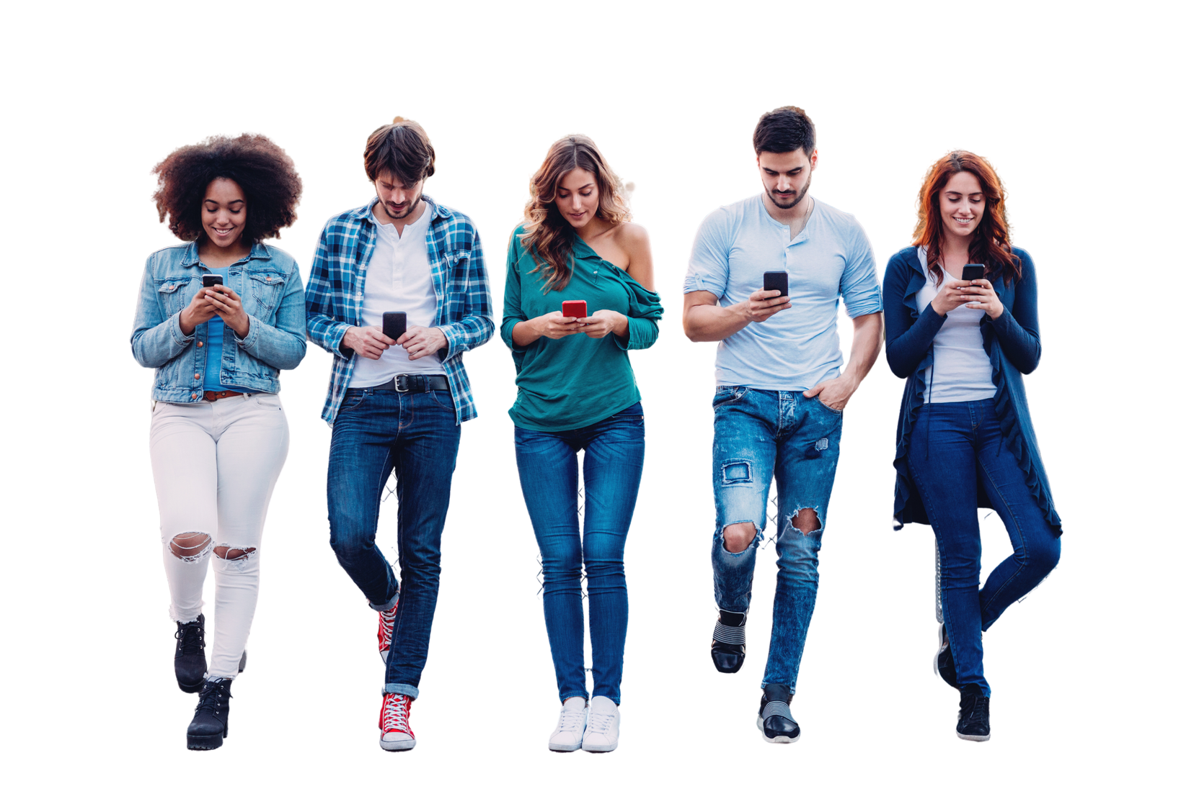
Things to consider
about your target audience
Who are they
How Tech Savvy Are They
What platforms Do They Use

Slide 11
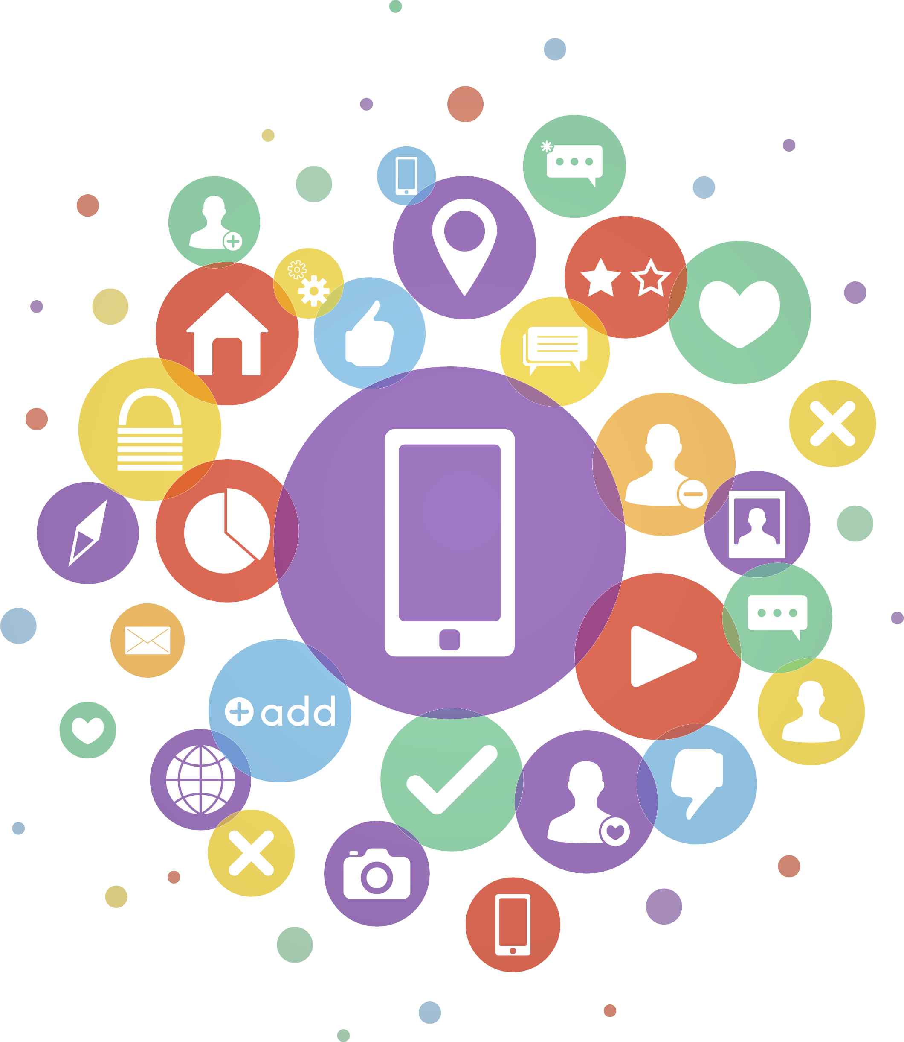
Choose Your Platform

Slide 12






Social Media Stats
# of monthly active users: 2.7 billion
Largest age group: 25-34 (26.3%)
Gender: 44% female, 56% male
# of monthly active users: 2 billion
Largest age group: 15-25
Gender: 72% of all female & male
# of monthly active users: 1 billion
Largest age group: 25-34 (33.1%)
Gender: 57% female, 43% male
# of total users: 738 million
Largest age group: 46-55
Gender: 51% male, 49% female
# of daily active users: 187 million
Largest age group: 30-49 (44%)
Gender: 32% female, 68% male
# of monthly active users: 400+ million
Largest age group: 30-49
Gender: 78% female, 22% male

Slide 13


Questions To Ask
What platforms does your audience favor
Do you speak the platforms language
Do you know what the algorythm rewards
Where do your talents lie

Slide 14
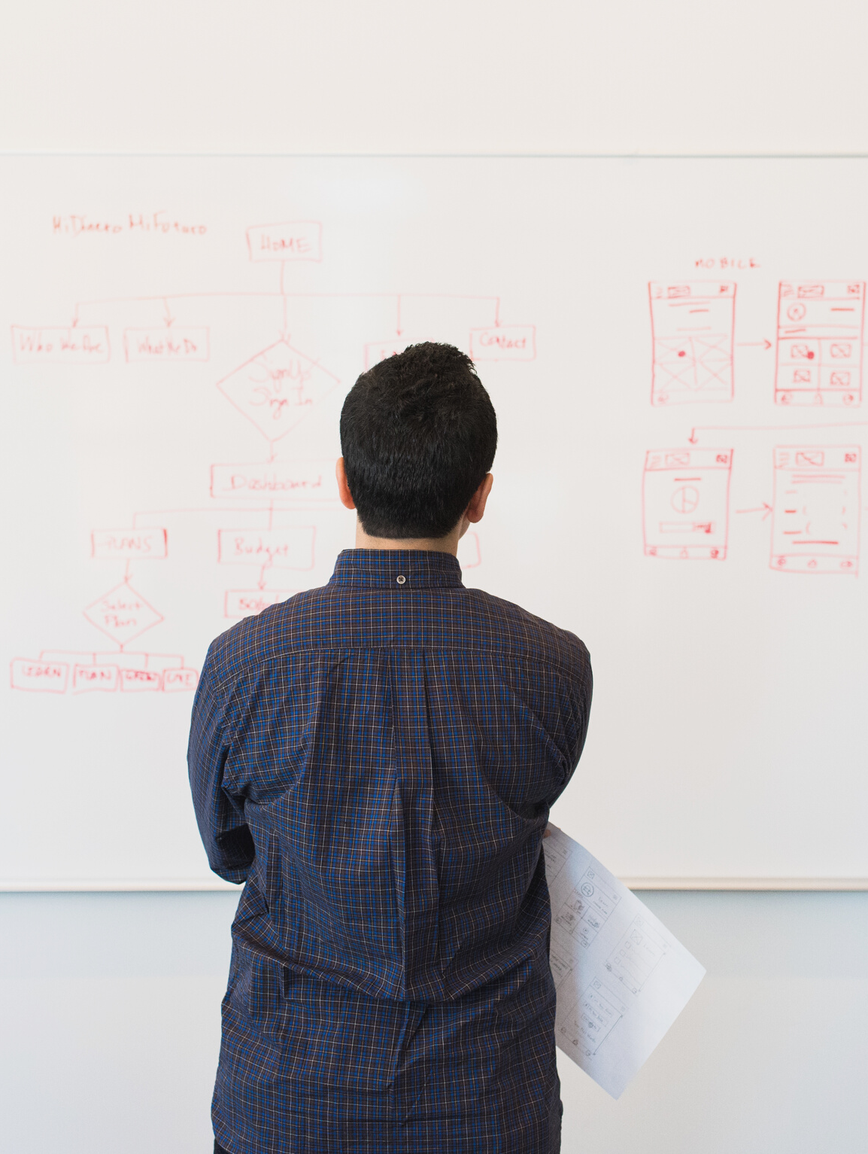
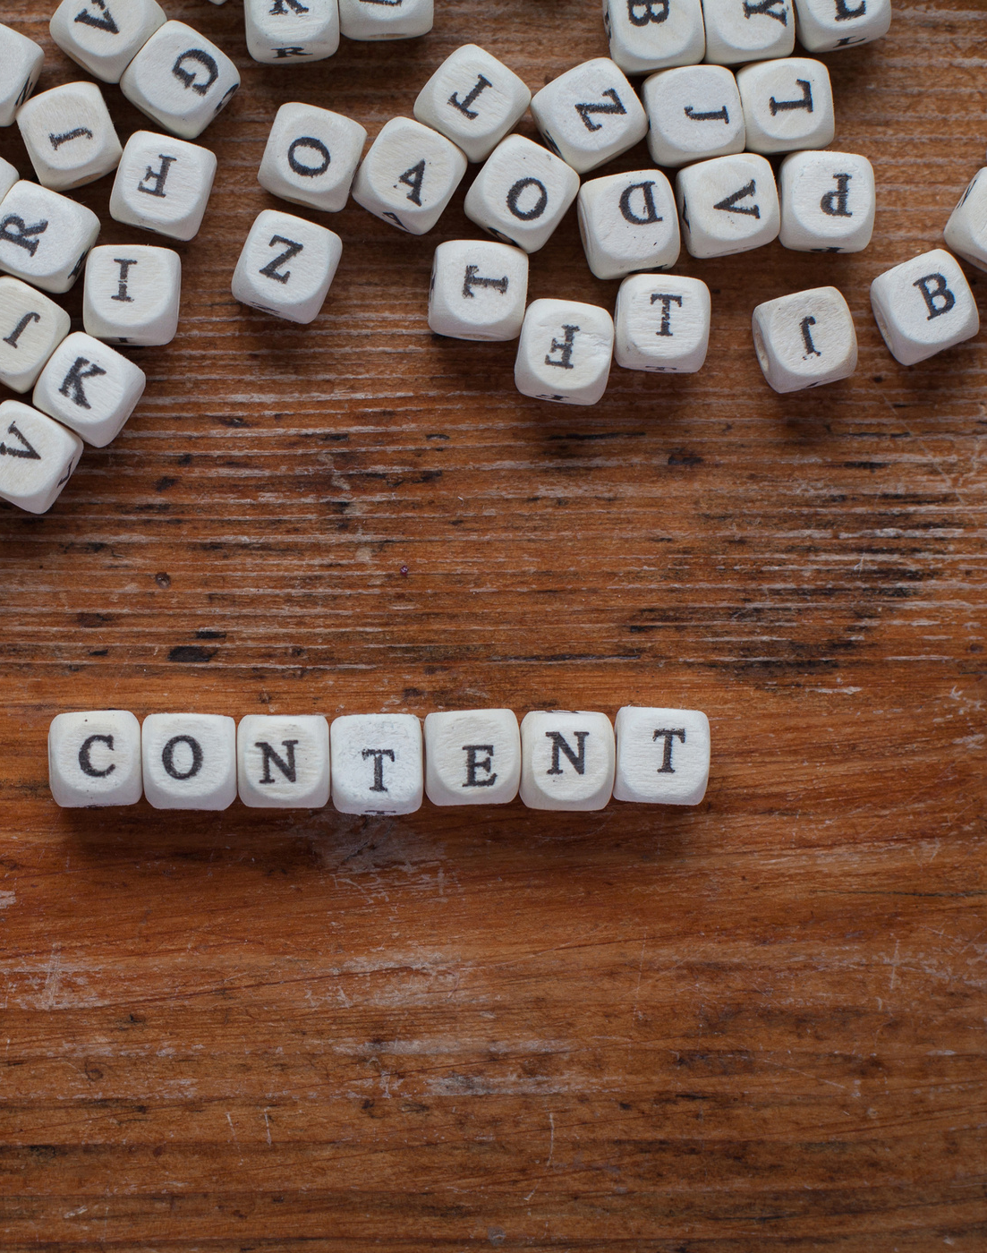
Content:
Created VS Curated

Slide 15
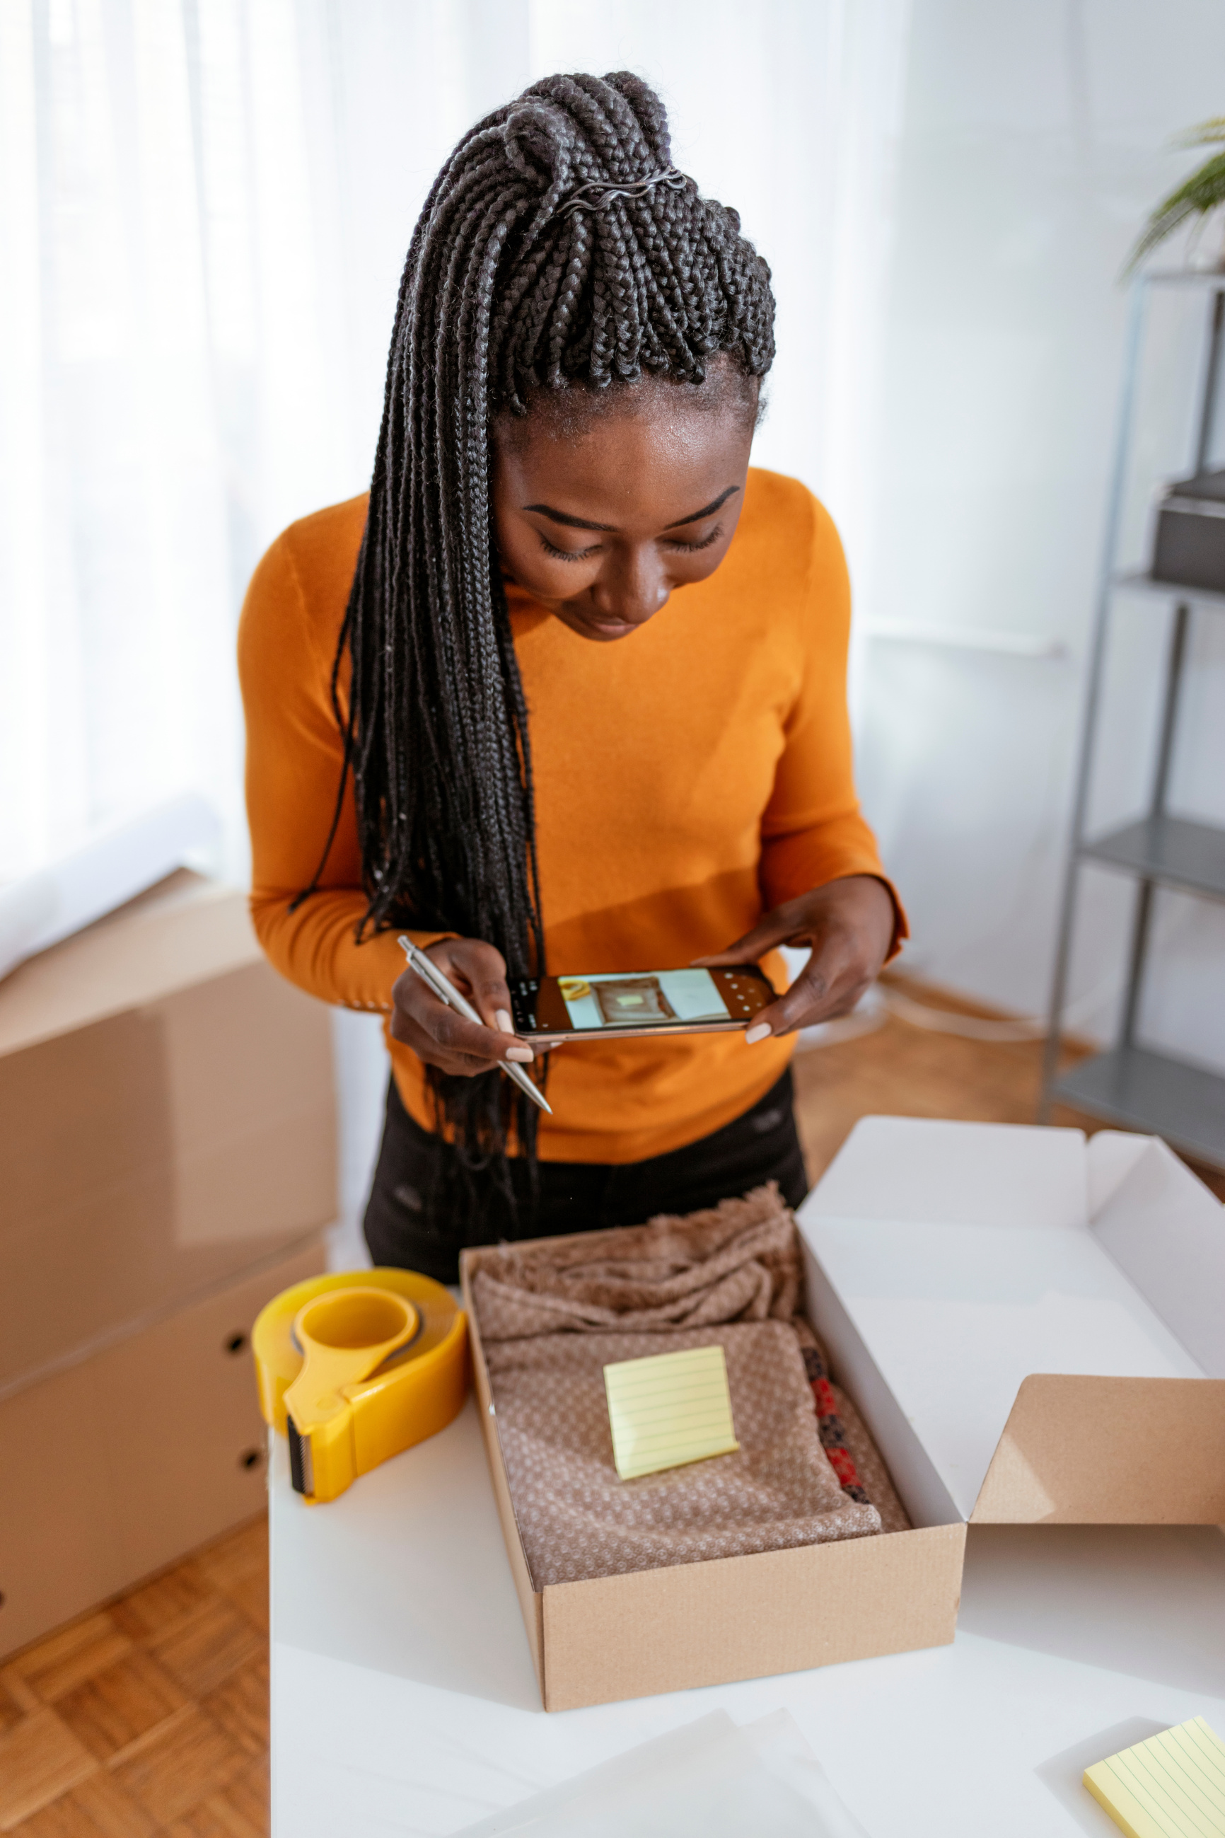
Created Content
Make Content Around
Programs & Events
Video
Podcast
Images
Scripted Posts
Newsletters

Slide 16
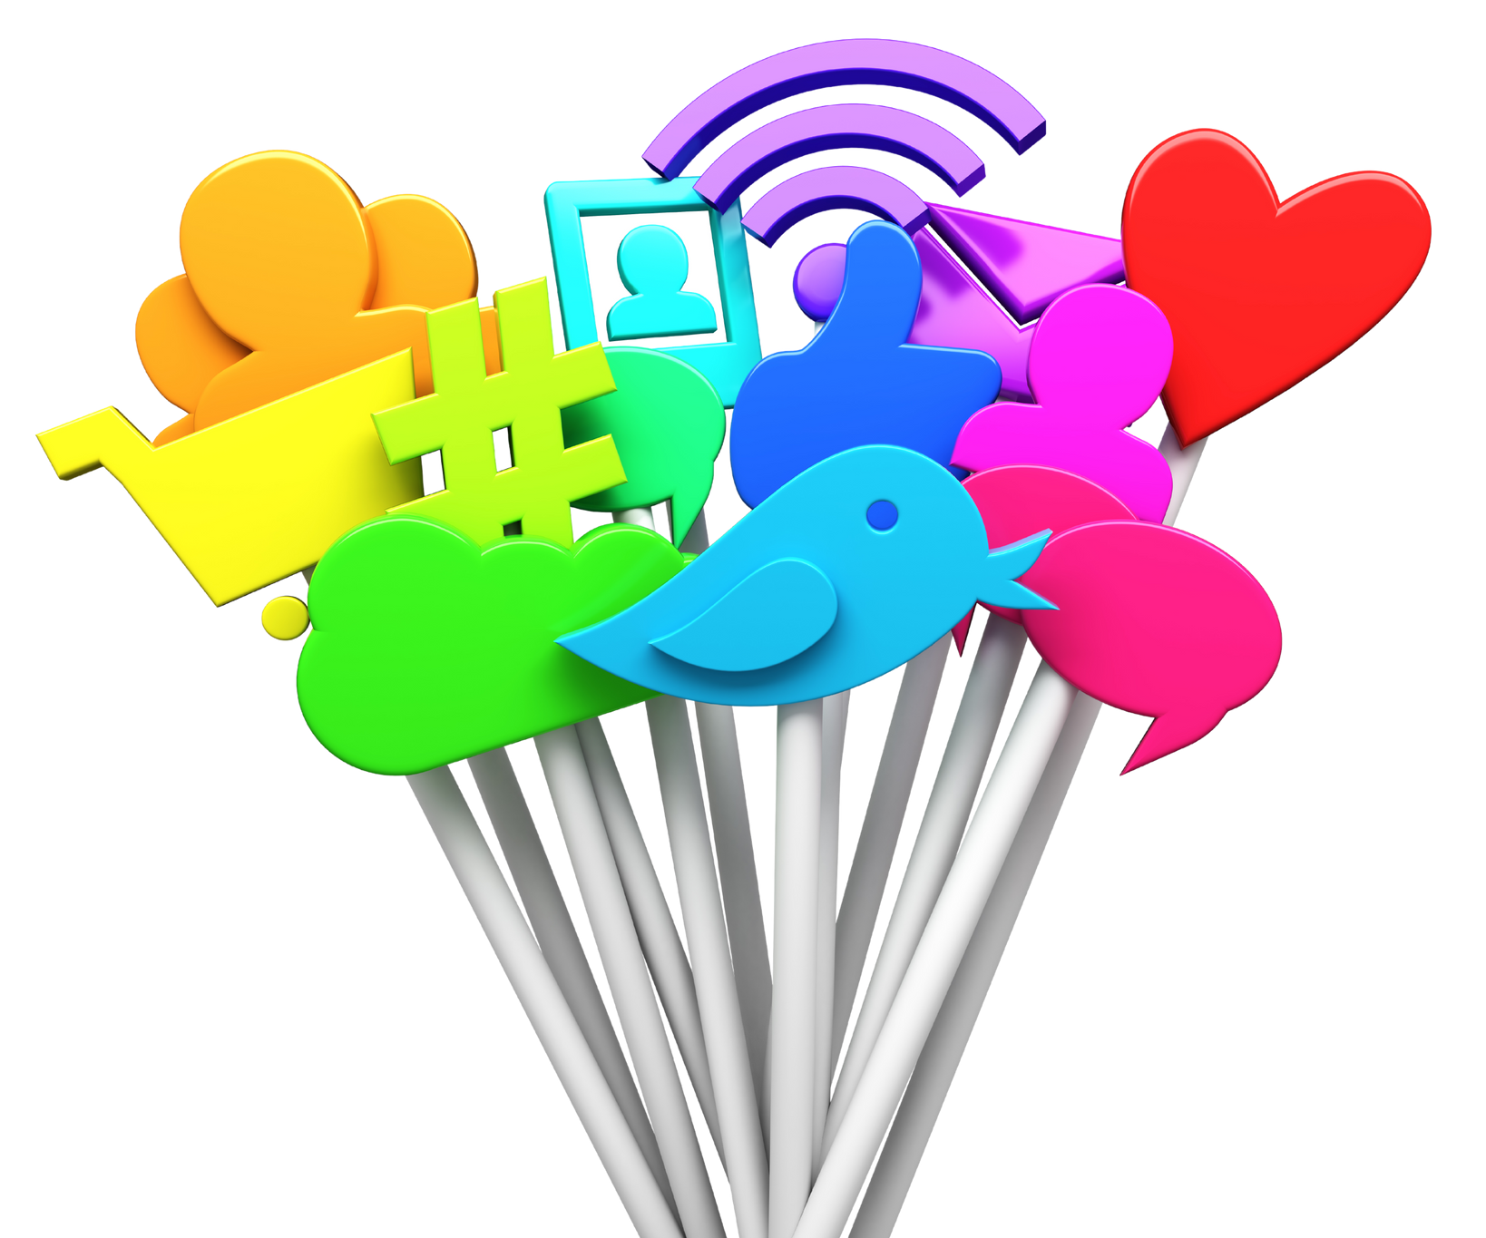
Curated Content
What Should You Collect?
Library Resources
New releases
Past Library Events
Current Trends & Topics
Things That Offer Added Value

Slide 17
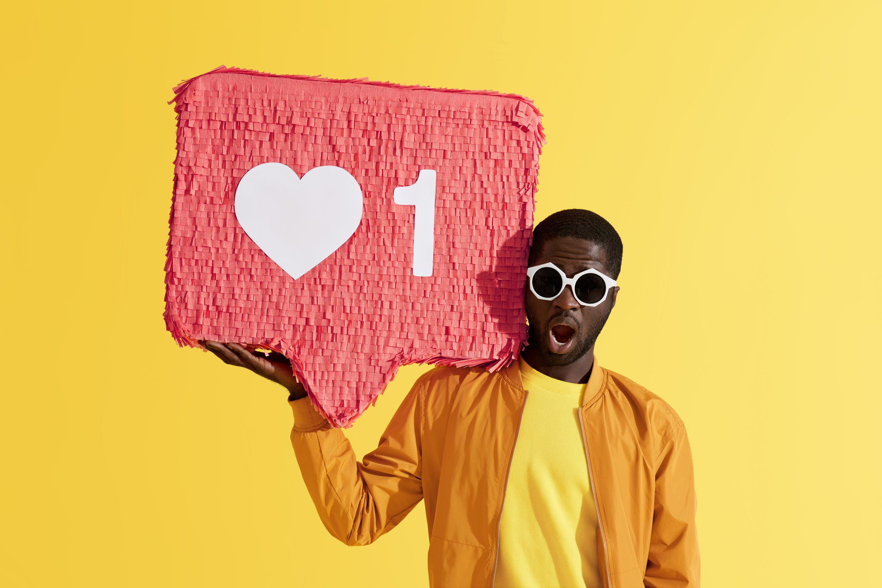
Analytics What To Measure & Why

Slide 18
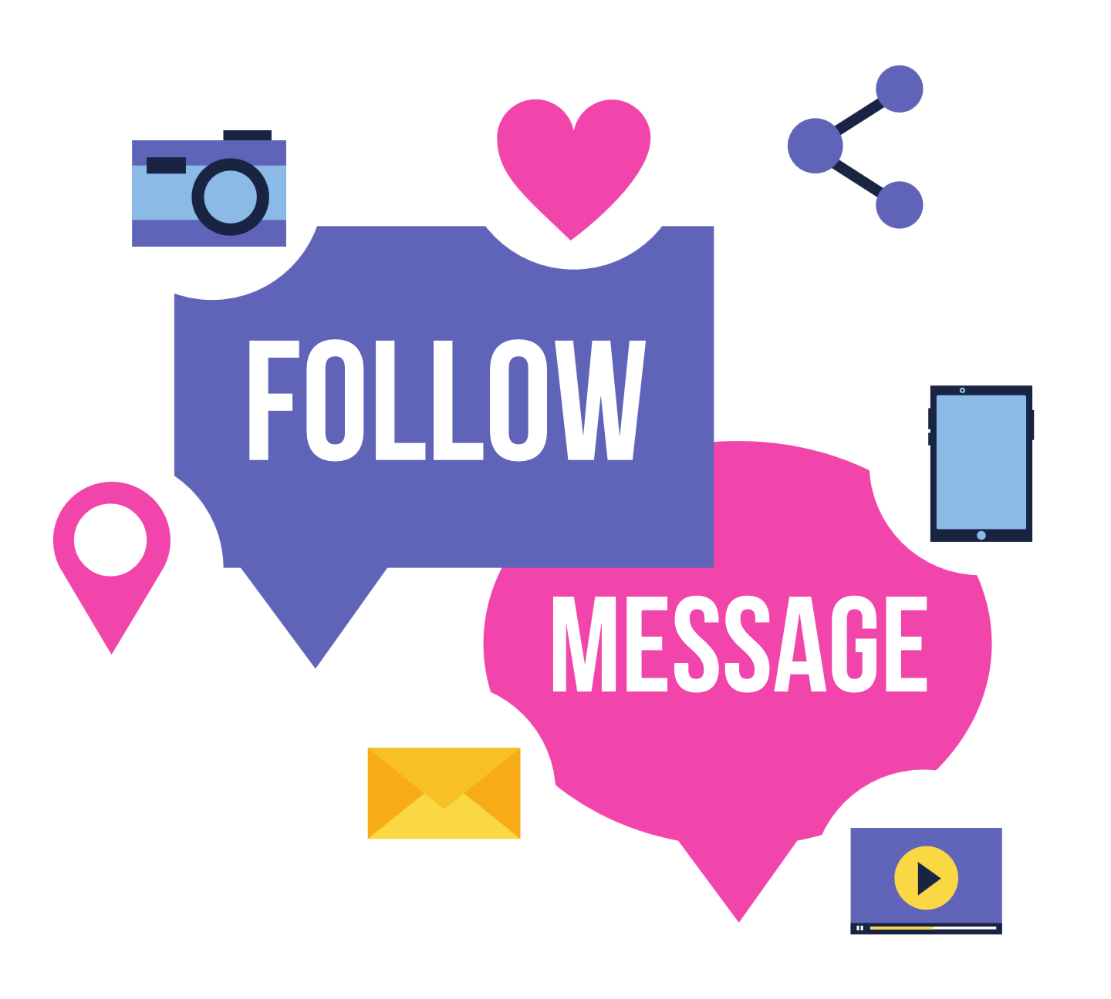
Questions for Social Media
Followers
How many people are following your account?
Reach
How many people see your content?
How many times is your content displayed?
Impressions
Engagement
How many times do people interact with your content?

Slide 19
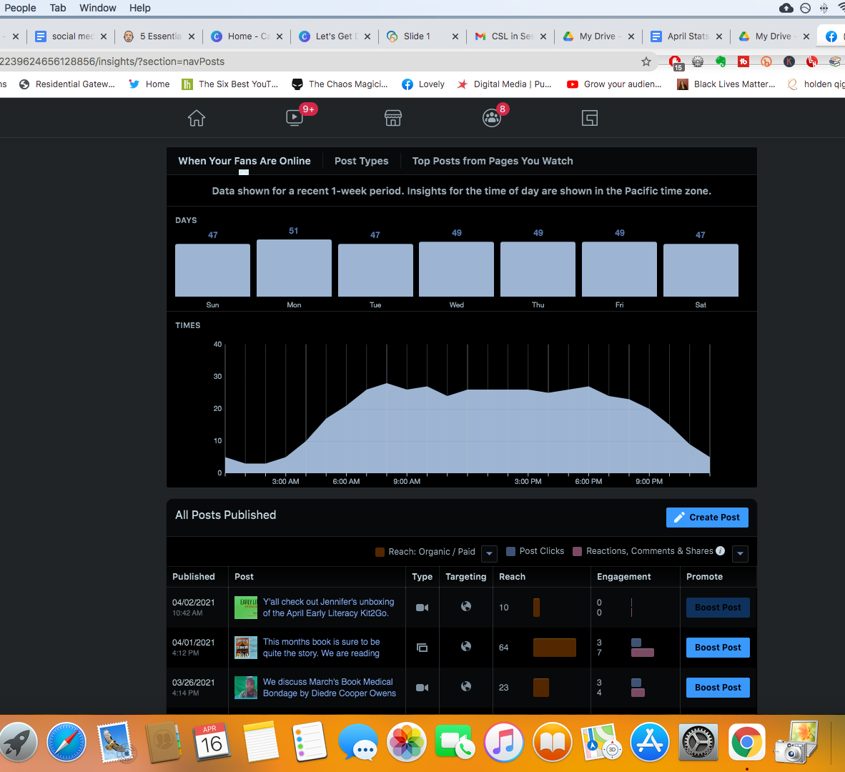
These same metrics can be used to report to your manager and "show your work"

Slide 20
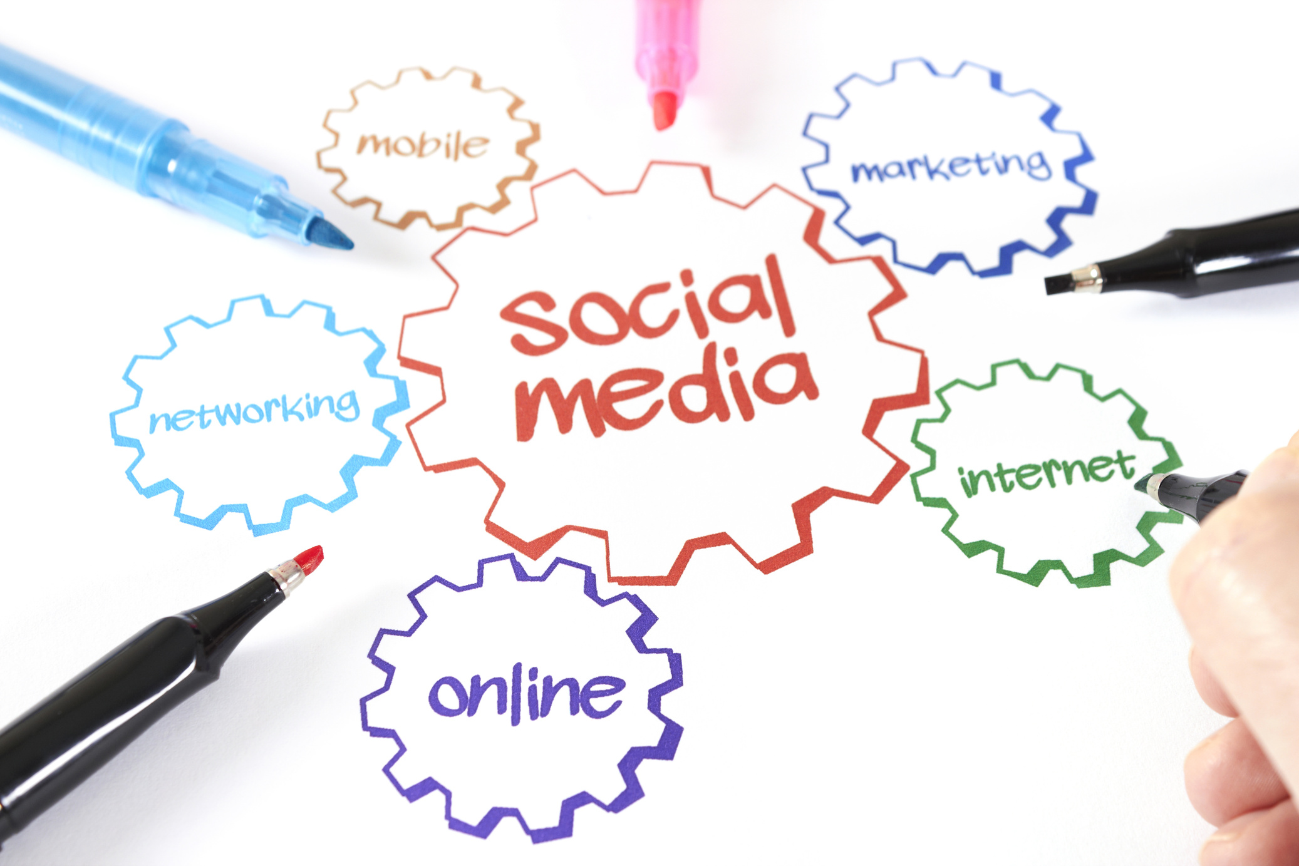
Marketing To Your Audience

Slide 21
Marketing To Your Audience Continued
Content calendar
Newsletter
Print Advertisement
Call To Actions

Slide 22
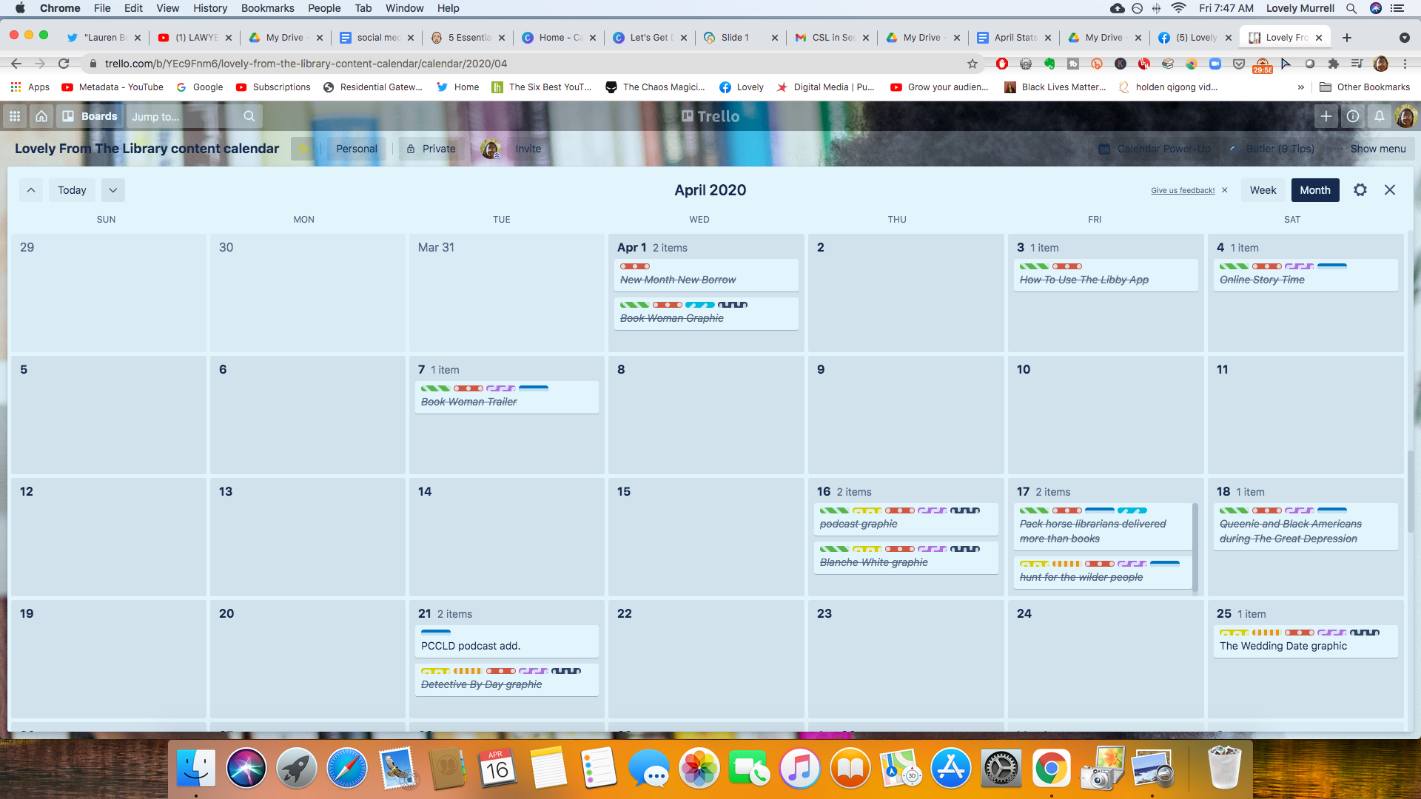
Calendar

Slide 23
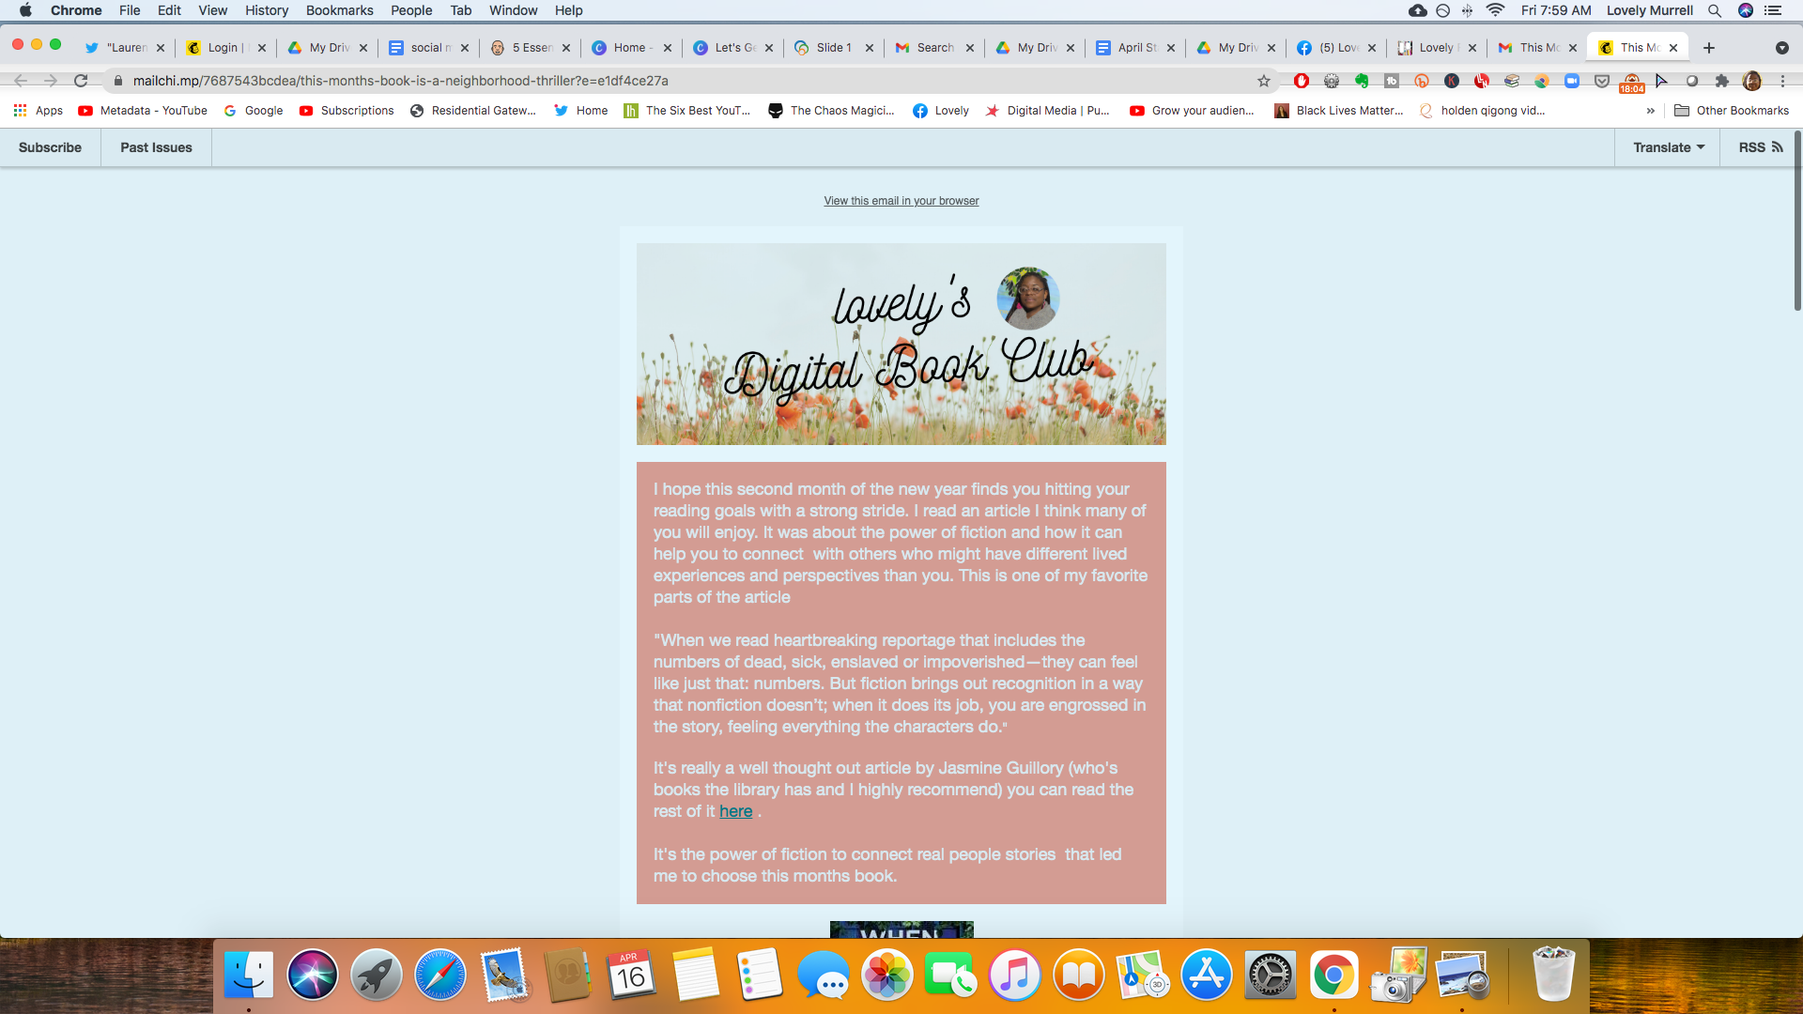
Lovely’s Digital Book Club

Slide 24
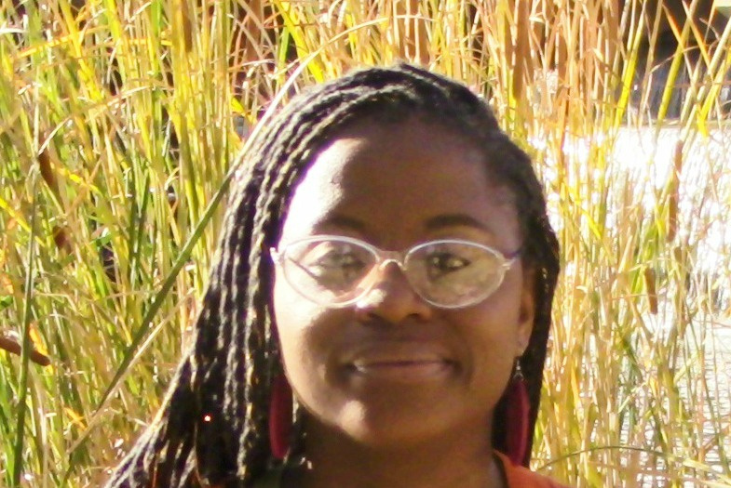
Thank You
Lovely.Murrell@Pueblolibrary.org
Lovely From The Library on Facebook

