Slide 1
Leading doesn’t have to be loud
Amy Hitchner
Statewide Collaborative Programming Coordinator
Colorado State Library
ahitchner@coloradovirtuallibrary.org

Slide 2
Why are you here?

Slide 3
Why am I here?
I’m an introvert.
I’m interested in introverts as leaders.
I want to make the workplace better for all types of people.

Slide 4
Let’s start with personality

Slide 5
“Every person is, in certain respects like all other people, like some other people, and like no other person.” -Brian Little, author of Me, Myself, and Us.
Genetic Traits
Adaptive Behaviors
Free Traits

Slide 6
The Big Five Traits
Agreeableness
Openness
Extroversion
Conscientiousness
Neuroticism
Disagreeableness
Closed to experience
Introversion
Spontaneity
Emotional stability

Slide 7
Three Things to Remember
Introversion is just one of the Big Five traits.
Each trait is on a continuum.
You can act “out of character” to achieve a goal.

Slide 8
The myth of the introvert

Slide 9

You’re an introvert?!
Bookish
Shy
Misanthrope
Awkward
Boring

Slide 10
An introvert is someone who is over-stimulated easily, and who needs lower levels of stimulation in order to recharge.

Slide 11
The Biology of Introverts
Introverts
Ideal Neocortex Arousal
Extroverts

Slide 12
Oh, and there are ambiverts

Slide 13
Introverts as leaders

Slide 14
Famous Introvert Leaders
Warren Buffett
Marissa Mayer
Barack Obama
Mark Zuckerberg
Bill Gates
Abraham Lincoln
Eleanor Roosevelt
Mahatma Gandhi
Laura Bush
Rosa Parks
Albert Einstein

Slide 15
You are already a leader*
*or you’re well on your way
Leadership is gained through influence, not position or title.
Influence is gained through trust.
You have more influence than you think.

Slide 16
Start from your strengths
What are you already good at?
Learning
Writing
Listening
Mediating
Communicating
Planning
Building relationships
Creating
Take a Strengthsfinder Test

Slide 17

Next, get out of your head
How will you?
Lead a project
Present a session
Organize a potluck
Write a blog
Start a book club
Tweet

Slide 18
Manage your energy at work

Slide 19
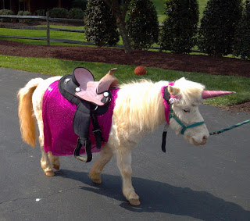
Be authentic
Faking it will eventually drain your energy and your credibility.
Image courtesy of thatsabigif.blogspot.com/

Slide 20
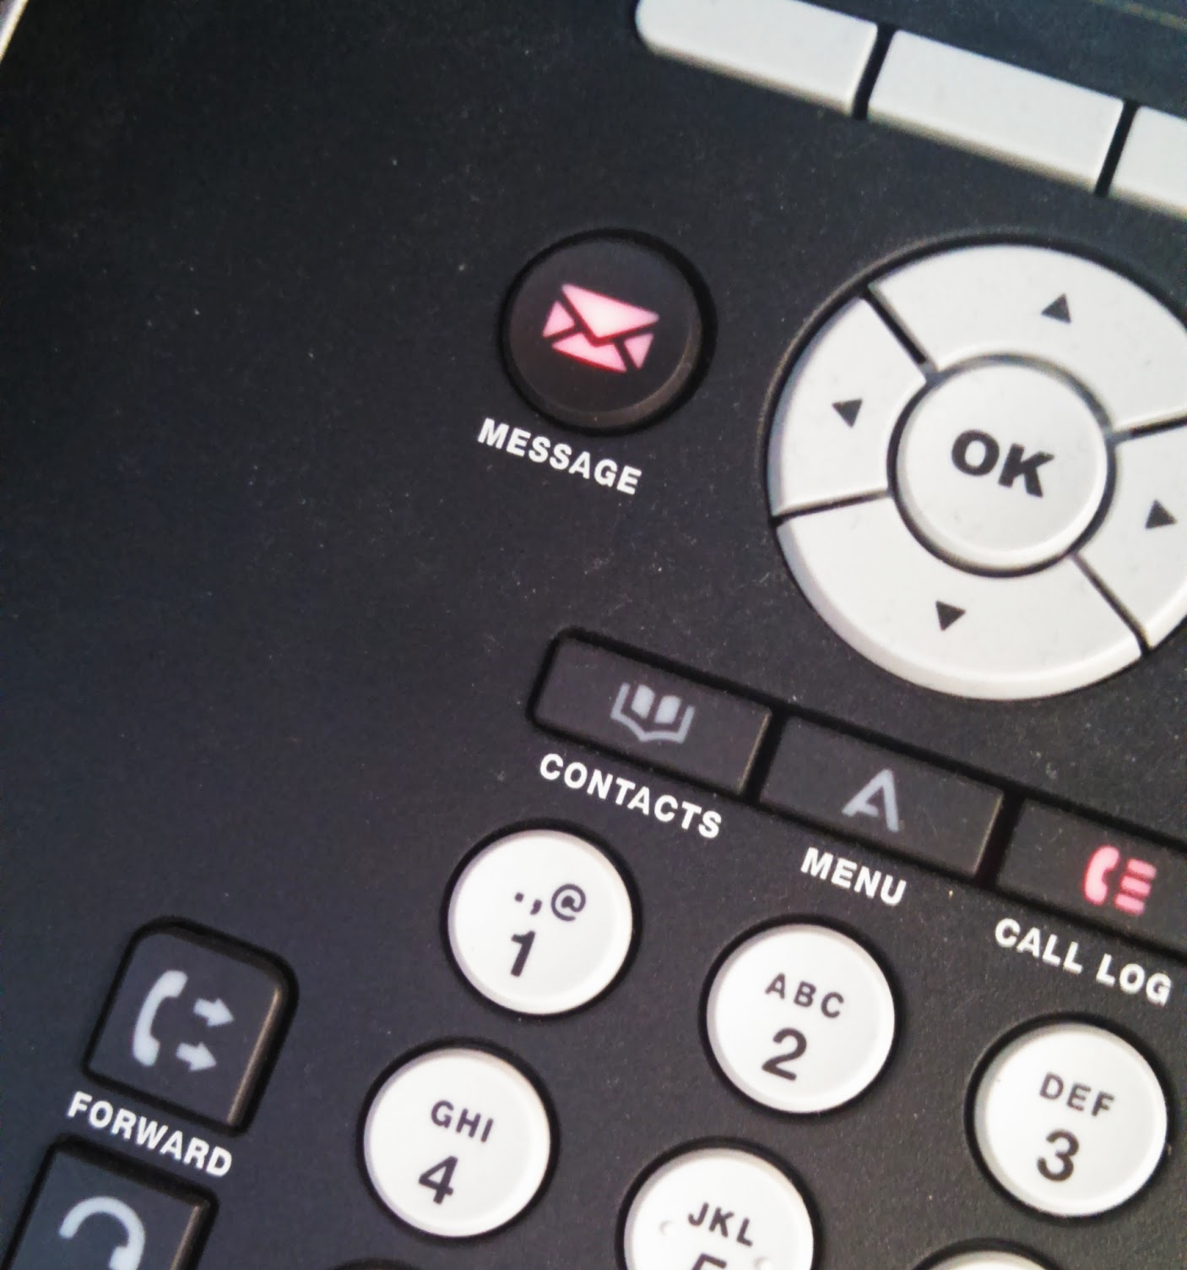
Do the draining stuff first

Slide 21
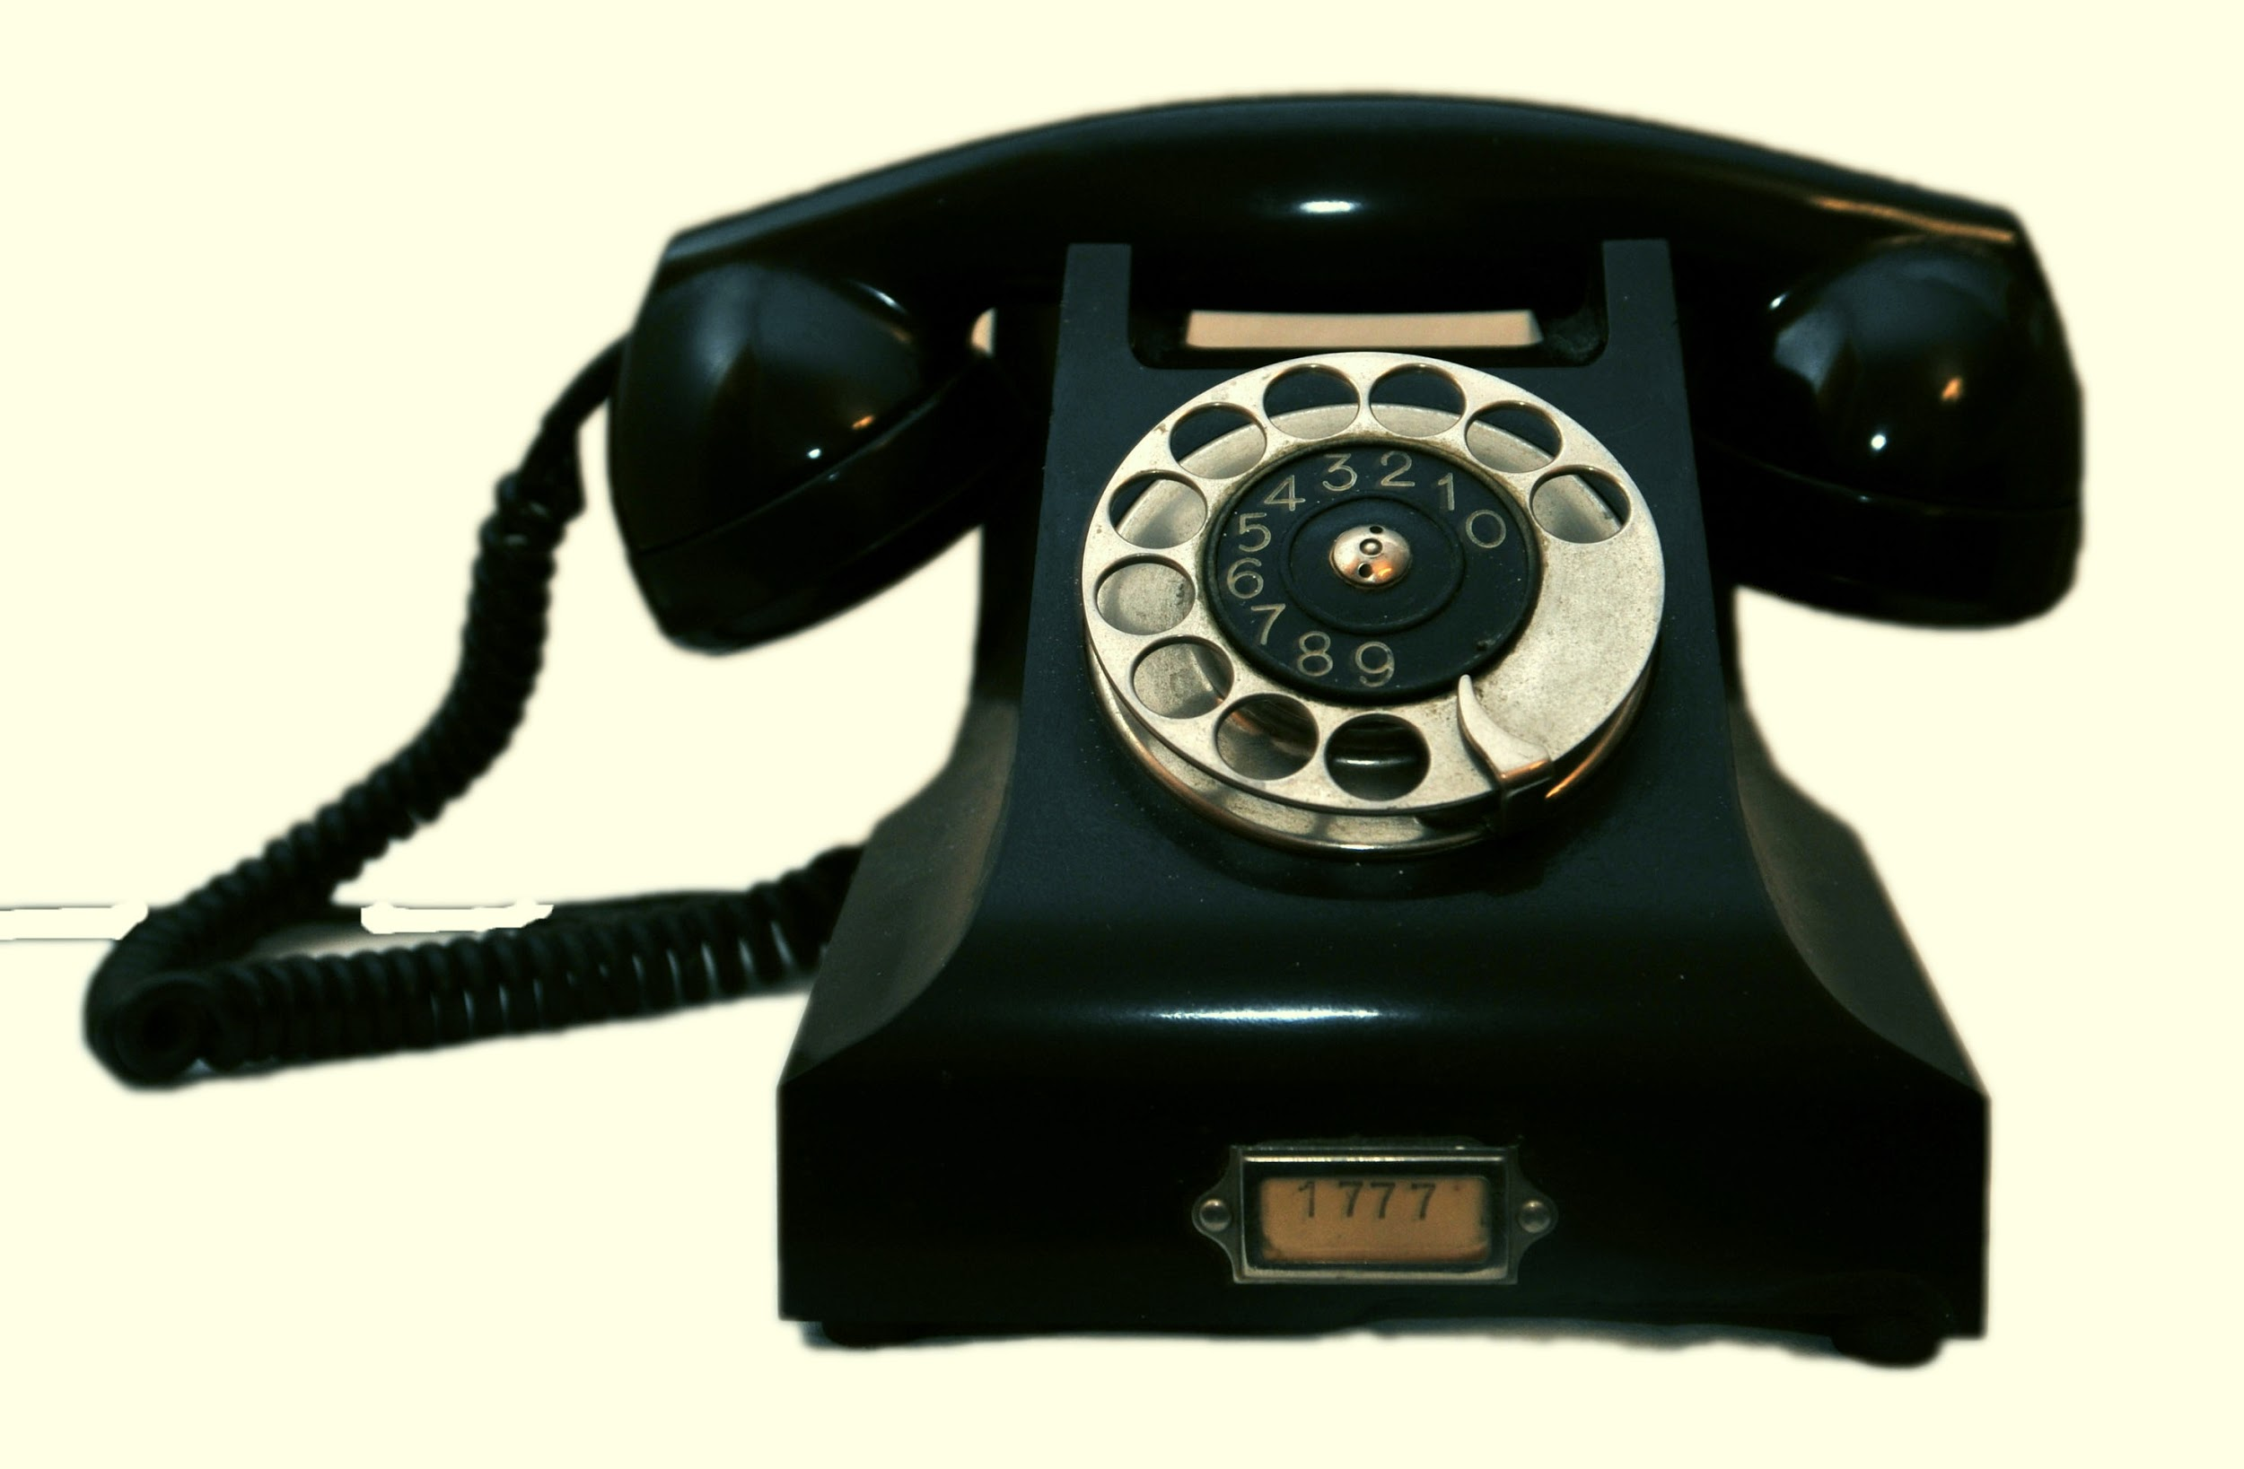
Manage your space
“Hello, this is the Introvert Hotline. Please reach me via email.”
shhhhhhhhhhhhh
simplynoise.com
shhhhhhhhhhhhh

Slide 22
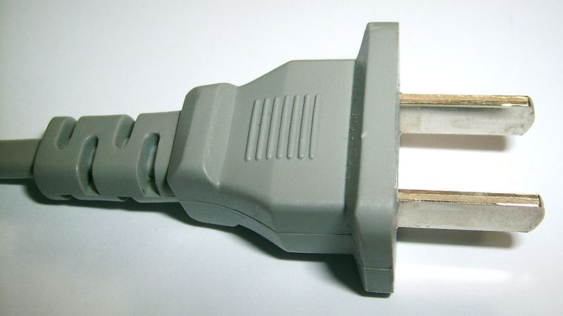
Recharge
Image courtesy of Maddin the brain CC-BY-SA-3.0 (http://creativecommons.org/licenses/by-sa/3.0/)], from Wikimedia Commons

Slide 23
Seek balance
What energizes you?
What drains you?
large group work
passion projects
scheduled work alone time
meetings
networking events
small group work
Draining
Energizing

Slide 24
How to play nicely with others

Slide 25
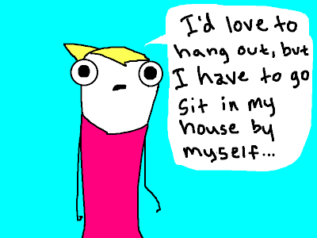
Use Humor
Image courtesy of hyperboleandahalf.blogspot.com

Slide 26

Respect your extroverts
They are not doing “that thing” just to annoy you
They think out loud a lot
Clarify actions and expectations
Advocate for your needs

Slide 27
Put relationships in perspective
Relationships
Networking
Work life
Home life

Slide 28
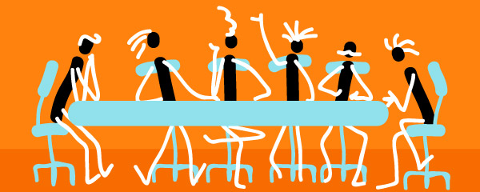
Make meetings better for everyone
Send agendas ahead of time
Solicit written and verbal feedback
Avoid forcing snap decisions
Image courtesy of http://sha3teely.com/

Slide 29
Summary and other stuff

Slide 30
You CAN be a quiet leader
Leadership comes from trust, not a title.
Know what you need...
but don’t be bound by labels.
Put thoughts into action.

Slide 31
Resources for Introverts
Books
Quiet: The Power of Introverts in a World that Can’t Stop Talking, by Susan Cain
Me, Myself, and Us: The Science of Personality and the Art of Well-Being, by Brian R. Little
Blogs
The Introvert’s Corner, psychologytoday.com/blog/the-introverts-corner
Introvert Spring, introvertspring.com/
Video
Brian Little’s TED Talk

