Slide 1
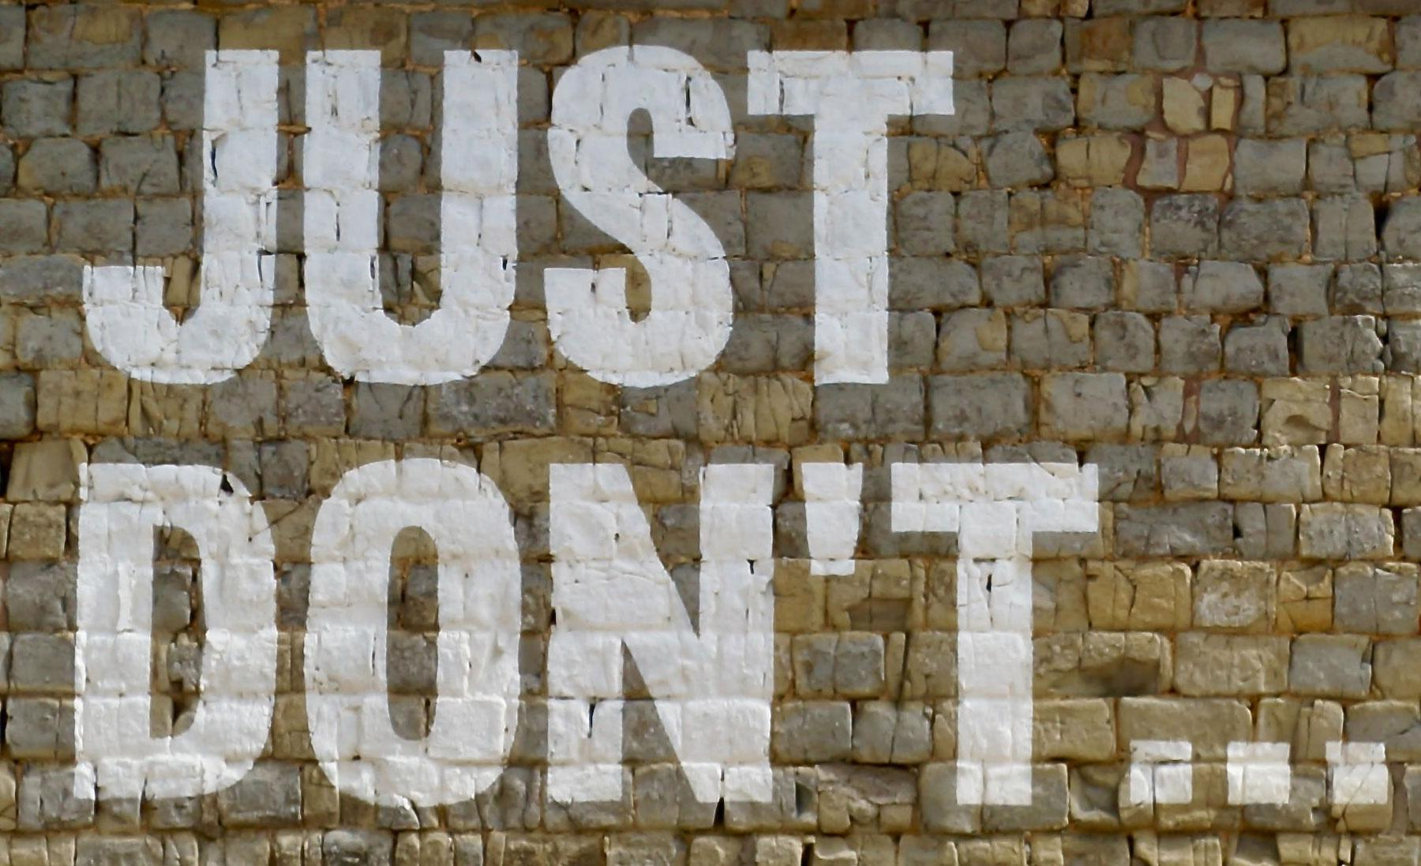
Just Don’t Do It!
Finally a session on how to say NO at work
Photo-by-James-Orr-on-Unsplash
Notes:
12 – 12:02
Opening Scenario
CK starts:
Good morning, everyone! Welcome to…
Kieran interrupts - Hey! Wait! I have the best idea…what if we take this great content from today's session and make an 18-module e-learning and share it with national groups link PLA, and CALIFA….
CK tries non-answer. Ummmm, but we are in our session…(OMG, can you believe this?)
Can we just focus on this session?
CK
As I was saying, welcome to Just Don’t Do It: finally, a session on saying no at work! We are delighted to be with you today!
My name is Christine Kreger, and I am the Professional Development Consultant for the Colorado State Library.
Kieran introduces self - I am playing 2 roles today…I am not Christine’s boss…nor do I play her boss on TV
CK = outcomes
Today as we talk about saying no at work, we hope that all of you come away with:
An understanding of why it is hard to say no.
Recognition that saying no and setting boundaries is healthy and crucial for maintaining productive relationships
Practical strategies and scripts for saying no respectfully
Kieran introduces playbook - follow along, places to take notes, do the reflection activities, some great scripts for saying no, and resources
Link to PDF of Playbook in case anyone does not have a Word copy - https://drive.google.com/file/d/1WY403cEZxWbWG78LiolW-a3OY7Z6qSAo/view?usp=sharing

Slide 2
Reflection #1
What do you need/want to say NO to?
Notes:
12:02 – 12:04
KH
Reflection: The first thing we are going to have you do is to think about something you need or want to say no to at work (future, now or past), and write that down in your playbook on p. 1.
We are going to work through how you can say no as we go through today's session.
We will give you a minute to think about this. Feel free to share in chat if you feel comfortable, but this is mainly for you.

Slide 3
Why is it so hard to say NO?
Notes:
12:04 – 12:07
Redo scenario
CK - So to start…Kieran interrupts again
Kieran - Hey, as your boss, I think this content is awesome, and I would love to share it with the world….
CK grudgingly says yes - Ok, yes… boss
Skit ends awkwardly…we stare at each other for a few seconds…
CK
So, as you can see, saying no can be hard. But why?
Activity: Group brainstorm to answer why it is hard to say no – Use Chat
CK
Things we can mention
It is important
Patrons need so much
Can't say no to boss or other authority
We don’t want to let colleagues down
Path of least resistance - Yes just feels easier
People pleaser
Don't want to be rude
Don't want to seem lazy
Guilt
Perfectionism
Overachiever
If I dont do it no one will
No one can do it as well as i can
Saying yes to be the martyr - people do not admire martyrs
Just to say you did it
Afraid of missing out
Saying no is selfish
Because we have been taught that we have to
Good manners
Hard work ethic
CK - what about Vocational awe? - Vocational awe” refers to the set of ideas, values, and assumptions librarians have about themselves and the profession that result in beliefs that libraries as institutions are inherently good and sacred, and therefore beyond critique.
In addition to supporting the work we do as a sacred calling, Vocational awe encourages overwork, if some don't see the job as a vocation, they are often not seen as dedicated employees
And we see everyday how Capitalism supports the cult of busyness and the idea that people don't have value unless they are earning $$

Slide 4
How does it feel to say NO?
Notes:
12:07 – 12:09
CK - So let's dig in a little deeper.
Activity: How do you FEEL when you say no?
We use Chat
Frustrated
Resentful
Angry
Manipulated
Exhaustion
Fear
Hopelessness
Sadness
So, lots of emotions wrapped up in saying no. We will work on trying to change this

Slide 5
Reflection #2
Why do YOU say yes when you want to say NO?
Notes:
12:09 – 12:11
Kieran
Activity - Reflection p.1 of playbook
Why do YOU say yes when you want to say no - relate to your personal issue
Feel free to share in chat if you feel comfortable, but this is mainly for you.

Slide 6

The Gift of Saying No
Say NO, to say YES to more meaningful activities
NO is a precondition to saying YES effectively
Increased confidence
Boundaries protect your time and energy
Image by digital designer from Pixabay
Notes:
12:11 – 12:14
CK
The Gift of saying no
The first thing we need to remember about saying no, is that it is the key to healthy relationships – with ourselves and others. Saying no is actually a gift that gives us several things we need.
CLICK
Saying no to some things provides room for more meaningful activities - (time, energy to say yes to things you want – self)
Place much-needed value on your own happiness
CLICK
No is of equal importance to Yes and actually a precondition to saying Yes effectively. You cannot truly say Yes to one request if you cannot say No to others. So, saying yes always requires saying no to something first.
CK example - what topics to focus on for CE - only so much time - set priority
Ask yourself WHY you are about to say yes WHEN you want to say no. – Moment of pause
CLICK
Learning how to say no helps you feel more confident and in control of your life
Learn to let go of expectations (for yourself and of others) that don’t serve you.
I constantly battle with feeling I am not doing enough, that my work does not matter, and that does not help anyone
We need to address our feelings of saying no
You’ll eliminate anxiety about your choices and be more confident in them. More comfortable saying both yes and no.
CLICK
Boundaries protect your time and energy. And saying NO is part of setting boundaries

Slide 7
Signs you Need Boundaries
Feeling overwhelmed
Feeling resentful when asked for help
Avoiding interactions with others
Feeling you always help others and never get anything in return
Dreaming of running away
You have no time for yourself
Notes:
12:14 – 12:16
CK
I just want to stop for a few minutes to dig a little deeper into burnout, and boundaries, even though it could be a whole session in itself.
To put it simply, being overcommitted leads to burnout.
Burnout does not have a solid line that gets crossed. Most people don't realize when they cross over. And we, like may service professions are constantly asked to do more with less. Especially during the pandemic.
According to Jonathan Malesic, in his book, The End of Burnout, which is in your resources, 1 in 4 workers report finding nothing meaningful in work. Think about that, and how much time we spend at work.
Signs you need boundaries from the book Set Boundaries, Find Peace in your handout
You feel overwhelmed
You feel resentment toward people asking for your help
You avoid phone calls and interactions with people you think may ask for something
You make comments about helping people and getting nothing in return
You frequently daydream about dropping everything and disappearing
You have no time for yourself
We have to remember, there are no prizes for being a martyr, and I think we are often encouraged to wear burnout as a badge of honor. This only hurts us, and will eventually harm the organization as staff continue to burn out.
We all need to decide what is worth our time and energy.

Slide 8
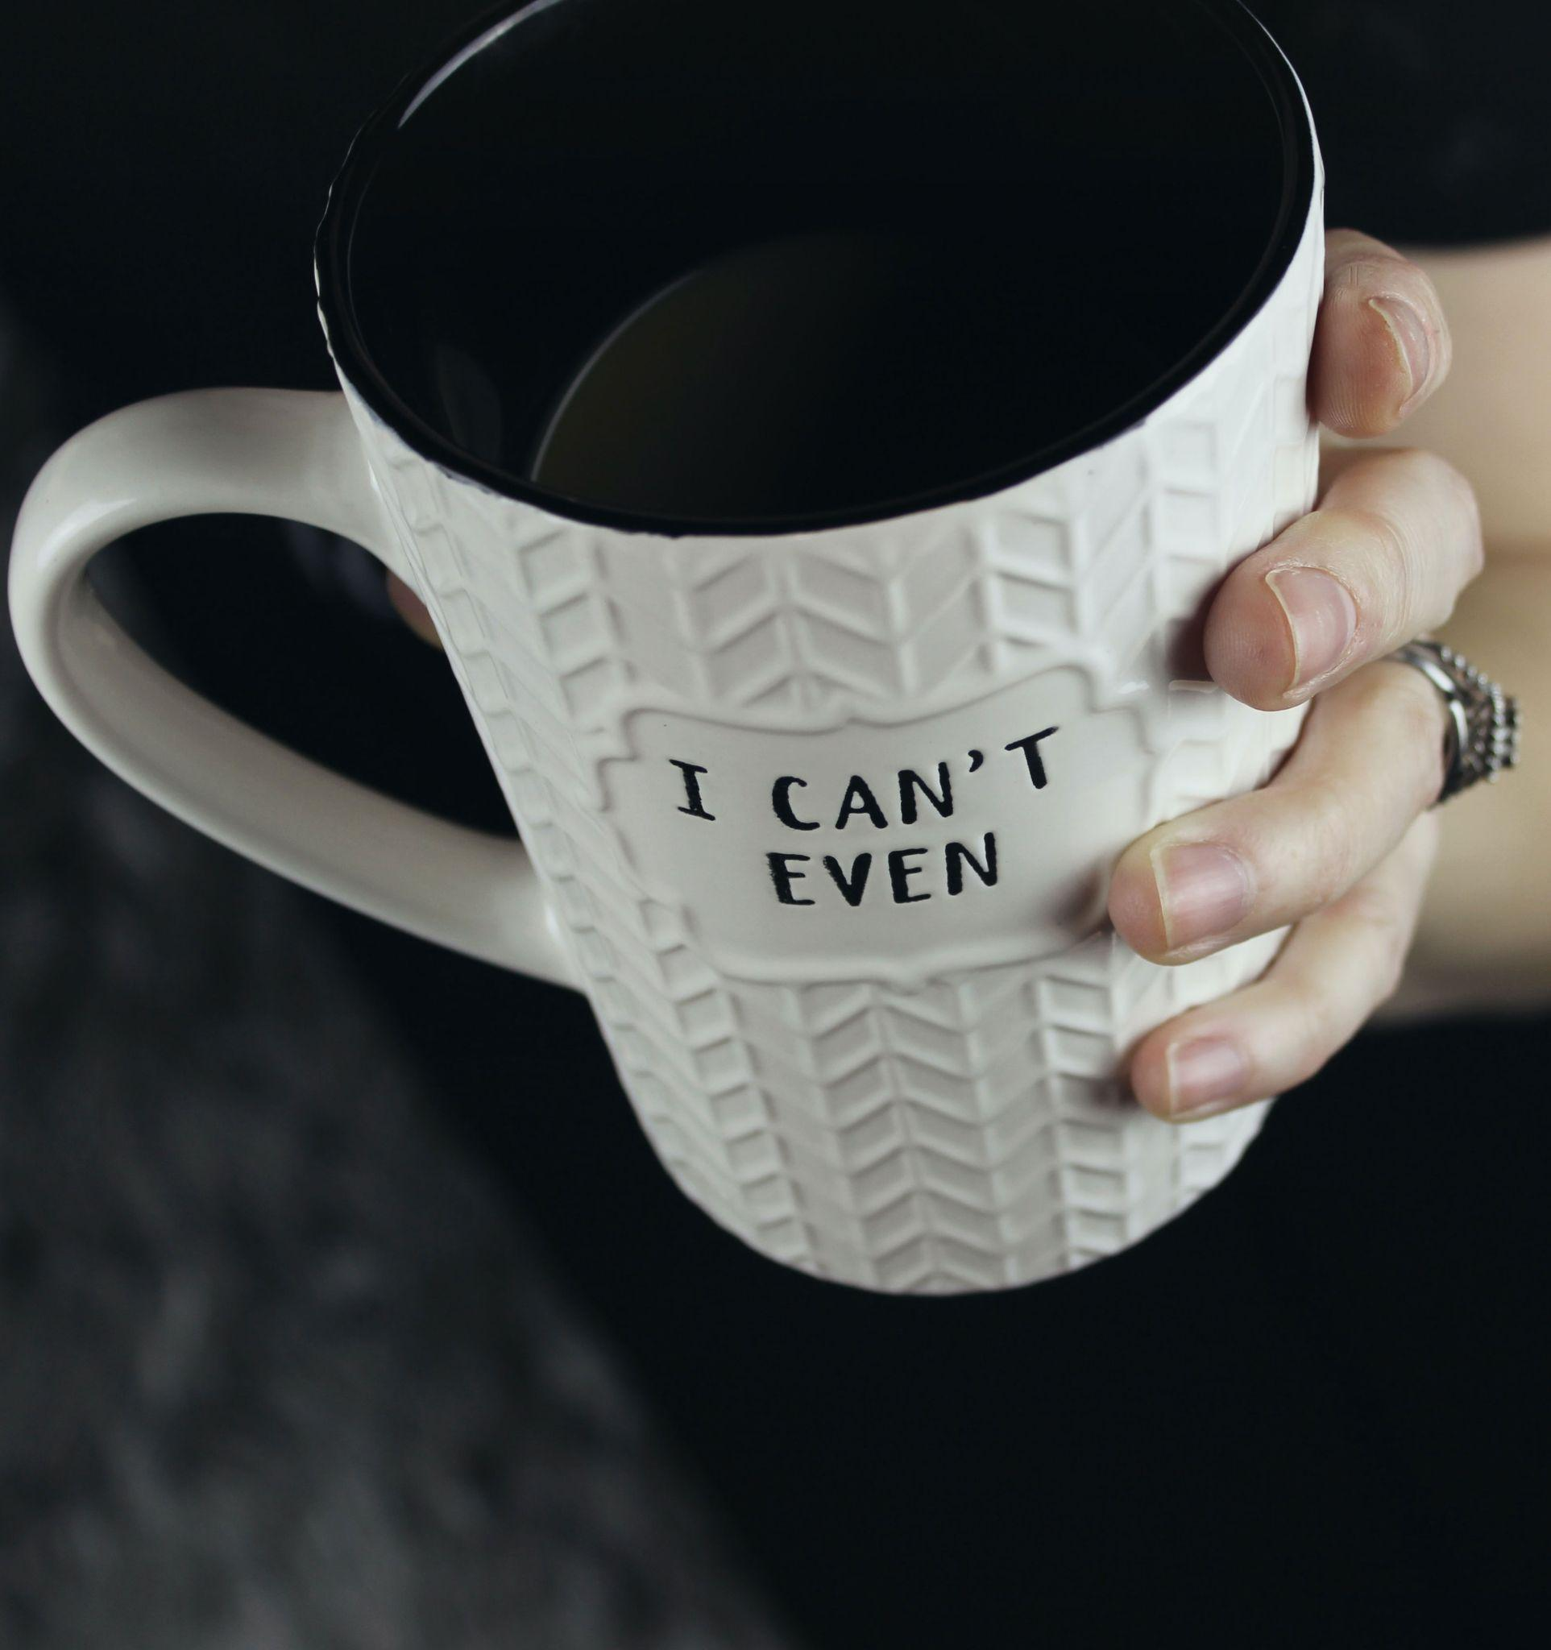
Give Yourself Permission to Say NO
You have the right to say NO
You deserve to have your needs met
You are the #1 priority in your life
Photo by Jen Theodore on Unsplash
Notes:
CK 12:16-12:17 -
We all need to learn how to give ourselves permission to say no
You have the right to say no
You deserve to have your needs met
You are the #1 priority in your life - old adage of putting your oxygen on first - if you are constantly burning out, you cant help others at work and in your life effectively.
You need to be able to reach no in your own mind before you say it to others.

Slide 9
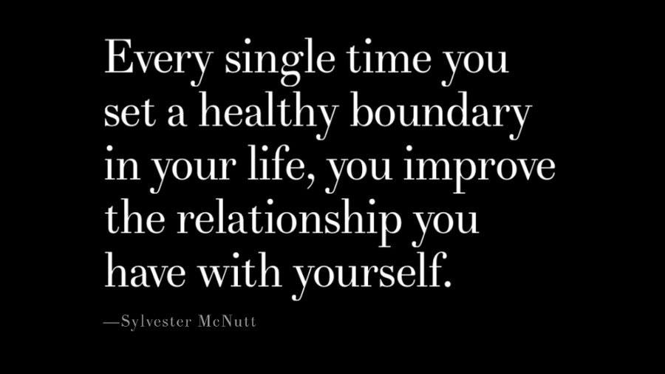
Screenshot of quote
https://twitter.com/sylvestermcnutt/status/1248959007555018752
Notes:
12:17 – 12:18
CK
So, to sum up. For every yes you say to something beyond your normal workload, you are saying no to something or someone in your personal life.
Set and protect your boundaries.

Slide 10
Reflection #3
Why do you want to say NO?
What are you saying YES to?
Give yourself permission to say NO!
Notes:
12:18 – 12:22
Kieran - bottom of p.2
Activity - reflection
Why do you want to say no?
What are you saying yes to?
Give yourself permission to say no - we want you to actually give yourself permission! You can do this on the top of p. 3
Feel free to share in chat if you feel comfortable, but this is mainly for you.

Slide 11
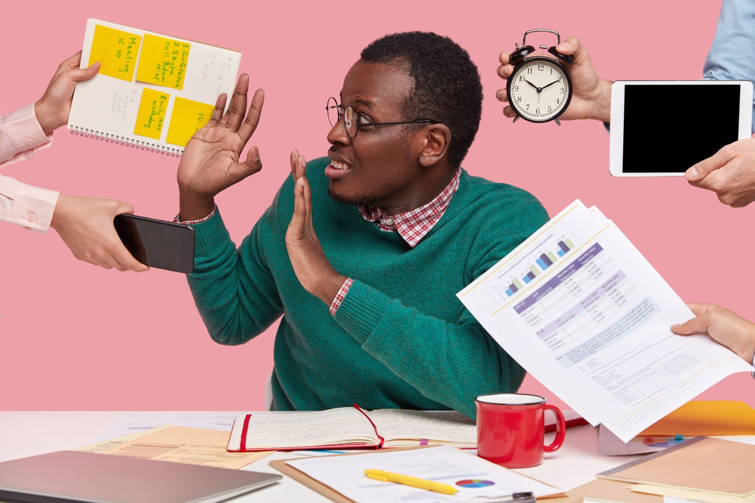
Saying NO is Key to
Healthy Working Relationships
Comfortable interacting with others
Able to be more authentic
Sign of respect
Image by wayhomestudio on Freepik
Notes:
12:22 – 12:29
Re-Do Scenario - we left off we my grudging yes
Make Rewind noise - Create ‘Awkward place’ but Kieran acknowledges that CK saying no is important
KH - as your boss I think this content is great, so I want to share. So, what if we plan to roll out 18 part blended learning in say 3 months?
CK explains rational – Um…I am thrilled you think the content is worth sharing, I worked really hard on it. However, In order to do such a large scale project, I would have to drop all of my other projects, and I am not sure I can get it all done in 3 months
How can we prioritize? I would want to give this the time and attention it deserves
Kieran - Let's talk more I really want this content to be shared! Maybe we can figure out a reasonable way to do it!
CK
William Ury, author of The Power of a Positive No, states that No is the tension between exercising your power and tending to your relationships.
It is okay to say no to our colleagues, and even our bosses to protect our mental, emotional, and physical health. So we need to think about what our needs are and if no is realistic in each case.
There will always be things we cannot say no to, but we need to understand and advocate for the best use of our time, energy and skills.
There is an excellent article in your resources called When to say yes (or no) that posits that learning to say no will:
CLICK
Make you more comfortable interacting with others. You will know where you stand, and when you can take on more.
Workaholism is a hard addiction to recover from.
Our culture upholds it
But you ignore your capacity at your own peril. It is the fastest route to resentment and burnout.
In the article, author Meredith Farkas recalls a Tweet she found to be important - “The pace you set is the pace they’ll expect.”
The more you say yes, the more your org will expect
The more libraries “do more with less”, the more our communities will expect - once again, the pandemic really highlighted this
Kieran cardboard box factory story
So, take your time, reflect and find the things you want to focus on. The places you can be useful, and don’t feel like you have to be doing all the things to prove yourself.
Marcus Buckingham – author and researcher on love and work – teams need people with different strenghts to be effective
CLICK
Being able to say NO enables you to be more honest and authentic with others.
Being honest about what you can and cannot do. Honest about your capacity will help you be more authentic with others at work
A more authentic relationship - less guilt, fear, resentment
CLICK
Sign of respect -
Saying no to some things helps us all focus on org and team priorities - avoiding unnecessary scope creep
Able to do quality work
Not missing deadlines and letting people down
Avoiding burnout - Burned out workers can also not serve colleagues and our patrons well.
Clarity saves relationships -a clear answer, even if it is NO, allows others to make needed adjustments
When stressed and overcommitted we cannot bring our best selves to work
We need to be able to put ourselves first, so that we can be of use to others
Others cannot respect us until we respect ourselves

Slide 12
“When work devours your waking hours, it also devours your will to do things that truly nourish you.”
https://www.theatlantic.com/ideas/archive/2021/12/how-care-less-about-work/620902/
Notes:
12:29-12:30
Kieran - Brainstorm with group – our scenario - chat
How might CK know she needs to say no
What might the implications on the relationship be?

Slide 13
Reflection #4
In your situation WHO do you need to say no to?
WHAT is the relationship and why is it important to you?
WHAT boundaries do you need to set and protect?
HOW will saying no benefit the relationship?
Notes:
12:30 – 12:34
Kieran - bottom of p. 3
Activity: Reflection
In your situation WHO do you need to say no to?
What is the relationship and why is it important to you?
What boundaries do you need to set and protect?
How will saying no benefit the relationship?
Feel free to share in chat if you feel comfortable

Slide 14
How to say NO! (finally!!)
Notes:
12:34 – 12:35
CK
So, we have talked about why it is hard to say no, and several reasons that we need to. Now we will get into the HOW

Slide 15
Steps for Saying No
Assess the ask
Reframe and re-envision
Say NO
Practice
1
3
5
7
Who, What,
When, Why
2
4
6
Listen to your emotions
Prepare to say NO
Stay firm
Notes:
12:35- 12:40
CK
We are going to break saying no into needed steps
CLICK - Assess the ask - pause - take your time
CLICK - who, what, when, why
The first is WHO – what who questions do we need to ask? Who is CK saying no to in our scenario
Who is this work for
With whom will I be working? You can be involved in doing impactful work that speaks to your values, but it can be hell to work with people who are difficult to work with, treat you badly, or take advantage of you.
Ok, what are some WHAT questions we need to ask?
What are you saying no to
What are you wanting to say yes to instead
What are you seeking to protect or change by saying no
What is the task and how much of a direct impact will this work have?
How much does this work speak to my values? – where do your values and the project or organization values overlap
What help and resources am I going to have help to accomplish the task
What might CK be saying yes to, if she says no?
What about WHEN questions?
What is the timeframe - Do I have adequate time to accomplish this task effectively
What will the workload look like?
You need some idea of how much time it’s going to take and when the busy times are for the work.
Will this require additional work outside normal work hours
What does my currently capacity look like?
If you agree, will your manager/team help you make space for the additional work
Do you have the time, energy, money to spend in the ask
Do you want to spend it
WHY questions?
Benefits and Hidden costs
What are the consequences if saying yes
What are the consequences of saying no
Do I really want to do this, or am I seeking to please
Am i comfortable with saying yes
Any hidden costs or benefits if CK says no?
CLICK - Listen to your emotions/gut
Listen to your intuition -
Latin word intueri = comprehend from within your own mind
Our feelings are rich in information about how we are reacting to the world
Fear and guilt cause us to react
Suppressing emotions does not work either
Name your emotions - these are natural reactions to life
How might CK be feeling?
CLICK - Reframe and re-envision
Focus on long term benefits – values – what does this allow us to say yes to
Re-envision what it means to give no as the answer
Your plans, desires, and commitments are just as important
Reframe the conversation, defang the word no, and destigmatize the act of saying no
See requests as invitations, not requirements
We will go into more detail with the next 4 steps
CLICK - Prepare to say no
CLICK - Say No
CLICK - Stay Firm
CLICK - Practice

Slide 16
Types of NO
Hard NO
I am afraid I don't have time right now
No for Now
I can't help you that today, but with more notice I may be able to help you in the future
1
2
I am afraid I can't do X, but I can Y
No and Switch
Thanks, I will need some time to think about it
Need More Time
3
4
Notes:
12:40 – 12:43
CK
To best prepare to say no, we need to decide what No we are going to use! There are 4 main types of no.
Hard No - I am afraid I don't have time right now - CK - I don't have time to create 18 modules right now
No for now - I can't help you that today, but with more notice I may be able to help you in the future - CK maybe next year we can put it in my workplan to do 1-2 modules
No and switch - I am afraid I can't do X, but I can Y - CK - while I can't do 18 modules, I am interested in doing 1 to see how it might work
be transparent about the extent of your support and leave little room for miscommunication.
Determine different levels of acceptable task completion
Not all tasks, require thorough excellence in execution
Define what satisfactory completion would look like
Need more time - answer later - Thanks I will need some time to think about it - KH - OK we can talk about it after this session!
Kieran
Activity - brainstorm
Ask attendees what type of no CK should use here
Ask attendees if they see pros/cons in each
No right or wrong, every situation is different. This is what reflection and preparation are key.

Slide 17

Saying NO
Keep it simple
Be positive and respectful
Remain firm
Listen respectfully and ask clarifying questions
Keep emotions in check
Accept no’s from others graciously
Image by Andrew Martin from Pixabay
Notes:
12:43 – 12:45
CK
Step 5 is actually saying no. Remember your why, and what kind of no, then
Keep it simple - for clarity
No is a complete sentence
You don't have to explain - How much detail depends on your assessment of the ask.
But don't over explain or apologize, it can dilute the power of the no- you are back into the feelings of guilt
Be positive and respectful
no does not have to be mean (honesty and politeness, respect)
Use I statements - explain your interests and needs
Use WE statements - appeal to shared interests
Remain firm - Kieran could negotiate the number instead of hearing no
Repeat your positive no as many times as needed
Remember that it is not easy hearing no, and people may resist
Be assertive - If someone gets upset about you setting a boundary. It's more evidence that a boundary was needed.
Use direct eye contact and Speak to the point
Listen respectfully - Ask clarifying questions as the conversation continues - part of potential ongoing negotiation
Keep emotions under control - Don't counterattack
Accept no’s from others graciously

Slide 18

Practice Makes a Perfect NO
Keep practicing - it takes courage, vision, empathy, patience, and persistence.
Image by jcomp on Freepik
Notes:
12:45 – 12:46 - explain
CK and step 7 is practice, practice practice!!!
Kieran
7 minutes breakout room – random rooms of 2-3 –12:46-12:53
Activity - Pairs of attendees practice saying no to either our scenario or own issue and get feedback from one another on their issue
Take turns briefly stating what you want to say no to – super brief context
Then practice saying your no actually say the words- There are NO scripts on the last 2 pages of playbook
Notice how it feels
Other person/s can give feedback
Then switch
3-minute people report how it felt, feedback – unmute or shrare in chat – 12:53 – 12:56
How did it feel when you practiced saying no?
Did you get good feedback?

Slide 19
No Action Plan
What do you want/need to say no to?
Why do YOU say yes when you want to say NO?
What are you saying YES to?
Give yourself permission to say NO!
What is the relationship and why is it important to you?
Why do you want to say NO?
WHO do you need to say NO to?
What boundaries do you need to set and protect?
How will saying no benefit the relationship?
What type of NO will you use?
Notes:
12:56 – 12:58
KH
You can see on p. 6 of the playbook, we have re-listed the reflection questions. This is your action plan. Finish working through all of the reflection questions, including thinking about the type of NO, and actually draft it out.

Slide 20
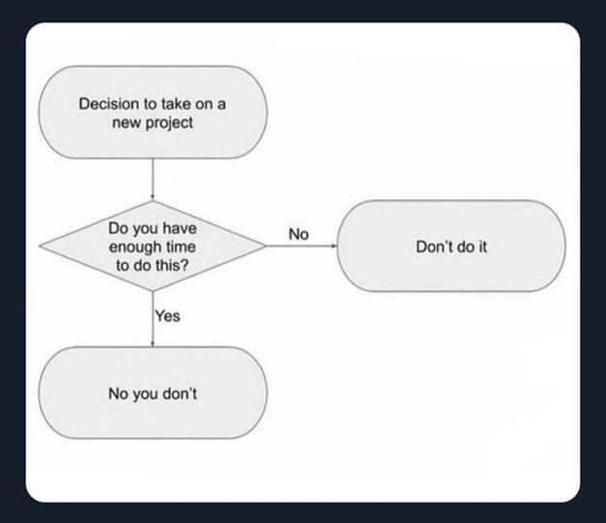
Thanks!
Any questions?
hixon_k@cde.state.co.us
kreger_c@cde.state.co.us
Notes:
12:58 – 1:00
CK
As we wrap up today, we want to say thanks for attending the session. Your gift today you say no is this lovely flow chart! Hang it up at work where you can see it as a reminder of your No action plan.
Kieran sends link to jpg - https://drive.google.com/file/d/1iDxNcyBzsW4X9ZV1zVMBKHgJ94YJFPam/view?usp=sharing
So use the last few minutes we have to work on action plan - and fill out survey
Survey - https://www.surveygizmo.com/s3/4404594/kreger-c
Questions?

Slide 21
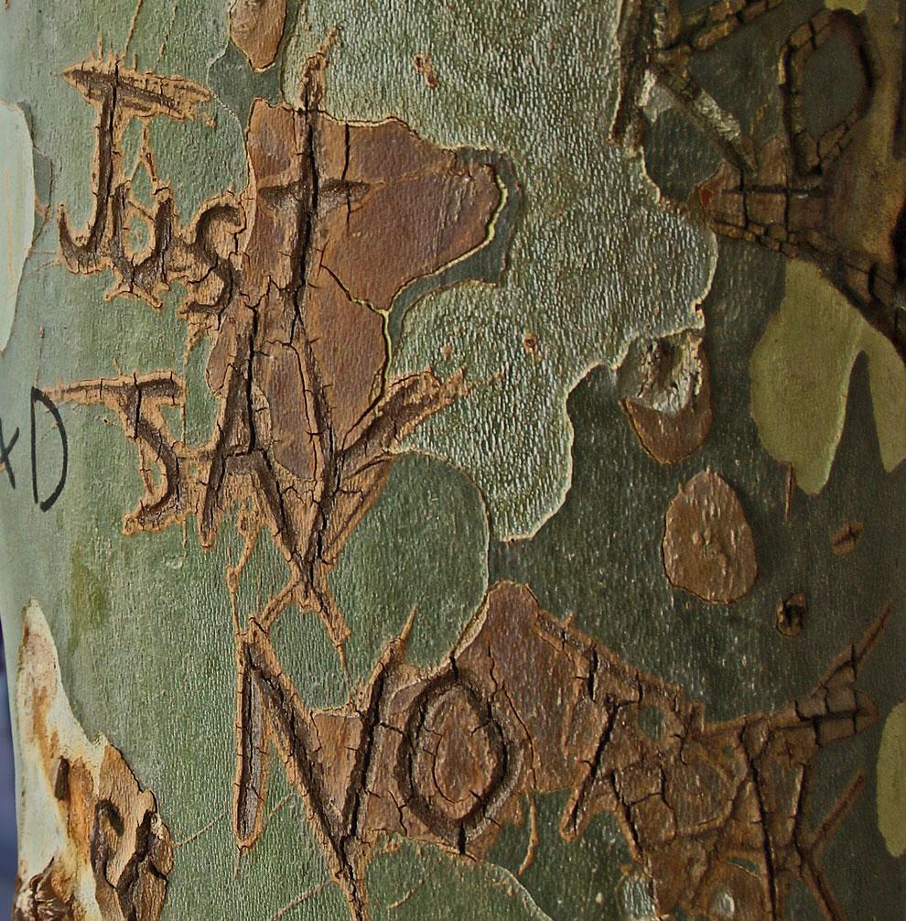
Credits
Special thanks to all the people who made and released these awesome resources for free:
Presentation template by SlidesCarnival
Photographs by:
Photo-by-James-Orr-on-Unsplash2
Image by digital designer from Pixabay
Photo by Jen Theodore on Unsplash
Image by wayhomestudio on Freepik
Image by Andrew Martin from Pixabay
Image by jcomp on Freepik
Death to the Stock Photo (license)
Image-by-Kevin-Phillips-from-Pixabay2
Image-by-Kevin-Phillips-from-Pixabay

