Slide 1
Job Hunting Like a Boss
Dave Hodgins & Miranda Doran-Myers
Library Research Service

Slide 2
LRS conducted a survey of job seekers. Respondents were more likely to have applied for how many positions?
Less than 10
10 to 20
More than 20+

Slide 3
Objectives
You gain a better understanding of how employers view the hiring process.
You talk with colleagues about ideas for how your library can better support patrons who are job hunting.
You are better prepared to compete for your dream job!

Slide 4
60 Second Survey
Those looking for a library job were more likely to say they had applied to more than 20 positions - some had applied to up to 100!
Those who are employed were more likely to say that they applied to 1-5 jobs before getting a position. However, a significant portion also said they applied for more than 20.
Most people who are employed in a library position interviewed one time before getting their job, while hardly anyone who is seeking a library position has had the chance to interview.

Slide 5
1914

Slide 6
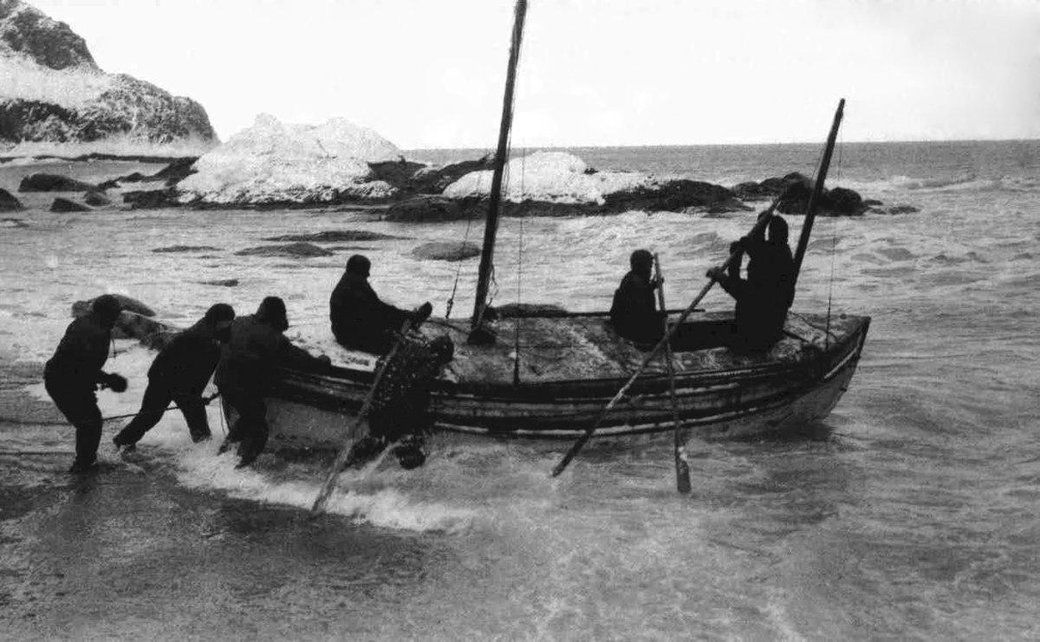
Shackleton & The Endurance
28 crew members
Several months stranded on ice and remote, uninhabited islands
Two lifeboat journeys over hundreds of miles of open seas

Slide 7
Every.
Single.
Person.
Survived.

Slide 8
MEN WANTED
Men wanted for hazardous journey. Low wages, bitter cold, long hours of complete darkness. Safe return doubtful. Honour and recognition in event of success.

Slide 9
Library job ads
are generally... terrible

Slide 10
Library Job Ads...
Tell you what you need in order to be hired.
DO NOT not tell you what you need in order to succeed.
DO NOT convey meaningful info about the culture of the organization.

Slide 11
Sailor Tech Wanted
Must be able to push a cart weighing 50 pounds.
Occasionally bend, stoop, kneel, crouch, crawl climb or balance.
Must have rope typing skills.

Slide 12
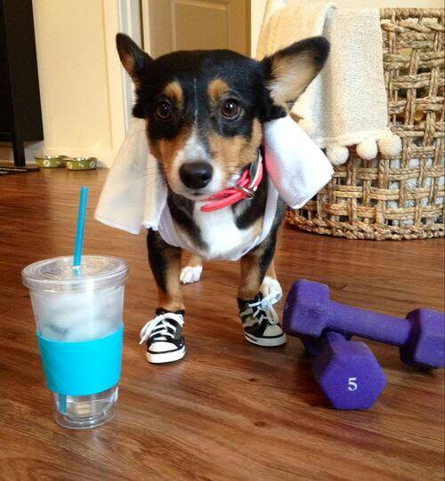
Research Makes - or BREAKS - Your Chances

Slide 13
It’s not You, It’s Me
Bosses look for “good fit,” because excellent bosses know that skills can be taught but personality cannot.
The least compelling thing you can demonstrate to an employer is that you meet the requirements of the job.
The most compelling thing you can demonstrate is that you understand the the role of the position and how it fits within the organization.

Slide 14
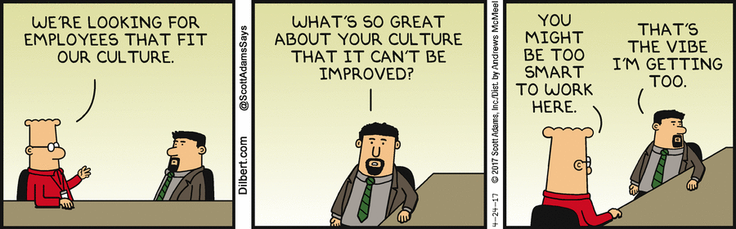
Organizational Culture

Slide 15
Know the Position
Research conferences and workshops relevant to the position. Find presentations, handouts, publications, and other materials by professionals in similar positions.
Research job ads for the same/similar positions. Look for keywords and concepts that you should research further.
You are building a vocabulary that will create dialog that goes beyond you simply parroting the job ad.

Slide 16
Know the Organization
Find the organization’s blogs, social media, newsletters, and, if you are really hardcore, their meeting minutes. Find presentations and publications by potential managers and colleagues. Be prepared to answer questions like...
How many employees are there?
How does the position’s unit fit within the organization’s hierarchy?
What are the mission and vision of the organization?
What major projects are in the works?

Slide 17
Set yourself apart
Casually mention a project, area of interest, or idea that you found in one of the aforementioned sources and you are guaranteed to set yourself apart from 99% of the other candidates.

Slide 18
A Job Interview is Not a Pop Quiz
Anticipate insightful questions.
Bosses ARE NOT looking for off-the-cuff responses.
Bosses ARE looking for good conversation, and that only happens when you are well-prepared.

Slide 19
Anticipate Smart Questions
Create a list of 20 questions that, based on your research so far, you anticipate being asked.
Show, don’t tell. Draw from your experiences and come up with real-world examples of how you make a difference. If you are new to the profession, tell me how you would do something.
Hand write your responses until you can repeat them from memory.

Slide 20
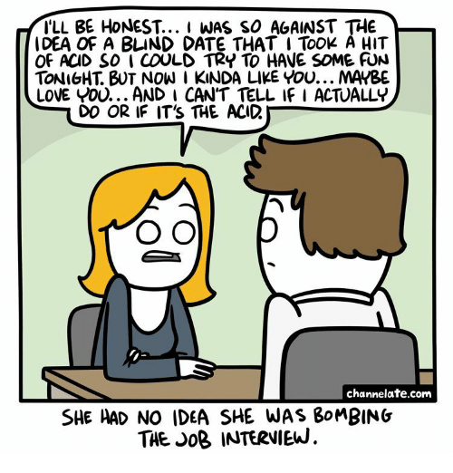
She had no idea she was bombing a job interview

Slide 21
How will the organization benefit from hiring you?
The hardest question to answer is, “How does this position fit with your short- and long-term career goals?”
Your response should demonstrate that you and the organization will benefit from your continued professional growth.

Slide 22
Be able to share a job specific weakness
The easiest question to answer - and one that 99% of candidates screw up - is, “What is one of your weaknesses”
Your response should NOT including anything personal, significant, and/or potentially devastating, but should instead focus on some trivial part of the job description.
“I see your library uses Library of Congress. I only have experience with Dewey, so…”

Slide 23
Tell Your Story
Your questions are not really questions, but are opportunities for further conversation.
Since your question time is always at the end of the interview, use the additional conversation time to emphasize what you can do for the organization, and to discuss skills and/or experiences that were not addressed by the questions they asked you.
Give the organization opportunities to showcase their success. “I noticed on your website that you are currently doing X and Y; how are those projects coming along?”

Slide 24
Prepare questions
Boring candidates ask boring questions which make for boring conversations.

Slide 25
Your Questions Must Demonstrate...
You are excited about the position. “What are 1 or 2 projects that will want me to tackle in my first 6 months?
You have a good understanding of the position. “I see the position requires web development skills. Tell me about your use of open-source frameworks or other types of content management systems?
You understand that work is about people and relationships. “How do you all, as a team or organization, celebrate your successes?

Slide 26

Your
Application Materials (in General)

Slide 27
Outsource Your Proofreading
You usually have grammar, spelling, and situational awareness issues in your documents.
If you are doing it right, you spend so much time staring at your own work that your perception and reality...diverge.
Identify two reliable proofreaders: one “in” the profession and one out. You will find that they focus on different, but important, aspects of your work.

Slide 28
Please Stop Designing Your Documents
Are you applying for a graphic design job?
YES
NO
Feel free to be creative with typography, color, etc.
Don’t even think about “designing”

Slide 29
The One and Only Rule for Application Design
Be consistent.
Body text is 12 pt Arial
Headings are 24 and 36 pt (no more than 2)
1” margins
Black and white

Slide 30
PDF Application Materials
Always submit your application materials in PDF format.
When I open your .doc[x] files, there is no guarantee that I will experience the formatting and layout that you intend. (P.s. you also sometimes have metadata, “tracked changes,” and comments that, while often humorous, are not relevant.

Slide 31
I am not interested in...
You almost never submit (but I would love to see)...
Your social media, personal blogs, hobbies, college clubs, reading preferences.
Portfolios, publications, and other relevant professional works.

Slide 32
Your Resume
Choose a consistent format (Googling is perfectly acceptable here).
Relevance is more important than length.
Focus on your WHAT.
Keep it up-to-date.
https://www.lrs.org/documents/job-hunting/sample_resume.pdf

Slide 33
Your References
Assume nothing. Interview your references.
When choosing a reference, go for substance over title. A “Director of…” who cannot speak directly to the quality of your work is less effective than a colleague with whom you have worked closely.
You should provide every reference with a copy of the job description, and the cover letter and resume you will submit.

Slide 34
Prepare your references
Give your references talking points.
It is not “cheating” to help your references help you. Period. End of sentence.

Slide 35
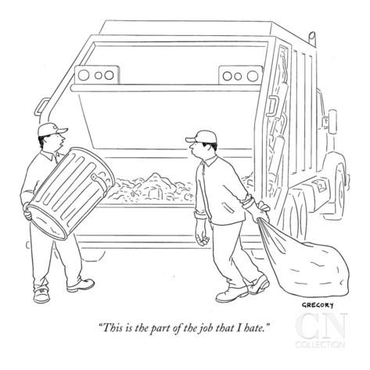
Your Cover Letter

Slide 36
Cover Letters
It is (painfully) obvious to us when you have simply Googled “cover letter example.”

Slide 37
Cover Letters are Hard
To whom it may concern,
Please accept this letter in application for the position of Librarian at Pebble Brook Library, as advertised on LibraryJobline.org. I believe you will find that I am well qualified for the position. You will also find attached my resume and a list of 5 references.
I have 10 years of experience working in public libraries. My current and previous duties include working at the reference desk for 20 hours per week, processing interlibrary loan (ILL) materials, and supervising 5-10 student shelvers.

Slide 38
Tell us who you are
Your cover letter is not an annotated version of your resume. It is the start of a conversation.

Slide 39
One-time Use Only
An excellent cover letter is almost always one-time-use only.

Slide 40
Elements of an Excellent Cover Letter
Open with enthusiasm
I am excited to apply for the position of Research Assistant currently open at the Colorado State Library…
Share vision/beliefs
I believe that harnessing data and making it accessible is essential for helping libraries to demonstrate impact in their communities, and my communication skills and sharp attention to detail would make me an asset in furthering this cause.

Slide 41
Elements of an Excellent Cover Letter - Reflect on your success/experience
Through this combination of theoretical and practical training, I have learned the importance of data and emerging technologies for helping libraries to both engage with their communities and understand how to better serve those communities as they evolve.

Slide 42
Elements of an Excellent Cover Letter - Show ambition
I was drawn to a career in libraries because I know it is a rapidly changing profession and want to be a part of redefining the role of libraries in all the kinds of communities that they serve.
I also would like to strengthen my leadership abilities by working with library stakeholders in a variety of forums to become an effective voice for how libraries can use data to demonstrate their impact on and importance to 21st century communities.

Slide 43
Elements of an Excellent Cover Letter - WHY, not WHAT
What I offer is a strong foundation of theory and practice in research and data analysis, coupled with a vision of how advocating data-driven evaluation initiatives can enrich conversations about the role of libraries today.
https://www.lrs.org/documents/job-hunting/outstanding_cover_letter.pdf

Slide 44
WHY do you do what you do?
Everyone has a WHY. Your WHY is the purpose, cause or belief that inspires you.

Slide 45
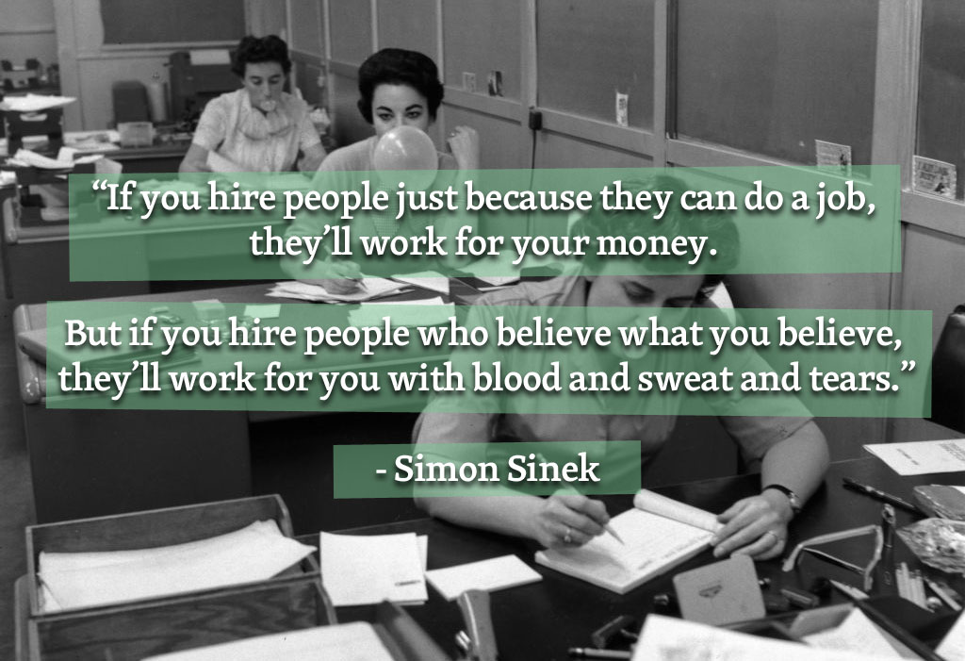
What is the why?

Slide 46
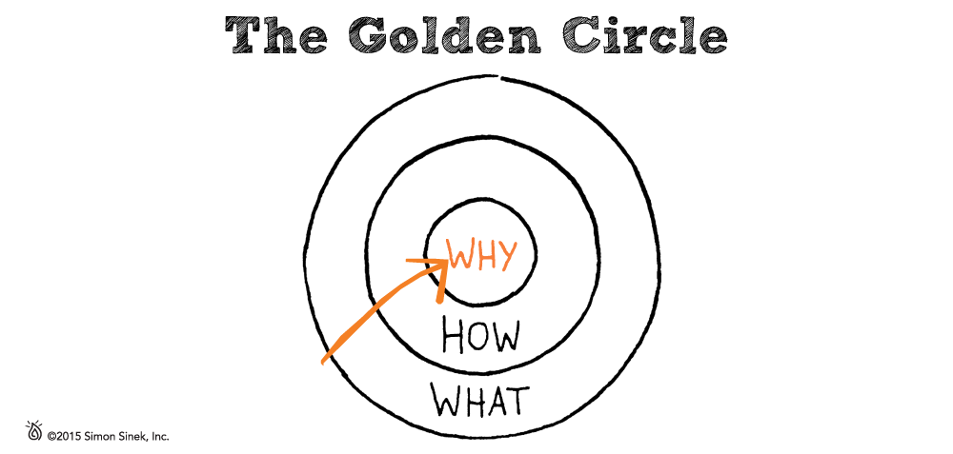
The Golden Circle

Slide 47
WHAT WHY
Provided reference service for genealogy vs.
Worked at the welcome/circulation desk vs.
Maintained the library website vs.
In charge of toddler storytime vs.
Connected my patrons to their past
Created a welcoming environment for my community
Provided access to the library for those who can’t make it to the physical premises
Passionate advocate for the importance of early childhood literacy

Slide 48
Contact Us
Dave Hodgins
hodgins_d@cde.state.co.us
Miranda Doran-Myers
doran-myers_m@cde.state.co.us
https://www.lrs.org/jobhunting

