Slide 1

Supporting Students with Invisible Disabilities
Elizabeth Novosel
Computer Science, Mathematics, & Social Sciences Librarian
University of Colorado Boulder
Notes:
I want to thank you for coming to my talk today about Supporting Students with Disabilities in the library classroom. My name is…

Slide 2
Today’s Topics
What are invisible disabilities?
How do invisible disabilities impact students in educational settings?
Invisible disability inclusion and support in instructional spaces
Notes:
My work with invisible disabilities has mostly been geared towards higher education settings, but the ideas in this presentation can help in a wide variety of settings

Slide 3
Presenter Positionality
&
Description
White
Female
Heterosexual
Cisgender
Middle aged
Highly educated
Have invisible disabilities (well managed)
Easily pass as non-disabled
Parent of two children with invisible disabilities
Notes:
All that said, I do not speak for others with invisible disabilities, I do not represent anyone else. Others with invisible disabilities would probably disagree

Slide 4

Please note:
I am not an expert
…but I’m really interested in disability issues.
I am still learning and hope to learn from you, too!
Close-up Photography of a Dog with Leash by Julissa Helmuth on Pexels

Slide 5
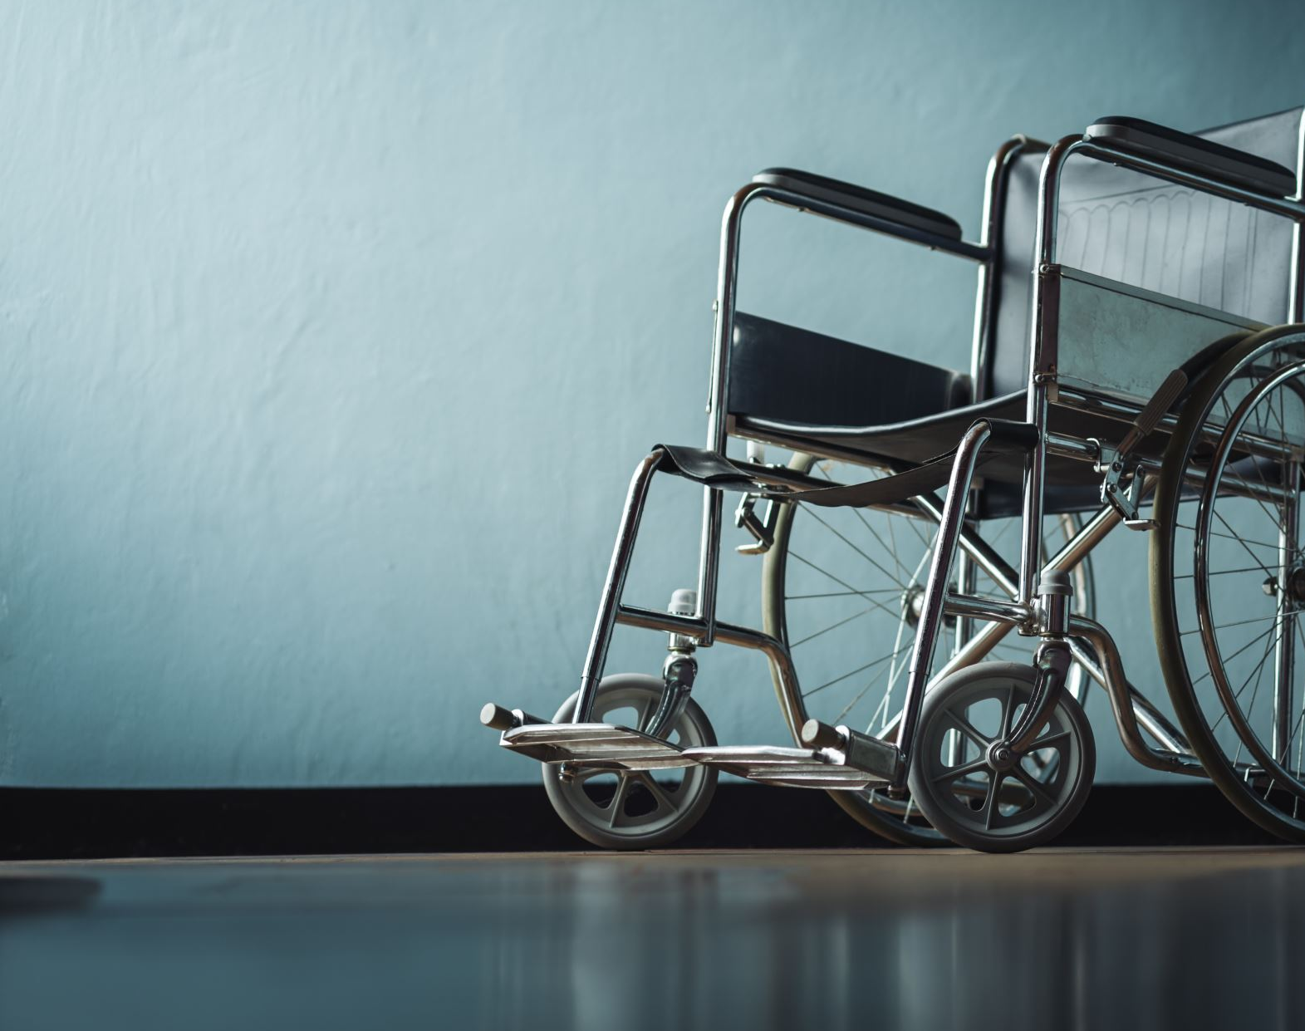
What is a “disability”?
How do you know if someone is disabled?
Notes:
Let’s take a minute and talk about this: what is a disability, as far as you understand it?

Slide 6
Activity:
Partner / Group / Individual Reflection

Slide 7
There will be 3 questions.
Feel free to:
- discuss the questions with others or
- write/journal/think about the questions individually or
-You can share in the chat

Slide 8
Questions for Breakout
When you hear the terms, “disabled person” or “person with disabilities,” what images come to mind?
Did you have any significant experiences related to learning about disabilities?
If so, how did those experiences impact you?
Notes:
We will divide participants into breakout rooms in very small groups, 2-3 people each to discuss. No one has to go to the room if they don’t want to! PUT QUESTIONS IN CHAT so people have it in their breakout rooms.
When you hear, “disabled person” or “person with disabilities,” what images come to mind? Did you have any formative experiences related to learning about disabilities? If so, how did those experiences impact you?

Slide 9
What was it like to talk about this topic?

Slide 10

Language Issues
Notes:
A good place to start: with language, Language is important and has a direct impact on people. So I wanted to mention that there is disagreement about how to talk about this topic.

Slide 11
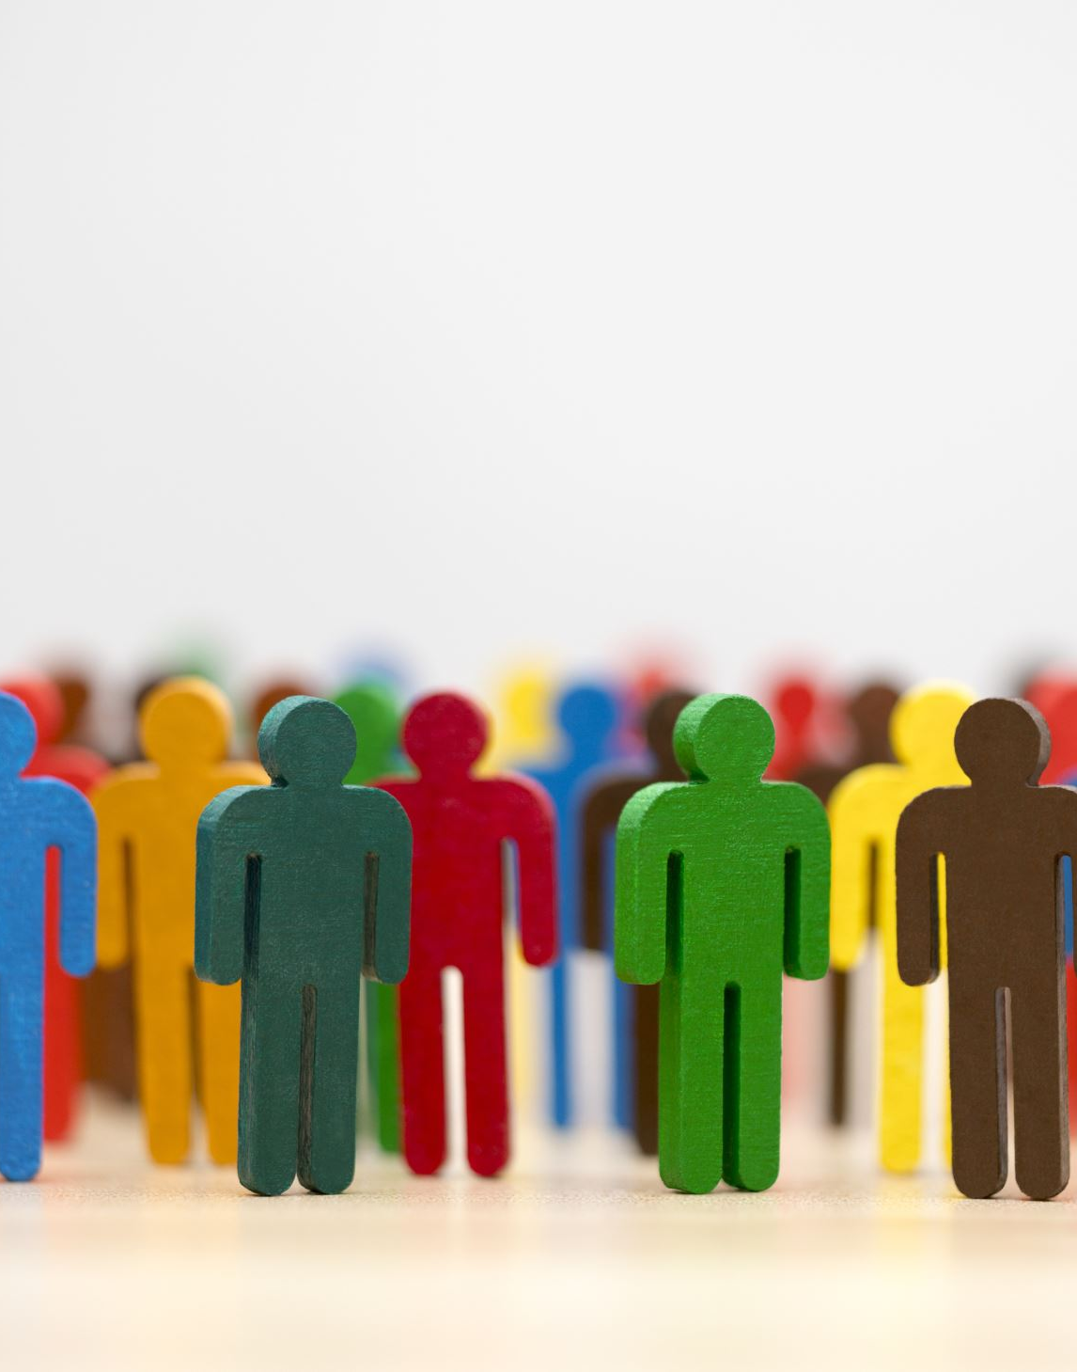
#1. Person First Language
“Person with a Disability” or
#2. Identity First Language “Disabled Person”
?

Slide 12
Unsatisfying Answer:
It depends!

Slide 13
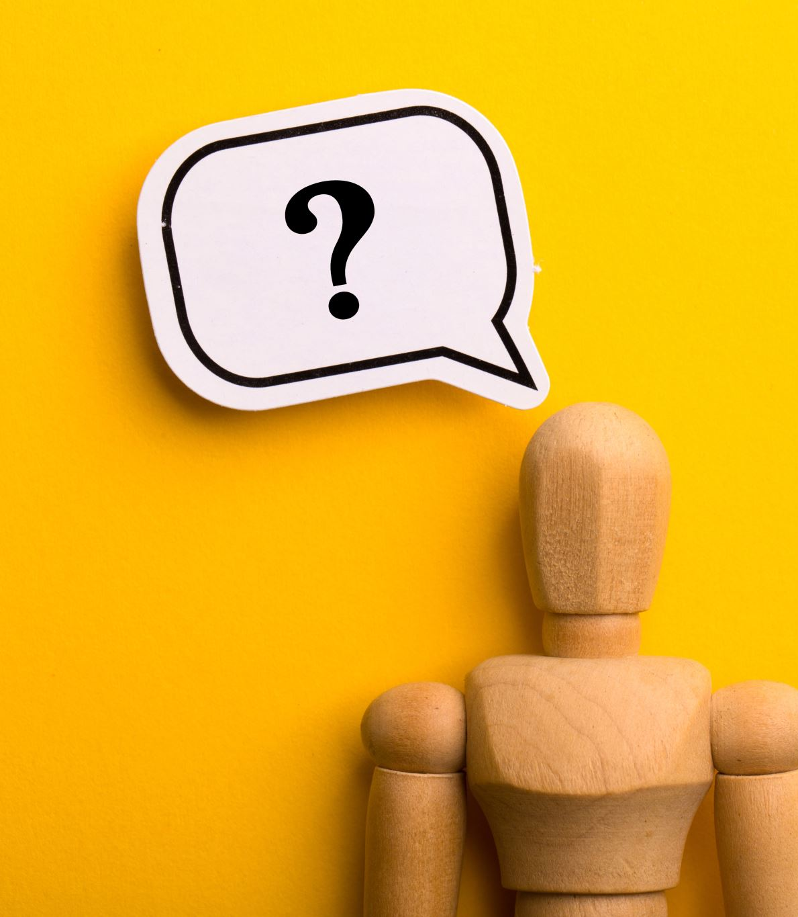
Invisible, Hidden or Non-Apparent Disability?
___________________
Which term is best?
Ask or notice what someone prefers!

Slide 14

A few definitions:
What is a disability?
What is an invisible disability?

Slide 15
According to the Americans with Disabilities Act (ADA):
“...a disability is a physical or mental impairment that substantially limits one or more major life activities.”
https://adata.org/

Slide 16
According to the Invisible Disabilities Association,
“...an invisible disability is a physical, mental or neurological condition that is not visible from the outside, yet can limit or challenge a person’s movements, senses, or activities. Unfortunately, the very fact that these symptoms are invisible can lead to misunderstandings, false perceptions, and judgments.”

Slide 17

Can you think of a few examples of invisible disabilities?
Put some in the chat?

Slide 18
A Few Examples:
Dyslexia
Anxiety Disorders
Chronic Pain
Chronic Fatigue Syndrome
Depression
Diabetes
Schizophrenia
Agoraphobia
Chronic Dizziness
Multiple Sclerosis
Autism Spectrum Disorder
Sleep Disorders
Bipolar Disorder
Asthma
Brain Injuries
Crohn’s Disease
Epilepsy
Fibromyalgia
Lupus
D(d)eafness/Hearing Loss
Chronic Dizziness
Lyme Disease
Metabolic Syndrome
Myasthenia Gravis
Narcolepsy
Personality Disorders
Rheumatoid Arthritis
Ulcerative Colitis
Attention Deficit Hyperactivity Disorder

Slide 19
Why is this topic important?

Slide 20
Invisible Disabilities Are Common
No exact consensus on numbers or percentages, 10-20% of population
You probably know many people with one of these conditions
Many people with invisible disabilities do not identify as being disabled

Slide 21
Statistics
1 in 4 people in the US have a disability
1 in 10 (or more) people are estimated to have an invisible disability
Approximately 20% of students in higher education are disabled
Only a third of students with a disability inform their college
Many disabled people do not go to college and do not achieve the same level of professional success, even if they do
Disabled people are at higher risk for depression, isolation, poverty, violence, health inequities, lack of access to transportation, and financial insecurity
Disabled people face daily struggles with accessibility, microaggressions and prejudice

Slide 22
Available Data:
National Center for Educational Statistics 2021/2022
7.3 Million students aged 3-21 received services under the Individuals with Disabilities Education Act (IDEA)
15% of all students in public schools
Approximately 75% of the 7.3 million students served by IDEA have invisible disabilities

Slide 23

What barriers do invisibly disabled students experience?

Slide 24
Barriers to accessibility
- Ableism and stigma
- Inaccessibility
- Social challenges
- Lack of support

Slide 25

Educational and other institutions generally use “accommodations” to provide support for disabled students.
Please note:
***Accommodations only address inaccessibility issues.
***They do not help with stigma, social impacts and the lack of other supports.

Slide 26
Accommodations are based on the
“Medical Model” of disability
Disability needs to be “cured” or fixed so that disabled folks can function closely to “normal” as possible
Accommodations are given to help disabled people gain access to resources (but they often don’t work)
Disabled people must rely on disclosure of their disability to get assistance/support

Slide 27
A Few Common Accommodations
Extended time on exams and assignments
Exams in quiet/alternate space
Modified assignments
Accessibility technologies for work/exams
Lecture notes provided
Oral (or other) exam option
Availability of recorded lectures
Sound cancelling headphones

Slide 28

Although accommodations do help many people, many others are not supported by disability services offices.

Slide 29
Why?
No diagnosis
Can’t get all the paperwork necessary
Process too long or hard
Still on the waitlist
Accommodations were not approved
Instructors could not or would not provide accommodations and there was no support or enforcement
Instructors have no training
Didn’t declare disability
Didn’t know what to ask for
Technology broken or isn’t compatible/appropriate
Other factors interfere with even getting to class/work (lack of transportation)

Slide 30

What challenges could invisibly disabled students experience in your class?

Slide 31
Accessibility Challenges
Accessibility tools don’t work as expected
No technical support for accessibility tools
Materials are not accessible
  Chat, PDFs, Equations, Images of text
Expectation of reading something quickly in class
Expectation of interacting with others
Cold calling
Requirement to present to class
Attendance requirements with no virtual option
No asynchronous resources, notes, recordings, handouts
Physically inaccessible spaces
  Includes scents, lighting, temperature, noise
Inflexible modes of communication
  (no anonymous options)

Slide 32
Let’s find ways to support disabled students better.

Slide 33
"Social Model” of disability
Disability is caused by a society planned and built for non-disabled people
Society and institutions should be designed to include everyone
Accessibility is a matter of justice and inclusion

Slide 34
Making Instruction Accessible

Slide 35
1. Implement Elements of Universal Design for Learning

Slide 36

https://udlguidelines.cast.org/
Based on Universal Design (UD) in architecture by Ronald Mace (1980s)
Goal: make buildings, spaces, and products usable by everyone
Aligns with the “social model of disability”: society is designed in a way that excludes disabled people and can be designed to include everyone
Center for Applied Special Technology (CAST) developed UDL in the 1980s
Goal: make learning accessible to all students
Premise: different brains function and learn differently; instruction and education can be designed for all brains. UDL involves both cognitive and emotional aspects of learning

Slide 37
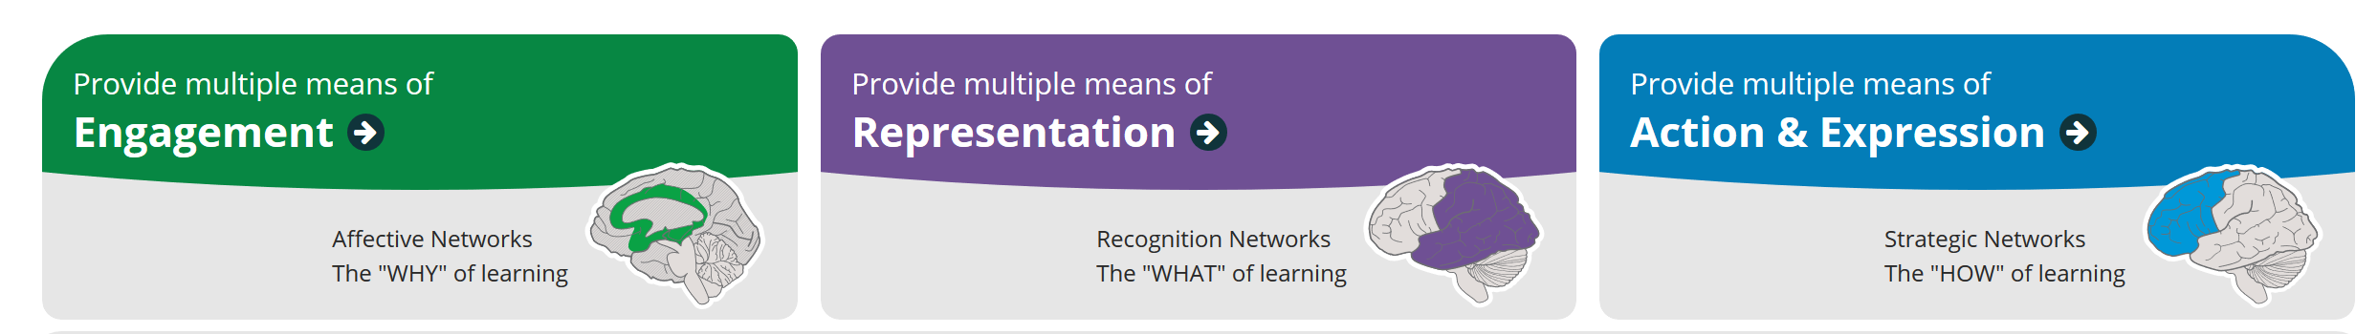
Basic Principles of Universal Design for Learning
Multiple means of engagement: tap into learners' interests, put learning goals in context for students to increase motivation
Multiple means of representation: give learners many ways of acquiring information and knowledge
Multiple means of expression: provide alternatives ways for students to show their understanding

Slide 38
2. Limit Content

Slide 39
Avoid overwhelming students
Be realistic about what you can cover
Communicate clearly about content and trajectory
Focus on skills that are the most relevant to session goals
Check for comprehension (do not assume no questions means “we get it”)

Slide 40
3. Make Content/Space/Activities Inclusive and Accessible

Slide 41
Students do not all engage or learn in the same way. Forcing them to do so can exclude many students.
Ensure physical access to spaces
Provide options for learning, communicating knowledge, and participating
Be aware of what can exclude students (or cause them to shut down)
Make asynchronous options for learning available

Slide 42
Physical Space Issues
Consider how hard it is to navigate to a space: can someone get there with a cane? Crutches? A wheelchair?
Lighting can create an inaccessible space, do not use flashing lights, avoid florescent bulbs (and some say LEDs too!)
Are electrical outlets accessible? Where are they located? Light switches?
Are spaces designed to be flexible?
Are there strong smells in the space? Are people wearing perfume/cologne or are there other strong scents?

Slide 43
Active Learning Challenges for Disabled Students
You may not know if anyone is disabled
Group settings can be difficult for neurodivergent students (distractions, noises, smells, anxiety)
Dyslexic or vision-impaired students or those with slower processing speed may not be able to read or perform tasks quickly
Many students may not feel comfortable or be able to interact with others or “perform” publicly
Students with physical disabilities might not be able to participate in movement-focused activities or move their seats easily
Students with hearing or visual impairments may not be able to hear instructions or interact with inaccessible materials
Anxiety is a major barrier for learning

Slide 44
Considerations for Active Learning
Use active learning techniques carefully
Consider how an activity could be experienced by students with different backgrounds and abilities
Physical movement, social interaction, or reading expectations may make disabled students feel excluded or uncomfortable
Provide options for learning and participation:
  Asynchronous options, written options
  Do not single anyone out

Slide 45
Accessibility Issues for
Digital Resources
Videos might not be accessible to visually impaired students
Internet links and equations often do not work with screen readers
PDFs are hard to make accessible
Flashing screens can be problematic for people with seizure disorders or other conditions
Charts and graphs can be inaccessible to screen readers
Pictures of text do not read on screen readers
Social media is often inaccessible
Columns on slides or documents can be problematic

Slide 46
Making Digital Content Accessible
Do not use color as a navigational tool or to differentiate items
Images should include Alt text ; complex images should have more extensive descriptions as a caption or summary
Functionality should be accessible through mouse and keyboard and be tagged to worked with voice-control systems
Provide transcripts for podcasts, recorded lectures, videos, or other media (include any “chat” questions or other questions that might be hard to hear)
If you have a video, provide visual access to the audio information through in-sync captioning
Provide asynchronous content (recordings, documents, notes, etc.) for students who missed some content for whatever reason

Slide 47
4. Don’t Rush.

Slide 48
Tips for handling challenges
When students get overwhelmed or lost, many will disengage (stop listening/learning)
Check in with students for comprehension
Give more time than you think for questions
Give anonymous options for feedback/questions
Less is more

Slide 49
5. Set an Agenda

Slide 50
More tips
Clarify goals of your session
Helps students see how it all fits together
Emphasize relevance of each topic

Slide 51
6. Collect Feedback, Evaluate, Keep Learning

Slide 52
Strategies for making the classroom more accessible
Communicate with students and instructors & incorporate their feedback
Read, learn, investigate, take classes, listen
Experiment with new techniques
Collaborate with colleagues
Creating anti-ableist, inclusive instruction is an ongoing, iterative process

Slide 53
7. Be empathetic, listen, and help

Slide 54
People often do not believe invisibly disabled students need support
People accuse them of trying to take advantage or exaggerating
This silences, shames, and disadvantages disabled students
Always believe a student
Provide as much support to all students as you can: many have not gotten accommodations due to systematic discrimination or feel disempowered to ask for them
If you can’t provide a support for someone, ask for help from your department, mentor, colleagues, disability services

Slide 55
8. Learn how to support mental health

Slide 56
Mental Health Issues and Disability
Disabled adults experience mental health distress 5 times more often than those without disabilities (Center for Disease Control)
Disabled people often have less access to health care and may experience bias and discrimination from health care professionals
Many disabled people have intersectional identities and may be subject to even greater levels of discrimination and abuse.
Educate yourself about discrimination based on factors such as race, gender, sexuality, nationality, religion, and age.

Slide 57
Digital Accessibility Resources:
Digital Accessibility:
Web Accessibility Initiative: https://www.w3.org/WAI/fundamentals/
CU Boulder Digital Accessibility Office: https://www.colorado.edu/digital-accessibility/about
  DAO offers a Canvas Course on digital accessibility and other training resources, as well as consultations on specific materials
Website Accessibility Guidelines: https://www.ada.gov/resources/web-guidance/

Slide 58
Universal Design for Learning Resources
CAST Guidelines https://udlguidelines.cast.org/
Understood.org’s Teachers’ Guide to UDL https://www.understood.org/en/articles/understanding-universal-design-for-learning
Coursera Course: An Introduction to Accessibility and Inclusive Design https://www.coursera.org/learn/accessibility

Slide 59
Questions? Comments?
Let’s Chat!
Please contact me at Elizabeth.novosel@Colorado.edu

