Slide 1


How Wide is your Window?
How Wide is Your Window?
A Thoughtful Approach to EDI Family Programming
Carolyn Valencia, Outreach Librarian Early Literacy Focus, HPLD
Bridget Parker, Outreach and Children’s Librarian, HPLD
Veronica Lucero, Assistant Principal Martinez Elementary, Greeley-Evans School District Six
Nate Fairchild, Educator, Greeley-Evans District 6
Image compliments https://tenor.com/view/open-fenster-offen-window-dream-gif-23003829
Notes:
Carolyn
5 min
land acknowledgement & intros

Slide 2

AGENDA
Who We Are
Where We’ve Been
What We Did This Year
You Can Do this Too!
Q&A
Notes:
1 min
Carolyn
Creation and evolution of WtW
Along with sharing the chosen resources, we'd also like to share examples of progressive courageous conversations among intergenerational community members which were deeply moving and transformative
Role play
advocate for the continual cultivation of professional and personal awareness.
QUICKLY SHARE INTENTIONS
Vero- My intention is to share my experience as a facilitator working alongside the library and our community. What went well, what challenged me, and how I grew in the process.

Slide 3
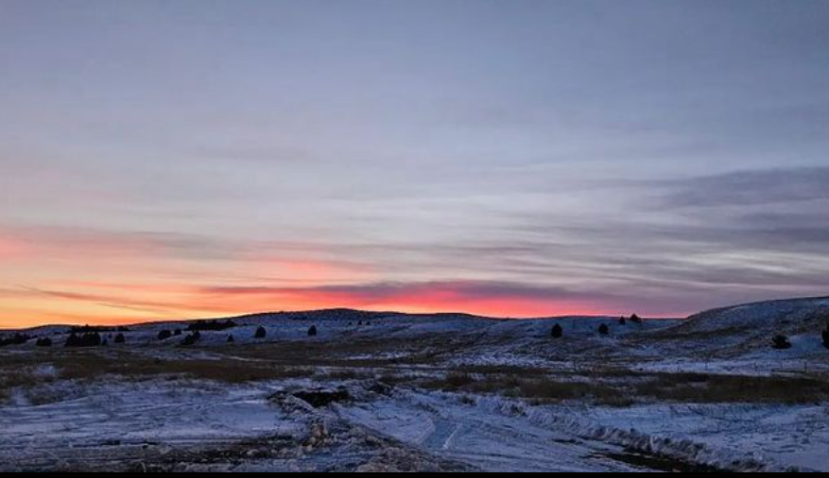
Setting the scene
Notes:
Carolyn

Slide 4
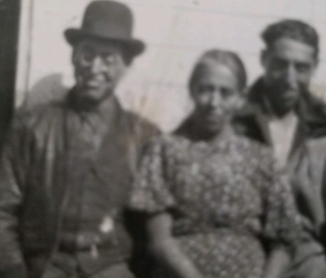
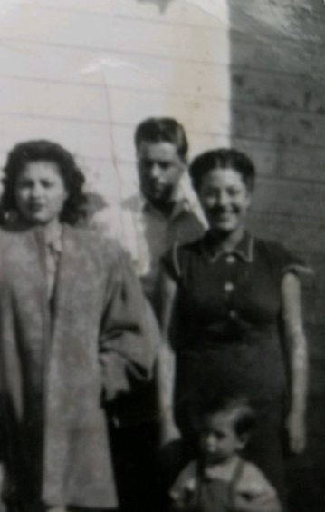
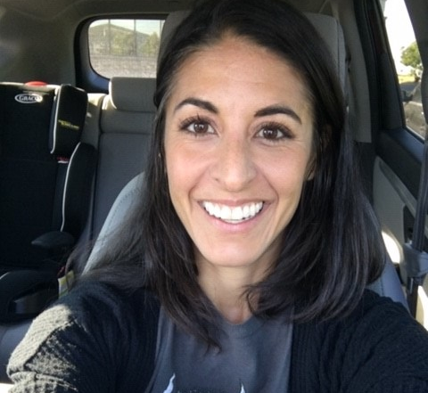
Carolyn L. Valencia (she/her)
MLIS from Emporia State University
Outreach Librarian, MOVE, HPLD
O.K.A.Y Certified
Stories, Songs and Stretches® Facilitator
Bikram Yoga Instructor
2020 Rising Star Award from the Colorado Libraries for Early Literacy
2021 Education Award from the Hispanic Women of Weld County
Lives in Greeley, Colorado with her daughter
Notes:
As our EDI Family book club focuses on race, racism and racialized trauma we wanted to share a bit of our lineage with
I identify as Hispanic and Native American, and use the pronouns she/hers
Here’s a picture of my grandmother, Susie and her mother, my great grandmother, Virginia who was a full-blooded Ute Indian
I use these pictures when I do story time services or programs on race
I also discuss my privileges in age-appropriate ways. In the past I’ve shared:
I’m an American citizen who is abled bodies
I’m educated and have a good job
I live in a house and have access to fresh water and nutritious food

Slide 5
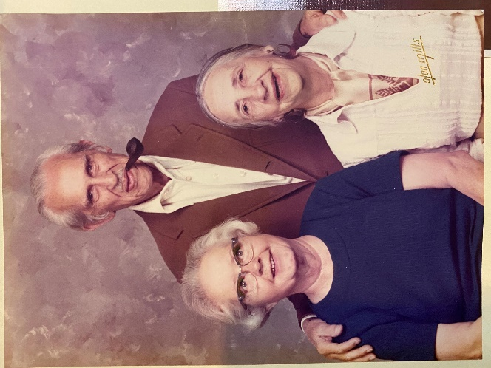
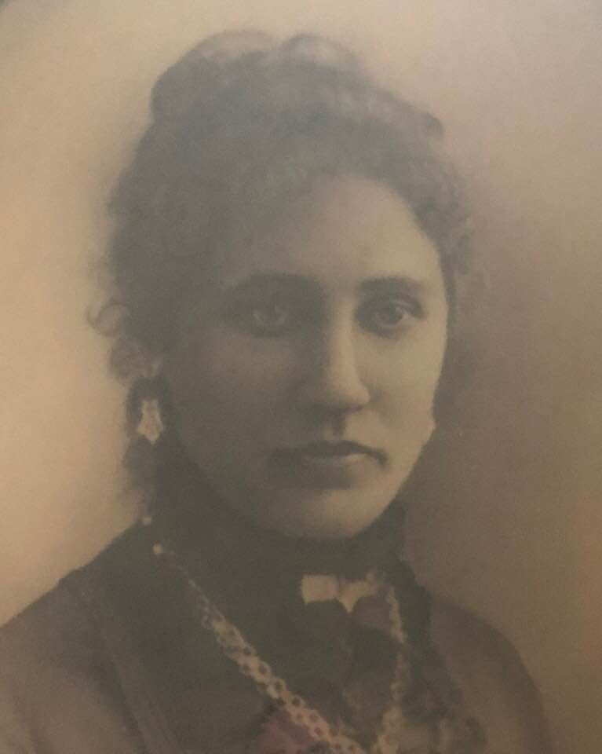
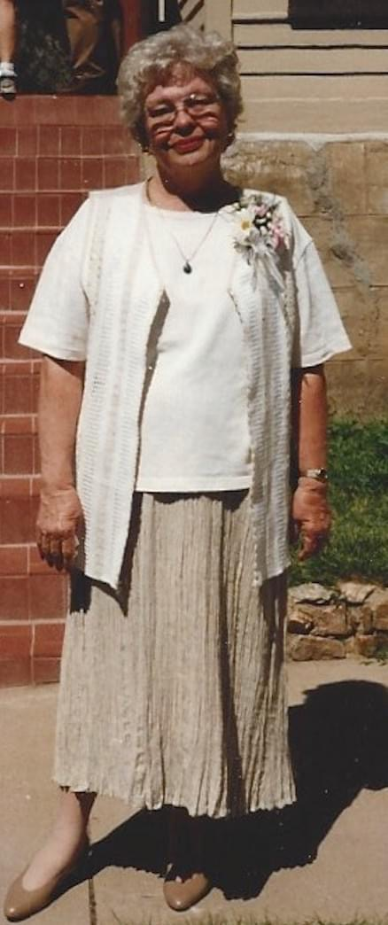
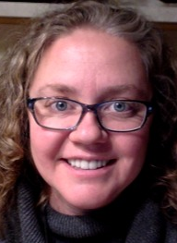
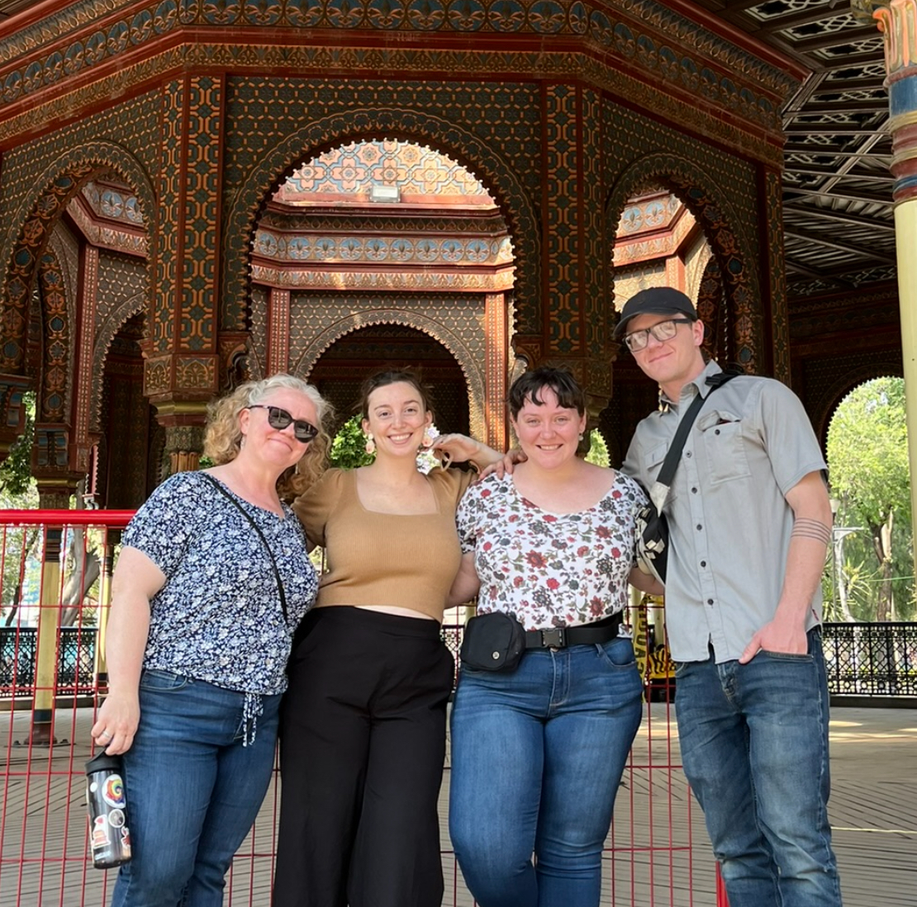
Bridget Parker (she/her)
MLIS from Emporia State University
Outreach and Children’s Librarian, High Plains Library District
Mom, sister, daughter, citizen, friend, descendant, and ancestor
Photos, from top left to bottom right:
Top row: Bridget’s great-great-grandmother Fanny Oliver Devitt; great grandfather Chester Butler with great-grandmothers Ellen Devitt and Blondell Butler; grandmother Ann Butler
Bottom row: Bridget; Bridget with her kids Liz, Lizzy, and Andrew

Slide 6
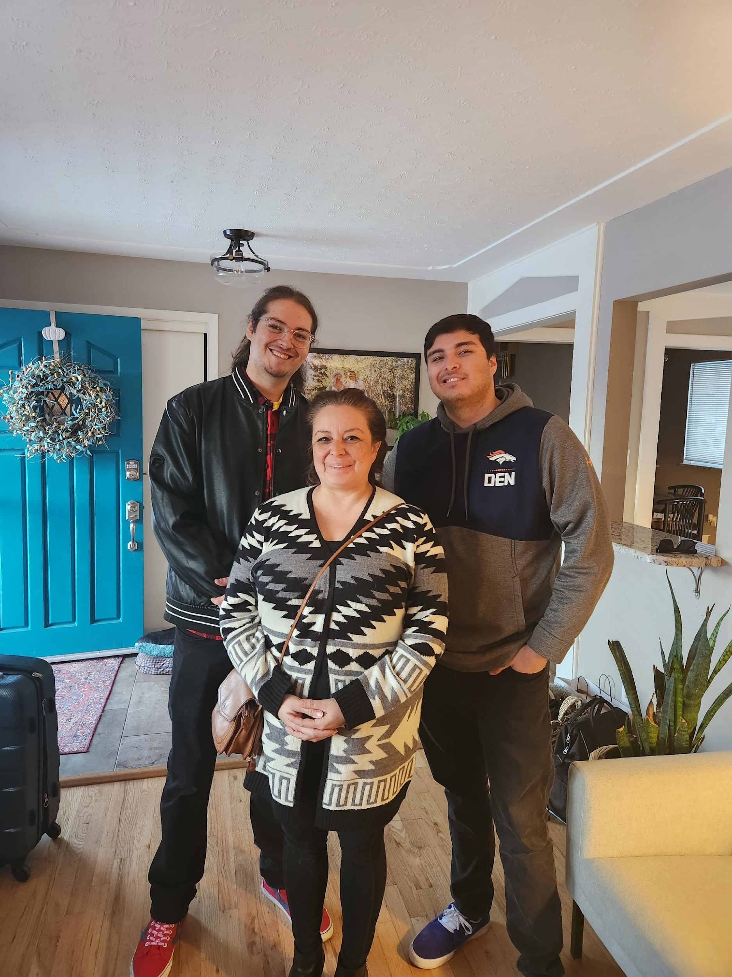
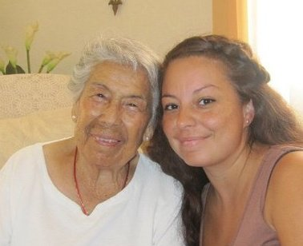
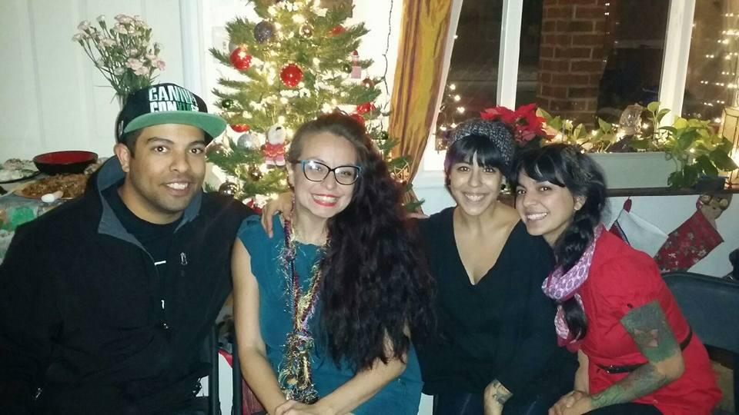
Veronica Lucero Ed.D.
(she/her)
Assistant Principal @ Billie Martinez Elementary
Ed.D Educational Leadership
M.A. Educational Leadership
B.A. Education @ UNC
UnboundEd Facilitator
2022 Education award from the Hispanic Women of Weld County

Slide 7
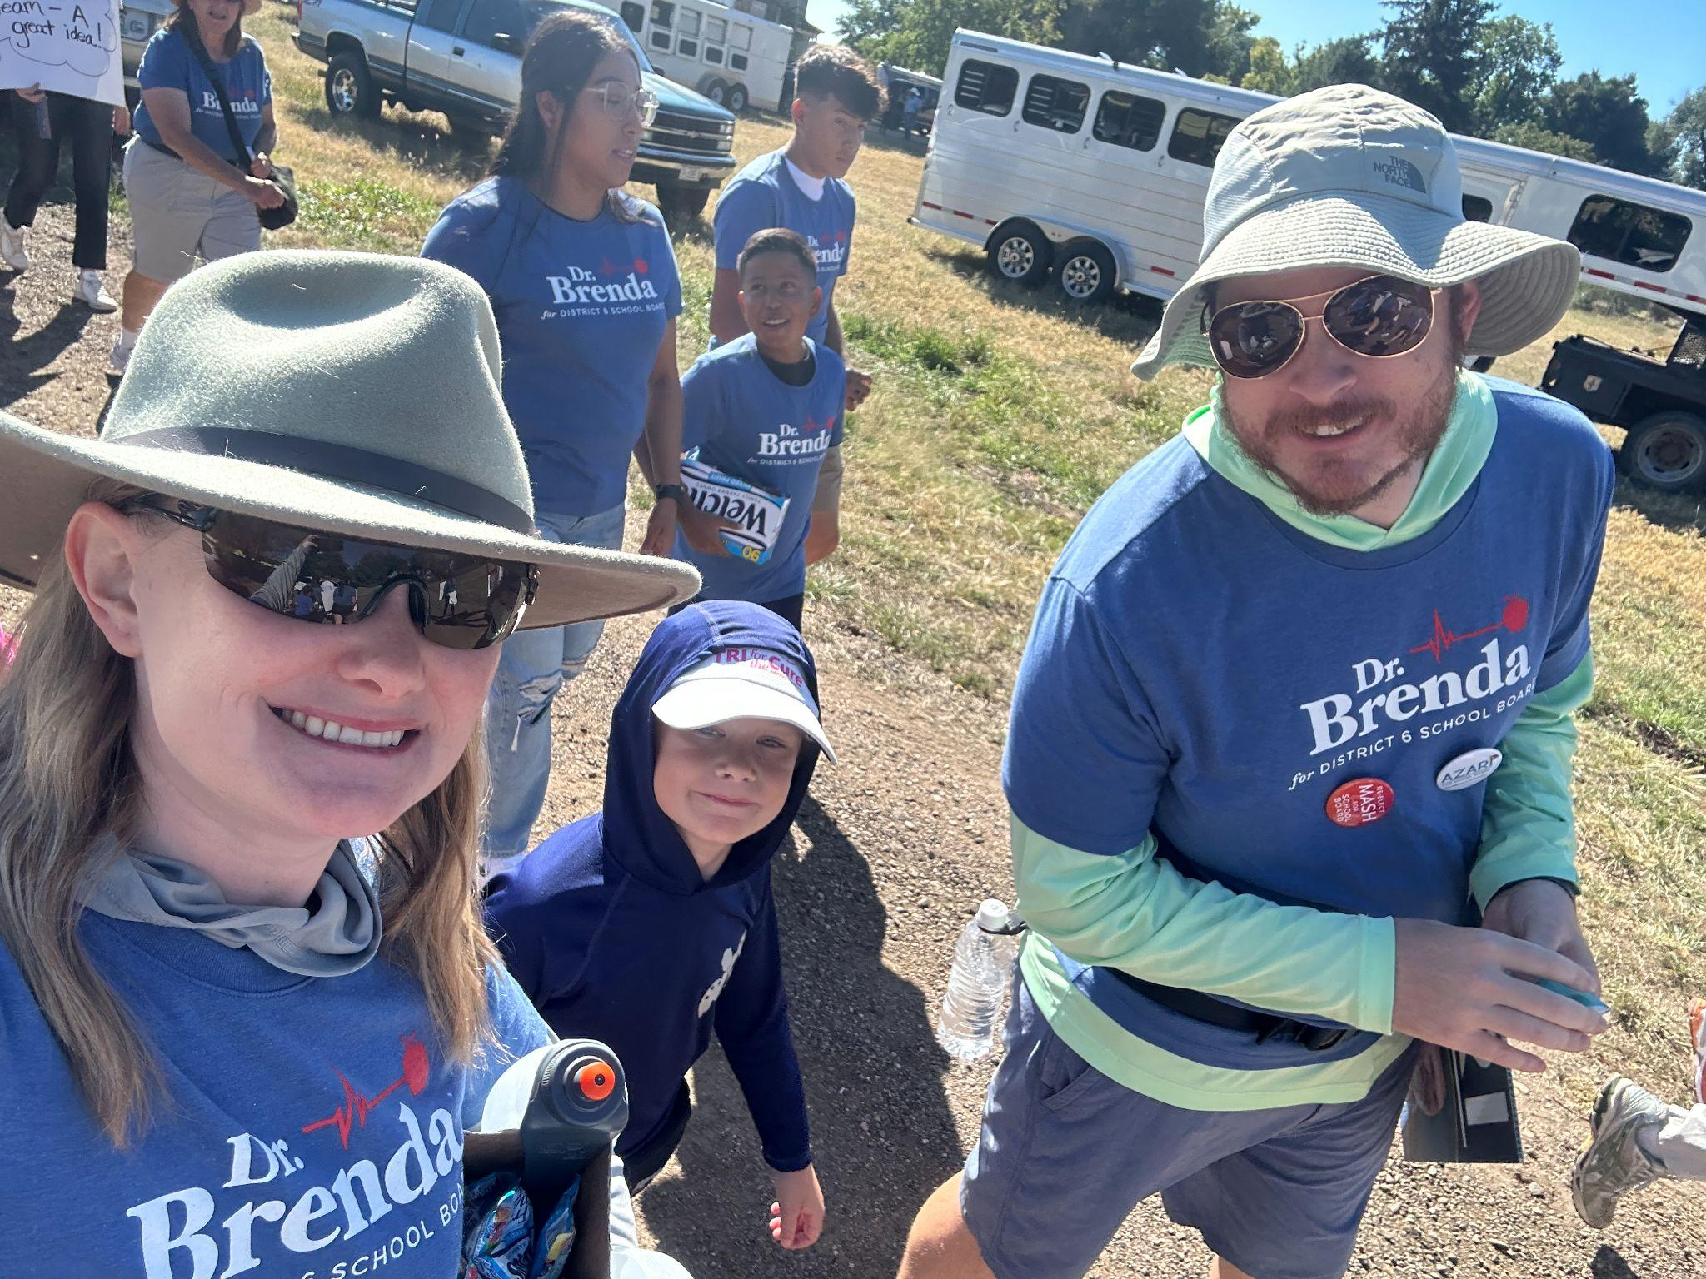
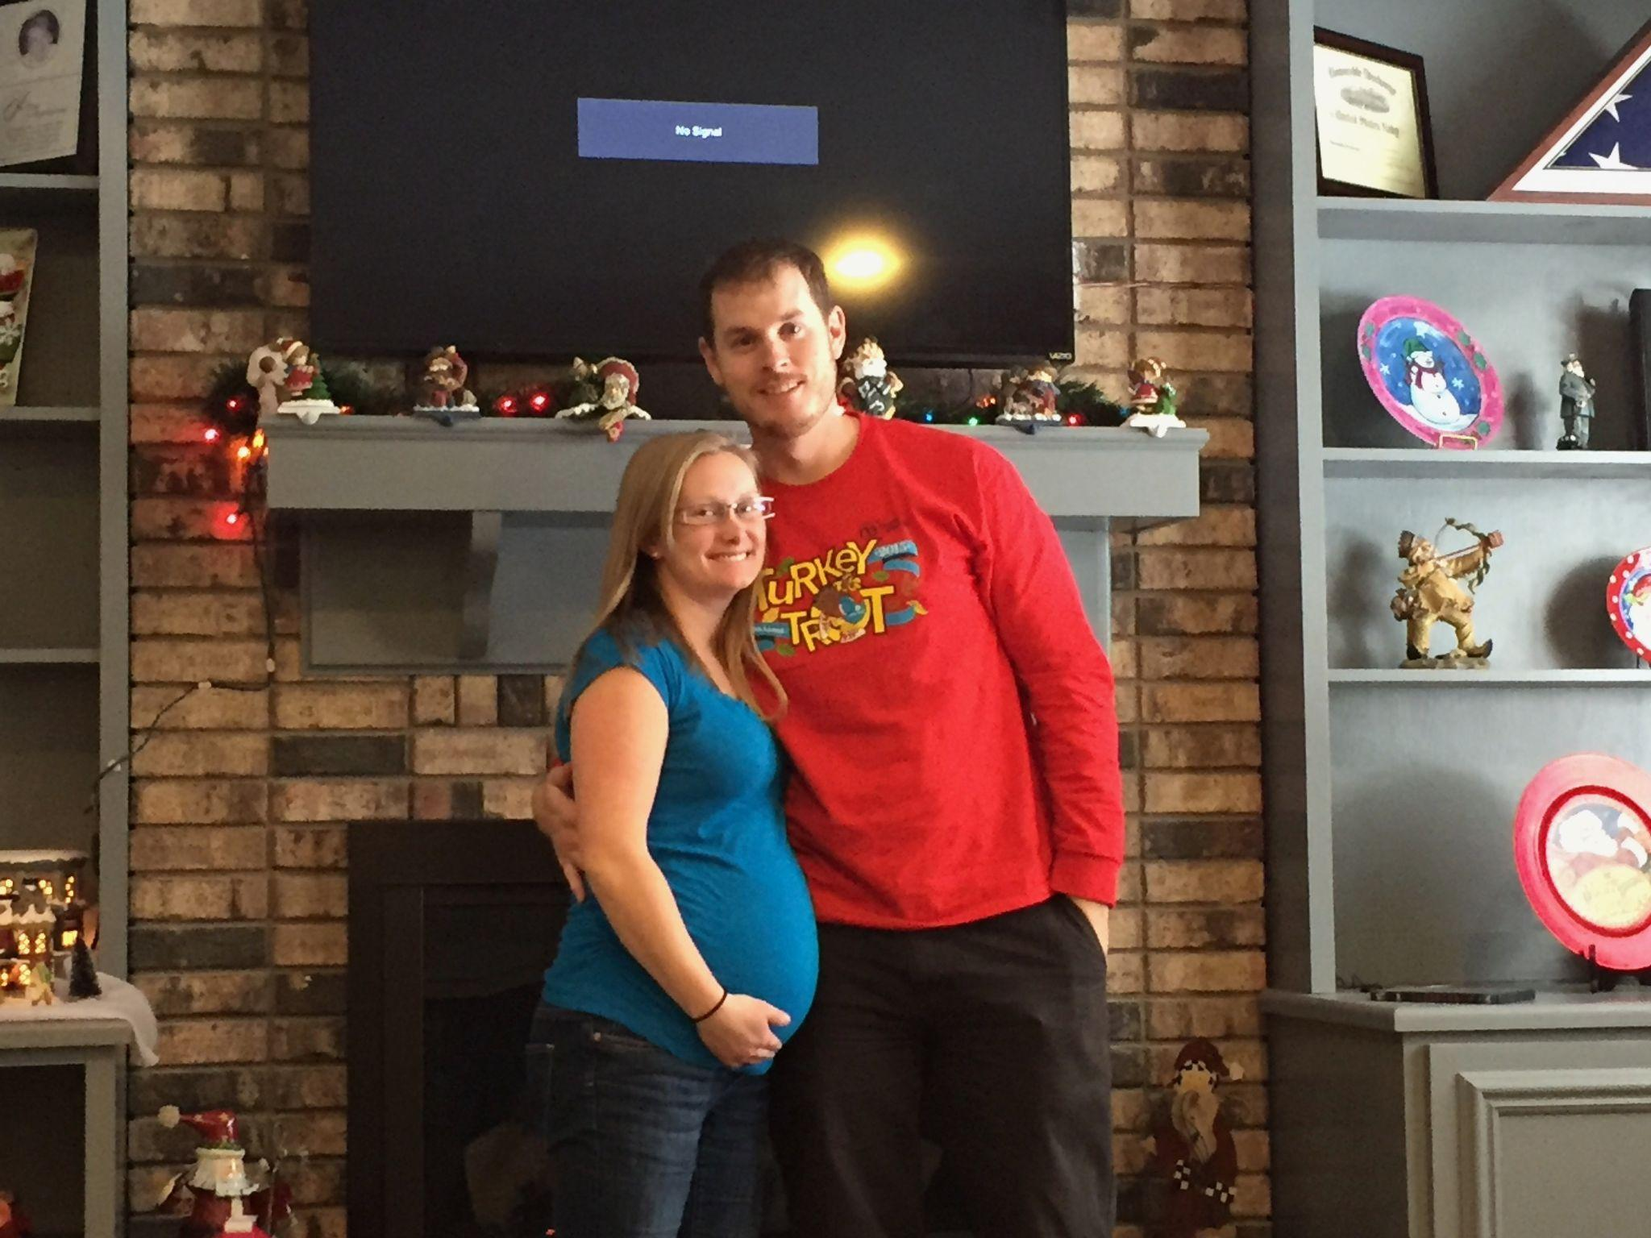
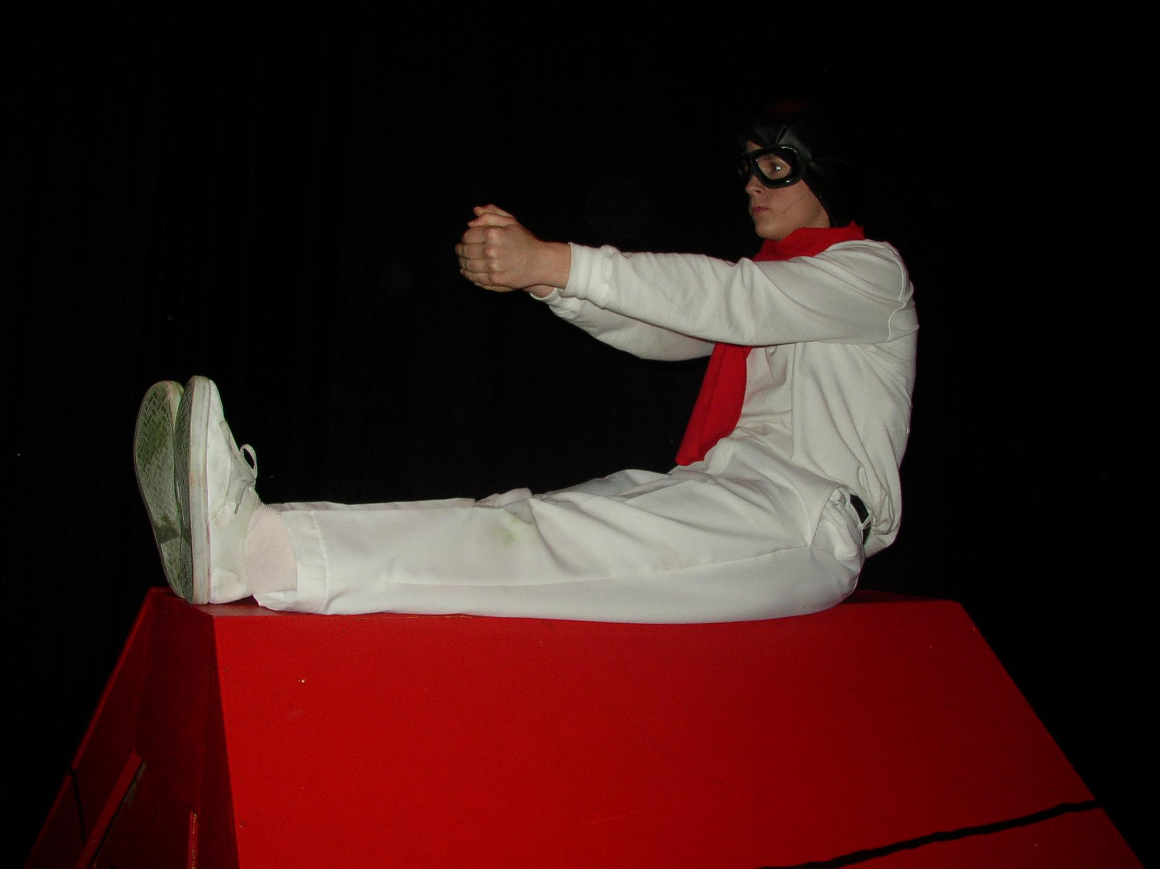
Nate Fairchild
(he/him/his)
Language Arts/History Teacher (8th Grade)
K-12 Certified: ELA/SS/Elem. Ed.
M.A.: Leadership
Graduate Certificate: (Principal)
B.A. Religion
School Based Equity Facilitator
Part Time Blacksmith

Slide 8
Widening the Window
FAMILY BOOK CLUB
Grant funded, gifted book bag
3 children's picture books, 1 adult book
Monthly commitment
An hour and a half-long program
20-minute family storytime featuring one diverse picture book focused on three themes over the 4-month period
60-minute theme appropriate craft / adult discussion focused on segments of the adult NF
Image compliments https://tenor.com/view/open-fenster-offen-window-dream-gif-23003829
Notes:
3 min
Carolyn
Here are the bare bones...
Unique family book club that has an EDI Equity Diversity and Inclusion focus with the intention to encourage thoughtful and courageous community conversation about diversity, race, and racialized trauma. It is grant funded and the book bags are gifted to the participants.10 book bags created: 8 gifted to participants, 2 absorbed into our collection for circulation
The book bag consists of three children’s picture books and one adult-reading-level non-fiction book.
This series requires a 4-month commitment, and we meet once a month.
We follow a specific model during our hour and a half-long program.
As folx arrive, they grab some refreshments.
Once they settle in, we began with a grounding exercise for families and facilitators, followed by an age-appropriate land acknowledgement.
We provide a 20-minute family storytime featuring one of the diverse children’s picture books from the bag. The picture books were chosen based on a specific theme.
For first year participants the three themes were: 1) observation, 2) empathy, and 3) loving-kindness. During the storytime, librarians model how to talk about diversity, inclusion, race, racism, and equality in age-appropriate ways with preschoolers and school-aged children (up to 8-yrs of age), parents, and caretakers.
After the storytime, we have a quick bio break and then the children participate in a theme-appropriate crafting activity three themes over the three-month period: 1) observation, 2) empathy, and 3) loving-kindness. Librarians will model how to talk about diversity, inclusion, race, racism, and equality in age-appropriate ways with preschoolers, school-aged children (up to 8-yrs of age), parents, and caretakers. Following the story time the children participate in a theme-appropriate crafting activity while the adults engage in adult conversation.
To assist with the adult EDI segment, HPLD partnered with D6 and employed two trained facilitators to direct the conversation focusing on certain segments of the adult non-fiction book, My Grandmother’s Hands by Reesma Menakem. Most of the time that happened, but sometimes it didn’t.
After the sessions, our PopUp or Bookmobile was available with heme-appropriate resources for check-outs.
Throughout the month, weekly prompts for self-regulation will be offered to the family members via email.

Slide 9


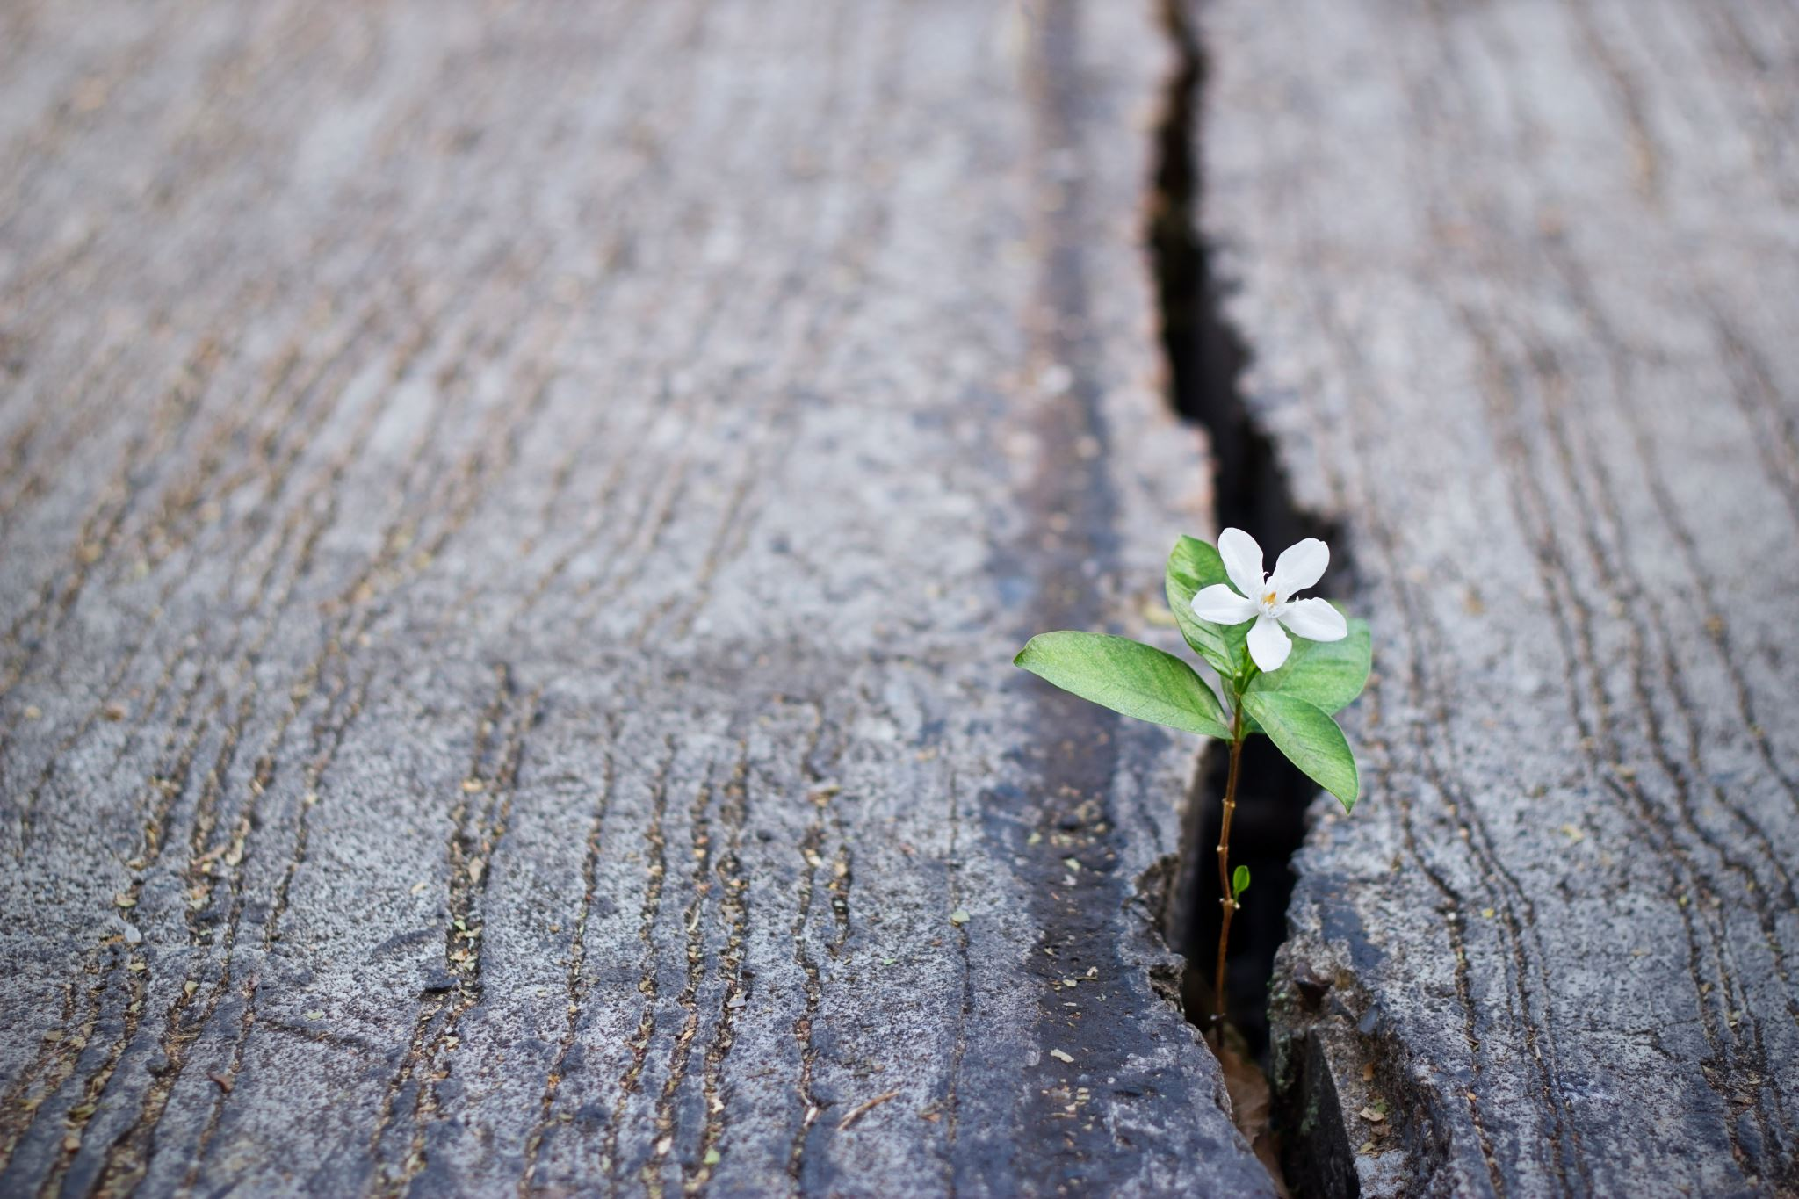

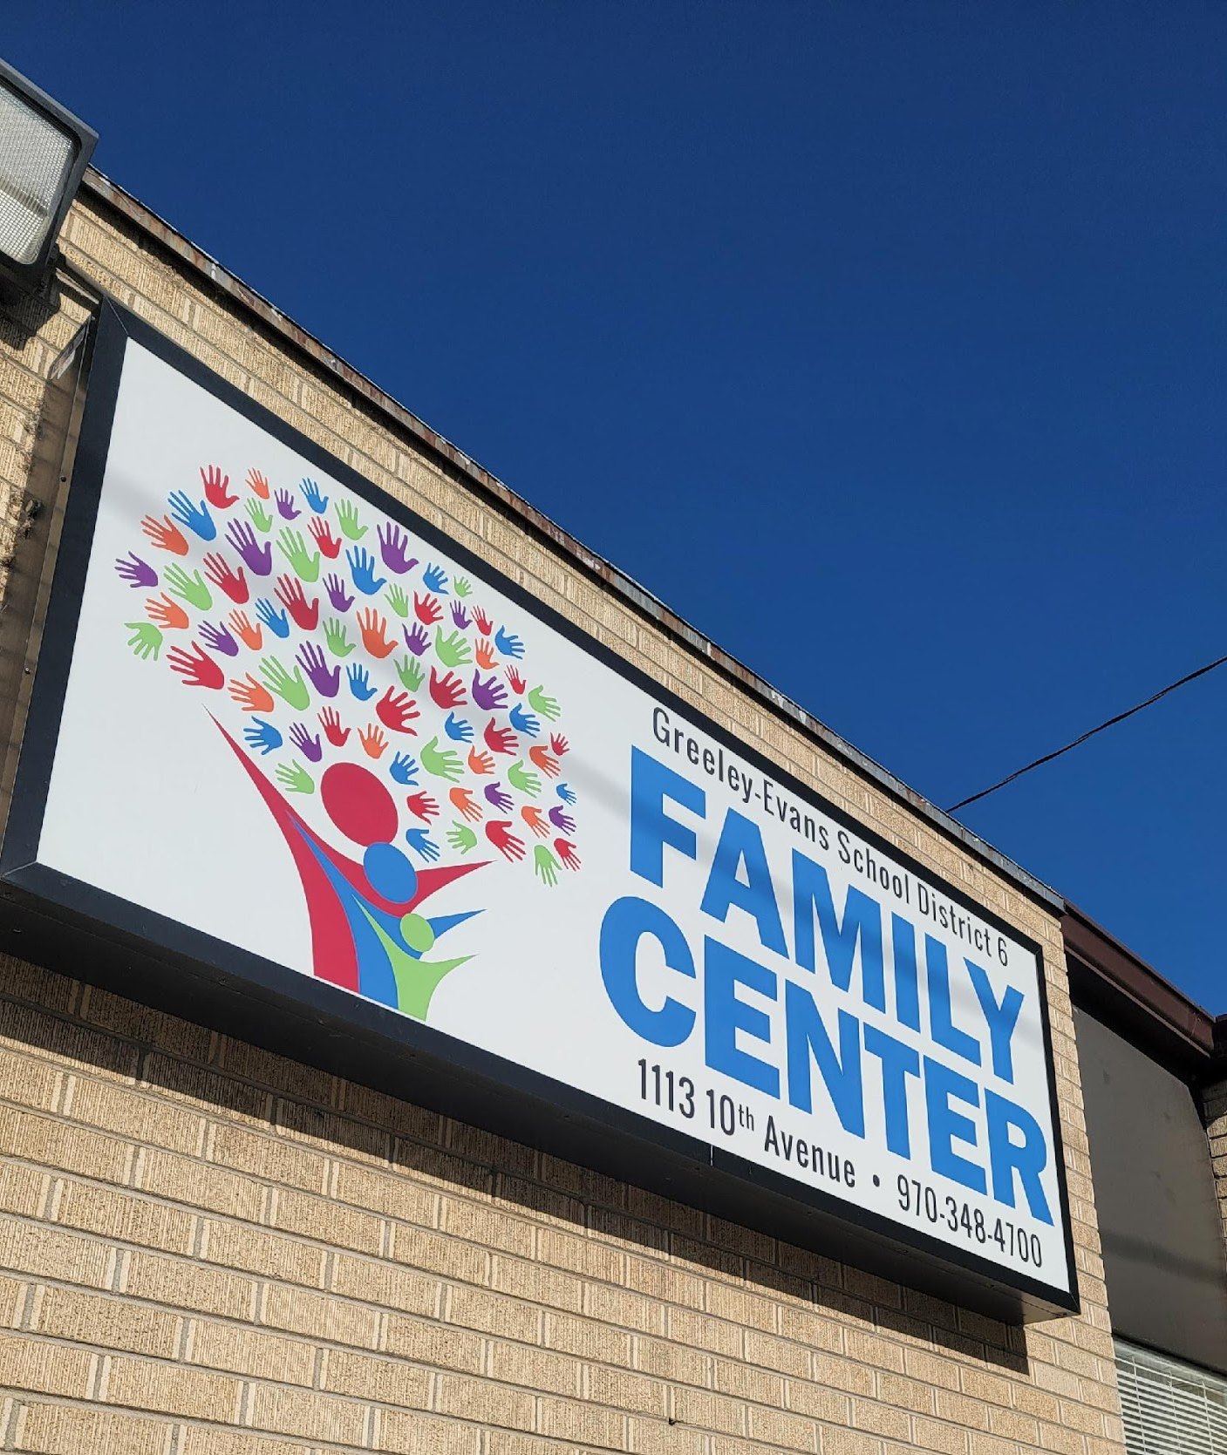

Timeline
Notes:
10 min
Carolyn

Slide 10
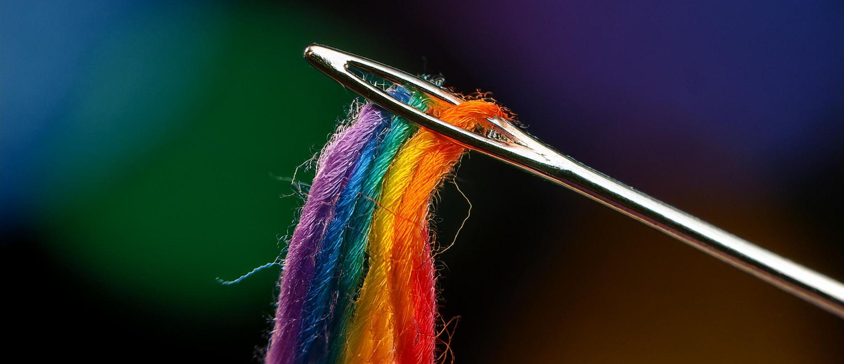
Marketing
It’s important to navigate EDI work in a way that is sensitive to the current culture of your organization.
The most important thing is for the work to continue.
Notes:
2 min
Nate
Draft to Jesse to provide feedback
Boggled down with wordsmithing and words are important, both things are true
Social Justice means different things to different people
Comfortable vs agreed upon definitions
Be clever = talk about the program without the trigger phrases.

Slide 11

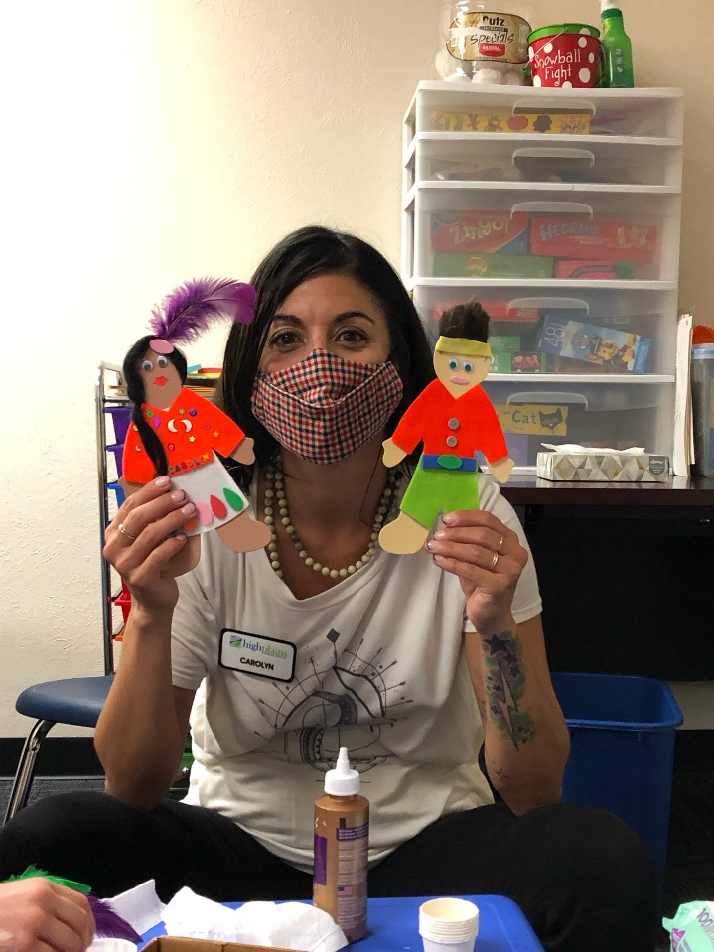
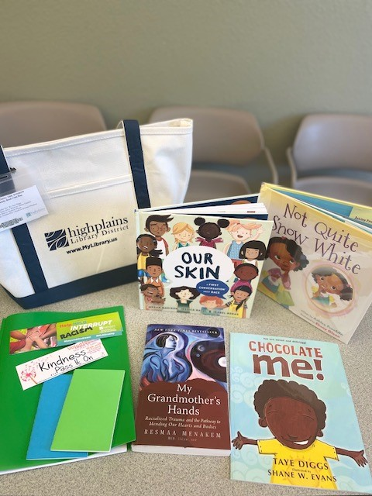
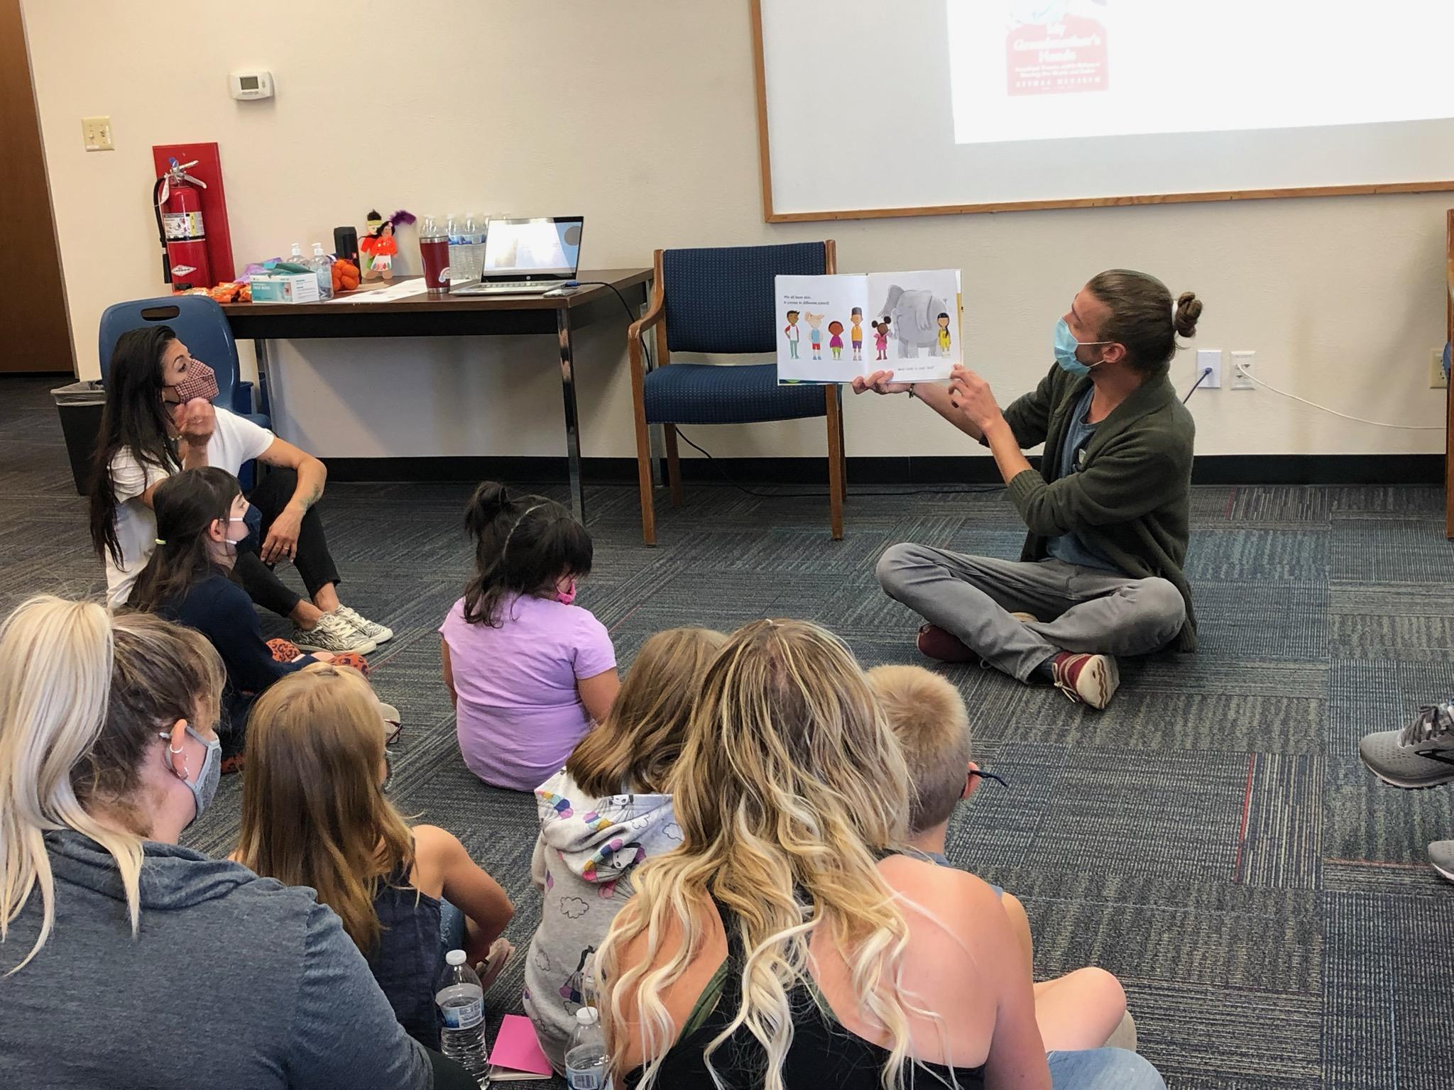
WtW 2021
Observation, Empathy, & Loving-Kindness
Notes:
5 min
Carolyn

Slide 12
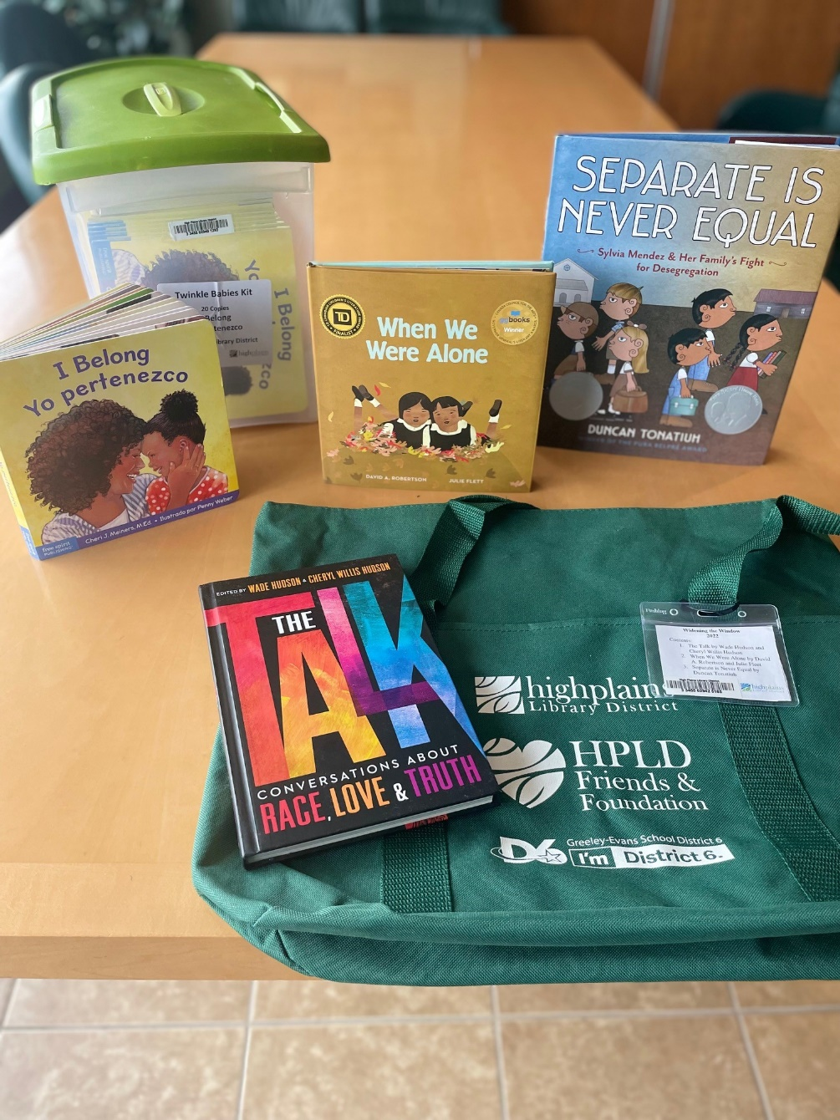
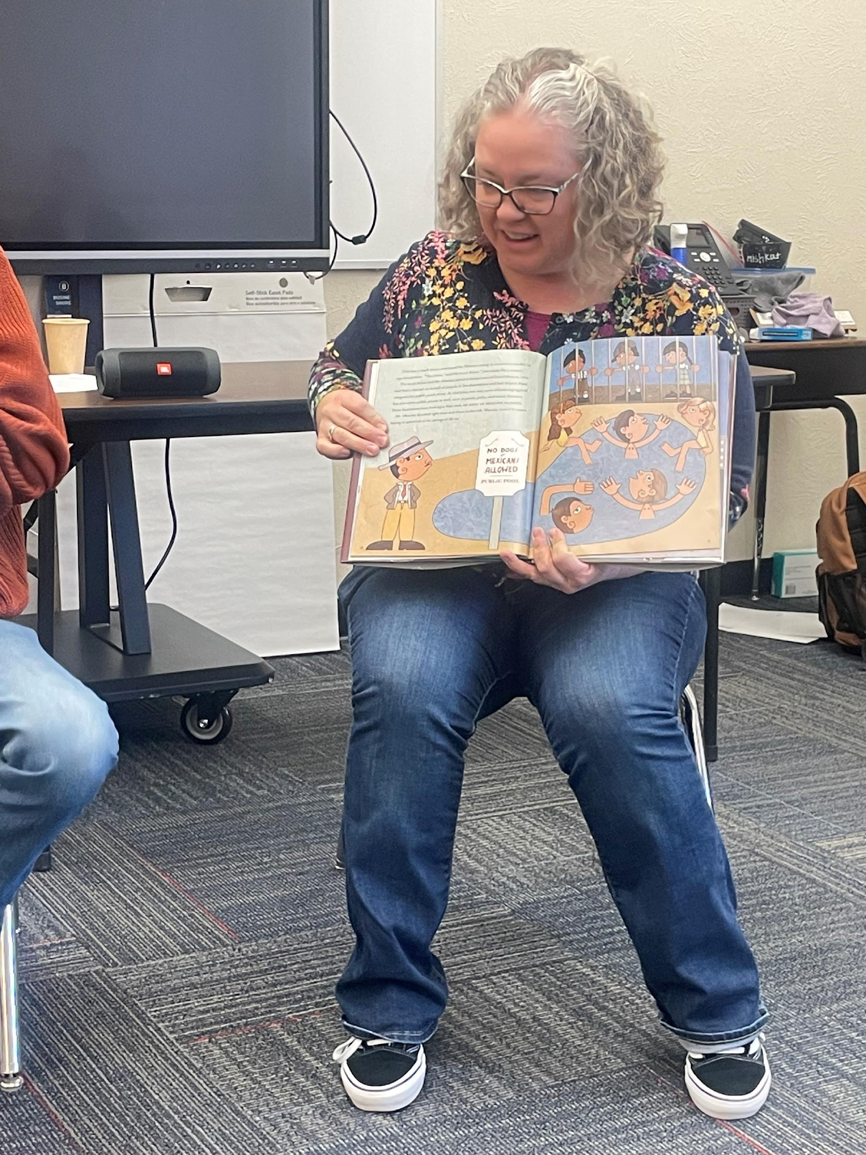
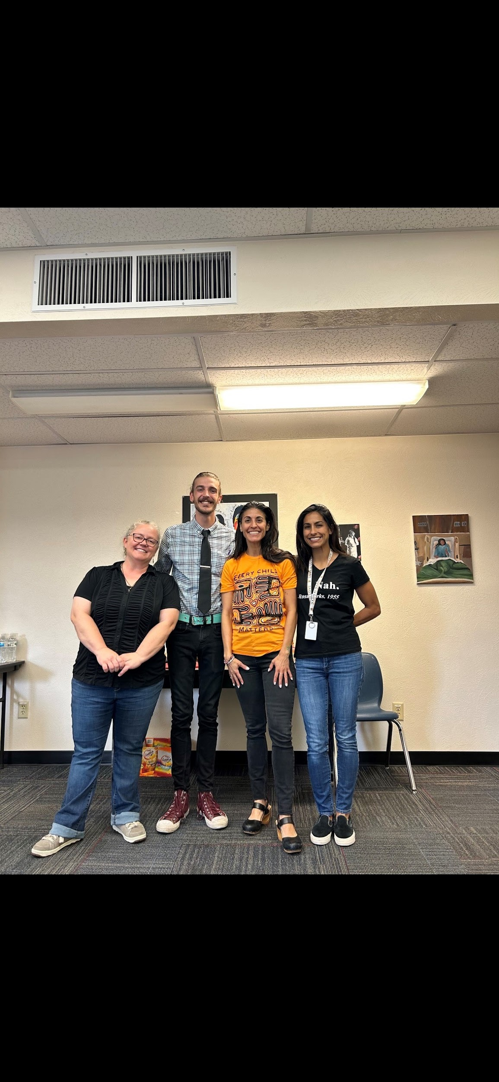
WtW 2022
Notes:
Bridget & Carolyn
5 min

Slide 13
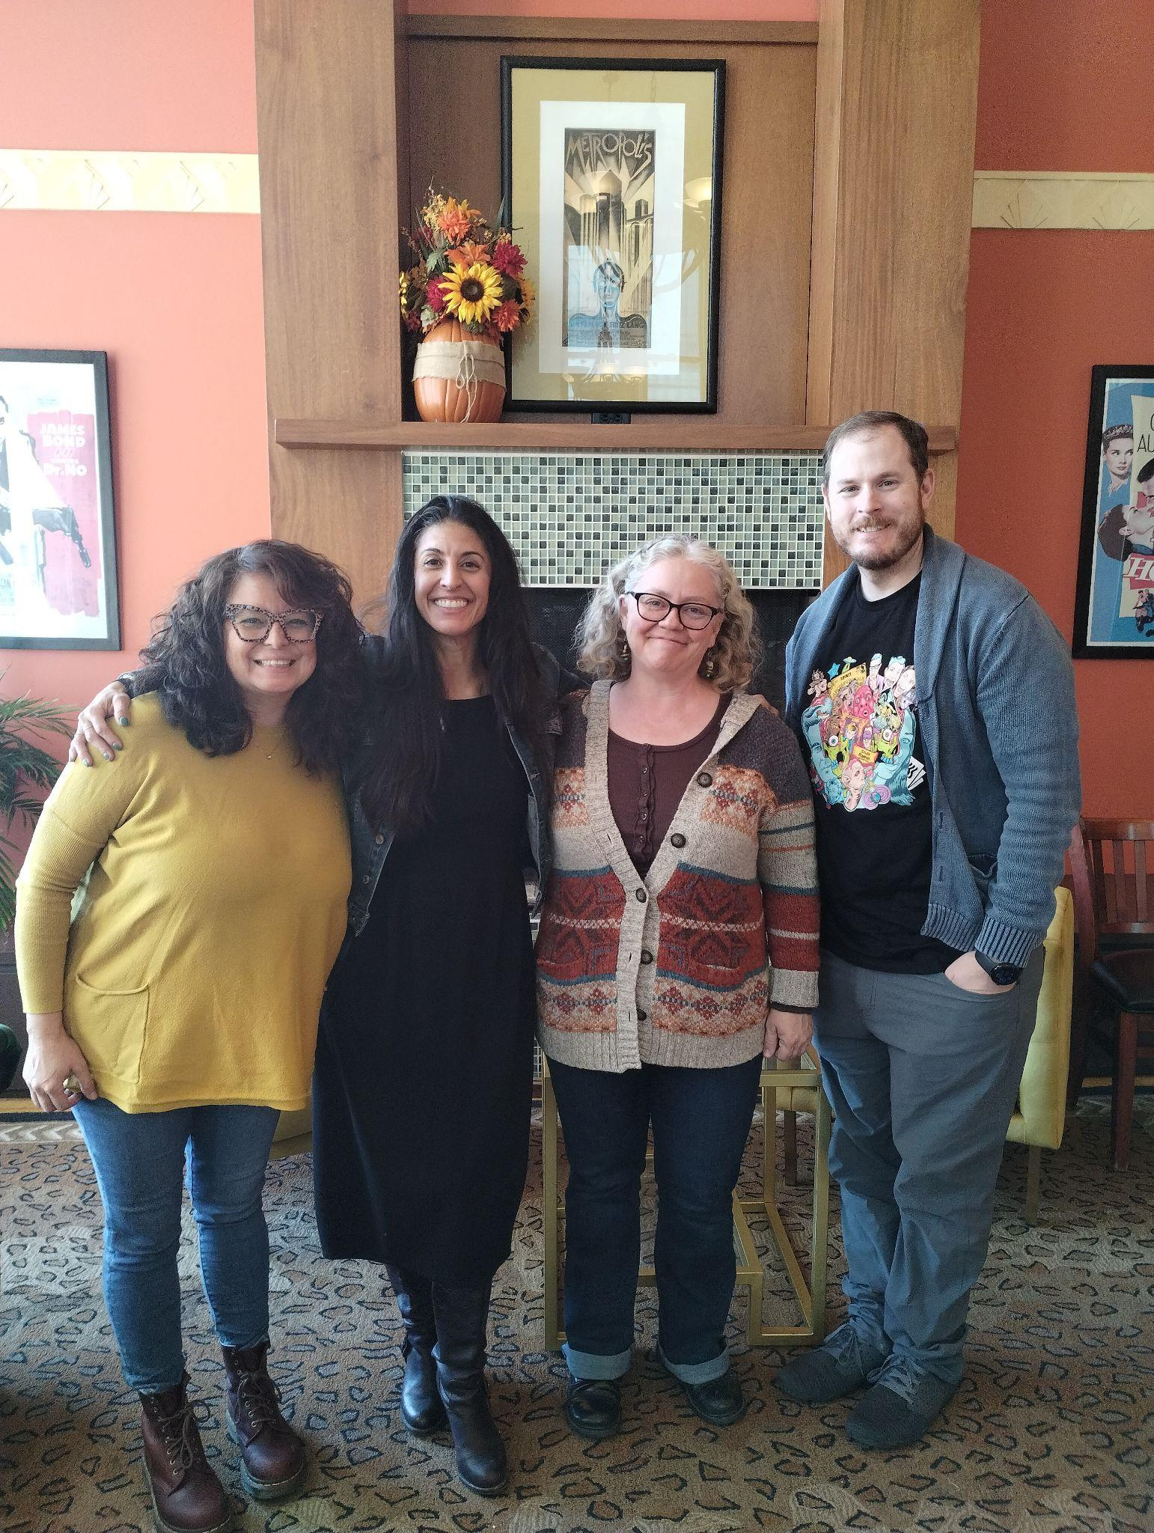
2024 Themes
Our 2024 Team of Facilitators
Veronica Lucero, Carolyn Valencia, Bridget Parker, and Nate Fairchild
Our Themes This Year
Humility
Accountability
Gratitude
Notes:
3 min
Veronica
took a year off, personnel changes, new location, lost our building with D6, rented a space in the community

Slide 14

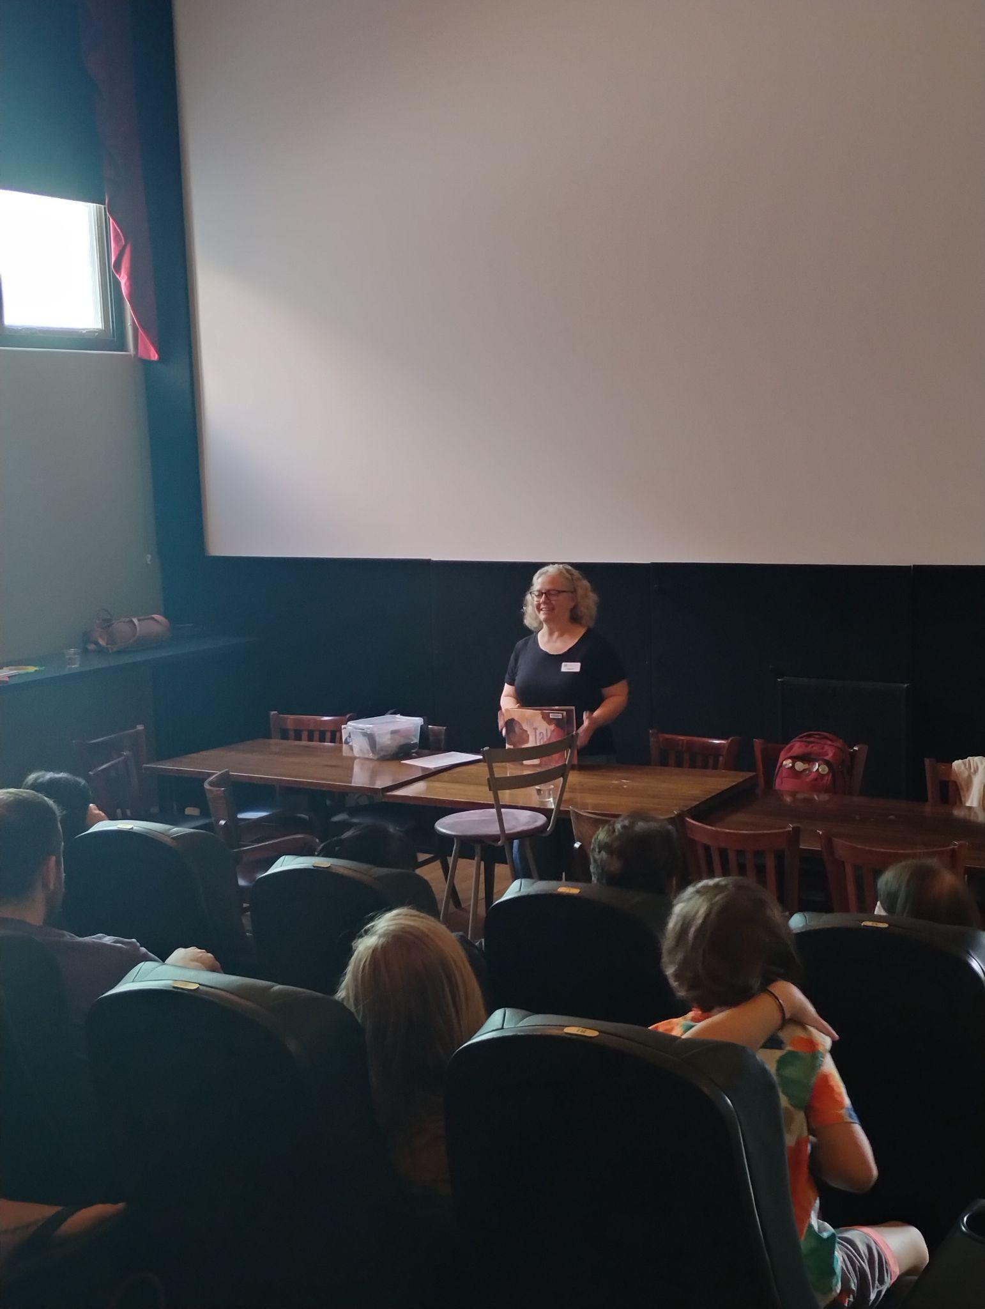

Theme: accountability
Topic: implicit bias
Family Storytime
The Talk
Written by Alicia D. Williams
Illustrated by Briana Mukodiri Uchendu
Notes:
3 min
Bridget

Slide 15
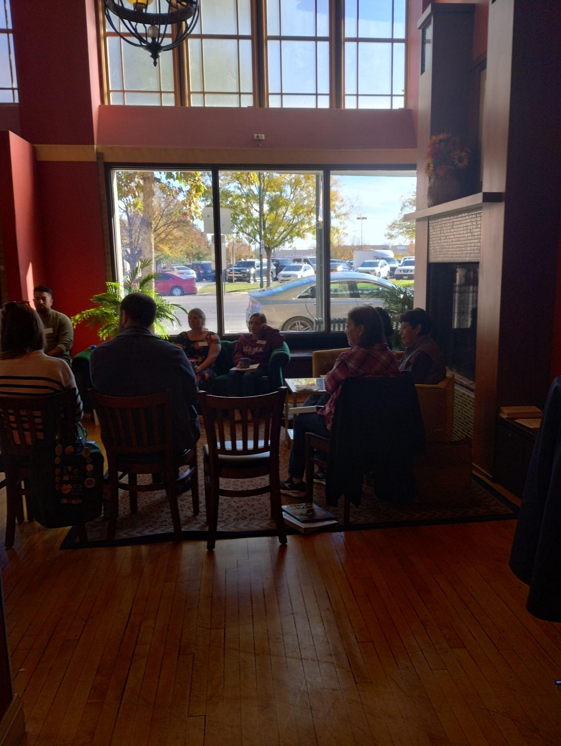
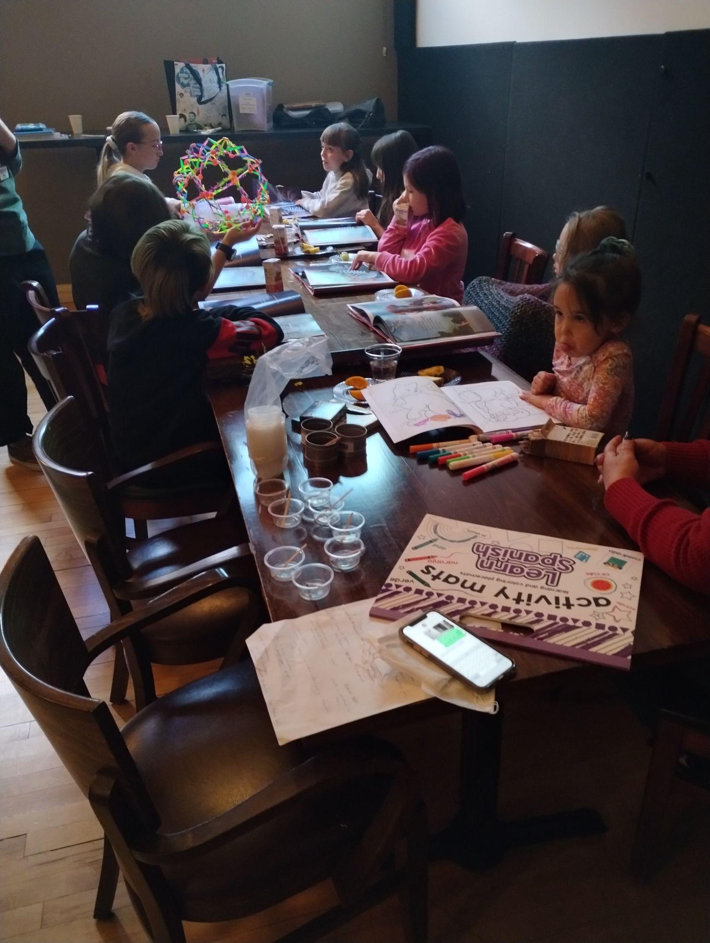
Examples
Notes:
2 min
Carolyn

Slide 16
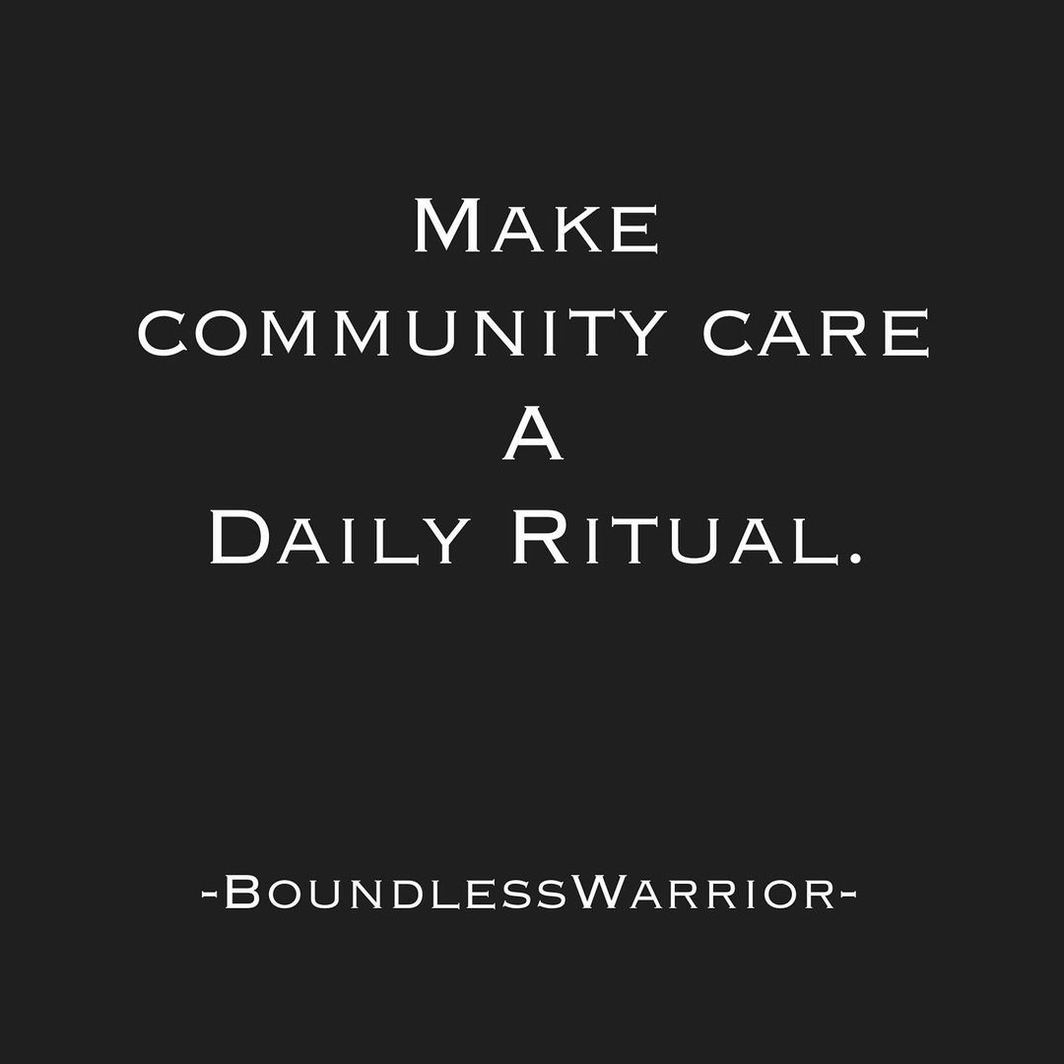
The process...
Notes:
Nate
2 min

Slide 17
Best Practices in EDI Facilitation
Guilt is not an effective change strategy.
Facilitators must model the participation they want.
“Speak the truth and shame the devil.” (The devil being oppressive systems…)
Focus on equity of voice.
Notes:
Nate
2 min

Slide 18
Best Practices in EDI Facilitation
Bring no ego, take no offense.
Your job is not to argue, but to redirect to more productive conversations.
People change their own minds, you don’t have the power to do that.
Notes:
Nate
2 min

Slide 19
Best Practices in EDI Facilitation
“Build the container”
Lift experiences in the room (yours too)
Challenge deficit language, and maintain a safe learning space
Know when to use strategies for participants dominating conversations, challenging concepts, or exhibiting destructive or disrespectful behavior
Notes:
Veronica
2 min
internalize norms, objectives, and agendas through activities encouraging interpersonal interaction, self-reflection, and community discussion
when to use strategies for participants dominating conversations, challenging concepts, or exhibiting destructive or disrespectful
the organizational processes for supporting intervention; use your resources.
your own biases.
detours (https://www.racialequitytools.org/resourcefiles/olson.pdf)

Slide 20
Best Practices in EDI Facilitation
Review and reflect on norms and own your accountability to group norms
Actively listen to comments and concerns and respond in a way that encourages self-reflection and learning by participants
Notes:
Veronica
2 min
internalize norms, objectives, and agendas through activities encouraging interpersonal interaction, self-reflection, and community discussion
when to use strategies for participants dominating conversations, challenging concepts, or exhibiting destructive or disrespectful behaviors.
the organizational processes for supporting intervention; use your resources.
your own biases.
detours (https://www.racialequitytools.org/resourcefiles/olson.pdf)

Slide 21
Breakout Groups: Intent and Impact
Scenario 1: A participant shares a deeply personal experience about when a teacher wouldn’t let them use the restroom until they pronounced the word in a more “white” way. They ended up urinating on themselves because of it and they were humiliated. How would you make sure they continue to feel safe after this moment of vulnerability?
Scenario 2: A white, male participant refuses to accept the idea that white, male privilege exists. They are being very forceful in both their tone and language to the point of interrupting others. You can see others in the group are feeling uncomfortable. How would you handle this moment?
Notes:
Veronica
8 min
Set the intention for the small groups.

Slide 22
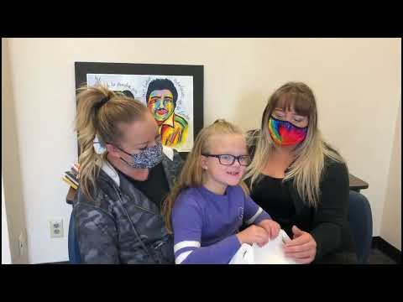
Patrons’ Testimonials
Notes:
Bridget
3 min

Slide 23
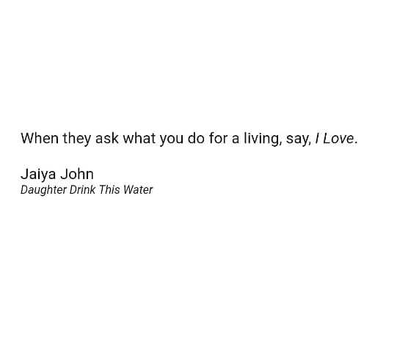
Questions?

