Slide 1
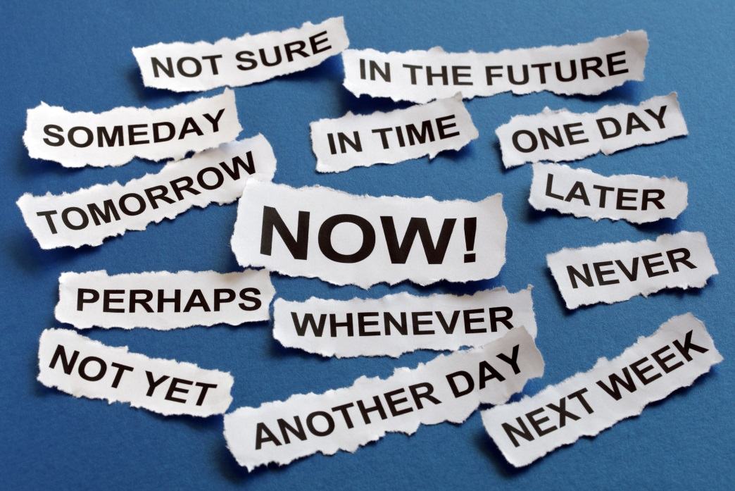

Getting Unstuck: the secret life of procrastinators
Jean Marie Heilig Christine Kreger
Fiscal Officer Professional Development Consultant
heilig_j@cde.state.co.us kreger_c@cde.state.co.us

Slide 2
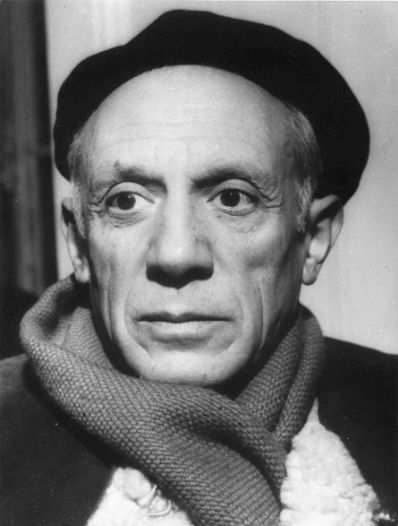
“Only put off until tomorrow what you are willing to die having left undone.”
- Pablo Picasso
Notes:
Jean

Slide 3
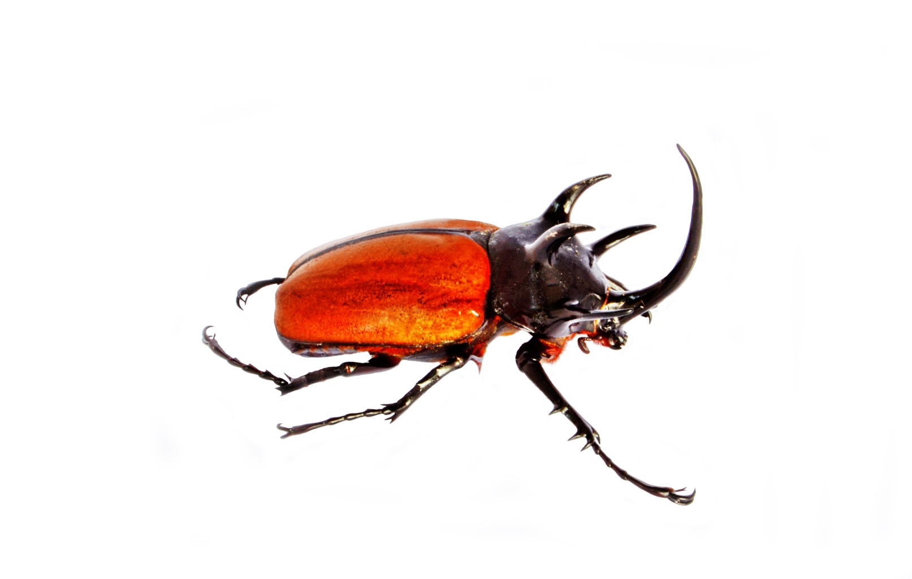
Eat an elephant beetle first thing
Mexico, Central America, and South American Rainforests
Notes:
Jean
Aim to “eat an elephant beetle” first thing, every day! Get those tasks that you find least pleasant out of the way early. This will give you the rest of the day to concentrate on work that you find more enjoyable.

Slide 4
Outcomes
Identify the triggers that cause you to procrastinate.
Walk away with strategies to help you overcome the habit.
Notes:
Jean

Slide 5
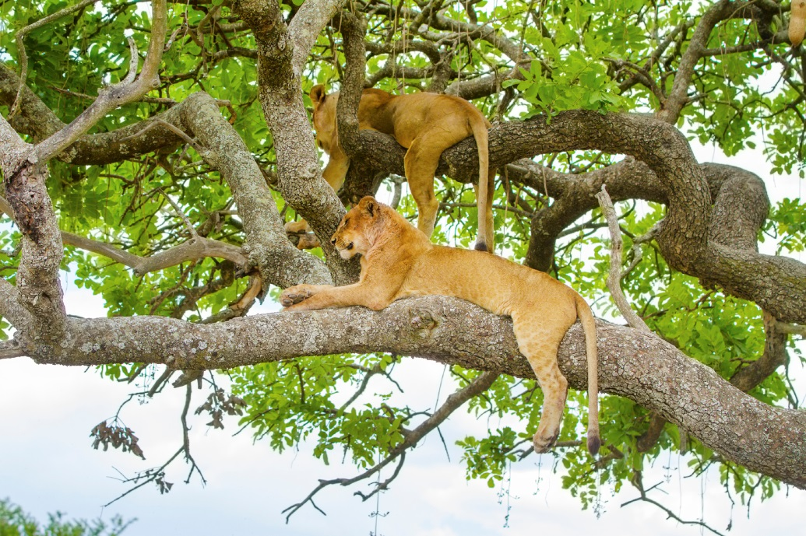
Procrastination vs Laziness
Procrastination is the habit of delaying an important task, usually by focusing on less urgent, more enjoyable, and easier activities instead.
It is different than laziness, which is the unwillingness to act.
Notes:
Jean
Procrastination is an active process- you choose to do something else instead of the task that you know you should be doing. In contract, laziness suggests apathy, inactivity and an unwillingness to do the act

Slide 6
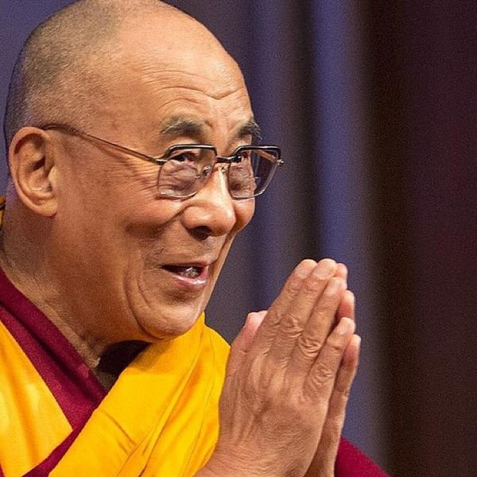
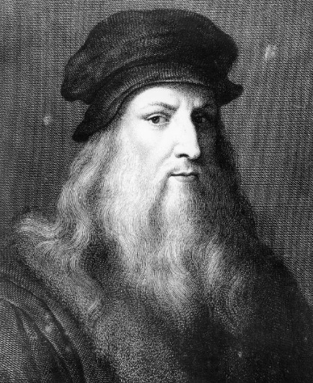
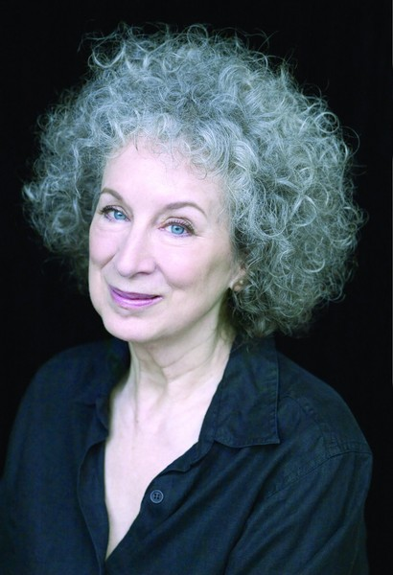
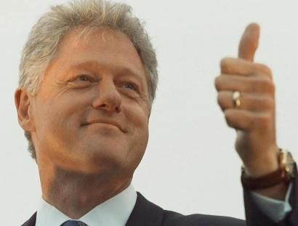
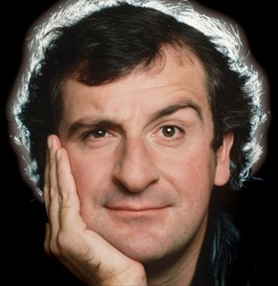
You’re in Good Company
“I love deadlines, I like the whooshing sound they make when they go by.”
-Douglas Adams
Notes:
Jean
Procrastination is a human condition. 95% of people admit to putting off work and one author argues the remaining 5% are lying!
Margaret Atwood- spends the morning procrastinating and worrying, and then plunges into a manuscript in a frenzy of anxiety around 3:00 pm
Leonardo Da Vinci- was easily distracted. His talents and energy were often wasted in doodles and unfinished projects (Mona Lisa took 16 yrs to complete),
Dalai Lama- as a student “Only in the face of a difficult challenge or an urgent deadline would I study and work without laziness”
Clinton-Al Gore said he was “punctually challenged” Hillary “maddening to try to keep him on any kind of schedule”
Adams- Cups of tea, baths, and days in bed were his ways of putting it off. Required editors to lock him in a room and scowl at him until he produced.

Slide 7
Why Do We Care?
Guilt/ Shame
Stress
Poor Quality Work
Restrict Potential
Undermine Your Career
Disrupt Teamwork
Reduce Morale
Job Loss
Reduced Productivity
Notes:
Jean

Slide 8
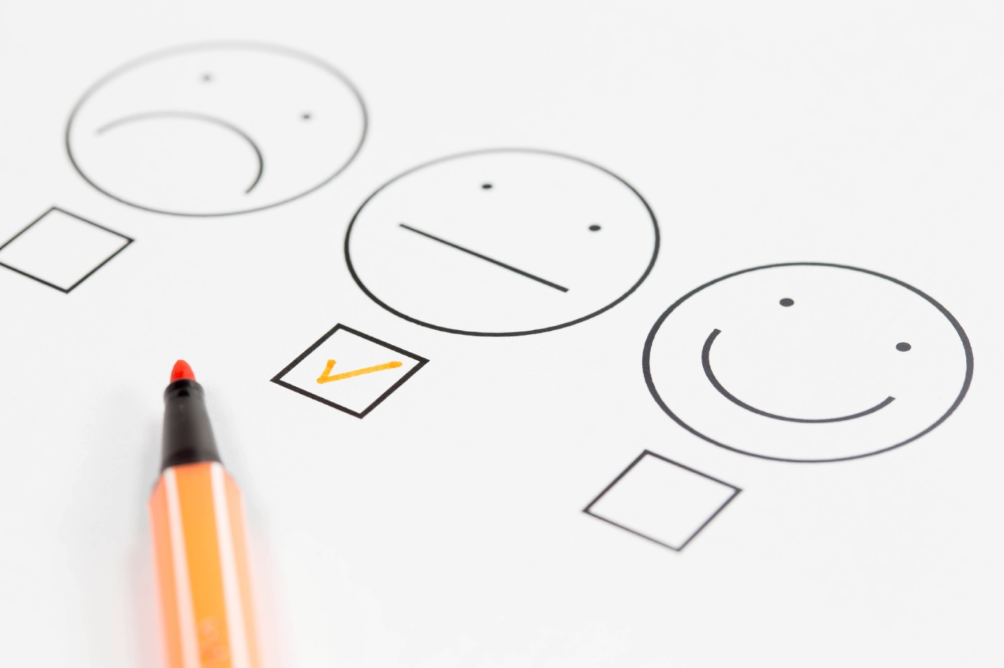
Are You a Procrastinator?
Notes:
Christine – 5 minutes
Now that we know the costs of procrastination, lets take a quick procrastination quiz!
Turn to page 3 of your packet, and take a few minutes to complete the quiz from MindTools. For each statement, mark the column that most applies by indicating the extent to which each statement is characteristic or uncharacteristic of you.
For now just rate yourself for each question, and we will score it when you are done. Go with your gut, we will give you about 4-5 minutes. (15 sec per question)

Slide 9
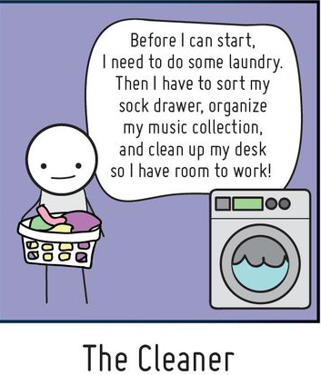
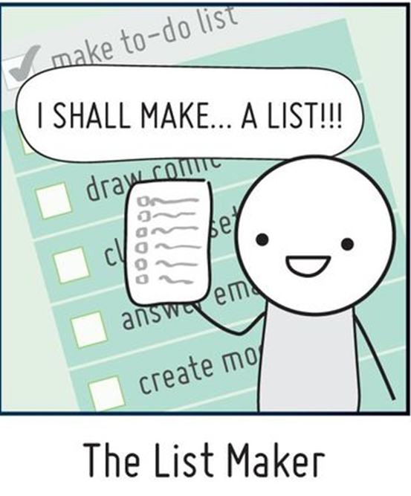
How We Procrastinate!
A Field Guide to Procrastinators- twenty pixels
Notes:
Jean – the cleaner
CK – The List maker – 1 minute
Ok…so I am a list maker. For me this goes beyond getting organized, but is basically a self soothing mechanism for making sure that I can get everything done in the time/space continuum we live in.
Who else is a list maker and loves crossing things off? We love the dopamine hit…right?
So, these are 2 of my lists…

Slide 10
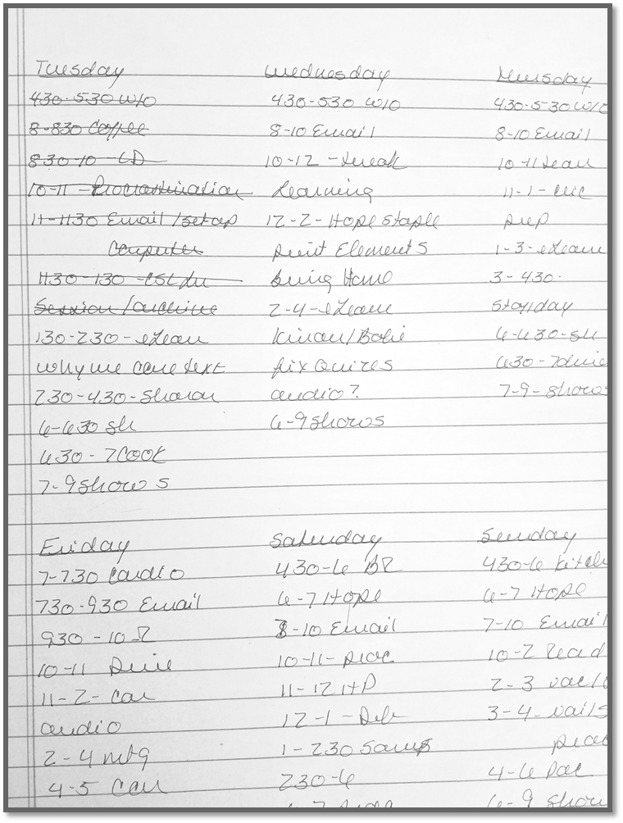
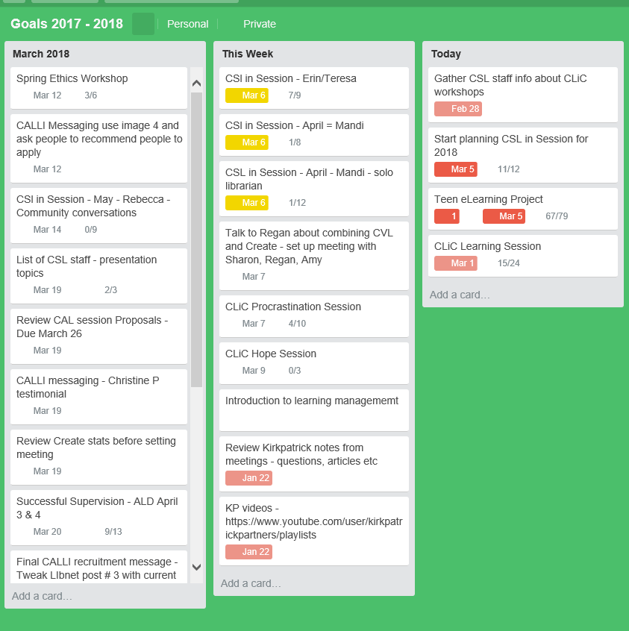
The List Maker
Notes:
Christine – 1 minute
On the left is Trello, the free to-do list software I use. On the right is a handwritten list that I make at the beginning of the week…my days by hour.
Where it gets out of hand is that when I get anxious, or don’t want to start a project, I need to fiddle with the lists, reset due dates, rewrite the list. Basically spending time listing when I should be working on projects.

Slide 11
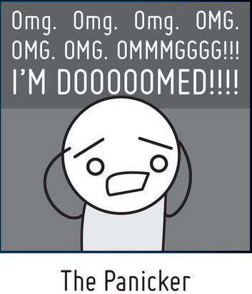
How Do You Procrastinate?
A Field Guide to Procrastinators- twenty pixels
Notes:
Christine – 30 seconds
So, I think most of us can relate to this guy…the panicker! Who are my panickers?

Slide 12
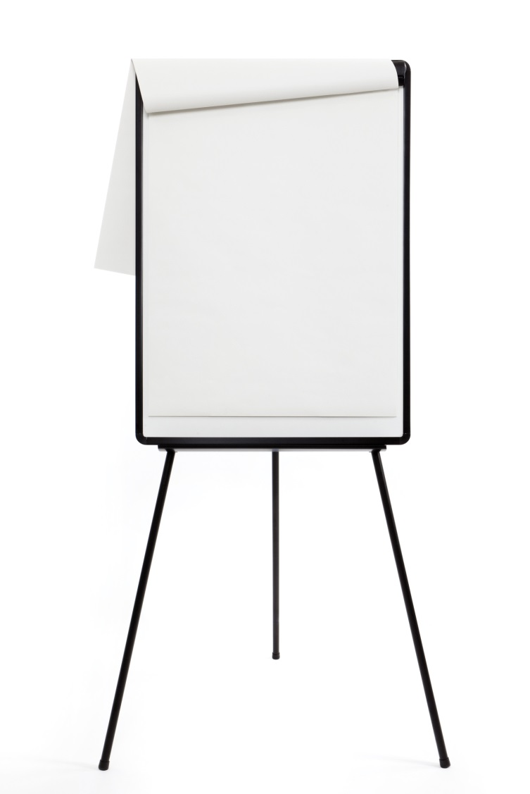
How else Do You Procrastinate?
Notes:
Christine – 3 minutes
But, what other ways to do you procrastinate?

Slide 13

Why Do We Procrastinate?
Because
We Can!
Notes:
Jean- The majority of the time things still get done and no real consequence is suffered. Students- cramming at the last minute, Adults- changing our minds and deciding not to do it after all, Work- another member of the team gets worried and picks up the slack. Home- work around chores that are not finished or count on someone else to do them. Late fee on our credit card bill, so what? We pay it and manage w/o the extra money.
We live in a world of extra chances- IRS, alerts and advance warnings

Slide 14
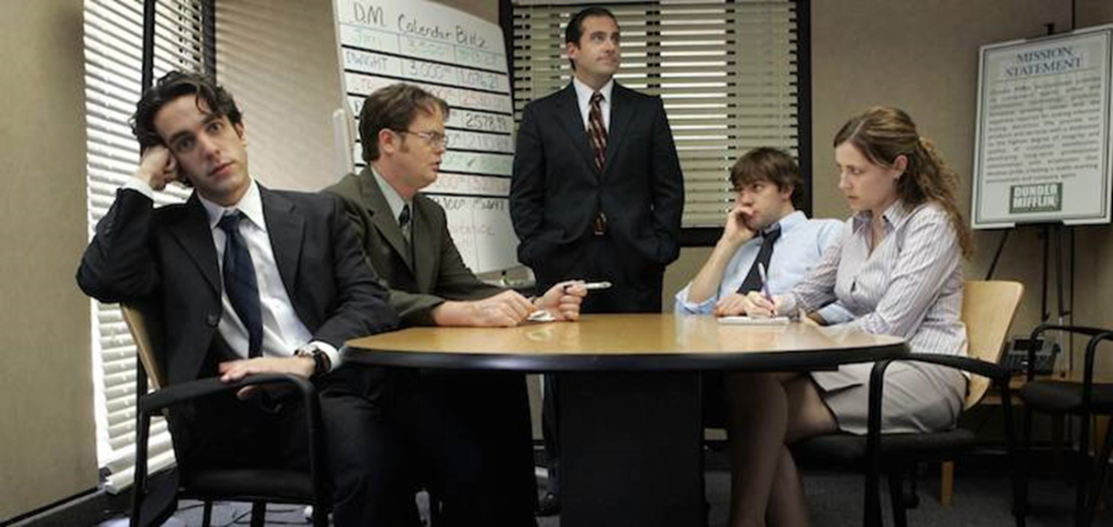


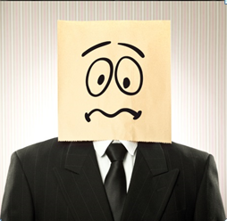

Why Do We Procrastinate?
Worrier
Easily Distracted
Defier
Crises Maker
Lack of Confidence
Notes:
Jean- Worrier: task seems risky or unnecessary, stay in comfort zone. Defier- task seems unfair or unnecessary use of time. Crises: works best under pressure enjoys working under deadline on a task that might otherwise seem boring.

Slide 15

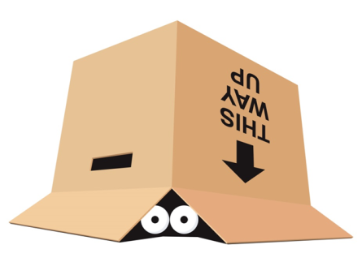
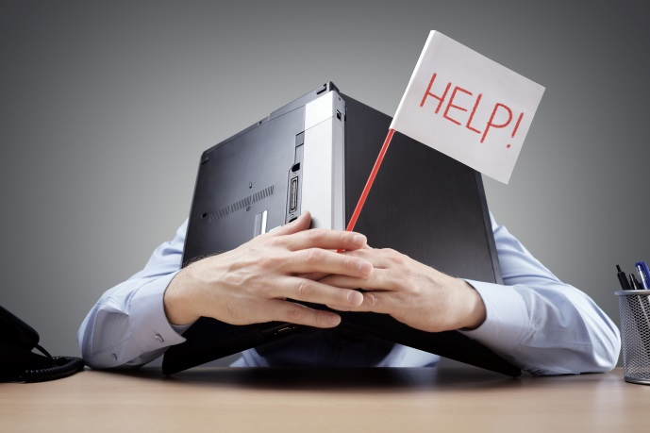
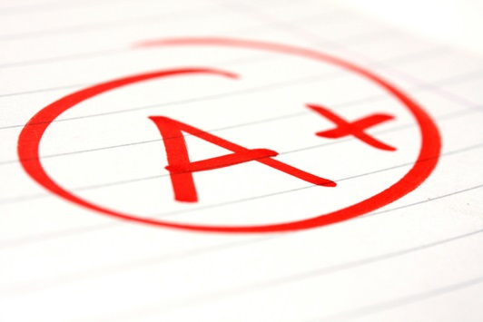

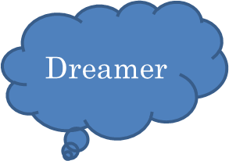
Why Do We Procrastinate? More examples
Dread
Medical
Overwhelmed
Creatively
Blocked
Perfectionist
Notes:
Jean- Health: ADHD, OCD, anxiety, depression. Overwhelmed: You have doubts about your ability and are worried about failing, so you put it off and seek comfort in doing work that you know you are capable of completing.
Dreamer: abstract thought are more pleasant to think about than real-life actions that need to be taken. Perfectionists: they would rather avoid doing a task that they don’t feel they have the skills to do, than do it imperfectly.

Slide 16
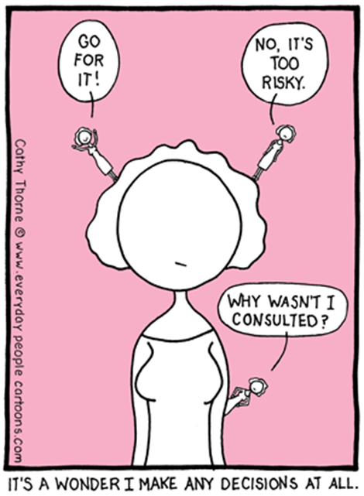
Why Do We Procrastinate? Decision making
Notes:
Jean- poor decision making- if you can’t decide what to do, you’ll likely put off taking action in case you do the wrong thing.

Slide 17

Create Your Project List
Project | Needed by | Impact or Consequence
1.
2.
3.
www.mindtools.com
Notes:
Christine – 5 minutes
So, as part of this session, we said that we would help you identify strategies for overcoming procrastination. One way is to develop an action plan. We are going to walk you through the steps of a solid action plan as we go through the rest of the session.
The first part is creating a project list (one that is better that my procrastination lists)
On page 5 of your packet, you will see a chart like this.
So, to start I want you to think of 5 things on your work to-do list that have been there for more than a week. For each of these, write down the project, the deadline, and the impact of finishing and/or the consequences of not finishing the project.
Reprimands
Disappointing someone
Lost opportunity
Stress…
And we will come back to this in a bit…

Slide 18


What Makes a Task Procrastination Worthy?
Boring
Frustrating
Difficult
Ambiguous
Unstructured
Lacking a Personal Meaning
Not Intrinsically Rewarding
Notes:
Jean- Not intrinsically rewarding- you don’t find the process fun. Ambiguous- open to or having more than one interpretation, having a double meaning, unclear

Slide 19
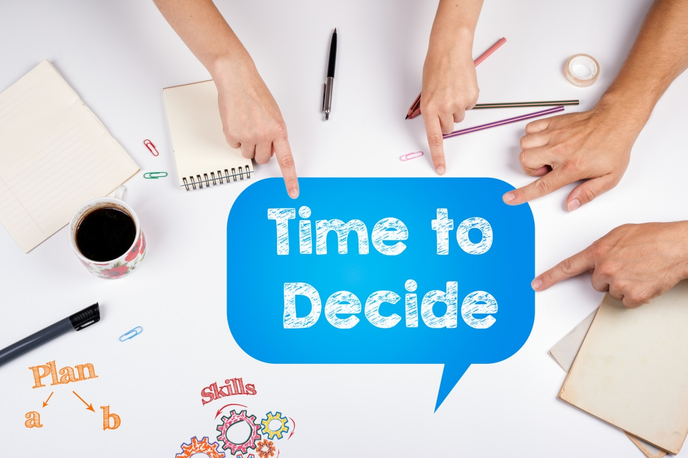
Resisting the Pull of Procrastination
High vs. Low Value Projects
Notes:
Christine – 3 minutes
So, we need to think about how to prioritize our work.
Lets go back to your project list on page 5.
Place a checkmark next to the projects that will have the greatest impact on your life. (and no, you cannot put a checkmark next to all of them).
Place a star next to items that you, and only you can complete.
Which items fit both of these categories? These are your high value projects, that you should not avoid.
When you know what work you REALLY should be working on, it becomes harder to justify putting them off. We will continue working on your action plan in just a moment.

Slide 20

Resisting the Pull of Procrastination - options
Motivate Yourself
Clean your desk
Disconnect
Email
Public Commitment
Accountability buddy
Social Media
Texting
Supplies
Resources
Organize space
Clear Your Space
Rephrase your internal dialog
Peer pressure works!
Minimize distractions
Notes:
Jean- Public Commitment: Telling people that we’re going to get something done can powerfully amplify the appeal of actually taking action, because our brain’s reward system is so highly responsive to our social standing. It matters greatly to us whether we’re respected by others- even by strangers. We don’t want to look foolish or lazy to other people. So by daring to say “I’ll send you the report by the end of the day” we add social benefits to following through on our promise- which can be just enough to nudge us to bite the bullet. Principle behind self help groups. Motivate Youself: rephrase your internal dialog. The phrases “need to” and “have to” imply that you have no choice in what you do. This can make you feel disempowered and might even result in self-sabotage. However, saying “I choose to” implies that you own a project, and can make you feel more in control of your workload.

Slide 21





Resisting the Pull of Procrastination – more options
Reward Yourself!
Scheduling
Prioritize goals
Confront the Downside of Inaction
Poor quality
Do Something to Get Started
Identify the first step
Reduced morale
Time bound tasks
Disrupt teamwork
Resistance levels
10 minutes
Notes:
Jean-Confront the downside of inaction- we’re strangely averse to properly evaluating the status quo. While we might weigh the pros and cons of doing something new, we far less often consider the pros and cons of not doing that thing. Known as omission bias, this often leads us to ignore some obvious benefits of getting stuff done. Suppose you’re repeatedly putting off the preparation you need to do for an upcoming meeting. You’re tempted by more exciting tasks, so you tell yourself you can do it tomorrow (or the day after). But force yourself to think about the downside of putting it off, and you realize that tomorrow will be too late to get hold of the input you really need from colleagues. If you get moving now, you have half a chance of reaching them in time- so finally, your gears creak into action.
Do something, anything to get started. Identify the very smallest first step, something that’s so easy that even your present-biased brain can see that the benefits outweigh the costs of effort. Work within your resistance level. When a task sets off procrastination triggers, we resist doing it. Let’s say you have to wade through a dense piece of research for an upcoming project. To find your resistance level, consider the effort you commit to that task along a sliding scale. For example, could you focus on reading for an hour? No, that period of time still seems unpleasant. What about 30 minutes? Shorten the amount of time until you find a period with which you’re no longer resistant to the task – and then do it.

Slide 22
Barriers & Breakthroughs
Break down tasks to reduce anxiety
Don’t allow “what if” thinking to take you out of action
Build your skills
Instead of “I can’t” say “I will”
Create an ideal work environment
Use distractions as rewards
Choose your battles and consider the consequences
Channel your rebellious side into a cause you care about
Set tighter interim deadlines
Get your adrenaline going with other activities
Notes:
Worrier
Defier
Crises Maker
Lack of Confidence
Easily distracted

Slide 23
More Barriers & Breakthroughs
Change your location
Brainstorm with others
Set realistic (not idealistic) goals before starting
Learn to make mistakes!
Plan out tasks in writing- be active
Schedule time for creative daydreaming
Reward yourself
Make a 10 minute promise
Break tasks down into smaller manageable ones
Set small amounts of time and achieve as much as you can
Notes:
Jean
Creatively Blocked
Dread
Overwhelmed
Perfectionist
Dreamer

Slide 24
Planning to Take Action – list projects
Project | Deadline | Task
1. |  | a) b) c)
2. |  | a) b) c)
3. |  | a) b) c)
www.mindtools.com
Notes:
Christine - 5 minutes
Now that we have some additional strategies for avoiding procrastination, it’s time to move forward with our action plan.
On page 7 list your high value projects…you should have no more than 3.These are the tasks you will work on immediately.
Set a reasonable deadline for each, and then break down the items into bite sized chunks or tasks. Breaking a project down into parts helps keep the task from feeling overwhelming.
Lastly, prioritize the tasks or activities for each project.
We will give you about 5 minutes…you may need to finish this part later when you have more time.

Slide 25
Planning to Take Action – break into tasks
Project 1
Task 1 | Incentive 1
Task 2 | Incentive 2
Project 2
Task 1 | Incentive 1
Task 2 | Incentive 2
www.mindtools.com
Notes:
Christine – 3 minutes
Now, lets add some motivation by thinking about incentives for taking action! When you have more time, you can add specific rewards to the activities in your action plan, but lets take a moment and brainstorm some possible incentives!
Hand out candy after brainstorming!

Slide 26

Questions?
Notes:
Jean and Christine
CK – so today we have: - 2 minutes
Defined procrastination
Looked at why we procrastinate and the different ways it can manifest itself
Learned about strategies for overcoming procrastination
And, you should have a good start on your action plan for your next 3 projects!

