Slide 1
Executive Function:
Building Core Capabilities for Life
Presented by:
Lisa Dengerink
Early Learning Librarian

Slide 2
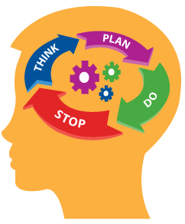
Definition:
A group of three skills that enable people to organize, plan and carry out a set of tasks in an efficient manner

Slide 3
Three Skills of Executive Function
Working Memory
Cognitive Flexibility
Working Memory
Cognitive Flexibility
EF
EF
Inhibitory Control
Self-Regulation

Slide 4
Children aren’t born with these skills—they are born with the potential to develop them.
-Understood.org

Slide 5

Working Memory
What is it?
The ability to remember and use relevant information while in the middle of an activity
Examples
Remembering steps in a recipe
Recalling rules of a game
Following instructions

Slide 6
Let’s Play
“Simon Says”
Notes:
When playing Simon Says, people have to use their working memory in order to remember the rules to Simon Says and follow the instructions that the leader says.

Slide 7
What do we do or can we do to help children build working memory?

Slide 8
Ideas for Working Memory
BABIES (0-18 Months)
TODDLERS (18-36 Months)
PRESCHOOLER (3-5 Years Old)
Peek a boo
Hide toys
Sing songs
Fingerplays
Naming objects
Songs with actions
Games that copy actions
Fingerplays
Imaginary play
Build background knowledge
Let children tell stories
Songs that add movements
Cooking!

Slide 9
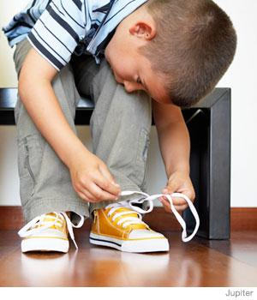
Cognitive Flexibility
What is it?
Helps people shift gears and think about things in different ways
It’s a key part of problem solving
Helps in planning tasks
Examples
Routine at school is different than home routine
Multiple ways of solving a math problem
Rules to a game they play are a little different
Notes:
Flexible thinking is when kids are able to think about something in a new way.
Set shifting is when they can let go of the old way of doing something in order to use a new way.

Slide 10
Read the words
RED GREEN PURPLE BLUE ORANGE PINK YELLOW GRAY BLACK
Notes:
First read the words. Now tell me the colors

Slide 11
Say the colors
RED GREEN PURPLE BLUE ORANGE PINK YELLOW GRAY BLACK
Notes:
First read the words. Now tell me the colors

Slide 12
Which was easier?
Notes:
When playing Simon Says, people have to use their working memory in order to remember the rules to Simon Says and follow the instructions that the leader says.

Slide 13
What do we do or can we do to help children build cognitive flexibility?

Slide 14
Ideas for Cognitive Flexibility
BABIES (0-18 Months)
TODDLERS (18-36 Months)
PRESCHOOLER (3-5 Years Old)
Modify peekaboo games
Change the words to songs
Do silly things with objects
Build together
Change the motions for songs
Do things “incorrectly”
Make predictions
Matching and sorting games
Use found objects for play
Make up a story together
Use complex movements and rhythms for songs
Puzzles

Slide 15
Inhibitory Control
What is it?
Being able to ignore distractions and resist temptation
Helps children to regulate emotions and keep from acting impulsively
Examples
Marshmallow test
Not checking your phone immediately when it buzzes
Holding onto a shaker egg without shaking it

Slide 16
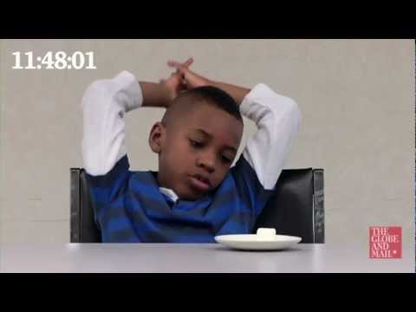
The Marshmallow Test

Slide 17
What do we do or can we do to help children build inhibitory control?

Slide 18
Ideas for Inhibitory Control
BABIES (0-18 Months)
TODDLERS (18-36 Months)
PRESCHOOLER (3-5 Years Old)
Bounces that start at stop
Focus on one activity at a time
Practice waiting
Don’t give in!
Change the speed in songs
Books with movement
Talk about feelings
Don’t give in!
Freeze games
Take turns talking
Activities that require focus
Don’t give in!

Slide 19
How does this all affect us long term?
Notes:
When playing Simon Says, people have to use their working memory in order to remember the rules to Simon Says and follow the instructions that the leader says.

Slide 20
Skills that show success
KINDERGARTNERS
ADULTS
EXECUTIVE FUNCTION SKILLS
Get along with others
Follow directions
Identify and regulate emotions
Resolve conflicts
Persist on tasks
Engage in conversation and play
Interpret others’ behavior and emotions
http://www.msue.msu.edu
Communication
Organization
Emotional Intelligence
Negotiation
Critical Thinking
Focus
Teamwork
Confidence
Lifehack.org, American Management Association and Forbes
Pay attention
Organize, plan and prioritize
Stay focused until task is complete
Understand different points of view
Regulate emotions
Keep track of what you’re doing
understood.org

Slide 21
What do you notice about all these skills?
Notes:
When playing Simon Says, people have to use their working memory in order to remember the rules to Simon Says and follow the instructions that the leader says.

Slide 22
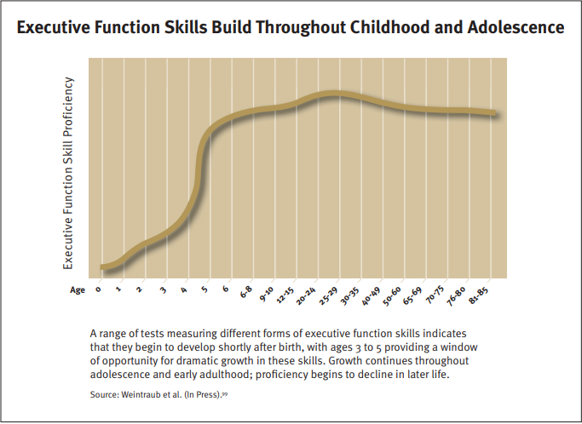
When do we start learning EF skills?

Slide 23
How do kids best learn these skills?
PLAY

Slide 24
What does this look like?
It’s scaffolded
Establishes routines
Models social behavior
Creates and maintains supportive relationships
Fosters creative play
Develops social connection
Teaches how to cope with stress
All while decreasing adult supervision over time!

Slide 25


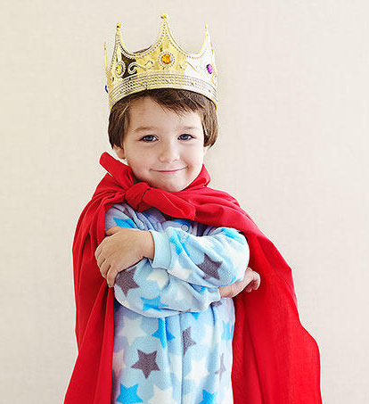
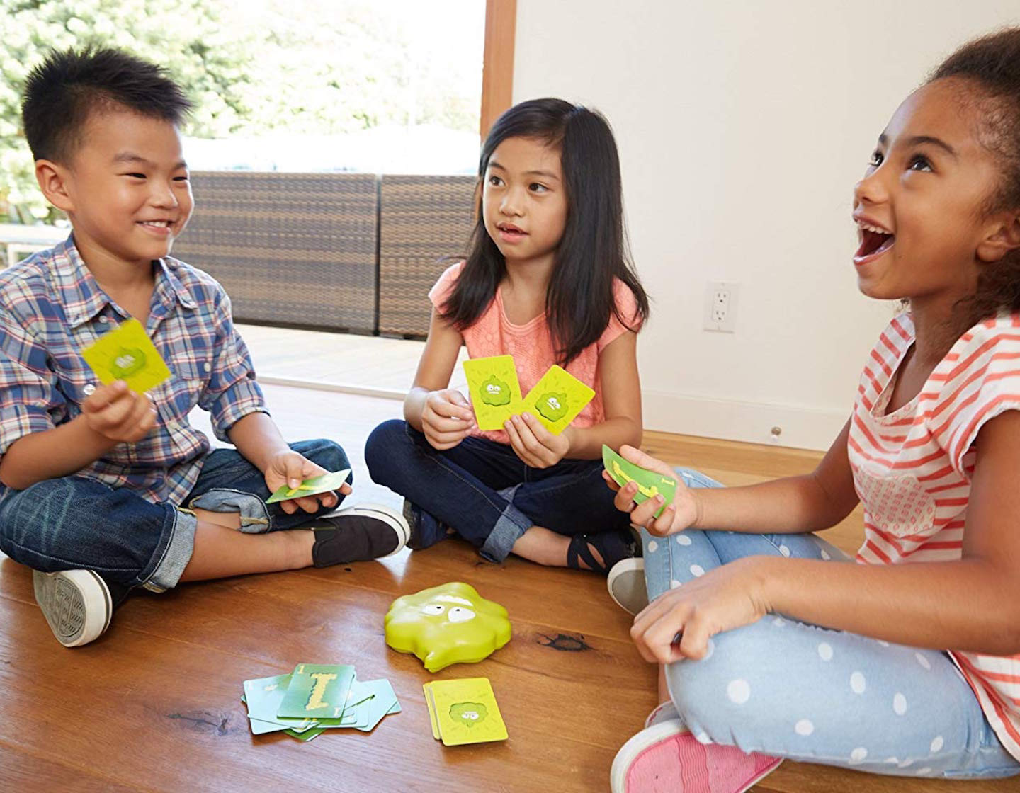
What are the children doing?
Notes:
What are the children learning/practicing in each picture?

Slide 26
What additional things did you think we do or could do?

Slide 27
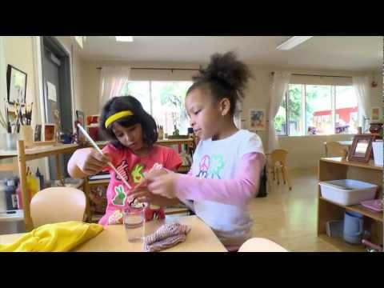
Video: Executive Function: Skills for Life and Learning

Slide 28
Questions?
Comments?
Last thoughts?

Slide 29


Resources
Harvard Center for Developing Child
Activities to Develop EF Skills
Understood for Learning and Attention Issues

