Slide 1
Empowering Teens Through Meaningful Service:
Louisville Public Library’s Approach to Teen Volunteers
By Lindsay Huth and Jessica Schwartz

Slide 2
Introduction
Who We Are
Our Library
Our Community

Slide 3
What We’ll Cover Today
How We Structure Volunteer Opportunities
Children’s Department Opportunities
Teen Department Opportunities
Logistics (recruitment, marketing, etc.)
Q&A

Slide 4
Structure
By Department
Children’s vs Teen
Who is the audience being served?
Seasonal vs Year Round

Slide 5
Children’s Department: Reading Buddies
Overview
Logistics
Role of Big Buddies
Role of Teen Coordinators
Role of staff
Why it’s meaningful

Slide 6
Quotes from the RBC:
“Through my volunteer work at the library with Reading Buddies, I’ve learned a lot about how kids develop reading skills and how everyone learns differently.”
“I like being creative with activities and finding ways to make learning fun.”

Slide 7
Let’s hear more about Reading Buddies…

Slide 8
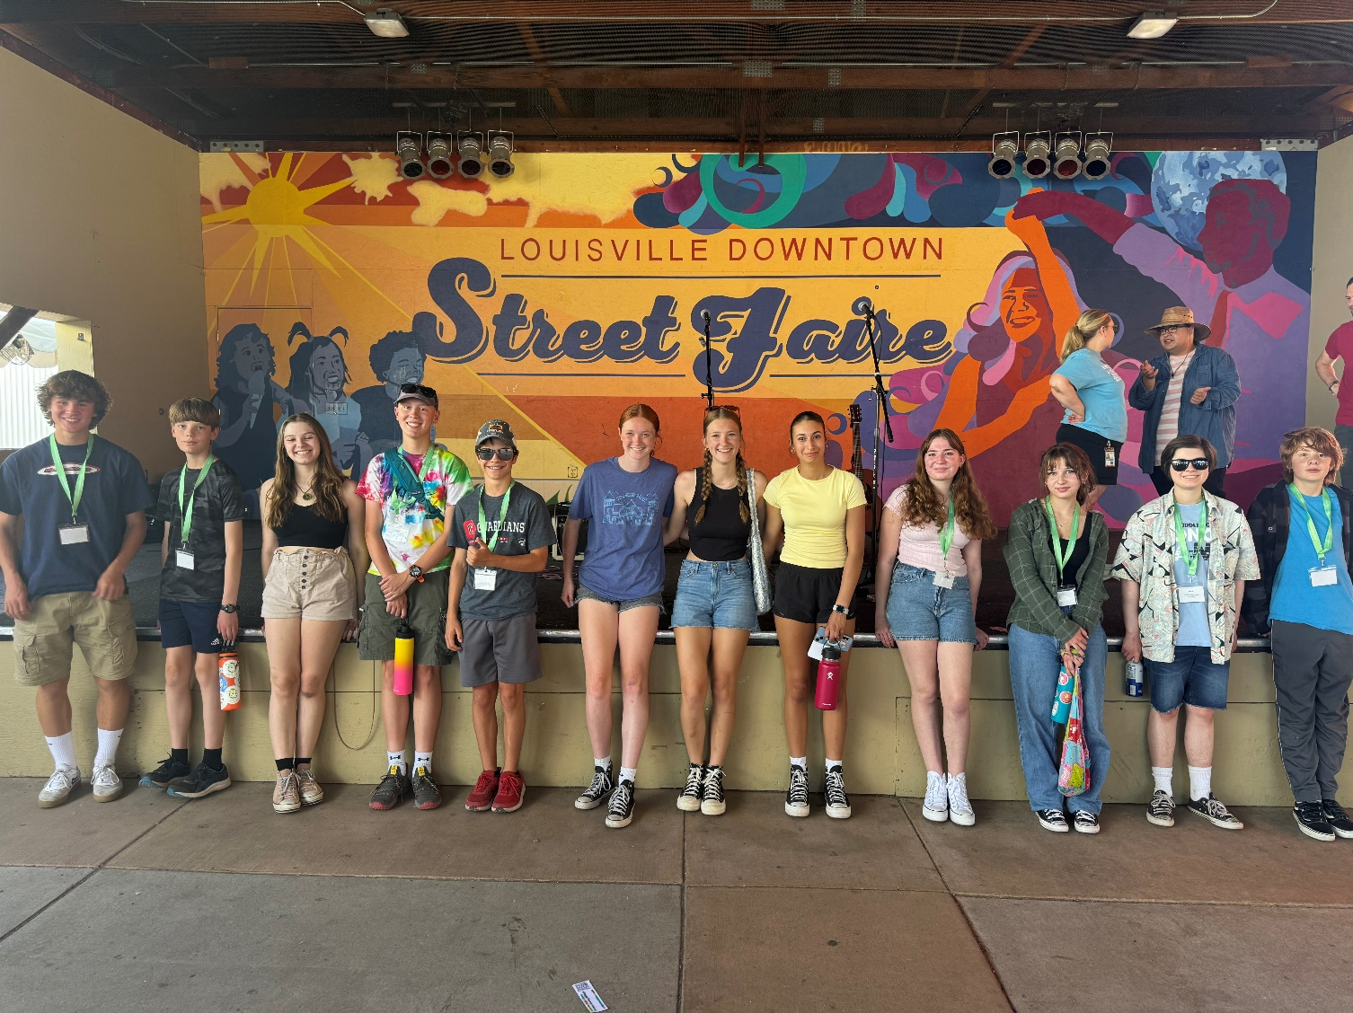
Children’s Department: Summer Squad
Overview
Application Process
Format and scheduling
Tasks
Why it’s meaningful
Photo description: Group of 12 teen volunteers lined up side by side.

Slide 9
Let’s hear more about Summer Reading volunteers…

Slide 10
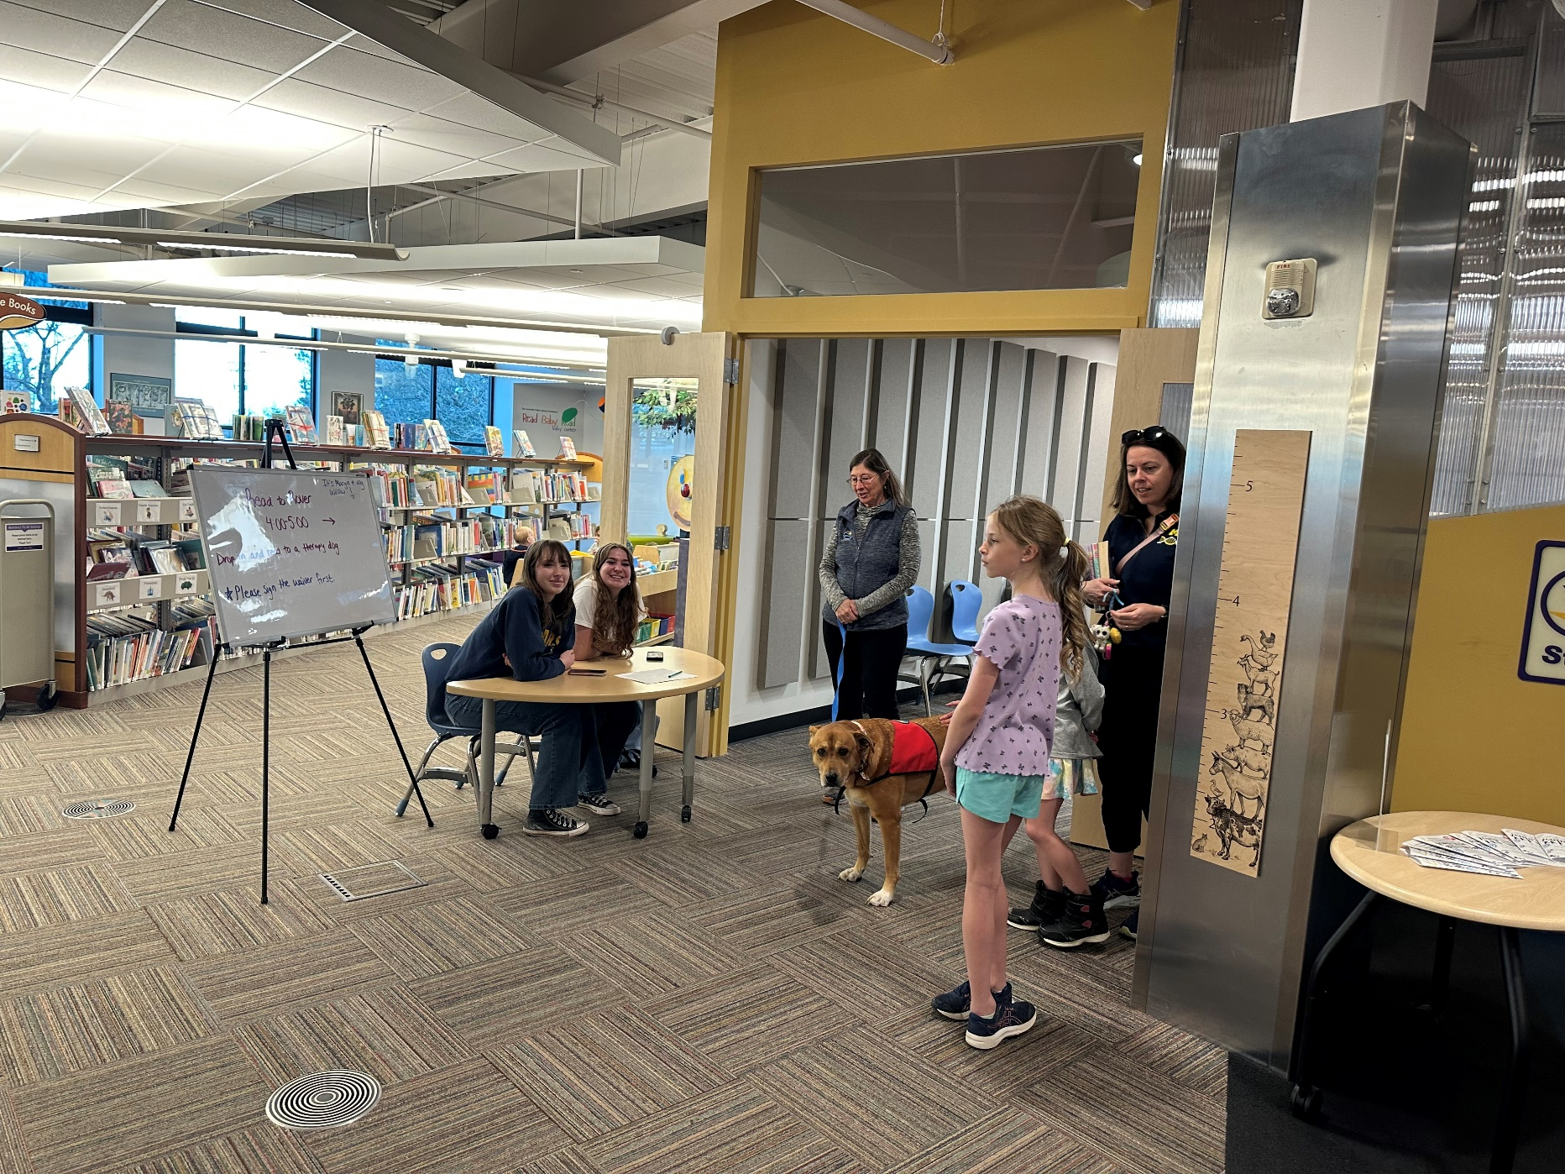
Children’s Department: Read to Rover
Goal of the program
Role of teen volunteers
Why it’s meaningful

Slide 11
They say:
“I enjoy the position because it gives me a chance to help people.”
“I have improved my communication and am better at explaining information.

Slide 12
Children’s Department: General Department Volunteers
Format
Types of tasks and responsibilities
Why it’s meaningful

Slide 13
The volunteers say:
“I am getting real-world experiences and I have a better idea of all the work that is put into running parts of the library.” “You guys changed my life as a high schooler, I just know you’re still making such an impact! I can never thank you all enough for giving me such a wonderful safe place when I was younger!”

Slide 14
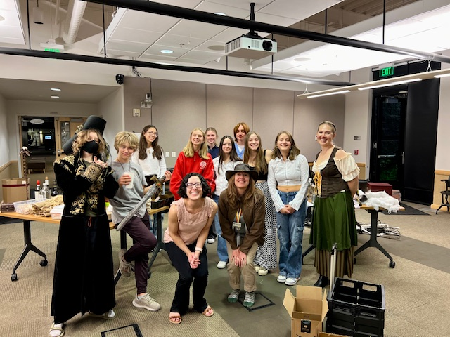
Teen Department: Teen Volunteer Council
Overview
What it is
Who it’s for
Schedule
Application process
Meeting structure
Why it’s meaningful
Photo Description: Teen volunteers and library staff, some in costumes, pose while helping to clean up after our annual After Hours Murder Mystery program.

Slide 15
Quotes From TVC Members
"I love being on the Teen Volunteer Council because I grew up going to this library, and I love getting to be a part of organizing the programs that meant so much to me as a kid." – Sena
“Being part of this council has given me an opportunity to connect with my community. I have created connections with teenagers also passionate about reading and planned events that bring people together.” - Taylor
“Teen Volunteer Council is meaningful to me, because it is a way to give back to the community through a place that has always been a staple for me. Libraries are more than just places that hold books (although they are certainly that); they also host events that unite the community through activities. My favorite parts of Teen Volunteer Council have been the murder mysteries every October and supporting younger kids through the stuffy daycare/adoption days.” - Muireall

Slide 16
Let’s Here More about
Teen Advisory Groups…

Slide 17
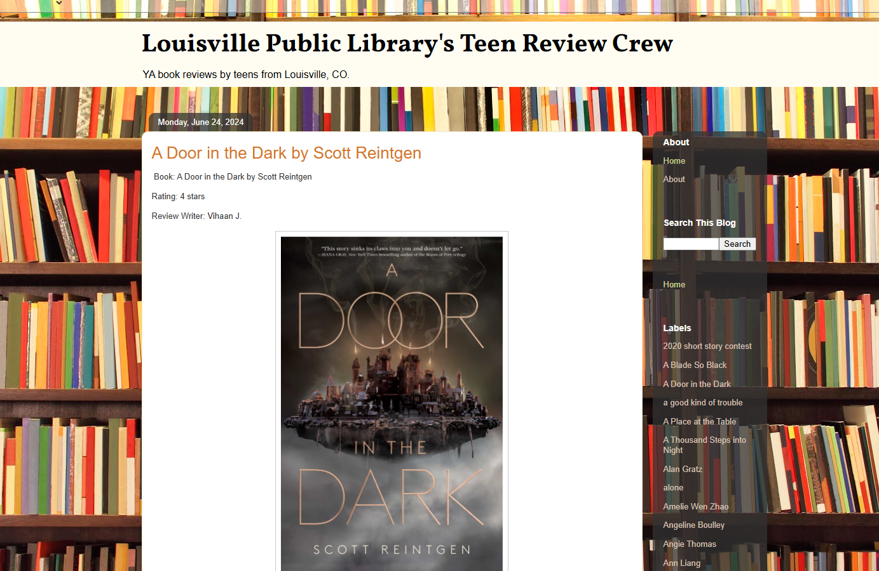
Teen Department: Review Crew
Overview
What it is
How it works
Logistics
Why it’s meaningful
https://lsvlreviewcrew.blogspot.com/
Photo description: An image of the Louisville Public Library’s Review Crew Blog featuring a review and book cover.

Slide 18
Teen Department: Tutoring Program
Overview and logistics
Role of Teen Volunteers
Role of Staff
Schedule – September through May
Why it’s meaningful

Slide 19
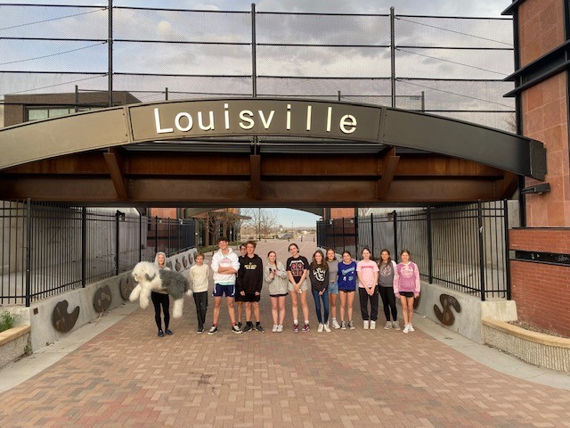
Teen Department: Youth Advisory Board
Overview
What it is
How it works
Not Library specific
Schedule – October through May
Current and past projects
Why it’s meaningful
Photo Description: A row of 13 Youth Advisory Board members stand side by side under a Louisville underpass.

Slide 20
Logistics
Recruitment
Onboarding
Thanking volunteers

Slide 21
More tips for recruitments and rewards…

Slide 22
Summary
Reading Buddies
Teen Summer Squad
Read to Rover host
Department volunteer
Teen Volunteer Council
Review Crew
Tutor
Youth Advisory Board

Slide 23
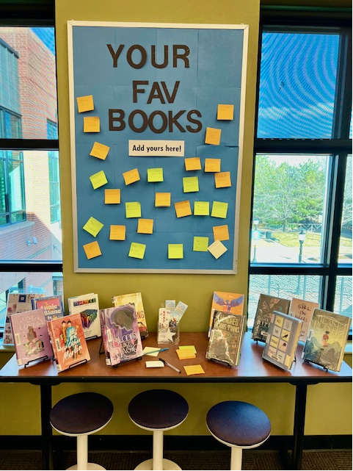
Getting Teens Involved – Share Your Ideas

Slide 24
Q and A
Any questions?
Stories to share?

Slide 25
Thank you!
Feel free to contact us:
Lindsay Huth – lhuth@louisvilleco.gov
Jessica Schwartz – jschwartz@louisvilleco.gov

