Slide 1

Can You Hear Me Now? Improving Communication and Relationships at Work with DiSC®
Jane Martel, Certified Everything DiSC® Trainer
Notes:
CK: Show OPENING QUESTION FOR EARLY ARRIVERS: Share a brief story of a time when you had a miscommunication with someone at work that you think was related to fundamental differences in your personalities.

Slide 2

Where are we going?
Notes:
We’ll cover:
What is DiSC
Why use it/How we use it at ALD
The four primary styles
How to communicate with each style
Resources

Slide 3

What is DiSC?
An assessment that identifies behavioral preferences along four scales
Notes:
Based on answer to 28 forced choice questions. Presented with four words. You identify which word is most like you and least like you.
“The DiSC® assessment is designed to measure traits that are described by the DiSC model (Marston, 1928). These traits are discussed as “styles” and are summarized briefly below. Dominance (D): direct, strong-willed, and forceful Influence (i): sociable, talkative, and lively Steadiness (S): gentle, accommodating, and even-tempered Conscientiousness (C): reserved, analytical, and logical.” `https://www.discprofile.com/DiscProfile/media/DiSC-Flash-Drive/PDF's_DiSC%20FLASH%20DRIVE/DiSCClassicValidationResearchReport.pdf

Slide 4
Free Online DiSC Assessments
http://personality-testing.info/tests/ODAT/
http://www.discoveryreport.com/DiscoveryReportForm_quick.php
http://www.onlinepersonalitytests.org/disc
https://discpersonalitytesting.com/free-disc-test/
https://free.peoplekeys.com/
https://www.123test.com/disc-personality-test/
https://www.tonyrobbins.com/disc/
Notes:
Some may require your contact information, may not offer a full report, or be based on the full set of questions.
Still, they could be a place to start if you are unwilling to pay for a full test and report.
These are in alphabetical order.

Slide 5
Poll/Chat
Have you ever taken the DiSC assessment?
If not, have you taken other work style inventories? Answer in chat.
Notes:
CK: INSERT POLL HERE
Have you ever taken DiSC? Answer in chat.
If not, have you taken other work style inventories?

Slide 6
DiSC
The lowercase “I” has no meaning. It is simply Inscape Publishing’s attempt to brand their information and be unique. It’s a bit like ToysRUs (instead of Toys Are Us).
Notes:
I know some of you are wondering!

Slide 7


The Purpose
Greater understanding
enhanced communication
strengthened relationships
Notes:
Why use it? To better understand yourself and others
Idea is to change your behavior to meet the needs of the person with whom you are communicating. Speaking so another can hear you
Communicating with others about a difficult situation; navigating uncomfortable conversations
Developing and or maintaining trust with others
Supporting, encouraging, or empowering others
Listening to others

Slide 8
Be Better
Provides insight and self-knowledge to unleashing all of the potential we have to be effective and successful in our careers and in life.
We can learn to adapt and to be flexible when interacting with others to build stronger working relationships and healthier, more productive workplaces.
Notes:
From td.org
“The more individuals know about their own needs, motivators, stressors, and strengths—and those of others—the better able they are to adapt their behaviors in ways that build more effective relationships and contribute to building better workplaces. With the Everything DiSC Workplace solution, individuals at every level, in any role in your organization can begin to understand their style and appreciate the different priorities, preferences, and values everyone brings to the workplace, and how they can learn to adapt to the style of others.“

Slide 9

We’re drinking the Kool-Aid®
Certified in 2009
Leaders trained for two days ~2010
All other employees trained on “Effective Communication Using DiSC” for two hours
Notes:
Certified in 2009 at Everything DiSC trainer
“DiSC provides a common language that people can use to discuss what behaviors they share with others and what they do differently. It’s about improving communication to build better relationships internally with other employees and with our patrons.” Part of our internal customer service training.
Objectives
At the end for the session, you will be able to:
o Name one appropriate way DiSC is to be used at ALD.
o Explain two reasons why ALD is implementing DiSC.
o Name at least two descriptors for each of the 4 DiSC styles.
o Identify the four DiSC styles.
o Identify one personal/behavioral characteristic that is explained by your primary DiSC style.
o Share with your supervisor one example of a personal/behavioral characteristic from your profile that surprised you.
o Determine two ways you could use DiSC at work to enhance your working relationship with others.

Slide 10
Don’t just take it from me
“I use DiSC to make sure that I'm heard…What kind of information do they require in order to take me seriously? When coaching,…does it help me understand why they are hung up on something in particular?”
Jill Corrente, Manager, Web Systems

Slide 11
Quote #1
“I wanted to learn as much about my new staff members as I could before I started working with them, so I would be aware of any challenges ahead of time and also how best to motivate them…The preponderance of C and S primary styles is in direct contrast to my own Di-ness; I see that I will have to temper my tendency to jump on bandwagons with their need for stability…My immediate intention is to use my awareness of my staff members’ DiSC profiles to…make them feel appreciated for the work they do.”
~Kathleen Robertson, Supervisor, Smoky Hill Library

Slide 12
Quote #2
“DISC has especially helped me when I have something more challenging like a big change to share with individuals on my team…I keep the ‘Value to Team’ chart on my office wall to remind me to be aware of the terrific and varied perspectives that make up our strong team!”
~Lori Romero, Supervisor, Early Literacy

Slide 13
Quote #3
“It has also helped avoid misinterpreting the intent in other's communication with me. …Learning that this person was a high C, helped me to rethink my interpretation. I realized that this person finds more data, and more authoritative sources very helpful in their problem solving and might be intending to offer what would help them most to me. I had a direct conversation with them about it, and, yep! sure enough that was exactly their intent. Having at least considered where they might be coming from helped me have this conversation in a non-confrontational way.” ~Daisy Grice, Library Manager
Notes:
I NEED TO GIVE TIME TO READ THE QUOTE
Whole quote: I have found DiSC a very valuable tool as a Manager, a colleague, and beyond. Primarily it has helped me adjust my own communication style to be more effective with individuals and even with whole teams. It helps me remember not to overplay to my strengths/tendencies. It has also helped avoid misinterpreting the intent in other's communication with me. For instance, I have a colleague who would send me unsolicited professional articles to read that seemed targeted to issues I had tried to talk with her about in order to seek her advice. This landed on me initially as rather passive aggressive, like this colleague did not want to have a face to face conversation with me; and as a bit insulting, as if I was not well-educated on the topics at hand. Learning that this person was a high C, helped me to rethink my interpretation. I realized that this person finds more data, and more authoritative sources very helpful in their problem solving and might be intending to offer what would help them most to me. I had a direct conversation with them about it, and, yep! sure enough that was exactly their intent. Having at least considered where they might be coming from helped me have this conversation in a non-confrontational way. I was also able to articulate what would help me more.

Slide 14
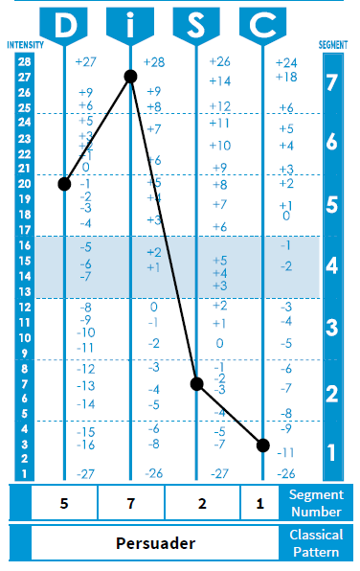
Sample Chart
Notes:
This is what you might see in your report. Your relative strength on four scales.
4 is average.
You’ll see something called classical pattern at the bottom, which is the way your four dimensions (Dominance, Influence, Steadiness, and Conscientiousness) combine
15 commonly occurring unique patterns
Too hard to remember
We’ll focus on four—easy-to-remember---primary styles

Slide 15
Reliability and validity?
These are not yes/no concepts but
Yes.
Notes:
“Collectively, the results of the present study provide evidence that the IML (Institute for Motivational Living, Inc.) DISC provides a robust measure of personality style. The reliability and validity evidence indicates that the IML may confidently use the DISC in their effort to better understand the personality style of individuals in the workplace environment.” , p 13, https://peoplekeys.com/wp-content/uploads/2015/01/IML_DISC_Validation_Study_2015.pdf, accessed 01/04/17

Slide 16

What is your primary style?
On sheet of paper, draw a + sign.

Slide 17
How about you?
If you are more active, fast-paced, assertive and bold, put an X at the top of the y-axis.
If you are more thoughtful, moderately-paced, calm and careful, put an x at the bottom of the y-axis.
X
X
Notes:
Would you say you are more:
Active, fast-paced, assertive and bold
OR
Thoughtful, moderately-paced, calm and careful?

Slide 18
Your turn
If you are more questioning, logic-focused, skeptical and challenging, put an X at the left of the x-axis.
If you are more accepting, people-focused, receptive and agreeable , put an x at the right of the x-axis.
X
X

Slide 19
Quiz
Active, fast-paced
D
i
Logic-oriented, questioning
People–oriented, accepting
C
S
Reserved, even-paced
Notes:
CK: QUIZ: At which corner is your intersection of Xs?
Answer choices: D, I, S,C
Each style has commonalities with their adjacent, or neighboring, styles.
Task: D and C
Ds and Is verbal

Slide 20
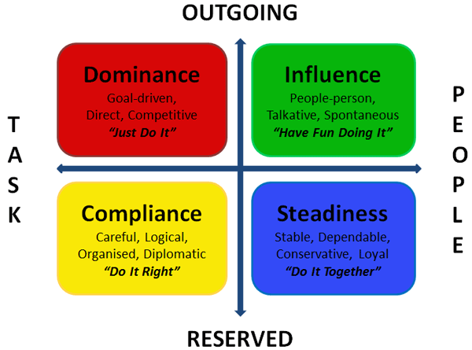
Four Quadrants
Notes:
The big picture

Slide 21
POLL: Does this ring true for you?
Notes:
CK: Poll: DOES THIS RING TRUE FOR YOU? Answer choices: Pretty much! Not so much.

Slide 22
Reading Others
Think about someone you work with, maybe someone whom you find difficult in some way.
On the next four slides, watch for their likely primary style while you learn about your own.
Notes:
Think about others with whom you work, too.

Slide 23
D: Dominance
Dominant, direct, demanding, decisive, determined, doer
Results/bottom line-oriented, firm, strong-willed, forceful, decisive, independent, and to the point
Enjoy challenges
Notes:
How to communicate with them:
Be concise and focused in your communications with this team member. Avoid rambling and chitchat.
Be open to this person aiding in the decision-making process rather than coming to her with the decision already made.
When disagreeing, ensure that you disagree with the facts in the matter instead of directing your disagreement at the individual.

Slide 24
I: Influence
Inspiring, influential, interactive, impressive, interested in people
Social, outgoing, enthusiastic, optimistic, friendly, high-spirited, and lively
Enjoy being on teams, sharing openly, entertaining and motivating others
Notes:
How to communicate with them:
Be personable, and warm up the conversation with a little chitchat. At the same time, don't allow the main purpose of communication to become completely derailed.
If a decision needs to be made, ensure that it's made by the end of the communication. Follow up in writing.
When discussing ideas with this employee, support your point-of-view with testimonials given by people that this particular staff member admires or respects.

Slide 25
S: Steadiness
Supportive, steady, stable, sensitive, sincere, status quo, specialist
Team players, cooperative, even-tempered, accommodating, patient, humble/modest, and tactful. Often good listeners.
Prefer being in the background, working in a stable environment, and avoiding conflict and change
In chat, predict how you think it would be best to communicate with them.
Notes:
Jane to ASK THEM TO PREDICT IN CHAT HOW BEST TO communicate with them. I FILL IN WITH WHAT’S MISSING.
Similar to the influence assessment style, the steadiness style employee needs a little friendly conversation before leading into business.
After talking to this team member, listen to what she has to say. Provide time to think things through if requested. This person does not like to be rushed or forced into a decision.
Stay true to your word, avoiding empty promises to maintain this employee's trust.

Slide 26
C: Conscientiousness
Cautious, calculating, competent, compliant, contemplative, careful
Analytical, reserved, precise, private, systematic, and concerned
Focused on quality, details and accuracy
In chat, what do you think would be the best way to communicate with them?
Notes:
Jane to again ASK THEM How to communicate with them then she’ll fill in with what they missed.
Prepare organized, concise supporting evidence before speaking with this employee about new ideas or changes.
Lead by example, and always follow through on what you've said you'll do.
Respect personal space during face-to-face conversations with this DISC assessment type.

Slide 27

Like what you heard?
Each style includes flattering and not-so-flattering traits, or strengths and weaknesses.
Any strength, when used excessively or inappropriately, can be perceived as a weakness.
The good news? We can change our behavior.

Slide 28
Au contraire
How can these be a strength and a weakness?
Direct
Enthusiastic
Patient
Accurate
Notes:
CK: MOVE TO FOUR CHAT WINDOW. FILL IN WHERE YOU’D LIKE. A WINDOW FOR EACH TRAIT.

Slide 29

Disclaimer
Every individual is unique, as are snowflakes.
You are more than a letter.
You are the expert on you.
Notes:
Fingerprints, too.
Still, DiSC is a really helpful way to approach relationships!

Slide 30

Change Your Communication to Match the Receiver’s Style
We do this naturally with kids and dogs.
There are a myriad of such suggestions online.
Notes:
See resources at end

Slide 31
Prepare for Communication
D: What?
i: Who?
C: Why?
S: How?
Notes:
About their focus
What are they likely to ask about? Be ready to give that info.
Used in sales
“DiSC has helped me to better understand my supervisor (who is diagonally opposite from me…C and i) and not to take things personally, which I had been. Also, I’ve learned about different perspectives and how diversity adds value. DiSC helps me prepare for important conversations.” ~Nevet Tenne, Training Coordinator

Slide 32

“You’re being a D”
Not a label
Talk about the behavior
Notes:
While knowing DiSC styles gives us a common language, it doesn’t mean that it should become a label.
It would be more effective (and sound less accusatory) to state the behavior that is upsetting rather than use the phrase above. For example, “I think that you’re focusing too much on the results when, in this case, the means of how we reach the end matter. Could we talk a bit more about how we might accomplish the results you’re seeking?”

Slide 33
Contraindications (aka, don’t do it!)
DO | DON’T
Use your knowledge of your colleagues’ DiSC information to best meet their needs | Expect more, or less, from a person based on their DiSC information
Tailor your communication in a way the other person prefers (match their preferences) | Use DiSC information as a basis for important decisions
Get to know individuals | Be dismissive of or underestimate a person based on their DiSC information

Slide 34
Back to Reading Others
Now about that person you work with and their likely primary style.
POLL: Were they diagonally opposite your style (D – S or I – C)?
Does it help explain anything?
Notes:
CK: QUIZ:
Was the person with whom you clash diagonally opposite your primary style (i.e., D-S or I-C)?
Yes/no

Slide 35
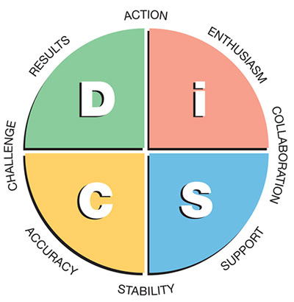
DISC Profile
https://www.onlinediscprofile.com/what-is-the-disc-profile, accessed 01/03/17

Slide 36


Take an Educated Guess
What primary styles do you think are attracted to library work?
Notes:
CK: QUIZ: Multiple response permitted, not multiple choice. D, I, S, C
I can share our breakdown

Slide 37

DiSC’s Value for Teams

Slide 38
Accomplishing Tasks Together
Work best together:
  1. D-S
  2. i-S
  3. i-C, S-S, S-C, C-C
Least likely to work well together: i-i
Notes:
CHAT. Why might that be?
What do you notice?

Slide 39
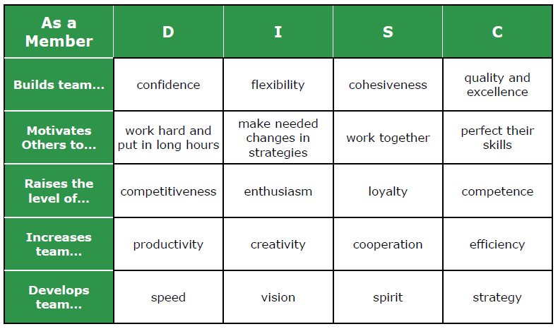
Value as Team Member
Notes:
From Takeflightlearning.com

Slide 40
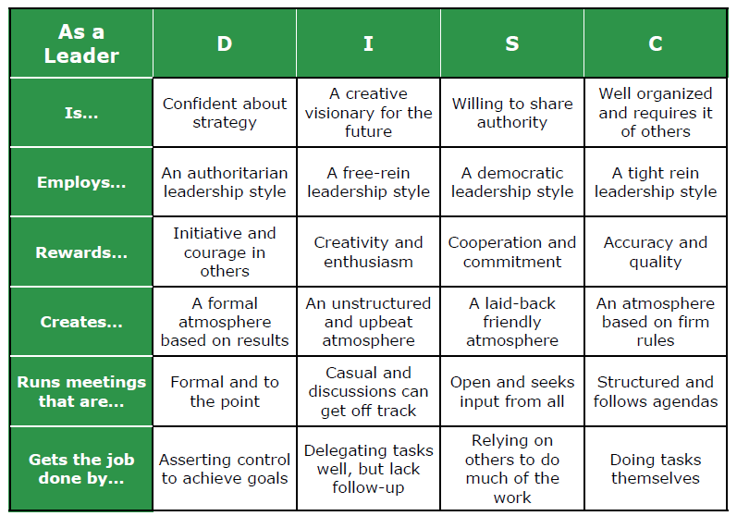
Value as Team Leader
Notes:
From Takeflightlearning.com

Slide 41
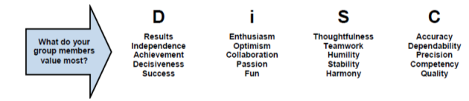
Your Library Has a Culture
Notes:
Your dept., your library, your whole organization.
Has implications!

Slide 42
A Few Resources
https://www.onlinediscprofile.com/
https://internalchange.com/research-articles/
https://www.intesiresources.com/pdf/everything_disc_application_library_research_report.pdf
http://infocustraining.com/disc-clues/d-i-s-c-communication-dos-and-donts.html
https://www.sandler.com/blog/how-use-disc-assessments-appropriately-customize-workplace-communication
http://takeflightlearning.com/products/downloadable-resources
https://www.td.org/Publications/Blogs/L-and-D-Blog/2016/01/Bringing-Out-the-Best-in-D-Style-Contributors
Notes:
Job aid shared on CSL website

Slide 43
More DiSC Resources
https://www.td.org/Publications/Blogs/L-and-D-Blog/2016/01/Bringing-Out-the-Best-in-D-Style-Contributors
https://www.td.org/Publications/Blogs/L-and-D-Blog/2016/01/S-Style-Contributors-to-Build-Healthy-Workplaces
https://www.td.org/Publications/Blogs/L-and-D-Blog/2016/01/I-Style-Contributors-Bring-Balance-and-Energy-to-the-Workplace
https://www.td.org/Publications/Blogs/L-and-D-Blog/2016/01/C-Style-Contributors-Offer-Precision-and-Practical-Solutions-to-Their-Teams

Slide 44

Questions
Notes:
Time for Q&A

