Slide 1
LilyPad Training Centennial Elementary 2012
Material by Linz Craig
Revision by Sarah Bloms
Additional images by Modkit & Adam Meyer

Slide 2
What is a LilyPad?
People use Lily Pad to light up their jackets, wirelessly communicate between purses or stuffed animals, and create fashion that also helps blind people
Sew it into a kite, a sweater, a backpack… or even your leather jacket!

Slide 3

How do you want your robot brain (also called a microcontroller) to talk with the input (that’s the sensors) and the output (LED lights and buzzers)?
Notes:
This is another option for an Overview slides using transitions.

Slide 4
NOTE: DO NOT SNAP APART THE LILYPAD BOARD YET! IF YOU DO, YOU WILL NOT BE ABLE TO EASILY PROGRAM IT!

Slide 5

Parts of the LilyPad board: microcontroller, input and output

Slide 6

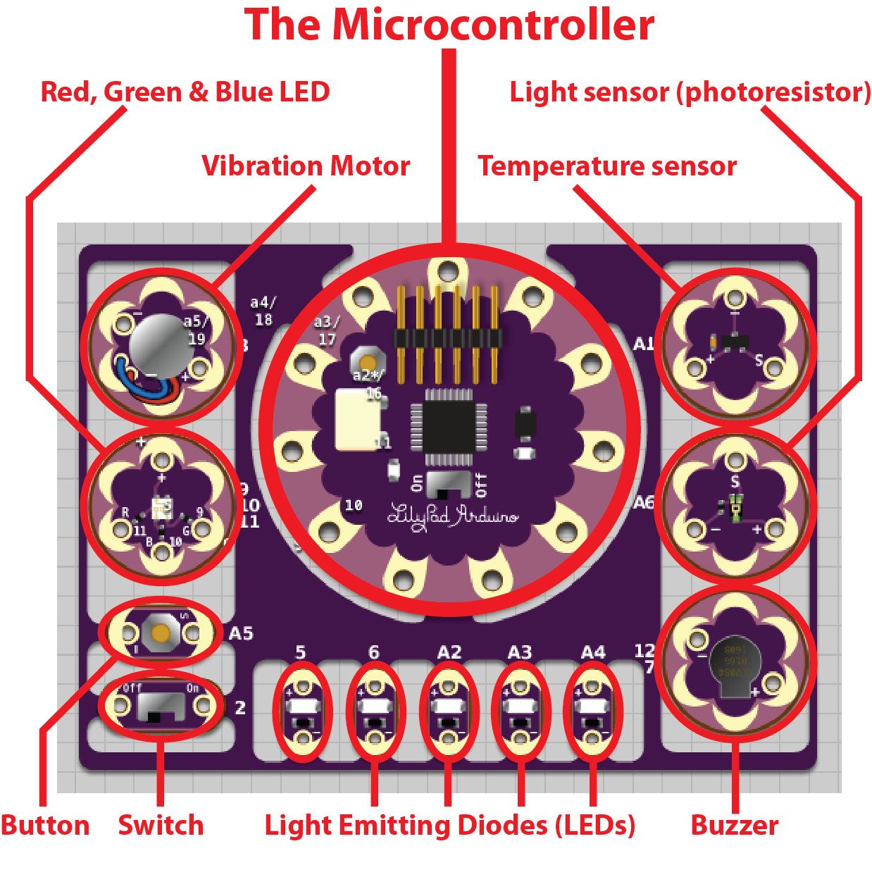
Notes:
The microcontroller is the most important part of the Board you are holding. The microcontroller is like the body and brain of the system you are creating. You can connect sensors and LED lights to the microcontroller. The microcontroller takes information in from the inputs (sensors, button and switch). The microcontroller will then listen to you! It decides what to do with this input depending on the code you put in the microcontroller’s brain. Then the microcontroller tells the outputs to either turn on or off (depending on what you have told it to do).

Slide 7
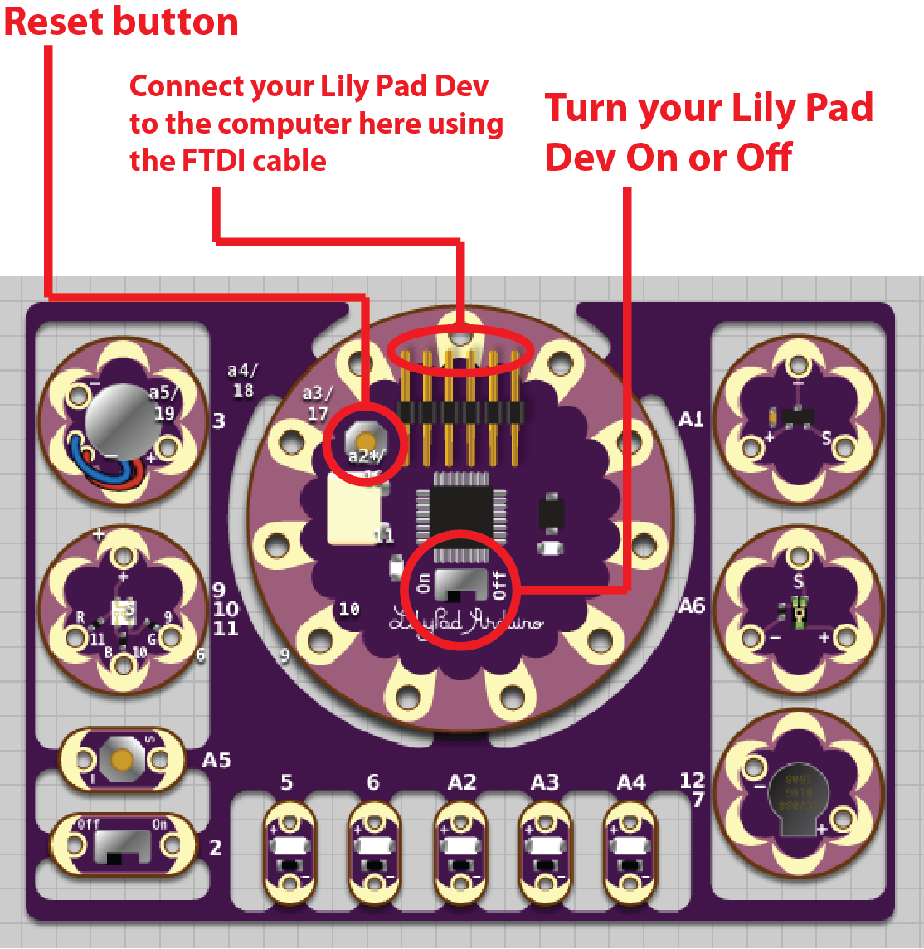
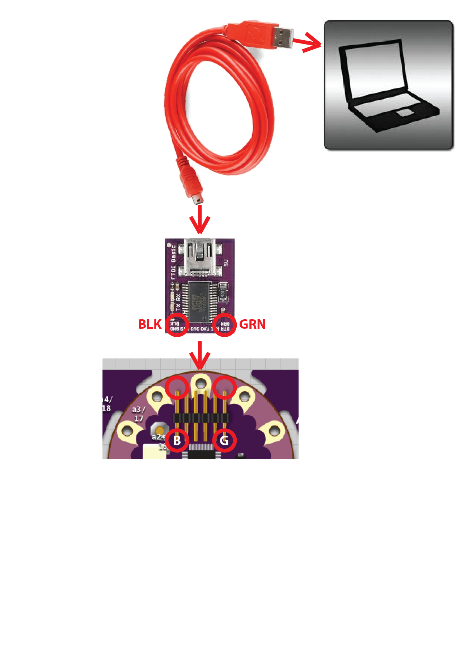
Notes:
Now you can turn the board on using the power switch. When you turn it on you will see a yellow LED light up near the On/Off switch. You can also reset the board by pressing the reset button. This will turn your board off for a second and then turn it back on.

Slide 8
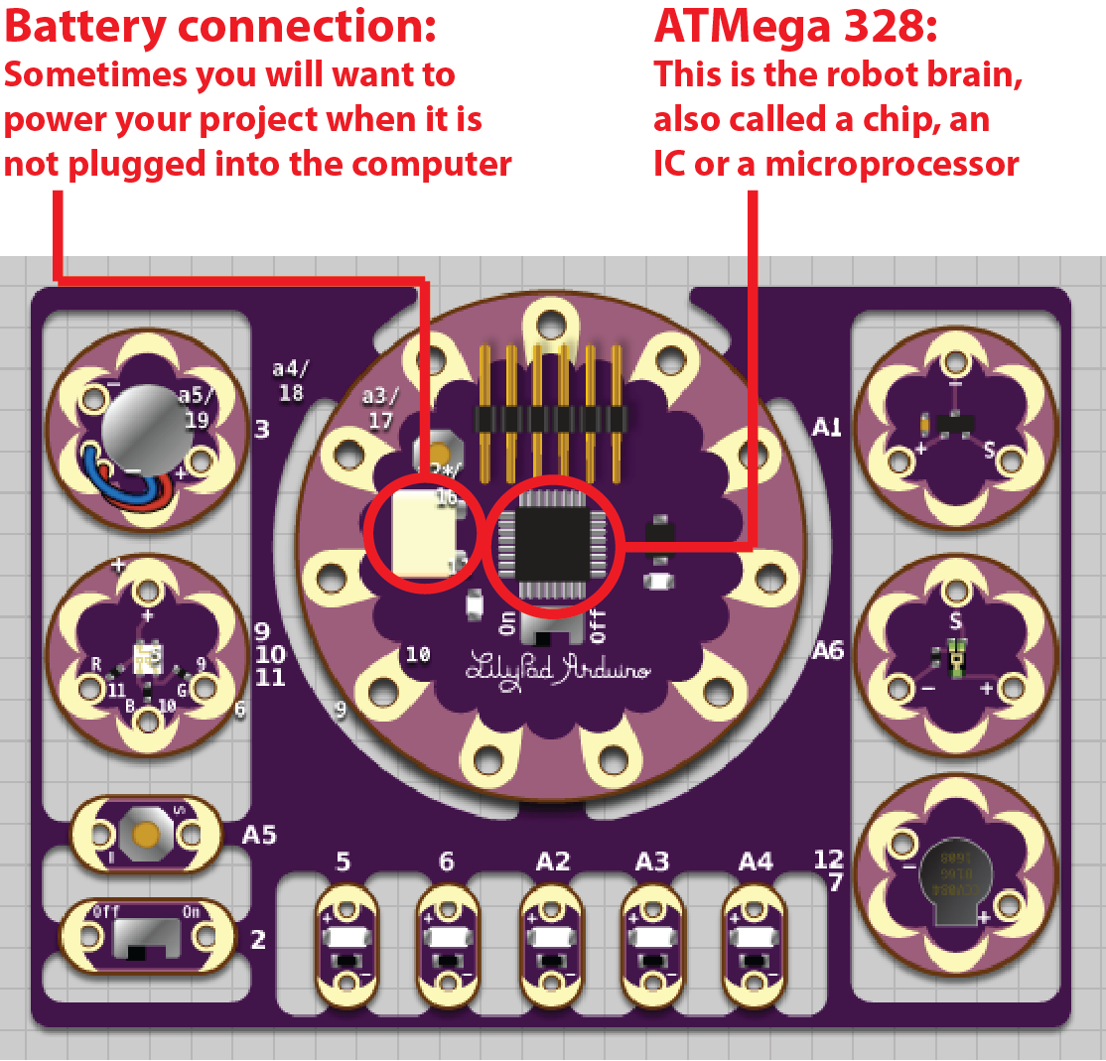
The LilyPad Dev Board needs at least a 5V power supply to work. You can use 4 AA batteries or a 9V “wall wart.”
Notes:
There is the actual computer chip (called an ATMega 328) that stores the code you upload to the microcontroller and the battery connection in case you want to unplug the LilyPad Dev from the computer and power it with a battery or plug it into the wall.

Slide 9
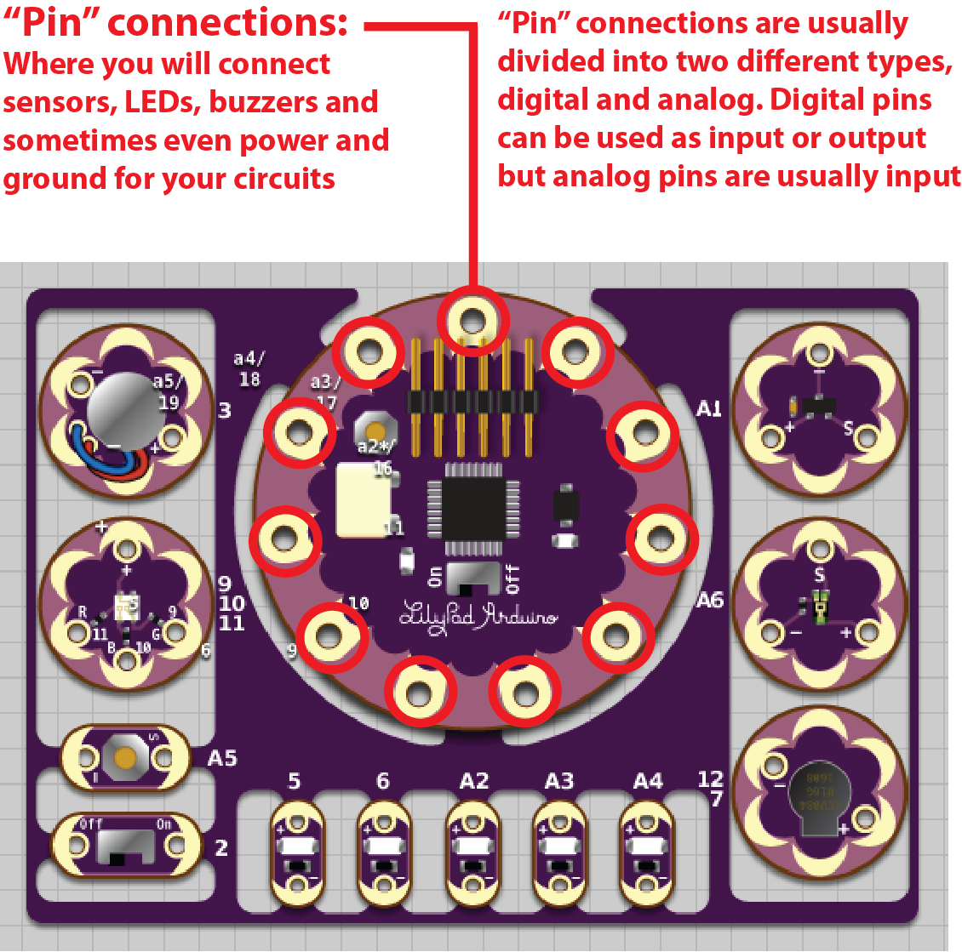
Notes:
The Digital Pin connections are numbered one through eleven or twelve. There are also six Analog Pins named A1 through A6.
The regular LEDs are connected to Digital Pins five and six and Analog Pins A2, A3 and A4.

Slide 10

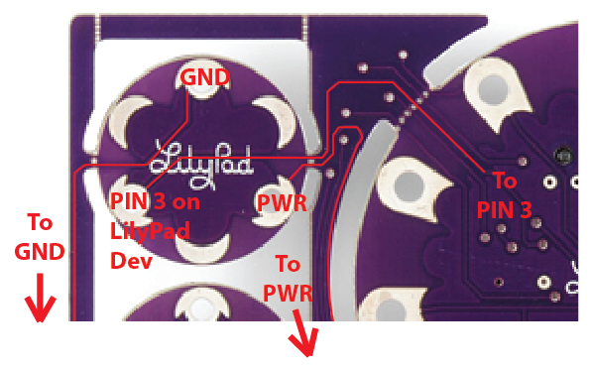
Look closely!
Do you see the wires that are running to the sensors, LEDs, and buttons?
The microcontroller can already talk to the inputs and outputs!
Notes:
I have highlighted the traces that actually connect this sensor to the other pin connections on the microcontroller. The pin 3 connection is how the microcontroller gets a reading off of the sensor. The PWR connection is where the sensor is connected to a power supply. The GND connection is where the circuit is completed by running to the Ground connection on a power supply. As you can see there are pin connections on the input and output circuits as well.
The PWR and GND connections travel through the rest of the board, connecting to the other sensors as well. This is why only the pin 3 connection actually goes back to the microcontroller.

Slide 11


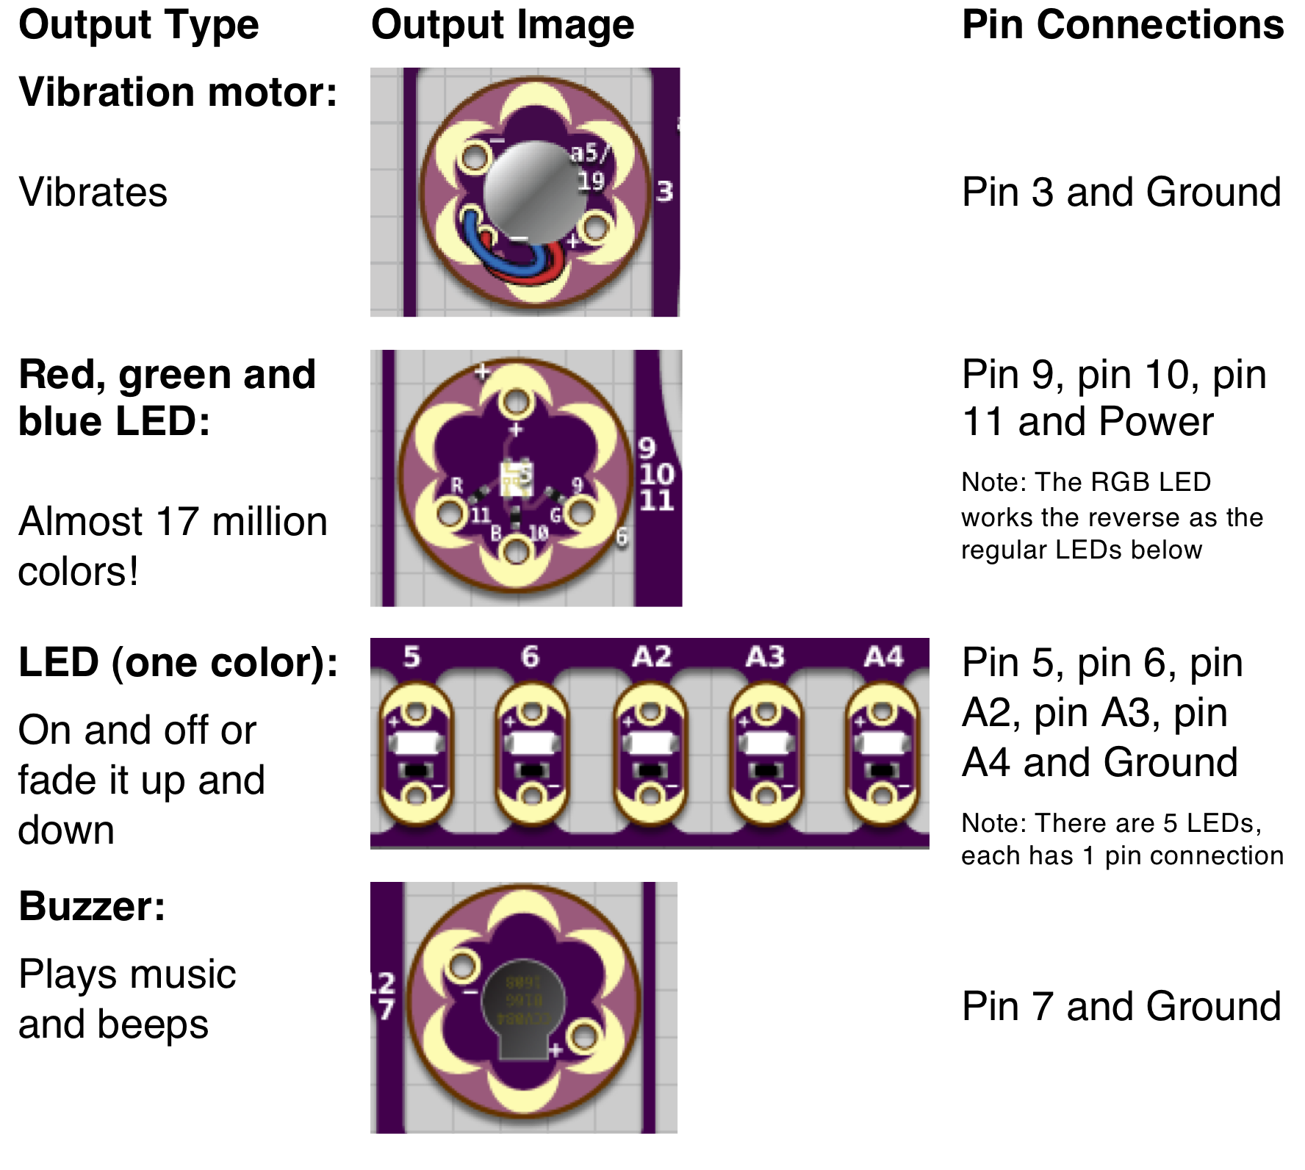
The Outputs (Can change the real world in some way)
Outputs are like your hands and feet! Outputs can make a system walk, pick stuff up or simply turn an LED on or off!
Outputs can NOT put things IN the brain (microcontroller)!

Slide 12


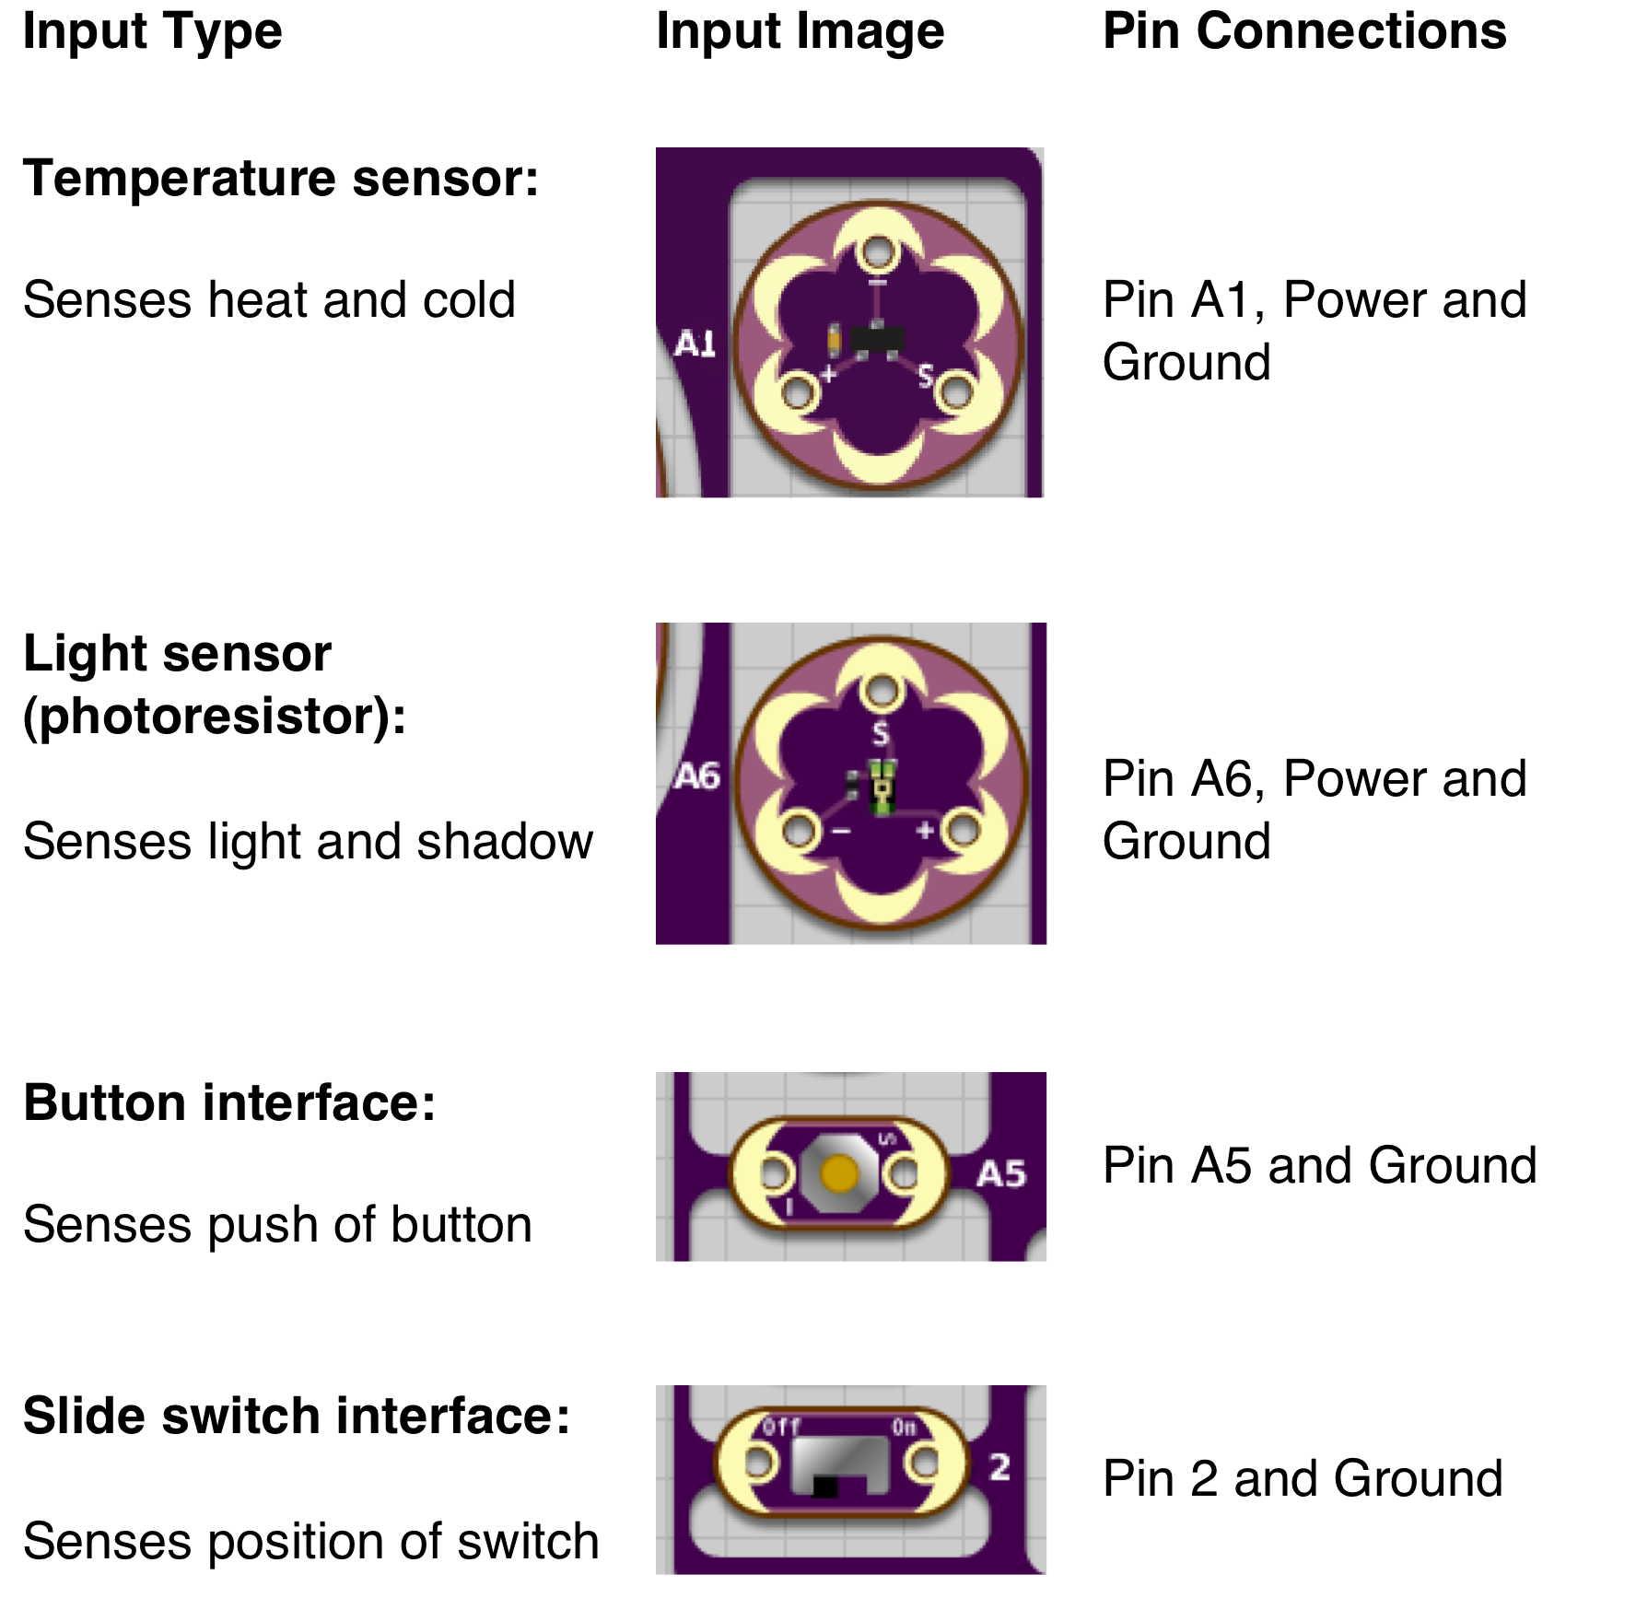
The Inputs (Takes real-world information and sends it back into microcontroller)
Inputs are like your eyes and ears! Inputs take IN information and send it back to the brain!

Slide 13
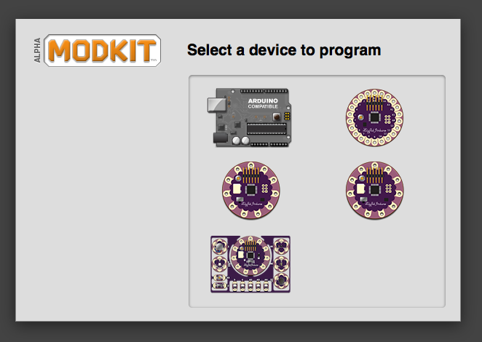
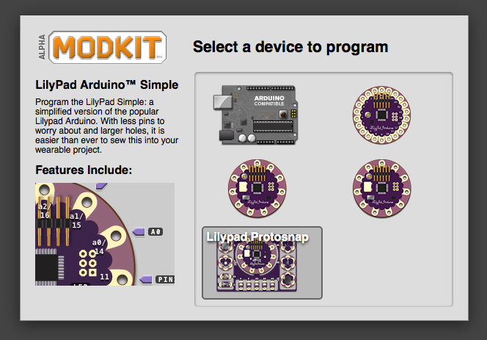
Now we can start telling our robot brain what to do! 1) Open ModKit
2) Select the LilyPad board on the lower left.

Slide 14
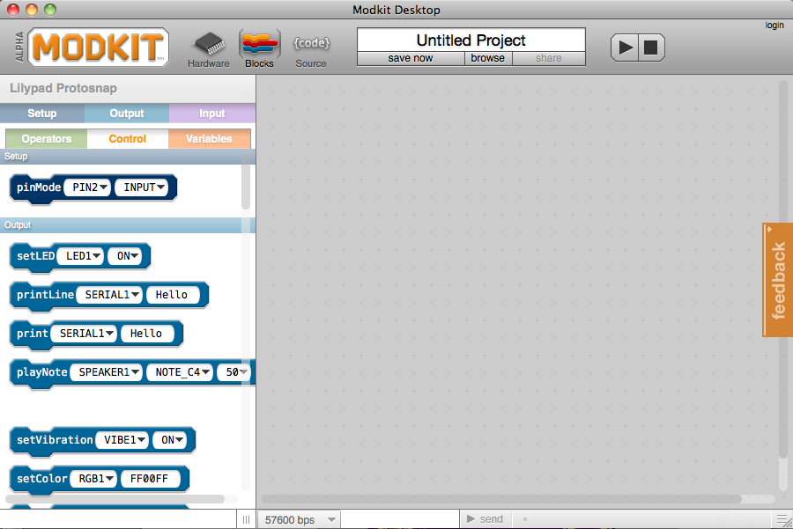
Your screen should look like this!

Slide 15
Can your computer talk to your LilyPad?
Click on the “Hardware” button.

Slide 16
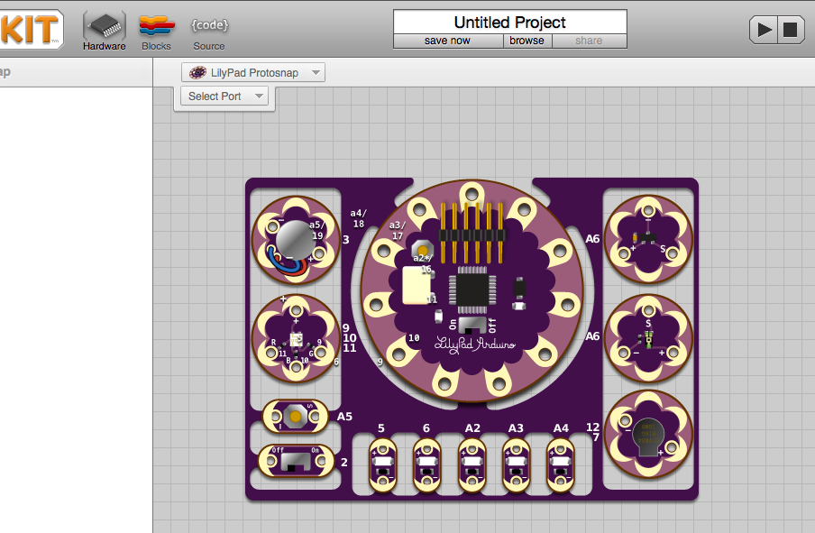
Now it looks like this!
CHECK:
✔Type of Board you are programming
✔COM Port the Board is plugged into
Let’s make sure that the LilyPad Protosnap is selected.

Slide 17
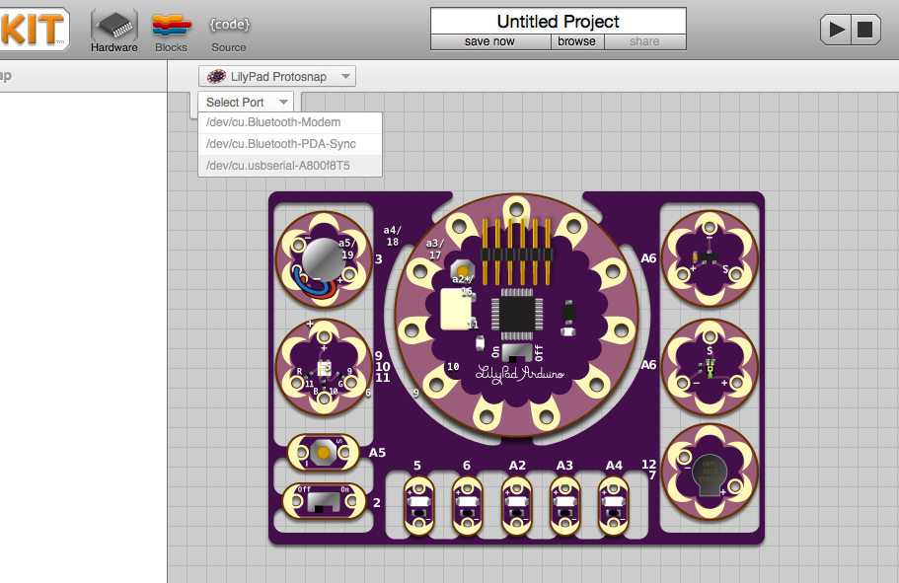

Let’s make sure we are talking to the right connection!
Click on “Select Port” at the top.
Click on “usbserial-” Is your number different than the person’s next to you? Good! ☺
Notes:
Note: This may look different on a PC

Slide 18
Time to write some code!
Click on “Blocks”
view to get started
Notes:
This is another option for an Overview slide.

Slide 19
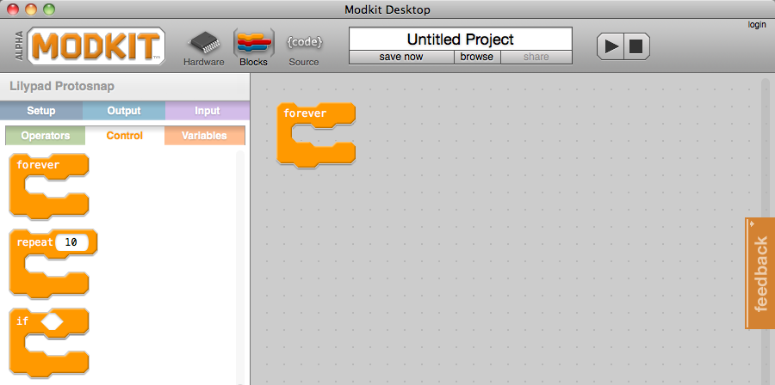
The All Important Forever Loop!
We’ll need a “forever” loop
in our sketch!
(It’s in the YELLOW “Control” tab on the left side.”)
Notes:
This is another option for an Overview slide.

Slide 20

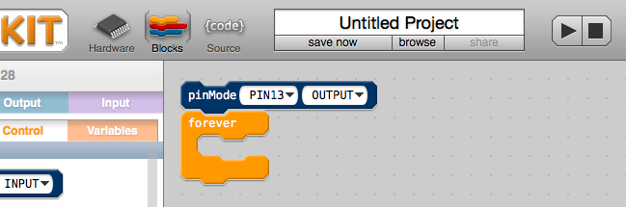
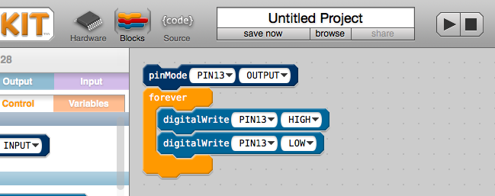
BLINK!
Let’s program the green LED to blink ON and then OFF.

Slide 21
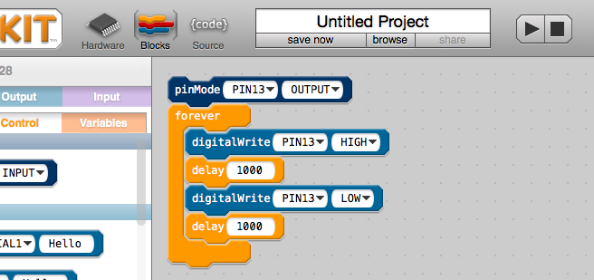
Click “Control” again
Add 2 “delay” blocks

Slide 22
Guess What? You’re ready to upload code onto your LilyPad Dev Board!!! Click on the upload button. It looks kind of like a play button.

Slide 23
pinMode tells Pin 13 to act like an output
forever makes the code repeat
digitalWrite turns the LED on (or HIGH)
Pause for a second
digitalWrite turns the LED off (or LOW)
Pause for another second
Try changing the numbers in delay and uploading your code again. What happens?

Slide 24




DIGITAL SIGNAL: ON or OFF
HIGH means on
LOW means off

Slide 25
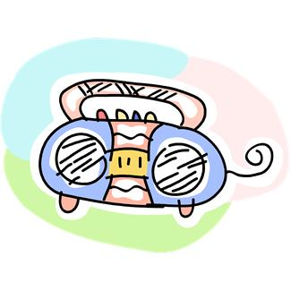
How can we make it light up halfway? Let’s change the Pin! ➔Most pins are digital, but you can’t turn digital pin 13 halfway off! ➔PWM pins can be a little on, halfway on, or all the way on! Like the volume control on my radio!

Slide 26
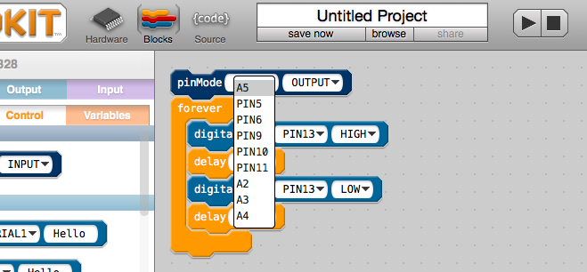
Let’s change from Pin 13 to Pin 5.

Slide 27
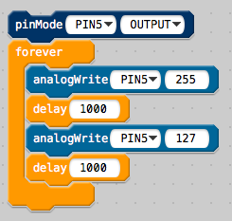
Switch to analog blocks.
We can control how much electricity goes to each light.
255 is all the way on.
0 is all the way off.

Slide 28




PWM Signal: ON, everything in between, and OFF
255 means on
127 means half on and half off
0 means off

Slide 29
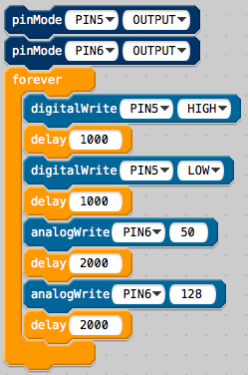

What if I want 2 LEDS to blink at once?
Pin 5 Pin 6

Slide 30
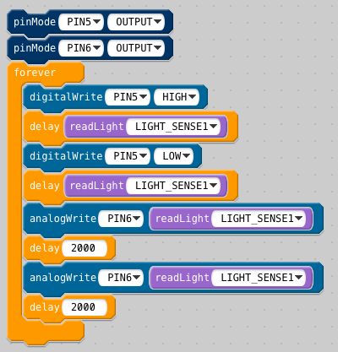
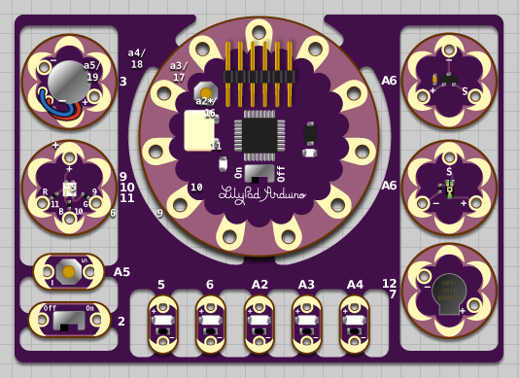
This input uses the light sensor.
The light sensor is an analog sensor.
The light sensor goes up to 1023.

Slide 31
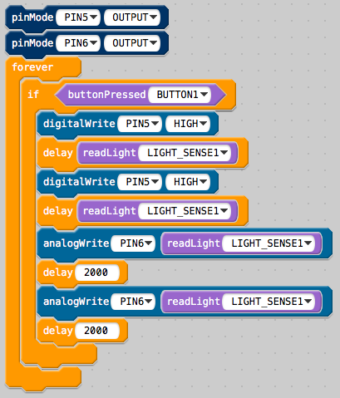
How do I use the digital inputs like the button?
This code uses the button.
To make your lights blink and change brightness you have to press the button.

Slide 32
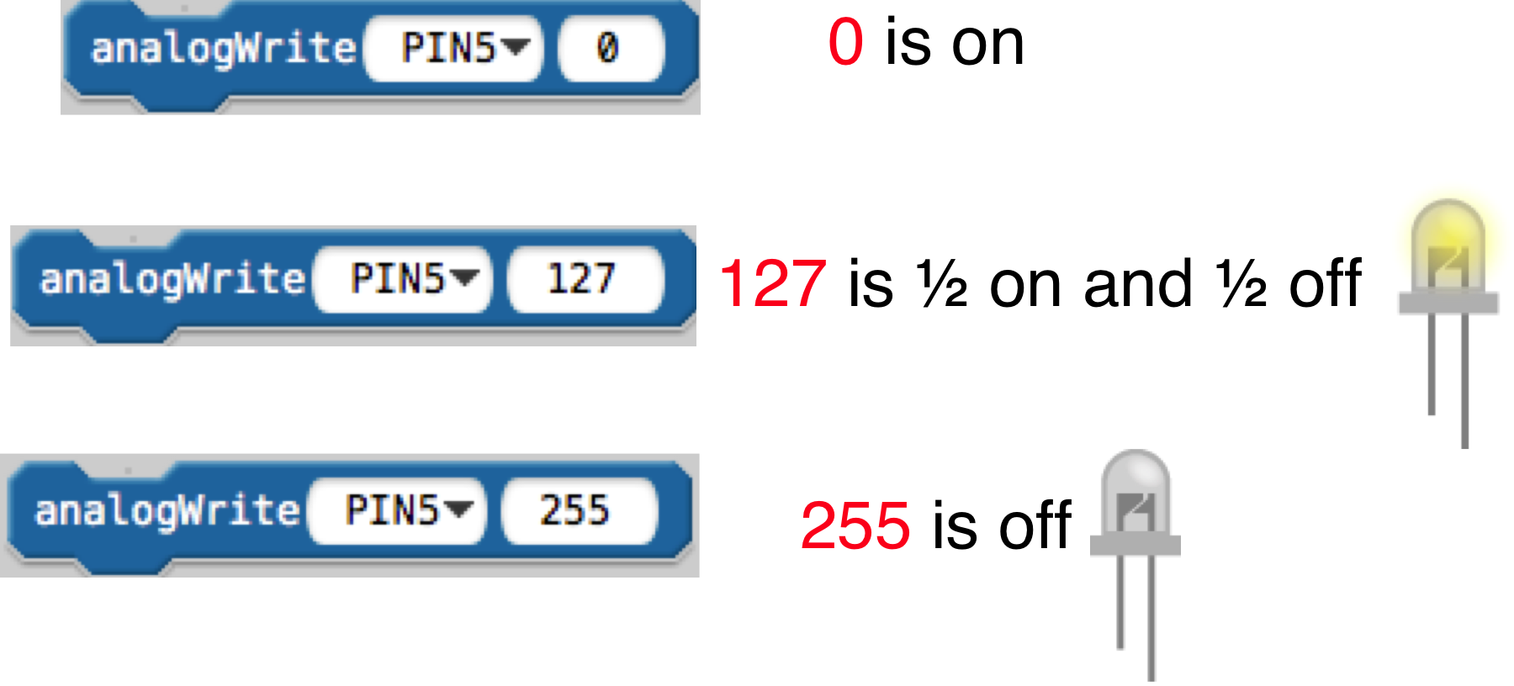
This guy is weird.
The Red, Green and Blue LED
is backwards!

Slide 33
Challenges, questions, and discussion

