Slide 1



Hands On Speed Training
Learn the Four Basic Concepts of Arduino in 45 Minutes

Slide 2
Overview of Class
Getting Started:
Installation and Applications
Electrical:
Components, Input and Output, Analog and Digital
4 Basic Concepts
I/O
Analog / Digital
Serial Comm
OpenSource Resources
Notes:
Add your own to this if changing.

Slide 3
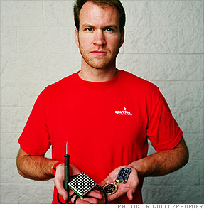
SparkFun Electronics

Slide 4
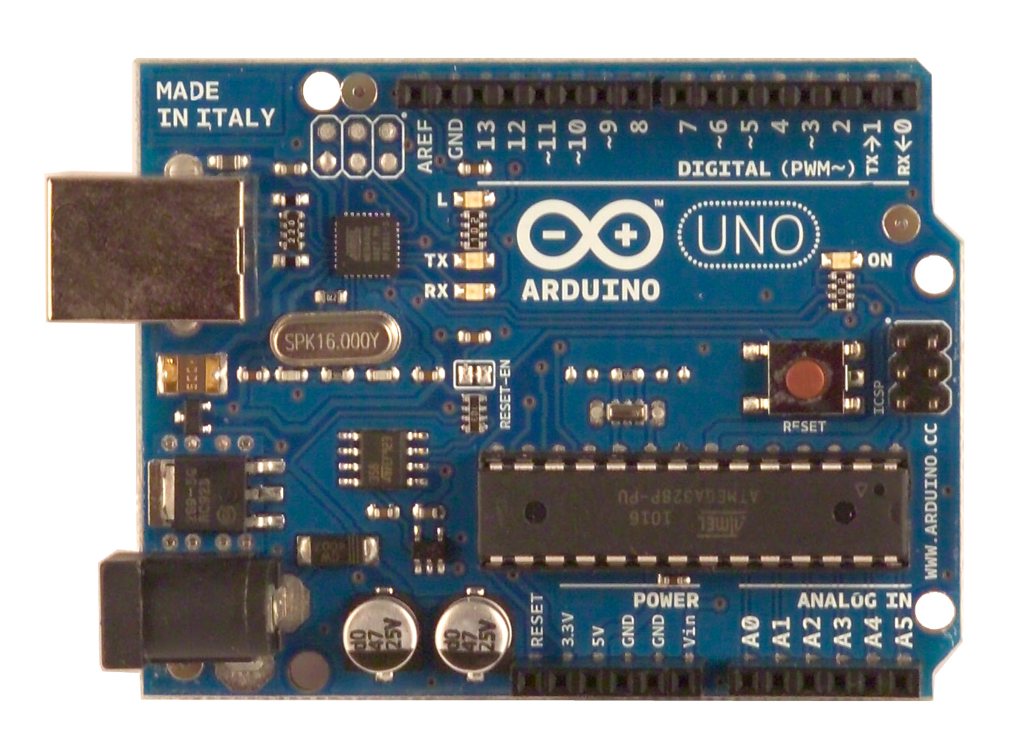
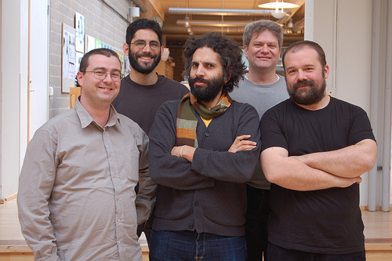
Arduino Board
“Strong Friend” Created in Ivrea, Italy
in 2005 by Massimo Banzi & David Cuartielles
Open Source Hardware
Atmel Processor
Coding is accessible (C++, Processing, ModKit and MiniBloq)

Slide 5
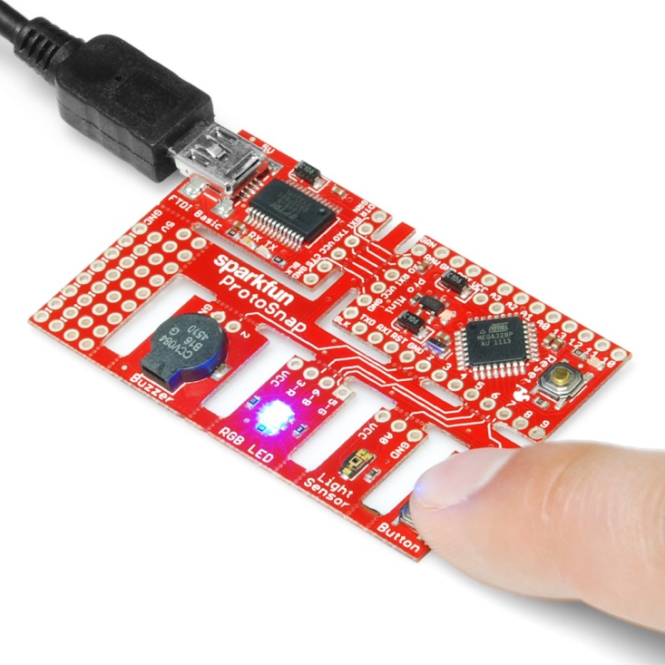

Slide 6
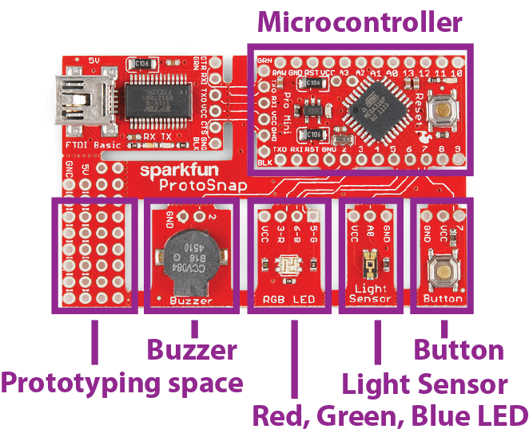
The ProtoSnap Mini Board
Notes:
Worst thing that will ever happen is you’ll short out your com port fuse in your computer. To reset reboot.
Conductive thread, paint, ribbon, fiber, ink etc….
3.3V system.

Slide 7
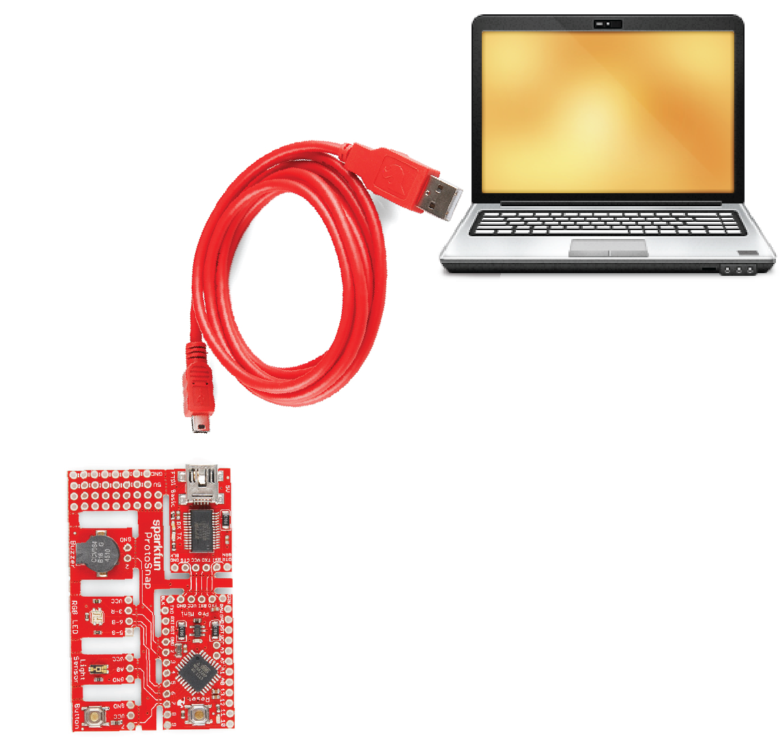
Plug it in
Notes:
Plug it in. FTDI is Serial buffer, 5V, GND, reset.
40-50 miliAmps source
3.3V system. 9 pins broken out. PWM and analogs. You can reconfigure analog ins to be outputs.

Slide 8
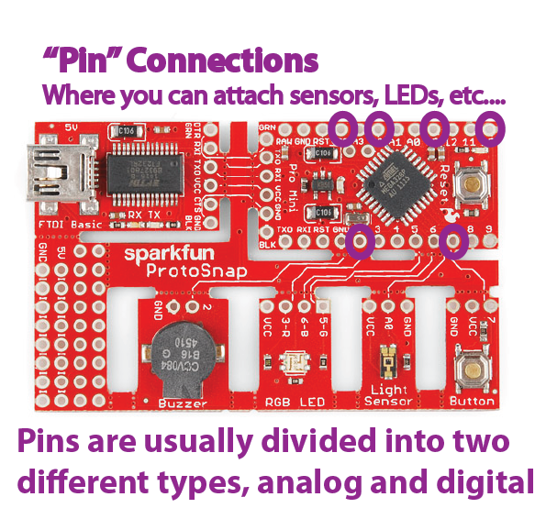
Notes:
Super important. Ask people to identify what sensor is connected to what pin later on.

Slide 9
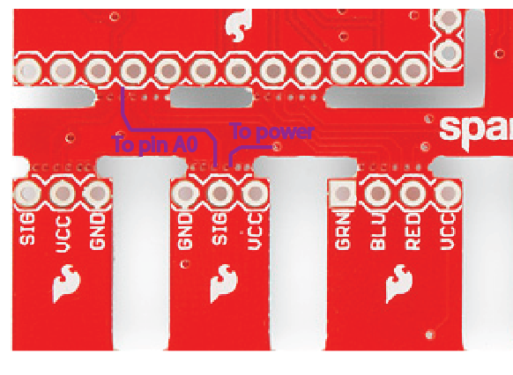
Flip the Board Over
Do you see the wires that are running to the sensors, LEDs, and buttons?
The microcontroller can already talk to the inputs and outputs!
Notes:
All ready teaching about traces! Talk about PCBs, traces, layers and gerbers if you’re familiar. Otherwise talk about the circuit. There is always a power, GND and comm connection somewhere.

Slide 10
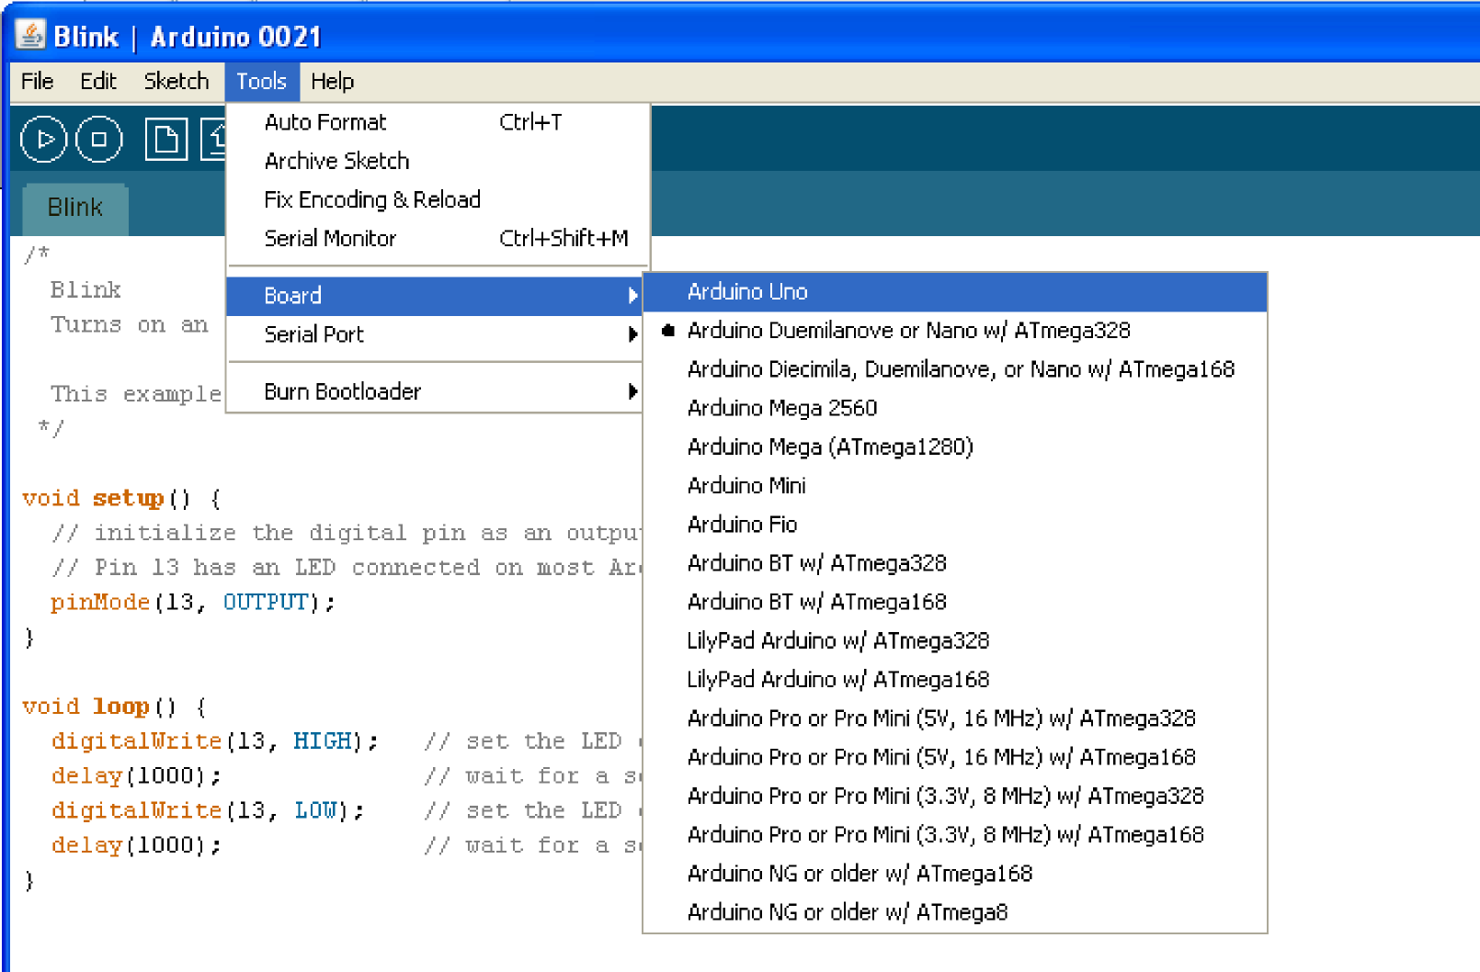
Board Type
Notes:
Talk about different board types

Slide 11
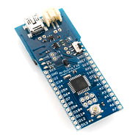
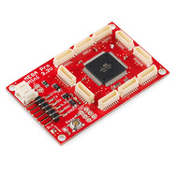
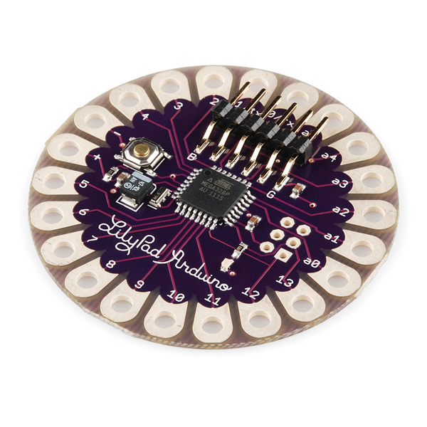
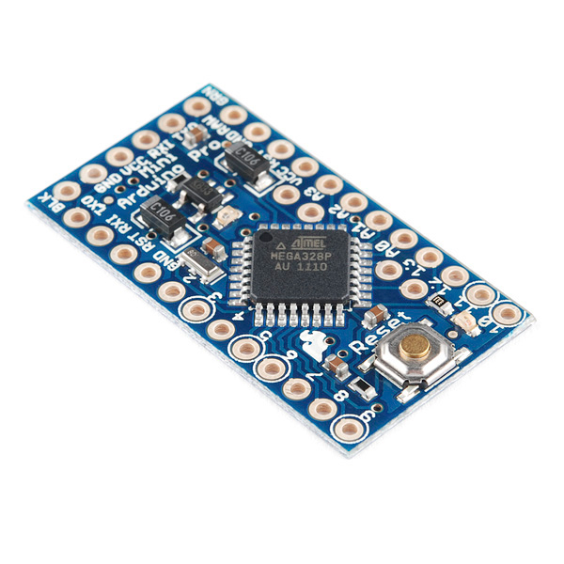
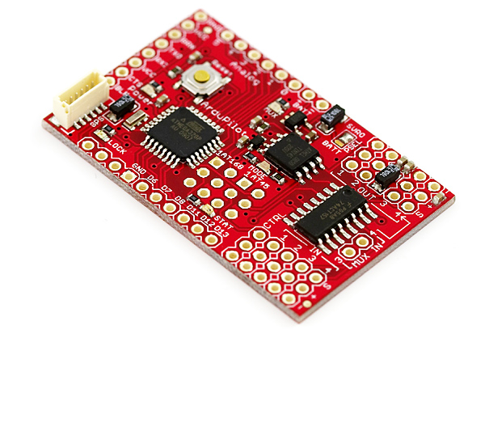
Other Board Type
Notes:
LilyPad 328 Main Board
Arduino Fio
Mega Mini 3.3
Ardupilot Mega
Arduino Mini Pro 3.3

Slide 12
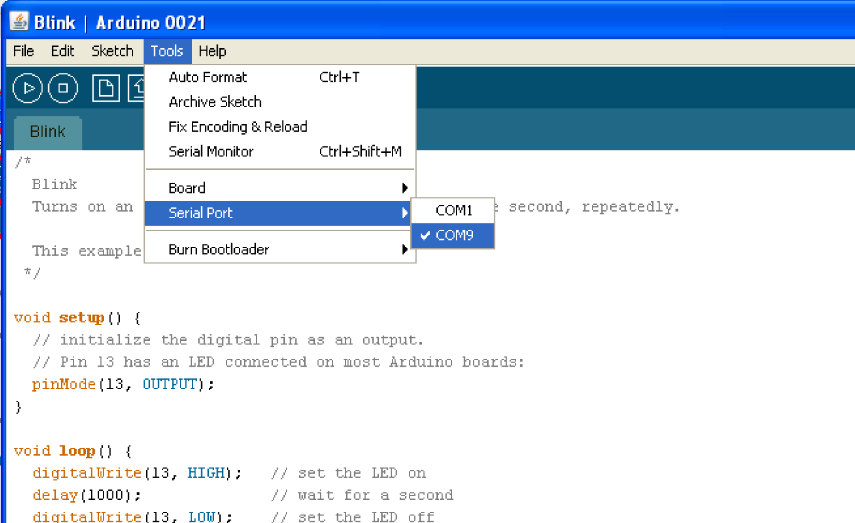
Serial Port / COM Port
Notes:
All connections to computers- mice, printers etc use a serial port. Gotta pick the right one.

Slide 13
Analog and Digital
Analog – A continuum of voltages between 0 and 5 V
Digital – One of two states (HIGH or LOW)
Because it is a digital device, the Arduino only understands Digital –
Analog Inputs require an A/D Conversion
Analog Outputs rely on PWM
Notes:
Metaphors abound. Zipper and button is nice. Cuz if people are paying attention later you can talk about the zipper teeth as being PWM values.

Slide 14
Hello World
In Physical computing – “Hello World” is a simple blink.

Slide 15
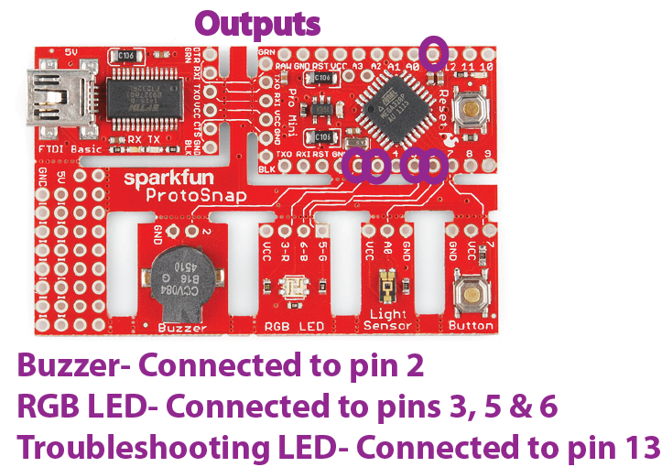
Notes:
Ask people what’s connected to what pins. Talk about Common Anode (The RGB is reverse functionality because of this) Have people program that.

Slide 16
void setup()
Setting up the hardware:
pinMode(pin, INPUT/OUTPUT);
ex: pinMode(13, OUTPUT);

Slide 17
Digital Output
To Output a Digital signal (On or Off) use this code:
digitalWrite (pinNumber , value);
Where value is HIGH or LOW
ex: digitalWrite(13, HIGH);
Notes:
File examples basic blink
Change pin to 5.
Encourage delay change
Change blink digitalWrite to analogWrite (will have to change the pin)
Switch to Arduino and do code, talk about code, SLOWLY.
Comments and changing pins from pin 13 to pin 5
Show them what it looks like when you screw up pinMode
2^8

Slide 18
Analog Output
…but, output is always Digital?
Using a Digital signal that pretends to be an Analog signal is called Pulse Width Modulation
Use Pulse Width Modulation, or P.W.M., for anything that requires a signal between HIGH and LOW
P.W.M. is available on Arduino pins 3, 5, 6, 9, 10 and 11
Notes:
Window is 500 miliseconds? Don’t quote yourself on this one, Mike Hord said so. I couldn’t find any info on it with a quick search. I tend to believe Mike Hord. He’s a believable guy. He’s also an unbelievable guy.
Open File/Examples/Basics/Fade after changing blink to analogWrite with values mid range.

Slide 19
Analog Output
To output a signal that pretends to be Analog use this code:
analogWrite (pinNumber, value);
Where value is a number 0 - 255
ex: analogWrite(9, 150);
Notes:
File examples basic blink
Change pin to 5.
Encourage delay change
Change blink digitalWrite to analogWrite (will have to change the pin)
Switch to Arduino and do code, talk about code, SLOWLY.
Comments and changing pins from pin 13 to pin 5
Show them what it looks like when you screw up pinMode
2^8

Slide 20
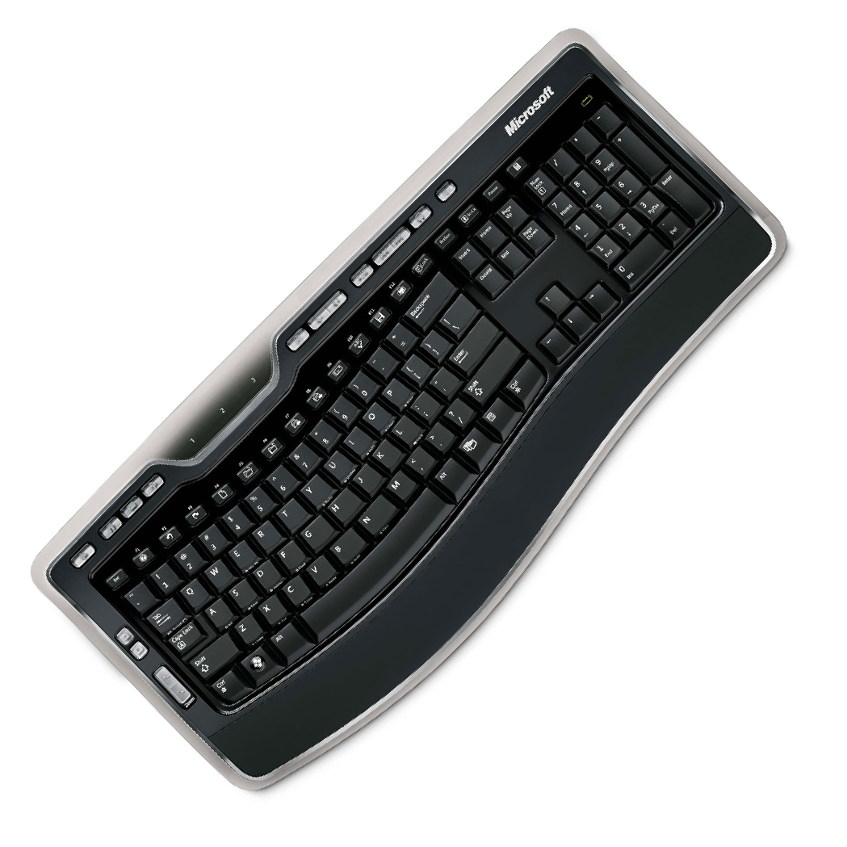
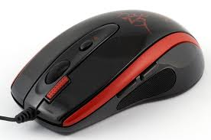
Input
Input is any signal entering an electrical system
Both digital and analog sensors are forms of input
Input can also take many other forms: Keyboards, a mouse, infrared sensors, biometric sensors, or just plain voltage from a circuit
Notes:
Take your pick. Neuro-net inputs and bio-metrics! Oh my. I once saw a pen and a table that could be used to manipulate some liquid ferric substance with an array of magnets under the table. The pen and screen are the inputs, the magnets turning on and off to manipulate the liquid are the output. The liquid was just the environment or materials being manipulated. Tangent. Hope you get my point about cool examples of inputs, I’m sure you’ve got a bunch.

Slide 21
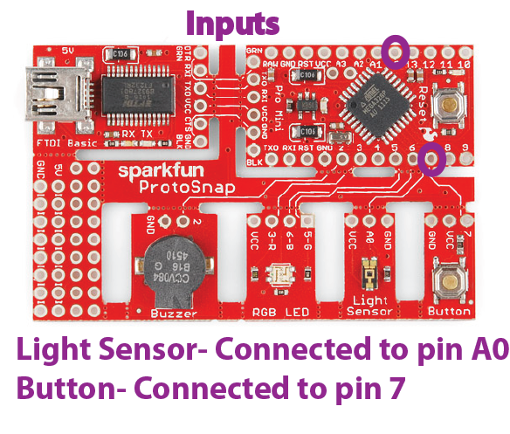
Notes:
Code: file examples/ analog/ analogInput
Switch to file examples/ analog/ analogInputSerial

Slide 22
Analog Input
To connect an analog Input to your Arduino ProMini use Analog Pins: A0 – A3
To get an analog reading:
int sensorVal = analogRead (pinNumber);
Ex:
int sensorVal = analogRead(A0);
Analog Input relies on a 10-bit A/D -- varies from 0 to 1023 on an Arduino
Notes:
Show manipulating the input variable value and like this:
variableValue = analogRead( pinNumber ) /4; (maps to 255)
2^10

Slide 23
Digital Input
To connect digital input to your Arduino use Digital Pins # 0 – 13 (Although pins # 0 & 1 are also used for serial/programming)
Digital Input needs a pinMode command:
pinMode (pinNumber, INPUT_PULLUP);
To get a digital reading:
var = digitalRead (pinNumber);
Digital Input values are only HIGH (On) or LOW (Off)
Notes:
Button and Switch.
Talk about how the buttons works with internal pullup resistors, cement later.

Slide 24
Serial Communication
Serial Communication is the transferring and receiving of information between two machines, the Arduino dedicates pin # 0 to receiving information and pin 1 to transferring information
Notes:
Communication between computers and Arduino. Arduino and Arduino. GPS signals, etc.

Slide 25
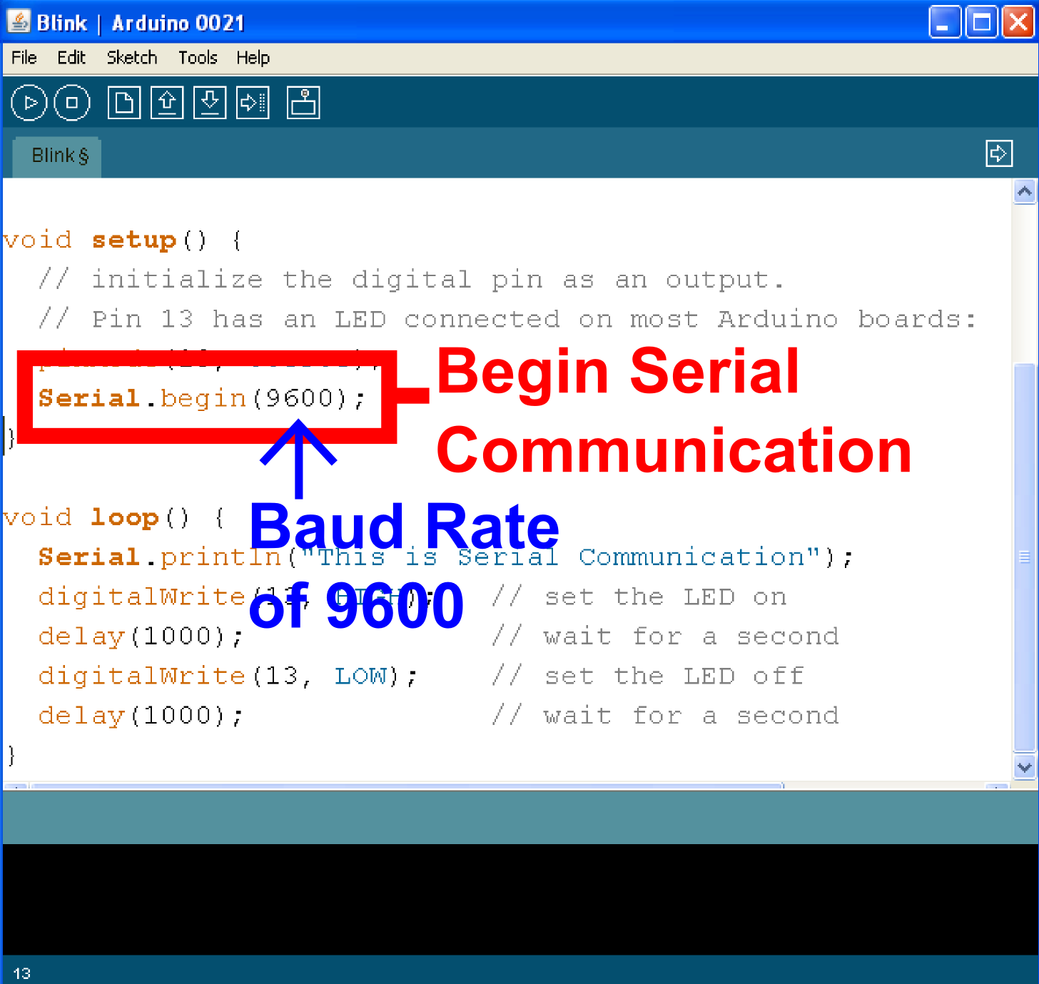
Serial in Setup
Notes:
This is the speed at which the computers talk to each other? Ever had somebody speak to you real fast and even thoughthey’respeakingEnglishyoucan’tunderstandawrdtheysay. It’s like that when you get mismatched baud rate. Check it out.
Talk about the pros and cons of faster and slower baud rates

Slide 26
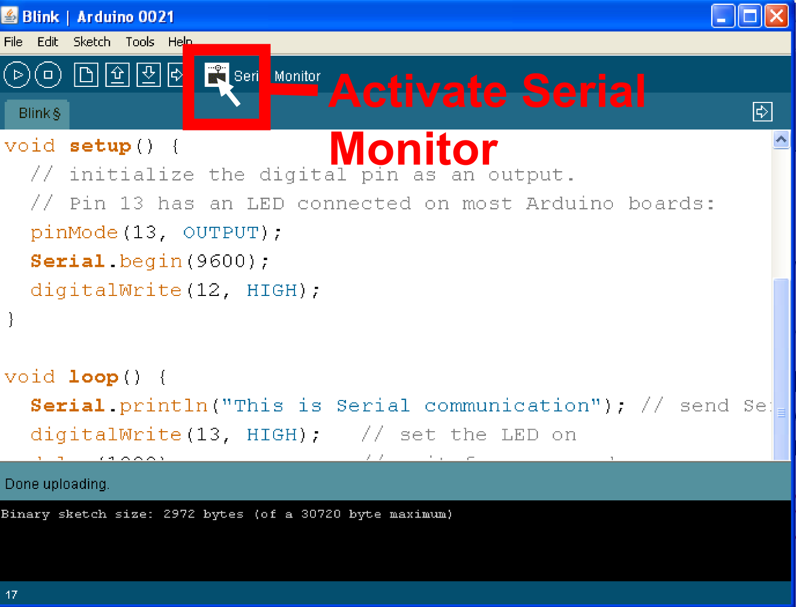
Serial Monitor
Notes:
Needs updating.

Slide 27
Serial Communication: Serial Setup
void setup ( )
{
Serial.begin(9600);
}
In this case the number 9600 is the baud rate at which the computer and Arduino communicate
Notes:
Add to button example

Slide 28
Serial Communication: Sending a Message
void loop ( )
{
Serial.print(“This is: “);
Serial.println(“Mechatronics”);
}
Notes:
Put a Serial.print(); in first. Watch it scroll across the screen. Put a Serial.println(); afterwards. Maybe thank the people you’re putting on the workshop with?
Explain how to use Serial Char commands to steer a vehicle?

Slide 29
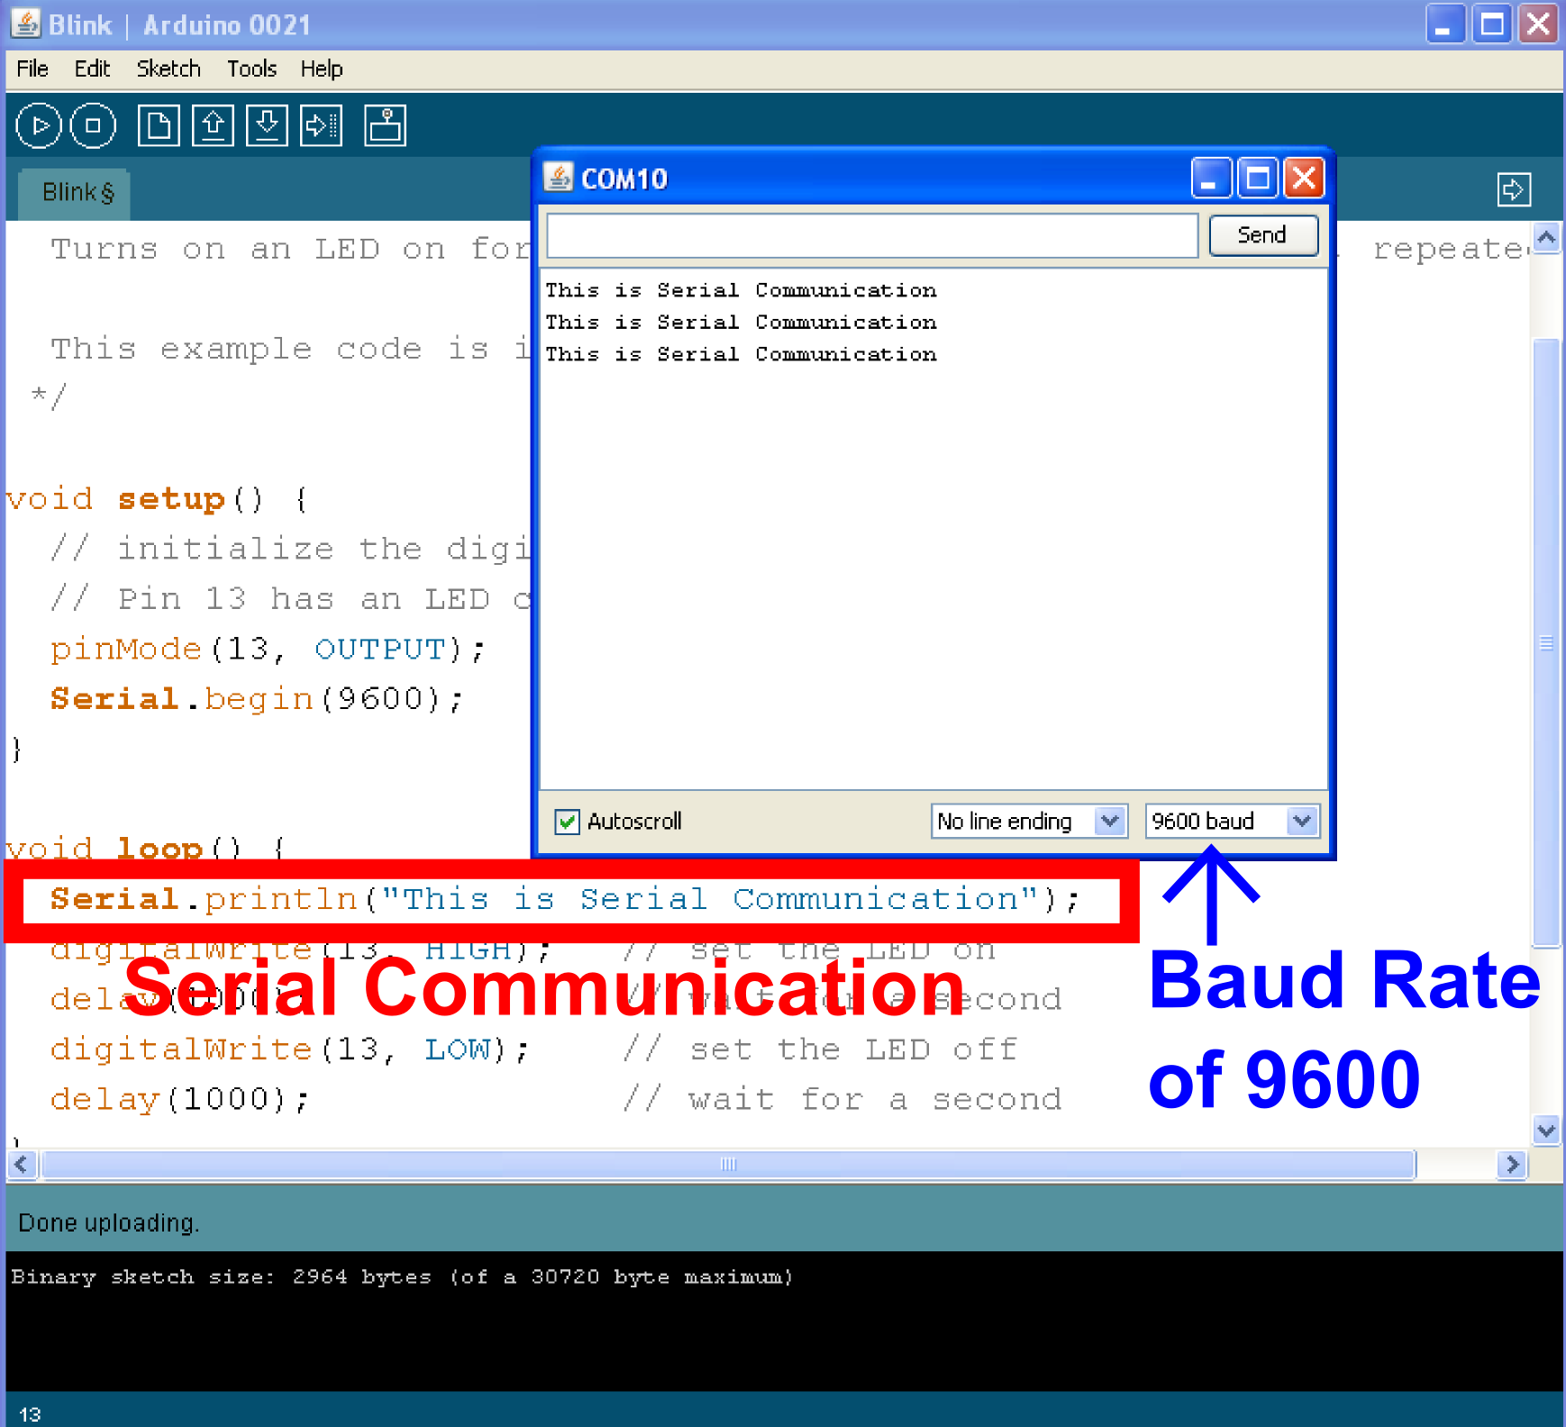
Serial Communication
Notes:
Blam.

Slide 30
Serial Communication: Serial Debugging
void loop ( )
{
int xVar = 10 ;
Serial.print(“Variable xVar is “);
Serial.println (xVar);
}
Notes:
Put this in the button example code. (Just the red example part)
Have it print something out if you’re pressing the button and not pressing the button.
Have them play with the switch too if you’ve got time. Same code again, just switch pins
This is good for debugging code. Keeping track of a timer. Looking at how many times an iteration of code is repeating, etc…

Slide 31
Serial Communication: Serial Troubleshooting
void loop ( )
{
Serial.print(“Dig pin 9 reads“);
Serial.println(digitalRead(9));
}
Notes:
Checking circuits. Troubleshooting instead of debugging. Electrical engineering aspect vs. computer science aspect. I hope you’ve been stressing the two ways to skin cats and corresponding sides of embedded systems- The electrical and the logical.

Slide 32
Last bit… the buzzer
Final command to know
tone(pin, freq, duration);
pin – the OUTPUT pin the buzzer is connected to.
freq – unsigned int (0 … 65,535)
duration – unsigned long (0 … 2^32 - 1)

Slide 33
World’s cheapest dubstep instrument
Tie both the buzzer and the LED to light sensor… and, create the world’s cheapest dubstep instrument.
Play with the frequency – scale it by applying multiplier factors or offsets.

Slide 34
Challenge – Who wants to be a winner?
Put together a project with the protosnap
Post it to social media – twitter, facebook, youtube
Send a link to education@sparkfun.com
Include:
Name, Business
What you do
Code
Deadline: Wednesday by midnight.

Slide 35
Resources
http://www.sparkfun.com
http://learn.sparkfun.com
http://www.arduino.cc
http://www.bildr.org
http://www.processing.org

Slide 36


Slide 37

Questions?

Slide 38

www.sparkfun.com
6175 Longbow Drive, Suite 200
Boulder, Colorado 80301

