Slide 1
Curating Your Best Collection
Becker Parkhurst-Strout
Monica Washenberger

Slide 2
Session Objectives
Understand CM concepts: What & Why
Develop a draft plan for CM at YOUR library
Identify YOUR library’s training needs & get ideas about how to meet them
Notes:
(Becker)

Slide 3
Who’s in the room?
How many people here are from public libraries? School libraries? Academic? Other types?
How many people work in library systems with ten or more branches? Less than ten? Less than five? One branch?
How many people have a system for weeding?
DPL at a glance: urban public library with 26 locations, 2 bookmobiles, 600+ staff.
Notes:
(Becker)

Slide 4
The Evolution of CM at DPL
Pre-floating
Floating = Culture Shift
Small team—Standards? Options?
CM Team formed with Admin Support
Notes:
(BECKER) Prefloating--local control, widely differing practices; Floating--culture shift, no one “owns” anything
Small team to look at standardization & options--needed support from management to implement ideas
CM team formed--met monthly--subcomittees for tmtl, documentation, training

Slide 5

The Evolution Continues…
Calendar & Standardized Reports
Developing detailed guidelines for non-conditional weeding (outdatedness, etc)
Robust communication plan
Notes:
BECKER Monthly calendar, which reports to run when, everyone weeds same section at same time, best for CDO in filling gaps/getting replacements
More standardization--cracking down on local stickering, special sections--need consistency in ILS--if you don’t change it in Polaris, you can do what you like
Detailed nonconditional guidelines--B & B (CEN has a big, old collection)--health, business, tech, science, outdatedness
Robust communication--google group (not just for reps), CM buddies, notes shared with managers to keep cm on their radar

Slide 6

DPL’s System of Collection Maintenance
Notes:
(Monica)
Our guiding philosophy - Why we weed? For currency, for use, the items you see are the face of the library
At first we met monthly - now we meet quarterly.
Monthly Assignments (will talk about this more later) CM 101 training, CMBuddies Group to help hold everyone accountable. Following are how we talk to people about weeding.
GUIDING Philosophy → why → weeding is important but not the be-all, end-all

Slide 7
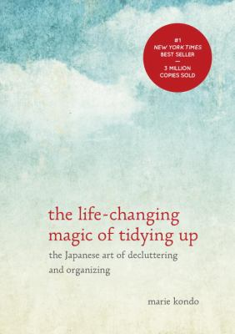
Life Changing Magic of Weeding
From Marie Kondo:
“when you discard an item, show appreciation for all it has done for you. Even if it is a [book that has never circulated] — it has served its purpose, and you thank it for showing you what doesn't work for [our collection].”
A light bulb went on (for Stephanie Two Eagles, PKH shelver)— if I silently acknowledge each worn-out book for its service before I dispose of it, I could weed like crazy. “Let them go, with gratitude,” she says.
Notes:
(Monica)
How do you get started weeding? How do you convince the reluctant weeder?

Slide 8
The Three Us: Used
Has the item been USED? (has it circulated/served its purpose?)
Cost per circulation goal = $3.45
CDs/DVDs = 5 circulations
DVD TV shows = 13 circulations
Books = 6 circulations
Paperbacks/Board Books = 3 circulations
Audiobooks on CD = 10 circulations
Magazines = 1 circulation
Notes:
Monica
Numbers established with the help of the Library board through research of other library districts.
While some titles don’t make it this far, many will circulate as much as 100 times. (18,626 items over 100 circs!)
This helps you cope when the new Disney travel guide falls into the Gulf of Mexico

Slide 9
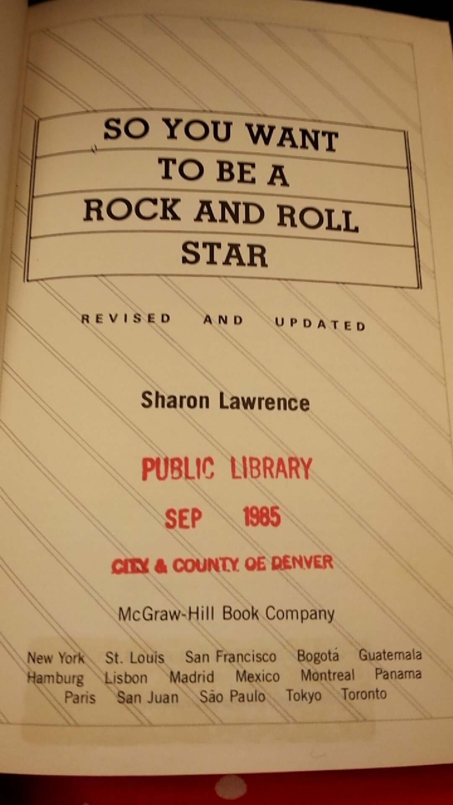
The Three Us: Useful
Is the item USEFUL?
Current
Supply/Demand
Notes:
Monica How to be a rockstar from the 1980s
Marketing on Myspace, Windows XP, Birds of the USSR, Atkins Diet
Who is asking for or using the item? Is it worth keeping for one customer? We are serving our communities with limited budgets, space, time, and resources. For many, we can access titles through Prospector and ILL.
Are they getting good usage from it? Just because they take it home, did it benefit them.
***
Computer books on Windows XP, Atkins Diet,
Is it just one customer who wants the stamp catalog? Is it worth keeping for one customer? We’re serving all of Denver with limited budget, space, time, resources
prospector, ILL

Slide 10
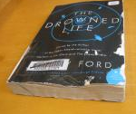
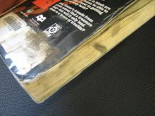
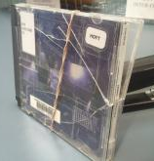
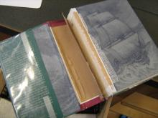
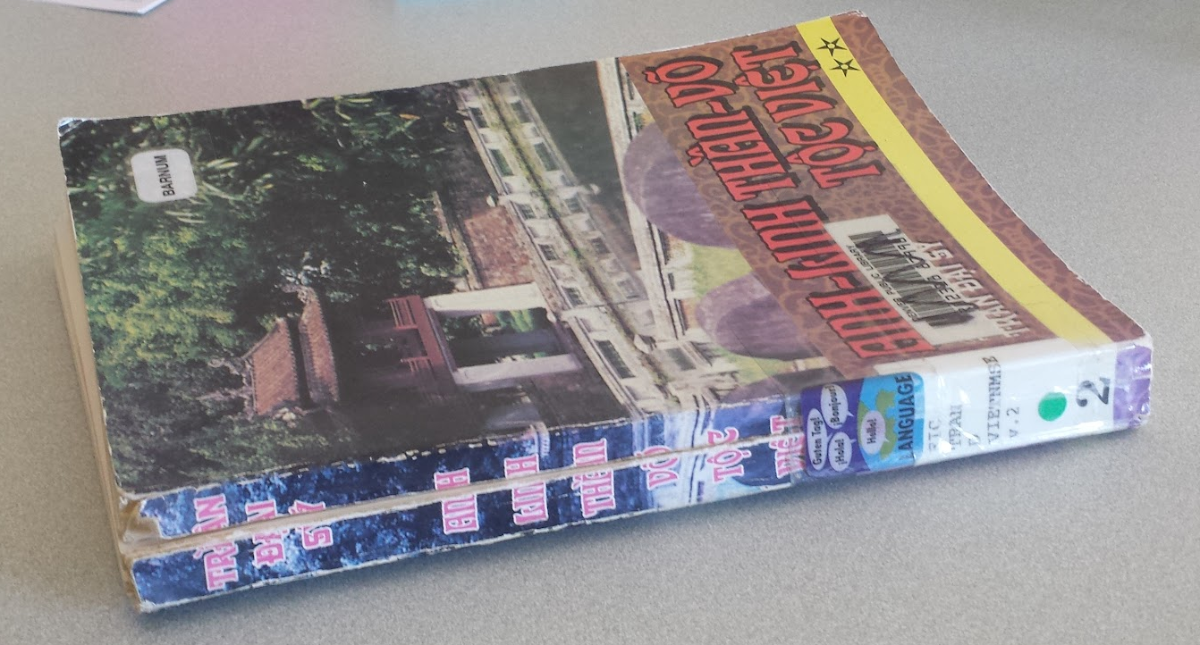
The Three Us: Usable
Is the item USABLE? (Is it in good condition?)
Notes:
Monica
“If the case for CDs doubles as a shank, please weed it.” — Monica
Taking a customer’s eye view, a first impression, the face of the library.
Having items that look nice encourages others to treat them well.
Would you take this book to bed with you?
Water damage
Guess the brown spot (example from CSL In Sessioin)
broken spine
pages falling out
ripped/written/colored on pages
defacing - crossed out words, highlighting, margin comments

Slide 11
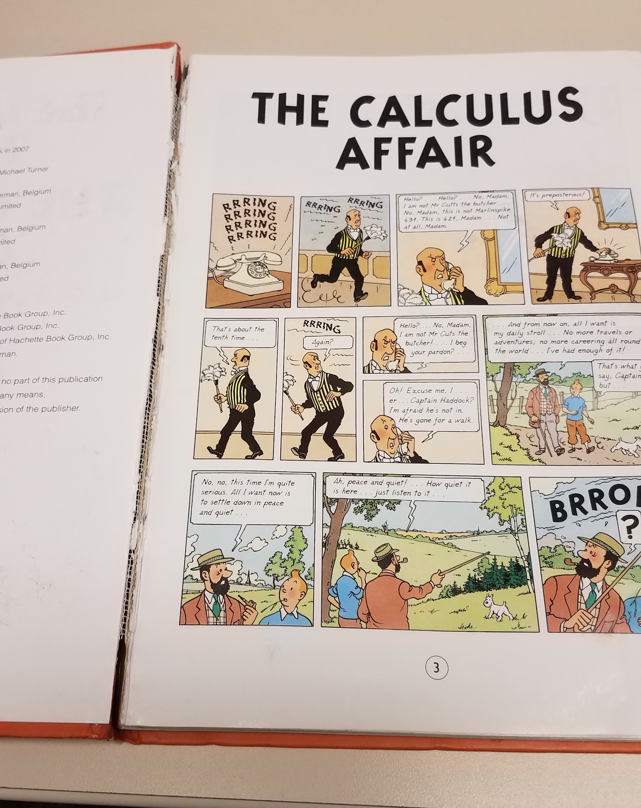
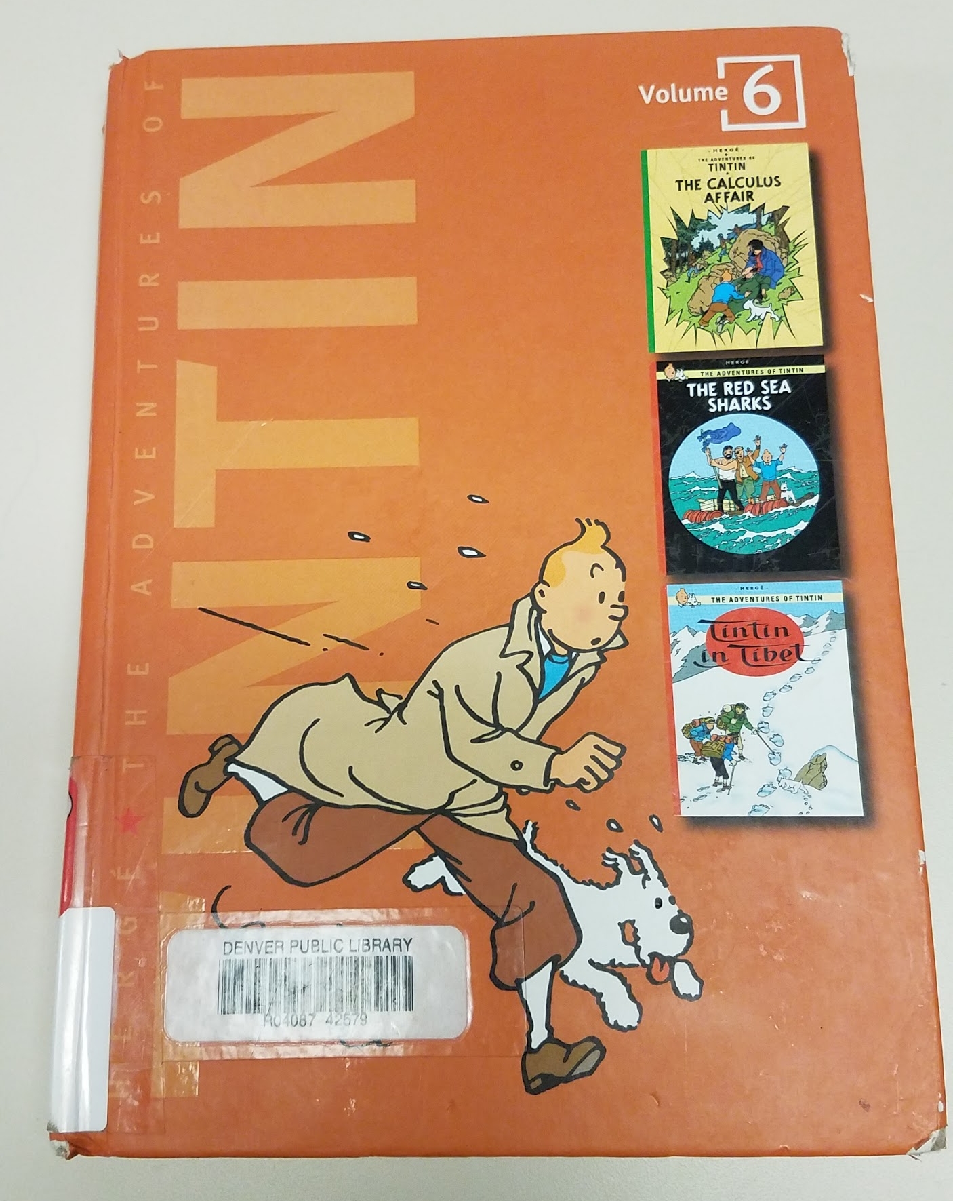
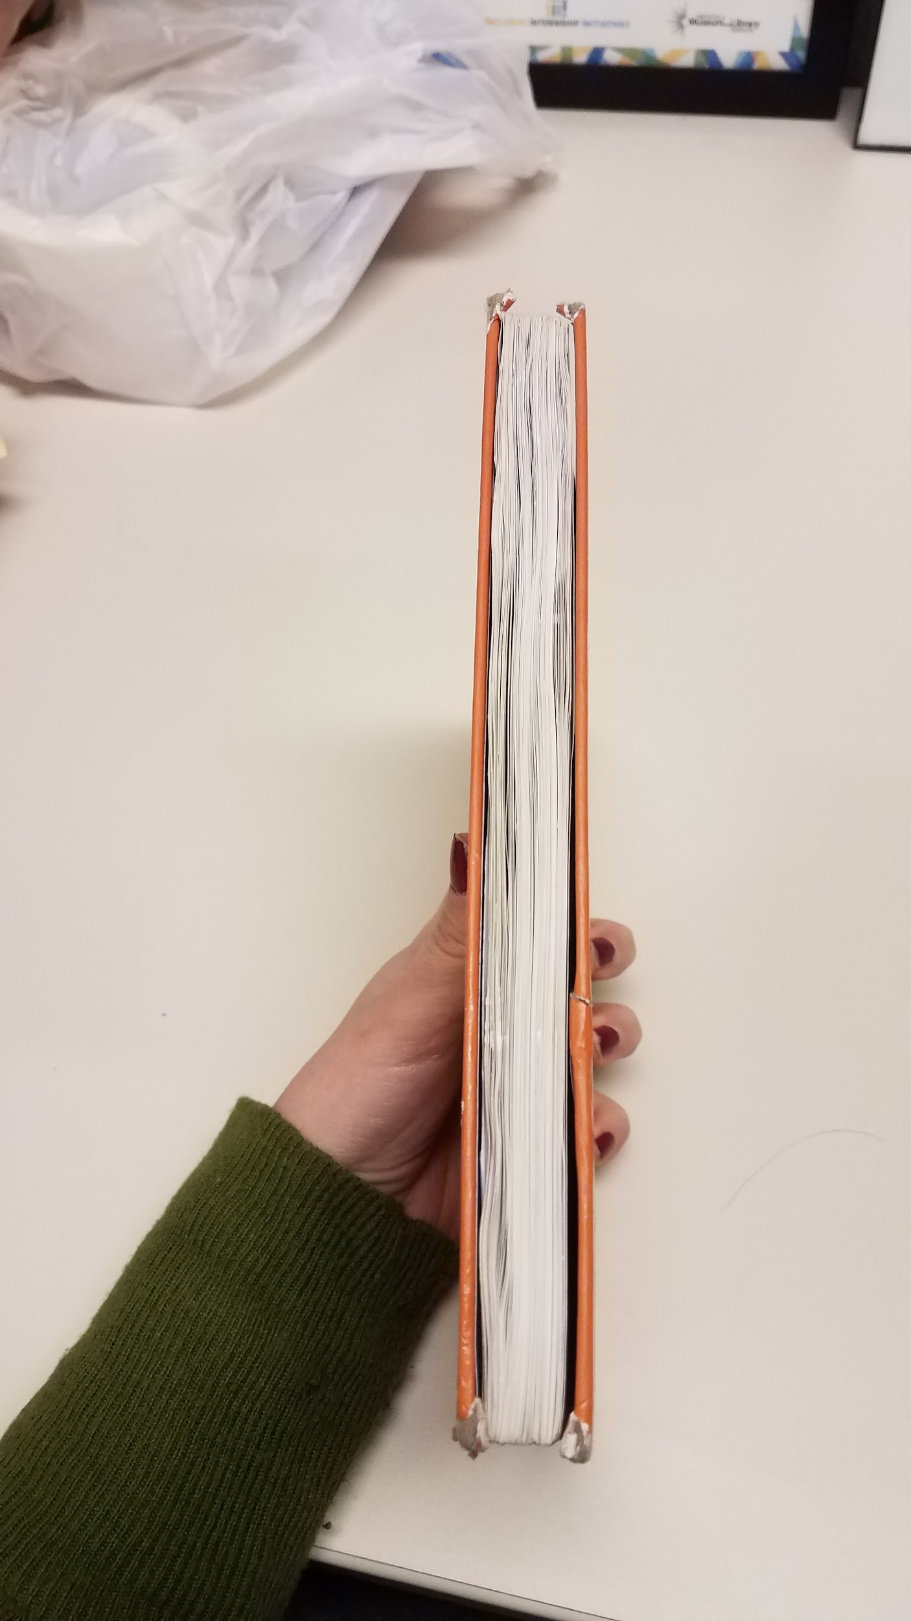
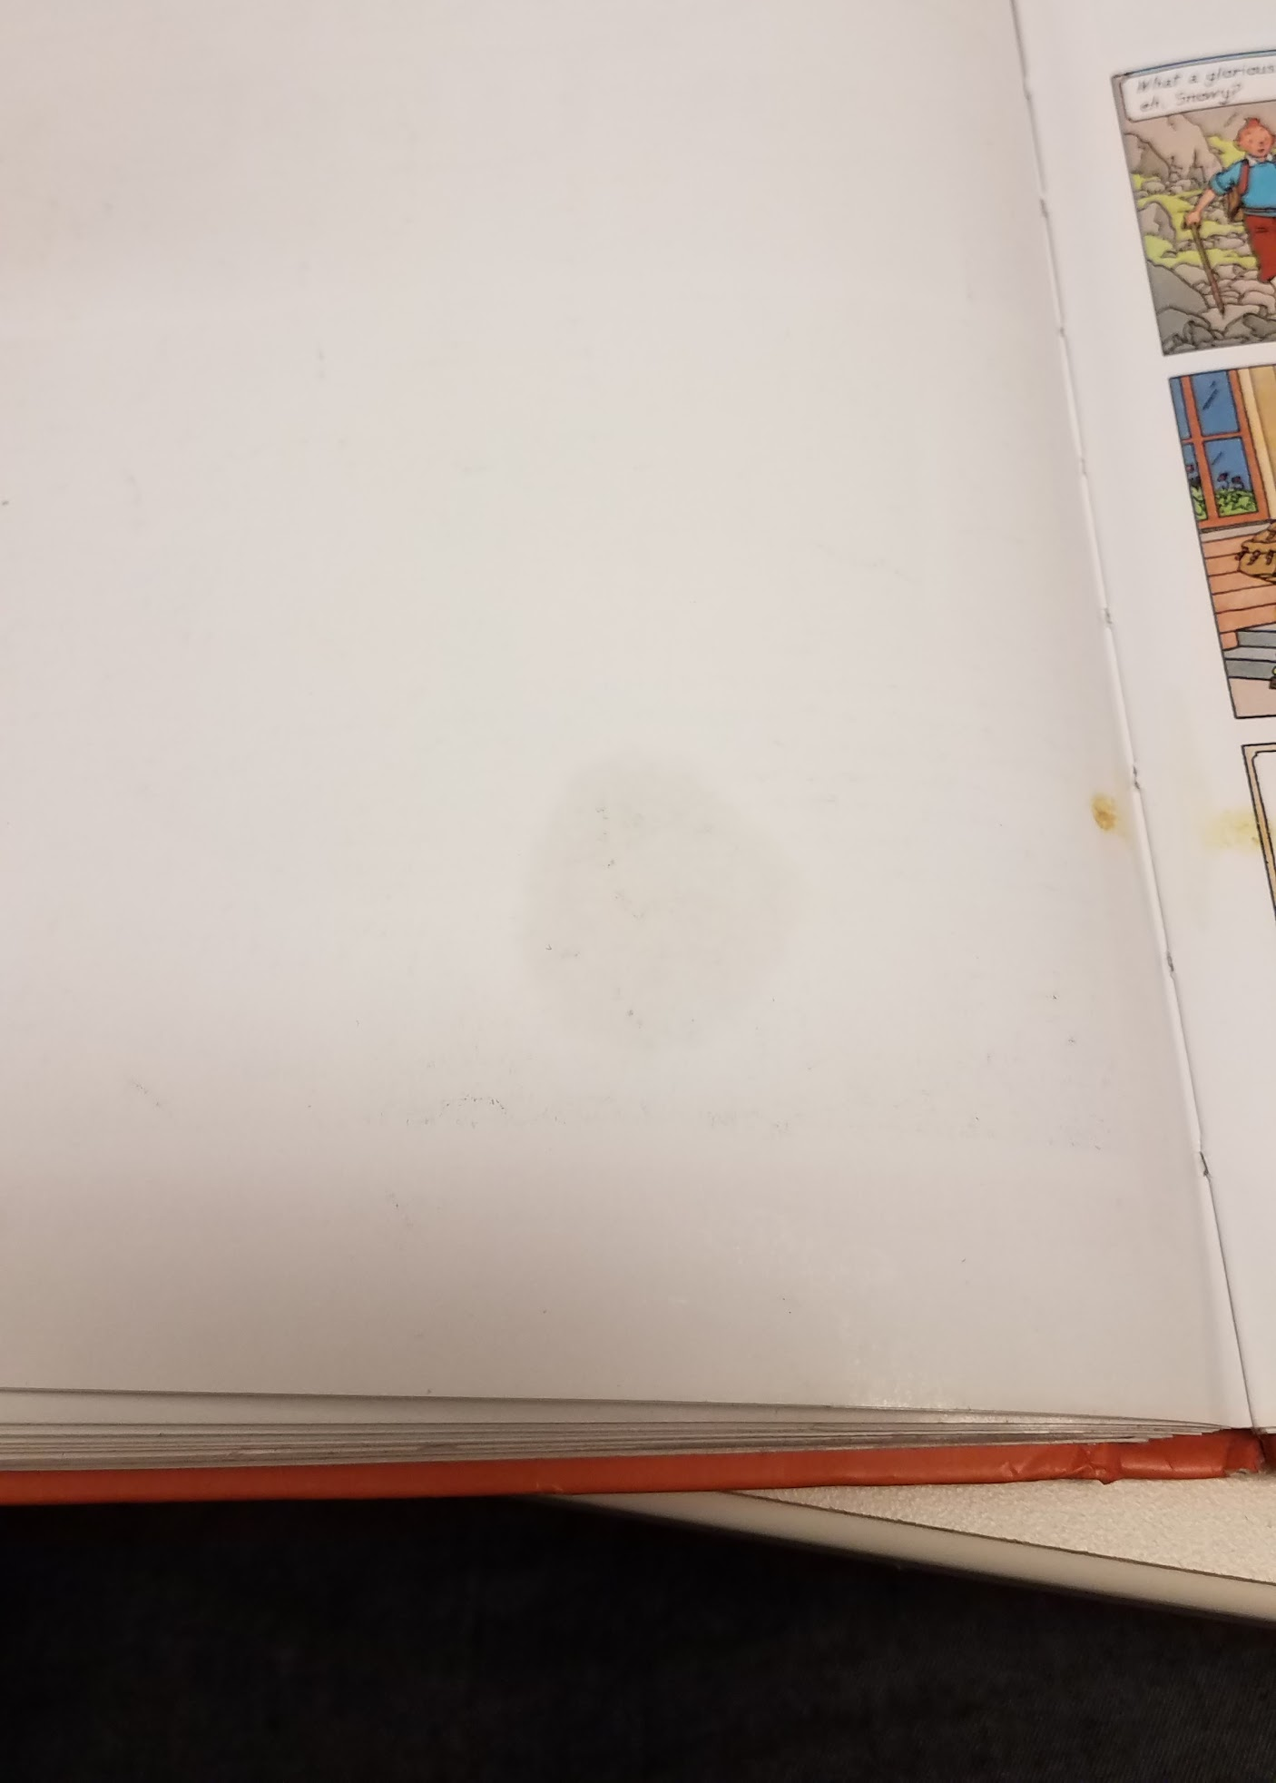
Would You Weed It? #1
The Adventures of TinTin, Volume 6
Notes:
This book also smells significantly of essential oils!

Slide 12
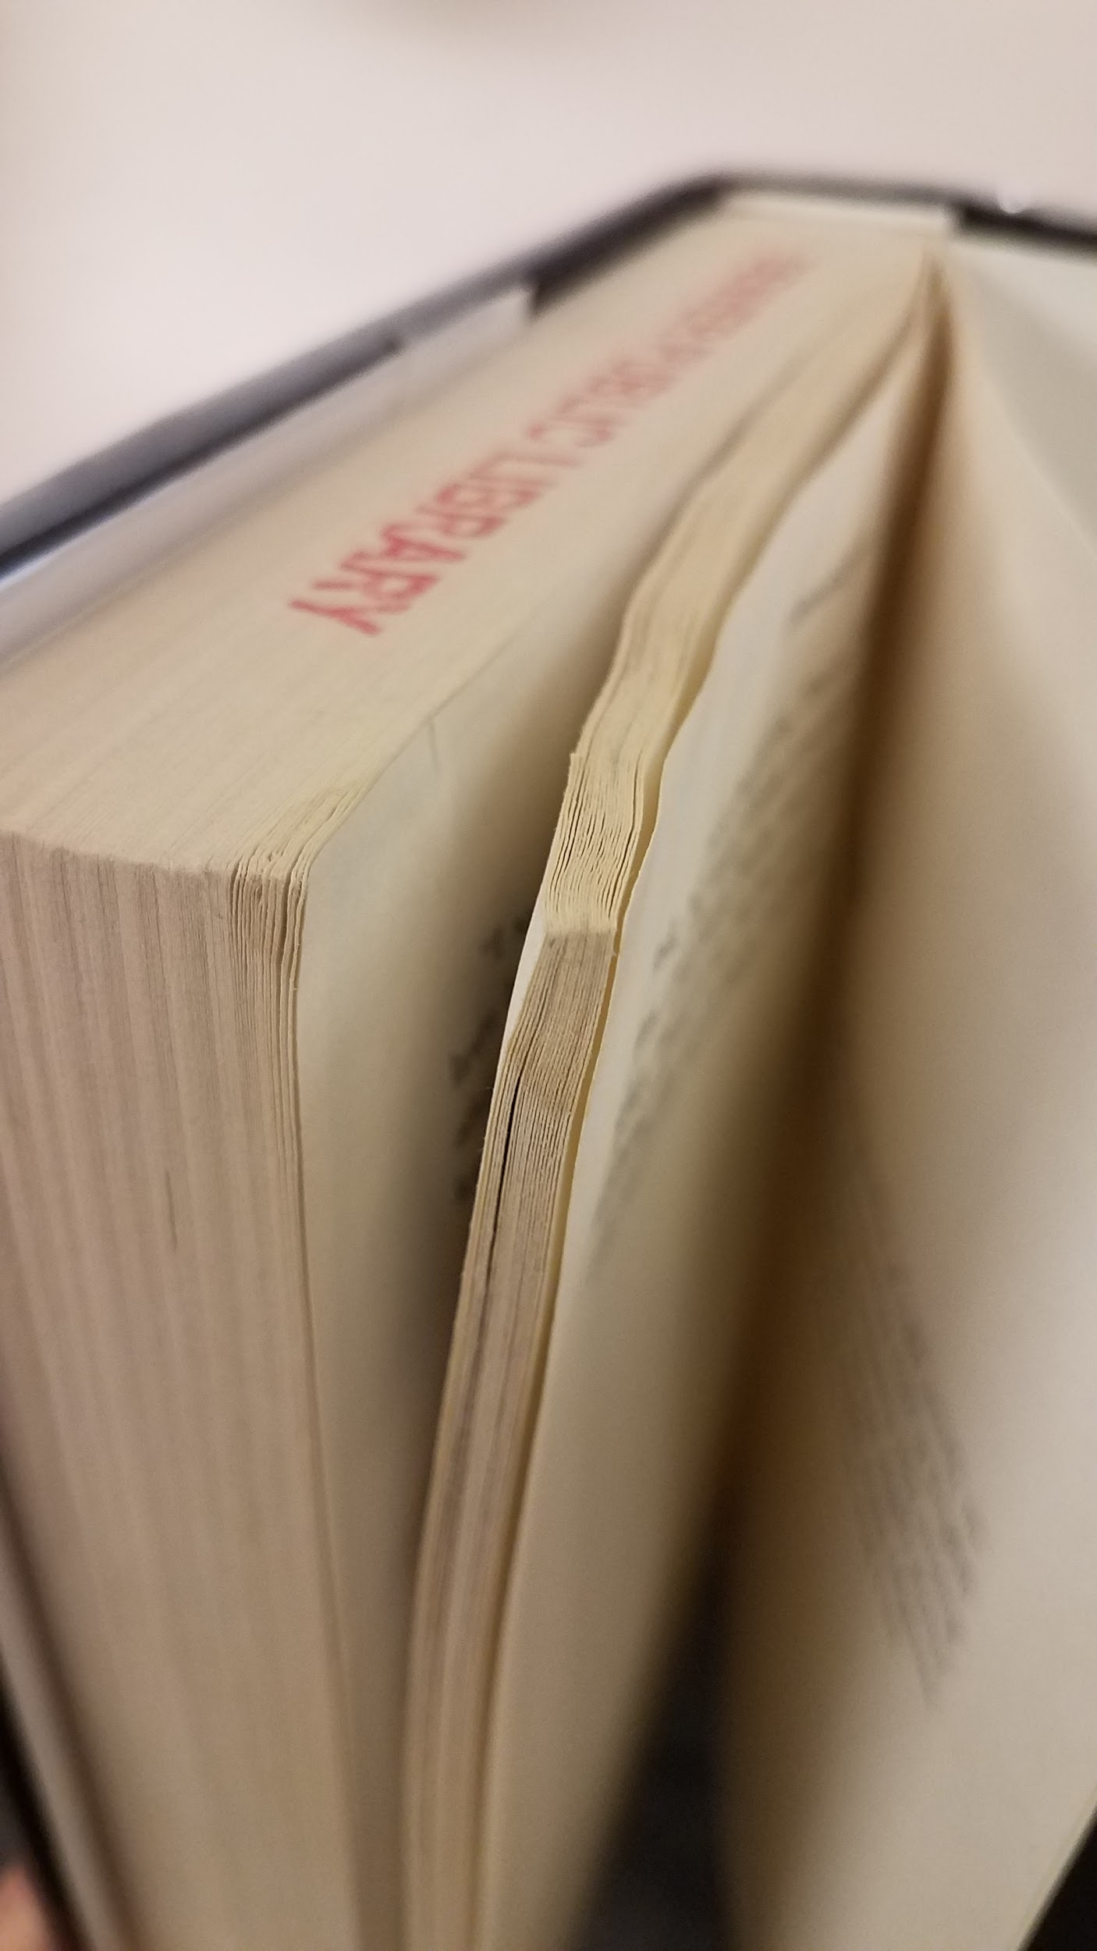
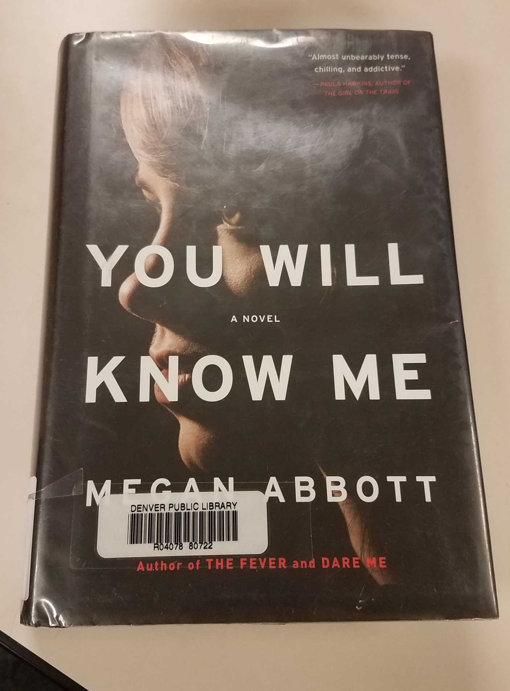
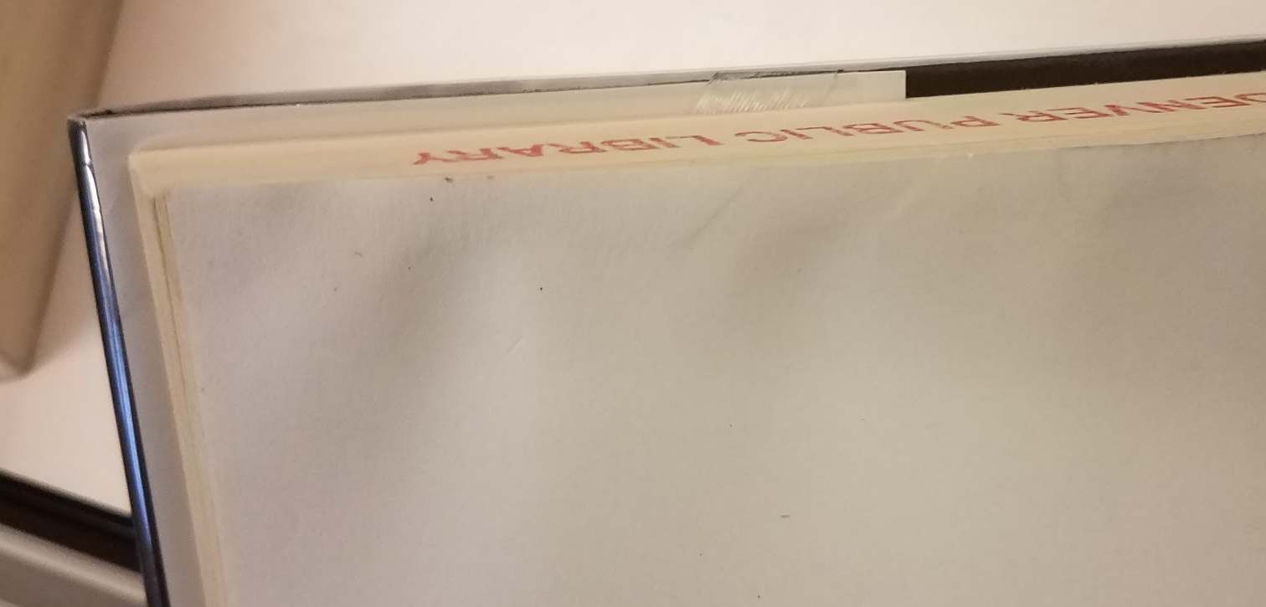
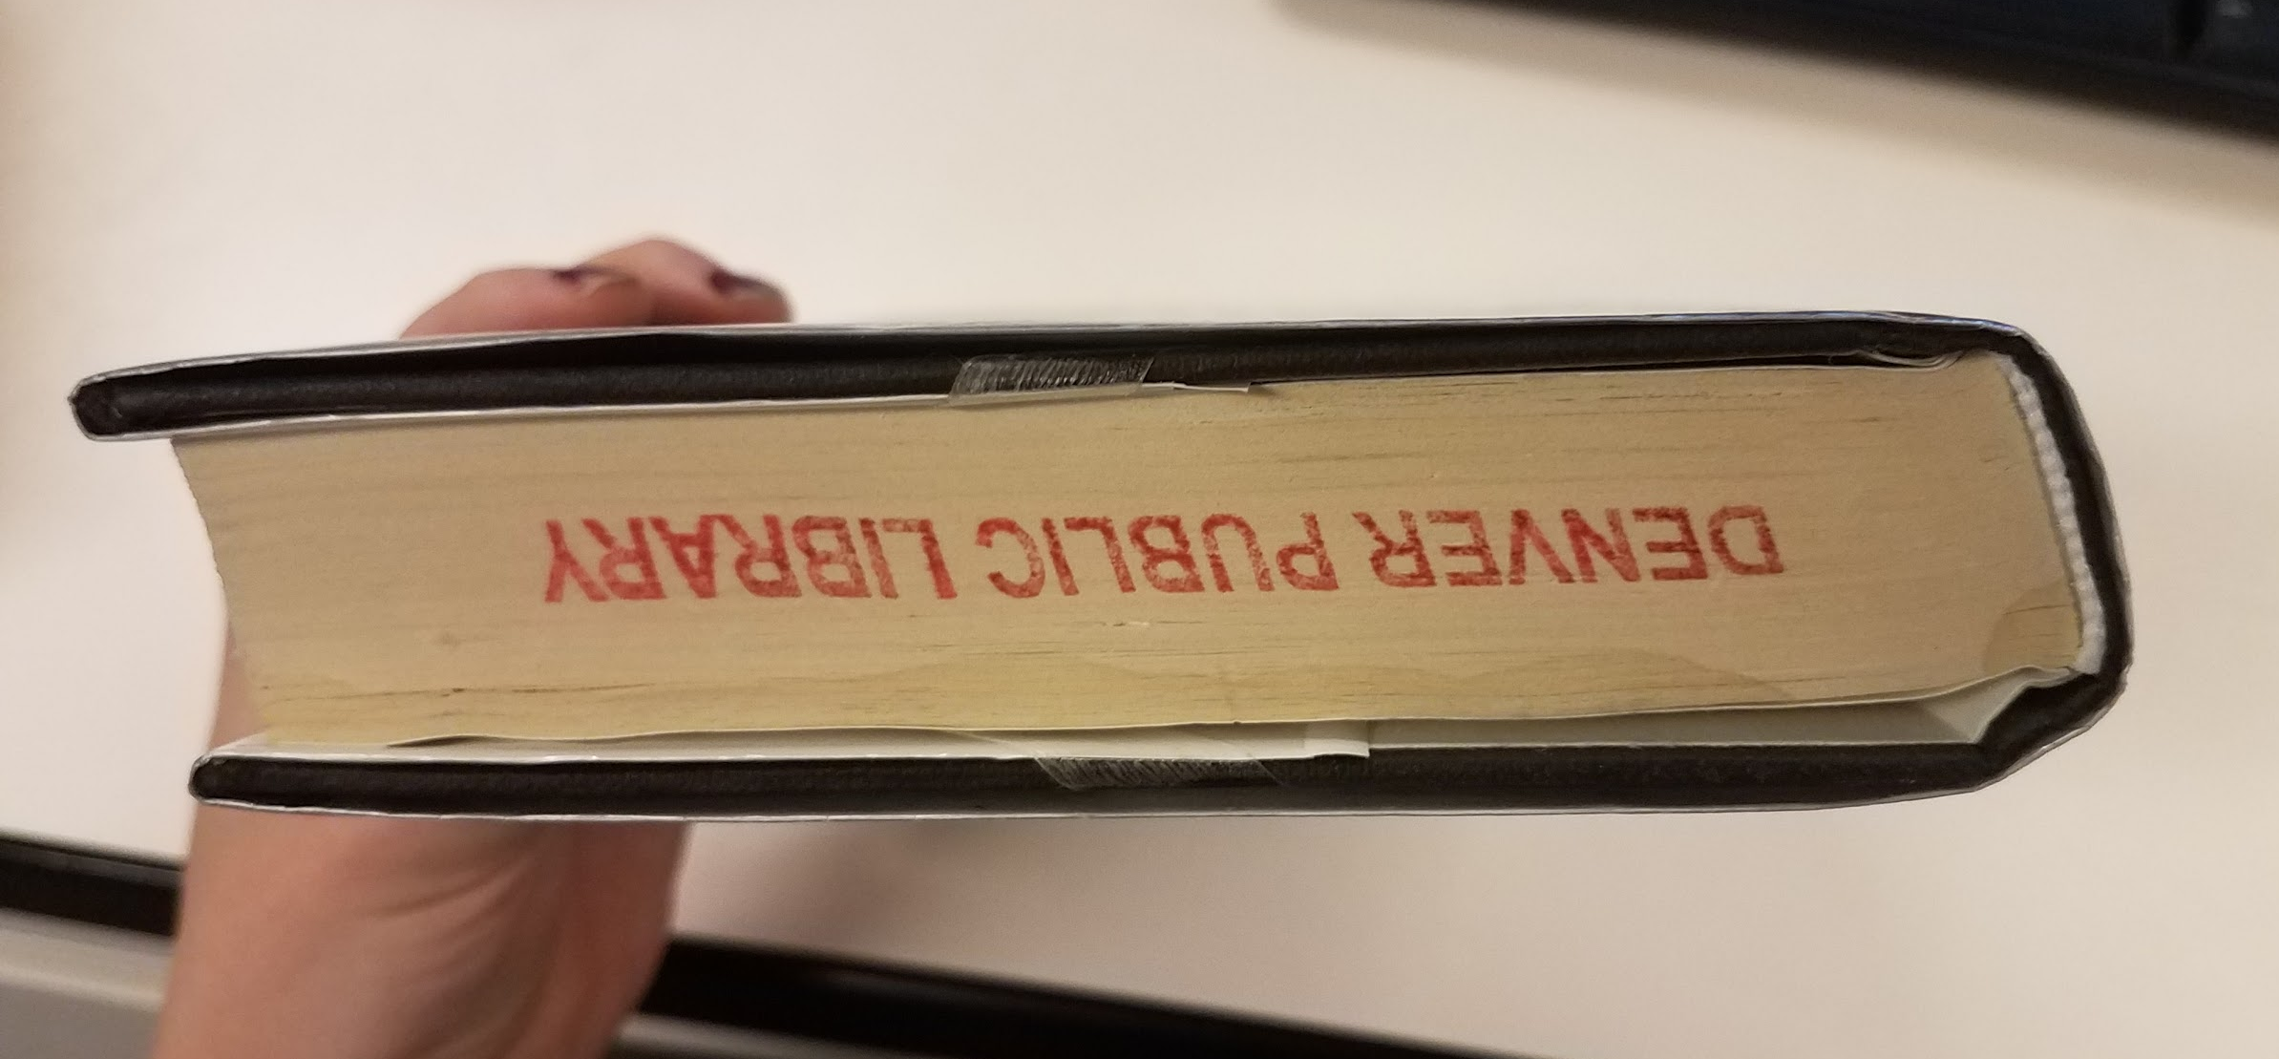
Would You Weed It? #2
You Will Know Me: a novel
Notes:
YTD Circ: 5
Life Circ: 24
Added 4/12/2016
17 Active copies w/ 3 out
Last Circ 9/24/2018

Slide 13
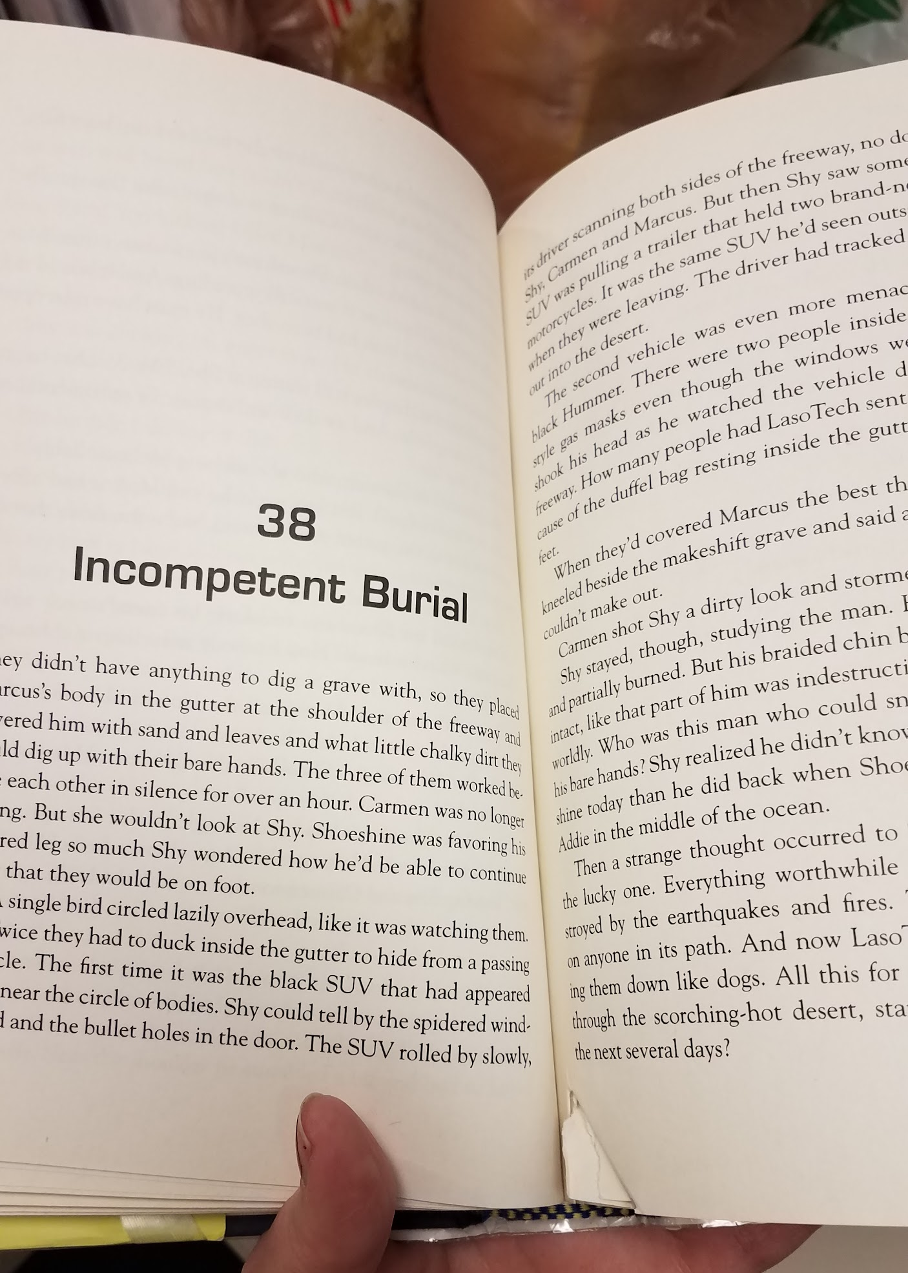
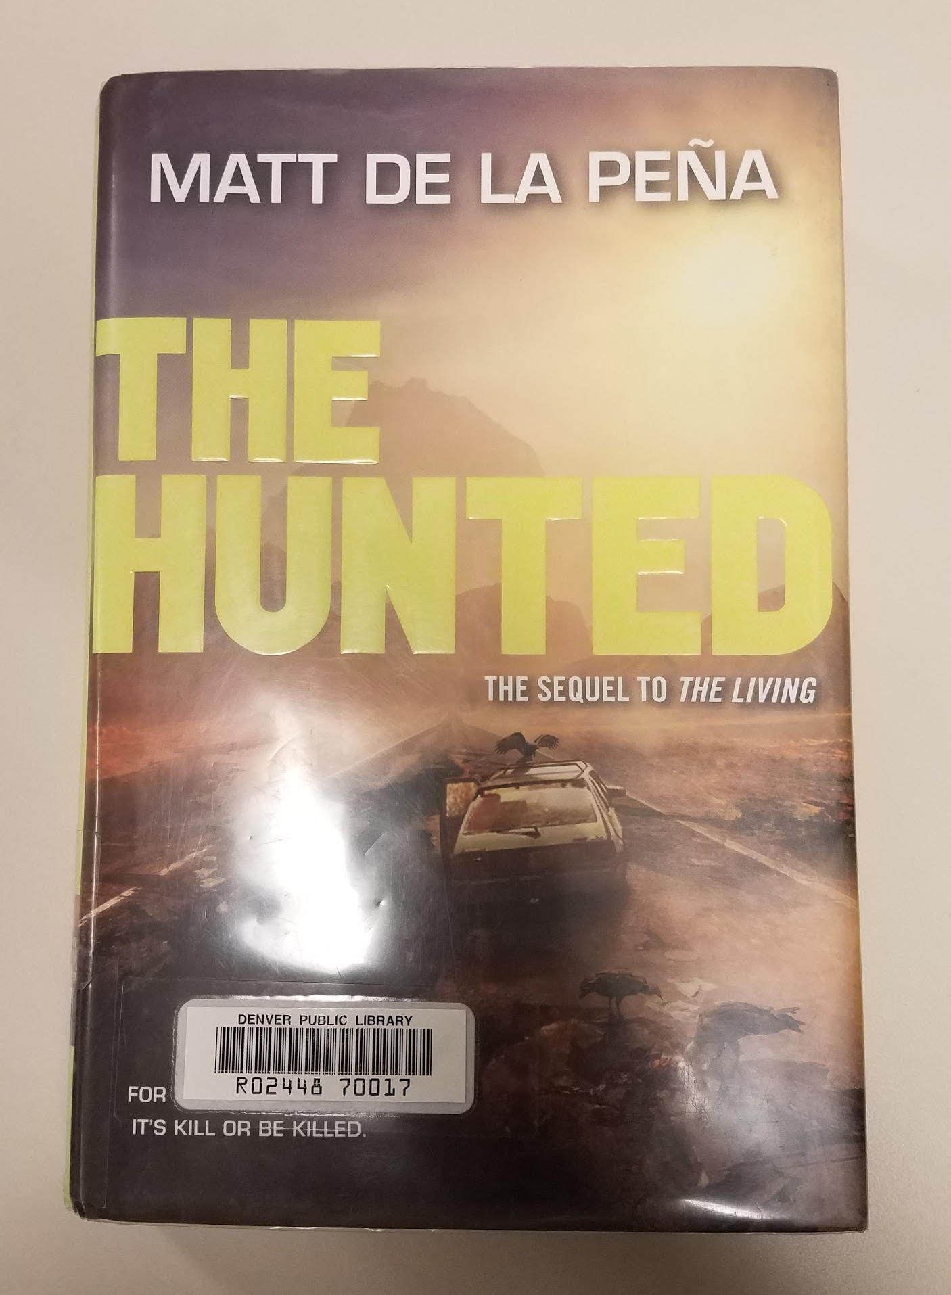
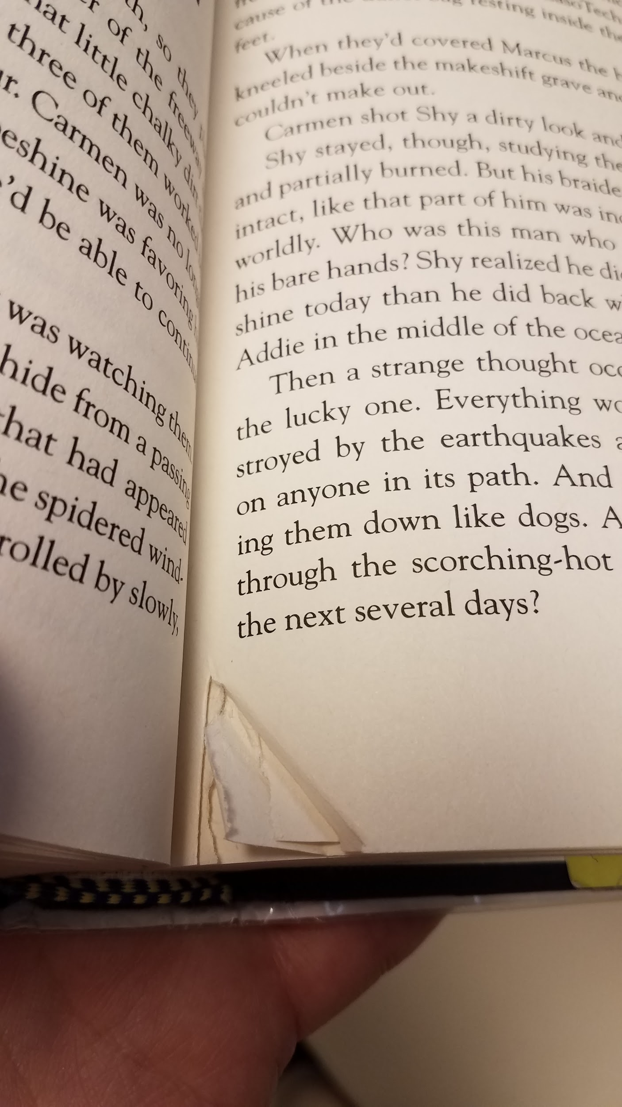
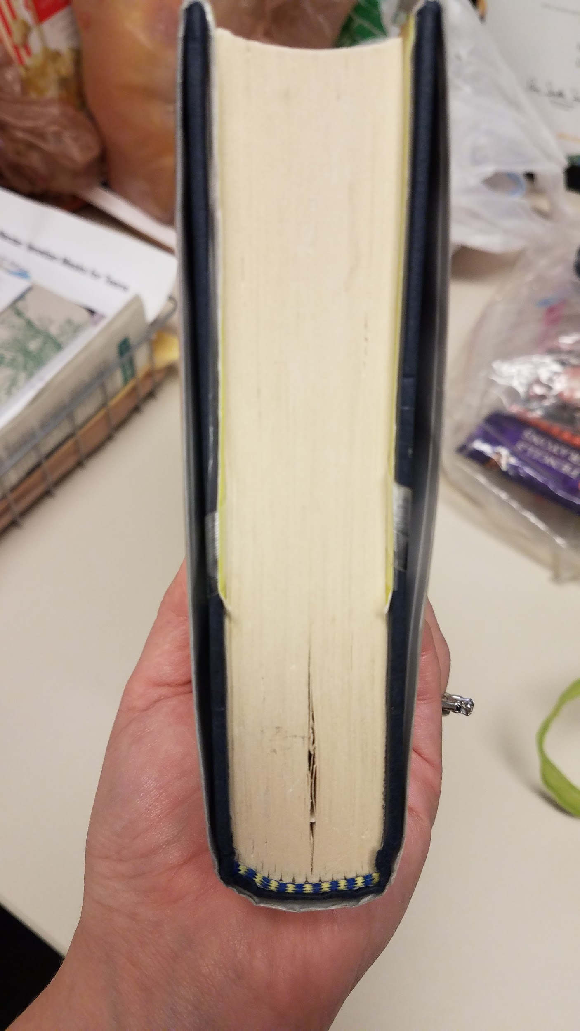
Would You Weed It? #3
The Hunted
Notes:
This book has not circulated in 4+ years

Slide 14
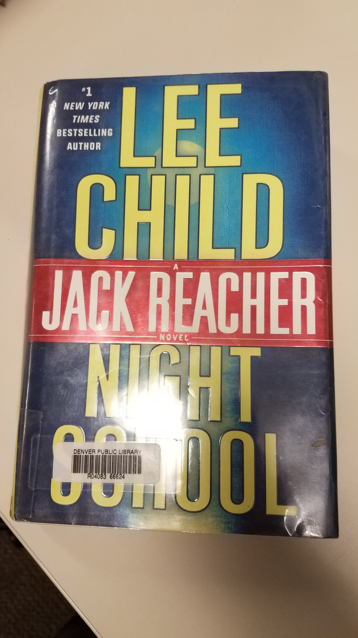
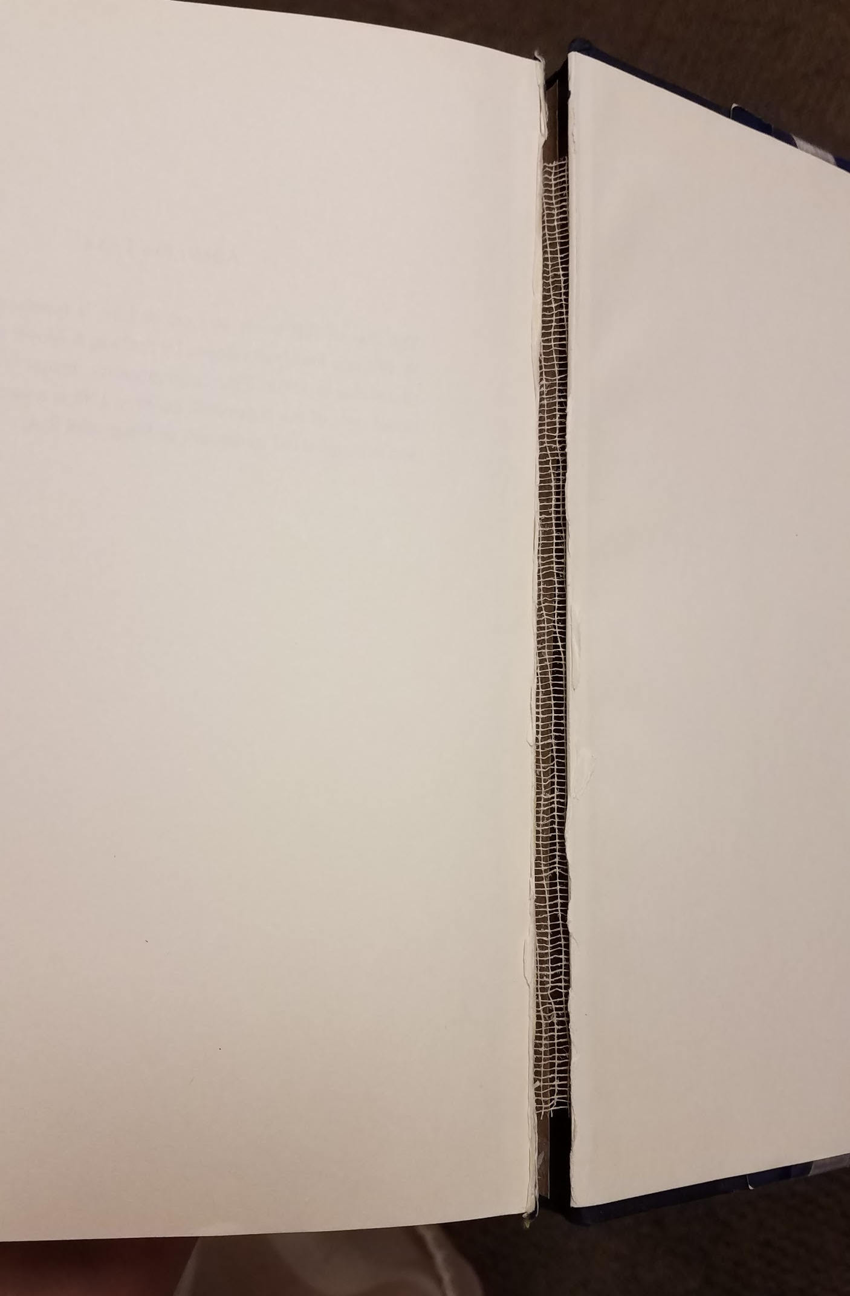
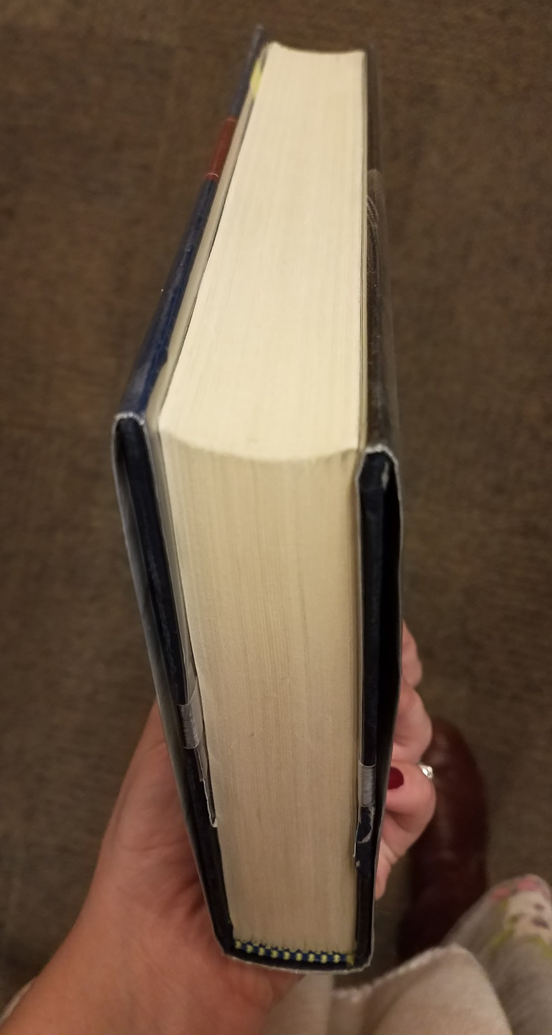
Would You Weed It? #4
Night School
Notes:
This book also smells significantly of essential oils!

Slide 15
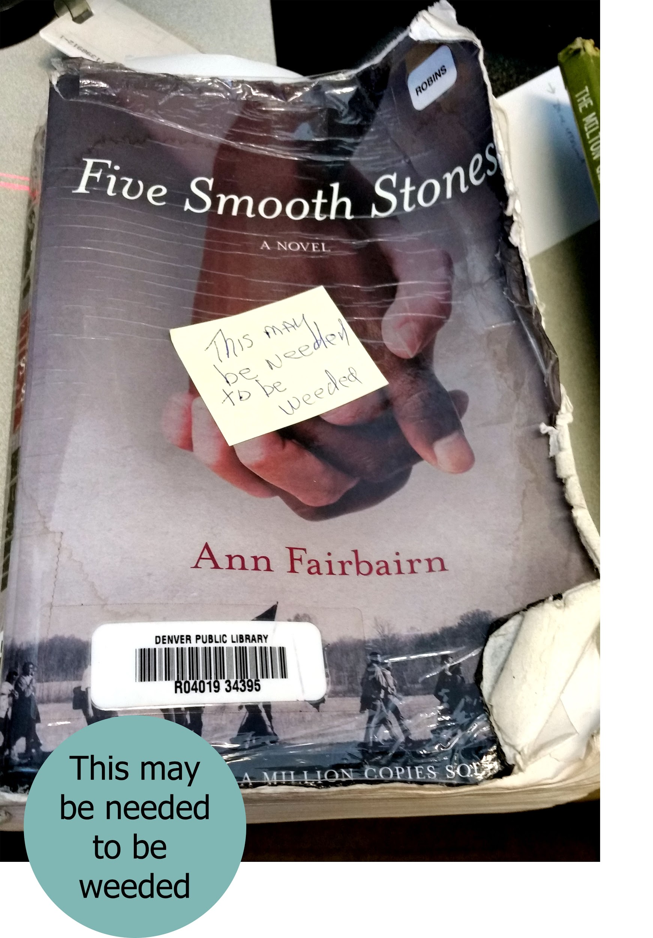
Informed Judgment
A double edged sword
Balance between empowerment and following standards
Have someone that you can go to for a 2nd opinion
Notes:
Monica
Build in checks that allow people of all staff levels to get involved but everyone is not necessarily the final decision maker. At DPL it varies by location.
Smiley with their “Weedatorium”
Informed judgment can be a double edged sword from a tiny fleck requiring a sticky note with an arrow to “this book with the block falling out can circulate one more time”.
Maintaining a balance between following weeding standards and being empowered to make reasonable decisions for your branch (while we might weed items where more than 20 items exist and less than 10 are checked out, can you apply that ratio to other items circulating poorly
Have someone for when you are second guessing, but be careful not to pass the buck, e.g. this item that came in delivery to our last copies team with a note that says, “This may need to be weeded”

Slide 16
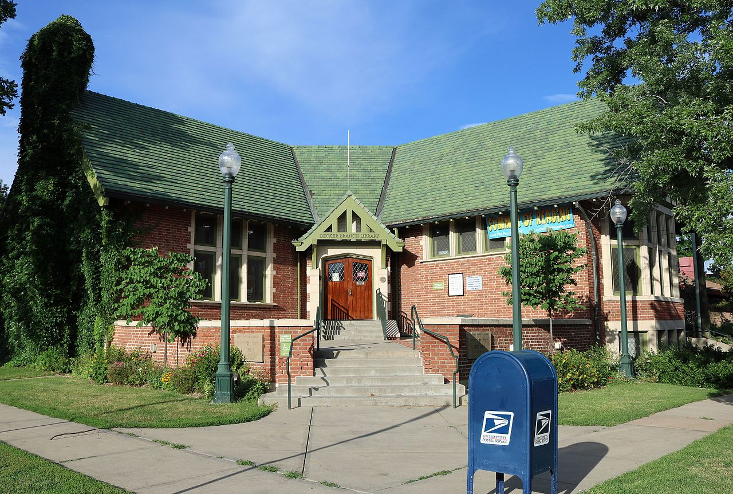
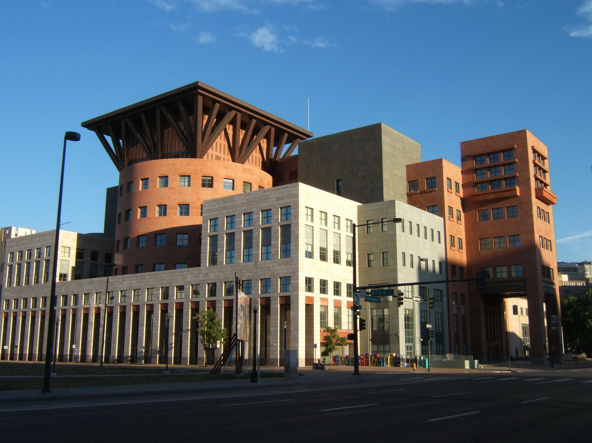
Scalability
Notes:
Monica (quick) Each location or library system can scale the ideas for what works at *your* library. Size?
371,854 items at Central vs. 12,109 items at Smiley (3.3% of what is on the shelf at Central)

Slide 17
Activity:Start a Draft CM Plan
Use the provided template to start listing the elements you would like to see in your CM Plan.
5 minutes: just to get ideas started
Notes:
Monica → Current state or needs assessment. What’s going well? Where is there room for improvement?

Slide 18
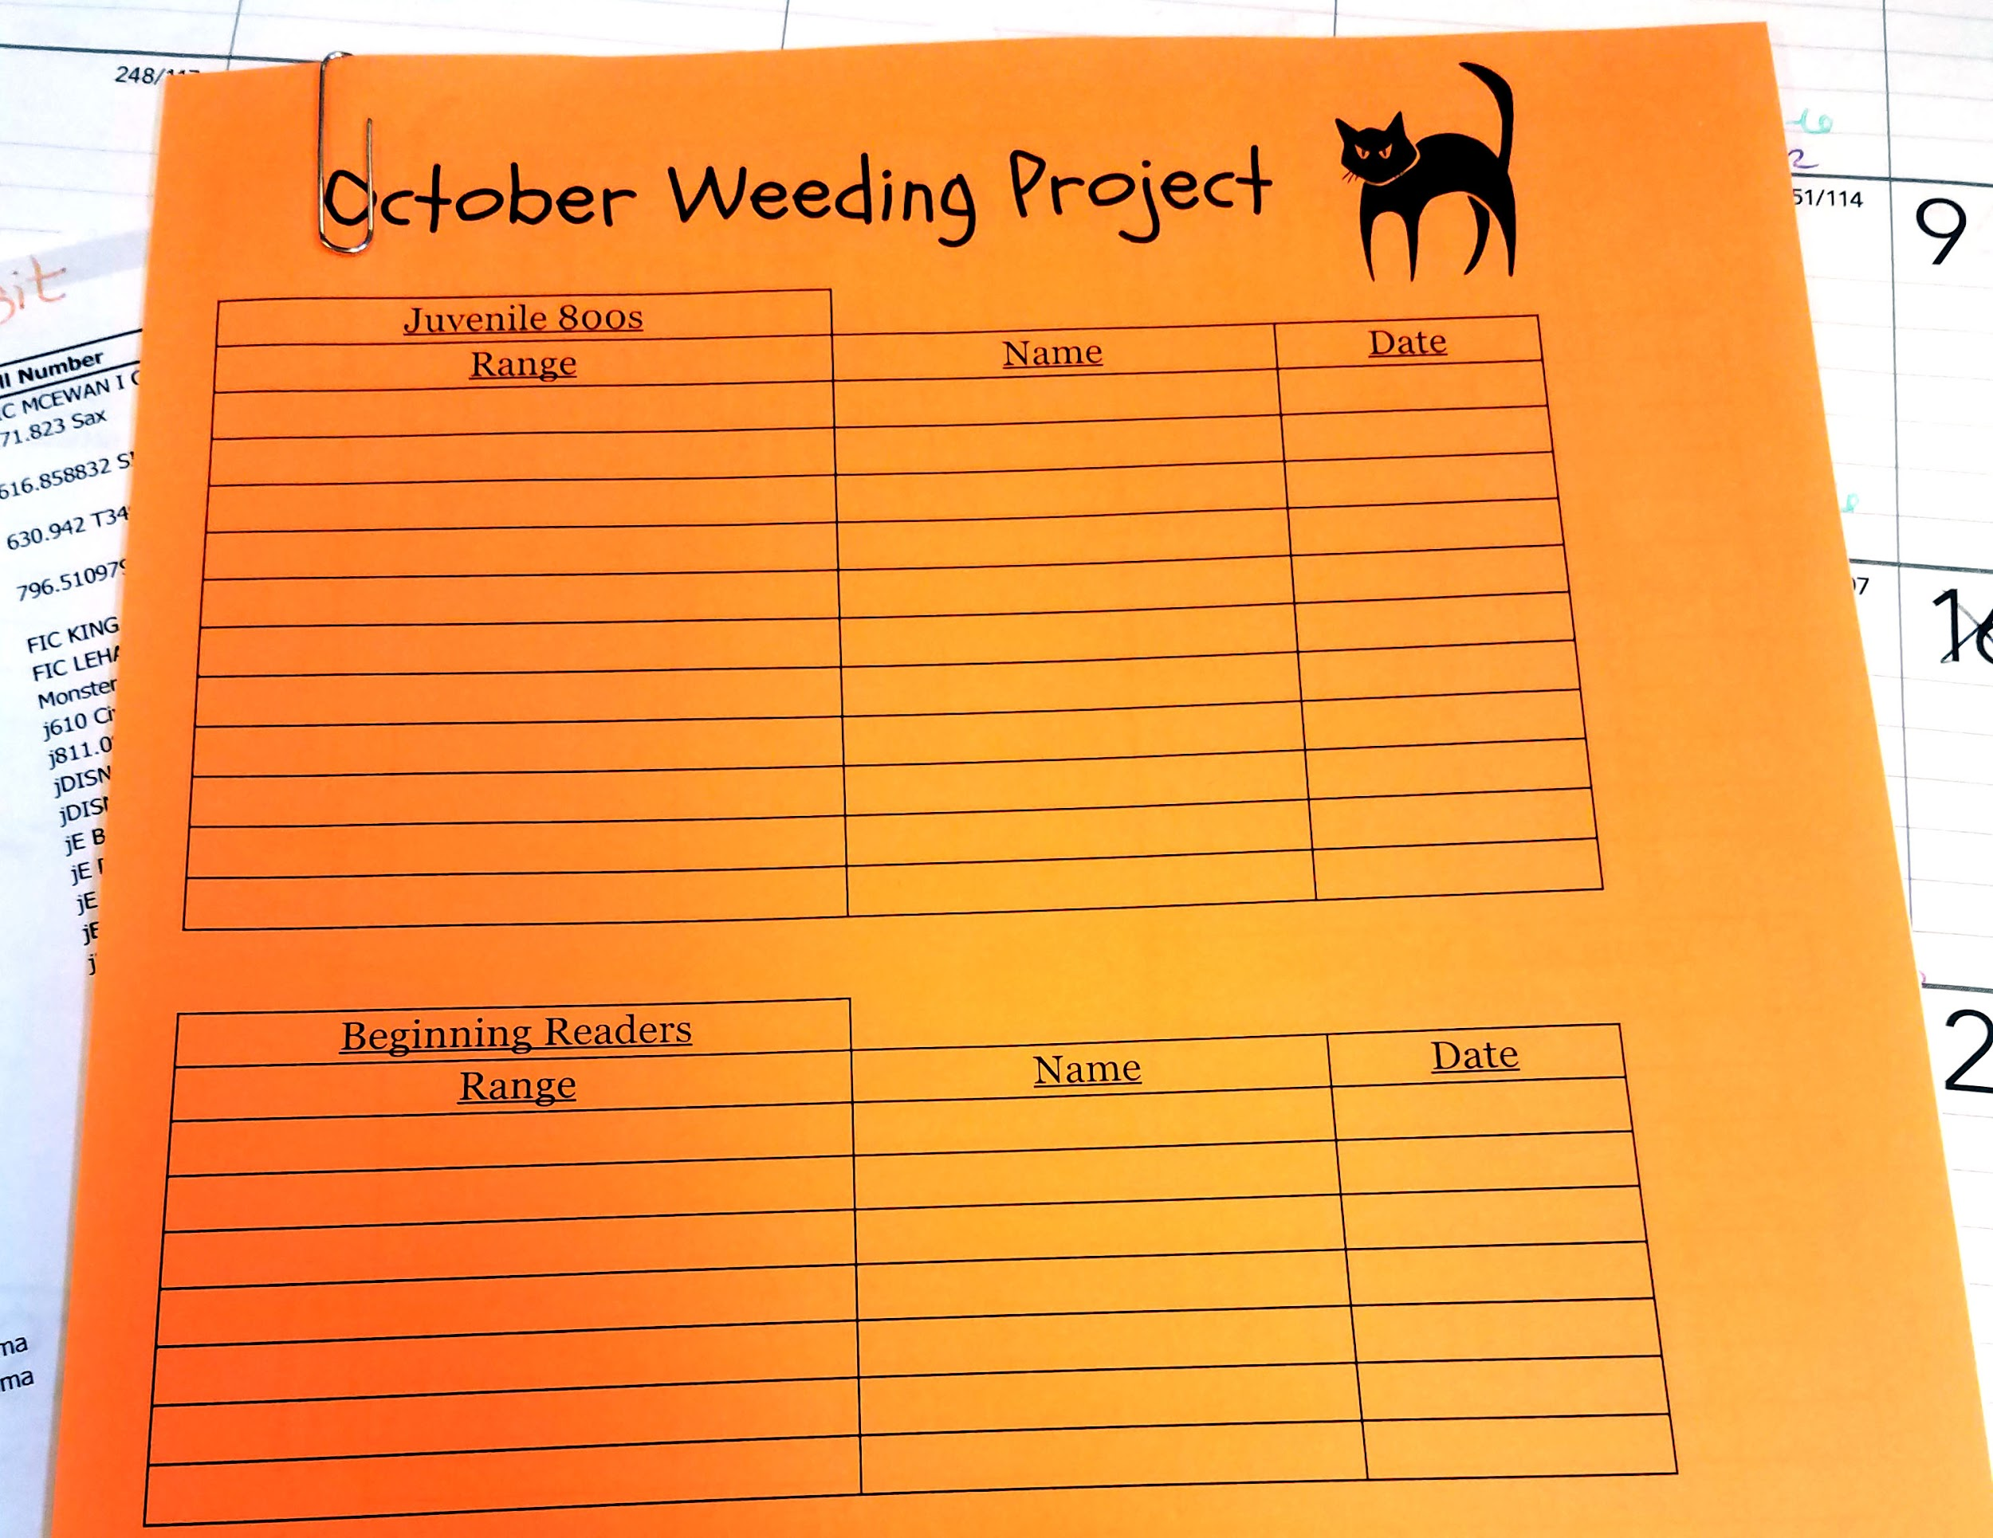
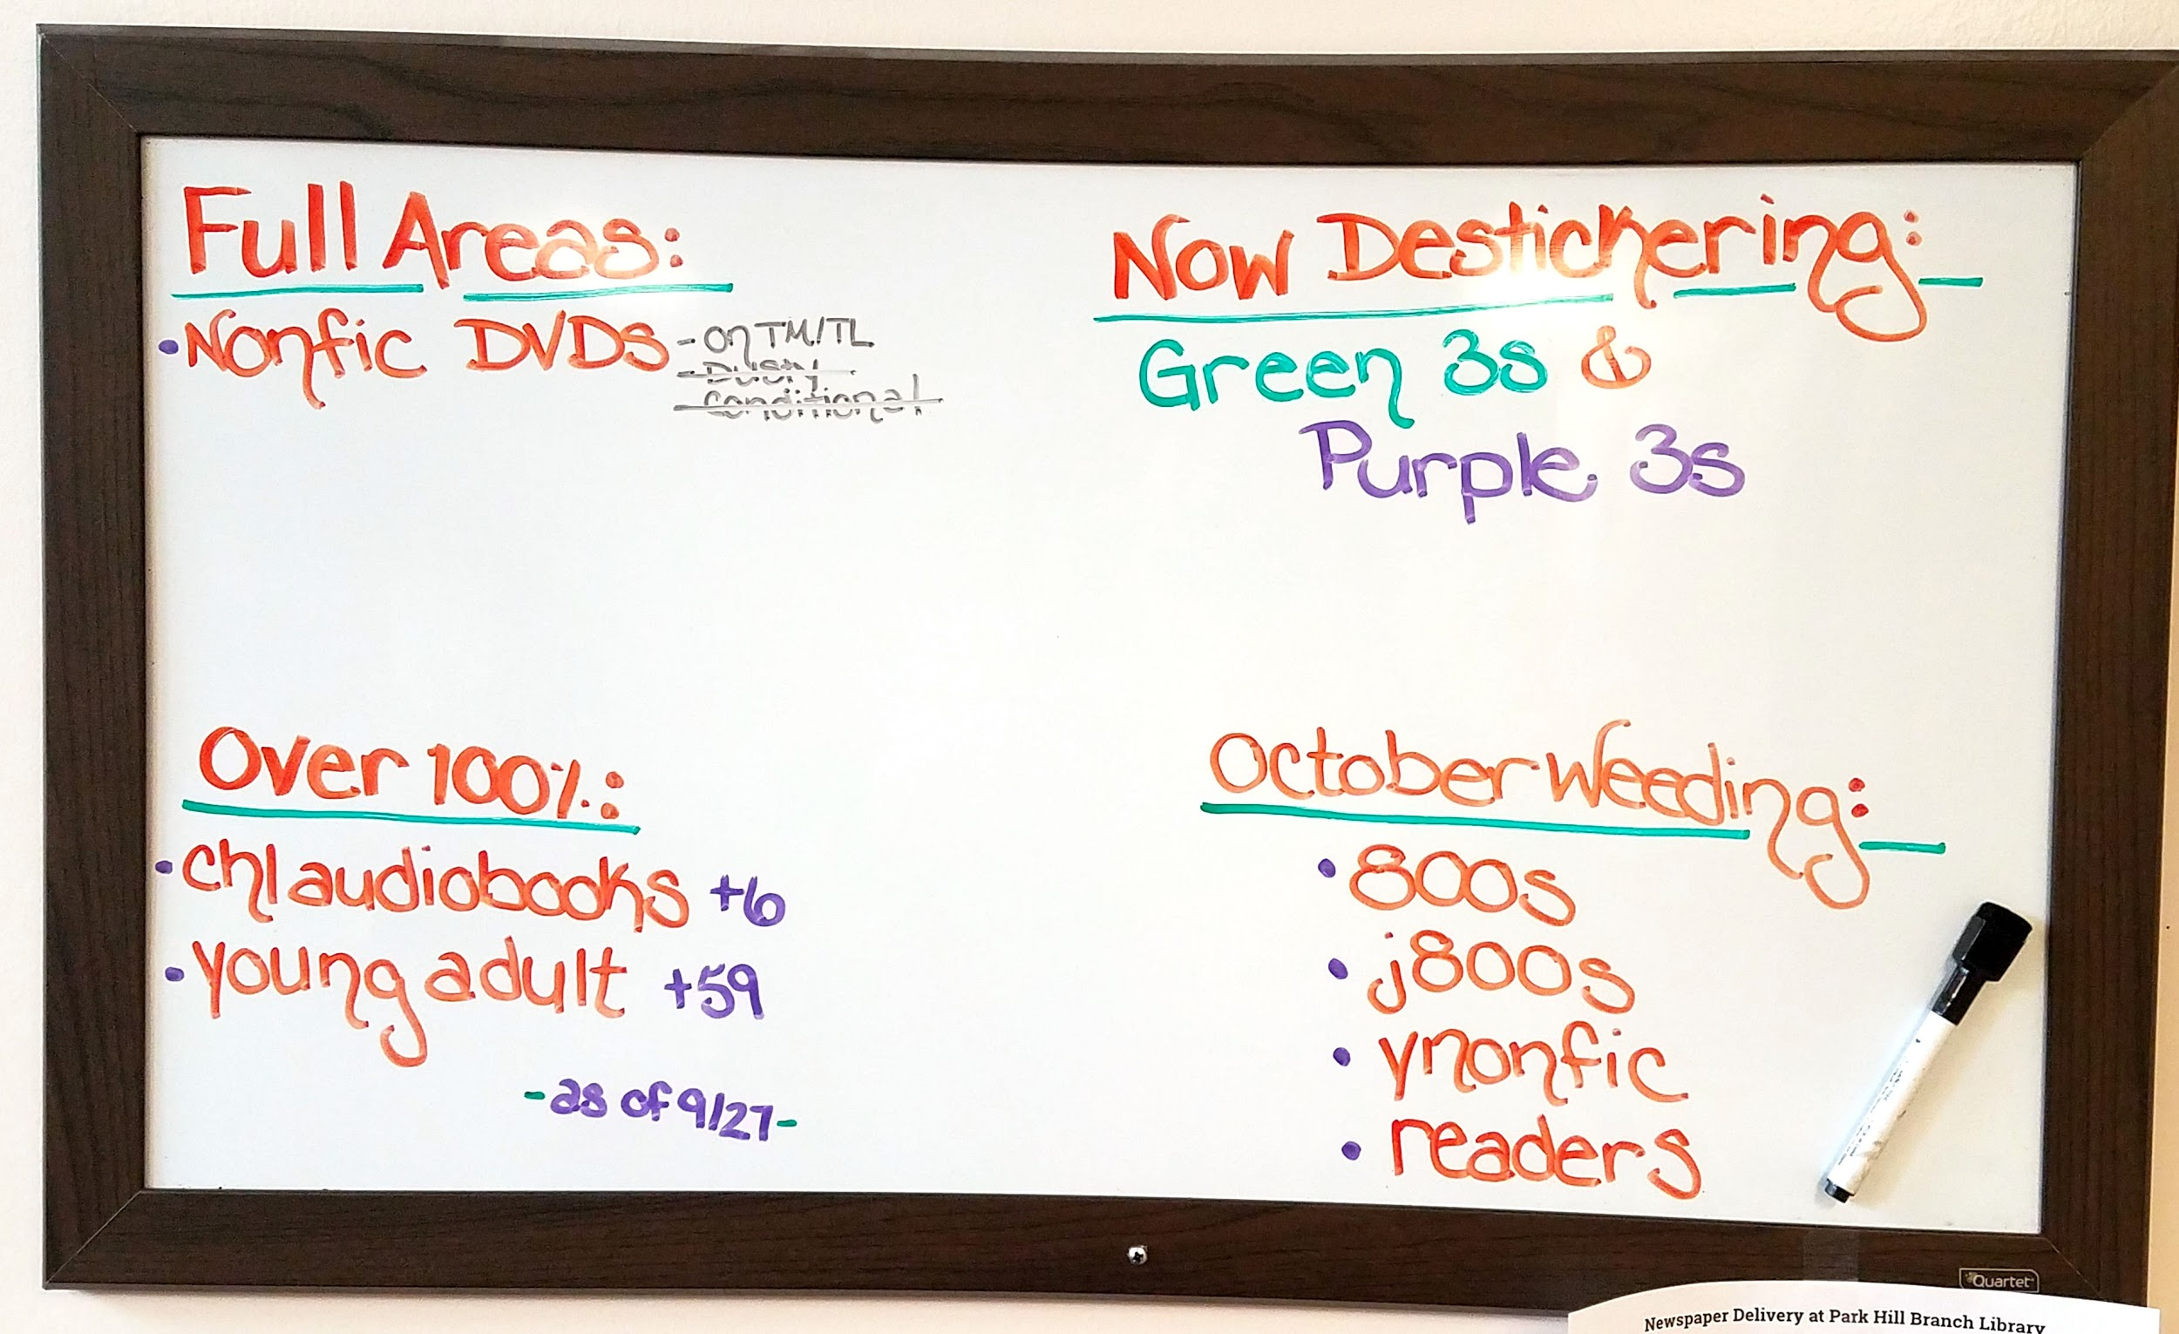
Communication
Began as an interdepartmental team including representatives from all 26 locations in 2013.
Meetings were monthly, then bi-monthly, now quarterly.
It doesn’t have to be high tech.
Notes:
Monica Team meetings, representatives (with the expectation of disseminating information), trainings, google group, meeting notes (digested for managers), buddies, Google Drive folder, binders, whiteboard, email and email groups, forms → it doesn’t have to be high tech (we use paper logs). Meetings also include speaking with other departments to work out finer points of policy (should we keep buying children’s music CDs; REF and B&B developing guidelines) How do we get things to CDO & TAS? Courteous emails! I am not tied to these images.- MW Everyone was invited to join (with supervisor approval)

Slide 19
Documentation - Chart
Month | Adult Books | Children’s books
JANUARY | Adult Fiction A - I | Picturebooks A-I
 | 000s | 000s
 | Audiobooks | Audiobooks
 |  | Holiday Books
FEBRUARY | Adult Fiction J - Q | Picturebooks J-Q
 | 100s - 200s | 100s-200s
 | YA Fiction
The Annual Calendar
Instructions for specific areas of the library
Do it yourself reports
Notes:
Monica Annual weeding calendar departments and branches to come up with specific guidelines for each area of the library for non-conditional weeding., Established guidelines for and shared out who does what (CDO & TAS forms, roles established in CM 101, buddies to steer people in the right direction). Worked with Google Drive has been so important-- documents kept up to date, easily shared, commenting, virtual meetings. We gave up on the intranet. Is it Used (Grubby), Is it Useful (

Slide 20
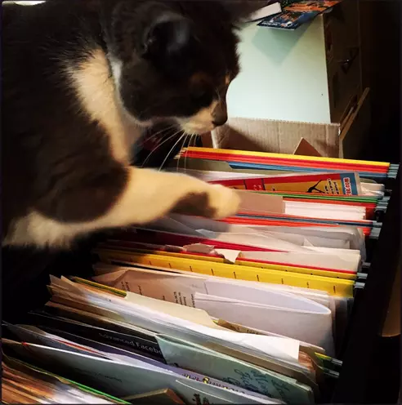
Documentation
Who does what?
Streamlined by standardizing communication
It’s the destination, not the journey
Notes:
Monica Annual weeding calendar departments and branches to come up with specific guidelines for each area of the library for non-conditional weeding., Established guidelines for and shared out who does what (CDO & TAS forms, roles established in CM 101, buddies to steer people in the right direction). Worked with Google Drive has been so important-- documents kept up to date, easily shared, commenting, virtual meetings. We gave up on the intranet.

Slide 21
Training and Staff Alignment
How many people work in libraries where all/public facing staff participate in collection management?
How many people have talked about weeding with your whole staff?
How many people train new hires on CM?
Notes:
Becker CM buddies → design training for CM topics and also reporting software. Have small email group

Slide 22
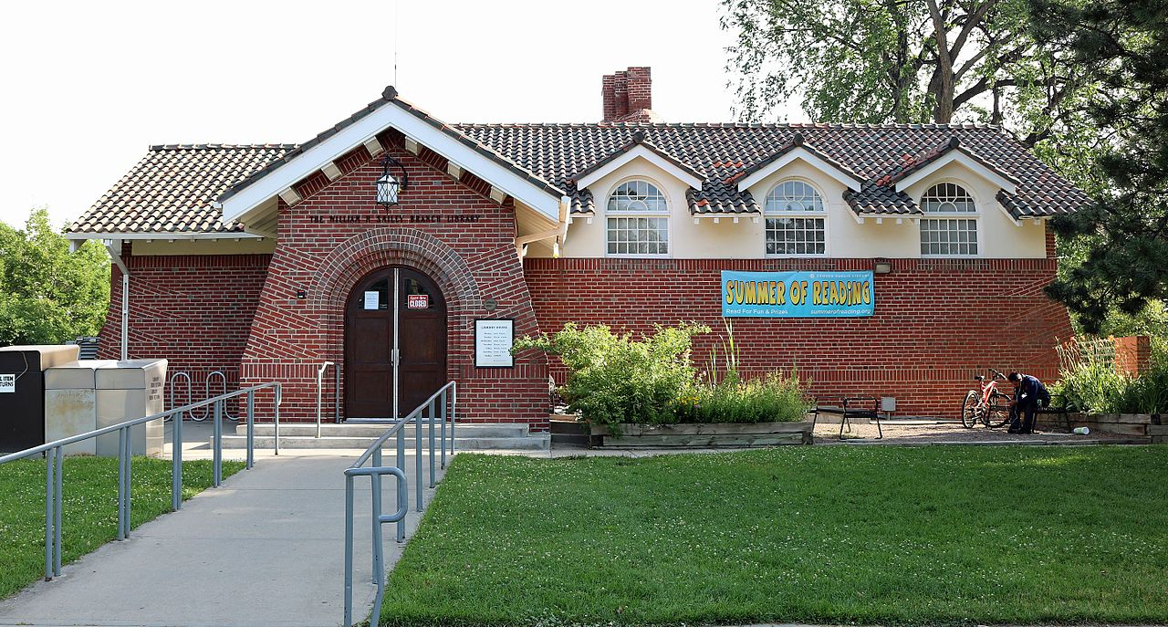
Two Perspectives, One Dynamic Collection
Books & Borrowing at Central:
Department of 50, group of 17, circulating adult materials only, longtail collection
Smiley Branch Library:
Staff of 7, materials for all ages in all formats, popular collection
Notes:
Becker
Also using volunteers & how

Slide 23
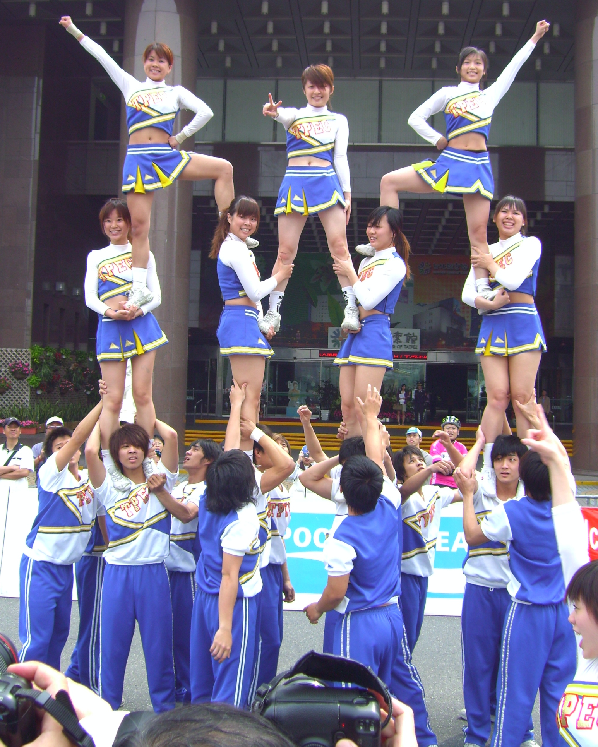
We’re All in This Together
CM is an ongoing conversation
Experimentation is key
Everyone learns from and supports each other
Remeber CM IS customer service
Notes:
Becker

Slide 24
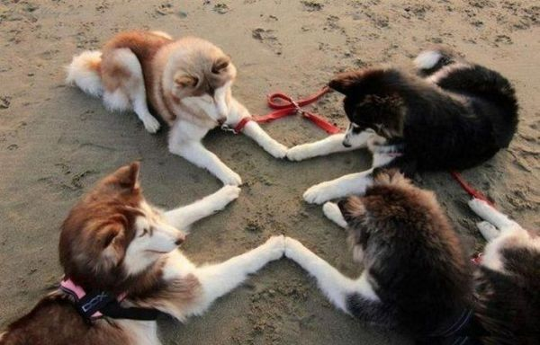
Staff Alignment = Staff Empowerment
Notes:
Becker Creation of the culture: anecdata. In our case, success has been varied but the impact is noticeable. Chicken and egg change and collection maintenance. All libraries are increasingly data-driven and getting people involved in data collection. People will treat a beautiful collection well

Slide 25
Activity: What are your training needs?
On the back of your sheet, jot down what you would need in terms of staff training to reach your CM goal.
Notes:
Becker

Slide 26
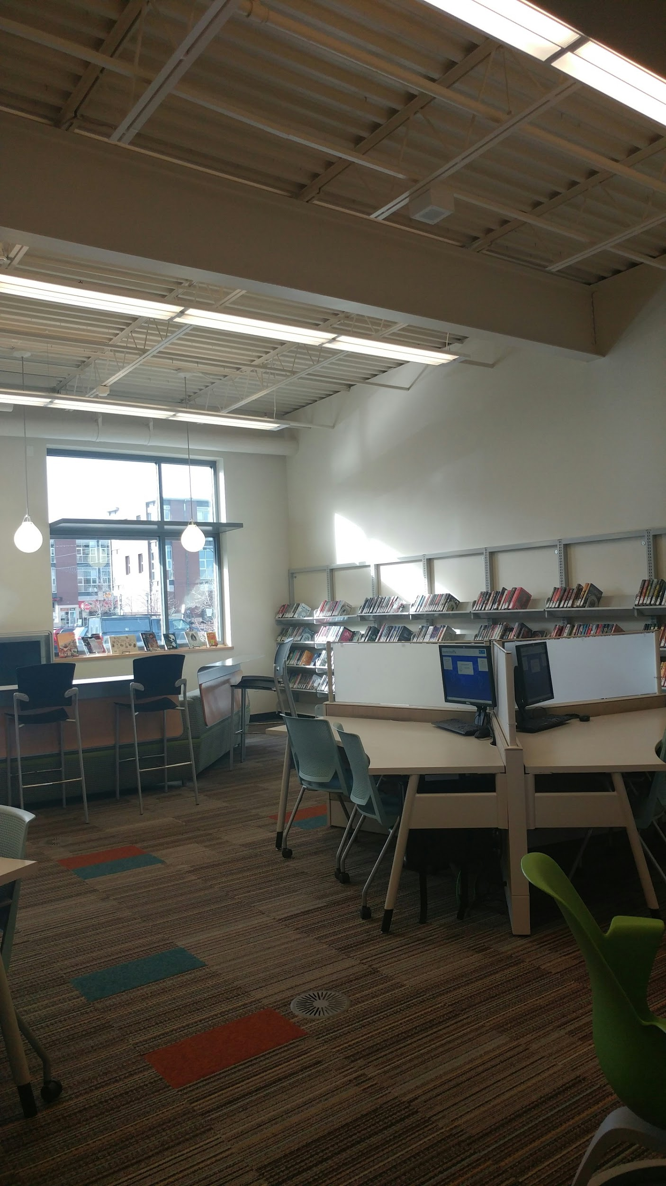
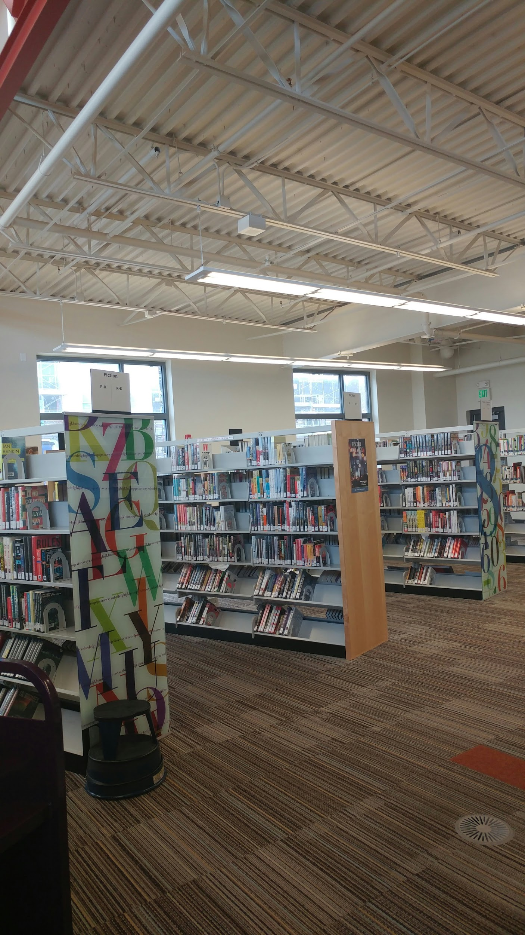
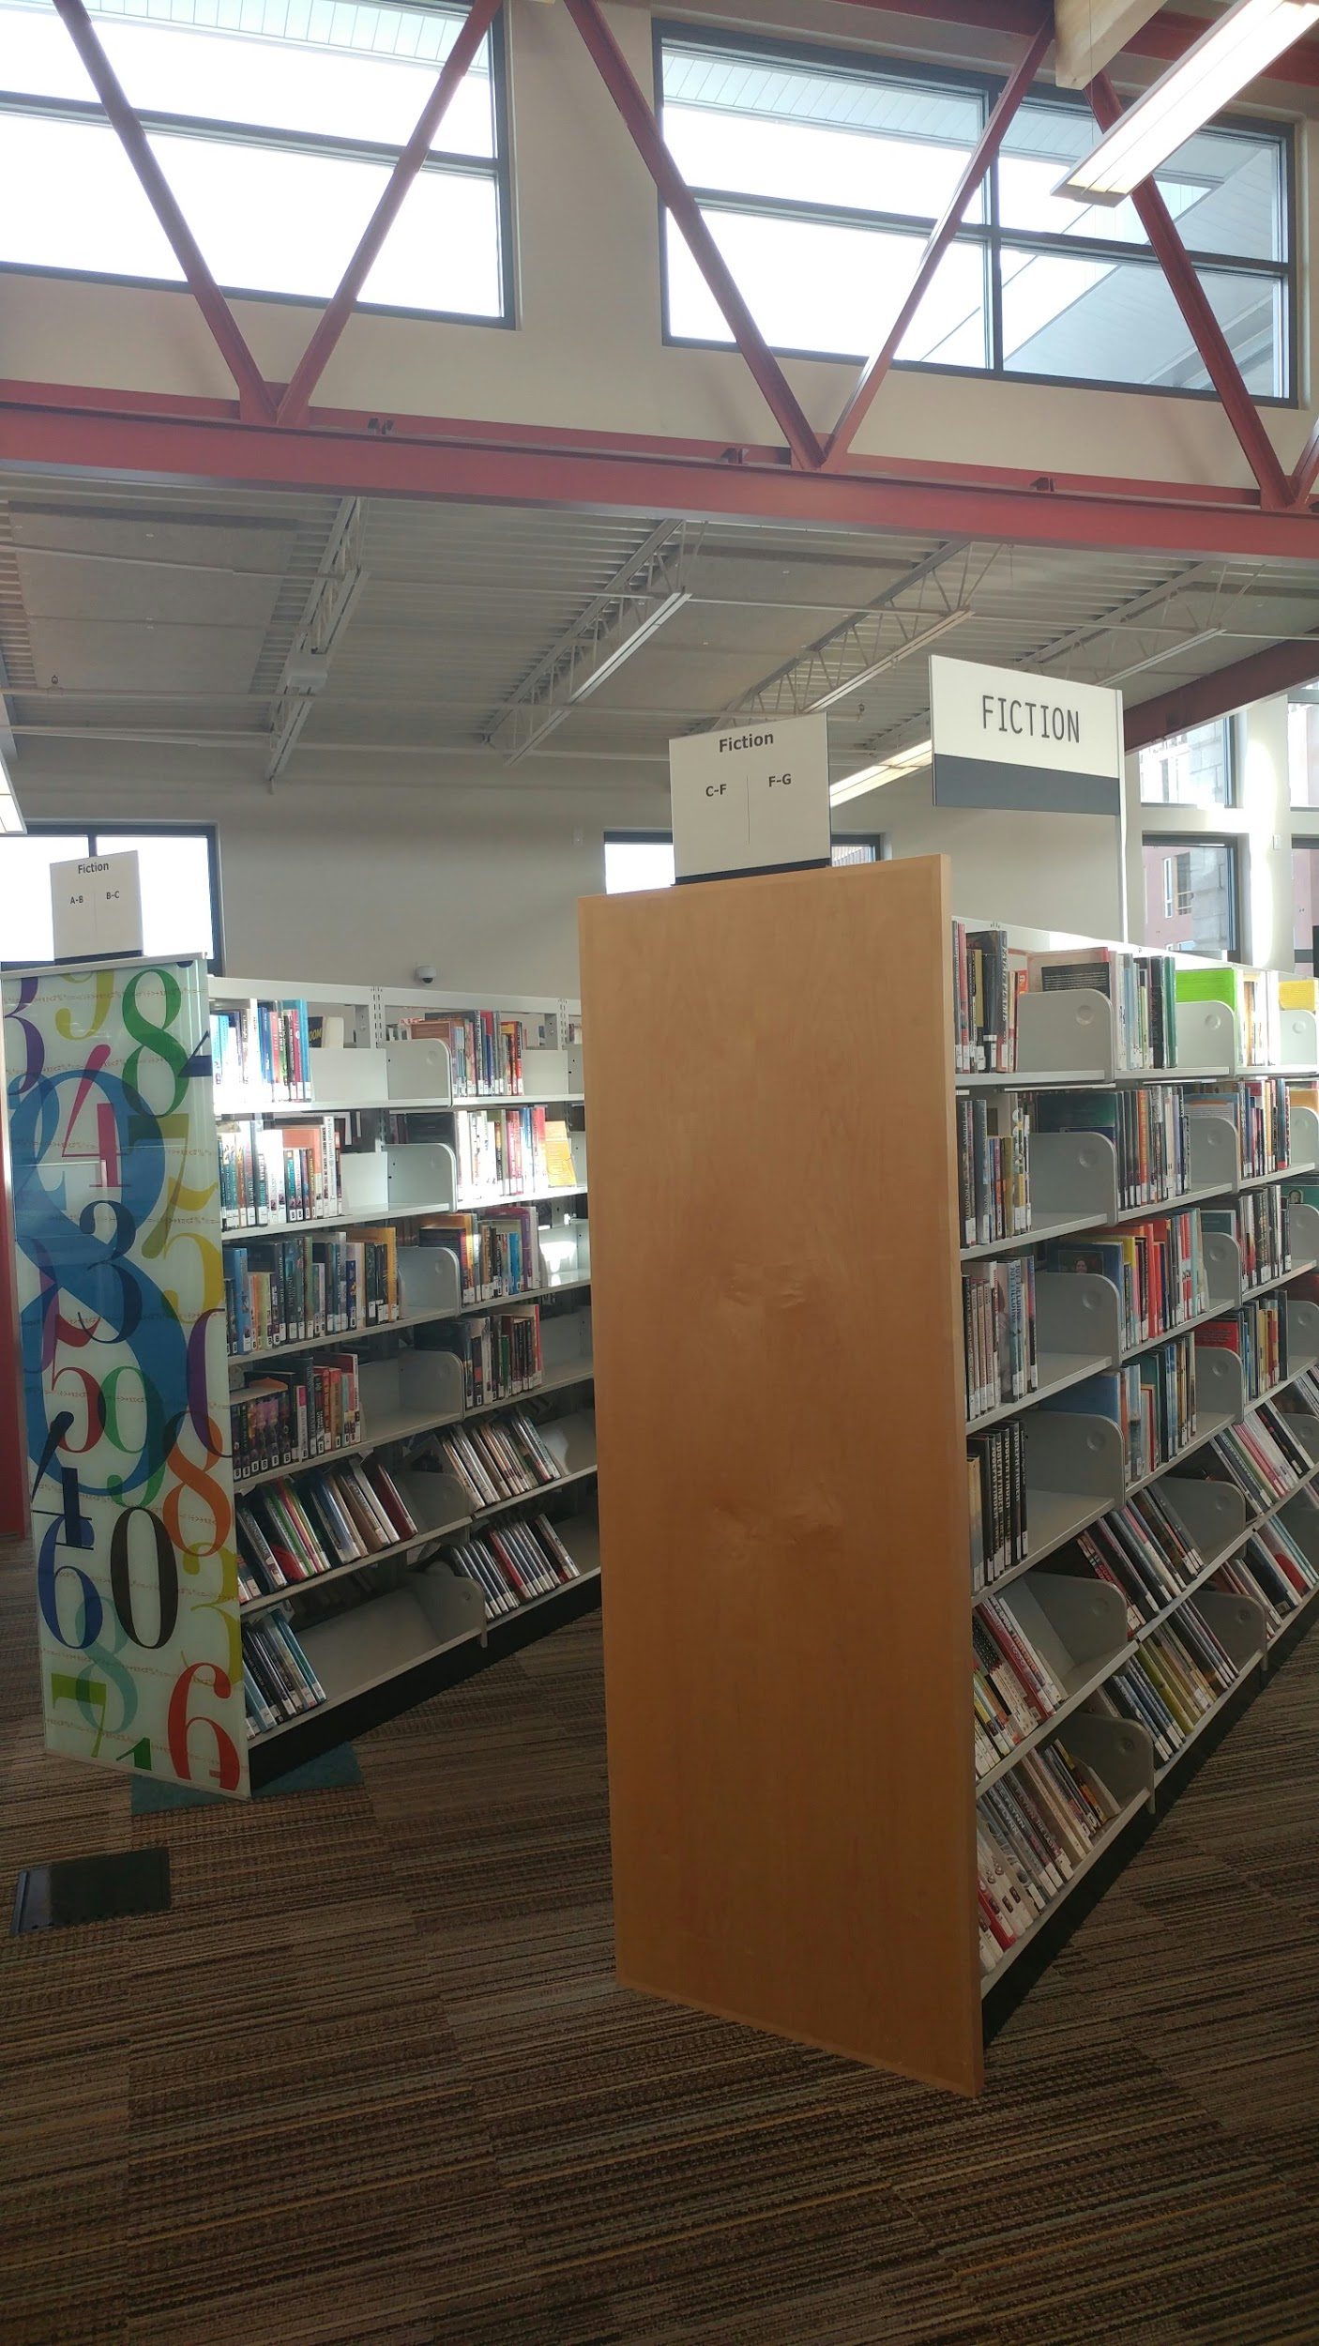
Bringing it all together
Notes:
Becker - Sam Gary spent a year gathering the numbers on how our collection was circulating. How many items were on the shelf vs checked out, etc. We determined that some collections had too much room & some didn’t have enough (Teen, Adult fiction, High Kids Circ). Added shelving and moved collections to give them more visibility.7983 fewer adult DVDs on shelf than projected
6432 fewer children’s DVDs on shelf than projected
2954 fewer adult fiction on shelf than projected
3690 more jFiction on shelf than projected
2837 more jNonfiction than projected
1715 more jPicture Books than projected
2005 more adult nonfiction than projected It works!

Slide 27
Questions?
cmbuddies@denverlibrary.org
Notes:
Becker

