Slide 1
How a COOP creates a roadmap for any condition
CSL in Session
April 14, 2022

Slide 2
Presenters
Steve Chestnut, Director of Facilities & Construction JCPL
steve.chestnut@jeffcolibrary.org
Lizzie Gall, Assistant Director of Public Services JCPL
lizziegall@jeffcolibrary.org
Padma Polepeddi, Assistant Director of Public Services JCPL
padmapolepeddi@jeffcolibrary.org
Julianne Rist, Director of Public Services
juliannerist@jeffcolibrary.org

Slide 3

Introduction
Why have a COOP plan
Basics of a COOP plan
How a COOP plan helped in the Covid19 Pandemic

Slide 4
Basics of a Continuity of Operations Plan

Slide 5
A COOP Planning Model
Initiate the COOP planning/review process
Maintain and update the plan
Evaluate the hazards and risks
Evaluate the impact of those risks
Train, test and exercise the plan
Build the plan
Determine essential functions

Slide 6


Some things to consider for hazard assessment
Winter Storm
Utility Outage
IT Service Outage
Windstorm
Building Damage
Network Attacks/Viruses
Pandemic Event
Flood
Wildfire
Building Fire
Tornado
Explosion
Terrorism
Earthquake
Riot
Hazardous Material

Slide 7
Activity – Evaluate hazards and risks
List your hazards and risks
Rank by probability and impact to your operation
Determine mission essential functions
Examples: wildfire, flooding, gas leak, etc.
Hazards and Risks | Mission Essential Functions | Impacts
Eg: Wildfire

Slide 8
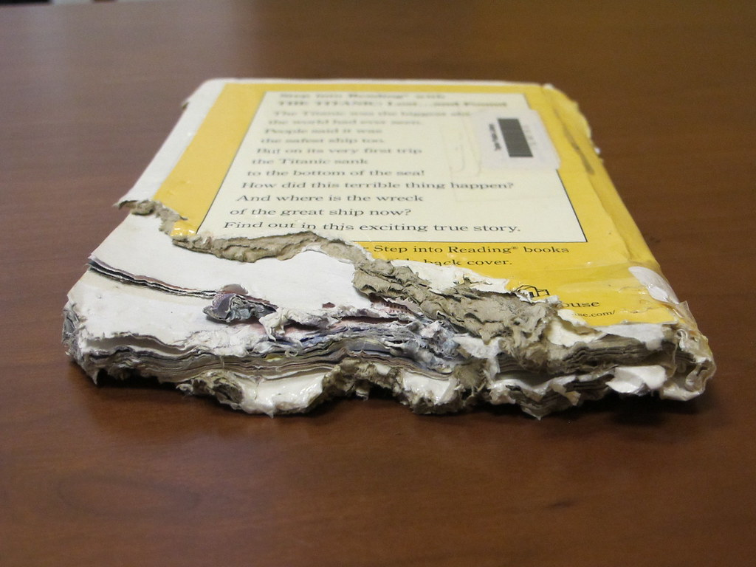
Identify Essential Functions
Provide building security?
Assure facilities are safe to access?
Keep utilities available and functional?
Provide network security?
Inform employees of critical issues?
Provide access to spaces?
Provide access to materials?
Check in and out materials?

Slide 9
Activity – Identify Essential functions
List Mission Essential Functions | Prioritize from 1-10

Slide 10

BUILDING THE PLAN
Hazards/Risk Assessment
Essential Functions
Alert Notification Procedures
Orders of Succession
Delegation of Authority
Facilities
Communications
References and Authorities

Slide 11

Succession Plan for Facility Relocation
Position Title Division Name
Primary Director of Facilities Facilities Employee Joe
Alternate #1 Operations Manager Facilities Employee Mary
Alternate #2 Director of Public Services Public Services Employee Sharon

Slide 12

Delegations of Authority
Who can do what once COOP is activated
Close a building
Sign contracts
Authorize emergency purchases
Hire & fire contractors
Communications
Authorize travel
Represent organization with Emergency Operations Center

Slide 13
Activity – Identify Roles
Position | Title | Function | Name
Primary
Alternate #1
Position | Title | Function | Name
Primary | Facilities Director | Facilities | George
Alternate #1

Slide 14
COOP Plan During a Pandemic

Slide 15
COOP During a Pandemic
Short Term
Long Term
First 90 days
Limited staff
No in-person services
Mission essential functions
Transition to long term
Mission essential functions
Prioritize services
Follow health guidelines
Flexible staffing and services

Slide 16
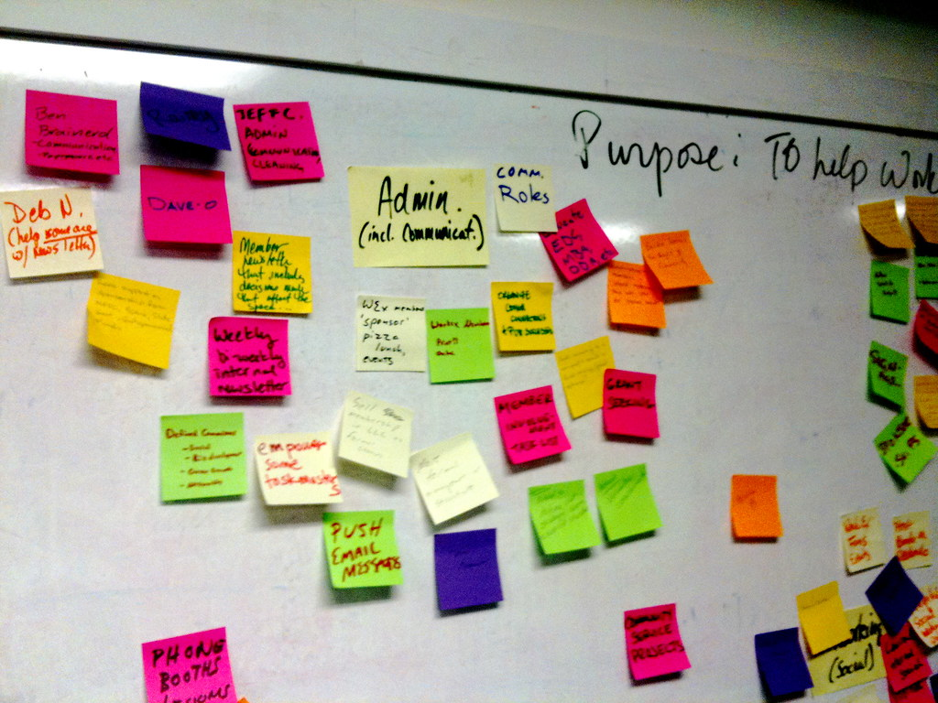
Prepared Before
Pandemic Team Members Identified
Pandemic Chief
Public Services
Facilities
Information Technology
Human Resources
Communications

Slide 17
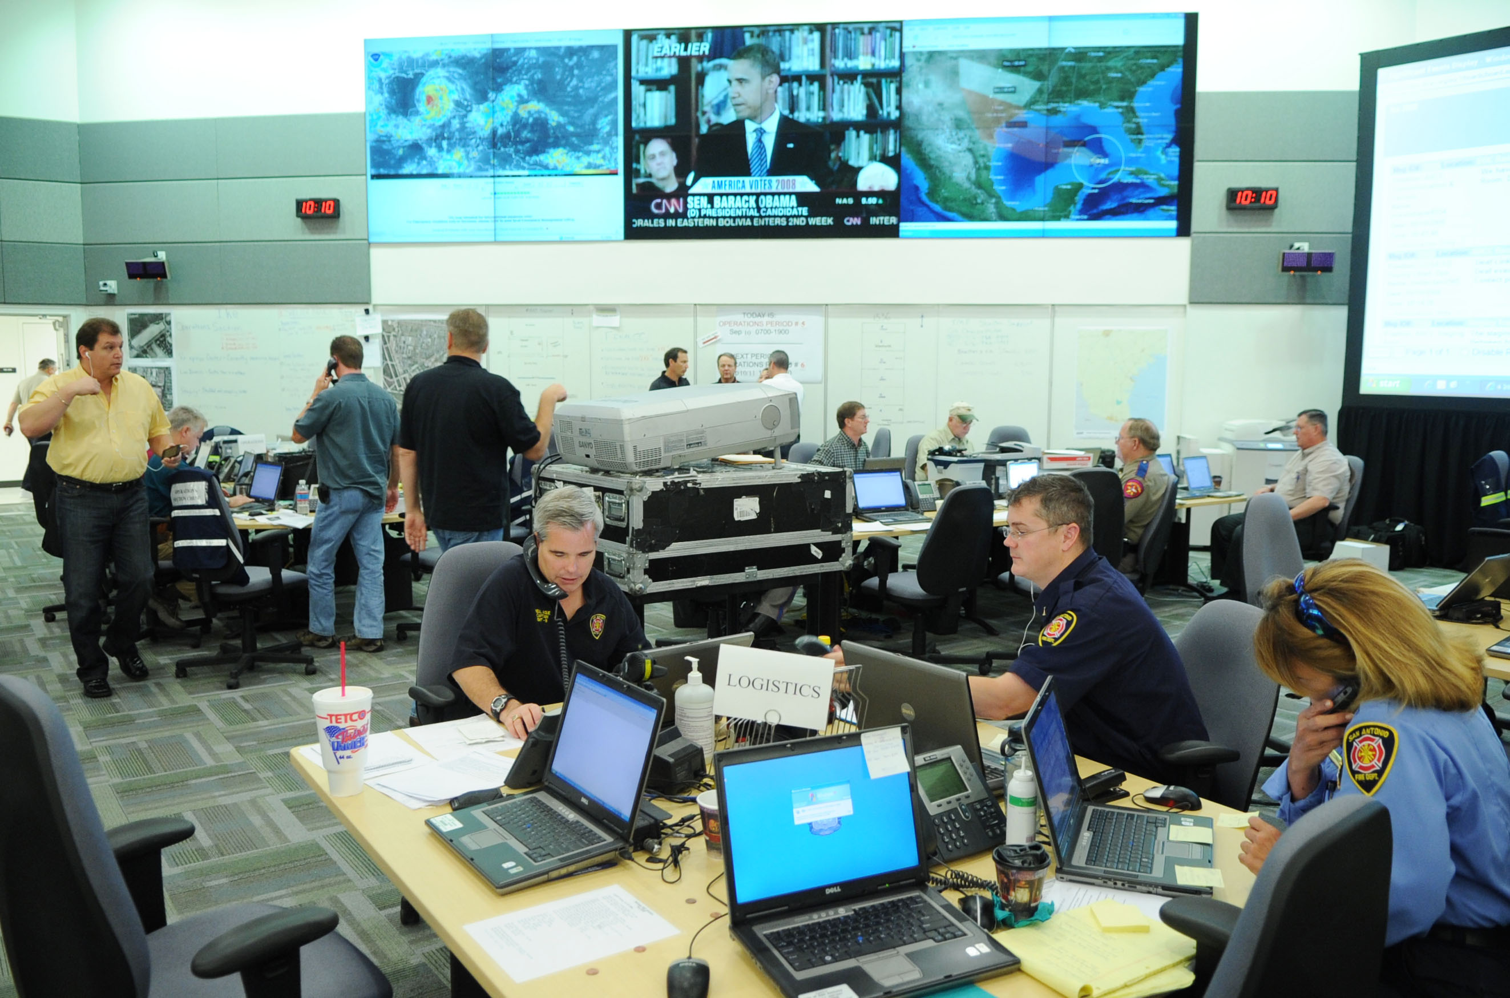
Reality of our Response
Stand up team day one
Services
Strike teams
Health guidelines

Slide 18

Mission Essential Functions
Tier 1
provided without interruption
Tier 2
service need to provide if interruption lasts a week
Tier 3
provide services interrupted a month or more

Slide 19

Priorities
Tier 1
Access to digital resources
Access to patrons’ questions and phone calls
Access to programs
Access to Wi-Fi and computers
Access to physical materials
Collect and evaluate statistics
Tier 2
Access to spaces
Purchase and process books and materials

Slide 20
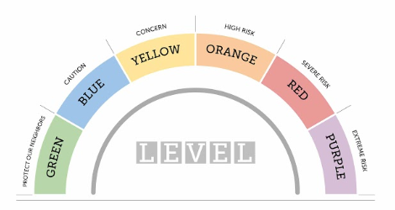
Recovery
Pandemic Team Disbanded
Gradual Return to In-Person Services Team
Proactive
Flexible
Quick Implementation
Strike Teams

Slide 21
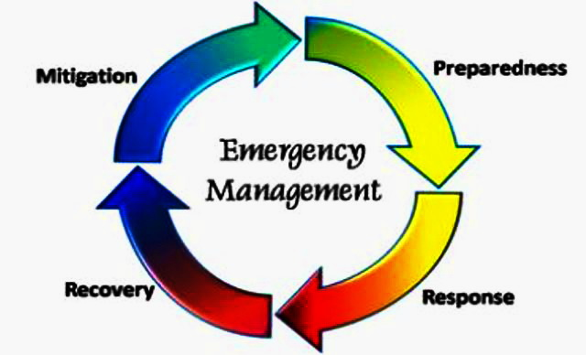
Wrap Up
Why have a plan
Building blocks for a COOP
Identified Hazards
Mission Essential Functions
Roles & Responsibilities
Other times a COOP plan could be utilized

Slide 22

Questions

