Slide 1

Conducting the
Reference Interview
Reflect on a time you had a tough question because it was difficult to figure out what the customer really wanted.
Tell us what you did in the moment that made it successful or what you would change?

Slide 2

Conducting
the Reference Interview
Robin Filipczak
RFilipczak@denverlibrary.org
Stacey Grijalva
SGrijalva@denverlibrary.org

Slide 3

Today’s Goals
Participants will:
Receive a six step tool kit to conducting a reference interview.
Discover and discuss obstacles and solutions to common reference interview problems.

Slide 4
Reflection
Reflect on a time you had a tough question because it was difficult to figure out what the customer really wanted.
Tell us what you did in the moment that made it successful or what you would change?

Slide 5
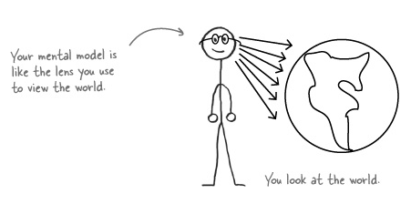
Mental Models

Slide 6
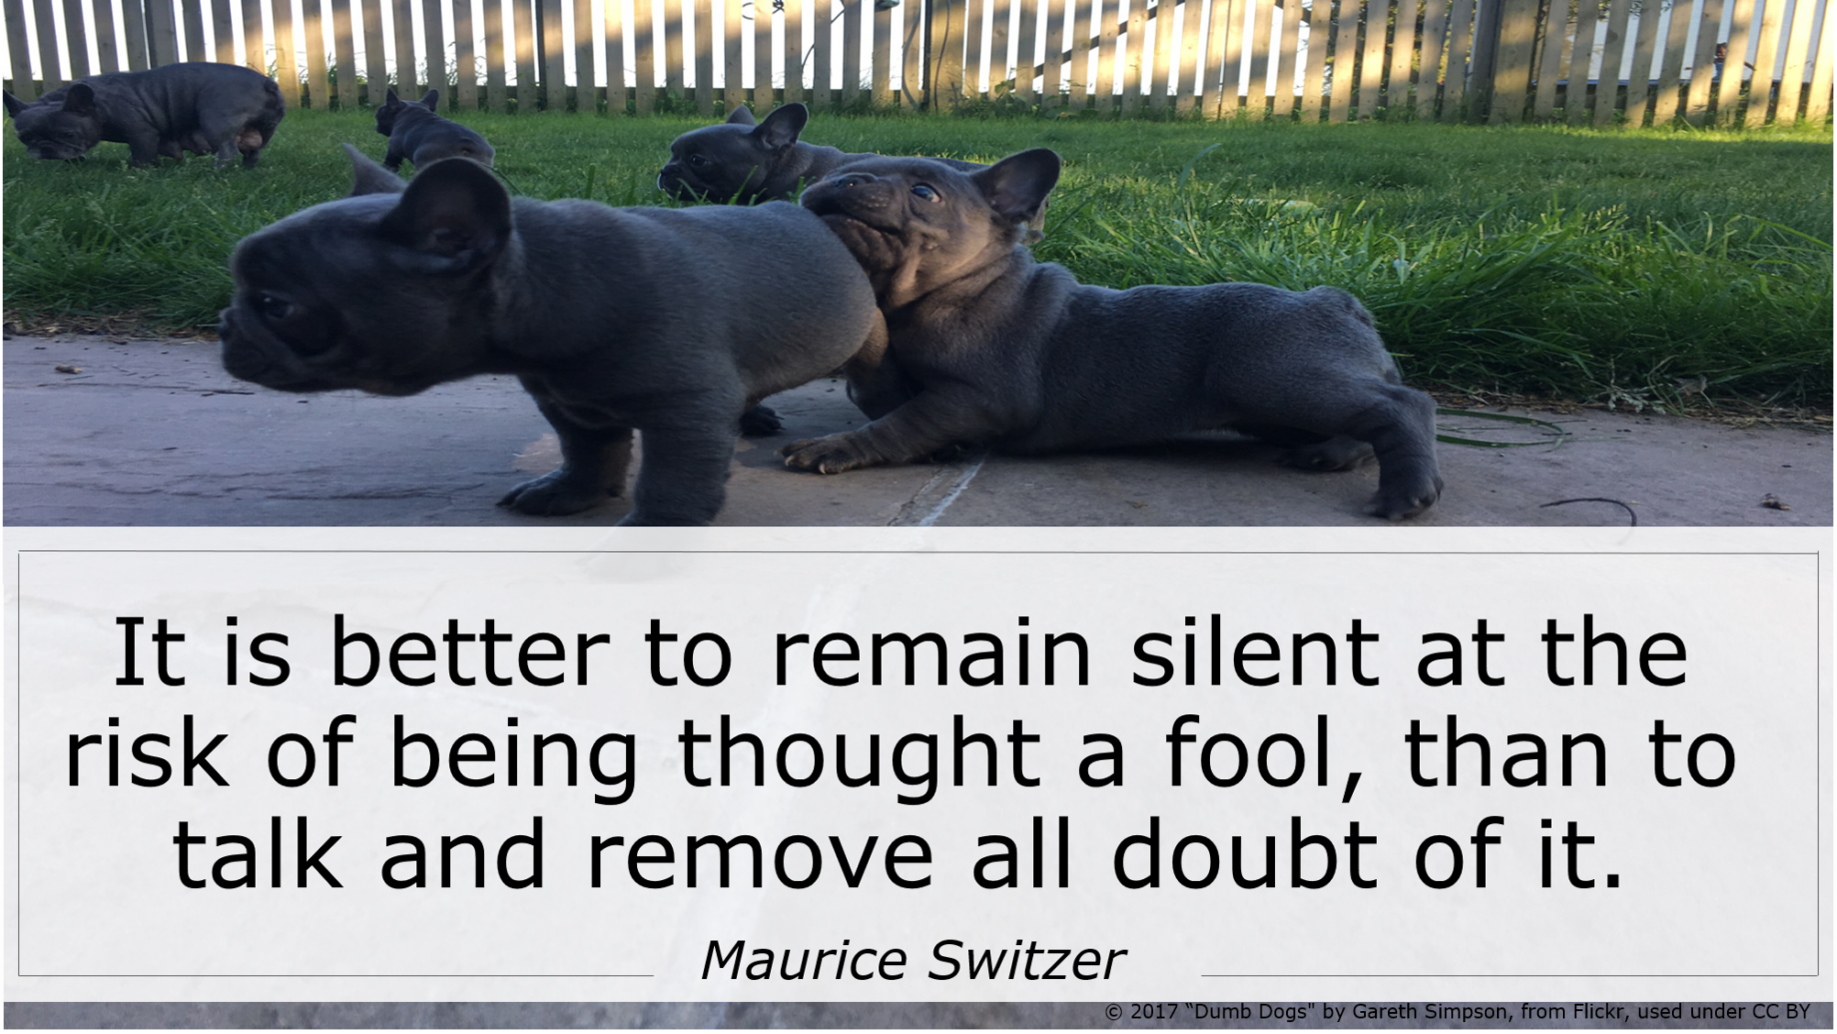
Library Anxiety

Slide 7

The Reference Interview

Slide 8
Tool Kit for a
Reference Interview
Be approachable and interested
Listen
Interview
Search
Answer
Follow-up

Slide 9
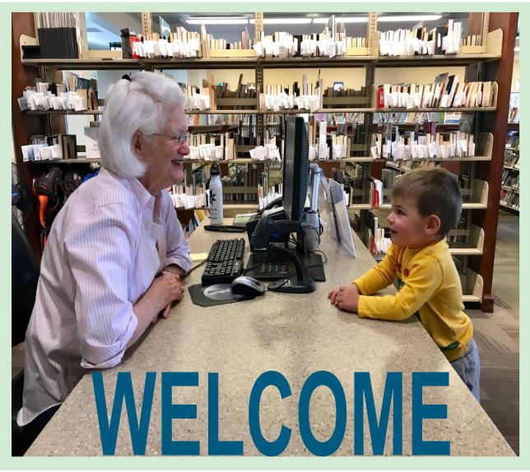
1. Be Approachable
and
Interested
WELCOME

Slide 10
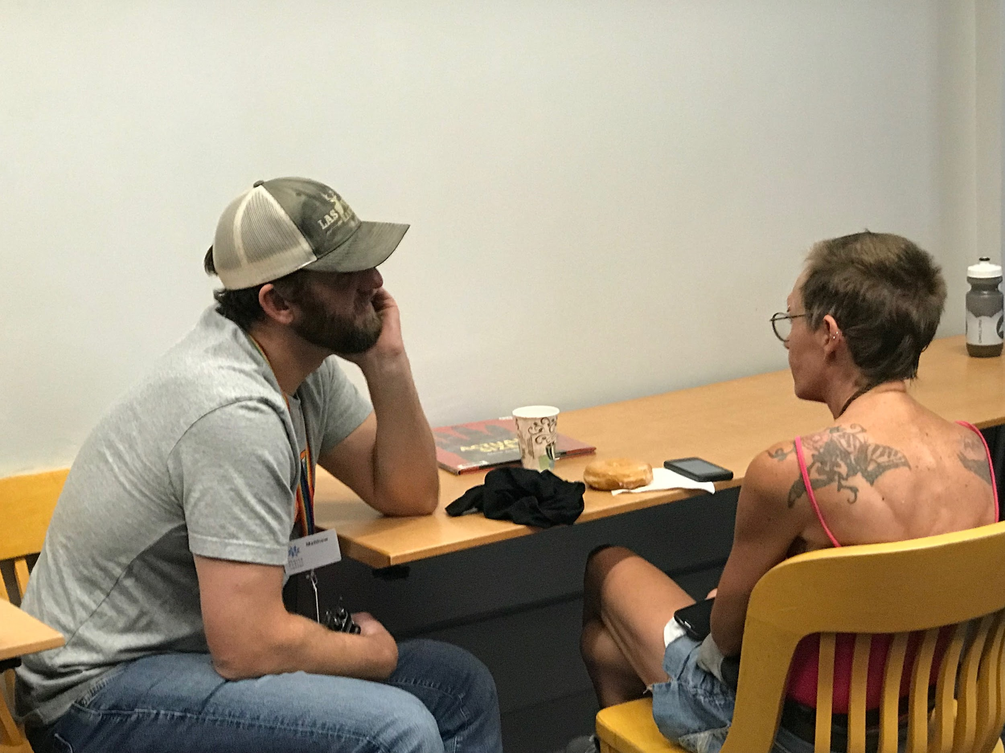
2. Listen
Listening is an art that requires
attention over talent, spirit over ego,
others over self.
~Dean Jackson

Slide 11
“Where are your travel books?”

Slide 12
“...because I'm looking for books about traveling in my RV.”

Slide 13
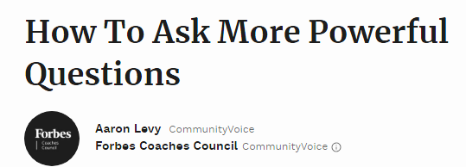
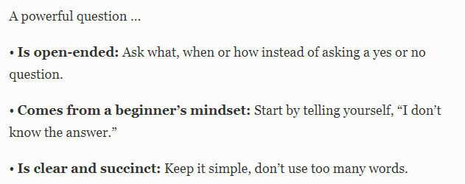
3. Interview
Notes:
Forbes link: www.forbes.com/sites/forbescoachescouncil/2017/12/19/how-to-ask-more-powerful-questions/#18f34a0e47dc

Slide 14

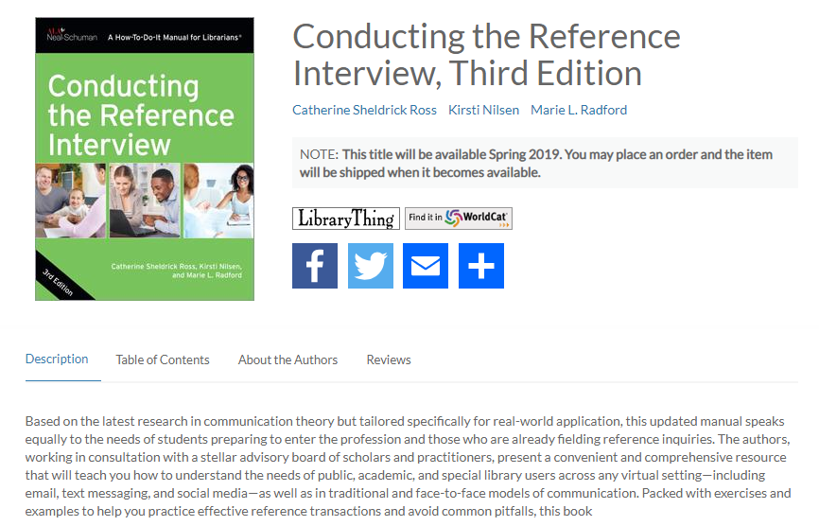
3. Conducting the Reference Interview Book

Slide 15
3. Ask More Powerful Questions
Notes:
Forbes link: www.forbes.com/sites/forbescoachescouncil/2017/12/19/how-to-ask-more-powerful-questions/#18f34a0e47dc

Slide 16
3. Open-Ended Questions
I'm not familiar with _____________. What else can you tell me about it? What are you trying to find out? What would you like to know about this topic? What do you mean by _____________? Would you tell me more about ___________? What are you trying to do? What do you already know about _______? Would you explain that to me in more detail? Can you give me an example? | Do you know some other terms for this topic? Is it spelled any other way? Does it go by any other names? Where have you checked for information so far? If I could find the perfect book to help you, what would the title be? Where did you hear or read about ________? I'm not familiar with that person. What is he/she known for? Good for homework questions Can you tell me more about your report and what is required for it?

Slide 17
Demonstration of the Reference Interview

Slide 18
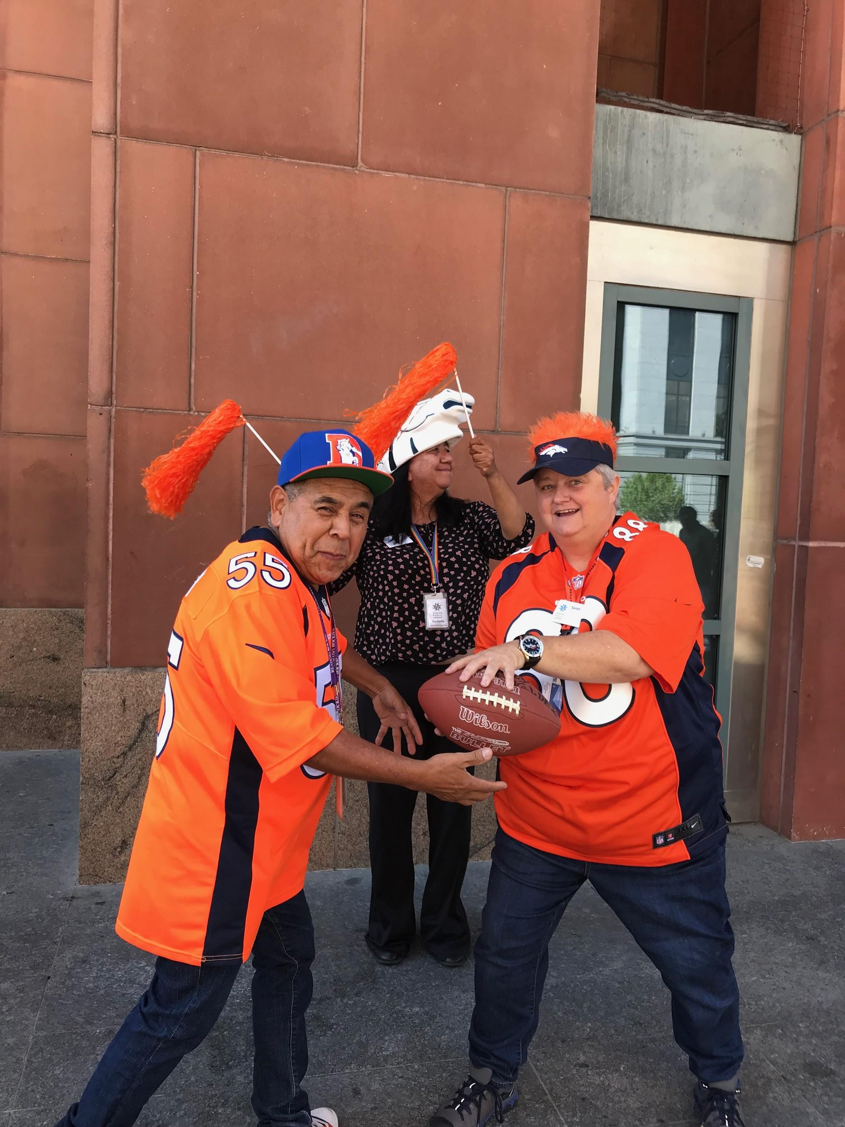
Group
Exercise

Slide 19
3. Open-Ended Questions Example
I'm not familiar with _____________. What else can you tell me about it? What are you trying to find out? What would you like to know about this topic? What do you mean by _____________? Would you tell me more about ___________? What are you trying to do? What do you already know about _______? Would you explain that to me in more detail? Can you give me an example? | Do you know some other terms for this topic? Is it spelled any other way? Does it go by any other names? Where have you checked for information so far? If I could find the perfect book to help you, what would the title be? Where did you hear or read about ________? I'm not familiar with that person. What is he/she known for? Good for homework questions Can you tell me more about your report and what is required for it?

Slide 20



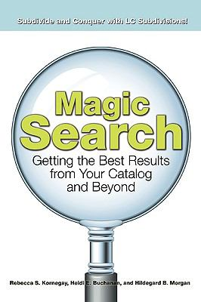


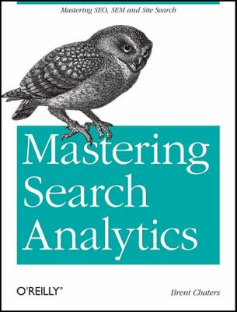




4. SEARCH

Slide 21
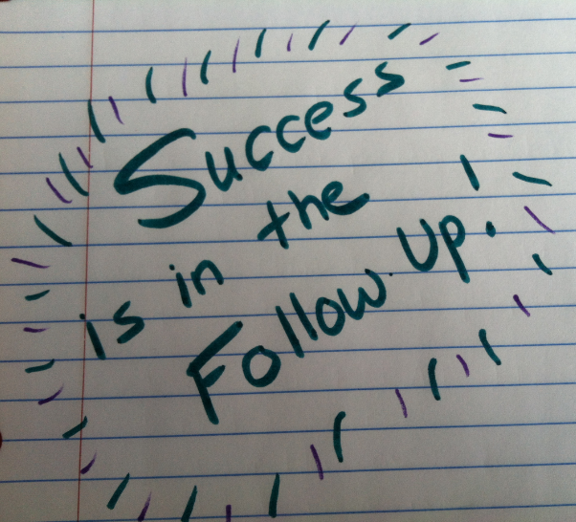
5. FOLLOW-UP

Slide 22
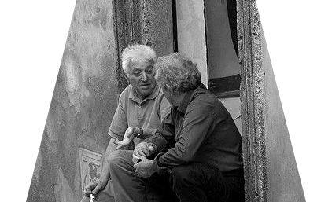
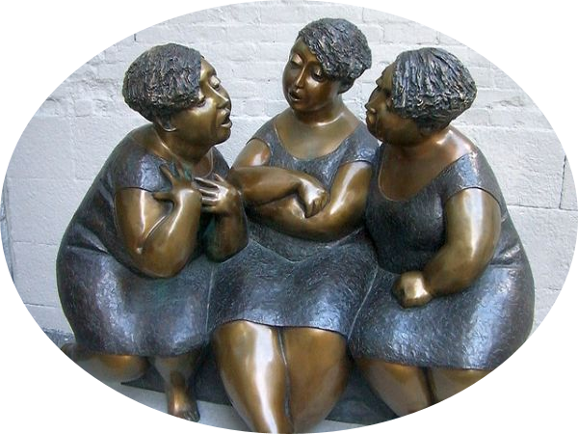
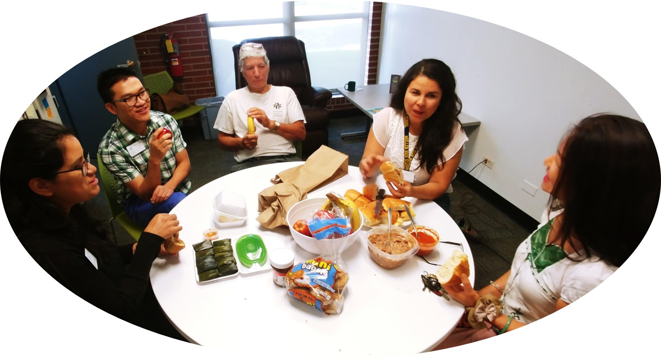
Discussion

Slide 23
Closing
What’s the number one takeaway from this session?
What are you going to share when you go back to your library?

Slide 24
Thanks!
Robin Filipczak
RFilipczak@denverlibrary.org
Stacey Grijalva
SGrijalva@denverlibrary.org

Slide 25
Handout
https://bit.ly/32e9mgV

