Slide 1

Icebreaker
Type it in the Chat!
Where are you in the world and what is your favorite thing about it?
Notes:
Andrea
Wordcloud – Mentimeter - https://www.mentimeter.com/app/presentation/alrw4ma32cwjtkga2m2qrmmzt3n7o22k/djei1s2uiqnp/edit
Talk about how this question relates to the subject we're talking about! Communicating helps prevent communication breakdowns!

Slide 2


Communication Breakdowns
Tools for Working Through Conflict in the Workplace
Notes:
Tessy
Thank everyone for joining.
Purpose statement

Slide 3

Table of Contents
Workplace Expectations
Identify your workplace expectations to establish a framework for productive conflict resolution when faced with a communication breakdown.
Healthy Vs Unhealthy Communication
Recognize and transform unhealthy communication into productive and healthy communication during a communication breakdown or conflict.
Tool – Crucial Conversations
Appraise and practice a conflict resolution tool to be prepared for a future communication breakdown.
Tool – Emotional Intelligence
Appraise and practice a conflict resolution tool to be prepared for a future communication breakdown.

Slide 4


Terms
Conflict
A conflict is a struggle and a clash of interest, opinion, or even principles
Communication Breakdown
Lack of communication; failure to exchange information

Slide 5
Thinking Time
How does your HR/Organization handle a conflict your workplace?
How does your Supervisor handle a conflict in the workplace?
How does your Team handle a conflict in the workplace?
How do You handle a conflict in the workplace?
Notes:
Spend 2 minutes writing down how your workplace expects you to handle conflict, your team expectations for handling conflict, and your own values and approaches to conflict resolutions. W/ music

Slide 6

Healthy
Vs
Unhealthy Communication
Notes:
As much as we try not to be, humans are not perfect communicators. There is no such thing as a 100% healthy conflict. With the right approach, a communication breakdown can be an opportunity for clarification. Here are a few ways you can identify healthy and unhealthy communications so you can bring the conversation back to a healthy one.

Slide 7

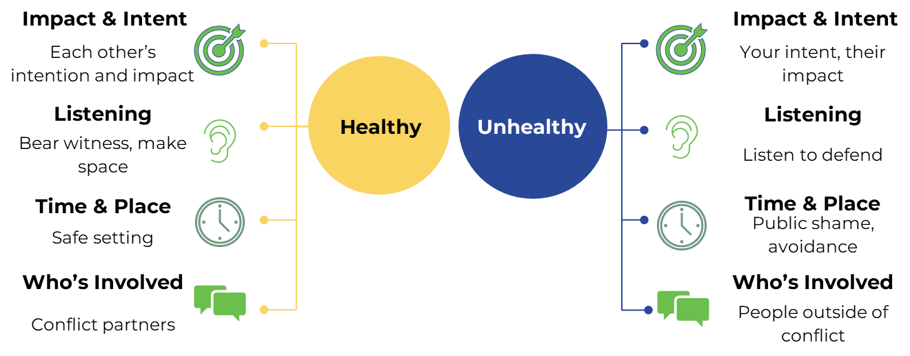
Recognizing Communication Approaches

Slide 8
Scenario
Felix works at the Youth Services public service desk at the Mountain Sky Public Library. He loves his job and gets to work on programs with the librarians when he has downtime at work. Felix wants to be a Librarian eventually and views the work as valuable experience. He recently got a new co-worker, Chris, who works in the same building but at the Adult Services public service desk. At first, they had friendly interactions, but after a few weeks, Chris started to be a bit dismissive in their conversations. When Felix offers helpful work tips, Chris doesn’t use them and says things like, “I have it handled.” Felix decides he will give Chris some space since they don’t work closely together anyway, until one day, Felix’s supervisor, who has been impressed by his recent programming work with the librarians, asks him to work on a cross-department program with Chris. Felix is very excited since this would be his first solo library program and wants to do a good job.
Chris is hard to reach since he keeps ignoring Felix’s emails, but eventually, Felix manages to ask him in person , and they coordinate a meeting. When they finally do have a planning meeting, Chris is late and then barely pitches any ideas so Felix feels like he has to do all of the work, even the adult programming parts of the project, which he doesn’t feel confident about planning.
A few days after the meeting, Chris and Felix are both helping out at the circulation desk when Felix’s supervisor comes up to chat. Chris is very friendly, which surprises Felix. When his supervisor asks about the project, Chris chimes in and tells them about Felix’s ideas but makes it sound like Chris was the one who came up with them.
Felix is very upset. What should he do?

Slide 9
Breakout
Discuss healthy and unhealthy communication approaches you noticed in the scenario.
How would you have changed the unhealthy approaches?

Slide 10

Tool – Crucial Conversations
Notes:
Crucial Conversations
A way to master having the hard and "crucial" conversations in a respectful and professional way
Goal of a Crucial Conversation
Aiming for shared meaning/understanding between two people and a better relationship via a candid and respectful conversation
Consider the consequences of the problem and the intent of the other person.
What do you want for yourself, the other person, and the relationship?
If you decide to go silent, consider:
Are my emotions bubbling through? Do I keep feeling I should say something? Am I downplaying the consequences of speaking and avoiding confrontation? Am I telling myself it won't make a difference?
CPR – can get stuck in flight/fight
Unbundle the problem with CPR
Consider what you really want – getting your heart right
What am I behaving like I want?
What do you really want for yourself, for others, the relationship, and the organization?
How would I behave if I really wanted those things?
Healthy vs Unhealthy reasons for having a conversation
Unhealthy
To be right
Look good/save face
Win
Punish/blame
Avoid conflict
Healthy
Learn
Find the truth
Produce positive results
Strengthen relationships

Slide 11

Having the Crucial Conversation
Share Your Facts
Ask for Their Perspective
Tell Your Story
Facts provide a safe way to start a crucial conversation. Facts are usually uncontroversial and persuasive.
Provide your interpretation of the facts and the conclusion you drew from them to add meaning to the facts. Keep an eye on conversational safety.
Once you've shared your facts and stories, ask the other person for theirs to create shared meaning. Carefully listen and be open to learning.
Use exploratory language to have the conversation.
"Can I share something with you that's been on my mind?"
"Would now be a good time to catch up with you about ________?"
"I'm wondering if this means that _____________"
"I feel like the impact it's having on me (or/and) us is _________"
" I realize I'm only seeing it from my point of view. It's important to me to hear yours."
" Our relationship is important to me. Can you help me understand?"
(Patterson et al., 2012)
Notes:
Its not about being right – its about shared meaning. - Use Tentative language& encourage testing (safety – make it safe for others to react to information)
"Can I share something with you that's been on my mind?"
"Would now be a good time to catch up with you about ________?"
"My perception is ________."
"I'm wondering if this means that_____________."
"I'd be interested in your perspective. How do you see it?"
"Our relationship is important to me. I thought I should check-in with you about it."
"I realize I'm only seeing it from my point of view. It's important for me to hear yours."
Before you have the conversation, pause and review the facts
We often tell stories about to ourselves about the situation that create emotions about the scenario.
Separate the facts from the stories
Avoid the following pitfalls
Victim - "It's not my fault"
Take accountability – what is your role in the problem
Villian - "It's all their fault"
Humanize the other person – assume positive intent
Helpless - "There's nothing I can do"
Commit to action – What should I do right now to move toward what I really want?

Slide 12
Creating Safety
When someone doesn't feel safe during a conversation they will.....
CHOOSE
Silence
Violence
Sarcasm, avoiding, withdrawing, etc.
Controlling, labelling, attacking, etc.
Pause the conversation and Build Back Safety with ...
Mutual Purpose
Mutual Respect
Contrasting Statements
I care about your goals....
We have the same goals....
Express your Intent
I care about you...
I care and want you to be successful....
Our relationship is important to me...
Clarify Content
Explain what you don't mean.
Then explain what you do mean.
(Patterson et al., 2005)
(Patterson et al., 2012)
Notes:
Clarify Positive Intent
Mutual purpose (care about what the other person cares about)
Mutual respect (care enough about the other person to want them to be successful)
Contrasting – can be used to further create mutual purpose and mutual respect & use if you think there has been a misunderstanding
Use if you believe there has been a misunderstanding
What you don't want them to think
Are they mistaking your purpose or do they feel disrespected?
What you want them to think
What are your motivations? How do you really feel about the other person?
Don't – How might others mistake my purpose? / How might they feel disrespected?
Do – What is my real motivation? / How do I really feel about the other person?

Slide 13
Tool – Emotional Intelligence

Slide 14

Emotional Intelligence
Your ability to recognize and understand emotions in yourself and others, and then use this ability to manage your behavior and relationships.
Self - Awareness | Self - Management | Social Awareness | Effective Relationships
What I See Realizing what emotions you're having and why you're having them. How you react to things including: triggers, specific situations, etc. | What I Do Using your self-awareness of your emotions to react to emotional situations with intent and also the ability to manage your needs to achieve long-term goals. | What I See Noticing other people's emotions and correctly understanding the cause of it; understanding the perspectives of others even if you don't agree with them. | What I Do Results in the ability to manage your relationships with others. Showing clear communication and effective conflict resolution. Creates strong relationships with many different people, even people you don't like.
How well do you really know yourself? How do others see you? | Do you control your emotions or do they control you? | Do you practice empathy? Are you intentionally opening or closing connections with the people around you? | What do your workplace relationships say about you?
(Bradberry & Greaves, 2009)
Notes:
turn purple part into a whiteboard for stamps – bob can we do this?
Internal Responsibility
Self-Motivation
What motivates and inspires you? What holds you back?
What derails you? How do you pull yourself out?
Takes effort and practice to think positive.

Slide 15
Emotional Intelligence Interaction
Practice empathy – stepping in someone else's shoes
Ask for feedback from a trusted person.
Be open by sharing information about yourself and be curious by showing interest in other people and asking questions
Self-reflect - spend time thinking about your emotions, why you might be feeling them, and how you are expressing them
Observe the body language of other people
Build trust with open communication, sharing, being consistent, and being reliable
Take slow, deep breaths to connect with the logical part of your brain
Create an Emotion vs Reason list
Listen to other people
Have an awareness of what you look like when you are upset.
Learn about other people's cultures and cultural rules
Take control of your self-talk
Acknowledge the feelings of others.
(Bradberry & Greaves, 2009)

Slide 16
Reflection Breakout
There's always room for improvement! What next steps can you take to improve communication....
As a Team?
As an Individual?
Notes:
Five minutes to meet and share – can talk about tools or own factors – tie back to first breakout

Slide 17
References & Other Resources
Bradberry, T., & Greaves, J. (2009). Emotional intelligence 2.0. TalentSmart.
Patterson, K., Grenny, J., McMillan, R., & Switzler, A. (2005). Crucial conversations: Tools for resolving broken promises, violated expectations, and bad behavior. McGraw-Hill.
Patterson, K., Grenny, J., McMillan, R., & Switzler, A. (2012). Crucial conversations : tools for talking when stakes are high (Second edition.). McGraw-Hill.
Further Reading
The Arbinger Institute. (2015). The anatomy of peace: Resolving the heart of conflict.
Gottman, J. (1995). Why marriages succeed or fail: And how you can make yours last.
Patrick Lencioni. (2007). The Five Dysfunctions of a Team, Participant Workbook. Pfeiffer.
Ross, J. & Ghadbian, W. (2020). Turning towards each other: A conflict workbook. https://movementstrategy.org/wp-content/uploads/2021/12/Turning-Towards-Each-Other-1.pdf

Slide 18

Questions?
Andrea Kingsley - Librarian
Aurora Public Library
akingsley@auroragov.org
Tessy Walker – Library Supervisor
Aurora Public Library
tswalker@auroragov.org
Notes:
Ask bob if we can take questions? Can we stay in room during the break?
Also tell people they can email us if they spotted the easter egg in the presentation. Something Tessy is a fan of.

