Slide 1

Collection Management Data

Slide 2
Collection Management Data: Quick and Easy

Slide 3
Why Would Anyone Use Data to Purchase Materials?
Know what is popular and what is not
Create a balanced collection
Anticipate what needs to be weeded
Budget ahead of time by forecasting trends
Spend less time guessing what patrons want

Slide 4
When Does Data Fail?
Poor metric – e.g. Saves (baseball stat)
Badly Collected – e.g. Broken Door Count
Bad Extrapolation – e.g. Reference stats once a year
Incorrect Assumptions – e.g. Low circ for a collection can be due to multiple variables (quality of materials, location in library) not just having bought too much

Slide 5

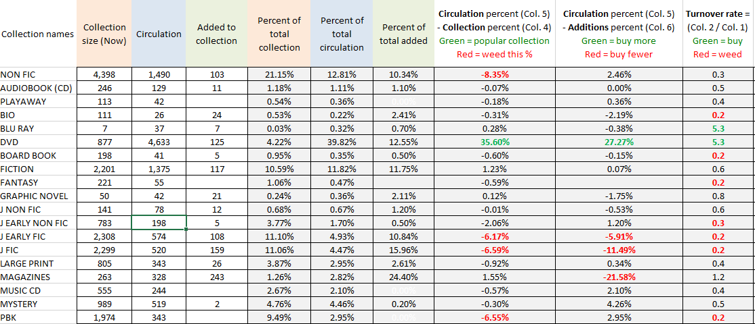
Collection Manager Tool
Notes:
Chris Rippel’s idea, has a creative commons license
Looking at the Template first
This is sample data filled in to show an example

Slide 6

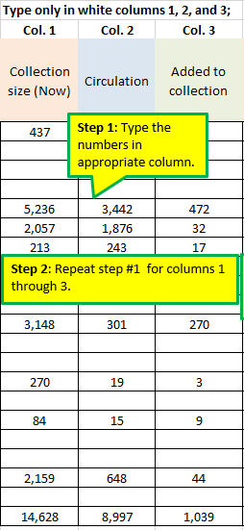
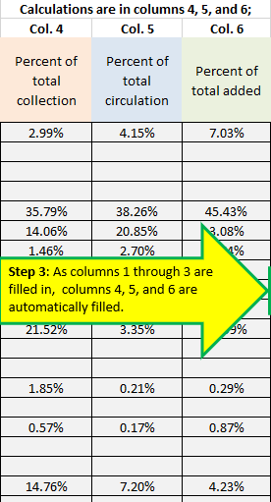
Example #1
Notes:
The instructions briefly describes the components that a user fills in
Columns 4 and on will autofill

Slide 7
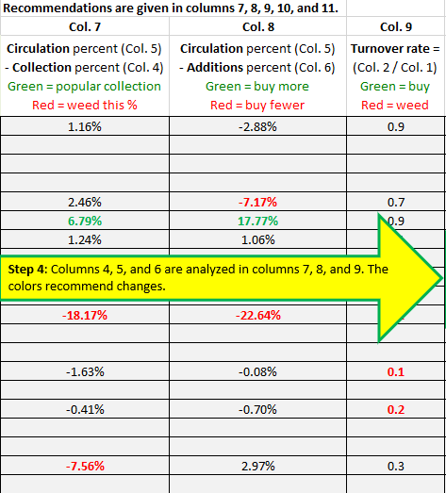
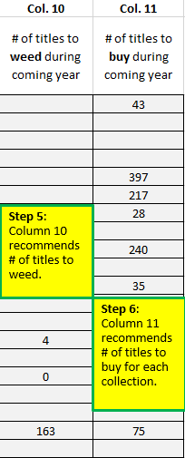
Example #2
Notes:
The colors are supposed to indicate a change that needs to be made based on a percentage threshold

Slide 8
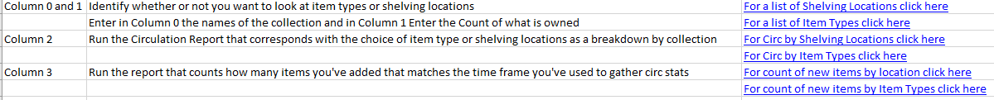
Example #3
Notes:
I created a list of report links for AspenCat libraries, this won’t apply for any other library
Find your own matching reports and link or reference them in the collection tool

Slide 9
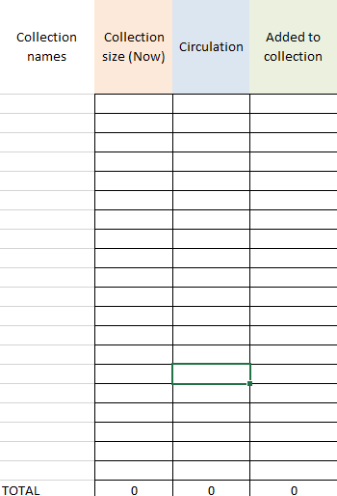
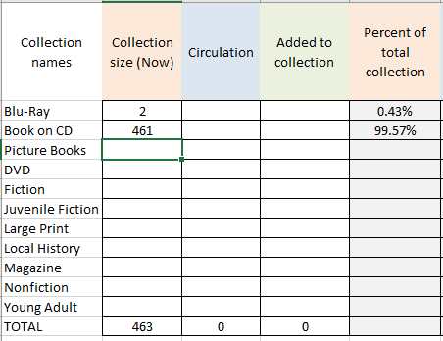
Example #4
Notes:
This is the blank part of what needs to be filled out
As information is filled out the calculations will begin in two areas

Slide 10
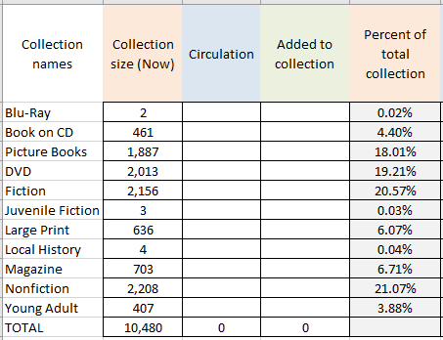
Example #5
Notes:
When the first two columns are filled in, it should look similar to this

Slide 11
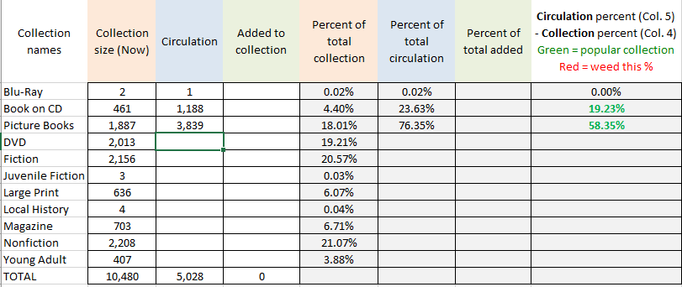
Example #6
Notes:
Adding the circulation column will start to display calculations in other areas

Slide 12
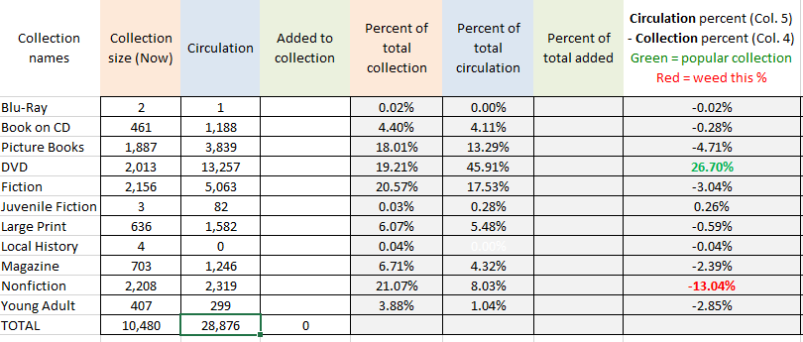
Example #7
Notes:
There may be some statistical oddities in your data, any idea why this juvenile fiction stat might look like this?

Slide 13
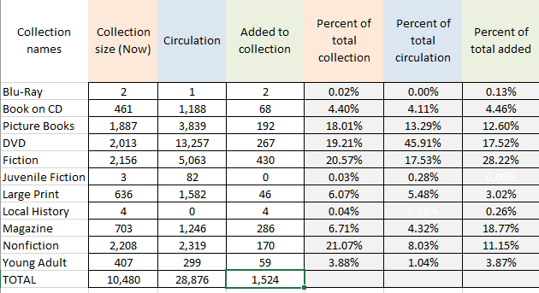
Example #8
Notes:
When all of the first 4 columns are filled out there will be lots of data that is useful without the other calculations

Slide 14
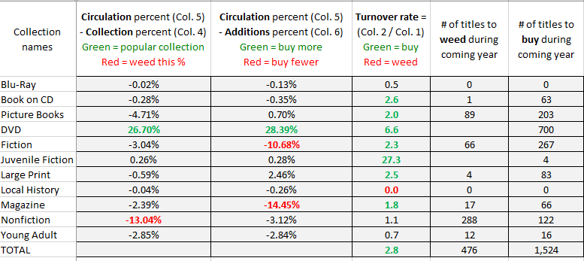
Example #9
Notes:
These are the rest of the data points
What jumps out at you?
What would you buy more or less of?
Should you follow this exactly and change your collection the way it recommends?
Are there other reasons that might explain these numbers that wouldn’t recommend buying more/fewer or weeding?

Slide 15
Questions?
For Additional Questions contact me at bbennhoff@clicweb.org
Collection Management Template can be found at
(https://tinyurl.com/collectiontool)
Notes:
Downloadable version doesn’t have AspenCat reports, but does have sample data for an example, and some descriptions of how to interpret the data

