Slide 1
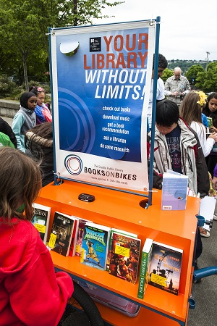
Summertime Outreach: Bringing Summer Learning into the Community
Beth Crist
Youth & Family Services Consultant
Colorado State Library
Notes:
Seattle public

Slide 2
[speaking to teens] “…we are going to serve you and give you what you need where you are and we don’t care whether you come into one of our buildings. It’s not about us and our buildings—it’s about you and your needs.”
Linda Braun, “Who Cares Where?,” VOYA, Oct 2015

Slide 3
“The services the library offers are as important for those who don't walk into the library as for those who do.”
– Sharon Smitty Miller, “Advocates: Think Outside the Cube,” Library Journal, 3/15/2014

Slide 4
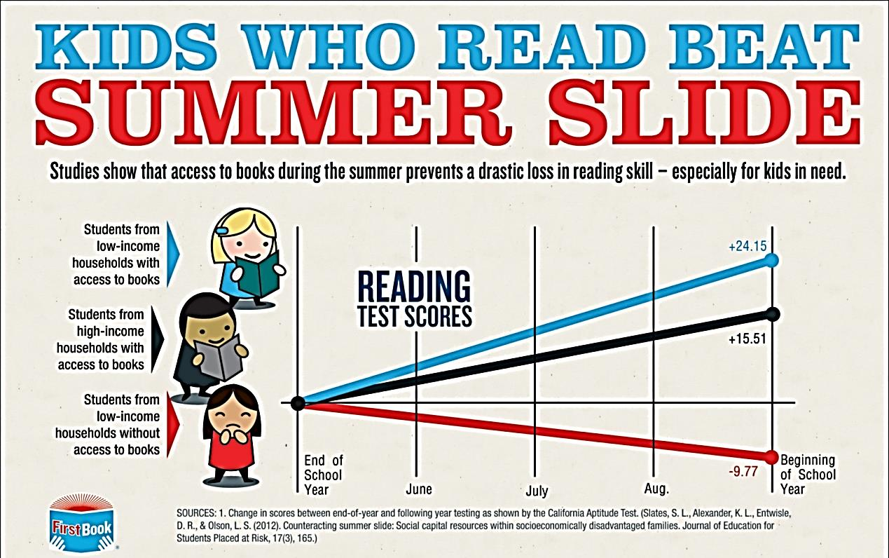
Why do outreach in the summer?
First Book, https://blog.firstbook.org/wp-content/uploads/ 2013/05/summer-slide-infographic-BLOG.jpg

Slide 5
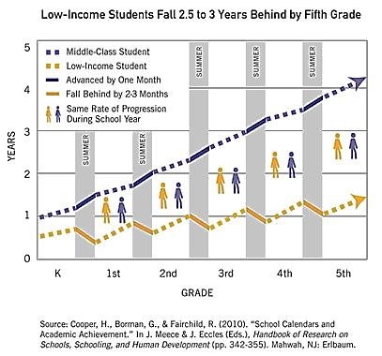
Campaign for Grade Level Reading, gradelevelreading.net/our-work/summer-learning-loss

Slide 6
How can you provide summertime outreach?
Start with a close look at your community:
Review the current demographics, and look ahead too
Who isn’t coming to your library? Why aren’t they coming?
Select a target audience

Slide 7
Planning
Reach out to leaders and organizations in target communities early in planning
Set goals that focus on outcomes, not outputs
Collaborate with organizations and individuals
Listen to partners and target audience
Notes:
Partner and work through existing infrastructures
Last bullet—includes where and when is best place to serve them

Slide 8
But who has the time??
Free up staff time by simplifying your summer program
Prioritize outreach
Collaborate with partners to deliver library services
Train volunteers to deliver library services

Slide 9
And the funding??
Same as above!
Seek funds from library Friends group
Ask local businesses for funds & in-kind contributions
Seek grant funds
Notes:
SAA: Free up funding by simplifying your summer program
Prioritize outreach
Work with partners & volunteers to deliver library services
See handout for grant sources

Slide 10
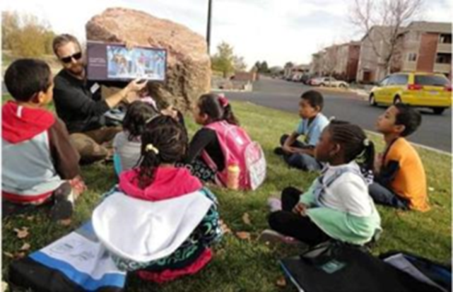
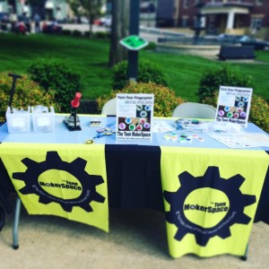
What might it look like?
Notes:
Programs you do in your library, like storytime and makerspaces
Arapahoe library district outreach
Public Library of Mount Vernon and Knox County in Ohio mobile makerspace with 3 modules: button maker, photo booth with homemade costumes, and teen coloring stations

Slide 11
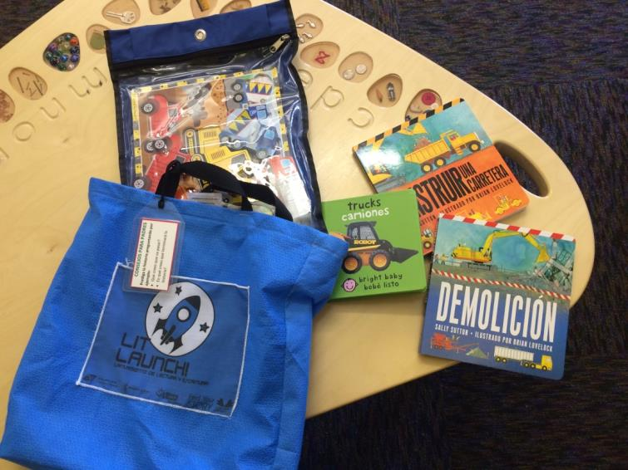
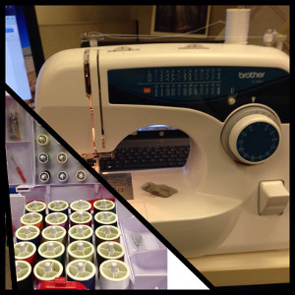
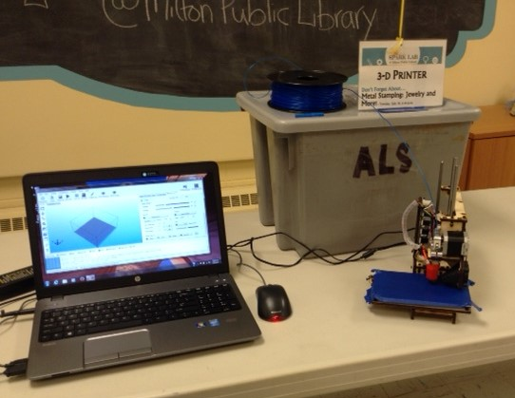
Garfield County Literacy Launch kits
Notes:
Garfield Co Lit Launch kits
Arrowhead Library System in Rock Co, WI, has Mobile Makerspaces that help library staff take makerspaces into community. Here are the sewing and 3d printing kits

Slide 12
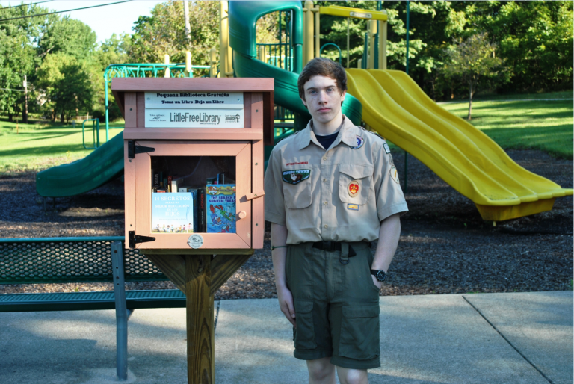
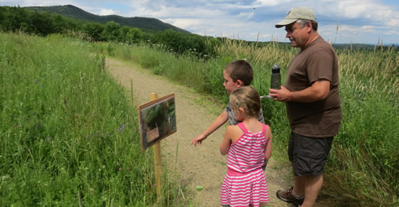
Passive programs

Slide 13
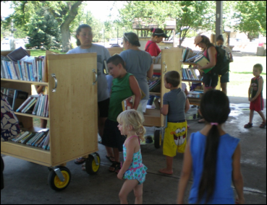

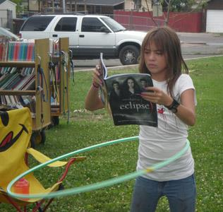
Partner: Summer Food Service Program

Slide 14

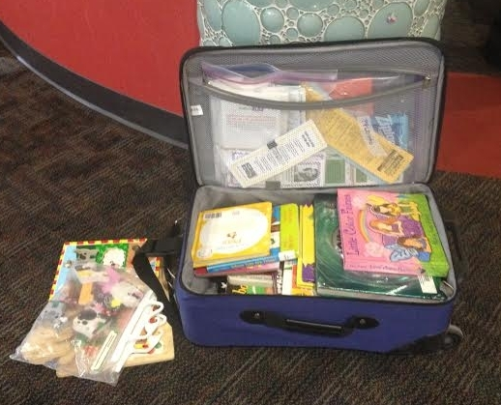
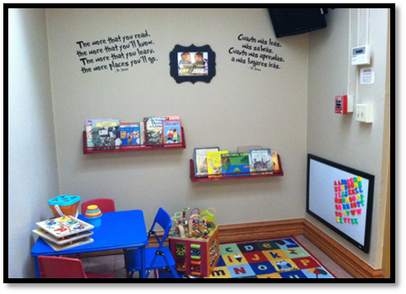
Partner: Reach Out and Read

Slide 15
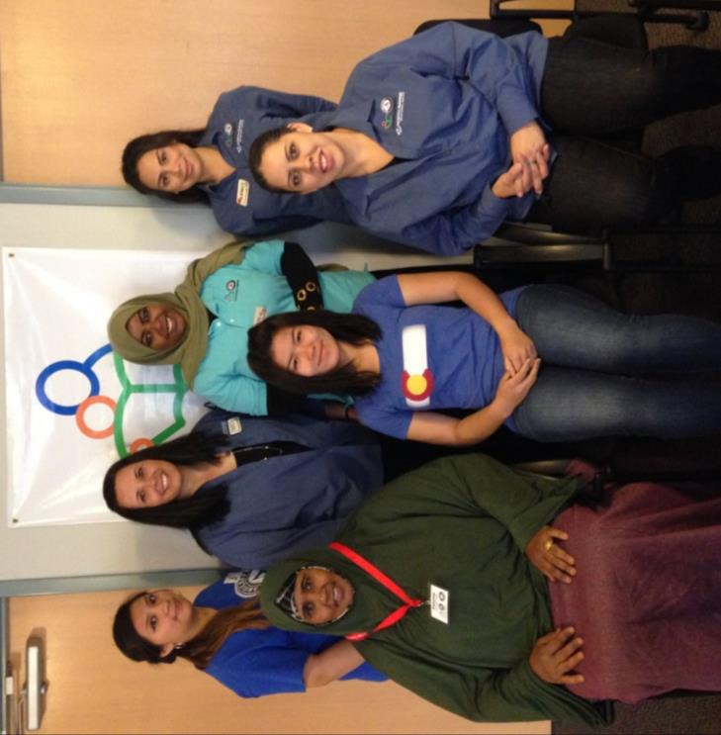
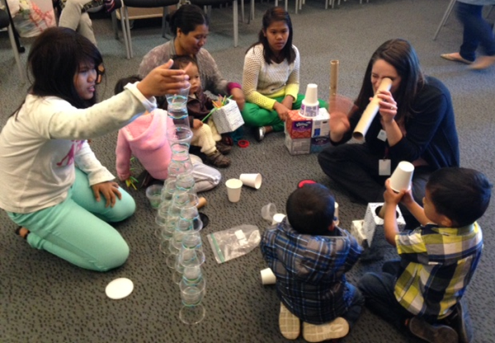
More partners

Slide 16
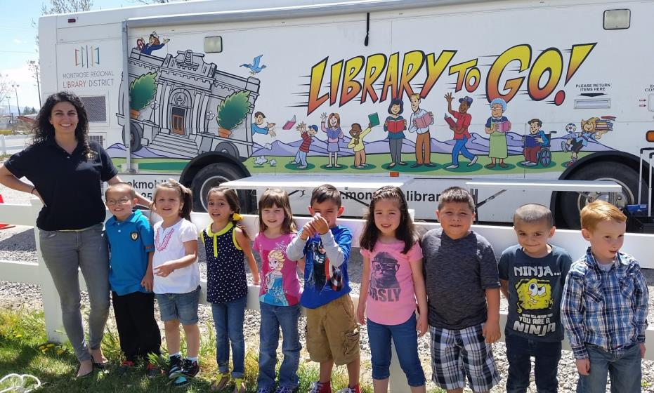
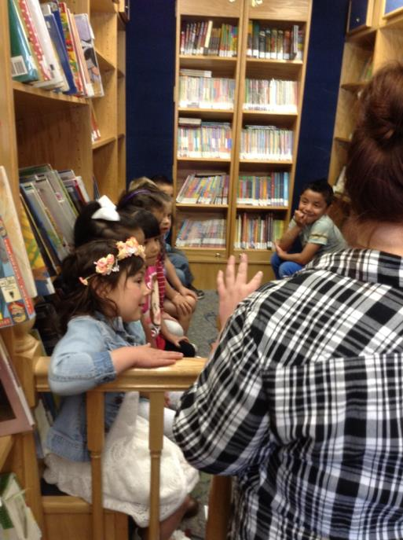
Be mobile

Slide 17
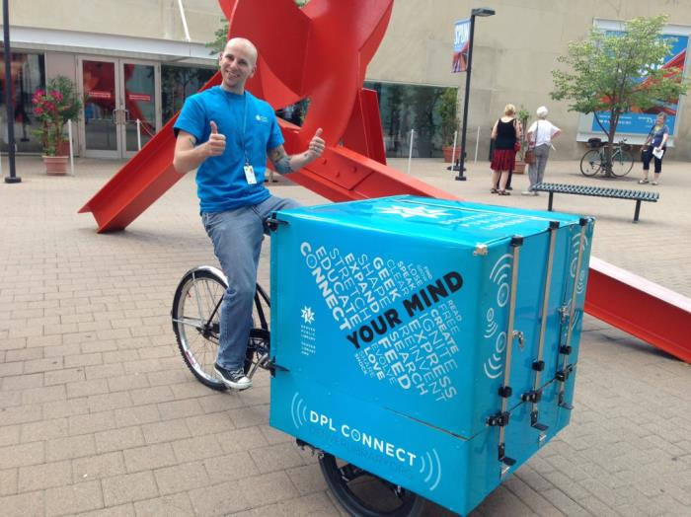
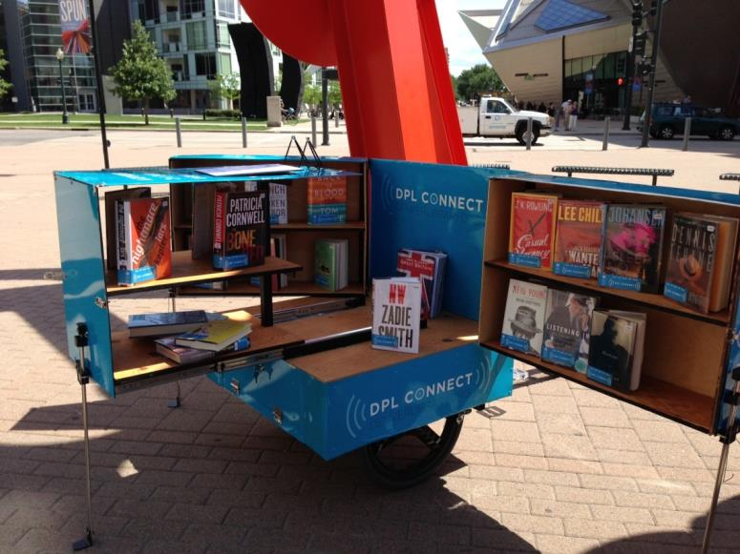
No bookmobile needed!
Notes:
DPL Connect: Denver Public Library’s pedal-powered mobile library and wi-fi hotspot

Slide 18
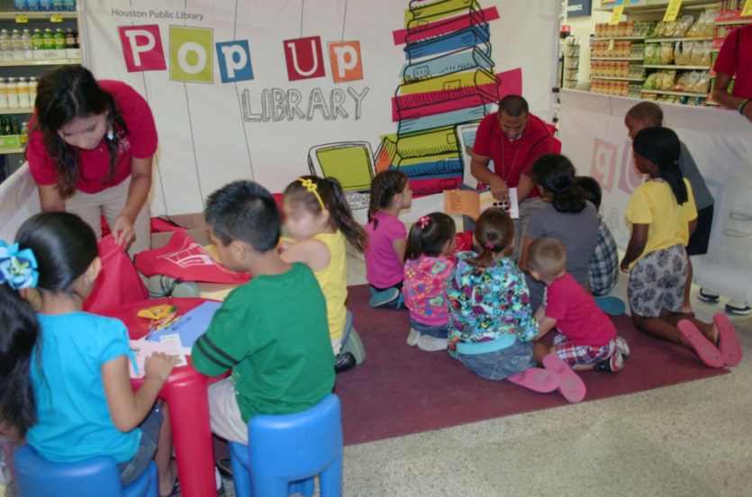
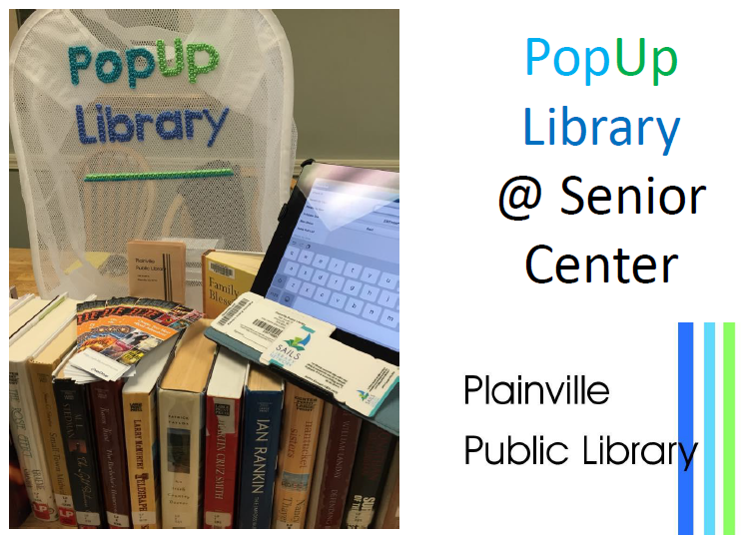
Pop Up Library
Notes:
Houston public—for young children. Ideal for preschool, childcare, any indoor space; includes tent with iPads, library materials and resources. Staff deliver storytimes. Also have version for children with special needs
Plainville- check books in and out and general circ, issue library cards, one on one tech lessons with patrons’ own devices

Slide 19
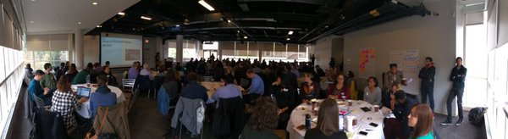
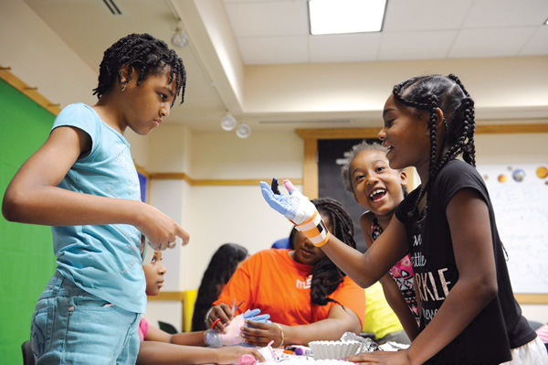
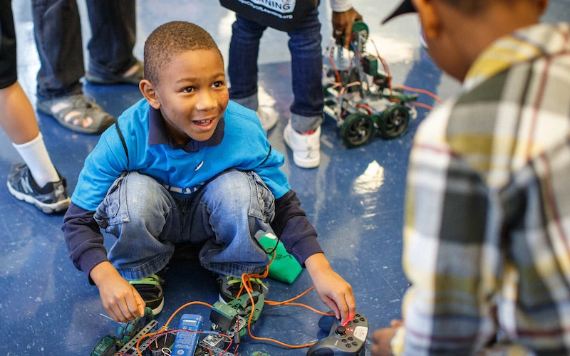
Take it community wide
Notes:
Chicago City of Learning

Slide 20
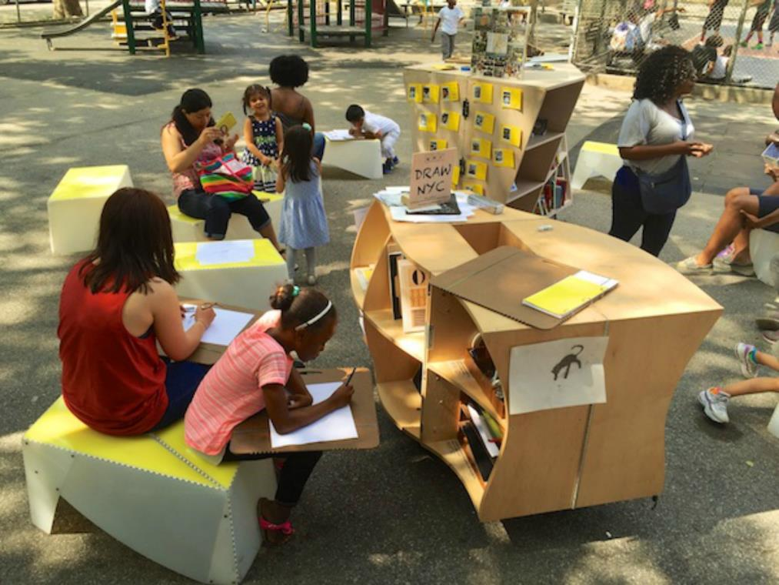
Thank you!
Beth Crist
Crist_b@cde.state.co.us
Notes:
The libraries are being organized by the Uni Project, the nonprofit that organizes roaming, open-air reading rooms all across New York City. mention resource handout

