Slide 1

Sticky Situations
Patron Privacy and Customer Service
Christine Kreger
Notes:
11:00 – 11:01
Today we will be discussing privacy and how it impacts customer service in the library.
I have created a playbook for this session that you should have received. If not, I will post in chat

Slide 2
Privacy
“Privacy is essential to the exercise of free speech, free thought, and free association.”
-Privacy Tool Kit
Notes:
CK 1 minute – 11:01 – 11:02
So, why a session on patron privacy and confidentiality?
All of us in this room have a wide variety of education and experience, yet we are all called to support a common set of professional values. Upholding patron privacy and protecting confidentiality is one of those professional values.
I hope to have a discussion with you today, so I welcome your questions and ideas throughout the session.
Note, as we go through today's session, we will also be talking about ethics, laws and policies related to our profession…I am not a lawyer, nor do I play one on TV.

Slide 3
What is Privacy? ALA
We protect each library user's right to privacy and
confidentiality with respect to information sought or
received and resources consulted, borrowed, acquired
or transmitted.
- ALA Code of Ethics Article III
http://www.ala.org/tools/ethics
Notes:
11:02-11:03
What is Privacy
Discussion -
What is privacy in regard to how we serve our patrons? Anyone want to give a definition or explanation?
Right to seek information without judgment or consequences
The user is in charge of what personal information is shared
As you can see on this slide, privacy is clearly outlined in the ALA Code of Ethics – Article III.
“We protect each library user's right to privacy and
confidentiality with respect to information sought or
Received and resources consulted, borrowed, acquired
or transmitted.”
It is a core value of our profession. But where does this value come from, outside of our profession?

Slide 4
What is Privacy?
“Congress shall make no law respecting an establishment of religion, or prohibiting the free exercise thereof; or abridging the freedom of speech, or of the press; or the right of the people peaceably to assemble, and to petition the Government for a redress of grievances.”
First Amendment of the U.S. Constitution passed by Congress September 25, 1789. Ratified December 15, 1791.
Notes:
11:-3-11:05
U.S. Constitution 1st Amendment - freedom of speech, thought and inquiry
The First Amendment gives everyone residing in the United States the right to hear all sides of every issue and to make their own judgments about those issues without government interference or limitations. The First Amendment allows individuals to speak, publish, read and view what they wish.
So, what other professional documents relate to privacy?
ALA Bill of Rights
All people, regardless of origin, age, background, or views, possess a right to privacy and confidentiality in their library use. Libraries should advocate for, educate about, and protect people’s privacy, safeguarding all library use data, including personally identifiable information.

Slide 5
What is Confidentiality?
Confidentiality exists when a library is in possession of personal information about users and keeps that information private on their behalf.
-ALA Privacy Toolkit
http://www.ala.org/advocacy/privacy/toolkit/corevalues
Notes:
11:05-11:09
So, what is confidentiality? How is it different from privacy?
Patrons = automatic right to privacy
Confidentiality is our responsibility as library staff to protect users’ personal information.
So, has anyone heard of PI and PII? Define?
PI – Personal Information - PI includes a Colorado resident’s first name or first initial and last name in combination with other Personal Identifiable Information.
PII - Personal Identifiable Information – Information that distinguished individuals from one another – for example name, telephone number or address

Slide 6



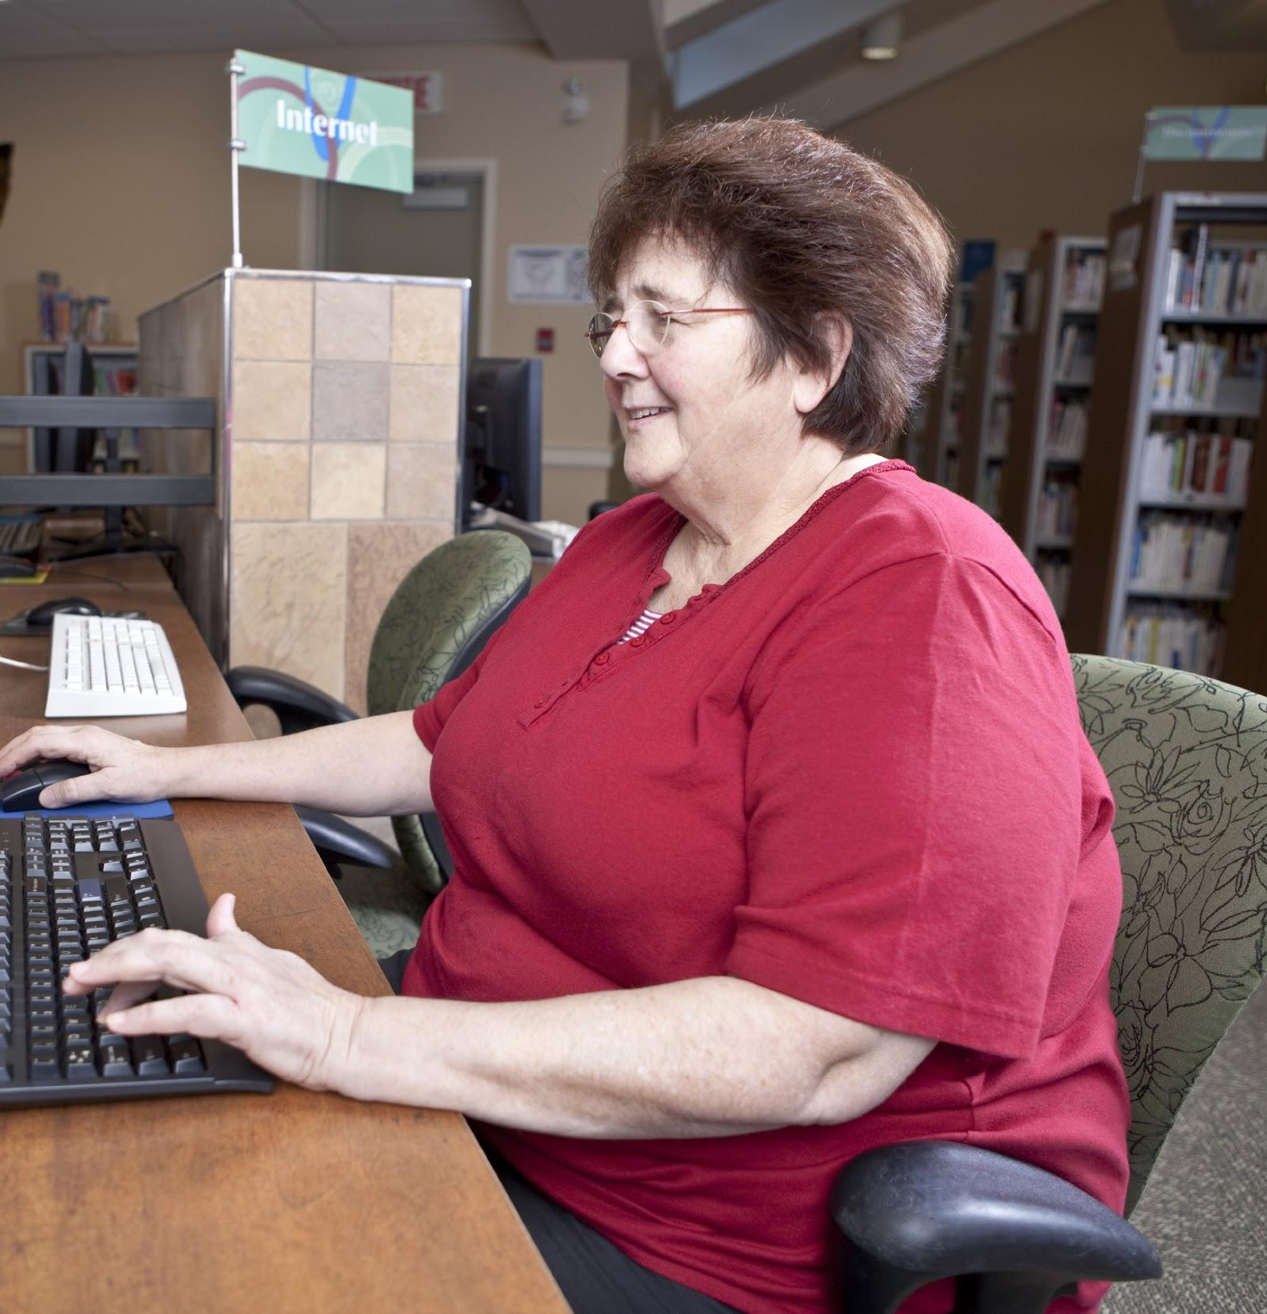
What are some examples of information we need to keep confidential?
Notes:
11:09-11:12
Brainstorm/discussion (CK): What are some examples of information that we need to keep confidential? Use the chat box to add your thoughts
Circ records
Computer use
Program attendance
Presence in library
Database use
Hold slips
library card number
financial information relating to a patron and his or her account
More than just name, address etc. PII can actually be used to develop a picture of your tastes and interests - often inaccurate
Show of hands, do you think your reading histories are a good representation of you as an individual?
Me murder mysteries and serial killer novels – yikes
Questions up to this point?

Slide 7
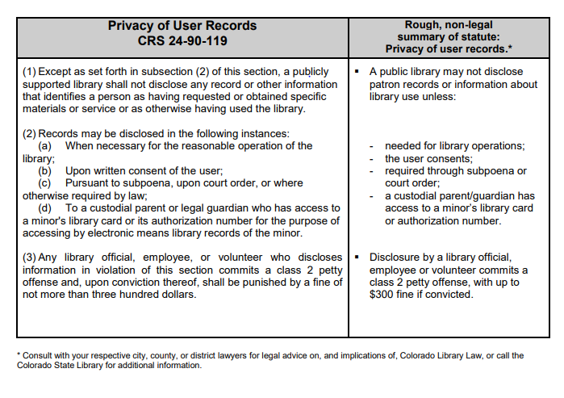
Colorado Library Law
http://www.cde.state.co.us/cdelib/qgprivacy
Notes:
11:12-11:14
Privacy is also the law. Many states provide guarantees of privacy in their constitutions and statute law, Colorado included.
On this slide is a copy of the Colorado Library Law – Section 119 –
If this is too hard to read, it is also on p. 3 of your workbook.
Colorado Library Law says that a library may not disclose any record or other information that identifies a person as having requested or obtained specific materials or service, or as otherwise having used the library.
Colorado Library Law (PDF)
In your playbook and link in resources

Slide 8



When are we allowed to share confidential information?
When are we NOT allowed?
Notes:
11:14-11:17
Discussion/presentation:
So, according to Colorado Library Law, when can we share confidential information? When are we not allowed to share confidential information? (ask for specific examples from their library)
Once again, use the chat area to share your ideas
When needed for reasonable operation of the library – example? – overdue notices
When person allows it through written consent
When required through subpoena/court order
When a custodial parent/guardian has access to a minor’s card for purpose of accessing the minors' records on the computer
What are your policies regarding access to info on a minors card?

Slide 9
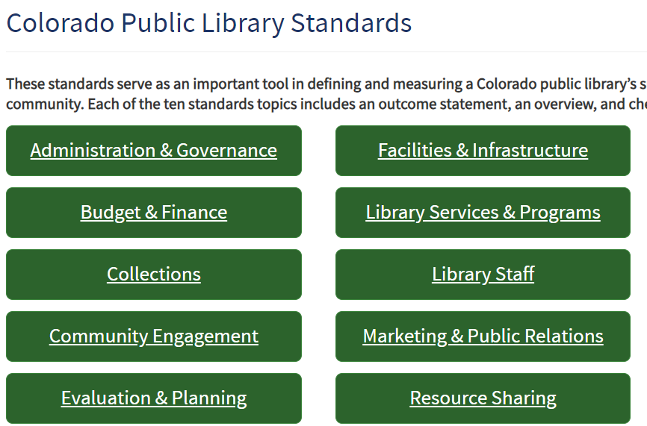
Colorado Public Library Standards
http://www.cde.state.co.us/cdelib/standards/index
Notes:
11:17-11:19
So, how do we ensure that libraries and library staff uphold patron privacy and confidentiality? And how do we connect library law and our code of Ethics to the work we do everyday?
Has anyone heard of the Colorado Public Library Standards?
The Colorado Public Library Standards provide both minimum standards for libraries in the Definition of a Public Library, and developmental standards in which a library can examine its current services and set goals for a better level of service for the local community.
If we look at the Administration $ Governance Standard, it outlines how libraries are run. What the board does, what the director does. Once again, outlined by Colorado Library Law.
Administer the library in accordance with state and local codes and ordinances, including Colorado Library Law, C.R.S. § 24-90-109.
Comply with federal and state laws applicable to libraries, including but not limited to the Americans with Disabilities Act, the Fair Labor Standards Act, Privacy of User Records (C.R.S. § 24-90-119), Colorado data security laws for government entities (C.R.S. §§ 24-73-101 – 24-73-103), Internet Protection in Public Libraries (C.R.S. § 24-90-601, et seq.), and the Science of Reading (C.R.S. § 24-90-121).
The library director and staff apply practical and acceptable management practices and standards to the daily operations of the library. These practices are should be clearly defined in a set of policies adopted by the Library Governing Authority, which are made available to the public.
So, what policies doe your library have related to Privacy and confidentiality?

Slide 10
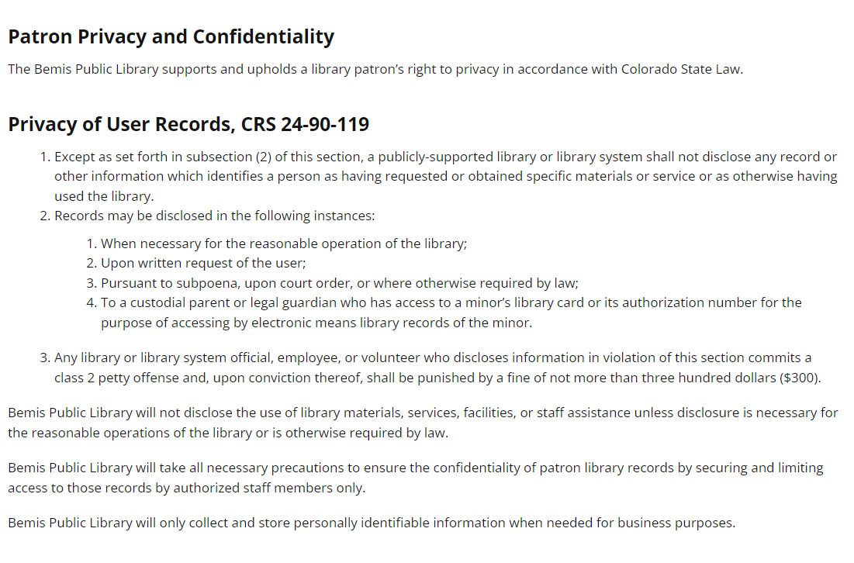
Library Policies
https://www.library.littletonco.gov/About-Us/Library-Information/Policies/Patron-Privacy-Policy
Notes:
11:19-11:24
Most libraries will have a Patron Privacy Policy, or something similar.
Show of hands - How many of you know your library’s policy…or where to find it?
On the screen is an example from the Bemis Public Library, I did this training for them last year. Their policy is accessible to the public on their website. Linked in the resources
Patron Privacy Policy
The Bemis Public Library is committed to patron confidentiality. The confidentiality of library records is a core component of library ethics and the Bemis Public Library follows the Code of Ethics of the American Library Association.
Patron Privacy and Confidentiality
The Bemis Public Library supports and upholds a library patron’s right to privacy in accordance with Colorado State Law.
Then if you go to their website (the link is listed in your resources), Bemis outlines
Colorado Library Law
Patron responsibility
Confidentiality for Children
Third Party Vendor Service
Data Collection
Data Disposal
And Government Requests for Library Records
Present/discuss: So, what policies does your library have to help direct your actions?
Does your library have any other policies that relate to patron privacy
What are some procedures/guidelines your library has to help you uphold your privacy and confidentiality policies?
Age restrictions for parents
Notification of holds
Hold slips
Information about fines/overdue books
So, keep your library’s policies and procedures in mind as we dig a little deeper into how this all related to daily customer service.

Slide 11

Once Upon a Time...
Notes:
11:24-11:29
One evening many years ago, I was working the circulation desk, and a detective came in and asked to see what items a certain patron had checked out. The patron in question was under investigation for a crime, and a book from the library where I worked was found in his possession.
In my case, I asked for ID and asked if he had a search warrant. I also called over the staff member in charge for the evening. The detective did not have a warrant, so we referred him to the library branch manager and library director.
Have any of you ever been approached by law enforcement looking for information about a patron?
Would you have handled it differently? – Let us know in the chat
Yes/No - broach subject of consistency.

Slide 12
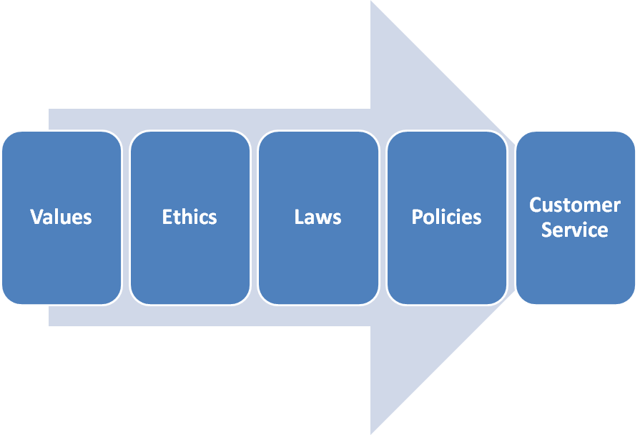
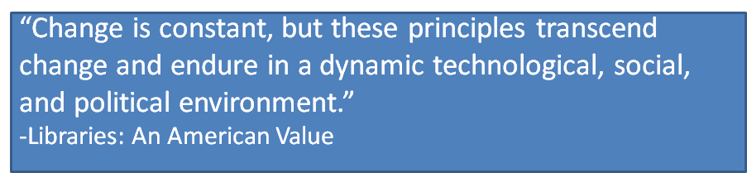
Natural Tension
Notes:
11:29-11:34
Need for consistency & equal treatment –
So, we have covered quite a bit of information so far, from defining patron privacy and confidentiality, to the Colorado Library Law, to your library policy.
But, what all of this really boils down to is customer service...more specifically consistent, quality customer service.
Consistent application of policies and procedures as we uphold privacy and confidentiality.
CLICK
What makes patron privacy sticky, and what makes situations sticky, is that there is sometimes tension between these areas.
We may wish to provide the customer the service they are asking for, but that contradicts our policies. We may want to uphold our professional values and ethics, and Colorado Library Law, but we have a law enforcement officer putting pressure on us to turn over patron information. It’s these tensions that make it difficult for us in the moment to make the right decision, and that’s one reason why it’s important for us to always provide service that is consistent with professional ethics and library law and policy. Once again, speaking to your procedures and guidelines.
And important to talk about issues as they arise in your day-to-day work.
Discussion: Challenges to consistency Raise hands
Have you ever experienced inconstant use of privacy policies?
Example: one staffer will look up patron spouse information and share it, but not another
What are some ways to address that in your organization? - CHAT
CLICK
Quote, transition to scenarios

Slide 13
Scenarios
Notes:
11:34-11:35
Ok, so now it is time to practice!
As we chat about these scenarios, I want you to consider:
ALA Code of Ethics
Colorado Library Law – or your state law
Your Library Policies and guidelines

Slide 14
Scenario 1
In between helping patrons on the floor, you overhear two staff members talking about a patron near the circulation desk. “He is a bit creepy! I bet he lives alone. He is just so awkward!” The other staff member responds by laughing, “I know, I helped him check out some items last week, and he was checking out books on dating and how to find your soulmate!”
What makes this situation sticky? Where is the tension?
Notes:
11:35-11:43
Ok, first scenario:
In between helping patrons on the floor, you overhear two staff members talking about a patron near the circulation desk. “He is definitely a bit creepy! I bet he lives alone. He is just so awkward!” The other staff member responds by laughing, “I know, I helped him check out some items last week, and he was checking out books on dating and how to find your soulmate!”
What makes this situation sticky? Where it the tension? Why is consistency important?

Slide 15
Scenario 1 – What should you do?
In between helping patrons on the floor, you overhear two staff members talking about a patron near the circulation desk. “He is a bit creepy! I bet he lives alone. He is just so awkward!” The other staff member responds by laughing, “I know, I helped him check out some items last week, and he was checking out books on dating and how to find your soulmate!”
What should you do? What should you say?
Notes:
What should you do? What should you say?

Slide 16
Scenario 1 – Checkout
In between helping patrons on the floor, you overhear two staff members talking about a patron near the circulation desk. “He is a bit creepy! I bet he lives alone. He is just so awkward!” The other staff member responds by laughing, “I know, I helped him check out some items last week, and he was checking out books on dating and how to find your soulmate!”
The staff are talking near the self-checkout machines.
Notes:
The staff are talking near the self-checkout machines. Does this change your response?

Slide 17
Scenario 1 - Complaint
In between helping patrons on the floor, you overhear two staff members talking about a patron near the circulation desk. “He is a bit creepy! I bet he lives alone. He is just so awkward!” The other staff member responds by laughing, “I know, I helped him check out some items last week, and he was checking out books on dating and how to find your soulmate!”
A mother complains that her child saw this patron
looking at pornography on the computer.
Notes:
A mother complains that her child saw this patron looking at pornography on the computer. Does this change your response?

Slide 18
Scenario 2
A patron wants to know what is checked out on his wife’s card so that he can return the items while she is out of town.
What makes this situation sticky? Where is the tension?
Notes:
11:43-11:51
Next scenario:
A patron wants to know what is checked out on his wife’s card so that he can return the items while she is out of town.
What makes this situation sticky? Where it the tension? Why is consistency important?

Slide 19
Scenario 2 – What should you do?
A patron wants to know what is checked out on his wife’s card so that he can return the items while she is out of town.
What should you do? What should you say?
Notes:
What should you do? What should you say?

Slide 20
Scenario 2 – 16 year old
A patron wants to know what is checked out on his wife’s card so that he can return the items while she is out of town.
The next time the patron comes in, he is asking to see what his 16-year-old daughter has checked out. When you check the daughter's account, you see that she checked out a book about teenage pregnancy.
Notes:
The next time the patron comes in, he is asking to see what his 16-year-old daughter has checked out. When you check the daughter's account, you see that she checked out a book about teenage pregnancy.
Does this change anything?

Slide 21
Scenario 2 – Family issue
A patron wants to know what is checked out on his wife’s card so that he can return the items while she is out of town.
One of the books on the child’s record is about dealing with a family member who is an alcoholic.
Notes:
One of the books on the child’s record is about dealing with a family member who is an alcoholic. What should you do?
Does this change anything?

Slide 22
Scenario 3
A frantic mom calls looking for her 11-year-old son, who did not show up after school. He loves the library, and she is wondering if you can page him, or look for him.
What makes this situation sticky? Where is the tension?
Notes:
11:51 - 11:58
Last scenario:
A frantic mom calls looking for her 11-year-old son, who did not show up after school. He loves the library, and she is wondering if you can page him, or look for him.
What makes this situation sticky? Where it the tension? Why is consistency important?
The son is a regular at the library, and he recently confided to you that there has been trouble at home. Does this change your response?
The mother asks what books the son has checked out recently. What do you do?
You haven’t seen the son in over a week, which is unusual. Does this change your response?

Slide 23
Scenario 3 – What should you do?
A frantic mom calls looking for her 11-year-old son, who did not show up after school. He loves the library, and she is wondering if you can page him, or look for him.
What should you do? What should you say?
Notes:
What should you do? What should you say?
The son is a regular at the library, and he recently confided to you that there has been trouble at home. Does this change your response?
The mother asks what books the son has checked out recently. What do you do?
You haven’t seen the son in over a week, which is unusual. Does this change your response?

Slide 24
Scenario 3 – Trouble ay home
A frantic mom calls looking for her 11-year-old son, who did not show up after school. He loves the library, and she is wondering if you can page him, or look for him.
The son is a regular at the library, and he recently confided to you that there has been trouble at home.
Notes:
The son is a regular at the library, and he recently confided to you that there has been trouble at home.
Does this change your response?

Slide 25
Scenario 3 - Unusual
A frantic mom calls looking for her 11-year-old son, who did not show up after school. He loves the library, and she is wondering if you can page him, or look for him.
You haven’t seen the son in over a week, which is unusual.
Notes:
You haven’t seen the son in over a week, which is unusual.
Does this change your response?

Slide 26
Conclusion
“Freedom is found through the portals of our nation’s libraries.”
- David McCullough
Notes:
11:58-12:00
Hopefully, you can see that many of the situations that you all deal with on a daily basis are not as clear cut. There are often nuances, circumstances, and even ethical dilemmas that come into play.
But, if we can use the common values that frame our profession as inspiration to provide exceptional, consistent and equitable service to our patrons and remember that our library policies are there to direct that service, much of the guesswork can be minimized.
My challenge to you: continue building on what we started with the scenarios and see if you can develop actual scripts (or prompts) that you can use when these sticky situations arise.
ALA also created free downloadable Privacy field guides – great tools to help you discuss privacy with others – 7 guides
Staff
Patrons
Groups
vendors
Listed in the resources in your handout
Questions?

