Slide 1
Customer service
From transactions to transformations
Notes:
CK CSL in Session Introduction 12:00- 12:02
CK moves to these slides

Slide 2
What we want you to know
What we are going to do today
It has been a few hard years with lots of constant change.
Library work is people work; people can be difficult.
Discuss ways staff have adapted over the last 2 years.
Learn about the Transformation Model and how it applies to customer service
Brainstorm what we intentionally want to carry forward.
Notes:
CK - 12:02 – 12:03
What we want you to know
It has been a hard few years with lots of constant change
Library work is people work, people can be difficult.
What we are going to do today
Discuss ways staff have adapted over the last 2 years
Learn about the Transformation Model and how it applies to customer service
Brainstorm what we intentionally want to carry forward

Slide 3
What is your favorite part about working at the library?
Notes:
CK -12:03-12:05
What is your favorite part about working at the library?

Slide 4
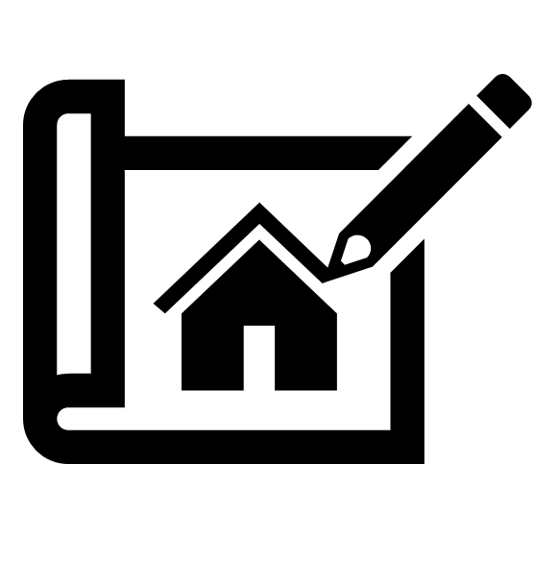
What are libraries?
A place with books
Err….
A place with stuff
Err….
A place for community
Err….
For? Of? People?
Things?
Notes:
KH - 12:05-12:09 – slides 4&5
When I started in libraries, I thought libraries were a place for books. Then I looked at all the myriad of things we circulate - makerspace etc and thought, the library is a Place for Stuff. Then I started considering the programs and interactions I had everyday and thought perhaps the library is more than a place of stuff, it is the stuff and the librarians

Slide 5
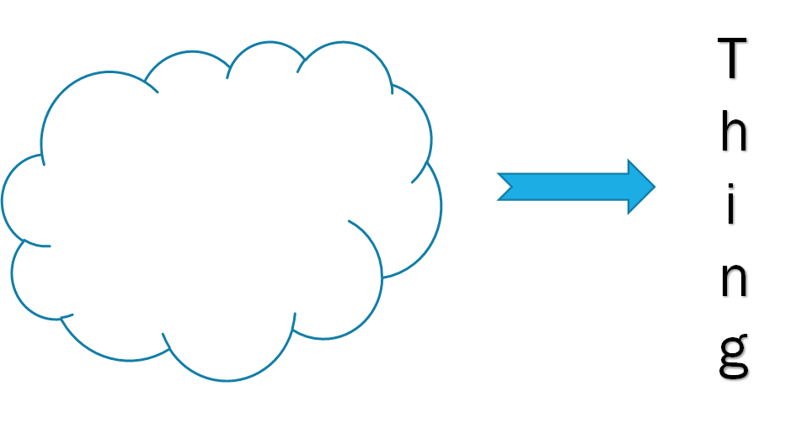

The stuff that gets people to the thing
Notes:
I have been in all sorts of libraries all over the country and regardless of the Stuff what I have noticed is that people come into the library for a thing. That thing might be a book, or the internet, or a place to be that doesn’t expect or demand a purchase, or human interaction, or insight on a subject. We help people solve problems by connecting to the thing - Need a dvd to chill out - Need access to medical information
The Library is stuff that gets folks to the thing. Part of that is actual items, some of that is the human interaction
We often think of library work as being about books, but it is really about people

Slide 6
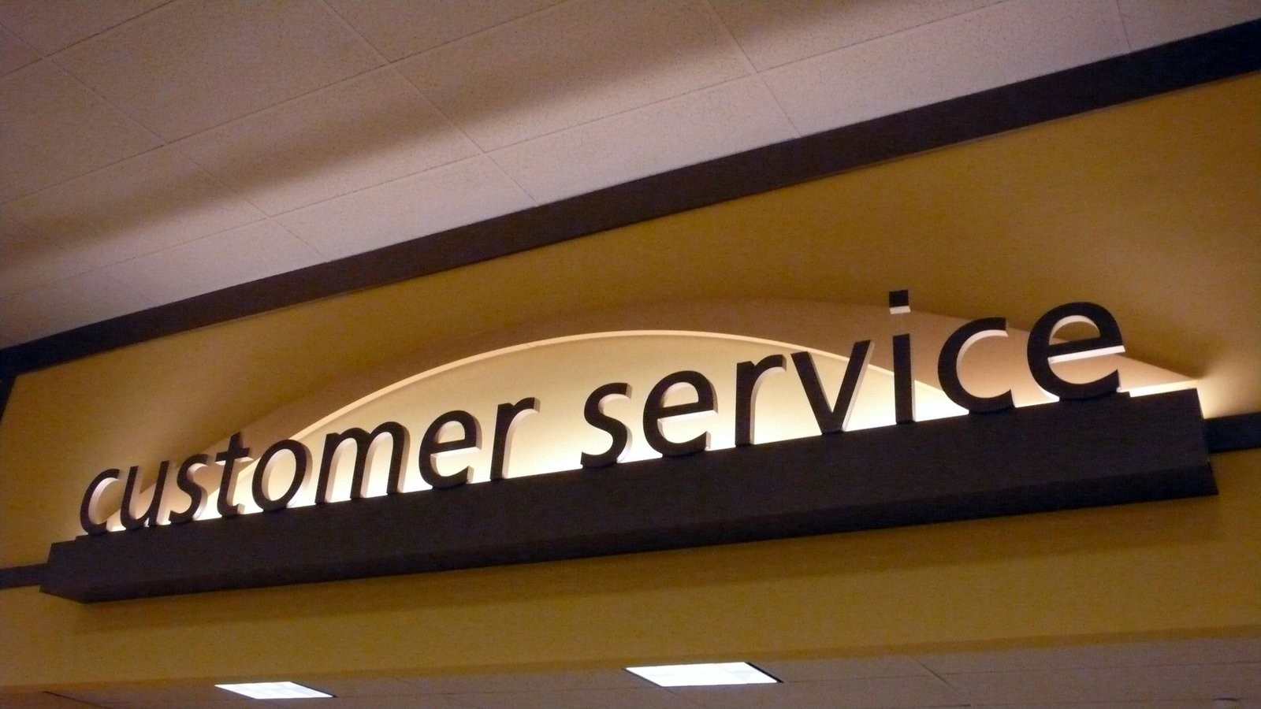
What is Customer Service
Notes:
CK - 12:09- 12:13
So, if libraries are about people, then providing excellent customer service is critical.
But, what exactly is customer service?
Think about the worst service service you have ever received - what did it look like/feel like? Verizon
Now, think about the best service you have ever received - How did that make you feel? Consumer Cellular
What made the service exceptional?
So let's see if we can apply these ideas to the work you all do here.
It helps to think about customer service in a library as an ongoing conversations between a library staff and library users.
It goes far beyond the patrons initial question
Even tough we may never witness it, these interactions have power!

Slide 7
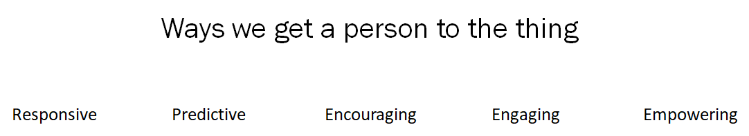
Ways we get people to the thing
Notes:
KH – 12:13-12:18
Ask 1-2 people to share their best library patron interaction before we get into these - CK Teen tipping story
Types of Interactions - Interactions from our (LIBRARY) point of view
Responsive - transactional
Predictive - anticipating needs - still transactional
Encouraging - goes beyond the question the patron asks - what else can we connect them to
Engaging - ie book club -
Empowering - we help people solve problems, learn new skills and make life better - transformational
Questions?
Can you think of a time when you were able to empower a patron?

Slide 8
Why do people come to the library?
Notes:
CK – 12:18-12:21
So let's switch gears a bit, and think put ourselves in our patrons shoes?
Why do people come to the your library?
Brainstorm
They come to get help with something. To solve a problem

Slide 9
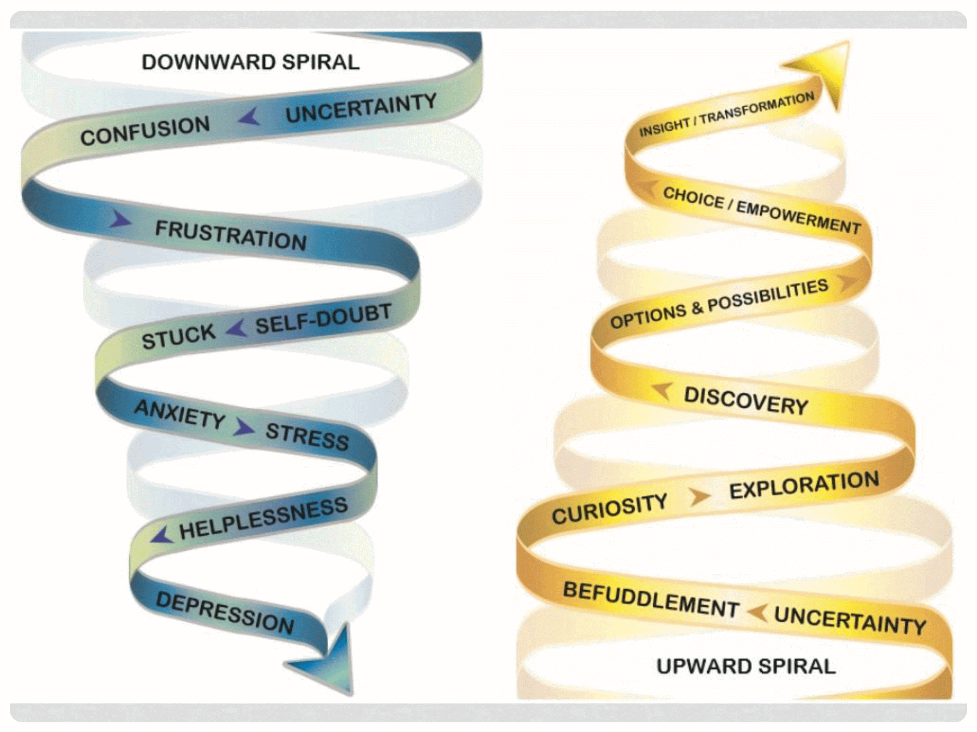
Transformation Spiral Model
Notes:
KH – 12:21-12:26
Transformation Spiral Model
We want to be able to help patrons solve their problems
When they come in they may be experiencing downward spiral
How can we recognize when patrons are in the downward spiral?
They may not even know what they need and libraries can be confusing and intimidating
We want to get them to befuddlement and start working them back up the spiral
Questions?

Slide 10
Are any of you experiencing a downward spiral?
(If yes, that is ok!)
Notes:
CK – 12:26-12:29
So, we have talked about the different types of interactions from the library point of view, and how to see things from the patrons point of view, but what about you? You are the ones doing the work.
CLICK
Customer service is hard in the best of times, but the pandemic has made everything harder. I attended a webinar this summer that mentioned that because we all have our own sets of experiences, we all experienced a different pandemic. Think about that for a moment. My pandemic was a different experience that Kieran’s, or yours.
I think this is critical when it comes to customer service and moving from transaction to transformational. Once again, it is all about people. The people you connect with everyday
CLICK
So, if any of you are experiencing a downward spiral. That is ok!
I am finding this part of the pandemic to be very hard for me, and I have the privilege of working at home.
Stress is a cumulative force, and we all have had to adapt to so many changes in the last year and a half.
How many of you are fairly new to the library? That is also a big change!
So let's see how we can apply the Spiral model to the work you do

Slide 11
How have you had to adapt at work?
Notes:
CK 12:29-12:33
Let's brainstorm all of the different ways you had to adapt during the pandemic
Can we take notes live? Give them something to work from later?
(may become small ventfest)
So, you all have had to adapt to quite a bit this last year. How did you do it?

Slide 12
Uncertainty to discovery
Notes:
CK 12:33-12:34
So, whether everything worked smoothly or not, let's take note of the fact...and celebrate that you took the uncertainty, and got creative. You were curious, you explored and discovered.
CLICK
You have already been doing the upward spiral!

Slide 13
What worked well?
What did not?
Notes:
KH 12:34-12:40
So we talked about all of the changes you all have made. Now lets talk about HOW we can be intentional with what we keep. What we choose to move forward with
Don't be in a rush to “get back to normal”
Lets keep that curiosity going as we discuss some of the changes you made and what is worth keeping
We look at notes of what they say they changed.
Discuss with them how they adapted and we ask them to think about what worked/what did not
How do you feel when things dont work out? When you have to adapt again?
Just because somethings don’t work out, remember to use befuddlement to regroup

Slide 14
Discovery to possibility
Notes:
KH – 12:40-12:42
So talking about and evaluating as a team or library what is working, and what is not moves us up the spiral. It can be hard to deal with failure. When things don't work. But it is all part of the process as you uncover what DOES work.
Lets see if we can be more intentional with our discovery, exploration, and possibilities. Learn from failure and mistakes.
And this all stems from our own openness and curiosity. Our own path up the spiral
This moves us all from discovery and possibility to choice and empowerment.
This is where the magic happens. The mindset shift from transactions to transformations.

Slide 15
How can we be intentional
with what we keep?
Notes:
CK – 12:42-12:47
Mission/Vision/values
What do we drop to keep other things
Who can remember what the mission statement is?
What still fits with the mission. Vision, values of your org?
The WHY your organization exists
Kieran story grocery store curbside
Who is using the service and why
We are the business of people and connecting to the stuff
Keep them in the spiral - frustration = befuddlement
As we review your changes, adaptations, lets focus on that mindset shift from transactions to transformations.

Slide 16
Possibilities to transformation
Notes:
CK – 12:47-12:52
Activity - Now let's brainstorm what you should keep vs discard.
Let's brainstorm from you shared what you should keep vs discard. What aligns with mission and vision or can align
Moving forward, it is critical to keep having these conversations. Working together as a library, as a team to develop, twerk, hone the services that impact the people you serve.
Collaboratively talk about values and goals. For the library, for projects, for staff. Help each other connect the dots between the work you each do, and how that supports organizational values. How the work you all do directly impacts your patrons.

Slide 17
Transformation Action Plan
What is one thing from this session you would like to explore or learn more about?
What is one thing you can commit to practicing in the next month to make your interactions more transformational?
What are two things your organization can start, stop, or change to transform a service?
Notes:
CK - 12:52 - 12:55
What is one thing from this session you would like to explore or learn more about?
What is one thing you can commit to practicing in the next month to make your interactions more transformational?
What are two things your organization can start, stop, or change to transform a service?

Slide 18
Questions?
?
?
?
Kieran Hixon – hixon_k@cde.state.co.us
Christine Kreger - kreger_c@cde.state.co.us
Notes:
12:55-12:58 Questions
12:58-1:00 – CSL in Session wrap up

