Slide 1

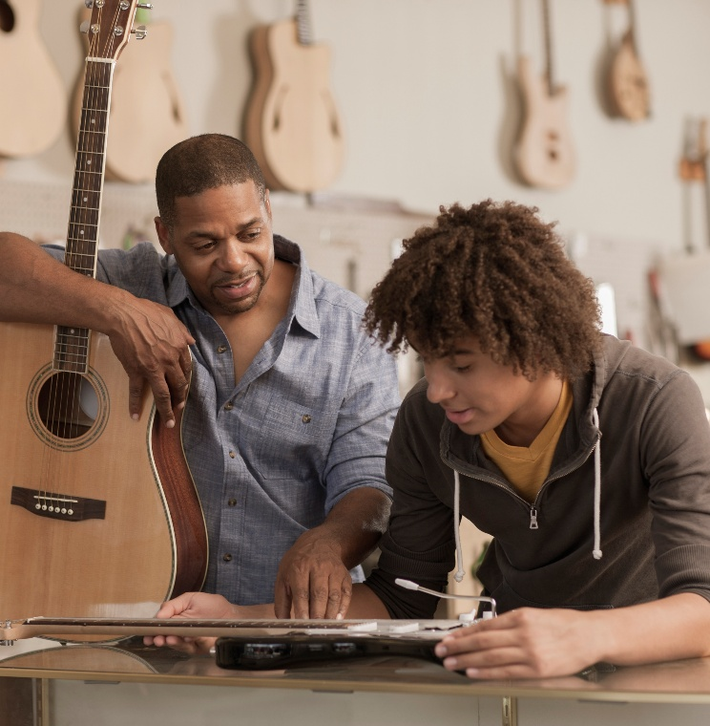
Understanding Teens: Building Positive Relationships

Slide 2
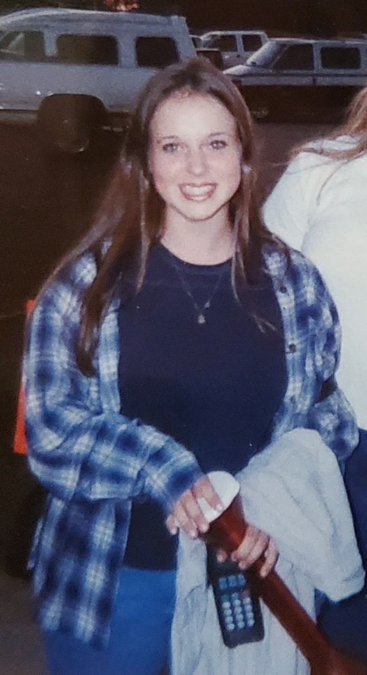
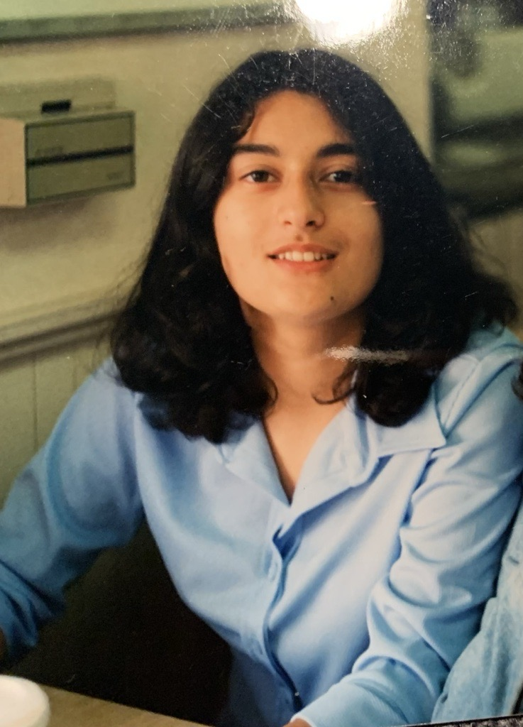
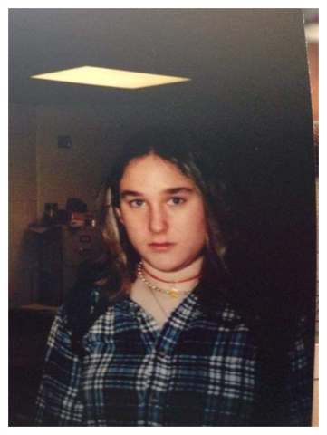
Introductions

Slide 3
we invite you to…
Stay curious
Be open
Consider intent and impact

Slide 4

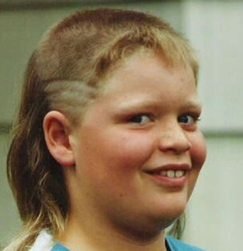
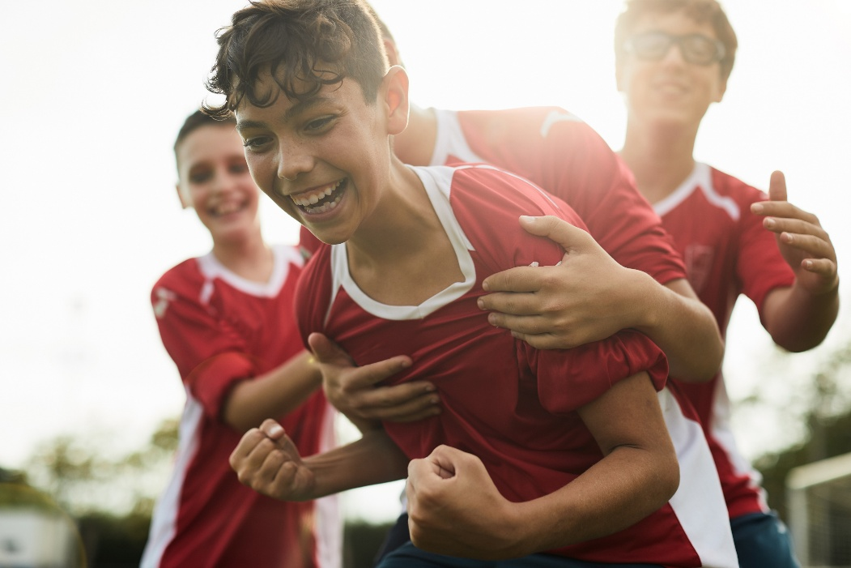
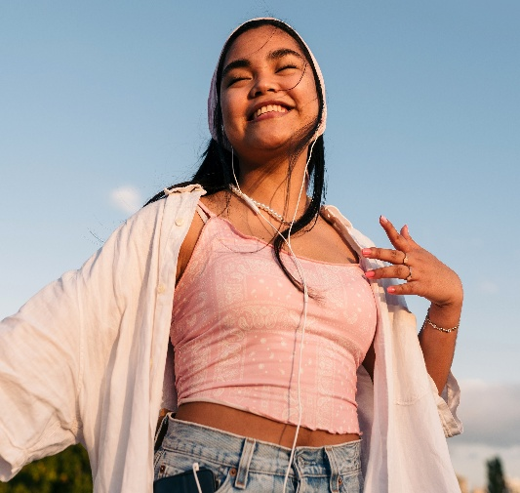
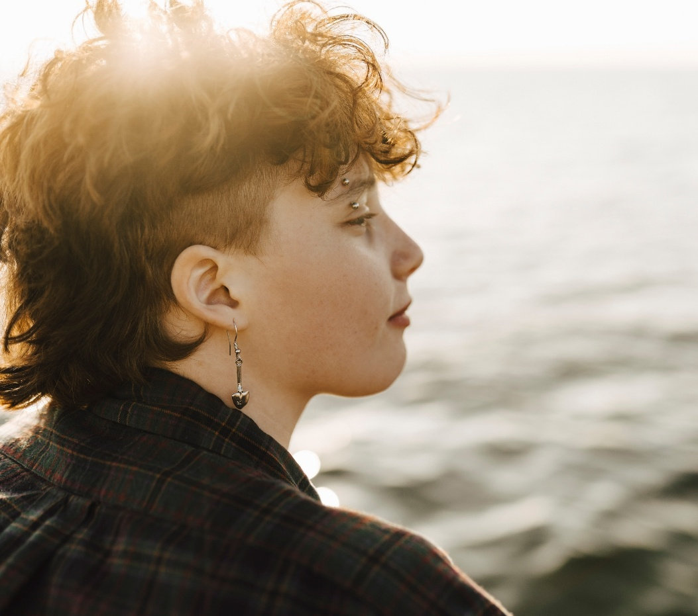


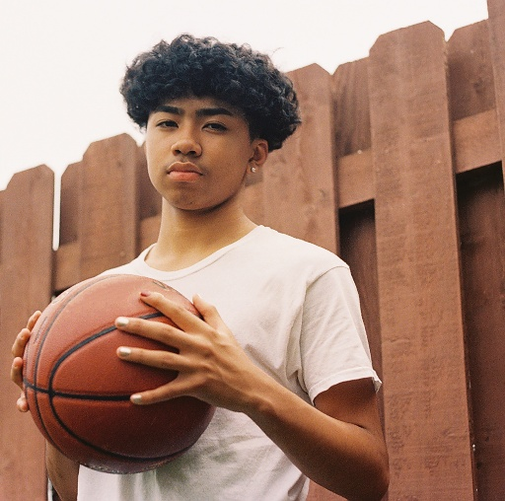
what is your
WHY

Slide 5
Building relationships & Positive behavior expectations

Slide 6
Think of an adult who had a positive impact on your life as a teen. How did they impact you? What did they do?

Slide 7

Think of an adult who had a negative impact on your life as a teen. How did they impact you? What did they do?

Slide 8

Please Share in Chat
If the teens in your library are sitting in a workshop like this 20 years from now, what do you hope they say about YOU?

Slide 9
Positive Adults…
Care
Are present
See potential
Don’t give up
Find strengths
Challenge youth
Notice changes
Take responsibility
Are consistent

Slide 10
Shifting our mindset
CONTROLLING
Negative Behavior
INSPIRING
Positive Behavior
Supports social emotional learning

Slide 11

Power to Partnership
Reactive
Responsive
Threatening
Listening
Looks for the negative
CONTROLLING Negative Behavior
Seeks out the positive
Anticipates challenges
Anticipates greatness
“What’s wrong with them?”
“What can I do differently?"
Motivates through fear
Motivates through connection
Problem-focused
Solution-focused
INSPIRING Positive Behavior
Respect means “do what I say”
Respect means “I value you”
Prioritize the rules
Prioritize the individual
Adult voice
Youth voice
Short term result
Long term growth
Relies on a quick fix
Requires effort and intentionality
Assumes motivation
Asks questions

Slide 12
We don’t see you as a problem.
We see you as an
OPPORTUNITY

Slide 13
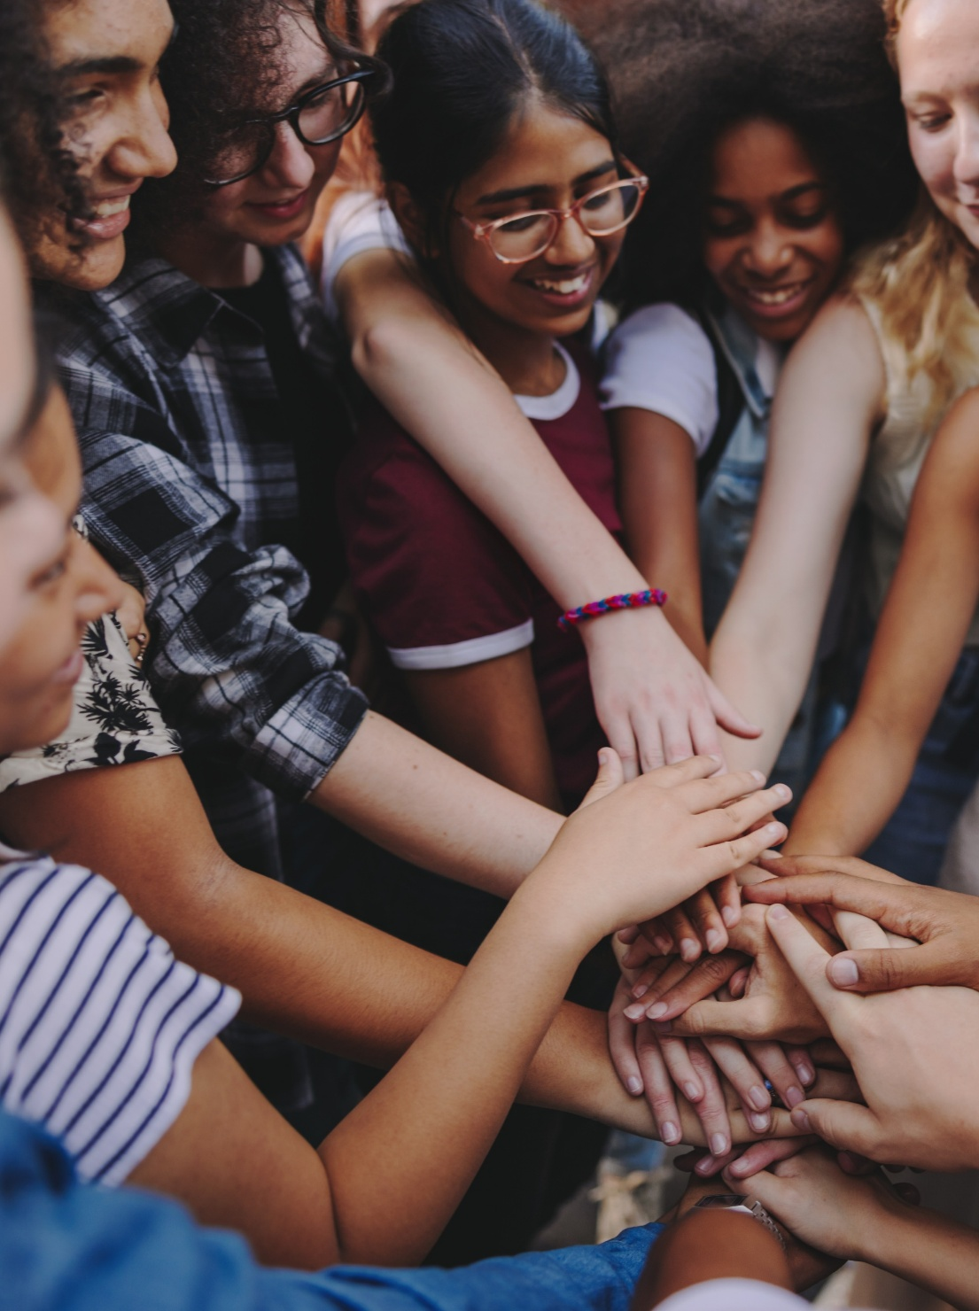
Keys to positive interaction
Respect is not automatic
It’s about community, not control
Power struggles are not productive
Fewer rules are better – co-create when possible
One-on-one when correction is needed
Train all staff
Don’t hold grudges

Slide 14
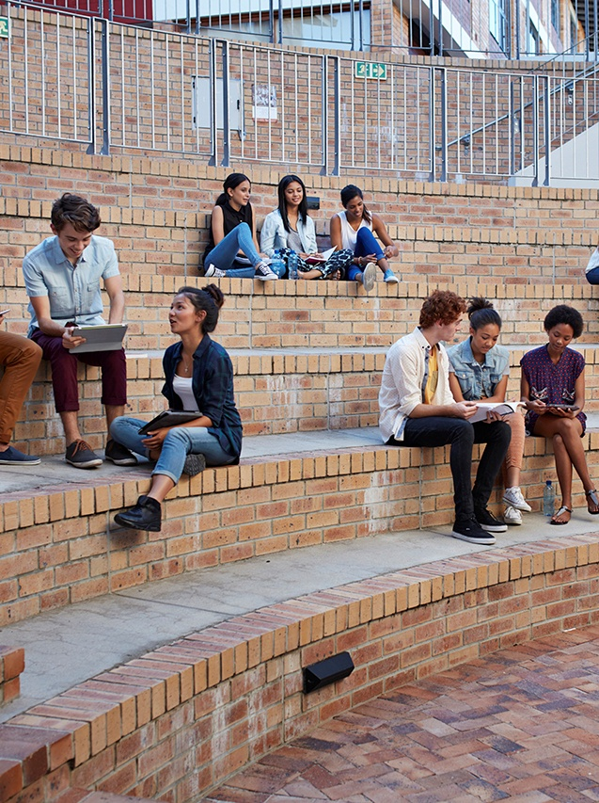

More Keys to Positive Interaction
Own your “stuff”
Try to remember names or faces
Get to know the teen
Recognize your biases
See the teen, not the behavior
See potential first
Demonstrate positive tone and body language
Talk WITH youth, not AT youth
LISTEN
Know when to back off

Slide 15
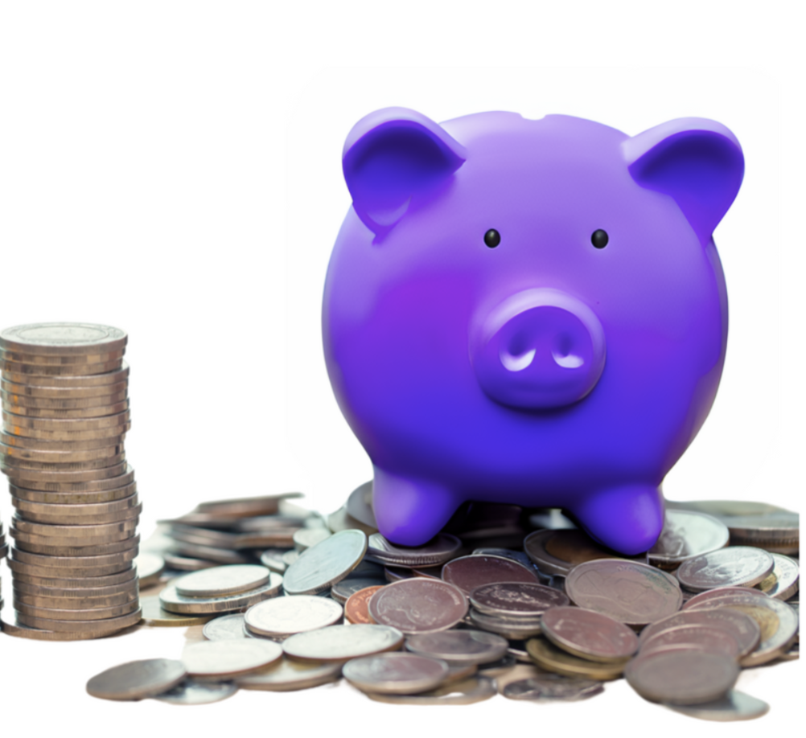
Trust is built or broken in moments
Dignity and Respect
+
Moments of Connection
+
Consistency
=
TRUST

Slide 16
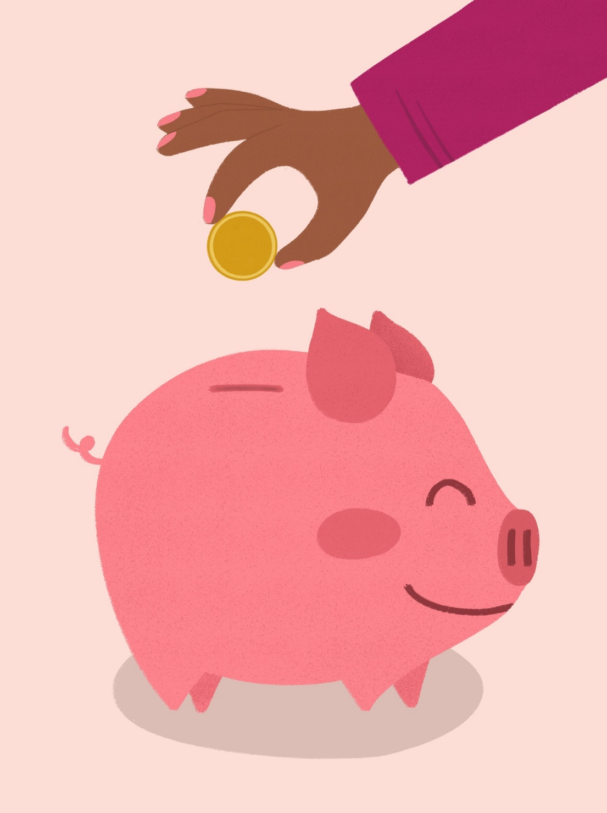
Please Share in Chat:
What are things we can do to add to the bank of trust with teens in our library?
What are things we do that take coins out of the bank of trust?

Slide 17
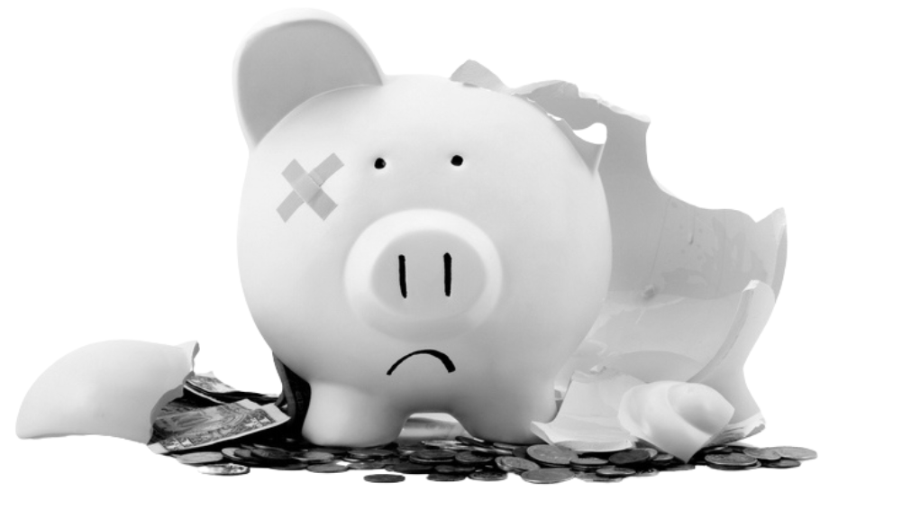
Repairing TRUST

Slide 18

TAKE A
PURPOSEFUL
PAUSE
WHAT DO YOU THINK THIS MEANS?

Slide 19
Research shows that we have 6 SECONDS to pause between experiencing an emotional hot button and experiencing emotional flooding.
6
5
3
2
sixseconds.org
4
1

Slide 20
What are your strategies for challenging situations?
Boundary setting with teens
Loud, large groups of teens
Messes left behind
PDA of any kind (or middle schoolers who don’t know how to flirt)
Cursing
Rough housing
New 6th graders

Slide 21
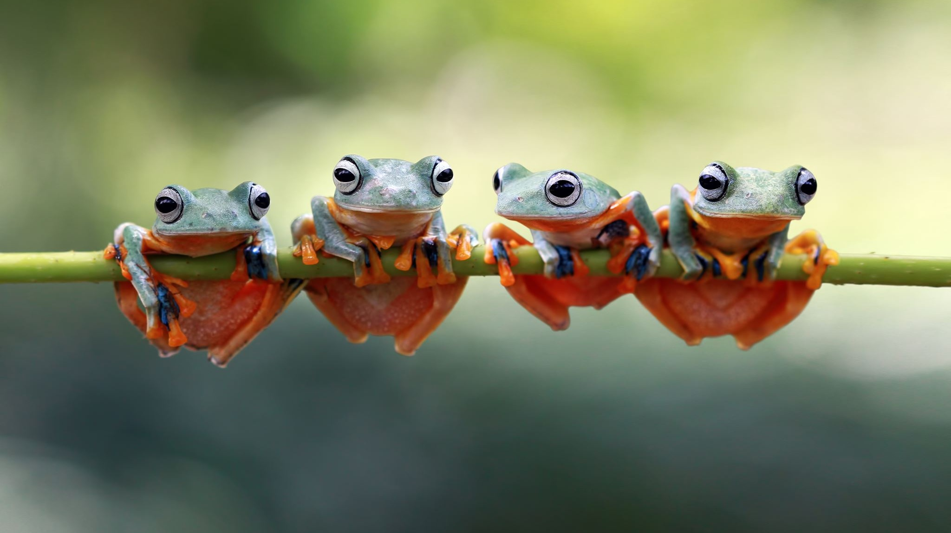
Questions?

Slide 22
Thank you!
Anush – abalayan@ald.lib.co.us
Catherine – cboddie@ald.lib.co.us
Erica – eschimmel@ald.lib.co.us

