Slide 1
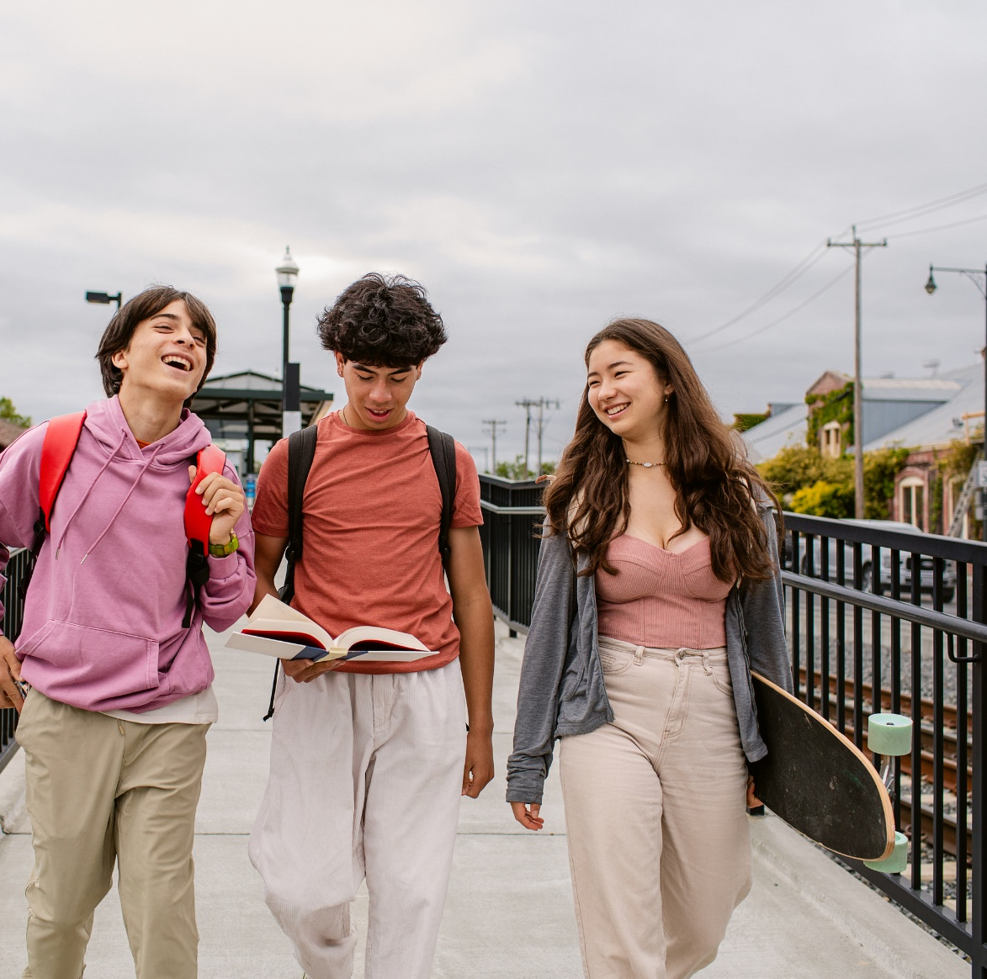
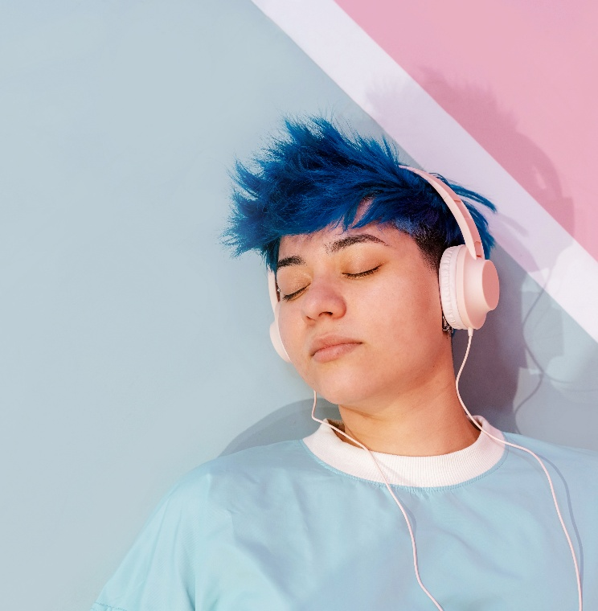
Understanding Teens – Biases & Stereotypes

Slide 2
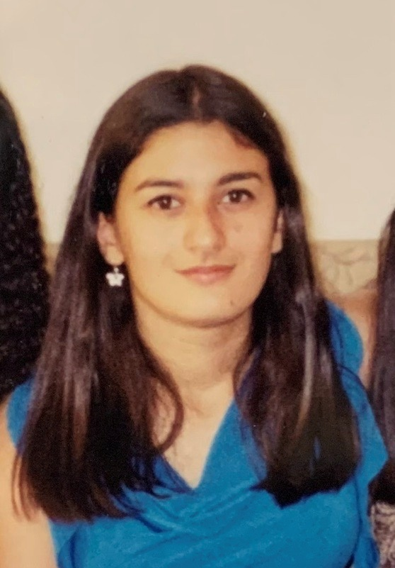
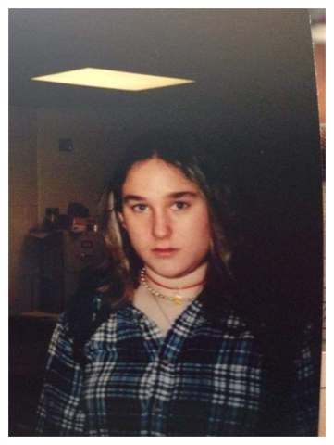
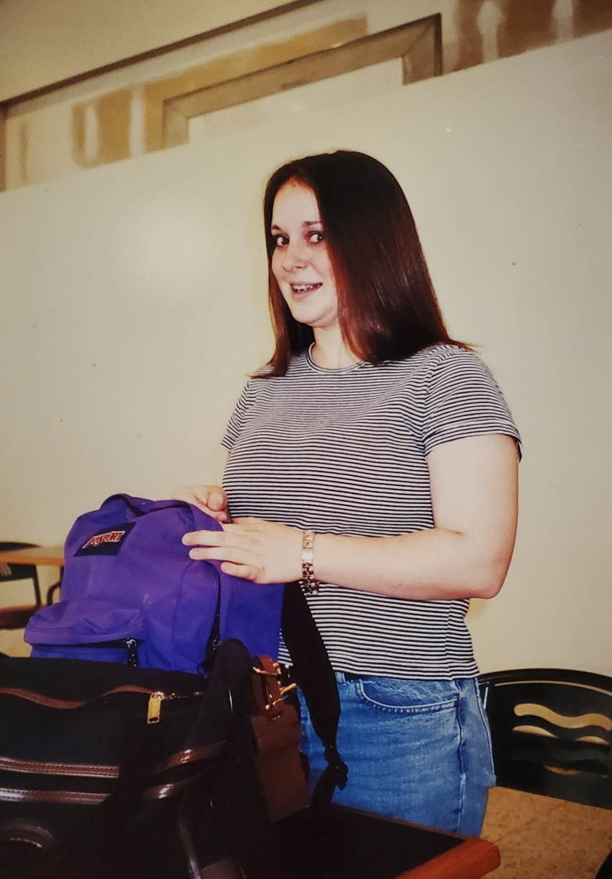
Introductions

Slide 3
we invite you to…
Stay curious
Be open
Consider intent and impact

Slide 4
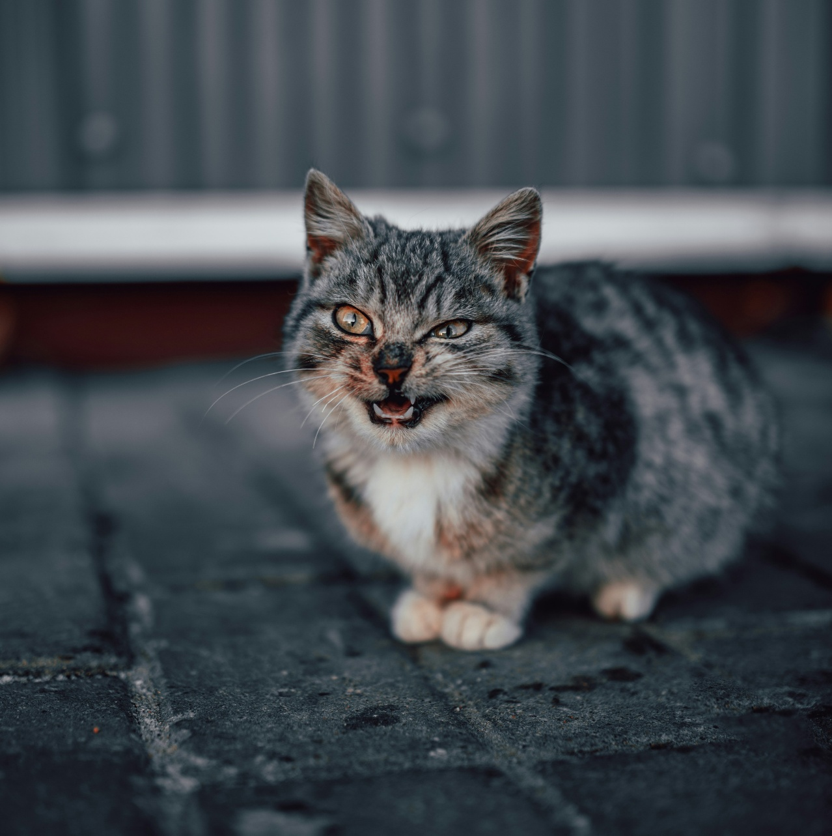
Please share in chat:
What is something that triggers immediate judgement for you? How does it change when working with children? Teens? Adults?

Slide 5
Stereotypes and Bias

Slide 6
Stereotype vs bias
Stereotype
An overgeneralization formed about an entire group of people based on shared characteristics or experiences.
"Preconceived notion"
Bias
An opinion formed about someone or something based on one's own perception of that person or thing.
"Tendency or preference towards a particular perspective."

Slide 7
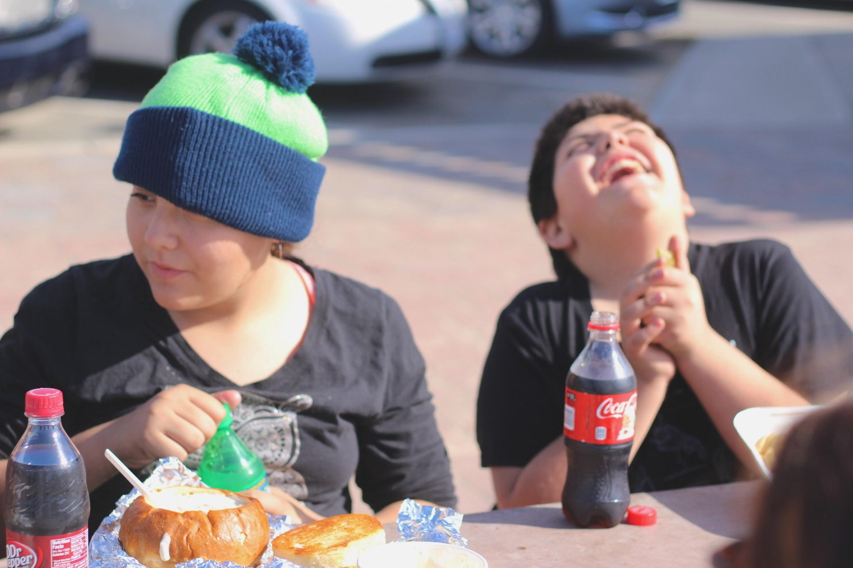
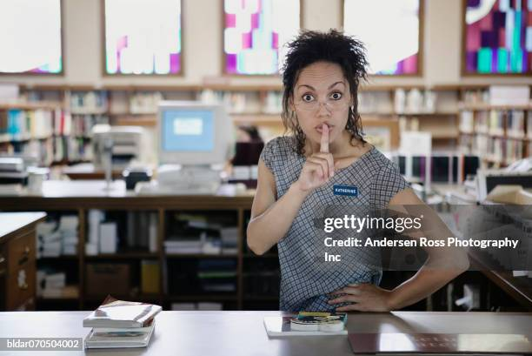
Group brainstorm: what are some common biases or stereotypes about Library staff? About teens?

Slide 8
Biases affecting behavior expectations

Slide 9
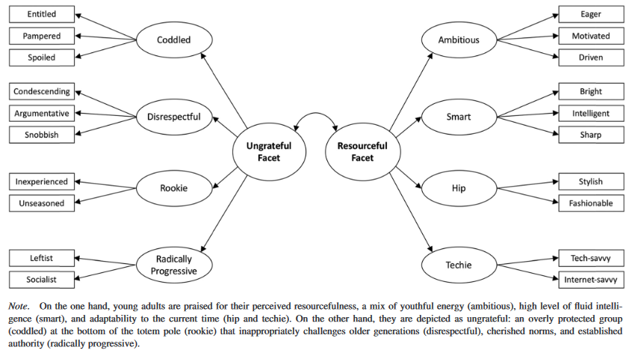
Ageism Bias

Slide 10
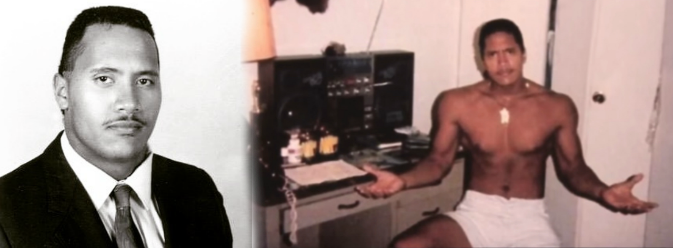
Adultification Bias

Slide 11
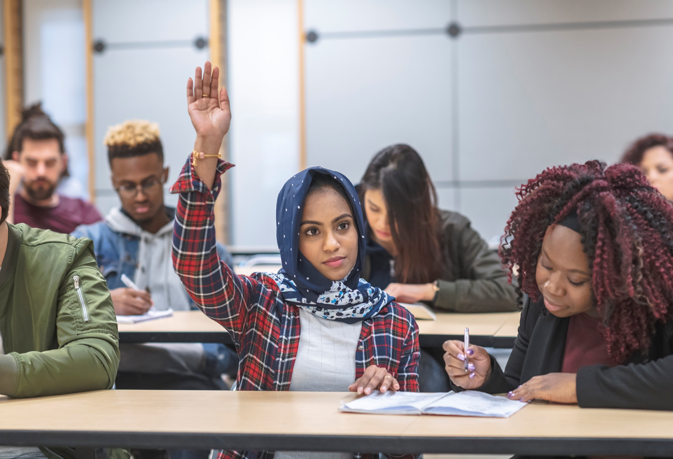
Racial & Cultural Bias

Slide 12
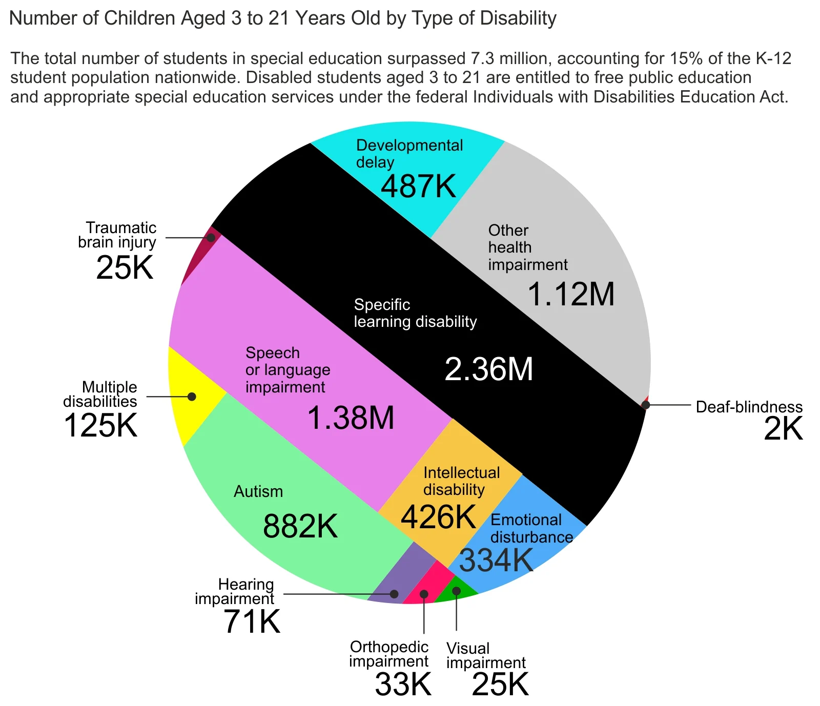
Ableism Bias
Source: National Center for Education Statistics - 2022

Slide 13
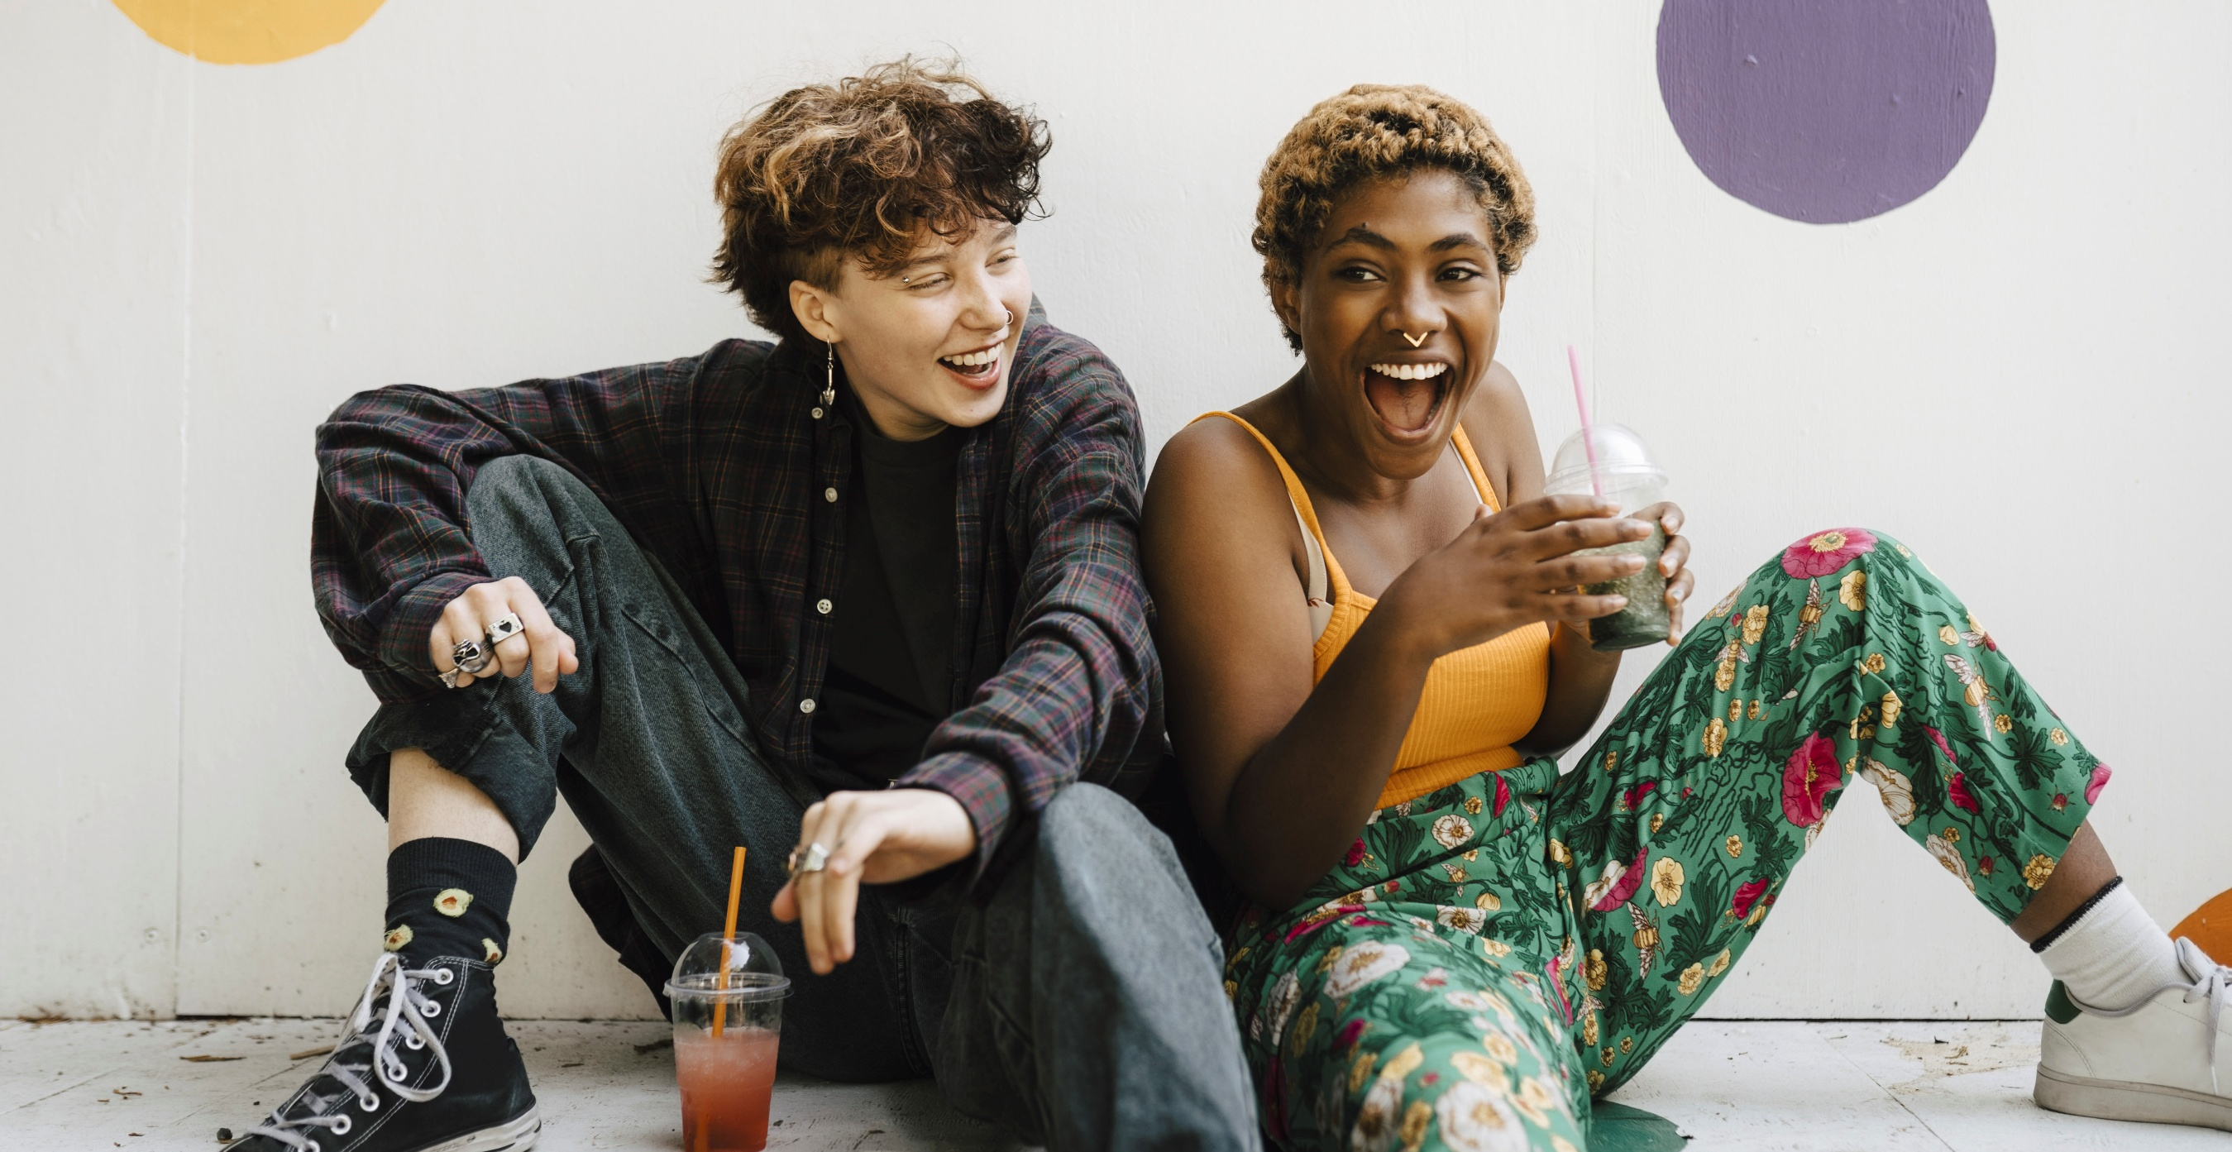
Code Switching, Masking, & Microaggressions

Slide 14
Individual reflection activity
Think about an interaction you’ve had with a teen at the library where bias may have affected your reactions. What would you do differently now?
Invitation to Reflect

Slide 15
When we ask a teen to leave for the day, how does our next interaction with them go?

Slide 16
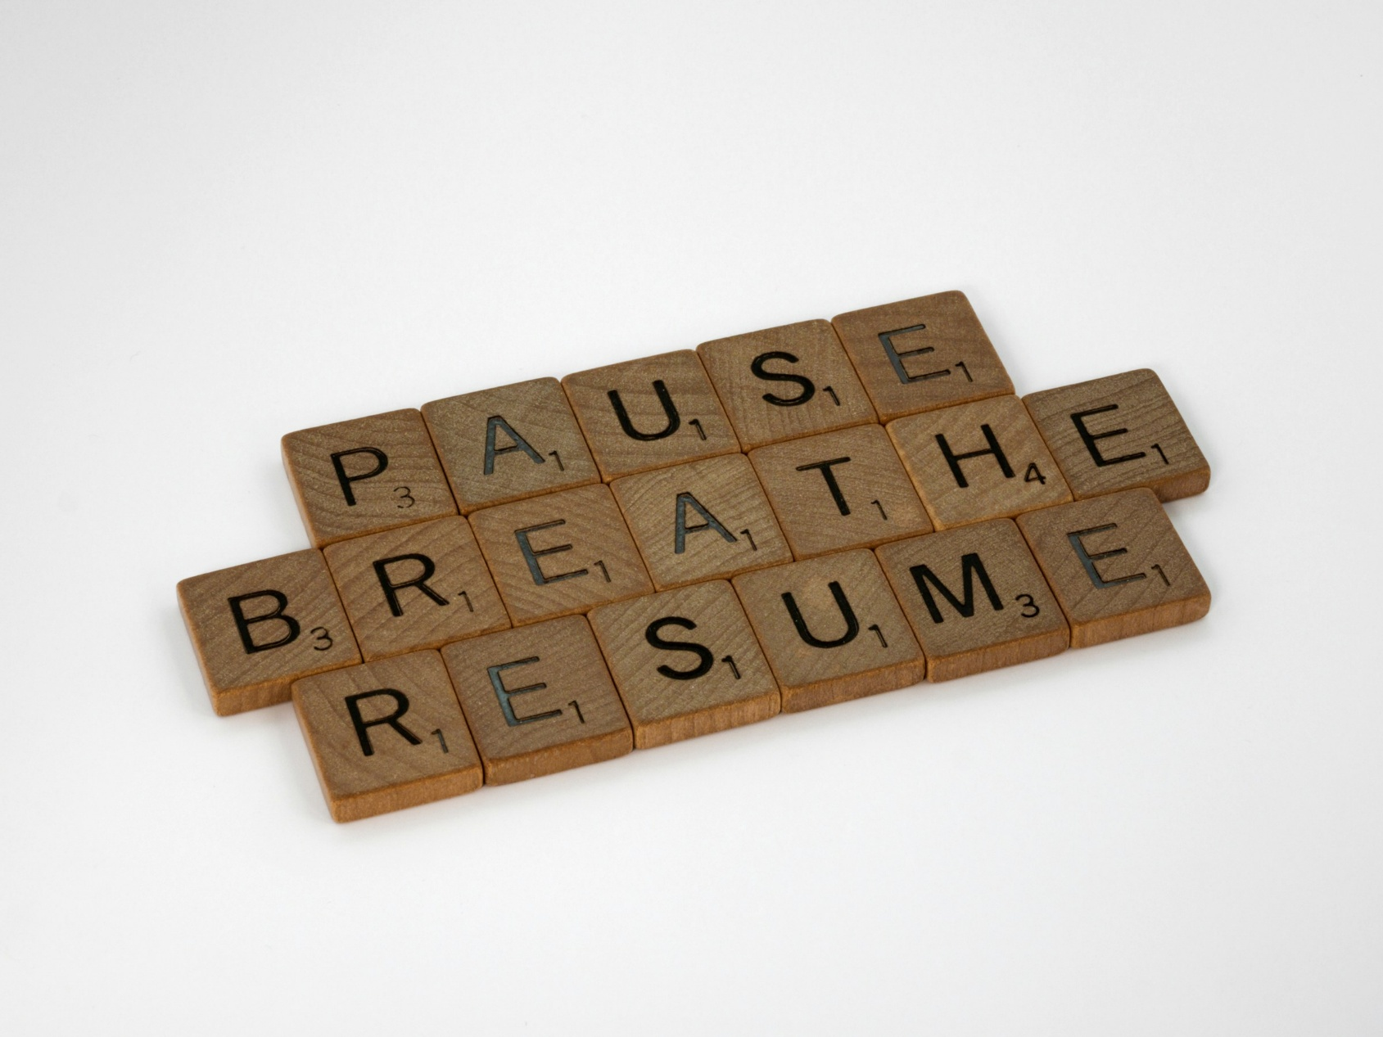
Purposeful pause.

Slide 17

Challenge Your Bias!
Get curious about yourself
Get curious about the young people in your library
Challenge yourself to give up your bias
Seek learning
Intentionally connect where you usually don’t

Slide 18
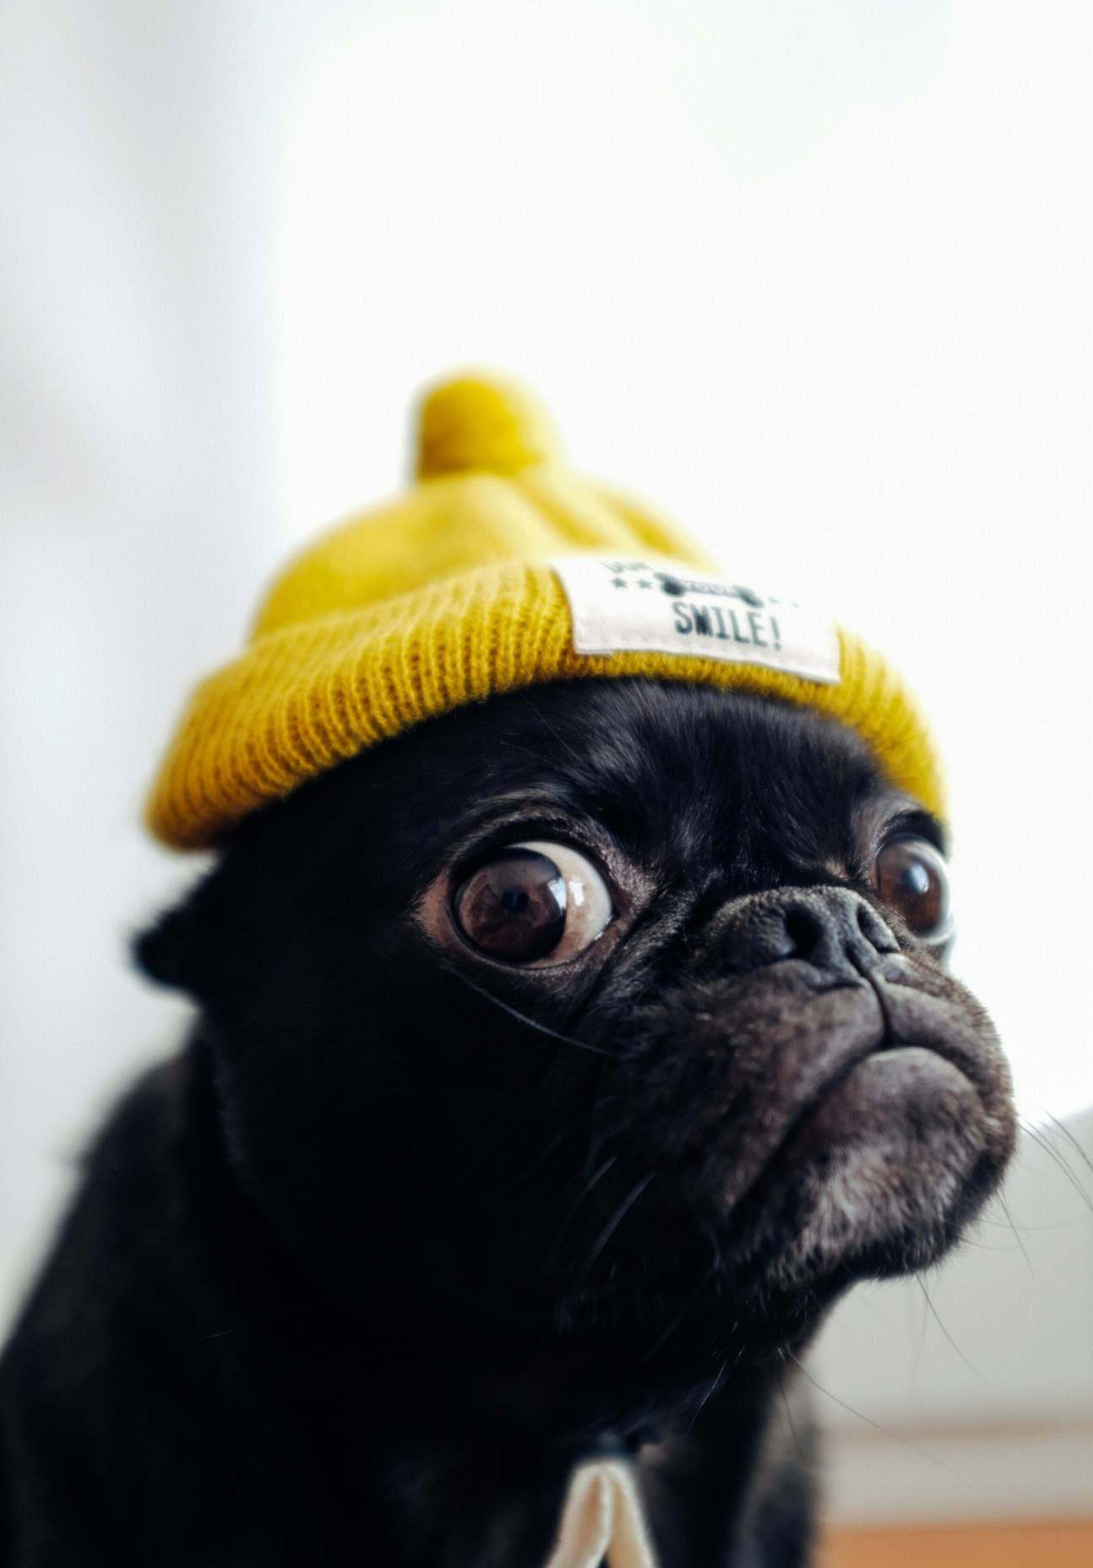
Questions?

Slide 19
Thank you!
Anush – abalayan@ald.lib.co.us
Catherine – cboddie@ald.lib.co.us
Erica – eschimmel@ald.lib.co.us

