Slide 1

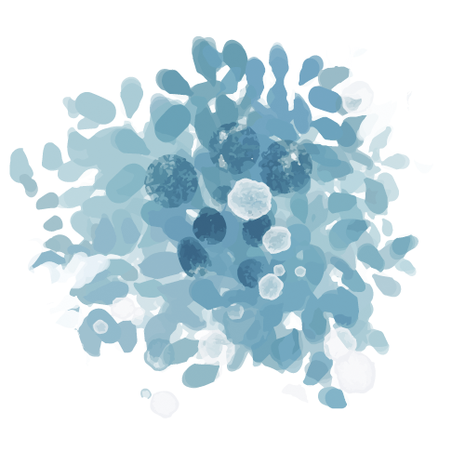


Compassion Fatigue
&
Libraries
Notes:
Rose Marie
Welcome everyone to Compassion Fatigue in Libraries
Thank you so much for being here.

Slide 2

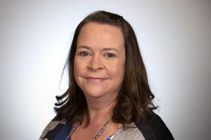

Introductions
Rose Marie Fraser rfraser@mcpld.org
Adult Programming Librarian, Mesa County Libraries
Cydney Clink cclink@mcpld.org
Head of Programming, Mesa County Libraries
Notes:
Rose Marie
I’ve been with Mesa County Libraries for almost 5 years. I’ve worked in youth services, branch services, reference, and programming
We’ve presented this training to our local library as well as at CALCON last year.
I became interested in CF when Cydney introduced me to the topic when I first started in libraries in 2019.
Through personal experiences as time went on at MCL and getting my MLIS at the University of Denver, I decided to do some research and was disappointed in the lack of literature.
CC and I also did a 9 week in depth training specific to the topic of Compassion Fatigue through a local organization called the the Counseling Education Center
Cydney
It’s funny for me to hear Rose Marie talking about the fact that I introduced her to the concept of CF
I did not believe that CF or VT existed in libraries! I was guilty of falling into the trap of comparing trauma and after working in other fields…
I first became aware of CF as it pertains to caregiver burnout…
I have always prided myself on my resilience. It was there until it wasn’t…
CEC gave me a much different perspective on “self-care”: What it really means, why it’s so important, and how to do it.
This is going to be a quick overview and if you want more information…

Slide 3

Agenda
How do we help ourselves?
Defining compassion fatigue in public libraries.
Trauma and our bodies.
Notes:
Rose Marie
We wanted to break this up into three different digestible sections.
What exactly is compassion fatigue and how do we think about it in relation to library work we all do.
Bring in some theories around the science behind what trauma does to our bodies to better understand ourselves.
How do we then take this information and learn to help ourselves in a way that will actually be meaningful and effective.

Slide 4

What is Compassion Fatigue?
The profound emotional and physical exhaustion that helping professionals and caregivers can develop over the course of their career as helpers.
Francoise Mathieu
Notes:
Rose Marie
What about librarians?
Sure compassion fatigue is in nursing, social work, teaching, animal shelters, and other caregiving professions. I found lots of literature on compassion fatigue for these professions.
In 2019 and 2020, what I didn’t find was literature for compassion fatigue in libraries. This concept isn’t new, but how do we as a profession talk about about it so we can combat it and learn from it.
Other terms for compassion fatigue.
Secondary Traumatic Stress Disorder
Empathic Strain
Just Secondary Trauma.
Another topic that’s really important right now is trauma informed care.
All of these terms aside, what the heart of what we’re getting at here is that Trauma is at the heart of Compassion Fatigue.
A good source for this is Trauma Stewardship. This is a book by Laura Van der Noot Lipsky. In it she states that “Trauma Stewardship encompasses why we do the work we do, how it affects us, and how we make sense of it to learn from our experiences. TO MAKE OUR WORK SUSTAINABLE”
In whatever way we choose to find the words to understand how we’re feeling, what matters is that we understand what we’re feeling so we find ways to take care of ourselves so our work can keep going.
What is Compassion Fatigue NOT
A diagnoses. There is nothing wrong with you. This is a biological reaction to being around suffering in its various forms for various amounts of time.
It is not a static state of being. It can vary depending on various factors and the symptoms vary from person to person and day to day.

Slide 5
Trauma is a pervasive problem
“It results from exposure to an incident or series of events that are emotionally disturbing or life-threatening with lasting adverse effects on the individual’s functioning and mental, physical, social, emotional, and/or spiritual well-being.”
- Trauma-Informed Care Implementation Resource Center
Notes:
Rose Marie
*We have a sheet that lists some symptoms you can have if you’ve experienced trauma
The root of compassion fatigue is trauma
Let’s define it in how we mean it in this training.
Notice that the incident is NOT defined
Let’s not put our trauma in a box that society gives us. We and our experiences deserve more than that.
Other things to consider in defining trauma for yourself
It’s subjective and how we deal with it can be determined by:
Age or developmental level
Past experiences
Your belief system
Support systems
Level of resilience

Slide 6
What’s the difference?
Primary Trauma
Vicarious Trauma
01
02
Secondary Trauma
Burnout
03
04
Trauma that happens to you.
Cumulative exposure to traumatic stories or images.
Witnessing a traumatic experience.
Exhaustion due to low job satisfaction or feelings of powerlessness.
Notes:
Rose Marie
*You have a sheet that goes over some compassion fatigue symptoms. These symptoms are not to diagnose, but have guided perspective.
The similarities:
Stress activates the body and brain. Period.
Our brains know the difference between stress and different types of trauma, but our bodies don’t and therefore our bodies react similarly to each one.
This is a good time to mention:
Cydney and I are librarians not psychologists. We can’t sit up here and diagnose which of these might be more of what you’re going through.
Let’s acknowledge everywhere this takes place.
Are the symptoms similar for each of these? Yes. So while we’re focusing on CF at work, CF can also be at play at home.

Slide 7
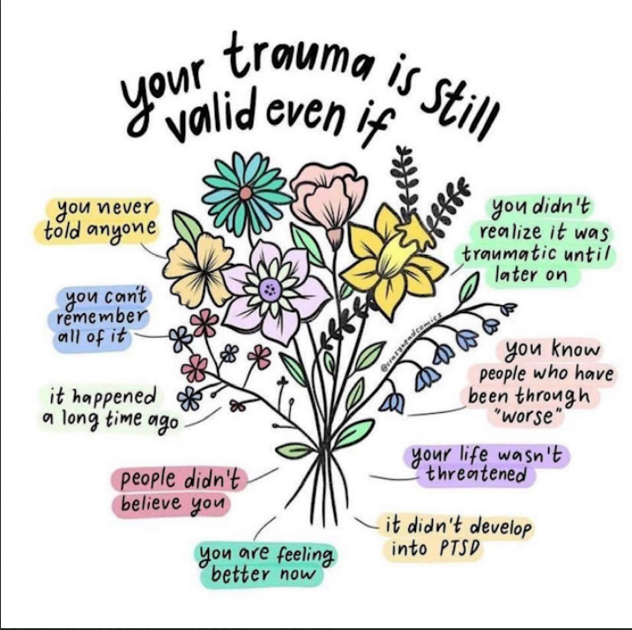
Your trauma is valid
Notes:
Rose Marie
Trauma is common and complex
We’re not here to compare or judge each other’s trauma
Take a moment to absorb this slide.

Slide 8
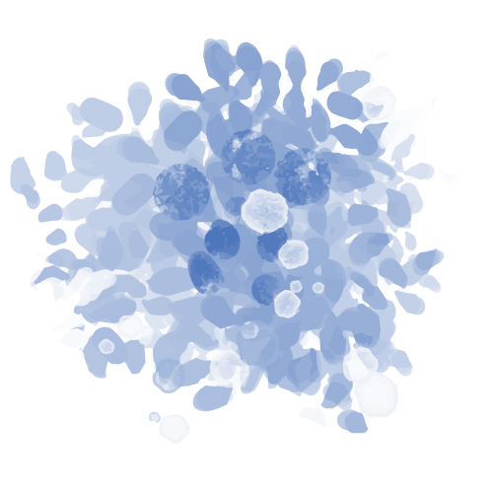
Low Impact Debriefing
Self Awareness
Fair Warning
Consent
Limited Disclosure
Notes:
Rose Marie
Vicarious Trauma is the culmination of sharing traumatic experiences.
Consider this as you share your traumatic stories with colleagues.
We were taught to think of it like sliming someone with goo.
Self awareness
Be aware of your surrounding as you share. Are you in appropriate company and are you in an appropriate environment?
Consent
Do you have consent to share this story? Maybe your colleague is also struggling that day?
Fair Warning
Once you have consent, give them some trigger warnings.
Limited Disclosure
You don’t have to share all the gorey details.

Slide 9
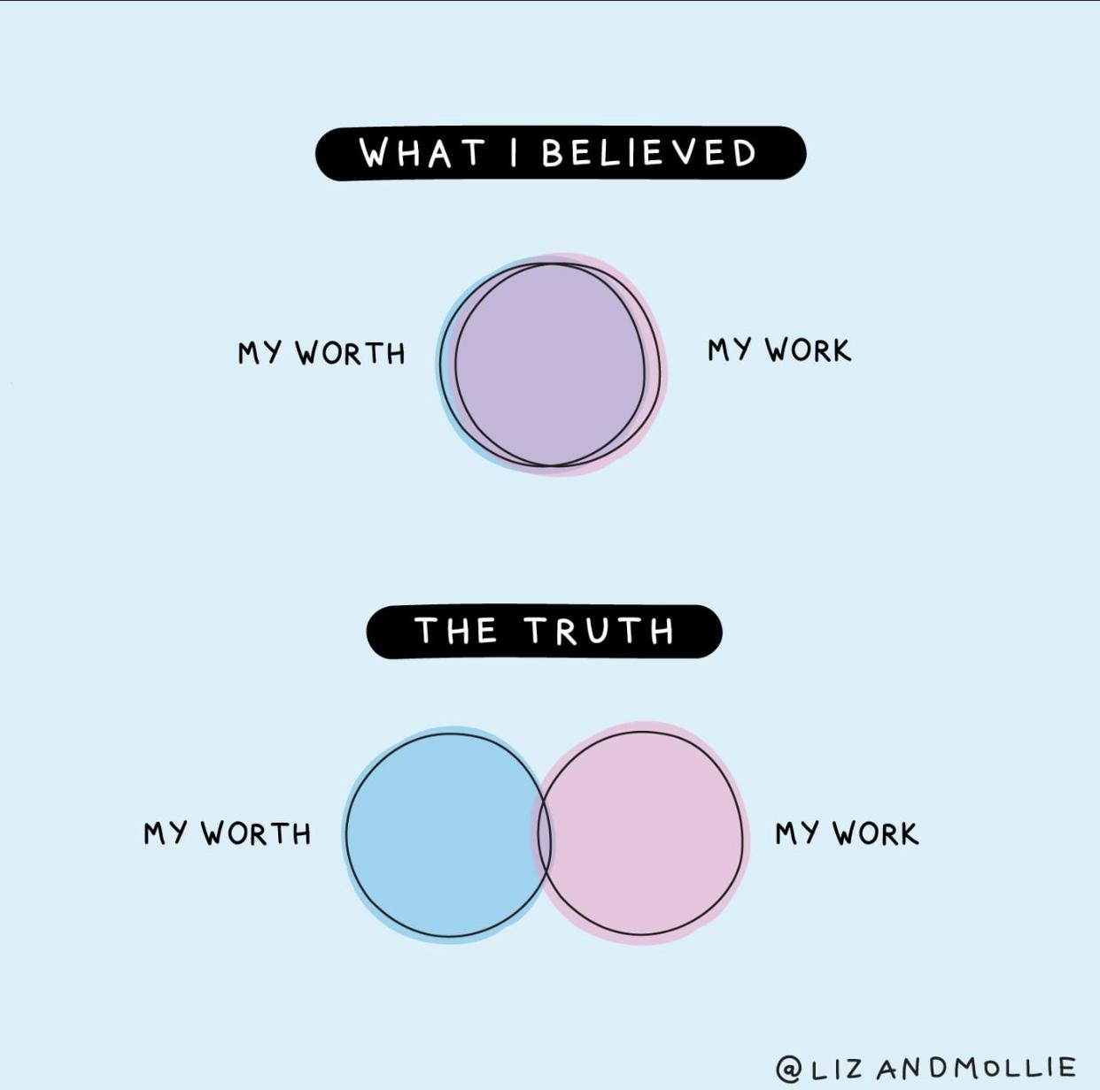
Vocational Awe
Notes:
Rose Marie
Let’s take a moment for Vocational Awe?
I want to briefly mention it here, because I do feel as though it plays an important role in our burn out.
2018 librarian Fobazi Ettarh Vocational Awe and librarianship: the lies we tell ourse
What ideas, values, and assumptions do we and others have about librarianship
There can be a notion that libraries are good and sacred, and therefore beyond critique.
This belief can manifest in a number of ways, such as:
Believing that librarians must be selfless and altruistic, always willing to put the needs of patrons first –
Scope creep in our jobs. We have to do all the things.
A belief that we are essential to democracy and education, and that libraries play a vital role in society –
while this might be true, a library is only a building! It’s the people who are are doing the work in the library that give libraries their value!
This isn’t necessarily a bad thing, but if we put these beliefs before ourselves it can lead to burnout
Vocational awe can be a positive force, motivating librarians to do their best and make a difference in the world.
This is great! Again, these can be good things
Just be careful so we can make this work sustainable

Slide 10
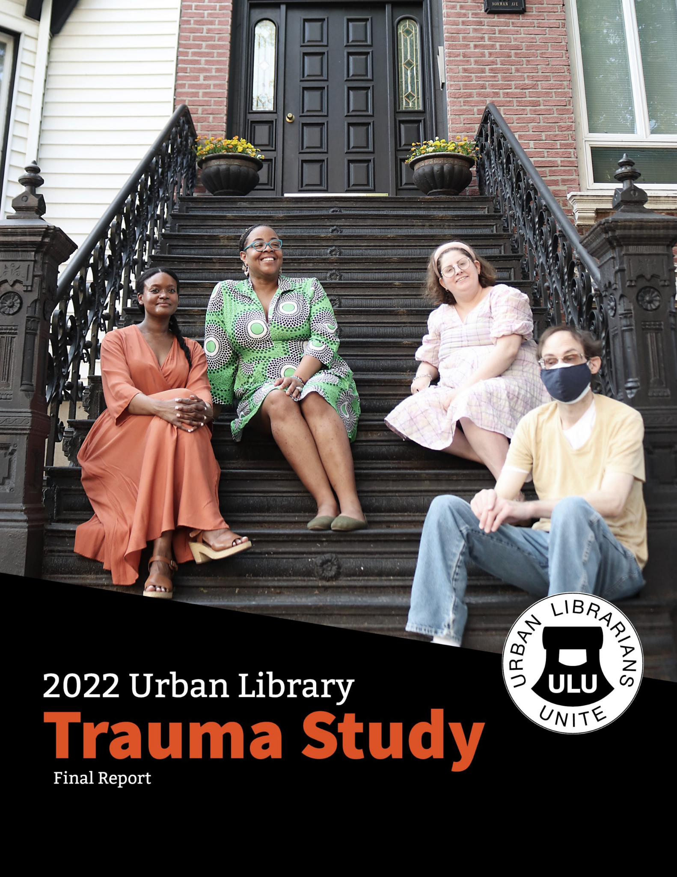
How does this impact library workers?
Notes:
Rose Marie
The 2022 Urban Library Trauma Study also found the discussion of trauma and CF in libraries insufficient.
This is what they did and found in this study
Literature review where they also wanted to see what has already been done or said. They also found it lacking.
They conducted surveys to urban library workers - about 435 responses were usable out of 578 surveys that were done.
They facilitated a series of focus groups -
These focus groups included virtual options and some in person groups to collect data.

Slide 11
85%
68.5%
83%
Have experienced trauma in the workplace and have shared it with others.
Have experienced violent or aggressive behavior from patrons.
Stated that they received support from another member of staff.
Notes:
Rose Marie
Here’s some data that was found
These numbers come from the 435 usable responses from the Urban Library Trauma Study
I want to put emphasis here that you don’t have to be public facing to be experiencing this.
Library news
Stories from colleagues
Troubles at home
Board Meetings

Slide 12
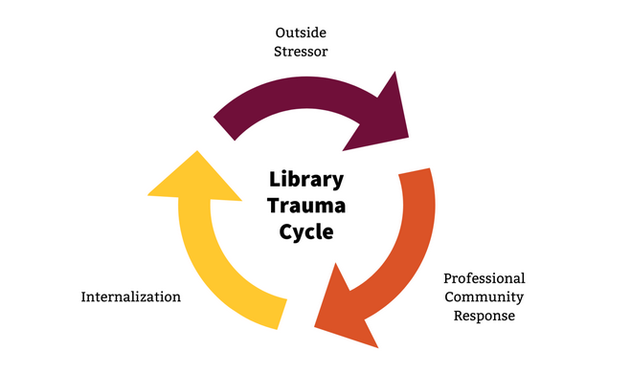
Library Trauma Cycle
Notes:
Rose Marie
This image is part of what came out of the in person focus groups on how to make change.
Walk through model
Keep in mind that NO response is a response.
How we AND our organizations respond to events will determine how we move forward.

Slide 13

Group Share
In what ways do we as library workers experience compassion fatigue?
Notes:
Rose Marie
Poll opens up for examples listed below:
Examples
Helping someone in crisis in person, over the phone, or virtually
Witnessing or hearing a story while doing a class or in person event
Witnessing others experience trauma in public spaces
Managing or leading staff through trauma
Hearing about troubling experiences from colleagues informally
Increasing workloads to meet the needs of our community
Insufficient work related resources to cope
Other

Slide 14

Introduction to Polyvagal Theory
LIFE THREAT
DANGER
SAFETY
Notes:
Rose Marie
Introduction to the Polyvagal Modal
One scientific theory called the Polyvagal Theory introduced by Stephen Porges in 1994
Named for the vagas nerve located in your neck that controls your autonomic nervous system
Autonomic Nervous system
This theory relates to the autonomic nervous system
The parasympathetic - The Ventral Vagal which supports social engagement
The sympathetic nervous system - The Dorsal Vagal which controls our fight or flight responses
This model goes into more detail about what our bodies do when we are safe or in danger
Let’s break this down into colors
Green - Safe zone. You’re ok, you’re thriving, your brain and body can function at an optimal level. We can be our best and most creative selves.
Yellow - This is where anxiety lives. Your body perceives a threat and wants to act accordingly. We’re in fight or flight. What do we do?
Red - This is dissociation. You are IN danger and the time to fight or flight has passed and our bodies shut down to protect ourselves.
Our surroundings have evolved, but our bodies have not.
There is no saber tooth tiger coming to chase you.
So what makes us think we’re in danger now?
That ONE work email?
Our consistent negative thoughts?
Witnessing someone in crisis?

Slide 15
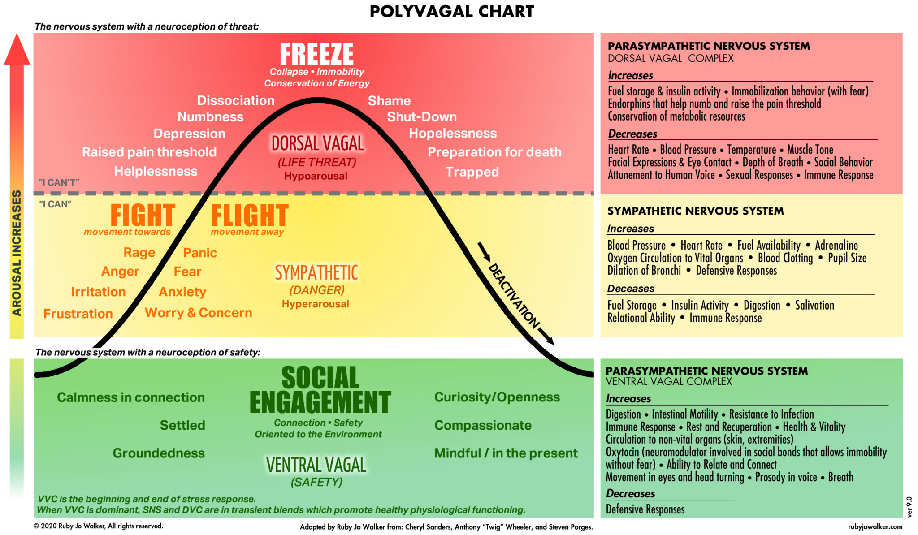
Polyvagal Chart
Notes:
Rose Marie
*Mention PDF of chart is accessible*
This is the professional chart with a LOT of information on it.
What I want to point out:
The black line showing us a bell curve is how it’s supposed to work when we’re healthy.
We’re safe, but then perceive the threat, we experience the danger, and then once in safety we can come back down again.
What happens if you don’t heal from an experienced trauma or you live in trauma consistently and you live in the yellow or are anxious for an extended period of time? Can you imagine what that will do to your body?
Emotions - along the bell curve are listed emotions dependant on our aroused states. Society has taught us to discredit our emotions. What’s societally appropriate to feel and act? In reality, those emotions are simply our body telling us what we need. Their tools.
For example: Anger
Does your body get hot?
How do you experience this emotion?
Is this an emotion you were ever taught to feel in a healthy way?
What’s more:
For those of us that may have dissociation, maybe our body makes us feel anxious but we don’t know what’s triggering those feelings. We may not remember, but our bodies do.
Each trauma and symptom is unique. We all experience this model in a different way. Do you have the ability to give yourself what you need to get back into the green? Into a calm state?
They always tell us “that nobody died” when work gets hard and we make mistakes and yet work gets really hard. What makes you feel safe or unsafe in your work environment.

Slide 16
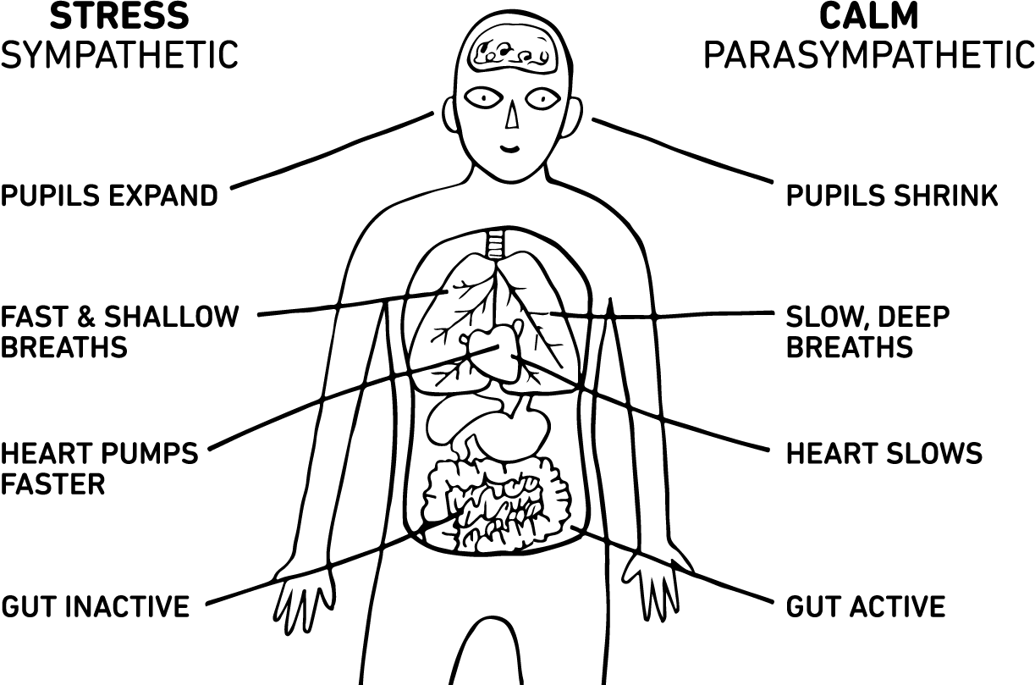
Sympathetic vs Parasympathetic Systems
onthegotherapy.com
Notes:
Rose Marie
This photo shows parts of our bodies and how they can react depending on which state we are in.
The stress side is are sympathetic nervous system.
If our bodies shut down or overwork themselves it can be hard to function. This affects our health.
The calm side is the parasympathetic nervous system (para) meaning alongside or with.
If we can calm down our bodies our brains and thoughts can follow.
Notice the lungs
The lungs are attached to the parasympathetic NS.
This means that all that yoga and meditation mean something.
Slowing down our breathing slows down our heart and TRIGGERS our body to slow down.
Telling someone to breathe can feel insincincer, I used to think so, but understanding this has helped me understand why this is so important.
This is just one way to calm your body down. What ways can work for you?

Slide 17

So let’s talk about self-care.
Notes:
Cydney
How many of you are at the point where you just cringe when you hear the words “self-care?” This is where I was when I took resilience class that we’ve spoken about. I didn’t want to be told to take a walk, take a bath, take a breath, or take time for myself, take a vacation… This is because I had some very limiting beliefs about self-care.
(raise hands)

Slide 18



Limiting
Beliefs
Notes:
Cydney
Defined: A limiting belief is a thought or state of mind that you think is the absolute truth and stops you from doing certain things.
You can think of these as part of your “operating system” – in that they are automatic and it’s often challenging to determine the origin
You can have limiting beliefs about yourself, about the world, about others and in the context of today’s training about what it means to care for yourself.
Getting to know our beliefs about self-care is important because it allows us to make more intentional choices
Exercise about limiting beliefs: We’re going to turn our attention inward! In a moment I’ll ask you to consider a phrase which I’ll say out loud and put up on the screen.

Slide 19
Your needs come first.
Notes:
Cydney
As you consider this phrase, pay attention to any thoughts, emotions, images, memories, body sensations, etc. that might arise.
Does anyone want to share any beliefs that came up for them?
Christine - opens up chat feature on full screen

Slide 20


Overcoming Limiting Beliefs
“What if I’m wrong?”
“How is this belief serving me?”
Create Alternative Beliefs
Test the Alternative Beliefs
Notes:
Cydney
Start by asking yourself a question about your limiting belief.
What if I’m wrong? challenge yourself to imagine a world where your assumptions are not correct. Look for facts that prove your premise false.
How is this belief serving me? – To rid yourself of the limiting beliefs, figure out if what you’re getting from holding on to that belief.
Create & Test an alternative belief – Write down your assumption, then come up with 4-5 possible alternatives. This shows you that you’re choosing what to believe and that you have options.

Slide 21



self-care
/self・kare/ noun
The active process of making your body and mind a pleasant place to inhabit by filling your own cup first.
-Amazon inspirational quote mental health poster
Notes:
Cydney
I wanted to mention these limiting beliefs and how to overcome them because society has been and will continue to give us a slew of ideas about what “self-care” is and how we should or how we shouldn’t; can or can’t.
But really self-care is anything that fills our cups. Anything that we can do to help activate the parasympathetic nervous system and help calm our sympathetic nervous system. Anything that moves us from yellow or red back into the green on the polyvagal chart!
***Self-Care Inventory***

Slide 22

Macro Self-Care VS
Micro Self-Care
Notes:
Cydney
Macro-Self Care: So often the message that we receive about self-care has been that it has to be these big, life-changing projects that you approach with a giant investment (energy, money, time) or it’s a waste of time completely and will have no beneficial outcome:
Examples of “Macro Self-Care” include:
Micro self-care focuses on the benefits of making small changes with reliable frequency
a paradigm shift to use small replenishing moments throughout the day
Available at all times on demand
Simple
Free
Most of all doable!
Little Bits of Self-Care:
Taking time to journal
Going to bed a little earlier
Waking yourself up with a gentle, loving routine – stretching, having a mug of tea/lemon water
Wear clothes you like!

Slide 23
Targeted Micro Self-Care
Grounding
Relaxing
Energizing
Notes:
Cydney
Grounding Tools = help when we’re exposed to trauma so we don’t drift off into a dissociative fog. Provides a feeling of safety – such as imagining yourself in a warm, safe place that make you happy. When you take a few seconds to imagine you’re in such a place, your body will react as if you’re there.
Energizing Tools = needed when you’re feeling compassion fatigue because we lack the motivation for emotional engagement due to waning empathy. Energize your sense of purpose and wellness – As you’re way to a desk shift; just before you engage with a difficult patron; you think to yourself “I do this work because…” Give yourself a burst of intentional motivation! Remember why you’re doing this work.
Relaxing Tools = needed when you’re burning out so you can feel replenished, at ease, and in a place to begin again – personal example of breathing in my car before going into work or home

Slide 24
Shifting Perceptions
External Locus Of Control
Internal Locus of Control
Dysregulated
Regulated
Victim
Empowered
Demand
Choice
Outcome Driven
Process Driven
Notes:
Cydney
We want to be cautious of binary thinking because this can cause us to feel as if we have no control. As we learn to recognize our stress responses as it is related to our sense of “danger”, we can learn to give ourselves what we need in the moment and move ourselves back to safety by mitigating our stress.
Dysregulated — Regulated
Reactive – sympathetic nervous system is operating and we’re in yellow or red – perceived threat
Intentionally responsive – parasympathetic nervous system – “Am I really in danger?”
Victim — Empowered
I’m a victim of my workplace – I don’t make policy, I can’t choose my schedule or my duties so I have no choice/control
“I make choices where I can.” I can chose/trained to be in this position. I choose to stay in this position/location. There are aspects of my work I love.
Demand — Choice
We’re in a service industry and sadly the old adage goes the customer is never wrong? We shouldn’t say no! So request = demand
Request = request – I have a choice of how I respond.
Outcome Driven — Process Driven
Desired Outcome – We want each patron to have a positive library experience!
Belief: My value is determined by the outcome of this interaction. This threat of failure is likely to activate your nervous system

Slide 25
Final Thoughts
What can we do to take care of ourselves?
Personally
Organizationally
Notes:
Rose Marie
What are the three things that would help you in your place of employment when it comes to avoiding, experiencing or dealing with workplace trauma?
Word Cloud responses
List of examples for conversation starters if needed:
Work
Employee Assistance Programs
Health benefits - Are you able to take care of yourself?
Physical health resources.
Mental health resources
Does your library have policies that help you?
Can you be empowered to leave situations where you feel distress?
Can you consider Low-impact debriefing?
Can you go to a trusted colleague or manager safely?
Are you encouraged to use your Paid Time Off for mental health?
Do you have trusted and safe security where you work?
Are you offered the appropriate training to handle difficult interactions?
Are you encouraged to set healthy boundaries with patrons?
Are you encouraged to take ALL of your breaks
Can you rotate your shifts enough so you aren’t public facing for your whole shift?
If not, how else can you get relief?
Home
Do you have home support?
Are you able to give your body and mind what they need to help you take care of yourself?
Do you have a way of taking care of your spiritual self?

Slide 26
Bibliography
Resilience for Professionals by the Counseling Education Center and Sydney Elks, MA LPC.
Laura van Dernoot Lipsky: Trauma Stewardship: An Everyday Guide to Caring for Self While Caring for Others
Rick Hanson: Hardwiring Happiness
Patricia Katopol: Enough Already: Compassion Fatigue
Ashley Davis Bush: Little and Often: Using Micro-Practices for Self-Care
Fobazi Ettarh: Vocational Awe and Librarianship: The Lies we Tell Ourselves
Fobazi Ettarh and Chris Vidas: The Future of Libraries: Vocational Awe in a “Post-COVID” World
Urban Libraries Unite: Urban Library Trauma Study
Trauma Informed Care Resource Center

Slide 27
Resources
Books and Articles
Grounding Techniques: 30 Examples & How They Help by Nicole Arzt, LMFT
No Time for Self-Care? Simple Micro-Practices to the Rescue by Ashley Davis Bush, LICSW
Simple Self-Care for Therapists: Restorative Practices to Weave Throughout Your Day by Ashley Davis Bush, LICSW
A Beginner’s Guide to the Polyvagal Theory by Deb Dana
The Comfort Book by Matt Haig
10% Happier by Dan Harris
Micro-Moments of Self-Care from A to Z by The Juniper Center Counseling & Therapy
Real Self-Care by Pooja Lakshmin, MD
The Compassion Fatigue Workbook by Françoise Mathieu
Selfcarefully: A Self-Helpish Book About Caring for Yourself by Gracy Obuchowica
Videos
How Does Breathing Impact the Brain? by Dr. Yewande Pearce
Hardwiring Happiness with Dr. Rick Hanson at TEDxMarin 2013

Slide 28
Resources Continued
Podcasts
Being Well Podcast with Dr. Rick Hanson and Forrest Hanson
Happier a podcast with Gretchen Rubin
The Happiness Lab with Dr. Laurie Santos
Unlocking Us with Brené Brown
Life Kit from NPR
Apps
Mindfulness Coach app developed by U.S. Department of Veterans Affairs National Center for PTSD (free)
Smiling Mind (free)
Amaha: Mental Health Self-Care (free app; limited content without a subscription)
The Fabulous - Build Better Ha
The Mindfulness App (free app; limited content without a subscription)
Calm (free app; subscription required offers 7-day free trial)
Clarity (free app; subscription required offers 7-day free trial)
Fabulous (free app; subscription required offers 7-day free trial)

Slide 29
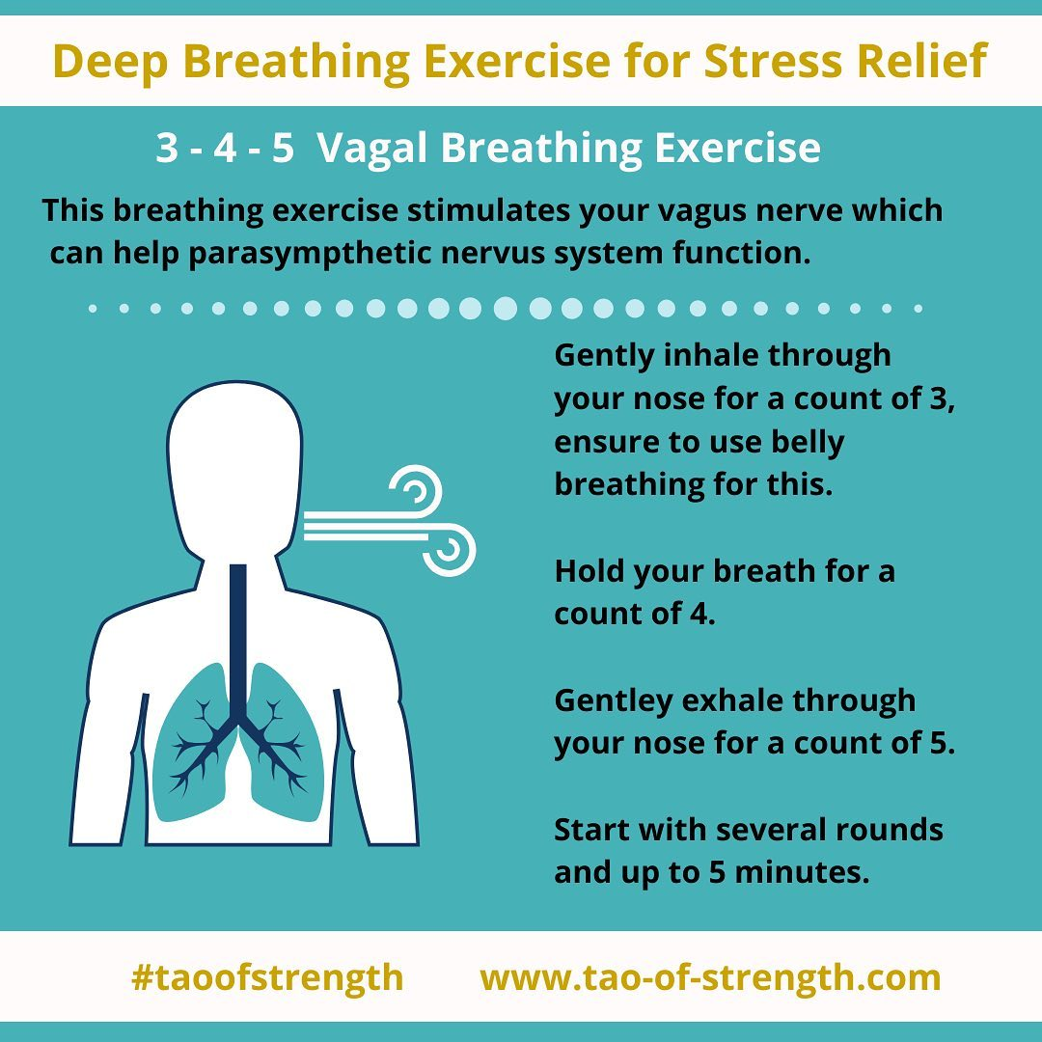
Deep Breathing Exercise
Notes:
Be done by 10:20
Rose Marie
3-4-5 Breathing or 2-1-4-1 breathing
This stresses me out, so I just try to remember that I need to breathe out longer than I breathe in to trigger the effect I need.
Why bring this up?
Breathing is just one example of how how bodies react to our outside situations and that ultimately we do have control over ourselves. There is science behind being told to go breath or go “Self Care”
Some more examples
Identify your surroundings with your senses
Physically look behind you to remind yourself that “No there is no tiger”
Walking away from the situation
Find what works best for you

Slide 30
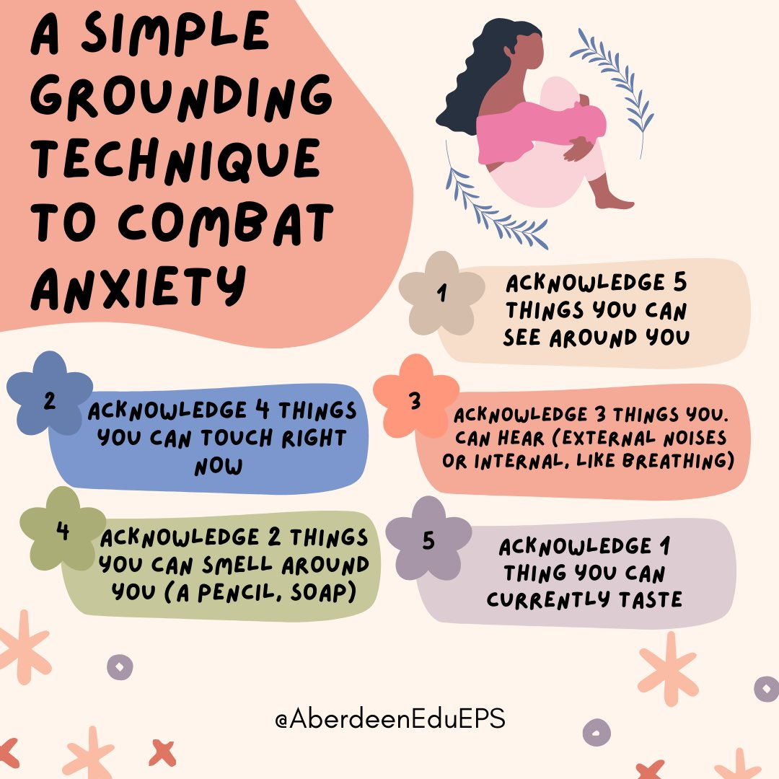
Grounding Technique

Slide 31

Slidesgo Logo

