Slide 1
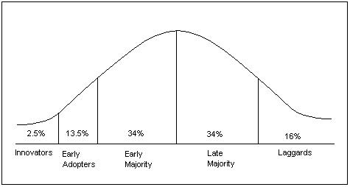
Trends &
How Libraries Respond
The Everett M. Rogers Diffusion of Innovations Bell Curve

Slide 2
Outcomes
Agenda
Identify trends that impact libraries
Analyze trends through the lens of library operations, services, and value
Gain new resources to explore trends into the future
Trends with 3 points of view
Growth Mindset
Guest Experience
Your Turn
Artificial Intelligence
Climate Change
Inclusion, Diversity, Equity, Access
Politics
Summary & Evaluation

Slide 3
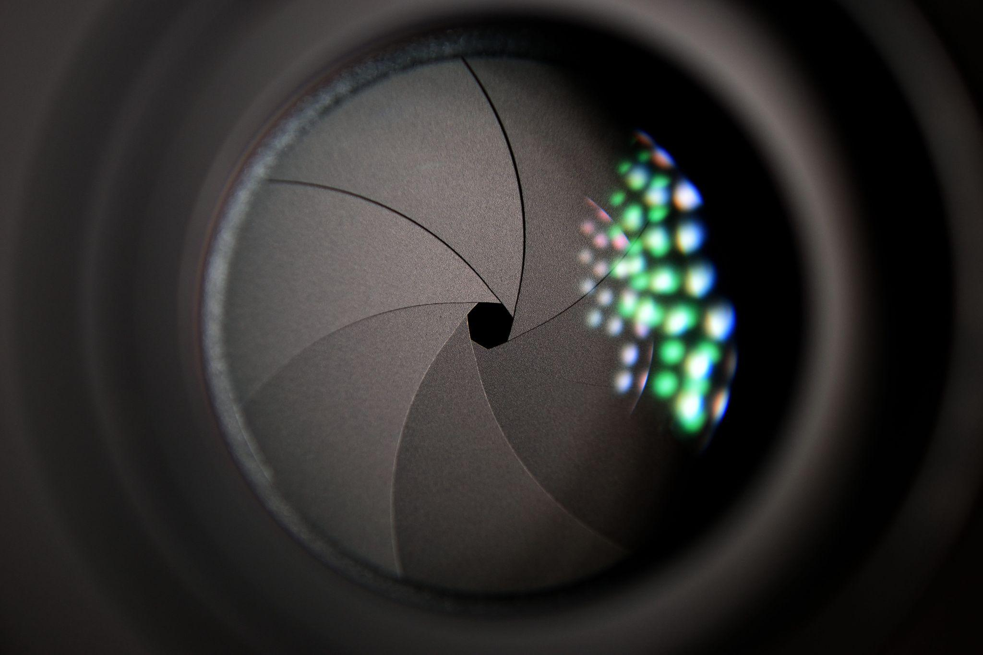
Using Many Lens to Look at Trends

Slide 4
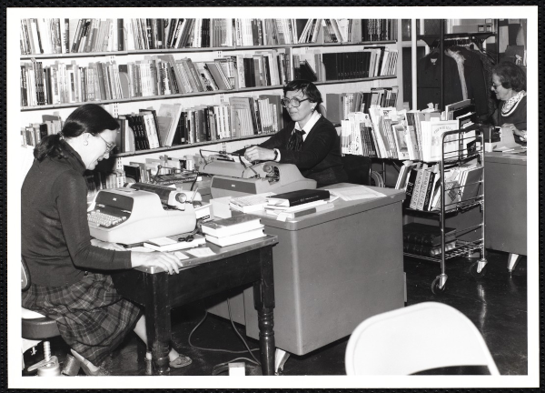
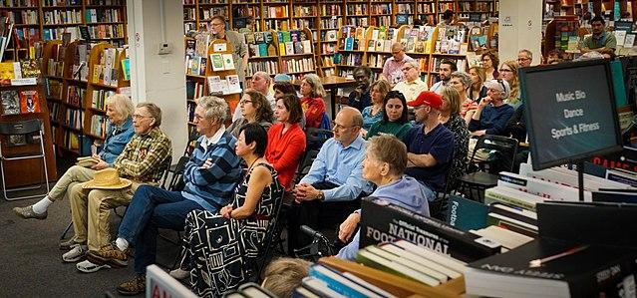
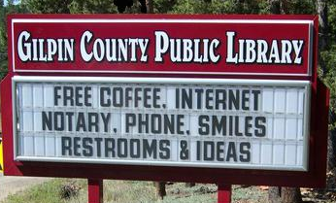
Three points of view
Behind the Scenes
On the Stage
On the Marquee

Slide 5
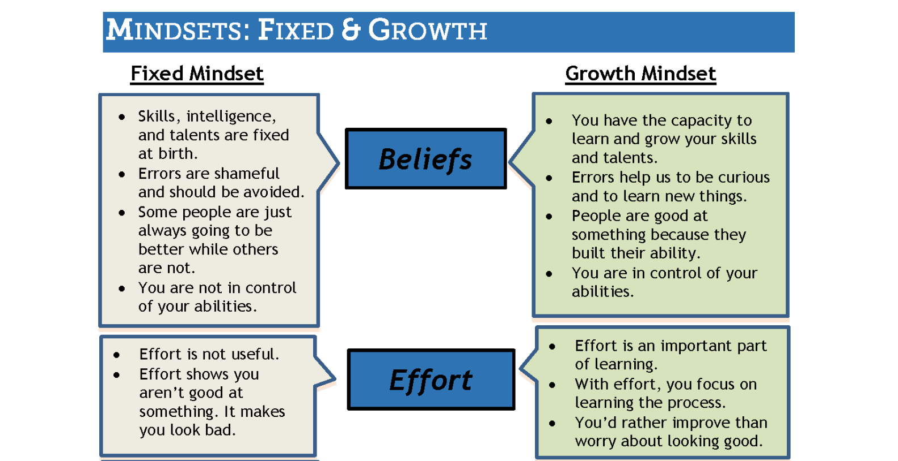
Growth Mindset (Full chart in handout you can print out!)

Slide 6
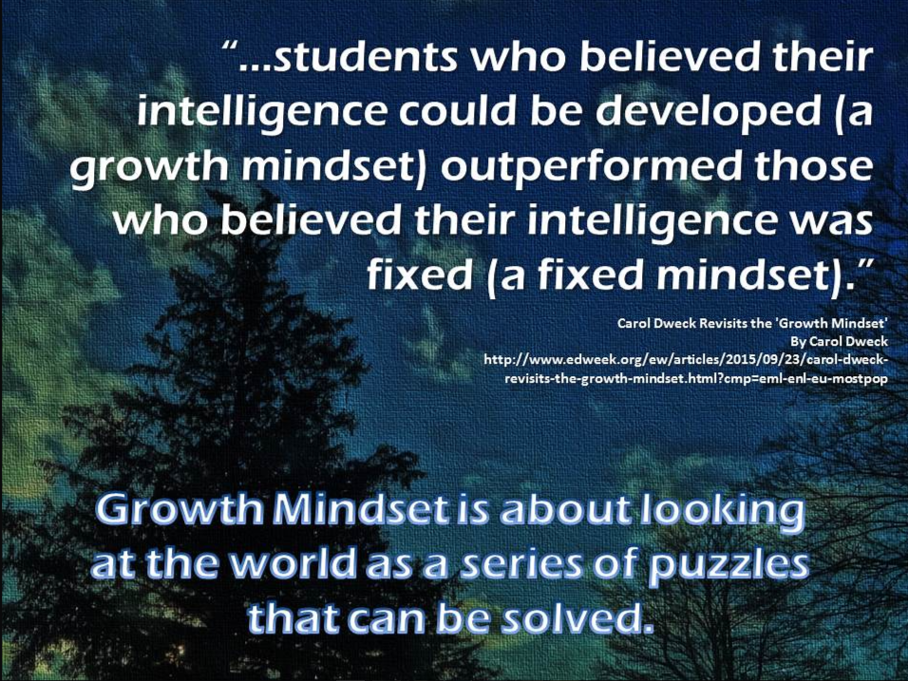
Growth Mindset

Slide 7
Activity: Your Library - Fixed or Growth?
FIXED
GROWTH
Mistakes = Problems
Effort → Weakness
Mistakes = Opportunities
Effort → Improvement

Slide 8
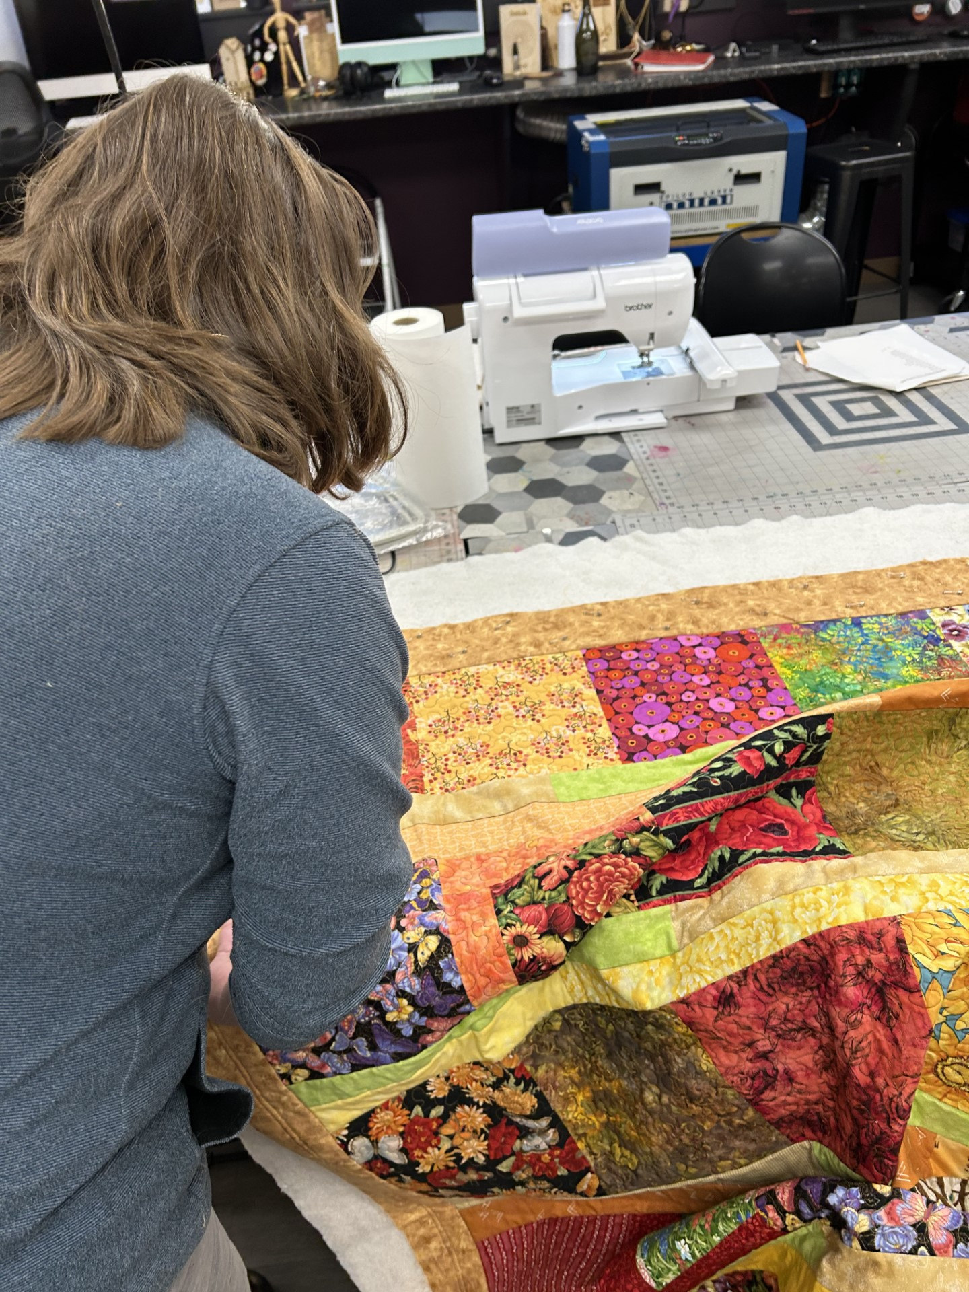
Chat Activity
Growth Mindset +
Library Users

Slide 9
Poll Activity
To what extent does your community think of the library as the center for: Growth & Learning
A lot: Most community members value the library as a learning place
Some: Some folks associate the library with growth & learning
Not much: A few people think of the library's role in growth & learning
None: People just come in to sleep and get movies
Not sure: I don't know what people in my community think of the library

Slide 10
Reminder: Handy Trends Analysis Technique
Notice a trend
Understand how another industry is moving forward with the trend (to understand the potential of the trend)
Think of the trend with 3 library lenses
Behind the Scenes: How do we use it to improve our work?
On the Stage: How do we empower others in our community with this trend?
On the Marquee: How can we leverage the trend to increase

Slide 11
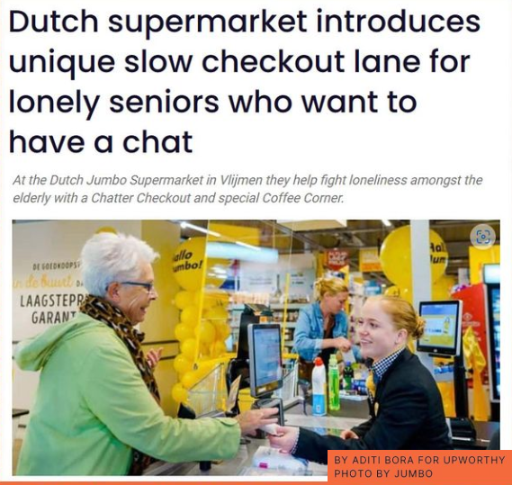
Guest Experience

Slide 12
Three points of view - Review
Behind the Scenes
On the Stage
On the Marquee

Slide 13




Other Trends
Artificial intelligence
Climate change
Political Divisiveness
Social justice

Slide 14
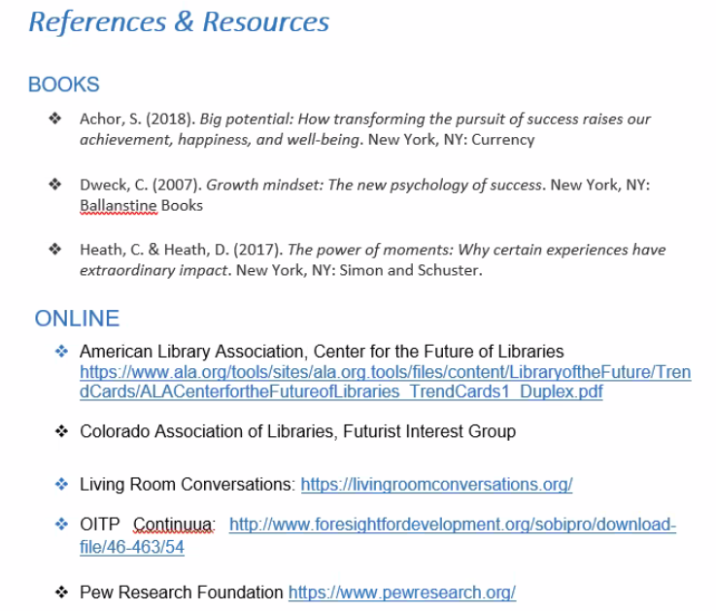
Wrap up
Some trends that impact libraries
Gained new resources to explore trends into the future
Artificial intelligence
Climate change
Book challenges
Social justice
Growth mindset
Guest experience
Analyzed trends through the lens of:
library operations
services
value

Slide 15
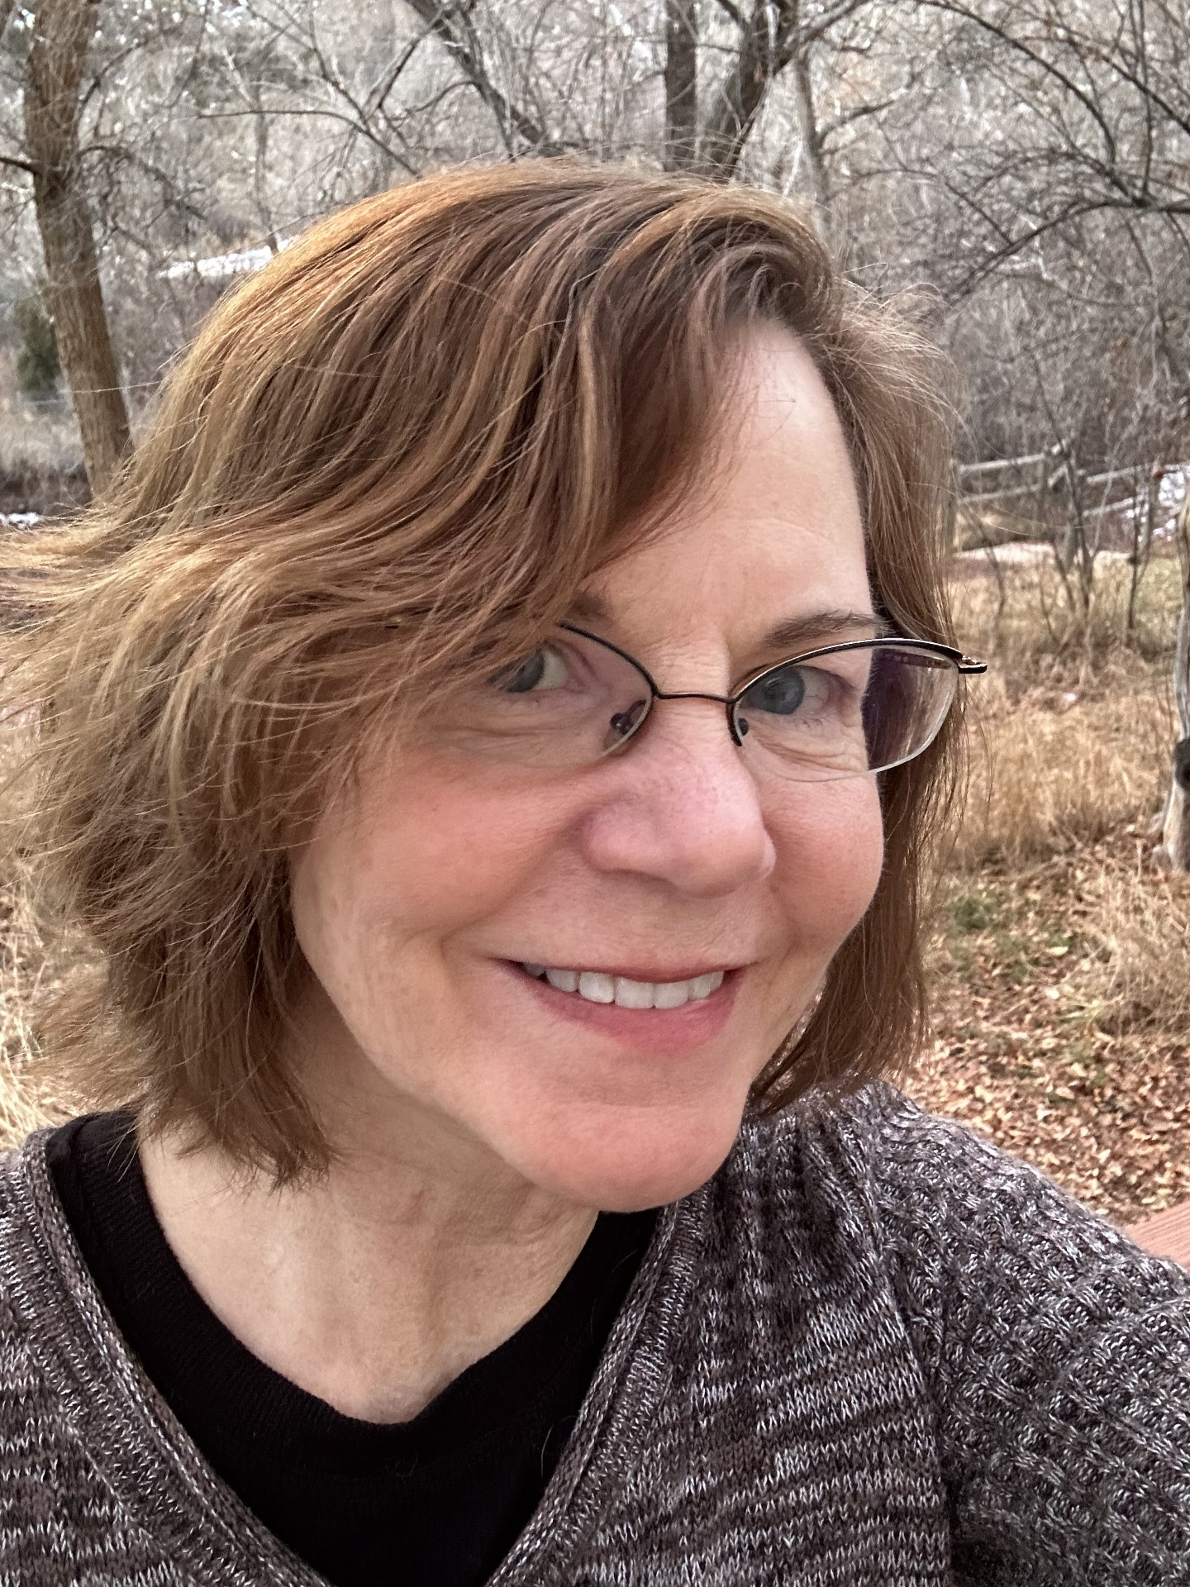
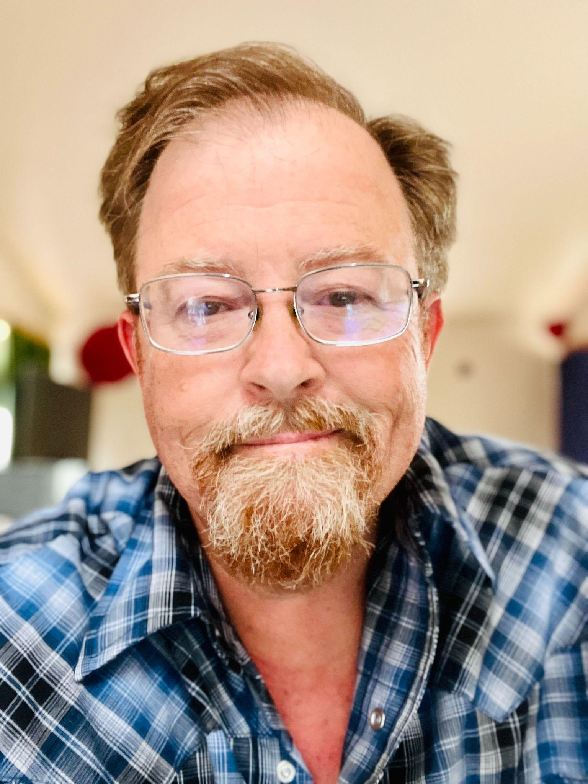

Contact Us
Thank You!
Sharon Morris, Public Library Leadership Consultant
morris_s@cde.state.co.us
Kieran Hixon, Rural & Small Library Consultant
hixon_k@cde.state.co.us

