Slide 1
Grow Your Own Library Staff:
Creating professional development paths for non-degreed librarians
CSL In Session
Tuesday, January 25th, 2022

Slide 2
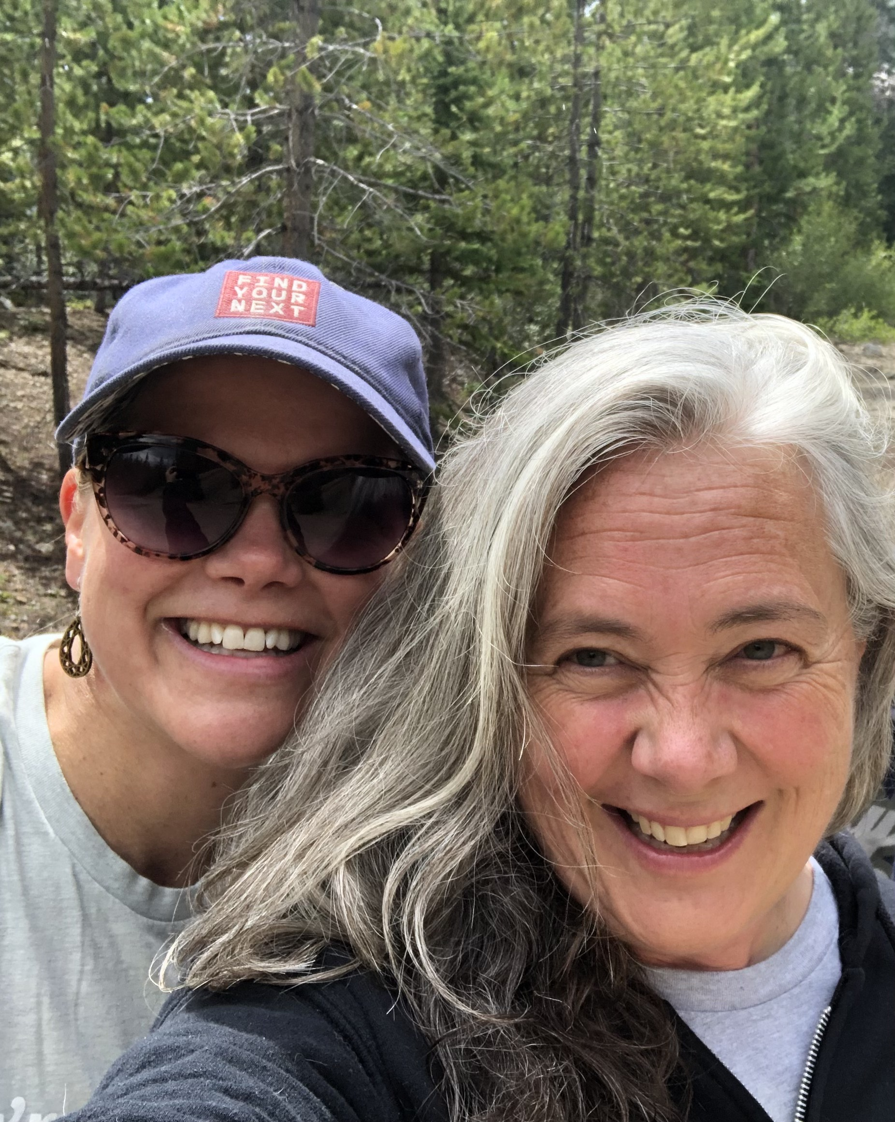
The WHY of professional development:
The world according to Anna
vs.
The world according to Polly
Notes:
3-5 minutes for this info

Slide 3

Group Exercise:
Let’s identify top training needs NOW
What do non-degreed librarians need to know?
Notes:
10 minutes total
Intro: We say “librarians” here, because the people visiting your library think that anyone working there is a “librarian.” So when we use that term we mean any library staff member, not a person with an MLIS degree.
Start BIG PICTURE (ex. Tech skills or customer service) People will type ideas into the chat
Broader topics Christine will create 4-5 category boxes based on those big picture items. Then we will drill down within each category to SPECIFIC Skills (so conducting a reference interview as part of library foundations, or helping customers with social media as a tech skill.)
Christine will compile

Slide 4

Step 2: Environmental Scan
Notes:
3-5 mins
1a: Review of staff education and previous trainings completed
1b: How do those relate to the library’s strategic plan? Are they moving it forward?
1c: Look at specific tasks and skills from job descriptions
1d: Identify growth opportunities for current staff members based on performance evaluations and interests
1e: Identify WHAT IS MISSING? What kinds of courses will provide the needed growth (rather than just ANY growth)? Ex: Google Docs trainings for Microsoft organization

Slide 5
Environmental Scan
WANTS
What training topics are you seeking?
HAVES
What resources do you already know and use?
What trainings are being provided already?
GAPS
What’s missing?
Who can help find/identify/evaluate good sources of training materials?
What funds and time are available?
Notes:
Wants: What were they for Grand County? Polly reviewed all the MLIS Programs (History/Foundations, Reference/RA, and Collections, Digital Technologies, Programming, Community Engagement, Rural Communities) Technology (Cybersecurity, Productivity, and Social Media), and Supervisory (Compliance, Building a Team, Performance Management)
How do you balance? Tuition reimbursement for formal library degrees vs. funds for other more informal conferences and learning opportunities.

Slide 6











Potential Resources for training
Notes:
Will a canned training do?
What costs can the library pay?
What will staff do (if anything) with the training? Share, innovate, be evaluated? Other?
Online or live?
Travel and hotel?

Slide 7
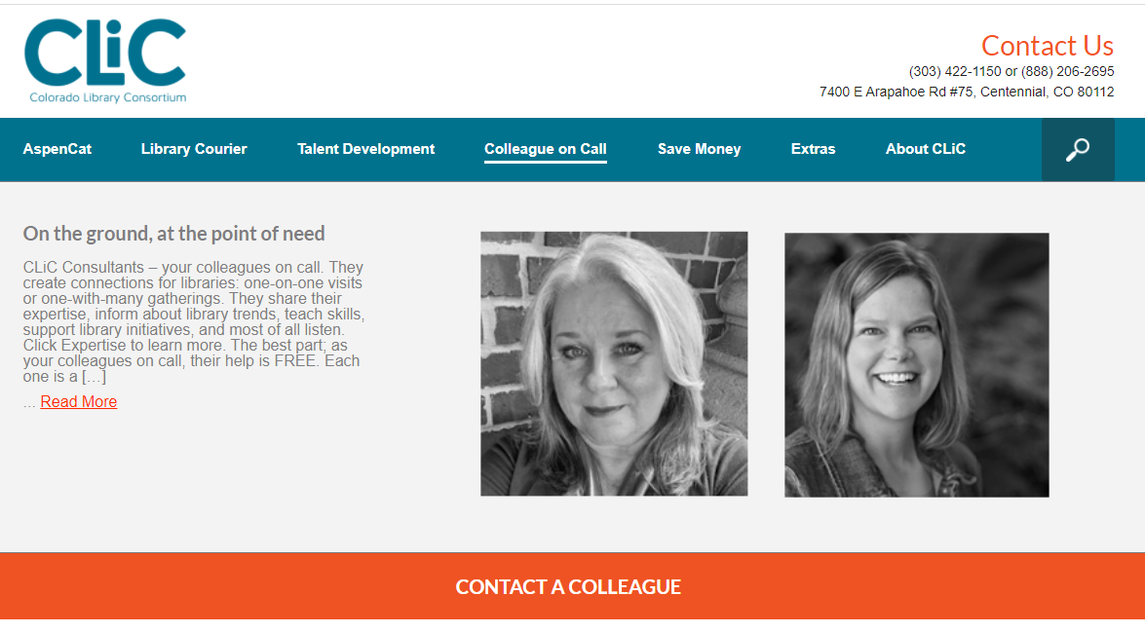
Or ask CLiC!
Notes:
Lead time: 3-4 weeks
Clear vision of learning objectives and outcomes
Tailored to your library
Your state likely has similar service with the state library or other library support organizations.

Slide 8


Implementation
Identify a team to evaluate resources
Create a way to disseminate courses to staff
What does success look like?
Notes:
Power of staff perspectives – multi-levels of staff (not top-down) (Anna) –
Polly: What does this (skill) look like for our organization? Ex: Display trainings with divergent messages.
What is the quality of the available resources? How do you evaluate the quality?
Show GCLD’s courses that they’ve created. The links to these are in the presentation documents for you to use as templates and customize to your libraries’ needs.
Which trainings do you include to set the expectations/tone of your specific library? (example: Divergent advice on displays—which one do you take on as your library’s standard?)

Slide 9
And, in all your spare time..
Review and Evaluate!
Notes:
Review sources, check for new trainings, and meet with staff about progress

Slide 10
Contact us (we’re fun!)
Polly Gallagher
Grand County Library District
pgallagher@gcld.org
970-887-9411 x 101
Anna Szczepanski
Colorado Library Consortium (CLiC)
aszczepanski@clicweb.org
720-739-5366

