Slide 1

Friends with Benefits
With 100% less JT and Mila.
Please introduce yourself in the chat!
What is one thing you hope to learn from this session?
Notes:
#sorrynotsorry

Slide 2
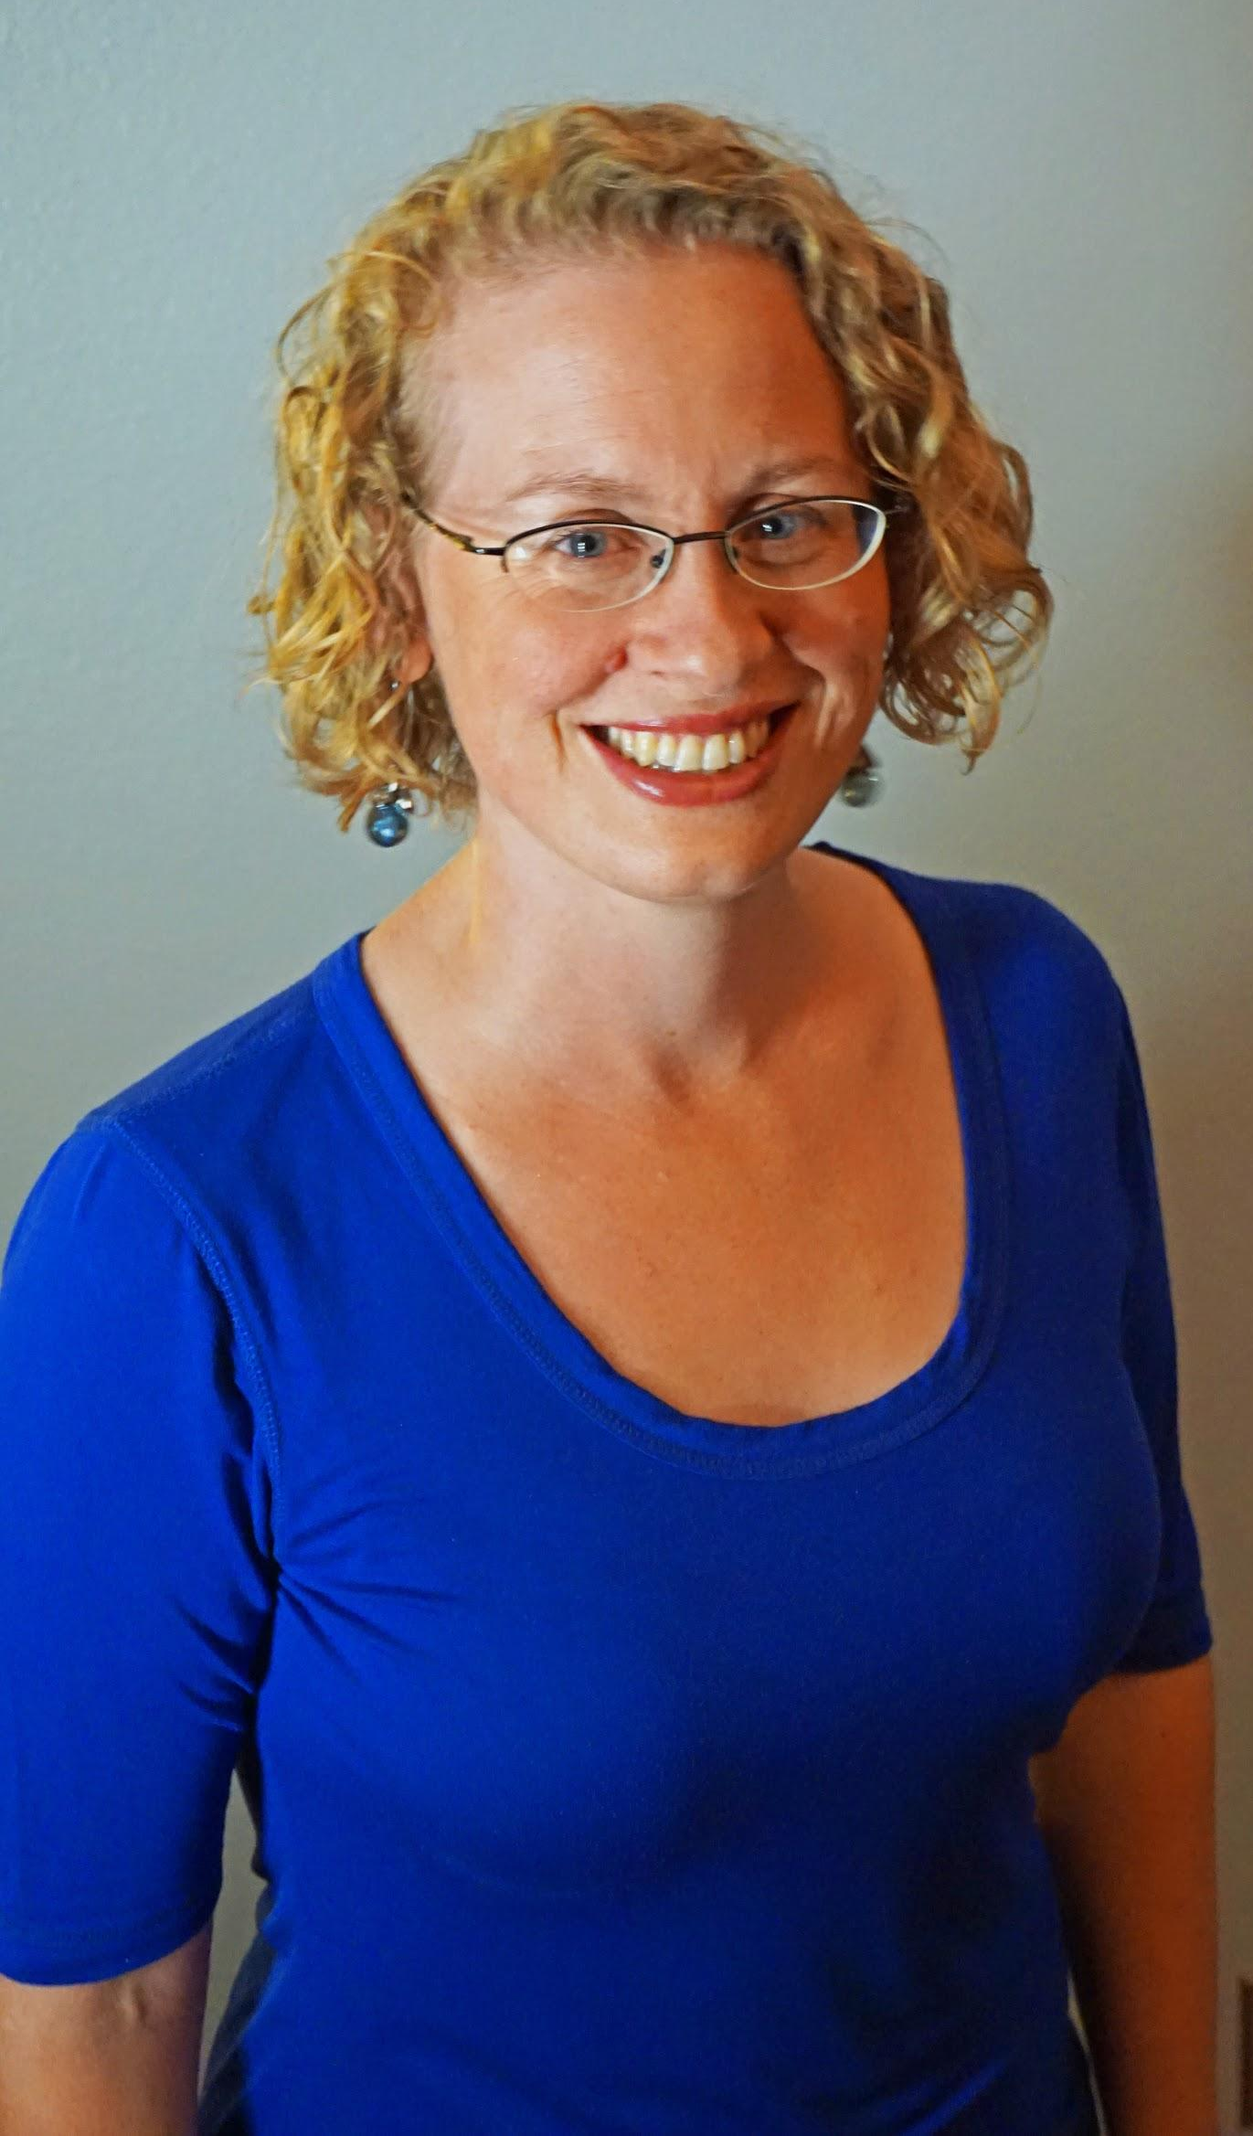

Friends with Benefits:
Programming to help develop social and emotional skills in teens
Joanna Nelson Rendón
Director of Young Adult Services
Pikes Peak Library District
Colorado Springs, CO
Becca Philipsen
Young Adult Services Sr. Librarian
Pikes Peak Library District
Colorado Springs, CO

Slide 3
What we’re going to talk about
Overview of Social-Emotional Learning
Practical Application of principles
Addressing Administration
Notes:
Becca: We’re hoping this will be a crash course in the concepts of Social/Emotional Learning and you’ll leave here feeling good about incorporating SEL in your programs/services. I hope you’ll leave confident in the basics of SEL and with a few ideas of how to implement it at your library and with your patrons.

Slide 4
What is Social and Emotional Learning?
Self-awareness
Social awareness
Self management
Relationship skills
Responsible decision making
From the report Ready to Lead by Collaborative for Academic, Social, and Emotional Learning.
Notes:
Joanna:
Social and Emotional learning is made up of five components. This is from the Ready to Lead report by the Collaborative for Academic, Social & Emotional Learning.
• Self-Awareness: Knowing what we are feeling in the moment; having a realistic assessment of our own abilities and a well-grounded sense of self-confidence.
• Social Awareness: Understanding what others are feeling; being able to take their perspective; appreciating and interacting positively with diverse groups.
• Self-Management: Handling our emotions so they facilitate rather than interfere with the task at hand; being conscientious and delaying gratification to pursue goals; persevering in the face of setbacks and frustrations.
• Relationship Skills: Handling emotions in relationships effectively; establishing and maintaining healthy and rewarding relationships based on cooperation, resistance to inappropriate social pressure, negotiating solutions to conflict, and seeking help when needed.
• Responsible Decision Making: Making decisions based on an accurate consideration of all relevant factors and the likely consequences of alternative courses of action, respecting others, and taking responsibility for one’s decisions.
Let’s see that in action with some programs.

Slide 5
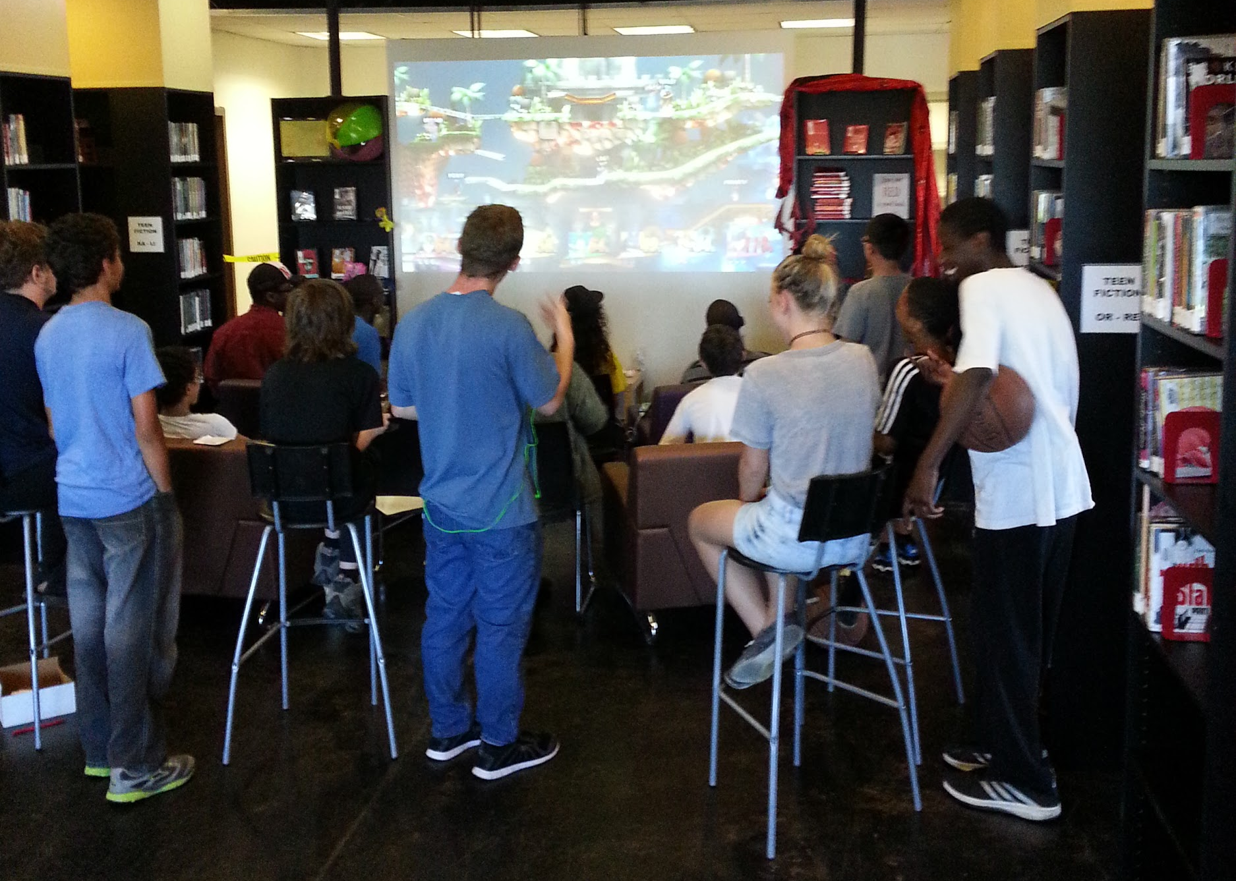
First Friday Gaming
Notes:
Joanna: Video gaming is a great way for teens to get to know each other and make friends. Basically, teens compete once a month at First Friday Gaming.
Few things they get to practice for Social and Emotional Learning
Relationship skills - they negotiated the rules that we play by. This is so helpful because they really talk through all the expectations and why pausing should not be allowed. Who knows why?
Self-management - teens have to learn to be okay with not winning. A few years ago, we had a teen who really hated to lose. His behavior was inappropriate for the space - he threw a game controller once (it was his) and would yell -- not at anyone in particular, but it didn’t make the winner feel like winning! He learned how to manage his emotions so he could continue to play. He had help!
Social Awareness - this is when one can take the perspective of others’ into account. Teens helped the poor loser and each other have fun and learn more.

Slide 6
Why is it important?
Notes:
--Define risk/protective factors and explain their role and place in prevention science.
--Show how SEL is protective factor, can buffer teens against risk factors--
--PYD/Social Development theory are two ways of teaching SE Intelligence to teens outside of curriculum based programs they are getting in schools. Can be a lenses that we approach our whole programs through.
Becca: To answer that question..we’re going to delve a bit into prevention science. Prevention science is mostly used in the public health community, but I argue that we have a lot of over lap in our goals (happy and healthy teens), and we can learn a lot from them. They have spent a lot of time looking at the elements in a young person’s environment that increase the likelihood of them engaging in health compromising behaviors (otherwise known as risk factors).

Slide 7
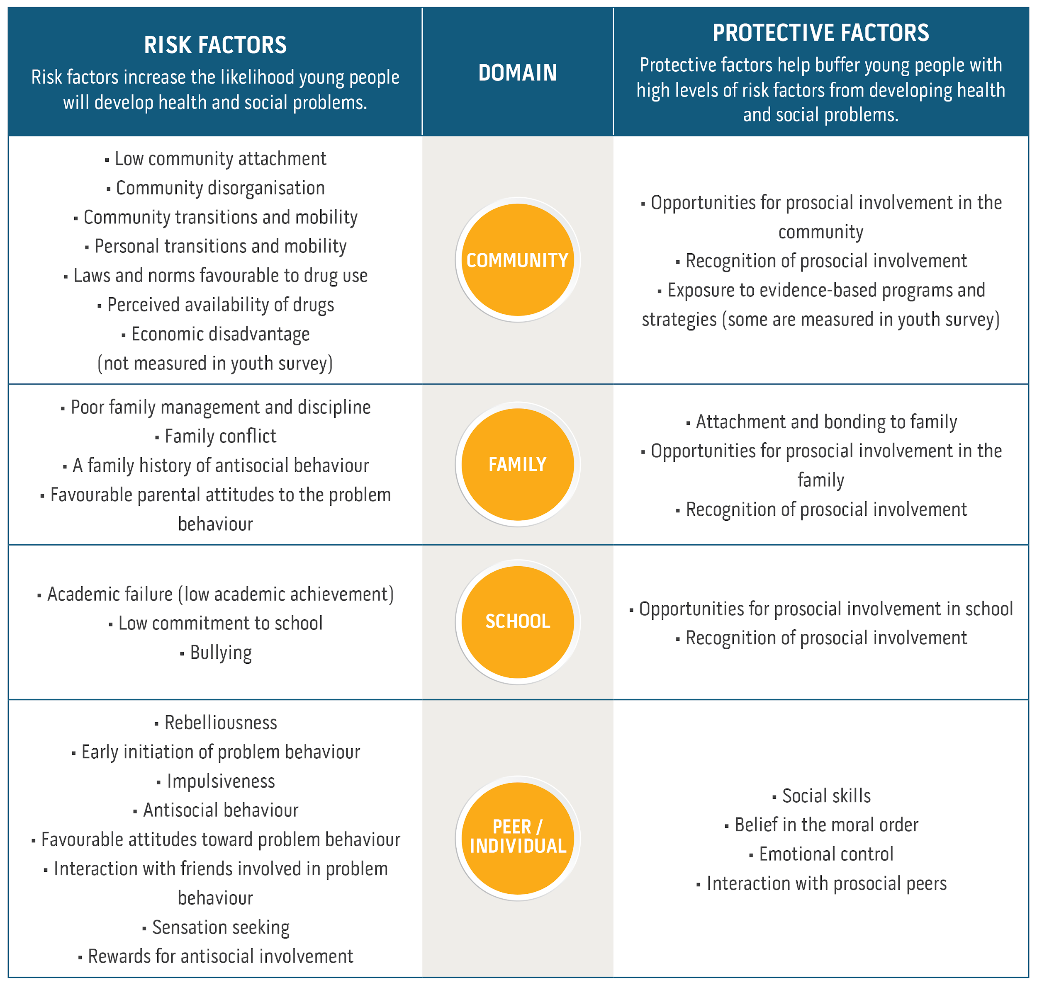
Risk Factors and Protective Factors
Notes:
Here is a chart of them divided into the domains they occur in (spread out through Community, School, Family, Peer/Individual). These chart comes from the Communities That Care program, if you want to look at it more yourself. Now, on the flip side of protective factors there are Protective Factors. These elements in a youth’s life buffer against risk in otherwise adverse circumstances by either reducing the impact of risk, or changing the way a child or young person responds to it. The science behind these factors could be their own presentation, but unfortunately we don’t have time to talk about them in depth. So why is this tangent into prevention science relevant? Social/Emotional learning are protective factors for youth. It gives them the tools and resources to dealw ith the crap this world is throwing at them. And as you can see on this chart, there are waaaaay more risk factors than protective factors. And some factors we have no influence over, so promoting the ones we can influence is important.
SE Intelligence is a HUGE protective for teens as they navigate adolescent and adulthood. It can help protect them against the risk factors they will encounter.
Current studies from schools with evidence-based SEL programs show a host of protective benefits--fewer students reporting anxiety, greater motivation to learn, improved relationships with peers, as well as fewer delinquent acts, conduct referrals, and reduced emotional distress, including fewer reports of student depression, anxiety, stress, and social withdrawal (Sklad, Diekstra, Ritter, Ben, & Grav-
esteijn, 2012; Wigelsworth, Qualter, & Humphrey, 2017).
IN ADDITION, SEL is a
-Teachable skill
-Truly ‘soft’ job-skills
-Will benefit teens for the rest of their lives--whether they go into the job force or not.
https://www.communitiesthatcare.org.au/how-it-works/risk-and-protective-factors

Slide 8
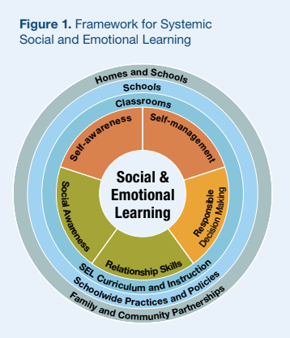
Framework for Systemic Social and Emotional Learning
Notes:
You may be asking yourself--this is well and good for schools to implement through curriculum. But I’m not a school, how do I fit into this?
We are not necessarily able to implement these evidence-based programs, HOWEVER, we can provide our teens with continued opportunities to develop those Social/Emotional skills while outside of school, as well as building a structure that supports those skills into our programming.
We can work in partnership with schools and parents to help decrease risky behavior through helping teens learn these skills.
Depaoli, J. L., Atwell, M. N., & Bridgeland, J. (n.d.). Ready to Lead: A National Principal Survey on How Social and Emotional Learning Can Prepare Children and Transform Schools (Rep.).

Slide 9
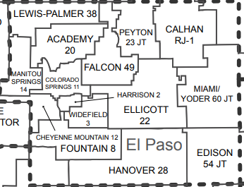
School Districts in the Pikes Peak Library Service Area
https://www.cde.state.co.us/cdeedserv/coloradoschooldistrictswithcountiesmap

Slide 10
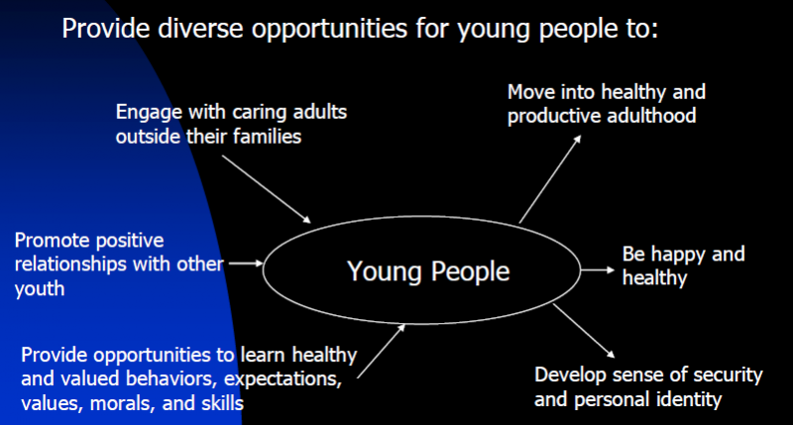
Social Emotional Learning Opportunites
Eccles, J. (2011).f Community-based programs for youth. Presented at National Academies of Science Conference: 10 Year
Follow-Up to “Community Programs to Promote Youth Development.”
Notes:
PYD is an intentional, prosocial approach that engages youth within their communities, schools, organizations, peer groups, and families in a manner that is productive and constructive; recognizes, utilizes, and enhances young people’s strengths; and promotes positive outcomes for young people by providing opportunities, fostering positive relationships, and furnishing the support needed to build on their leadership strengths. (youth.gov)
Past focus has been on solving a single issue (delinquency, substance use, etc). Now agencies are focusing on promoting positive asset building and considering young people as resources instead. There was also a lot of focus on the role of resiliency — the protective factors in a young person's environment — and how these factors could influence one's ability to overcome adversity. Some of these factors include
family support and monitoring;
caring adults;
positive peer groups;
strong sense of self,
self-esteem,
future aspirations;
engagement in school and community activities.
The more protective factors a youth has, the better outcomes they usually experience.

Slide 11
Positive Youth Development
Strengths Based
Inclusive
Youth as Partners
Collaborative
Sustainable
YALSA’s Action plan -
Notes:
If you don’t have a school implementing these programs, Positive Youth Development a great set of overarching principles in guiding your program to give youth a chance to practice SEL outside of school. It’s a non-curriculum based way to approach working with teens and helping develop their social and emotional skills in a way that works for a library.
There are five facets to PYD:
Strengths Based-focuses on the strengths rather than seeing them as a problem to be solved.
Inclusive
Youth as Partners-Nothing for us without us.
Collaborative--working with other youth focused organizations.
Sustainable
This is an approach libraries and other organizations can use to guide services so that “organizations can develop sustainable opportunities for youth to grow” (Danielle Tufft, ccasa.org) The other great thing about PYD is that you can do it on multiple levels. There used to be a great resource called Colorado 9to25, but unfortunately it doesn’t exist anymore. But it broke down the different facets of PYD into levels called planting, growing, and blooming. The idea is that no matter where you are on that spectrum -- maybe you are just planting on the youth as partners spectrum because you have a TAB but aren’t able to have a youth on the board - that’s okay - you are still doing PYD, just at the level your organization can handle in that moment. But, it also encourages organizations to continually assess where they are and what they may need to do to move up to that next level.
If you are familiar with YALSA’s Action plan, there are a lot of similarities between the two--much of it is in alignment with PYD principles. So if that tool and the action plan makes more sense to you, absolutely use it. It does a great job of laying out specifically how this looks in a library and may speak the language your admin needs to hear.
FOR YALSA:
Talk about Action Plan
Short activity to have folks assess how they are currently utilizing PYD?
https://youth.gov/youth-topics/positive-youth-development
https://sites.google.com/a/state.co.us/pydtool/youth-as-partners/shared-decision-making
ACTIVITY!
Scratch paper. Look at ‘youth input’ page. Give everyone one moment to write where they/their library is at, brainstorm ideas to move to next level.
Turn to person next to you--share where you are at and how to move to next level. Brainstorm barriers to moving up.
Repeat?

Slide 12
Practical Application
Best practices for programming
Notes:
Joanna:
Okay, now we’re going to look at few specifics of what we’re doing at PPLD and a few best practices to keep in mind for all your programs, not just ones that are specifically geared towards social/emotional learning.
Social and Emotional Learning chan happen when teens have time set aside to hang out and develop relationships.

Slide 13
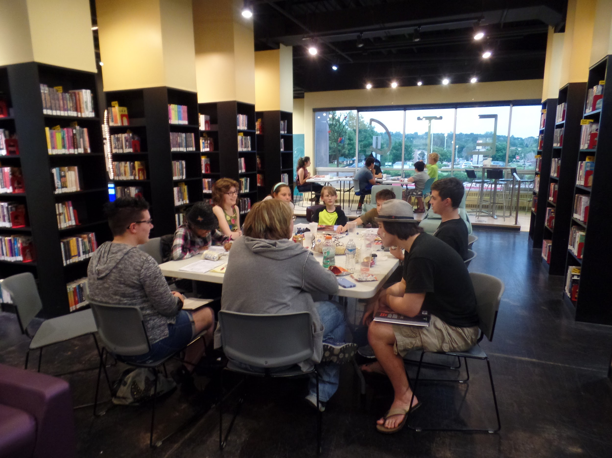
Dungeons & Dragons Club
Notes:
Joanna:
A few years ago a teen asked if we could start a D&D Club at one of our libraries. We said, yes, especially if you have friends to bring!
The club has been going strong and crates bonds for teens in many ways - they are friends. In fact, the first 30 minutes is pure socializing.
The example I want to talk about for D&D has to do with politics. Around the 2016 election two teens (who are friends) started talking about then candidate Trump. The girl was talking about how Trump wasn’t a good choice for the country because he is homophobic and that is against who she is. The boy was arguing that Trump was good for the country in other ways. Myself and another staff member stepped in and helped guide the conversation since it was getting heated and both felt wronged. The girl was hurt that the boy wouldn’t support her. The boy seemed shocked to know someone who identifies as a lesbian. With a little bit of guidance the teens managed their conflict - learning Relationship Skills.

Slide 14
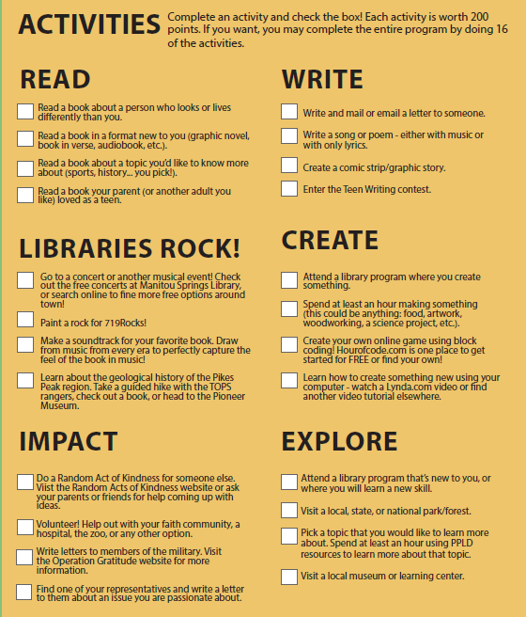
Ideas for Incorporating SEL into Programs
Notes:
Joanna
How do you incorporate SEL into a pre-existing program?
Already discussed some ways if it’s a program that meets in person, but how would it look to do it for a service like Summer Adventure (what we call Summer Reading).
Again, going back to the basics and viewing things through the SEL and PYD Lens.
We were going through a fairly major transition of our summer reading program and were incorporating activities in addition to reading. We were able to use these badges to help them develop some of those skills. We didn’t necessarily create these in a vacuum (Eagle eye audience members may see the similarities between our Read badge and the Reading Without Walls challenge…), but we did try to think of activities that would help teens develop and grow those skills over the summer while they may not be getting as much practice.
Going through the list, you can see how our some of the activities line up with SEL:
Read about someone who looks or lives differently from you = Social Awareness- understanding what others are feeling
Make a soundtrack for a book = knowing what we are feeling in the moment
Spend an hour creating something = persevering in the face of setbacks and frustrations
I think a large scale service like Summer Reading is one where you especially need to pay attention to your inclusive piece--What barriers are there to teens completing these? Do they require transportation? Do they cost money? What could prevent a teen from completing the activity?
The one we have the most work to do in is Youth as Partners. We have TAB groups, but I’d like to see more teen input on our program in general and how it is run, and compensate the teens for their time as well if possible. Another facet of PYD we spent more time developing this summer was working with other organizations (Collaboration) in the programs we offered--we worked with out city’s Parks and Rec department to offer guided hikes and a local music conservatory to offer a class in learning to play music, among others.

Slide 15
Best Practices
SAFE programs
Sequential, Active, Focused, Explicit
Value Added
Introductions/Pronouns
Let the teen be the expert, and...
http://actforyouth.net/youth_development/professionals/sel/
Notes:
Joanna:
Best practice programs are "SAFE" (from ActForYouth.net):
Sequential: skills are taught through sequenced activities
Active: youth have opportunities to actively practice skills
Focused: focused time is set aside for skill development
Explicit: programs explicitly target specific skills
Value added - programs that teach skills for their future - sewing, building, storytelling
Examples: pronouns, introducing selves, ground rules - created together, teen is expert
Learn from our mistake about the Manga Club...

Slide 16
Reluctant Admins
*sad trombone noises*
Hand Raise - who thinks their admin may have lots of questions about this?
Notes:
Joanna - we all know that admins can be resistant to new ideas and that’s a challenge...and sad...

Slide 17

Blind
them with science!
Notes:
Do your homework. Be prepared and organized. Provide them with evidence they can’t dispute.
SEL and PYD are important and science-based practices that help teens develop into healthy and happy adults.
Give them a plan for how you are thoughtfully implementing these practices. Create an evaluation tool, or use one that already exists
Joanna:
First library where I worked, I was told no a lot. At first I resented that - I had so much energy and wanted to do things, but I was hired to be on the desk. It taught me a valuable lesson about how to present ideas. Giving a lot of information in a consumable way helps admins say yes more often. It also helped me think all the way through what I was proposing. While it is difficult to be told no or to have to do a lot of research, it will help your program be better if you have thought about all of the possibilities.

Slide 18
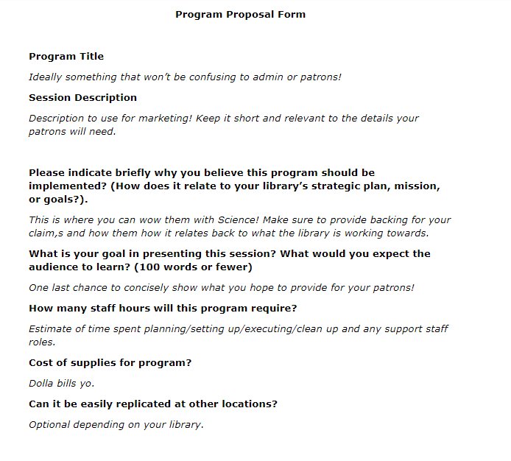
Program Proposal
Notes:
Joanna Here is an example of a program proposal you could use to organize your thoughts on the program and why it would be useful, if your library doesn’t already have something!

Slide 19

Evaluation
Notes:
Run, don’t walk!
Joanna:
Project Outcome is an impact based survey tool that is put out by the Public Library Association. It is free to use, but is very restricted in how it can be used. Results are compared at a national level.
Library Research Service - We conduct research about libraries, provide statistics and analyses to library stakeholders, and work with our colleagues in the Colorado library community and beyond to use data more effectively and persuasively.

Slide 20
But I know my admin will say….
Why do we need to teach S/E learning to teens?
Isn’t that their parents job?
Why should the library be concerned with S/E learning?
Notes:
Why do we need to teach that to teens?
Because the development a teenage brain goes through is INTENSE. They are going through as much brain development as babies do during ages 0-2. Since their brains aren’t fully developed, they use different parts of their brain to do the same tasks as adults, making them not as good at reading emotions or displaying good judgement. Plus, the skills of conflict resolution and empathy aren’t not always nature to humans. Social and Emotional Learning will help them develop these skills while their brains are maturing and they especially need those skills in their tool bet.
Isn’t that their parents job?
Partially. But if you look at either the Search Institute’s 40 Developmental Assets or the protective factors, they both identify large portions of youth development that happens outside the home. We are all working together to help teens learn how to be happy and healthy adults.
Why should we be concerned with it?
Here you really can blind them with Science. Ready to LEAD, a report for CASEL (Collaborative for Academic, Social, and Emotional Learning), found the following:
Protective factor for teens--”helps decrease decreased likelihood of mental health issues and dropping out of high school, and increased probabilities of college attendance and degree attainment” (Ready to LEAD).
Skills that will benefit teens in their future--”Surveys of employers found that they seek the very skills that social and emotional learning programs foster: problem-solving, communication, teamwork, and grit (Sigmar, Hynes, & Hill, 2012).”
The research points to one fact: when schools promote students’ academic,social, and emotional learning, students will possess the basic competencies, work habits, and values for postsecondary education, meaningful careers, and engaged citizenship.” And we’ve already looked at how we fit into the picture of SEL and supporting our teens in learning it.
Also a piece of the YALSA competencies, a national standard for library staff (Teen Growth and Development, Youth Engagement and Leadership, Interactions with Teens:).

Slide 21
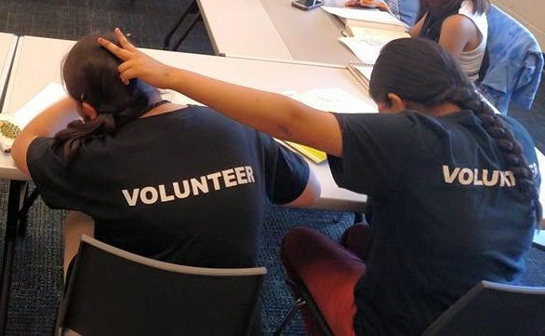
Summer Teen Volunteer Program with Library Research Service
Notes:
Becca writes things about LRS study here
-How it came to be - meeting Katie at CAL
Joanna and I did this presentation at CAL-CON in 2018. Katie Fox, a research analyst with Library Research Service, part of the Colorado State Library focused on research, saw it and reached out to us about doing some research around what we were doing with SEL at PPLD (since, at that point, we were just realizing SEL was happening at the library and hadn’t evaluated our programs to see if we could purposely implement SEL through programs).
This led to a lot of discussions about the all the different programs we saw SEL happening in, which ones we could maybe influence more than others, and finally which ones would let us track patrons over time to see a change. As you all probably know - we don’t always get the same patrons at programs week to week, so studying someone’s progress over time can be tricky. Through all these discussions, we identified that our Teen Summer Volunteer Program may be the best option since we would have consistent teens over a set period of time, and more importantly - the ability to get parental sign-offs on it all.
-Process and structure of the study
Had five out of 14 libraries participate as pilot libraries. Pilot libraries had their volunteers take a training curriculum throughout June and July designed to help improve their SEL skills and Job Skills, including things like Self-Management, Initiative, Professionalism, etc. We assessed if this training was working two ways - we had all the pilot group teens take a pre, mid, and post assessment about how they rated themselves, and then we had staff observe a sample of the pilot group twice in the summer to see if our observations lined up with their self assessments. The control groups at the other libraires took the pre and post assessments so we could see if just the experience of being a volunteer had an impact on them, or if the training curriculum was what made a bigger impact.
This also was to solve some other problems with our volunteers - not having enough to do, inconsistent experiences, etc.
- how it relates back to SEL - what are we learning about how the volunteer experience affected their SEL?
So, while a lot of what we focused in the training curriculum was on job skills, a lot of them were things that fall under SEL - Communication, self-management, and problem solving skills were all what we were looking for improvements on. We are coding that data right now, so unfortunately we have no results to share, but ultimately, what we would like to do is provide the curriculum and process to other libraries to use if we get data back that shows this is a way to develop SEL in teens at a library.

Slide 22
Thanks!
Any questions?
Reach us at:
jrendon@ppld.org
rphilipsen@ppld.org

Slide 23
Resources (Find more here)
Search Institute. (2018). The Developmental Assets Framework. Retrieved July 20,
2018, from https://www.search-institute.org/our-research/
development-assets/ developmental-assets-framework/ 40 Developmental Assets. (2018). Retrieved July 20, 2018, from https://www.youtherie.com/the-assets
Depaoli, J. L., Atwell, M. N., & Bridgeland, J. (n.d.). Ready to Lead: A National
Principal Survey on How Social and Emotional Learning Can Prepare Children and Transform Schools (Rep.).
“The Positive Youth Development Approach: 3 Things to Know.” Colorado Coalition Against Sexual Assault, 28 July 2015, https://www.ccasa.org/the-positive-youth-development-approach-3-things-to-know/.
Morgan, Erin, and Angela Huebner. "Skip Menu." Adolescent Growth and
Development. Virginia Cooperative Extension, 8 Feb. 2012. Web. 09 Jan. 2017.
Positive Youth Development. (n.d.). Retrieved September 7, 2018, from
https://youth.gov/youth-topics/positive-youth-development
W. (2015, May 01). Risk and Protective Factors. Retrieved September 7, 2018, from
https://www.communitiesthatcare.org.au/how-it-works/risk-and-protective-factors
Presentation template by SlidesCarnival
Photographs by Unsplash & Death to the Stock Photo (license)

Slide 24
Presentation design
This presentations uses the following typographies and colors:
Titles: Roboto Slab
Body copy: Source Sans Pro
You can download the fonts on these pages:
https://www.fontsquirrel.com/fonts/roboto-slab
https://www.fontsquirrel.com/fonts/source-sans-pro
Blue #0091ea
Dark gray #263238
Medium gray #607d8b
Light gray #cfd8dc
You don’t need to keep this slide in your presentation. It’s only here to serve you as a design guide if you need to create new slides or download the fonts to edit the presentation in PowerPoint®

